Slide 1
Simulation of Tape Systems
Fermilab Final Presentation
Sanchita Chakraborty – Computational Science Internship Summer 2023
University of Wisconsin - Madison

Slide 2
About the Project and Goals of Project
Tape storage systems continue to play a crucial role in long-term data retention for various industries, such as scientific research, and archival repositories, particularly at National Laboratories like Fermilab
Goals:
Present a comprehensive understanding of the current tape storage system
Accurately model the behavior of modern tape storage systems, including various components such as tape drives, libraries, and media
Identify key factors influencing system performance, such as data compression, and tape utilization patterns

Slide 3
Tape Library Characteristics

Slide 4
Tape
Library 1
Tape
Library 3
Tape
Library 5
Tape Library 2
Tape
Library 4
State of Tape Library:
state_S1, state_S2, state_S3, state_S4, state_S5: 0, 1, or 2 to describe occupied or not
Number of Departures Per Tape Library :
num_of_departures1, num_of_departures2, num_of_departures3, num_of_departures4, num_of_departures5
Total Departure Time of Tape Library :
dep_sum_S1, dep_sum_S2, dep_sum_S3, dep_sum_S4, dep_sum_S5
Departure Time From Tape Library :
t_departure_S1, t_departure_S2, t_departure_S3, t_departure_S4, t_departure_S5
Type of Storage Tape Library : based on user input
TYPE_S1, TYPE_S2, TYPE_S3, TYPE_S4, TYPE_S5

Slide 5
Organization Schematic of Servers

Slide 6
Non-IBM Tape Library
1
n+1
Tape Library
2
n+2
3
n+3
4
n+4
Slots
5
n+5
n
n+m
Accessor

Slide 7
n+1
n+2
n+3
n+m-1
n+m
IBM Tape Library
1
2
3
n-1
n
Layer 1
Tape Library
Layer 2
Layer 4
Layer 5
Layer 3
Slots
Accessor

Slide 8
Tape Characteristics

Slide 9
Tape Addresses - Alphanumeric
cpfes53f12e5kv4g
ja0fl2nbjj6dwju9
qrozoxi6bpj295k8
a99zjgvo84j5krdz
9mzk1d0vmhhu6bsi
0
1
2
num_tapes - 2
num_tapes - 1
Tape Location – Information about Tape Library, Slot, and Layer: tape_location[index] = [library, slot, layer]
[tape library, slot, layer]
[tape library, slot, layer]
[tape library, slot, layer]
[tape library, slot, layer]
[tape library, slot, layer]
0
1
2
num_tapes - 2
num_tapes - 1
Tape Type – randomized between LTO6, LTO7, LTO8, LTO9 based on user input of how many of each per server
LTO6
LTO8
LTO7
LTO9
LTO9
0
1
2
num_tapes - 2
num_tapes - 1
Tape Linear Density – Based on Tape Type
48078.9990373 bytes/inch
65620.8645647 bytes/inch
60623.4172634 bytes/inch
68132.2882086 bytes/inch
68132.2882086 bytes/inch
0
1
2
num_tapes - 2
num_tapes - 1

Slide 10
Tape Storage – Sample Tape with Files
File size
File Size
-2
-2
File size
Pause: -1
Pause: -1
0
1
2
Empty Space
Empty Space
Number of Tapes: user-input for each type
num_tapes: total number of tapes
Num_lto6, num_lto7, num_lto8, num_lto9: each type
Storage: dependent on type of tape and compressed/uncompressed status
LTO6_storage_uncompressed = 2.5E6, LTO6_storage_compressed = 6.25E6
LTO7_storage_uncompressed = 6E6, LTO7_storage_compressed = 1.5E7
LTO8_storage_uncompressed = 1.2E7, LTO8_storage_compressed = 3E7
LTO9_storage_uncompressed = 1.8E7, LTO9_storage_compressed = 4.5E7
Assumptions:
Each tape has an assigned location, type, storage capacity

Slide 11
Assumptions and Design of Model

Slide 12
User Input
- Number of Slots
Number of LTOx Tapes
Type of Tape each slot takes
IBM or Non-IBM Tape Library
Repeat # of tape libraries

Slide 13
3 Key Algorithms
Read Algorithm
Write Algorithm
No
Yes
Intention Algorithm
Identify File Size
Generate File Size
Read
Write
Write
Search
Address
Check if full

Slide 14
Address Match and Times Accessed
Alphanumeric Address
Tape
Library x
cpfes53f12e5kv4g

Slide 15
Address Match and Times Accessed
Alphanumeric Address
Tape
Library x
cpfes53f12e5kv4g

Slide 16
Address Match and Times Accessed
Alphanumeric Address
Tape
Library x
cpfes53f12e5kv4g
Linked Location Address
[tape library, slot number, layer (IBM only)]

Slide 17
Address Match and Times Accessed
Alphanumeric Address
Tape
Library x
cpfes53f12e5kv4g
Linked Location Address
[tape library, slot number, layer (IBM only)]

Slide 18
Address Match and Times Accessed
Alphanumeric Address
Tape
Library x
cpfes53f12e5kv4g
Linked Location Address
[tape library, slot number, layer (IBM only)]

Slide 19
Address Match and Times Accessed
Alphanumeric Address
Tape
Library x
cpfes53f12e5kv4g
Linked Location Address
[tape library, slot number, layer (IBM only)]

Slide 20
Address Match and Times Accessed
Alphanumeric Address
Tape
Library x
cpfes53f12e5kv4g
Read
Linked Location Address
[tape library, slot number, layer (IBM only)]
Write

Slide 21
Address Match and Times Accessed
Tape
Library x
Alphanumeric Address
Move + Shuffle ?
cpfes53f12e5kv4g
Read
Linked Location Address
[tape library, slot number, layer (IBM only)]
+ times accessed
Write

Slide 22
Data Analysis

Slide 23
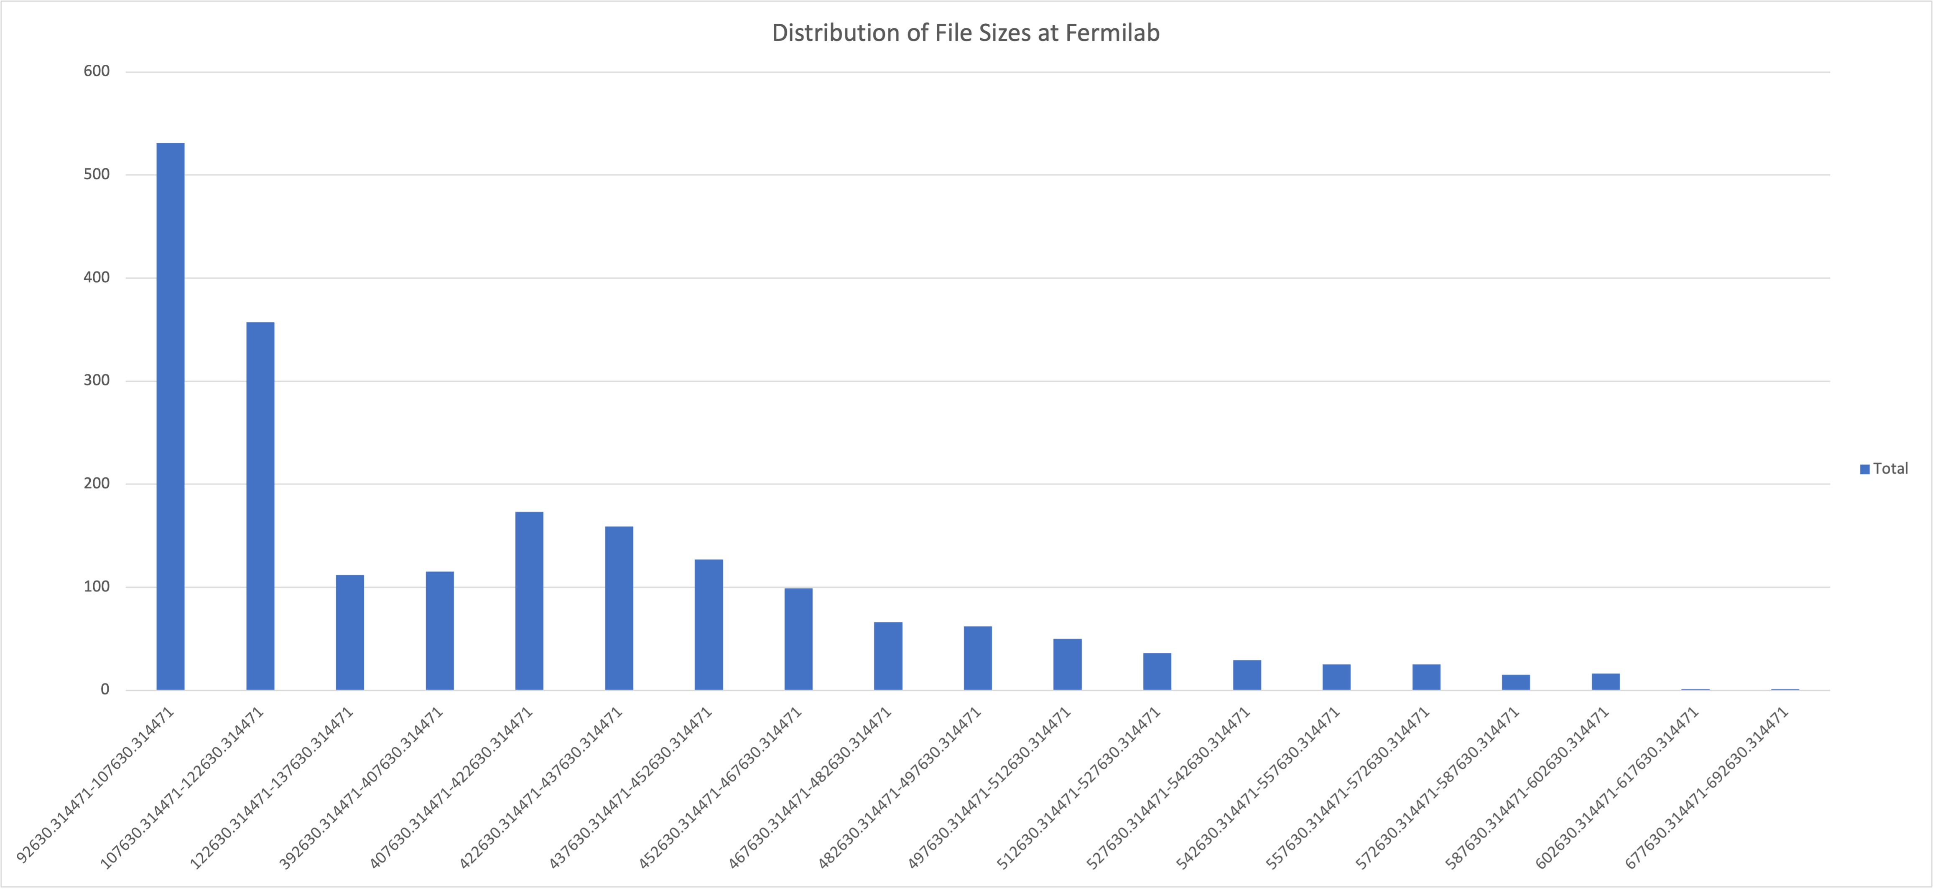
Data Analysis: Distribution of File Sizes – Read and Write
Left-skewed distribution of file sizes read and written

Slide 24
Data Analysis: Access Times
Normal Distribution of Access Tines
Peaks at 11 AM-12 PM
Adjusted Inverse Sampling Distribution to Normal Distribution for Arrival Times of Requests

Slide 25
Results

Slide 26
Results: Based on Manufacturing Manuals
Inputs:
Tape Library 1: IBM, 7 slots
Tape Library 2: IBM, 12 slots
Tape Library 3: Non-IBM, 15 slots
Tape Library 4: Non-IBM, 10 slots
Tape Library 5: Non-IBM, 20 slots
0 LTO-6 tapes
6 LTO-7 tapes
10 LTO-8 tapes
15 LTO-9 tapes
Ran 10 sample trials on 1000 files
Max Inter-arrival Time: 60 seconds
Improvement: 9-10% per server: Find closest slot

Slide 27
Post-Statistical Data Implementation
Average Service Time for 5 Different Tape Library Compared to Actual Data
Key Differences and Similarities
Data matches relatively closely for maximum service time
Simulation does not do as great a job of capturing the skewed-binomial distribution (see previous slide)
Data file sizes need to be drawn from a skewed binomial distribution instead of a normal distribution

Slide 28
Point of Interest

Slide 29
Stark Difference Between Manufacturing and Actual Speed Claims
Potential Causes
Huge slowdowns when accessing larger files vs smaller files
Manufacturing data may be based on much smaller data sets and for use starkly different from that of Fermilab
Number of individuals accessing files at the same time

Slide 30
Next Steps

Slide 31
Between Now and 09/01/23
Move the characteristic of LTO8, LTO9 to Slots
Gather data on efficiency change of acquiring a new tape library, slot, etc. to help determine what the optimal storage system setup may be
Instead of 2 tasks being completed at a library at a time, change to on average 1.2-1.5 tasks being completed at a library at a time

Slide 32
Questions?
Thank you for your time!

