Slide 1
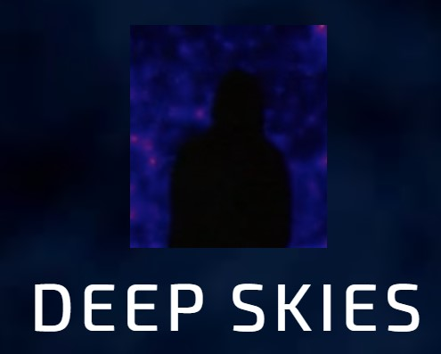
Link Prediction for Automated Scientific Hypothesis Generation
Pooja Ganesh
Advisor - Brian Nord
Co-advisor - Ashia Livaudais, Aleksandra Ciprijanovic
FCSI Presentation - Deepskies Laboratory
11 August 2023
Notes:
Good Morning folks! Today, I give a gentle introduction to graphs and link prediction for automated scientific hypothesis. I worked on this with Brian, Ashia, and Alex!

Slide 2
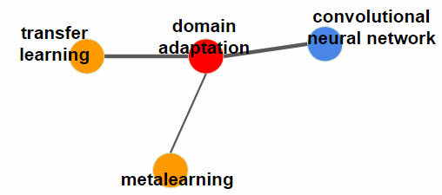
The HypoGen Project
Motivation
Can we accelerate scientific discovery using automated hypothesis generation, a machine learning method to make predictions about possible links across scientific literature?
Solution
Exploring link prediction for scientific concepts.
Graph Data Structure
Notes:
Thanks to our appetite for novelty, innovation is a requisite. As researchers and engineers, our never-ending goal is to come up with new ideas and hypothesis. New Ideas and the hypotheses attached with it require time- and labor- intensive human effort. Additionally, parsing vast amount of papers to study state of the art of any new idea can be tedious.
Idea is that we can use ML to accelerate this process of scientific discovery to make predictions about possible links across scientific literature
We choose to work with graph data since graphs have the ability to capture huge amount of information in its structure and topology, which make it well fit to store all scientific paper content.
As a first step to achieve this – we explore how graph data can be processed and trained to perform the task of link prediction to find future connections between existing concept keywords (ideas) in the graph.
**show graph on screen and tell how concepts are nodes and edges represent the fact that they have been seen together in papers before**

Slide 3
Pipeline - From Data Preprocessing to Model Assessment
1
Graph Data
Edge removal for training data
Creation of edge features and target
variable for unconnected node pairs
Prevention data leakage by careful splitting
Datasets - Cora, Science4cast
2
Node2vec
Vector Representation for nodes
Representation of network topology
Input for neural network model additional to features
Graph Convolutional Network Model
Link Prediction for unconnected node pair
Performance Metrics AUC
3
Notes:
Let me walk you through the the pipeline to understand the skeleton of the project.
Unlike text or image data, in graphs we need to create training data thru edge removal process which results also results in creation of features and target variables.
We cannot directly input graphical data into a neural network model, so we create embeddings
GNN for AUC

Slide 4
Graph Data and Link Prediction (Graphical Structure)
Existing link before or after prediction
Possible link before prediction
New connections after prediction
Before prediction
After prediction
At time t
At time t + n
Possible Link A--B
B
B
Link Formed A-B
Edge Prediction
A
A
D
D
C
C
Possible Link C-D
No Link Predicted C-D
We need to use graphs at two different instances of time to extract the target variable.
But in real life, we only have one initial graph.
Notes:
This is the first part of the pipeline. Here, we have a graph with some connections at time t. The nodes can represent any information in them. One could imagine this graph to be a facebook network where users are users and links are indicative of their friendship. Or one could think of graphs as a cluster of galaxies in the nodes where links represent gravitational force between the galaxies.
Constructing features using graphs essentially requires you to have two instances of the graph at different time points.

Slide 5
Graph Data and Link Prediction (Feature Set View)
Graph Structure
Feature Set
New Link Formed A-B
Features | Link (Target Variable)
A-B Node Pair | 1
C-D Node Pair | 0
B
A
D
C
No Link Predicted C-D
time: t + n
We need predictor and target variables to predict link between 2 unconnected nodes
Notes:
Feature set view.

Slide 6
Creating Training Data using Graph in present time t with one graph
Candidate Node Pair A-B
B
B
A
Remove Edges
A
D
D
C
C
Objective is to predict link existence between candidate node pair : A-B
Feature creation for all the unconnected node pairs including the ones for which we have removed the edges.
Usually imbalanced dataset, needs to be balanced to get proper evaluation
Features | Links (Target)
B-D | 1 (removed)
A-D | 0 (never existed)

Slide 7
Node2vec - Feature Extraction (Node Embeddings)
Workflow
Vector Representation
Operator on embeddings
Training Data
Node2vec
Node Embeddings
Edge Features
About node2vec
B
Mapping each node in graph with a vector sequence interpretable my a neural network model
Numerical representation of the graph
Dimensions size for each node = n (default = 128)
A
C
D
Nodes | Embeddings/Features
A | [0.1, 2.85, 3.25,....n]
B | [0.03, 4.95, 0.5,....n]
C | [1.02, 8.85, 4.05,...n]
D | [0.12, 0.25, 6.9,.....n]
Notes:
After creating training data, we extract node features using Node2vec
Vector representations of each node
Edge feature creation - Add up features of the 2 nodes.
Can choose different ways to calculate edge features using embeddings
Node2vec - second order:
On the one hand, when the return parameter (p) and in-out parameter (q) are set to be 1, it recovers the first order random walk exactly. However, on the other hand, when p and q are set to be positive values other than 1, the random walks can be biased to either be localized in network modules or, conversely, be across the network.

Slide 8
Node2vec - Feature Extraction (A peek inside the module)
Two major steps that happen - biased random walk, followed by training a skip-gram model.
Embedding Model
Biased Random walk
2nd order for diverse neighborhood exploration
Output - node sequences
Skip - gram model
Inputs node sequences from random walk
Output - learnt node embeddings representing graph topology
Notes:
In Node2Vec, random walks are generated to explore the graph's structure. These random walks provide sequences of nodes that can be used to train the SkipGram model, which is a part of the Node2Vec algorithm. The SkipGram model takes these sequences of nodes and learns to predict the context (neighboring nodes) of a given node.
The output of the SkipGram model in the context of Node2Vec is a set of learned node embeddings. Each node in the graph is represented by a high-dimensional vector in this embedding space. These vectors are learned in such a way that nodes with similar neighborhoods (structural roles in the graph) have similar embeddings.
To summarize, the output of the random walk process that goes into the SkipGram model in Node2Vec is a set of learned node embeddings, where each node is represented by a vector capturing its structural information within the graph. These embeddings can then be used for various downstream graph analysis tasks.

Slide 9
Science4Cast Benchmark Dataset
Motivation for benchmark - vast dataset with concepts as node to facilitate hypothesis generation
Problem Statement - originally used to predict new links between concepts n years into the future
Inside the dataset
construction
data
our network/graph
Concept keywords extracted from titles and abstracts of scientific papers
Concept examples - graph NN, recurrent NN
Papers between 1990 and 2014
Unweighted edges
64,000 concept nodes
18,000,000 edges
Multiple edges can exist between two nodes
That is a huge dataset!
Computationally expensive due to input to the model is a matrix of size N X M, where N - nodes and M is embedding size!
That is 64000 X 128 !!
Node2vec is also expensive
RNN
GNN
2013
2009
time series
GAN
2014
GNN
co-occurrence
RNN
time
Notes:
Lets talk about the science4cast dataset and its structure. Our main motivation to use this dataset is because it uses concept connection at its core, which is also our objective.

Slide 10
Science4Cast Dataset Link Prediction -Benchmark
Training Data
Feature Creation
GNN
Split across years before 2014
Example - graph for 2011, 2012, 2013, 2014
Handcrafted features for node pairs
Example - degree of the node pairs in various years
Simple 2 layer GNN
AUC train 0.74
AUC test 0.82
Workflow with visualization
More years
2011 2012 2013 2014
Training Data
As you add more graphs at other time points, the features will increase
5 features
5 features
5 features
5 features
More features
Combined to make 30 total features
GNN Model
Notes:
construction and working of science4cast dataset

Slide 11
Cora and Comparisons
Less complicated structure of graph dataset
Much smaller than Science4cast
Paper citation network
Undirected graph
Nodes - 2485 and Edges - 4689
cites
Paper 1
Paper 2
Dataset | Method | Features | AUC train | AUC test
Science4cast | 2 layer GNN | Hand crafted (30) | 0.74 | 0.82
Cora | Logistic Regression | Node Embeddings | 0.86 | 0.88
Observations
Recorded AUC for both test and train are higher for Cora dataset
Reason - small dataset, use of node embeddings
Scope for Improvement for science4cast dataset
Adding more layers in GNN
Increasing the number of handcrafted features
Adding node embeddings as model inputs to capture the graph topology better

Slide 12
Future work in HypoGen
Exploring other link prediction algorithms
Employing feature extraction methods other than node2vec to build edge features
Exploring new ways to build better edge features
Exploring larger, more complex datasets with predefined edge features and weights to strengthen link prediction algorithm.

