Slide 1
Flux Designations
ROM1, ROL1, REL0, ROL0, …
First two letters are the base formulation, but it’s complicated
IN – Inorganic.
OR – organic but NOT resins or rosins (resins and rosins are organic)
RE – resin which is NOT a rosin (rosin is also a resin)
RO – rosin, which is resin derived from tree sap
3rd letter is activity level ↔ how much etching it does. This one’s simple: L (Low), M (Medium), H (High). Lower is better … as long as it works
Last letter is halide content. Halides can cause long-term corrosion, so best to avoid
0 – no detectable halides (<0.05%)
1 – Measurable halides
Other designations
“No clean”
Mostly a cosmetic property: not less residue, but transparent residue
There’s separate tests for conductivity, and I don’t know of any flux used in electronics which does not pass
Water soluble.
Most fluxes require soap to clean off, though some come off with alcohol
Water soluble fluxes can be removed with warm water
Even if not done regularly, can be useful for debugging problems
Comes at a price
More acidic at high humidity
Spreads with condensation

Slide 2
Kester 44 (ROM1)
A classic! But maybe not suitable here
More active than needed ↔ etches wire more than necessarily
Activated with halides ↔ long term wire corrosion
Corrosion issues confirmed by manufacturer data

Slide 3
Loctite 362 (ROL1)
Test results not presented in a clean manner. Here’s my interpretation
Copper Mirror Corrosion (thin copper coating) “Pass” → didn’t completely remove copper. Probably moderate, similar to Kester
Corrosion test (bulk steel corrosion) “Pass” → no visible corrosion. Probably better than Kester
Silver chromate – is to detect halides. “Pass” means it doesn’t have more than the “1” designation implies
More benign than Kester 44… but halide-free would be better

Slide 4
Chipquik SMD3SW (REL0)
Copper Mirror: No breakthrough
Corrosion: No corrosion
Quantitative Halides: <0.05%
Water soluble
The only RE flux considered.
Also the only water-soluble flux
The “0” designation calls for more sensitive halogen test than silver bromide (so that is not listed)

Slide 5
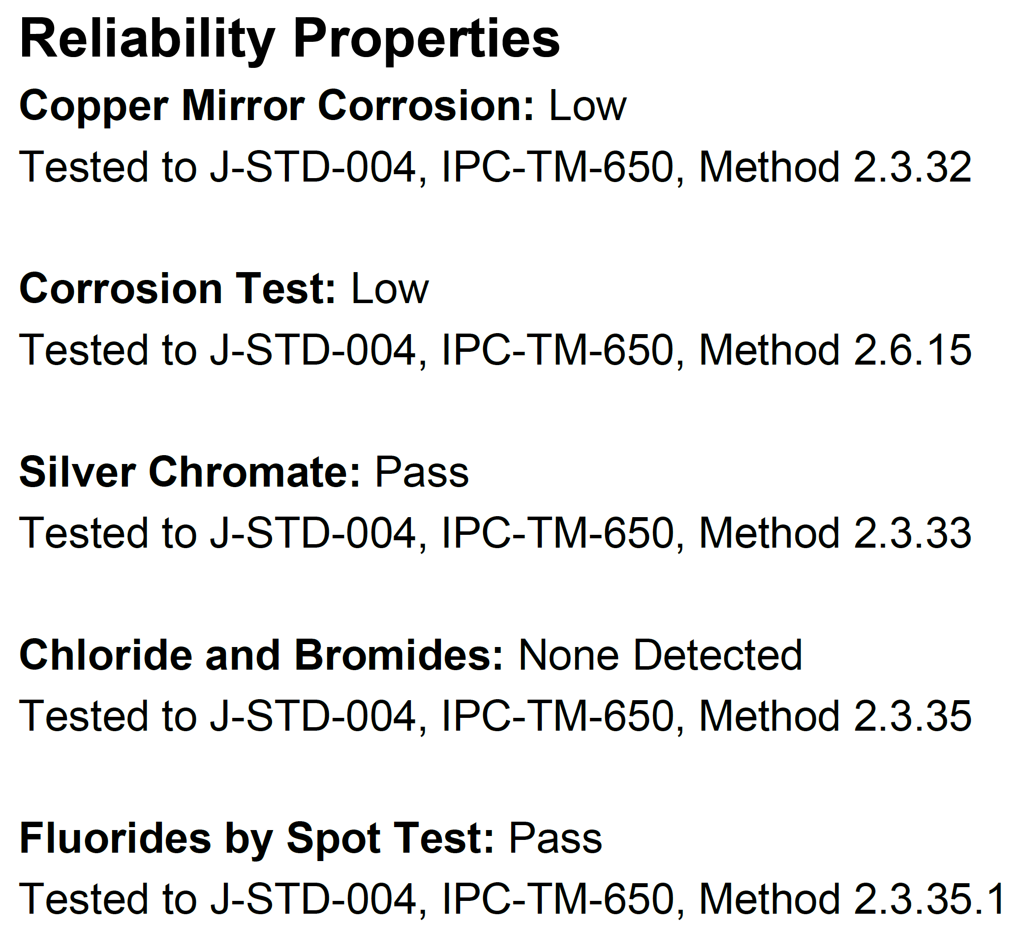
Kester 285 (ROL0)
Not sure how to compare with Chipquik
Copper mirror – is “Low” seems better than “No breakthrough”
Corrosion test – “Low” seems worse than “No corrosion”
Comparable to Chipquik except this is not water soluble.

Slide 6
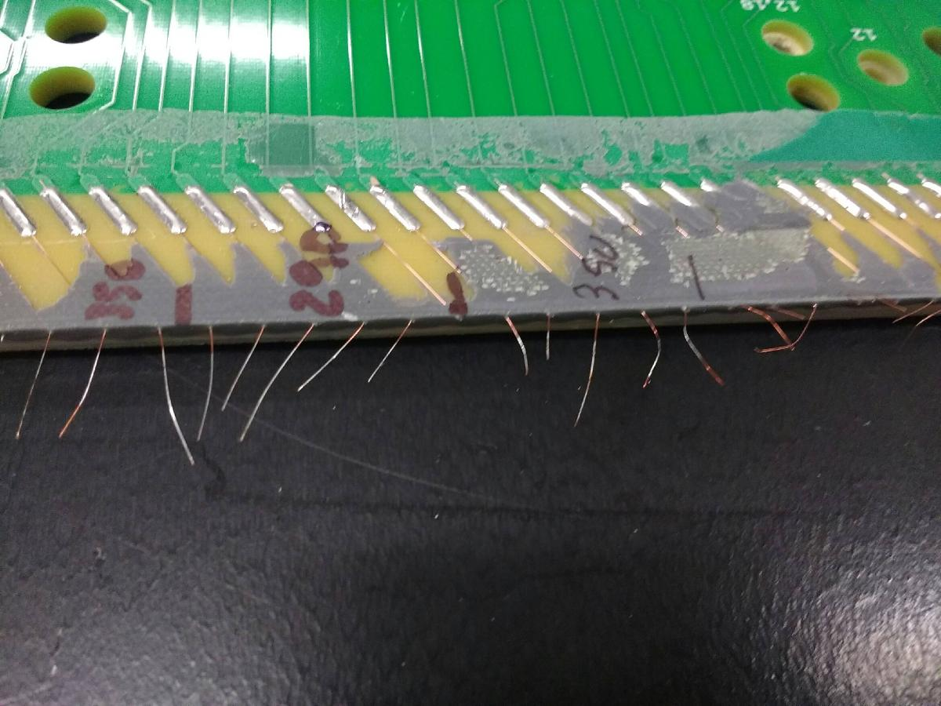
Conclusion
My crude tests show Chipquik REL0 wets the Protodune wire just fine at 290C
But didn’t work well on the AWI wire
Haven’t tried the Kester ROL0 but likely just as good
I suggested water soluble, but after reviewing discussions from early in Mu2e...
Mu2e tracker is small enough to keep in a humidity-controlled cleanroom. APAs will be in a warehouse, stringent environmental requirements may be expensive
Mu2e uses tungsten wires, not easily etched. APAs’ copper wire will be more sensitive
The disadvantages of water soluble seem to outweigh advantages in this case
If Chipquik and Kester 285 pass pull tests, suggest going with Kester 285

