Slide 1
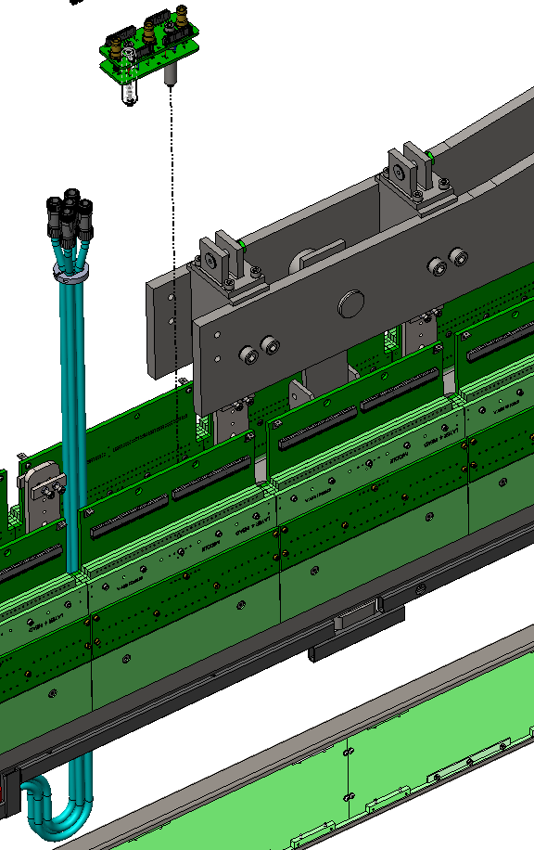
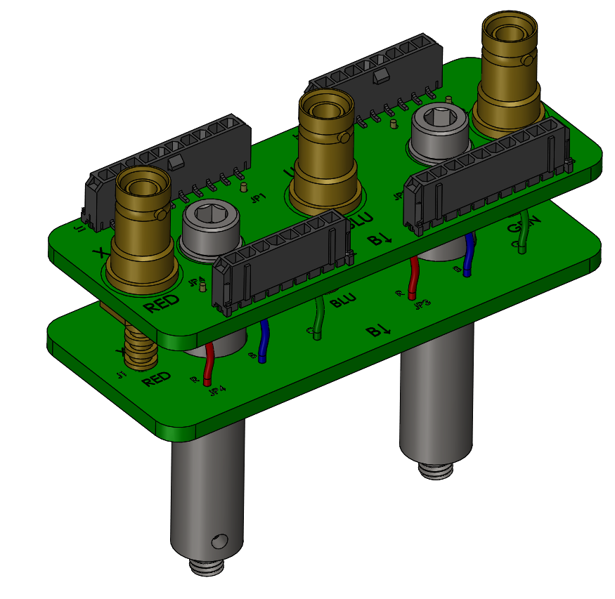
Moving SHV Assembly
KDZ
August 7, 2023

Slide 2
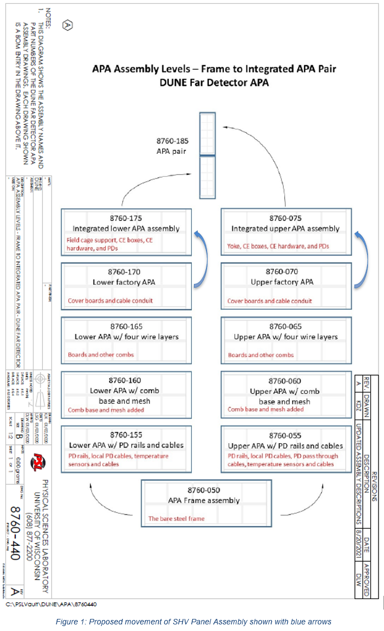
Eng. Change Request 0014
Request: Move the SHV Panel Sub Assembly from the factory APA to the integrated APA
Integrated APA is assembled in the SURF cleanroom (see blue arrows to the right)
Reason for change: A more streamlined process. CR-boards, G-bias boards and the bias voltage harness are installed in the SURF cleanroom.
Further, factory operations and testing do not depend on the presence of an SHV panel sub assem.
All protoDUNEII APAs were assembled in per the requested change
The requested change is not a technical issue (that KDZ is aware of). It should be simply presented and understood.
To do this change, what drawings are affected:
Upper Factory APA (8760070)
Lower Factory APA (8760170)
Integrated Upper APA (8760075)
Integrated Lower APA (8760175)
SHV Assembly (8760959)

