Slide 1
Influence of Solenoid Errors on Electron Cooling

Slide 2
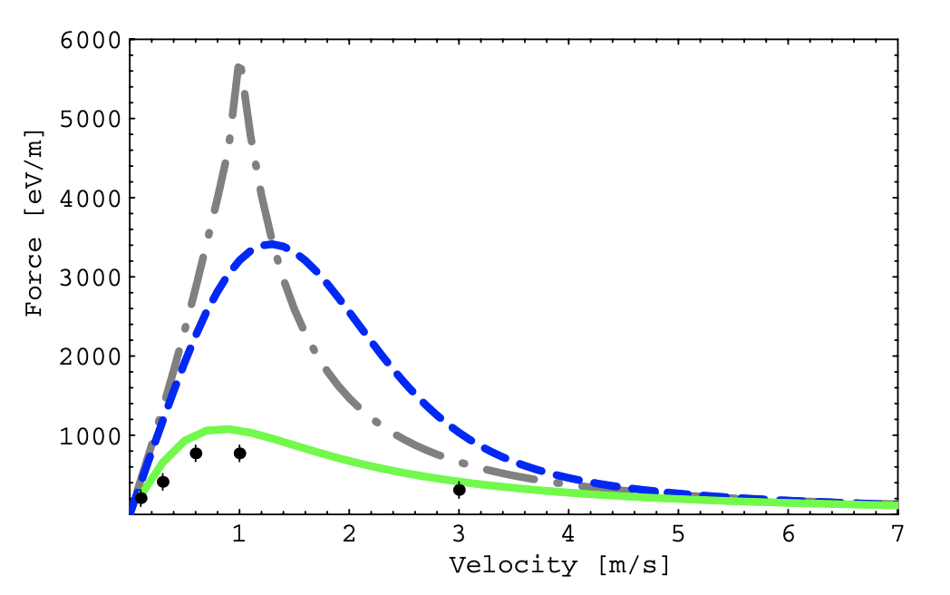
Motivation
Meshkov Asymptotic
Derbenev and Skrinsky
Magnetized electron trajectories follow magnetic field lines. -> Perturbations in velocity
Perturbations in velocity -> Reduction in electron cooling force
In Parkhomchuk model, the force depends on effective drift velocity.
Parkhomchuk
N particle simulations
A. V. Fedotov et. al., Numerical study of the magnetized cooling force, Phys. Rev. ST Accel. Beams 9, 074401, 2006.
Longitudinal drift: Voltage jitter, space-charge voltage depression.
Transverse drift: E X B drift, electron velocity perturbations due to magnet errors.
Larmor radius: Magnetic field, electron transverse temperature
Min/Max Impact parameters: Ion velocity, plasma frequency

Slide 3
Cooling Times
Used the Parkhomchuk model to calculate cooling times as a function of electron current density.
Requirement: Counter IBS heating times of the order of seconds at $\left|Δν_{y}\right|=0.5$
The minimum moves up and to the right at higher energies.
Strong Cooler
We’re at the limit of cooling rate achievable.
Estimates treat cooling as a single thin-lens kick and ignore tracking through the solenoid.

Slide 4
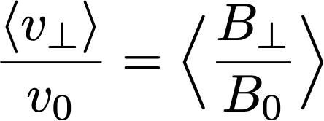
Field Errors: Simple Estimate
Assuming that the electrons follow the magnetic field lines. Ignoring the space-charge field from the electrons, the extra transverse velocity is:
The temperature contribution is:
The above estimate ignores space-charge.

Slide 5
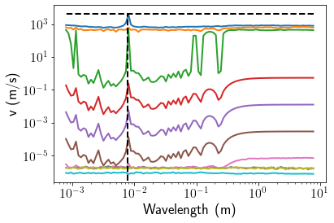
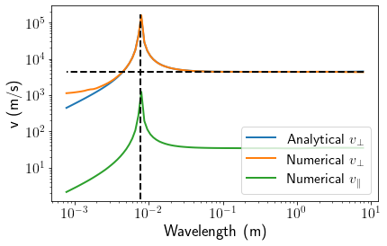
Recap of previous work
Constructed toy models of how magnetic field perturbations translate to electron velocity perturbations in the presence of static space-charge.
Multipole
Unrealistically small scales
Plane wave
C. Montag and J. Kewisch, in Proc. PAC'03, paper WPAE030, 2003.
D. L. Bruhwiler et al., in Proc. PAC'05, paper TPAT087, 2005.

Slide 6
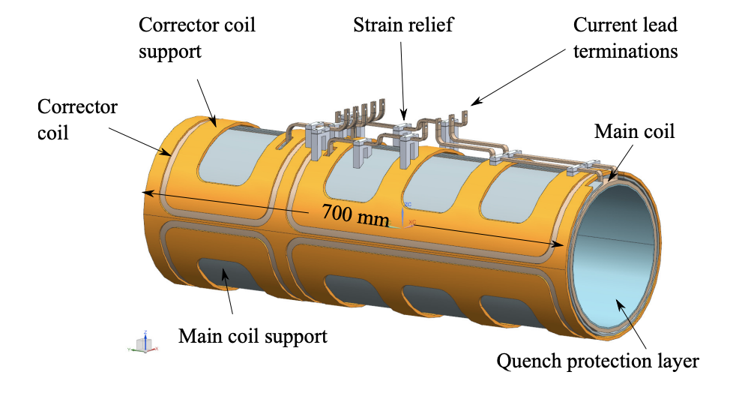
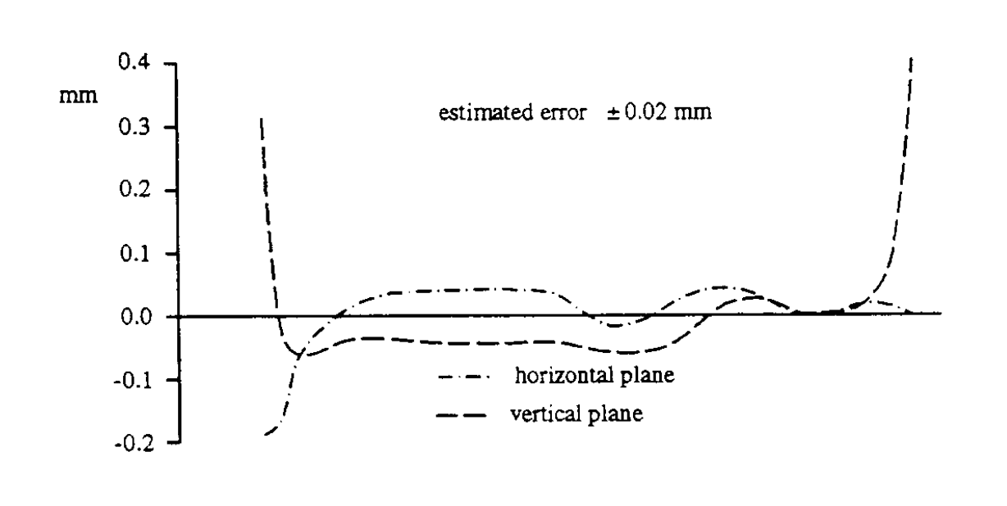
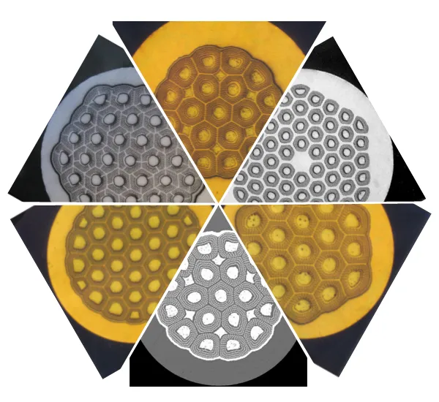
Actual Solenoid Design
Emulate field errors due to tolerances in coil fabrication.
How to model the effect on cooling?
https://www.luvata.com/
Transverse field line deviations in CELCIUS cooler. http://cds.cern.ch/record/398603/files/p235.pdf

Slide 7
A 2nd look at the Parkhomchuk model
Central to the Parkhomchuk model is the effective velocity parameter.
Random: Voltage jitter
Function of position: Space-charge voltage depression, E X B drift, electron velocity perturbations due to magnet errors.
Use the voltage jitter as the sole source of effective velocity, treat positional velocity changes as local frames of reference.
Predictions are very close!
This allows us to treat magnetic field errors as deterministic perturbations to the electron velocity field.

Slide 8
Tracking Algorithm
Solenoid Entry and Exit Kicks
Solenoid body map
Divide cooler into smaller segments.
Calculate local mean velocity of electrons at the position of the ions based on space-charge voltage depression, E X B drift, electron velocity perturbations due to magnet errors.
Calculate ion velocities w.r.t to this local rest frame.
Calculate cooling force using Parkhomchuk model and apply kick to ions.
Transport ions through a thick hard-edge ideal solenoid map in a drift-kick-drift fashion.
Transport through 1-turn 6D linear map.
Other complexities: Matched distributions, eigenmode emittance calculations, fitting, etc.
…
Thin-lens cooling kicks

Slide 9
Cooling times revisited with no errors
Cooling times for eigenmode b and longitudinal emittance is of the same order of magnitude as previous plot.
Current (mA) | Radius (mm) | Density (A/m²) | Cooling Times (s)
1.7 | 14 | 2.76 | 1.5, 0.45, 0.67
80 | 18 | 78.6 | 370, 5.3, 8.6

Slide 10
Next Steps
Model IOTA solenoid design following R.C. Dhuley et al., JINST 16 T03009, 2021. This gives the systematic perturbation to the cooling time. – In progress
Incorporate position and orientation errors on each winding.
Estimate sensitivity to different error classes.

