Slide 1
ND GAr
Callum Cox
8 Aug 22

Slide 2
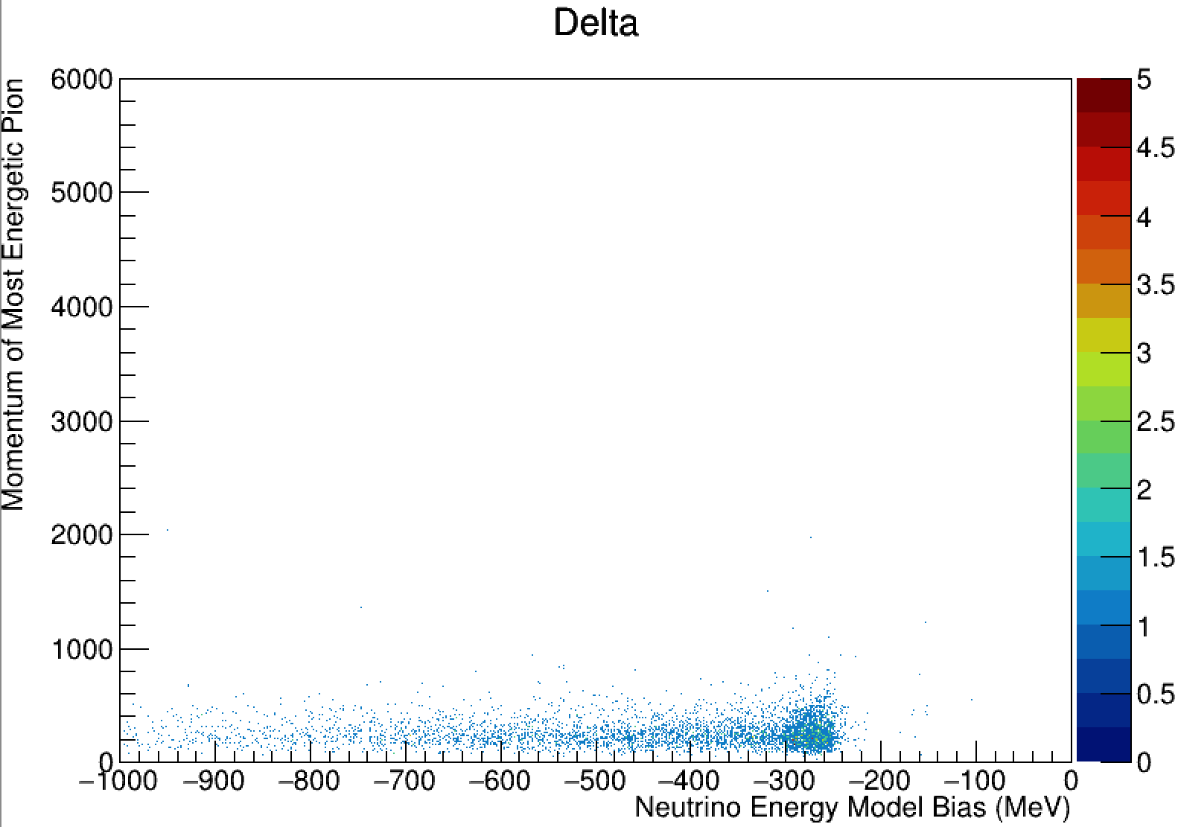
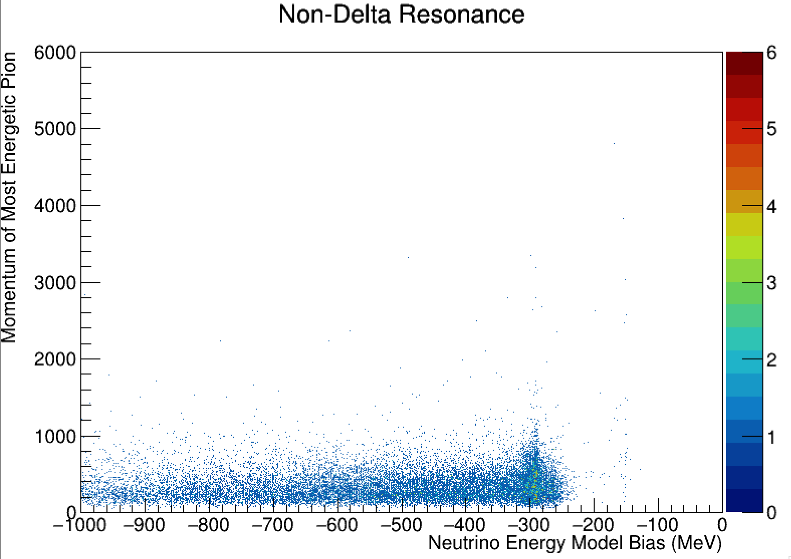
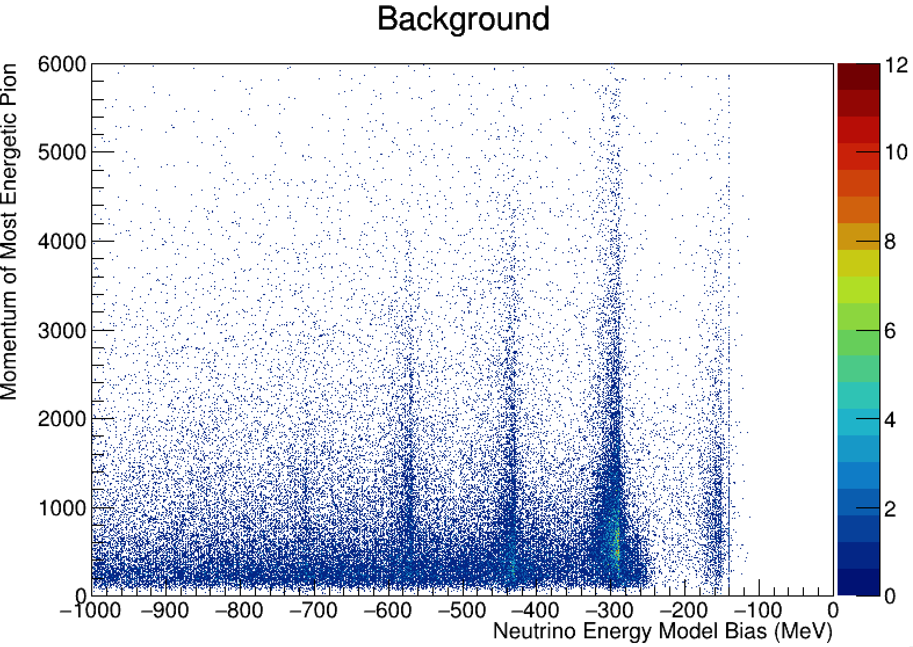
Most energetic pion momentum by bias
Producing 2D plots to inform pion threshold
Graphs show a 2D histogram of the most energetic pion’s momentum for a given event, and the respective energy bias associated with it
Split between background (non-resonance); resonance Delta (1232), and resonance non-Delta
Error in code leading to events producing a single pion being excluded (therefore, primary peak excluded)
Smearing of Delta resonance into second peak
Greater preference of non-Delta resonance in second peak
Background dominates non-primary pion peaks
Ensure pion momenta range fits for (MeV/c) expected magnitude

