Slide 1
Structural

Slide 2
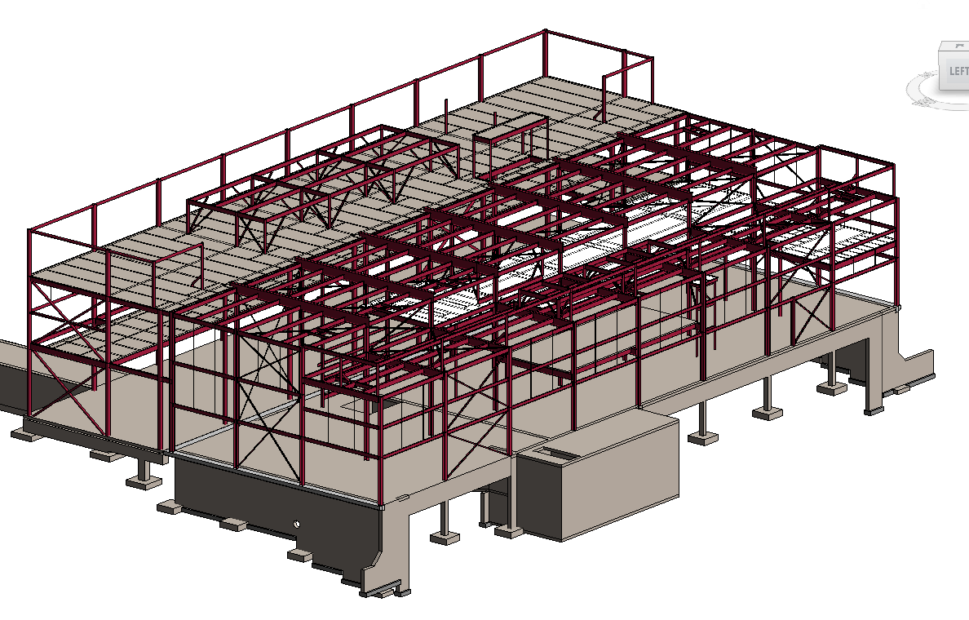
Structural – Existing CUB and CUB Expansion
Existing CUB
A full model of the structure of the existing CUB was created using the information from the existing structural drawings.
CUB Expansion
A full model of the expansion was created in Revit.
Shallow concrete foundations are anticipated at this time.
The super structure consists of steel members for columns, floors and braces.
BIM Model – Revit
Notes:
Gordon

Slide 3
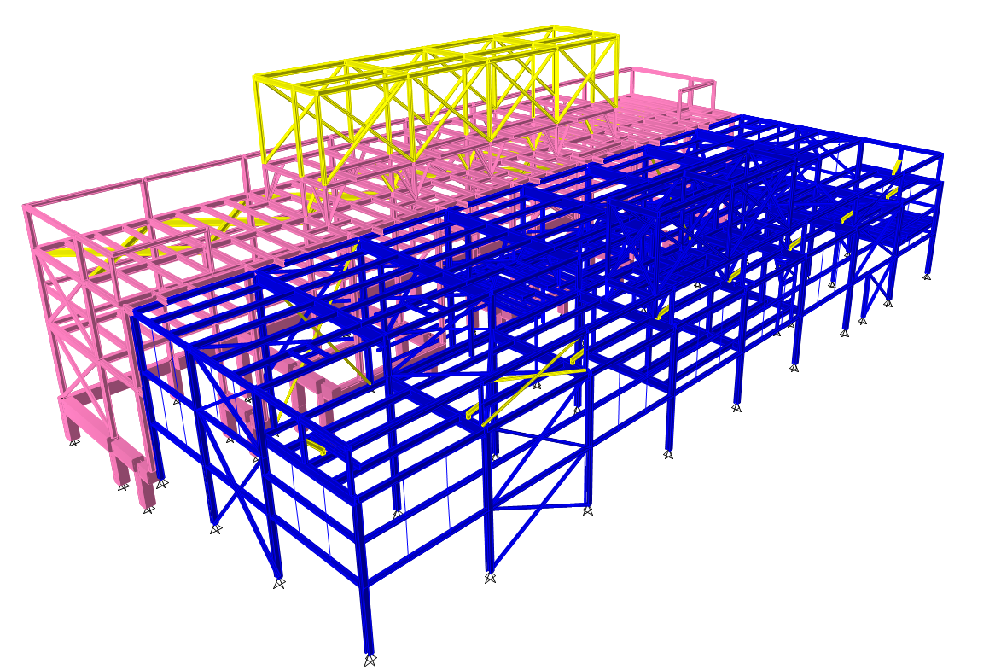
Structural – Analysis Model
Existing CUB
A full analysis model of the structure of the existing CUB was created using the information from the existing structural drawings.
CUB Expansion
A full analysis model of the expansion was created using the structural software Etabs.
Columns are HSS steel tube members.
The floor framing consists of wide-flange steel members.
Braced frames consists of HSS square section.
Brace frame are designed as tension only members.
Structural Model - Etabs
Notes:
Gordon

Slide 4
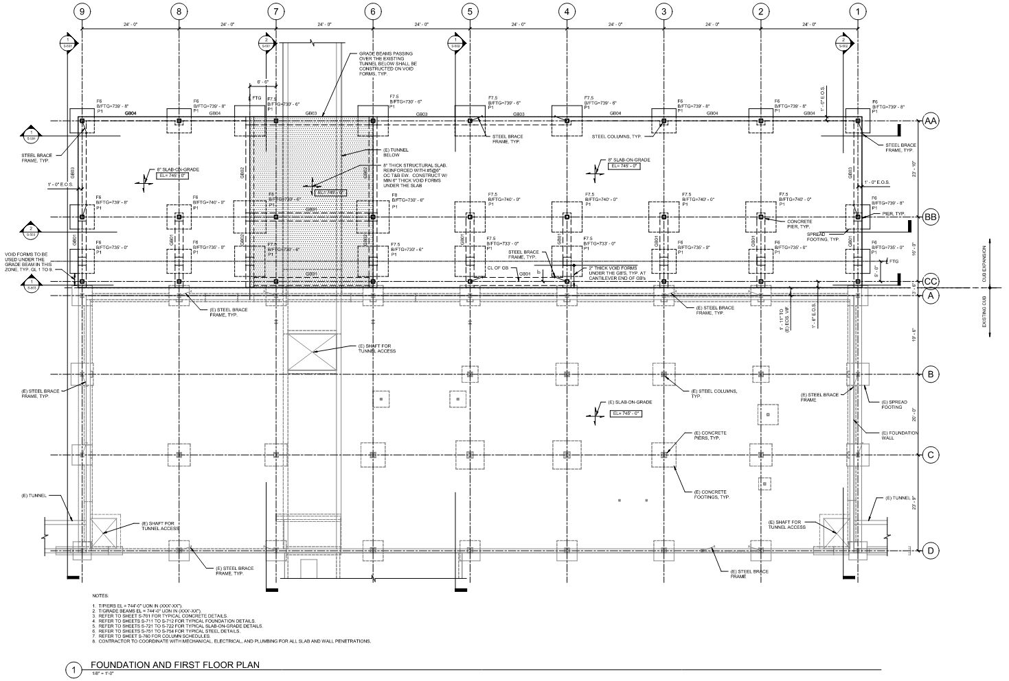
Structural – Foundation/Ground Floor Plan
CUB Expansion
The foundation of the CUB expansion consists mainly of concrete spread footings under each column.
Grade beams will connect the exterior column concrete piers. They will serve as frost wall.
Additional grade beams are placed between grid lines BB and CC. These grade beams are needed to be able to place the spread footings away from the existing CUB foundation.
The ground floor slab directly above the existing tunnel will be designed as an elevated slab supported on grade beams. The purpose of this is to reduce the loads on the existing tunnel.
The reminder floor slab is an 8” thick concrete slab-on-grade.
No geotechnical studies on the site have been conducted yet. The current foundation design is based on previous adjacent projects.
Notes:
Gordon

Slide 5
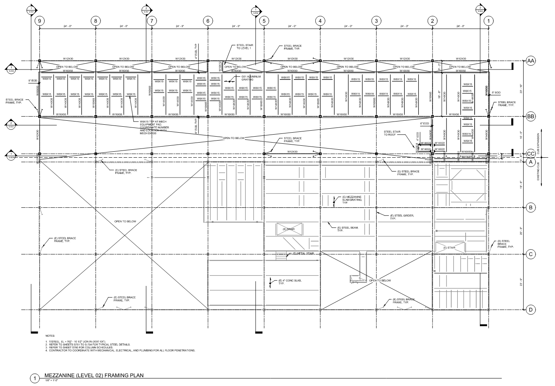
Structural – Mezzanine Level Plan
CUB Expansion
The mezzanine level will mainly support the pumps and other mechanical equipment.
The floor framing is made of steel wide-flange beams and girders.
Aluminum grating will be used for the floor surface.
Notes:
Gordon

Slide 6
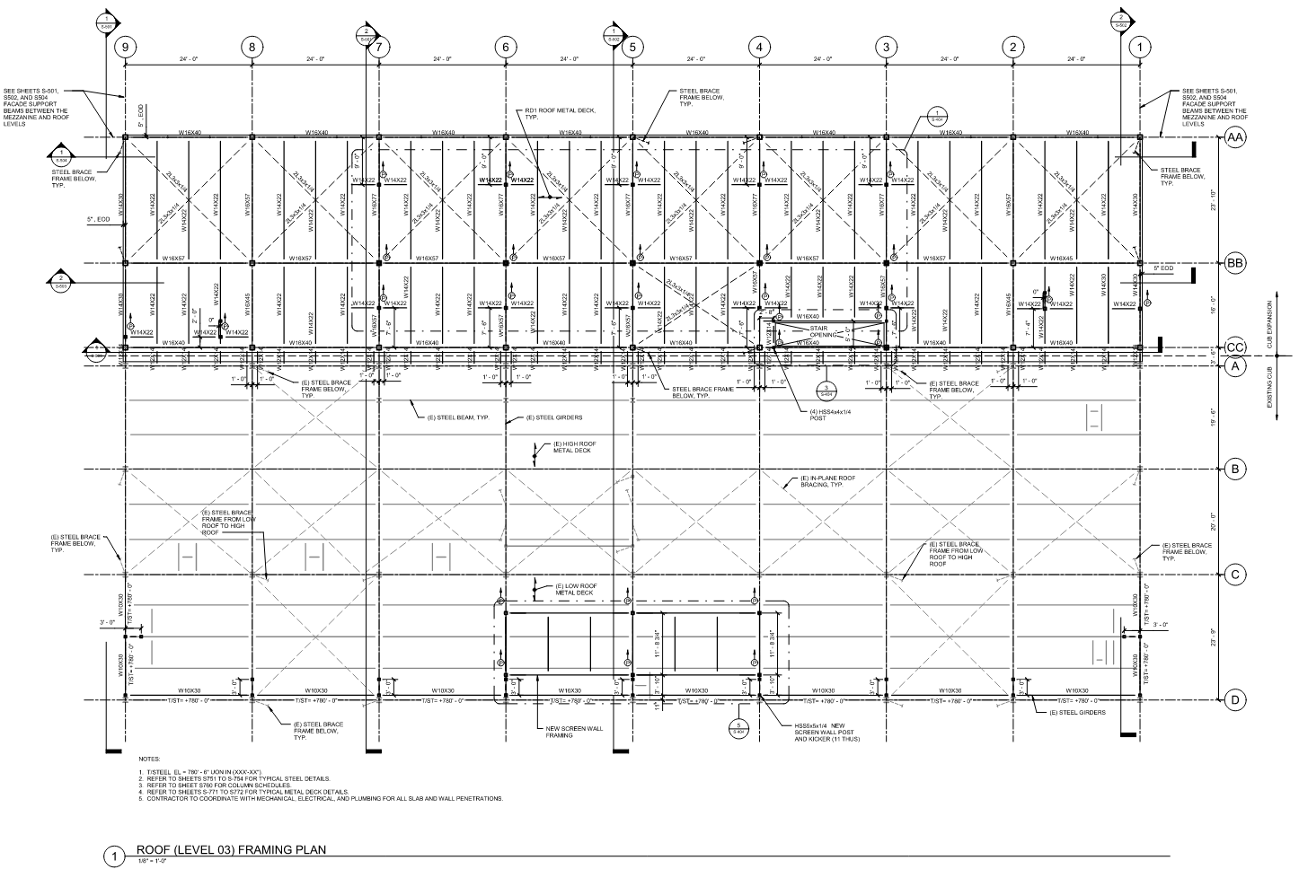
Structural - Roof Level Plan
CUB Expansion
The roof level framing will also consist of steel wide-flange members.
The roof structure will be built flat. Tapered insulation is being used to create the final roof slopes.
Steel metal deck is used for the roof surface construction.
Notes:
Gordon

Slide 7
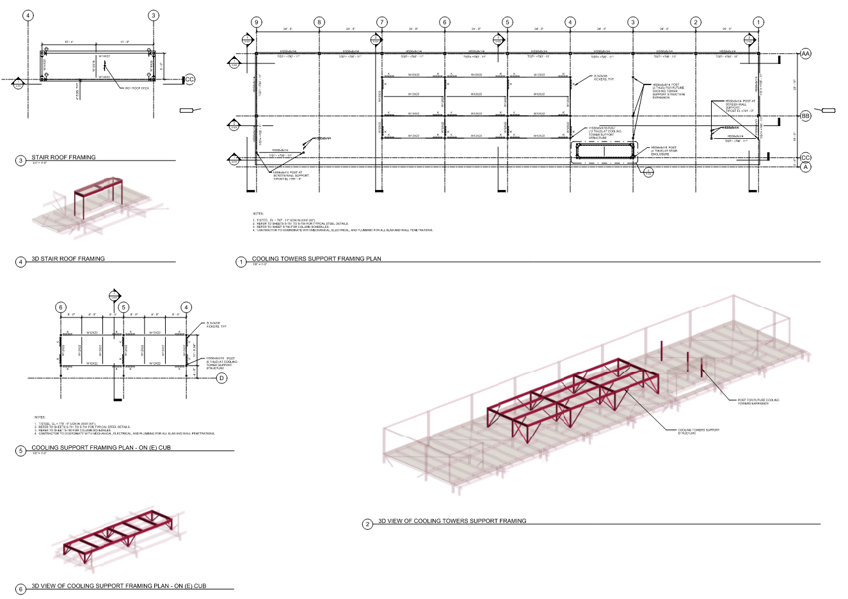
Structural – Cooling Towers and Roof Screen
CUB Expansion
A steel dunnage will be placed above the roof level to support the cooling towers.
A steel frame structure will also be added above the roof to enclose the service stair.
The exterior columns are being extended above the roof level to serve as supports for the screen wall.
Notes:
Gordon

Slide 8
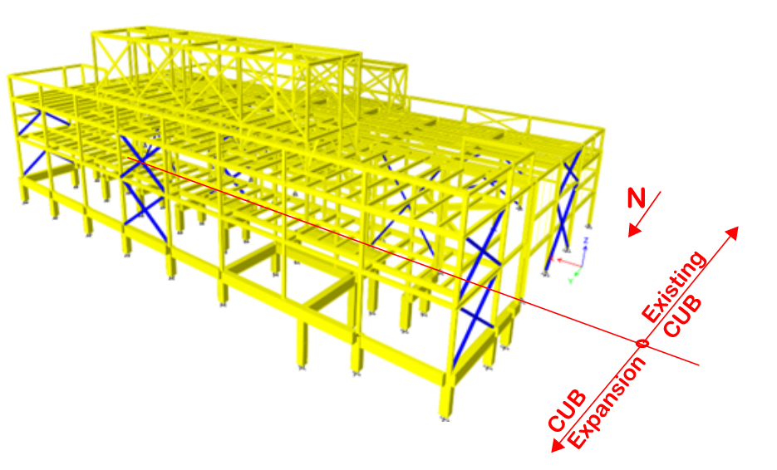
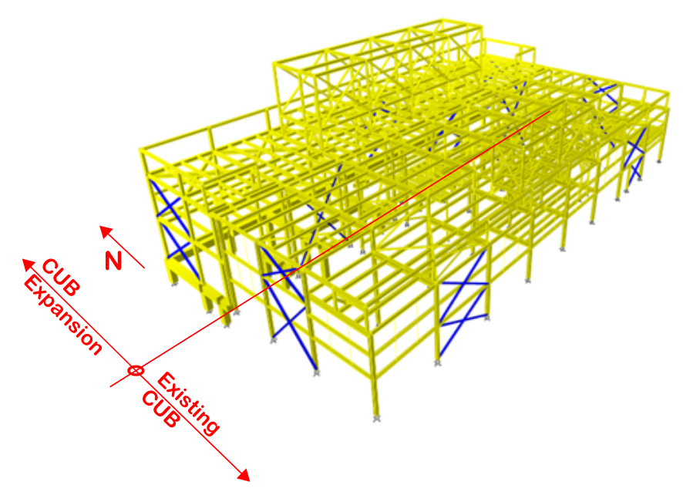
Structural – Lateral Loads Resisting System
Existing CUB
The lateral loads resisting system of the exiting CUB consist of cross braces placed on the exterior walls on each side of the building.
The IBC code requires that if alterations increase the lateral loads and cause that the demand-capacity ratio of the lateral loads resisting element to increase more than 10%, the structure needs to be retrofitted. The current structural model allows us to check every member of the structure. If any member exceeds its capacity, it will be retrofitted.
CUB Expansion
Similarly, to the existing CUB. The lateral loads resisting system of the expansion will consist of steel cross bracing, placed on the exterior wall and the column line adjacent to the existing CUB.
The new bracing frames in the East and West sides of the building are designed to carry the new and existing building loads.
Notes:
Gordon

Slide 9
Structural – Next Steps (Final Design)
Existing CUB
Confirm the final geometry of the roof screen and loads applied to the structure.
Verify the adequacy of the lateral force resisting system.
Verify the connections capacity of various elements as required.
CUB Expansion
Confirm the actual foundation scheme is still valid after the final geotechnical investigation is conducted (Summer 2024).
Verify all loads applied to the structure based on the final mechanical/electrical equipment selection.
Verify the roof and mezzanine level framing based on final piping configuration and loads.
Coordinate façade attachments with architecture.
Notes:
Gordon

