Slide 1
Fermilab UIP
100%PD Workshop
August 22 and 23, 2023
June 28th 2022
Gordon Carrie

Slide 2
Agenda – Day One (August 22)
Kickoff: 9:30am - 10:00am
Introductions / Team Overviews
Agenda presentation
Safety moment
Aims and objectives of the workshop
Project requirements
Break: 10:00 - 10:15am
Telecom presentation (Virtual): 10:15 -10:45m
Architectural presentation:10:45 - 11:30
Civil presentation: 11:30 - 12:00pm
Lunch: 12:00 - 1:00pm
Structural presentation: 1:00 - 1:30pm
Mechanical presentation: 1:30 - 3:15pm
Break: 3:15 - 3:30pm
Plumbing presentation(Virtual): 3:30 - 4:00pm
Notes:
Gordon

Slide 3
Agenda – Day Two (August 23)
Day 2 Kickoff : 8:30 - 8:45am
Electrical HV-MV presentation(Virtual): 8:45 - 9:15am
Includes discussion of CD3A scope
Electrical LV presentation: 9:15 - 10:30am
Includes discussion of CD3A scope
Cost estimation presentation (Virtual): 10:30 - 12:00pm
Lunch: 12:00 - 1:00pm
Cost estimation presentation (Virtual): 1:15 - 2:30pm
Includes discussion of risk
Sustainability discussion: 2:30 – 3:00pm
Conclusion discussion / Wrap up: 3:00 – 3:30pm
Site Visit: 3:30 - 4:30pm
Notes:
Gordon

Slide 4
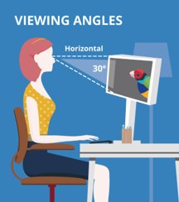
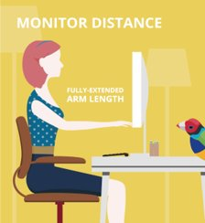
Safety Moment
Use of Digital Devices and Eye Strain
Digital eye strain can affect anyone who spends hours a day using digital devices. It can cause vision blurriness, tired and achy eyes, dry eyes, tearing up, and even stinging. ​
Try to blink more often. Studies show we blink less often when using digital devices. ​
Look away from the screen occasionally and focus your eyes on an object far away. Using 20-20-20 rule every 20 minutes shift your eyes to an object that is 20 feet away for at least 20 seconds. ​
Adjust the brightness of the screen to match the light around you. Difference in brightness of a screen makes your eyes work harder.​
Adjust your position. It is recommended to sit approximately 25 inches from your computer screen and position the screen slightly downward not horizontally or upwards. ​

Slide 5
Aims and Objectives
Project Status & Next Steps
Technical Presentation of Disciplines
Discipline Specific Coordination Items
Cost Estimation
CD 3A Process for Long Lead Items
Incorporation of Sustainable Design Opportunities

Slide 6
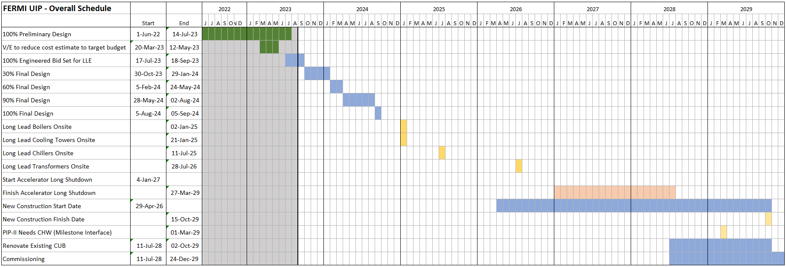
Design/Construction Schedule

Slide 7
Project Requirements
Unique REQ ID | REQ Source | REQ Text | REQ Revision | Design, Construction | Owner/Discipline | System | Work Package Number | Location | Linked Package | REQ Status
REQ-0001 | Fermi UIP - Concept Design Report | Provide comfort chilled water load capacity (via heat exchanger off of process chilled water loop from proposed chiller plant building) for expansion up to 2321 Tons. Match existing system supply temperature of 43F and return of 54F. Discharge pressure to be no greater than 120 psi. | Revision 1 | Design | Mechanical | Comfort Cooling | Package 1 - Central Utility Plant | Central Utility Building | 100% PD | Accepted
REQ-0002 | Fermi UIP - Concept Design Report | Provisions for this additional capacity include N+1 redundancy on the heat exchanger and distribution pumps. | Revision 1 | Design | Mechanical | Comfort Cooling | Package 1 - Central Utility Plant | Central Utility Building | 100% PD | Accepted
REQ-0001 | Fernu UIP - Updated Load Matrix | Updated future load matrix received 2/8/23 call for a future Comfort CHW load of 2591 (increase of 270 tons). | Revision 2 | Design | Mechanical | Comfort Cooling | Package 1 - Central Utility Plant | Central Utility Building | 100% PD | Accepted
REQ Status | Compliance Status | Verification Evidence | Checked by Discipline Lead? | Discipline Notes | Project Change Notice Ref
Accepted | Compliant | Sheet M011- Mechanical Schedules | Yes
Accepted | Compliant | Sheet M011- Mechanical Schedules | Yes
Accepted | Compliant | Sheet M011- Mechanical Schedules | Yes

Slide 8
Existing Conditions

