Slide 1
Electrical Low Voltage

Slide 2
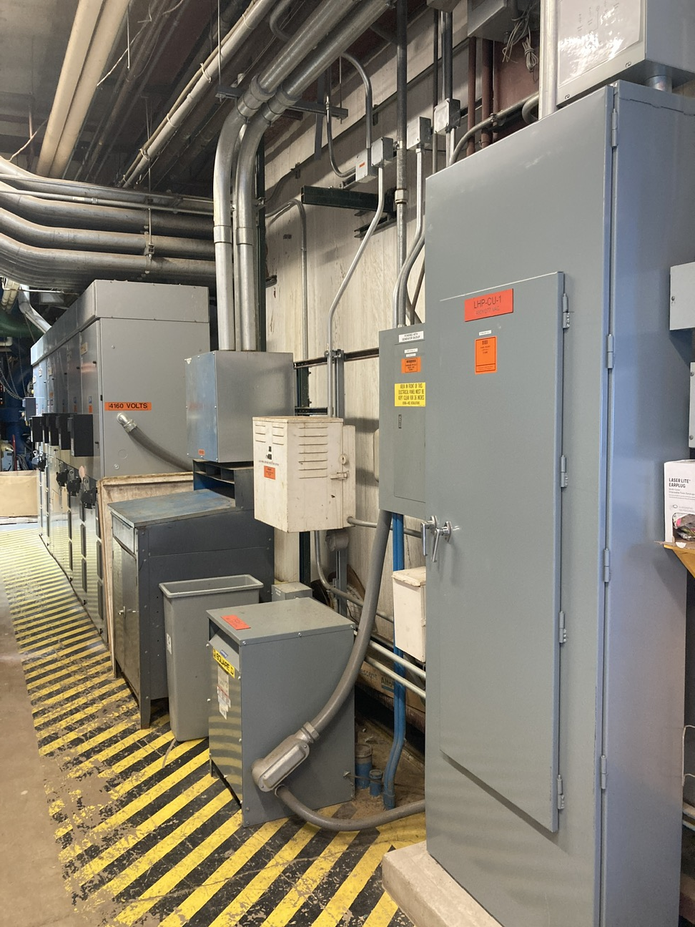
Electrical Low Voltage
Scope
Existing CUB
Two medium-voltage feeders provide redundant service to legacy unit substations (USS) in exterior yard.
HVAC loads supported at both 4.16kV and 480/277V.
Existing electrical equipment located throughout facility with minimal clearance; no dedicated electrical space.
CUB Expansion Scope
Replace USS’s with new MV transformers in yard and incoming switchgear interior to building.
All new HVAC equipment at 480/277V, fed by new cable-connected feeders in conduit.
Dedicated battery back-up added for life safety systems.
Optional standby augmented with additional ATS from second switchgear lineup, and UPS for critical controls loads.

Slide 3
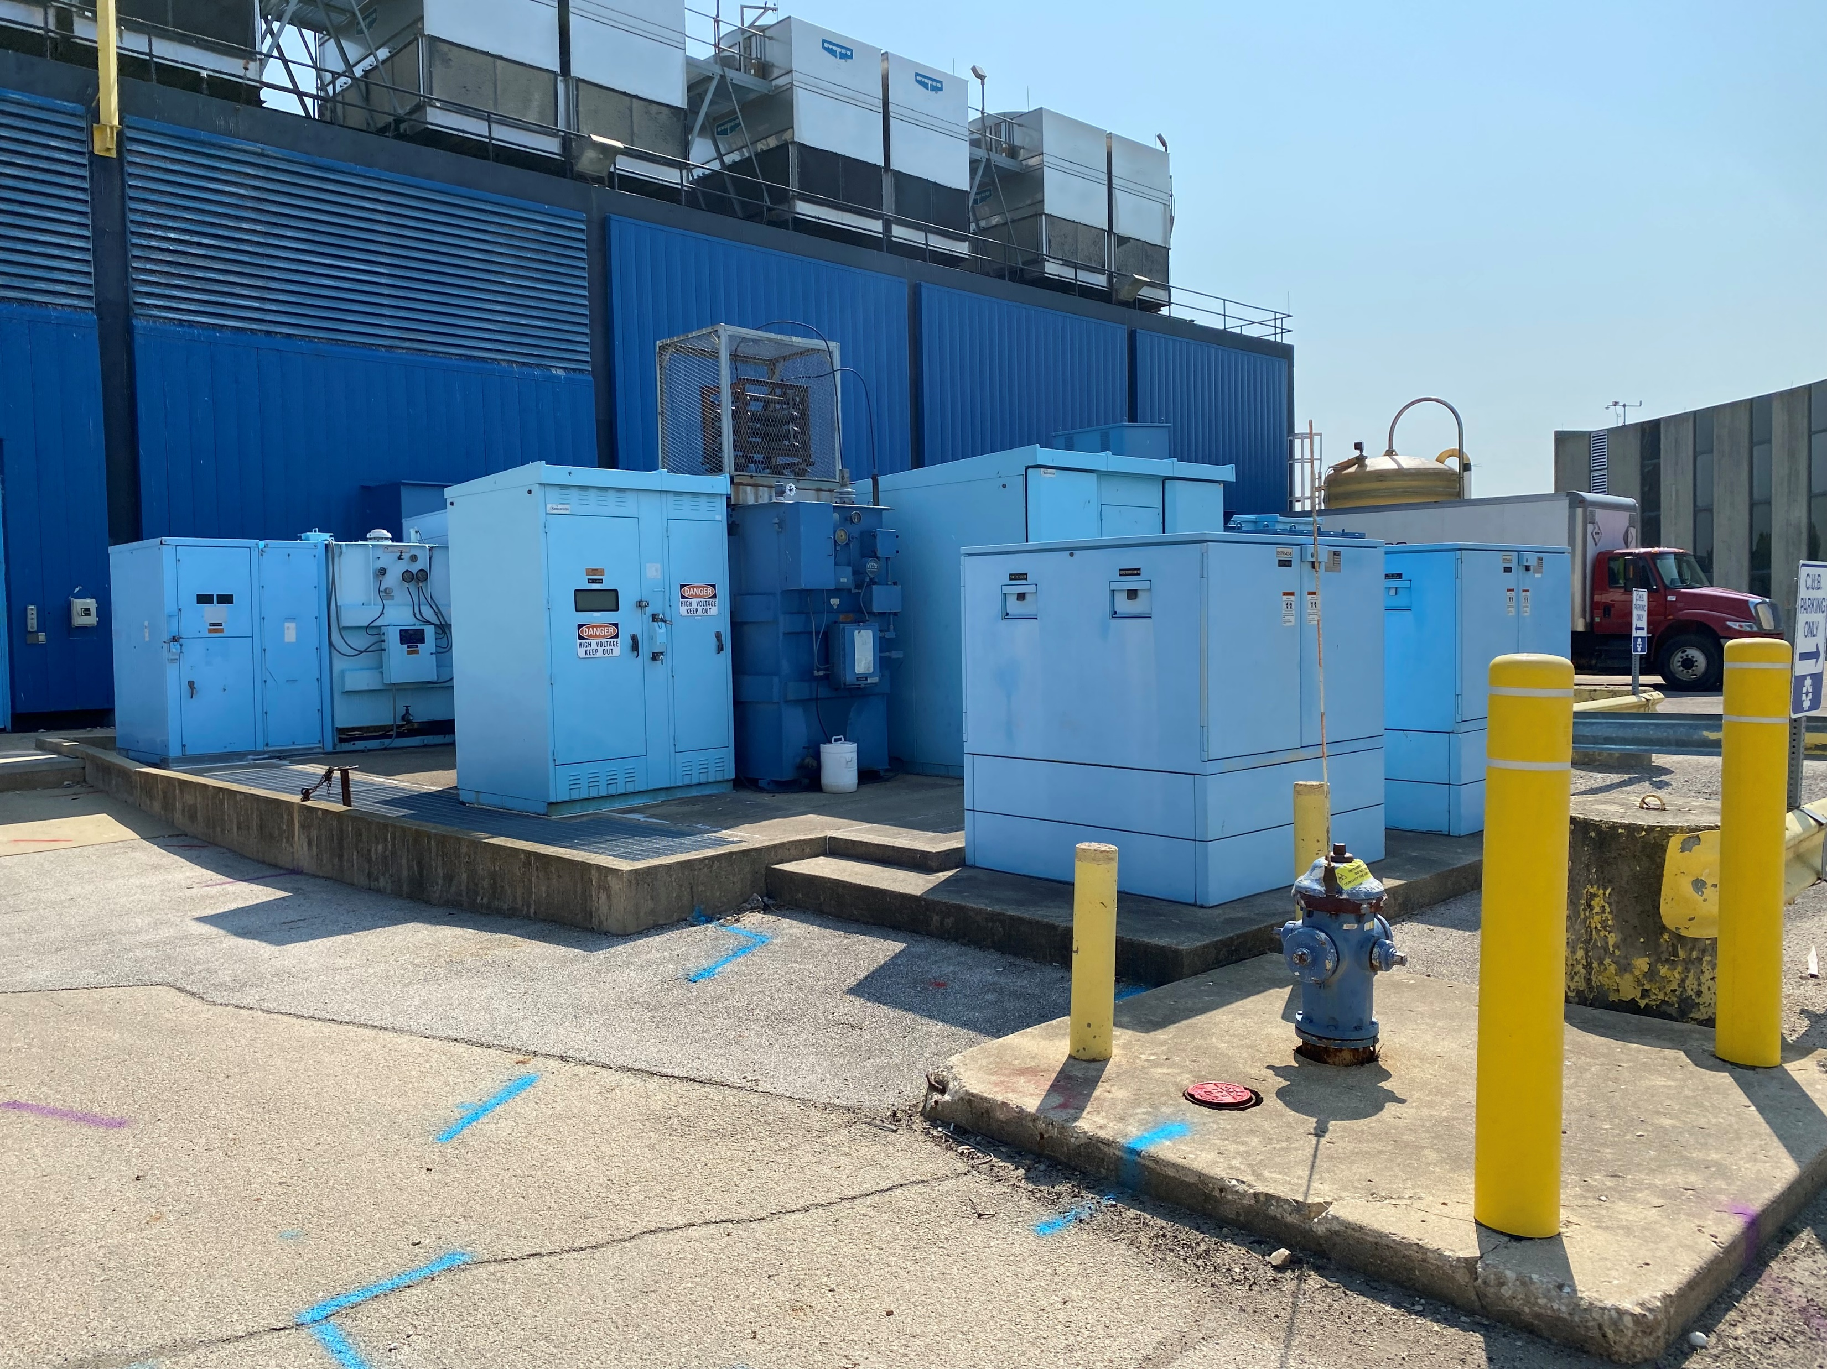
Electrical Low Voltage
Existing CUB Power Distribution
Incoming MV Gear: (2) double-ended unit substations in equipment yard.
CU-1 Substation: Feeds 4.16kV, 2000A Motor Control Switchgear, which serves (5) chillers.
CU-2 Substation: Feeds (7) 480/277V, 1600A distribution boards on Mezzanine level, which serve HVAC loads and primary branch of standby system.
Standby Power: 250kW Generator and 800A automatic transfer switch, which serve small HVAC equipment, controls, lighting, and general receptacle loads.

Slide 4
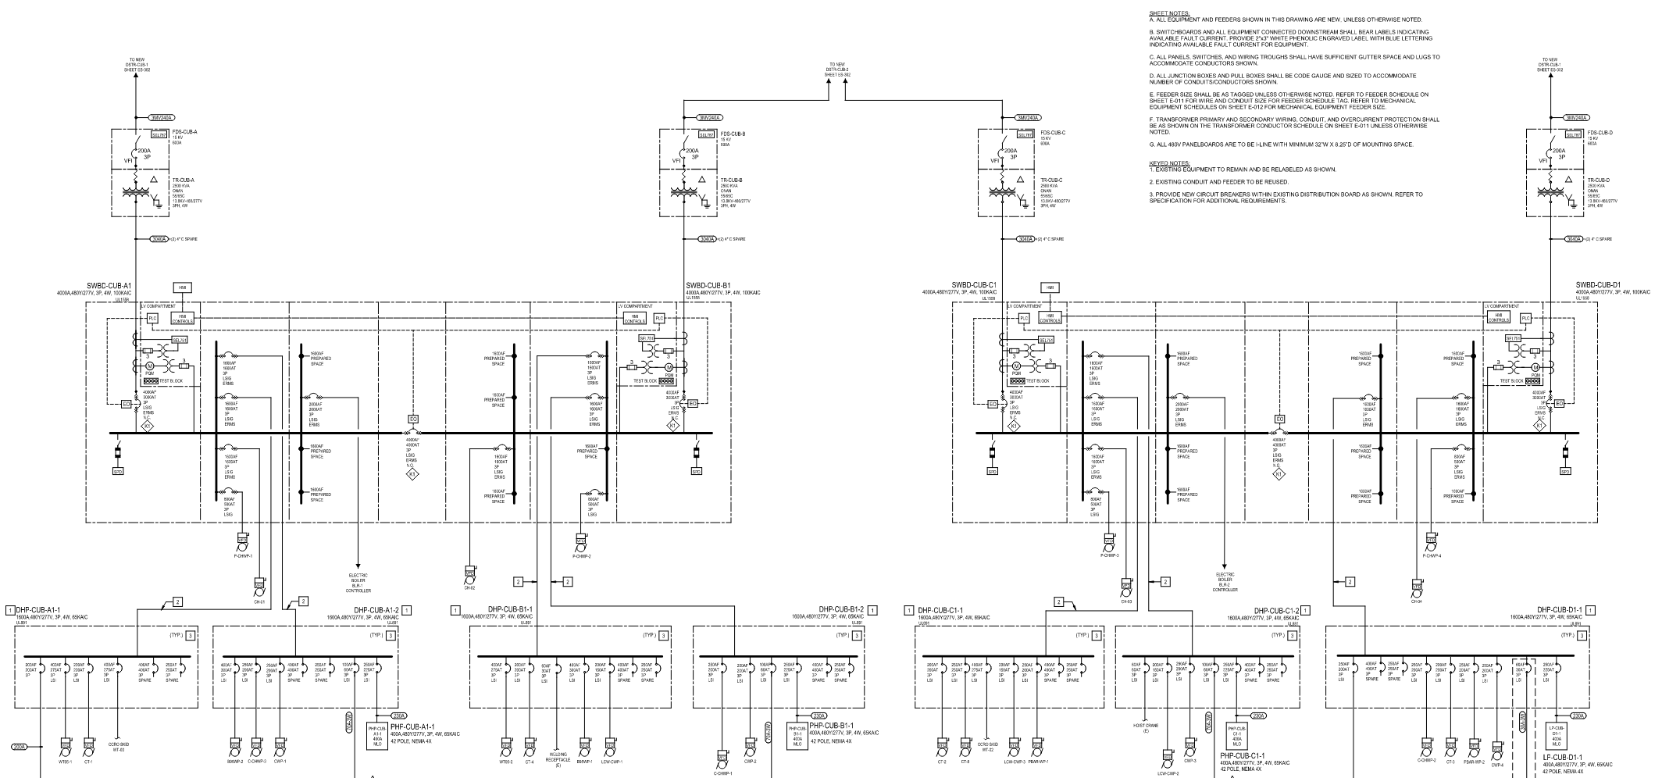
Electrical Low Voltage
Normal Power Distribution
Phased installation of (4) 2500kVA, MV transformers providing resilient service to (4) 480/277V, 4000A switchgear arranged into dual-ended lineups.
Reuse of existing 1600A distribution boards on Mezzanine.
HVAC loads distributed across switchgear branches.
208V/120V panels provided on each branch for small mechanical equipment and plug-loads.

Slide 5
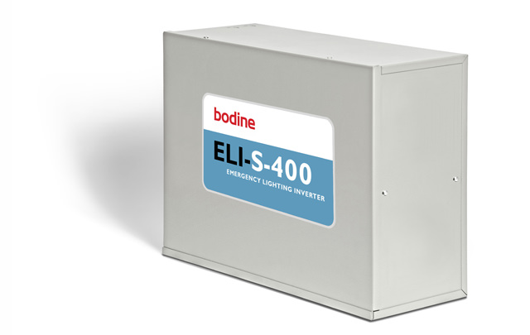
Electrical Low Voltage
Emergency Life Safety Power Distribution
Emergency life safety systems with battery back-up:
Emergency Egress Lighting: Fixture-integrated EM batteries, distributed EM lighting inverters for high-bay fixtures.
Fire Alarm: Secondary 24Vdc power supply system with batteries and automatic transfer switch.
Normal power circuits to all life safety systems served from optional standby distribution.

Slide 6
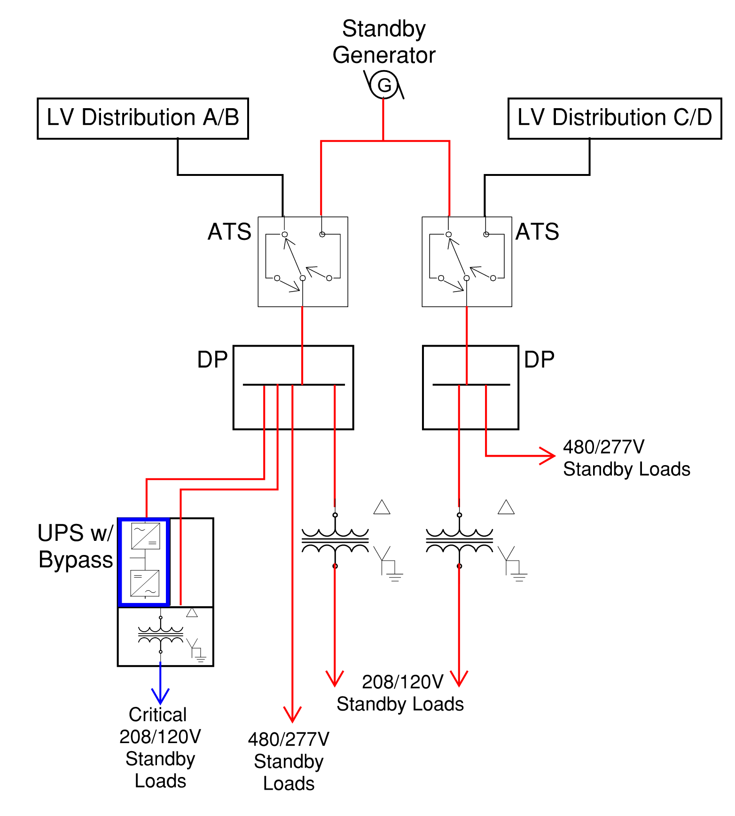
Electrical Low Voltage
Optional Standby Power Distribution
Reuse of 250kW, 480/277V standby generator.
(2) new 200A automatic transfer switches downstream of each LV switchgear lineup.
Standby distribution supports heating hot water pumps, heating system auxiliary loads, primary power to life safety loads, and mechanical controls UPS.
30kW, 208Y/120V UPS bridges power transfer for building controls, IT systems, and heating & refrigeration detection equipment.

Slide 7
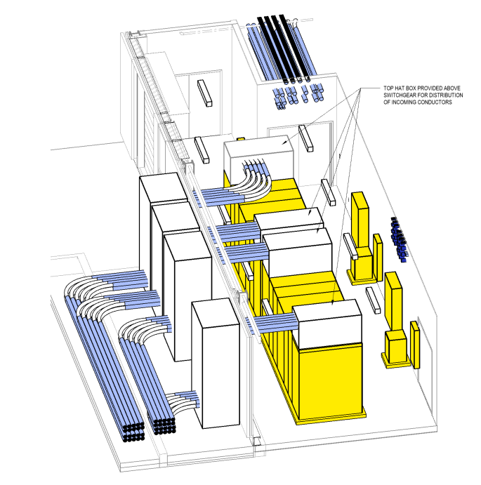
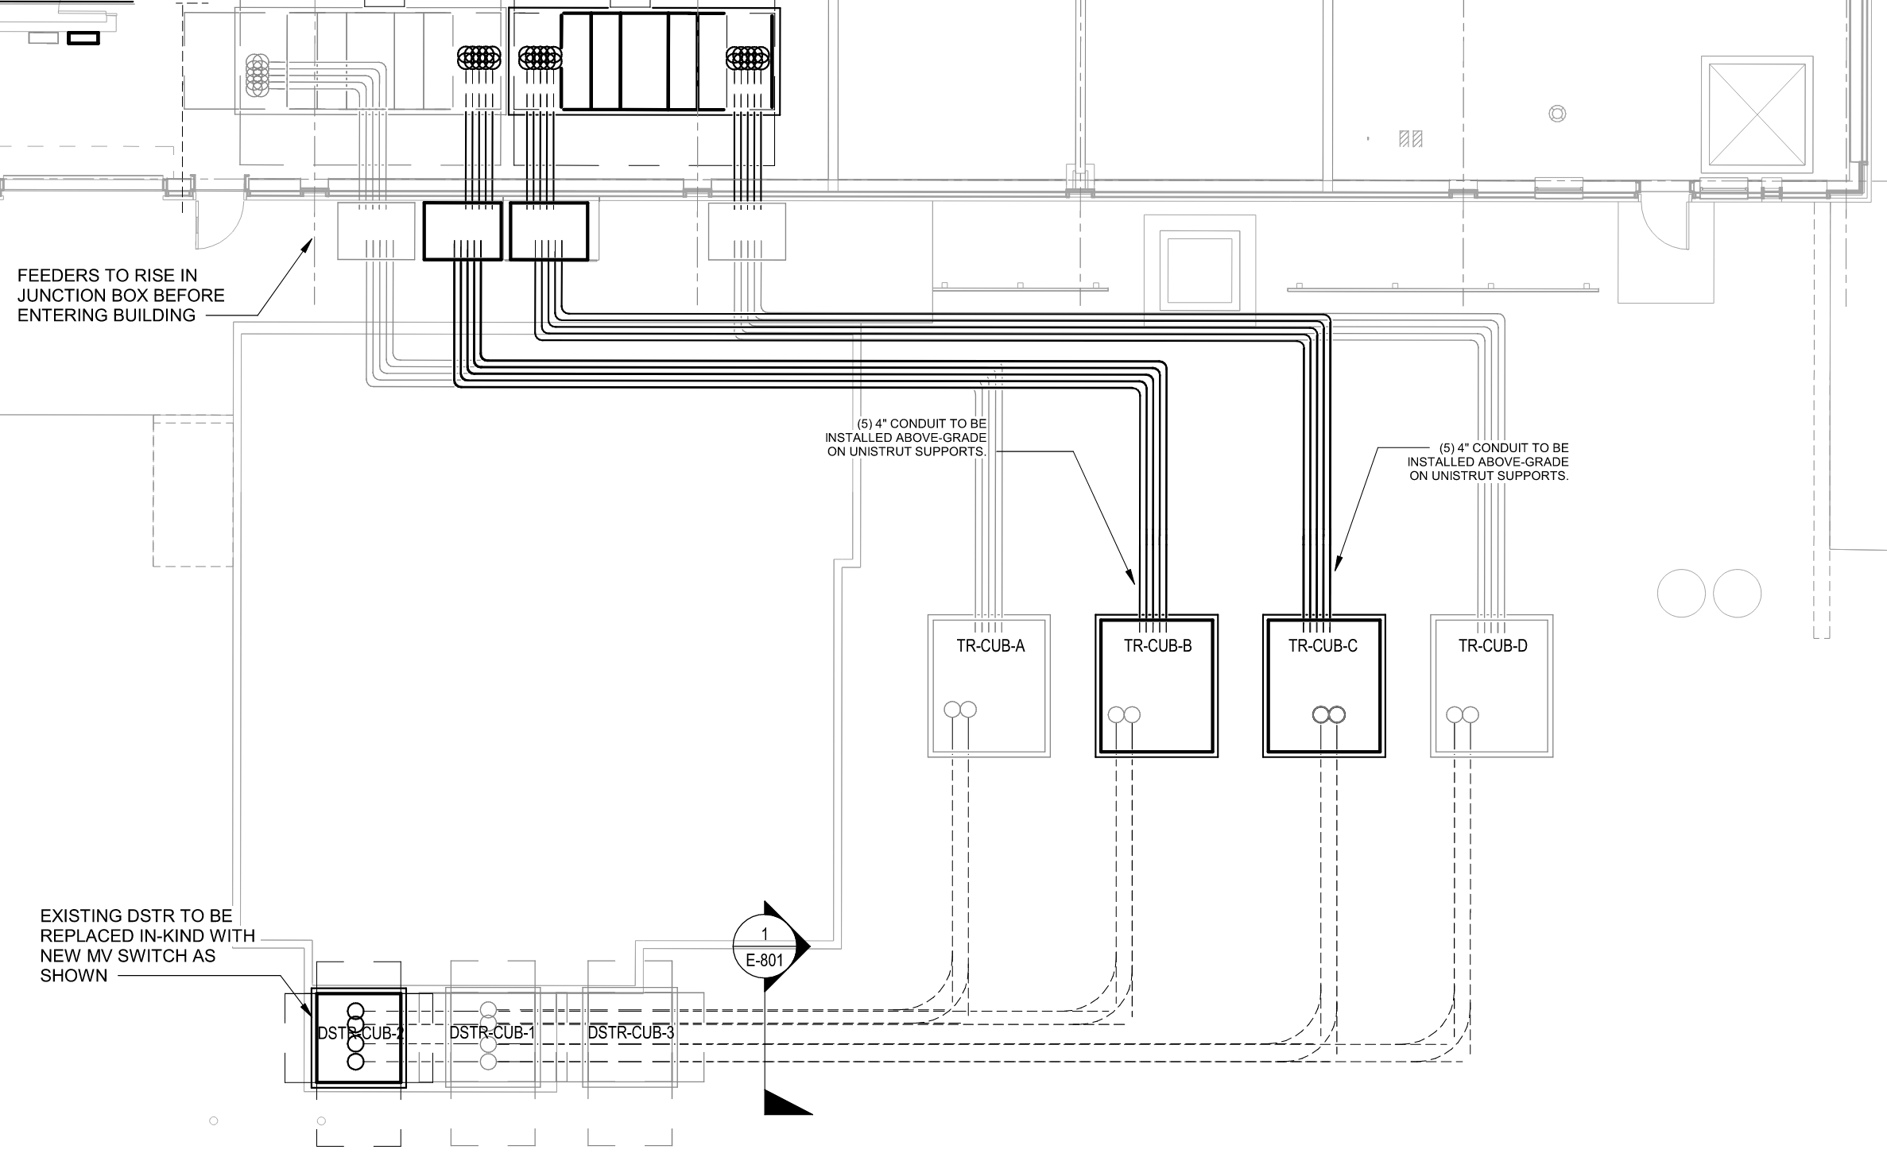
Electrical Low Voltage
Main Electrical Room Options – Base Design
Base Design: Main Electrical Room in CUB
(4) 4000A, 480/277V main switchgear located within a main electrical room inside the CUB, fed from the pad-mounted MV transformers outside the building.
Service feeders extend above grade from pad-mounted transformers in yard to pullboxes along the south building façade.
Upon entry to electrical room, feeders will enter the top of switchgear.

Slide 8
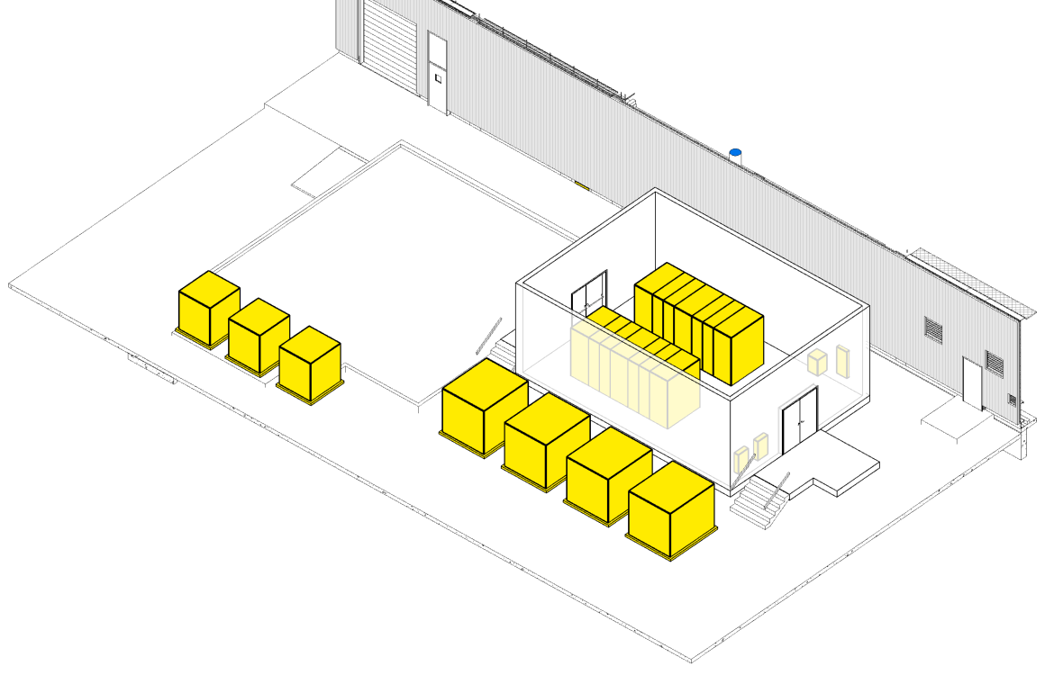
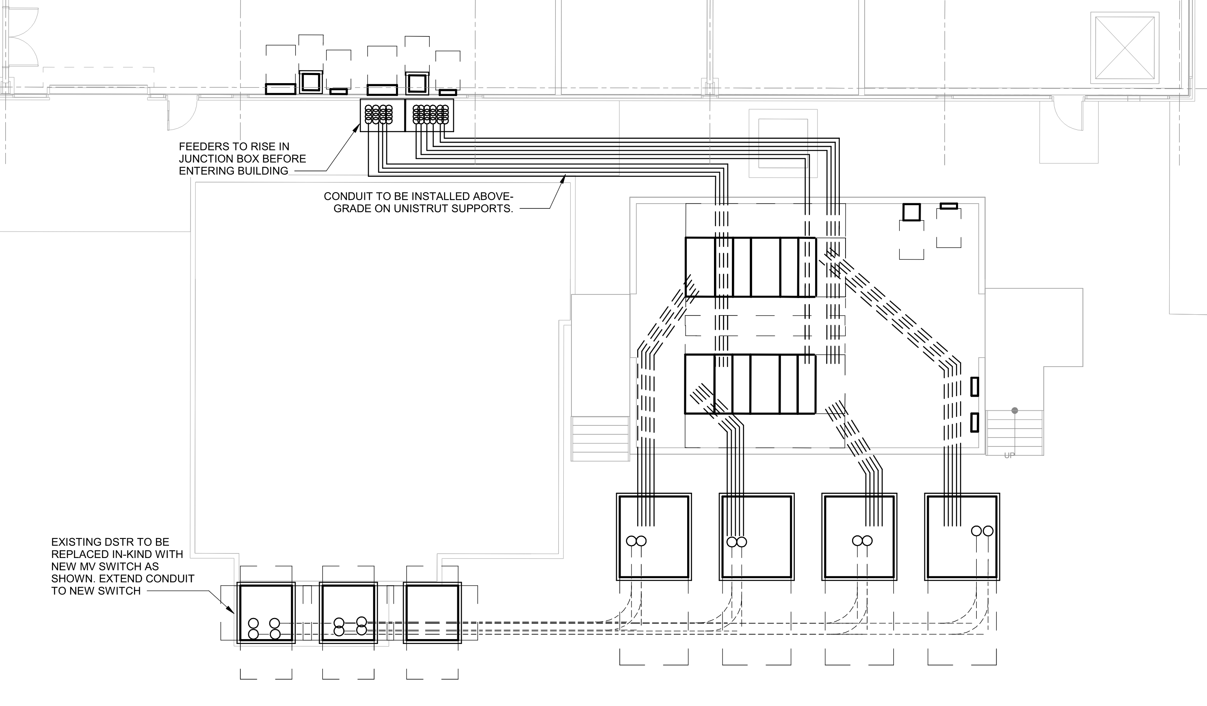
Electrical Low Voltage
Main Electrical Room Options – E-House Alternate
Bid Alternate: E-House Electrical Room in Yard
Packaged, pre-fabricated electrical house containing (4) 4000A, 480/277V main switchgear located south of the CUB. Interior space allocated for main electrical room can be repurposed.
Construction of E-House will occur off-site and simplify phasing and cutover of existing HVAC equipment.
New feeders serving major HVAC equipment & distribution boards will enter through south building façade.

Slide 9
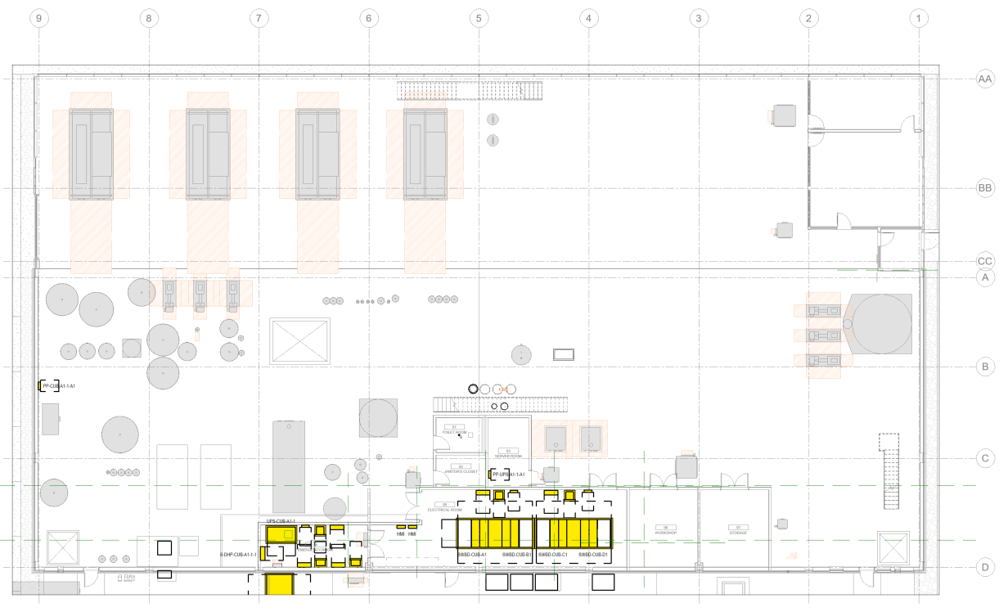
Electrical: Overall Floor Plan- Level 01

Slide 10
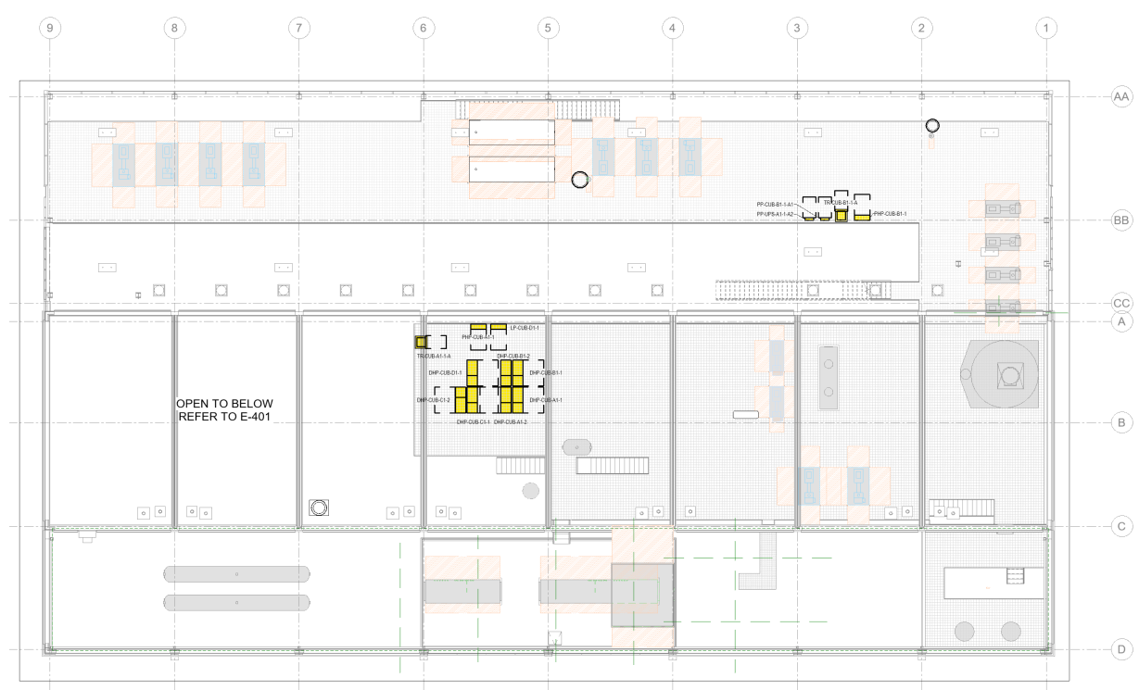
Electrical: Overall Floor Plan- Mezzanine Level

Slide 11
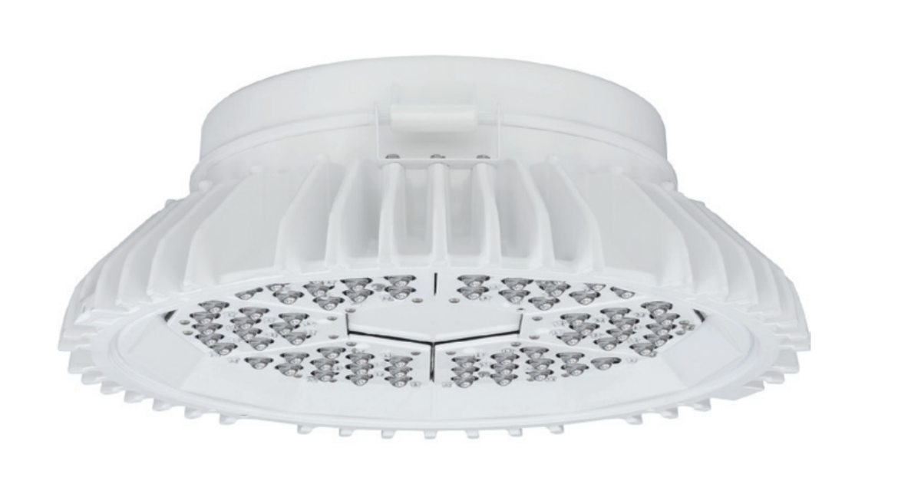
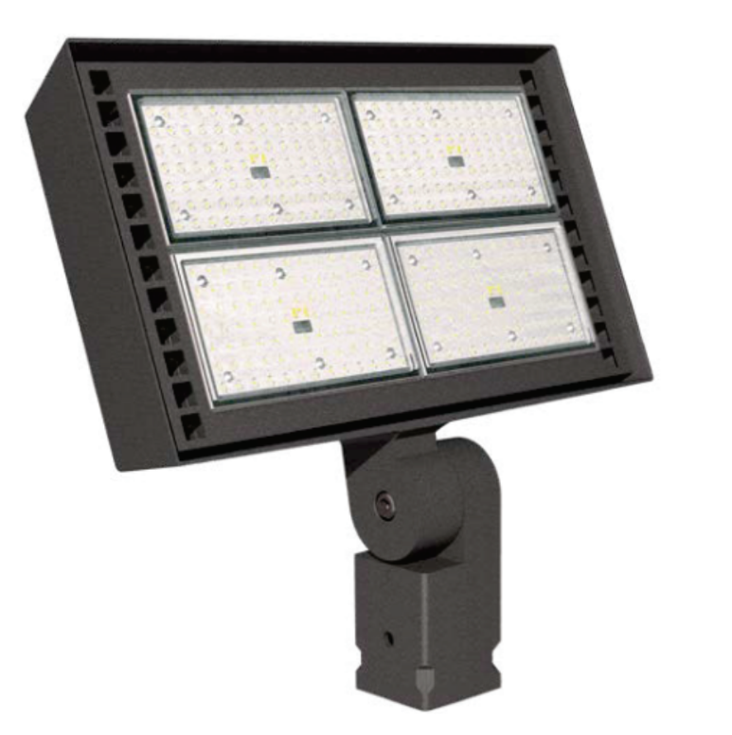
Electrical Low Voltage
Lighting & Lighting Controls
New LED luminaires provided throughout both new and renovated CUB spaces, rooftop, and south equipment yard.
Lighting levels and controls in accordance with FESS standards: maximum of 75 foot-candles in control rooms and machine shop areas.
Automatic lighting controls to maximize lighting energy savings using occupancy and daylight sensitive controls.
Occupancy sensor control not used in electrical rooms, shops, or similar spaces where automatic shut-off may endanger occupant safety.

Slide 12
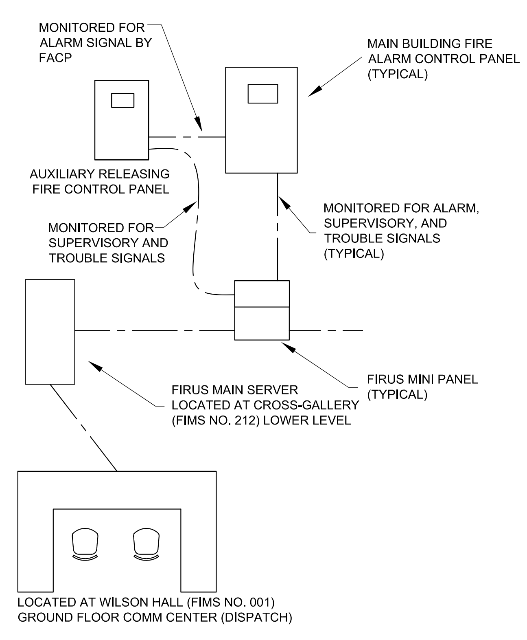
Electrical Low Voltage
Fire Alarm
New automatic fire alarm detection and notification system throughout both new and renovated CUB spaces.
Fire alarm control panel connected to Fermilab FIRUS network.
Fire alarm will turn-on emergency egress lighting during alarm activation.
All fire alarm initiation devices will be addressable and reviewed by the Fermilab Fire Department prior to program of FACP.
Heat detection provided throughout building.
Audible and visible notification devices located in accordance with NFPA 72.

Slide 13
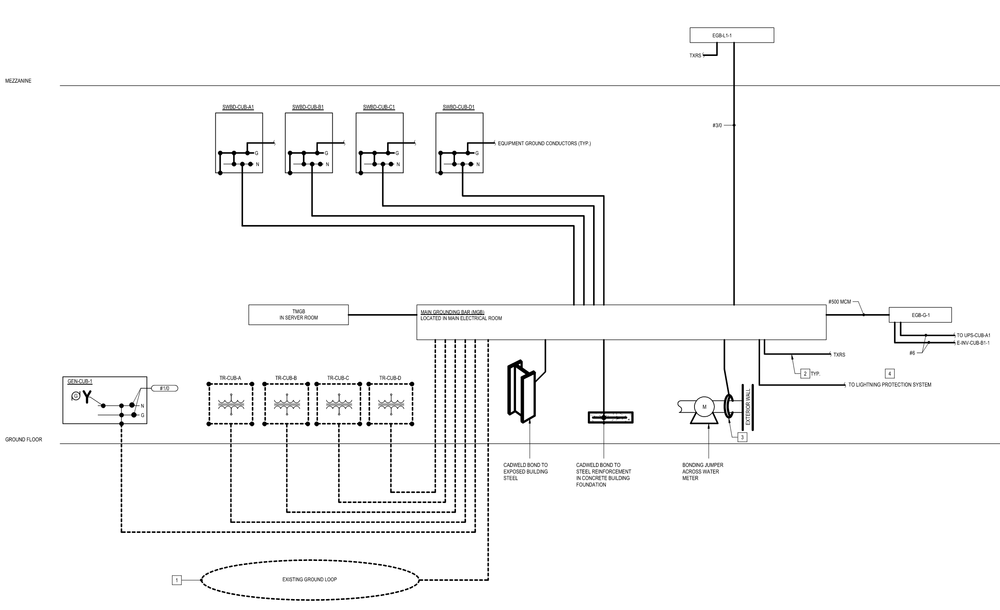
Electrical Low Voltage
Grounding & Lightning Protection
Central grounding system for the electrical service, all switchgear, and separately derived systems.
New grounding loop, ground rods, and bonding to building steel provided at building expansion, interconnected with existing ground loop.
All grounded busses from switchboards, transformers, generators, panelboards will be connected at a main ground bus in the main electrical room.
UL master label, class I lightning protection system at roof of both existing and new CUB structure. Existing lightning protection terminals to be replaced.

Slide 14
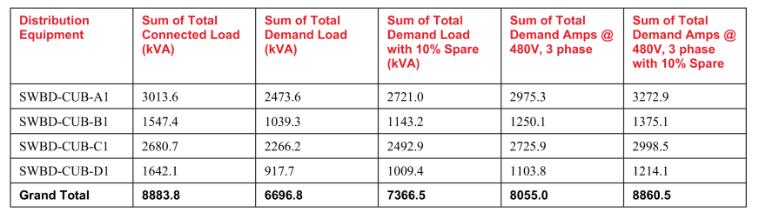
Electrical Low Voltage
Calculations
100PD Total Loads, without future mechanical equipment
Load Reduction Results
Reduce MV transformer size from 3000kVA to 2500kVA each
Eliminate (1) new 1600A distribution board; others are existing to be reused
Reduced conduit & cable feeder sizes to mechanical equipment
Preliminary Arc Flash
Maximum incident energy for CUB equipment at approx. 20cal/cm² at line side of incoming main circuit breaker of main switchboard.

Slide 15
Electrical Low Voltage
Next Steps
Decision between main electrical room internal to CUB vs. external E-house
Develop CD3A Long Lead Items Package
Advance detailing of equipment yard, including connection details and conduit pathways between MV transformers and main switchgear.
Coordinate phasing & cut-over plans for transition of mechanical loads between electrical services.

Slide 16
CD3A Long Lead Equipment

Slide 17
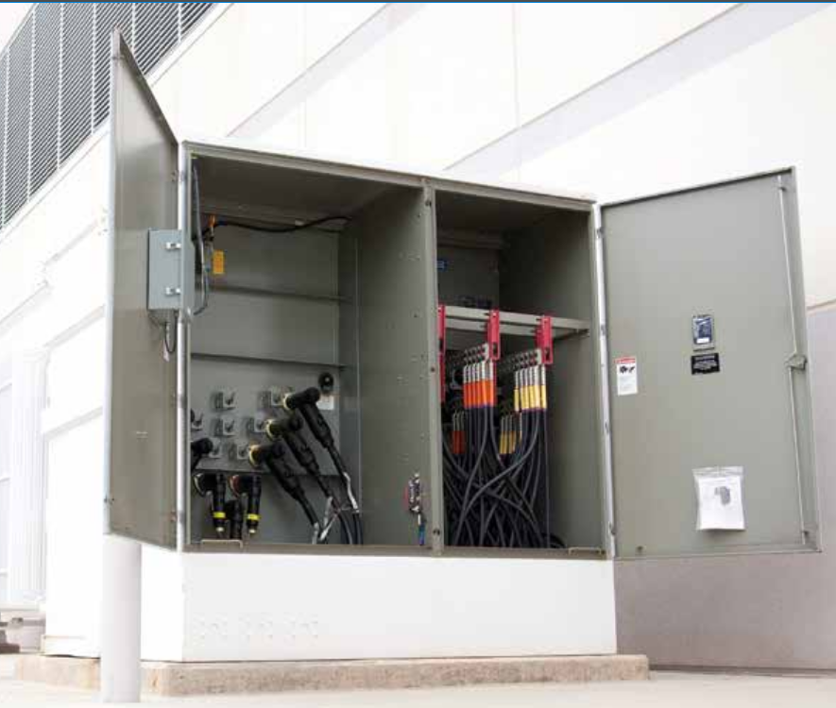
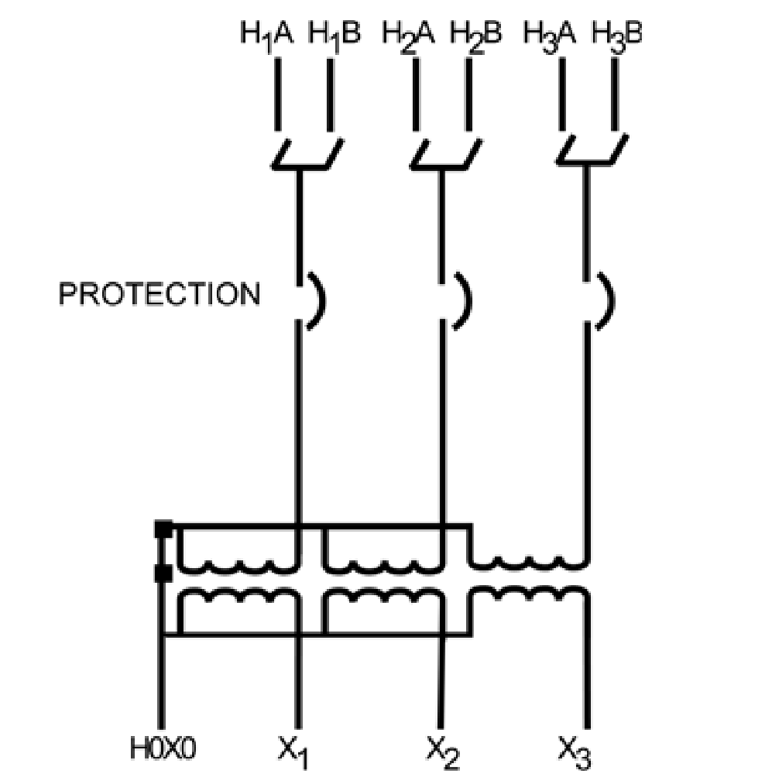
Electrical Low Voltage – CD3A
Equipment Specification
MV:LV Transformer
Pad-mount, oil-filled transformer
2500kVA capacity
13.8kV primary, 480Y/277V secondary
Integral VFI breaker and differential relay
Quantity: 4

Slide 18
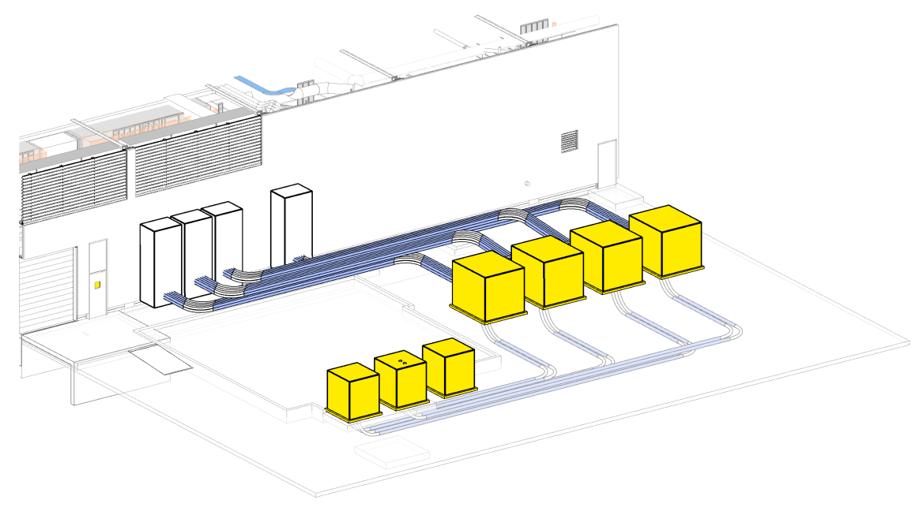
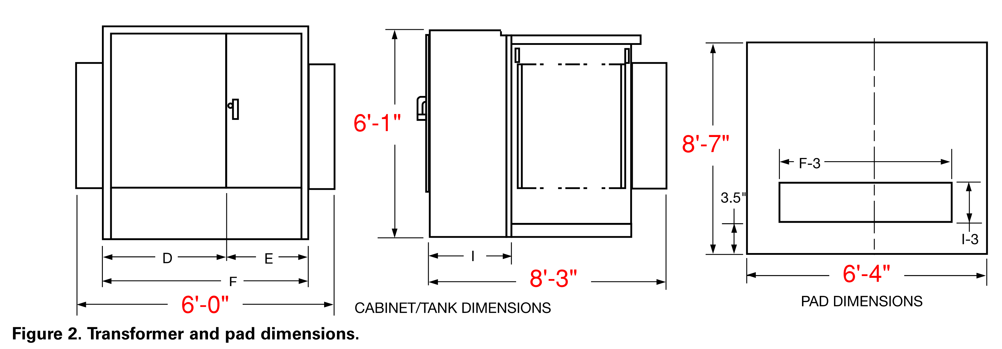
Electrical Low Voltage – CD3A
Equipment Details
Location
Dimensions
Total Weight:14,000 lbs.
Technical Coordination
Side-exit of transformer secondary feeders to CUB
External low-voltage compartment for instrumentation & gauges

Slide 19
Electrical Low Voltage
Vendor Outreach
Vendors
Eaton
Hitachi Energy
Fermilab Input Required:
Confirmation of preferred vendors
Manufacturer testing requirements & storage requirements
Coordination with Fermilab Procurement Team

