Slide 1
Cost Estimation

Slide 2
Estimate Classification
A Class 3 estimate typically conducted during the intermediate stages of a project when the project scope, design, and specifications have been developed, but some elements may still require further refinement.
Class 3 estimates are used for preliminary budgeting, procurement planning, and obtaining more accurate funding approvals. They provide stakeholders with an understanding of project costs and allow for initial decision-making.
Based on the level of design and the estimating approach, the accuracy range for the Fermilab TO1 Class 3 Estimate is expected to fall within -15% and +20% of the likely estimate.​

Slide 3
Estimate Methodology
Direct Costs
Direct Costs encompass the expenditures directly tied to the physical construction activities and materials
required for a project. Direct unit costs include the costs for material, equipment, and labor for each line item.
Such costs are obtained from vendors, past projects and data bases such as labor unions and Trimble Trade Service.
Labor productivity rates are derived from the Mechanical Contractors Association of America (MCAA) and the National Electrical Contractors Association (NECA).
Difficulty factors are included to increase the unit rate for activities which are anticipated to take more resources to complete than if they were completed in ideal conditions. Adverse conditions that result in higher difficulty factors include:
Small, confined working spaces
Remote locations for materials laydown that is over several hundred feet away from the final install location
Items where additional safety logistics will be required
Constrained areas due to existing conditions
It is assumed that the general contractor will subcontract the majority of the work. Long lead procurement items (Category B) will be purchased by the owner directly and stored by the general contractor and installed by the appropriate subcontractor per the construction schedule. The general contractor will be responsible for procuring and administering jobsite general requirements such as temporary utilities, job site trailers, temporary cranes, construction material hoists, overflow waste, etc.
No allowance has been made for special safety measures related to radiological or hazardous materials safety at the construction site.

Slide 4
Estimate Methodology
Indirect Costs
“Below the Line” (BTL) costs encompass the expenses necessary to facilitate and support the construction activities and overall management of a project. The following percentage markups have been included in the estimate.
Professional & Pollution Insurance (0.15%)
Subcontractor & Supply Subcontractor Default Insurance (1.7%)
City Permits & Fees (1.05%)
Contractor Bond (1.1%)
General Requirements (3%)
General Contractor (GC) Staffing & Overhead (8%)
Contractor Fee (6%)
Construction Contingency (10%)
Escalation (5% per annum)
Gross Receipts Tax (0.63%)

Slide 5
Summary: Variance Breakdown
Summary of Variance between 90% PD Estimate (April 2023) & 100% PD Estimate (July 2023)
CAT | Scope | Total Project Cost (90% PD) | Total Project Cost (100% PD) | Variance ($) | Variance (%)
A | Building / Sitework | $64,522,635 | $65,460,724 | +$938,089 | +1.45%
B | Long Lead Procured Items​ | $34,177,254 | $19,238,283 | -$14,938,971 | -43.71%
C | Site Preparation | $4,146,338 | $4,146,338 | $0 | 0%
D | Direct Buried Chilled Water Feeders | N/A | N/A | $0 | 0%
E | Tunnel Pipework Replacement | $471,034 | N/A | -$471,034 | -100%
Total Base Scope |  | $103,317,260 | $88,845,346 | -$14,471,915 | -14.01%
A ALT | Alternate Electrical & Plumbing Scope | $607,545 | $607,545 | $0 | 0%
E ALT | Tunnel Pipework Replacement Alternate Scope | N/A | N/A | $0 | 0%
Total w/ Alternatives |  | $103,924,806 | $89,452,891 | -$14,471,915 | -13.93%
- | Risk-Based Contingency | $4,094,277 | $3,556,385 | -$537,992 | -13.14%
Total w/ Risk-Based Contingency |  | $108,019,083 | $93,009,176 | -$15,009,907 | -13.90%
Note: Values presented in the table above are total project costs (includes direct costs + indirect costs).

Slide 6
Summary: Variance Breakdown
Summary of Variance between 90% PD Estimate (April 2023) & 100% PD Estimate (July 2023)
Description | 90% PD Estimate (April 2023) | 100% PD Estimate (July 2023) | Variance
Direct Cost | $71,064,705 | $59,747,965 | -15.92%
Indirect Cost | $32,860,101 | $29,704,926 | -9.60%
Risk-Based Contingency | $4,094,277 | $3,556,285 | -13.14%
Total | $108,019,083 | $93,009,176 | -13.90%
Justification for Variation:
Variance is driven by the changes to the direct costs.
Several scope items were removed or reduced in order to gain cost savings (see next slide).
Changes to indirect costs & risk-based contingency are driven by the direct cost updates.

Slide 7
Direct Cost Summary
Summary of Variance between 90% PD Estimate (April 2023) & 100% PD Estimate (July 2023)
$71,064,705
Item # | Description | Value
1 | Reduction of Equipment Systems | ($6,144,863)
2 | Updates to Equipment Electrical | ($2,379,835)
3 | Updates to Site Electrical for Utilities | ($1,431,285)
4 | Switchboard / Switchgear Eliminated | ($1,140,095)
5 | Tunnel Pipework Eliminated | ($298,669)
6 | Adjustments to Site Prep / Site Improvements | $146,301
7 | Fire Protection Updates | ($40,665)
8 | Structural Columns Updated | ($34,417)
9 | Updates to Plumbing Systems | ($25,533)
10 | Adjustments to Site Utilities | $17,001
11 | Demo & Replacement of LCW Exp. Joints Added | $15,320
$59,747,965
$0
Note: Values presented in the above are direct costs only.

Slide 8
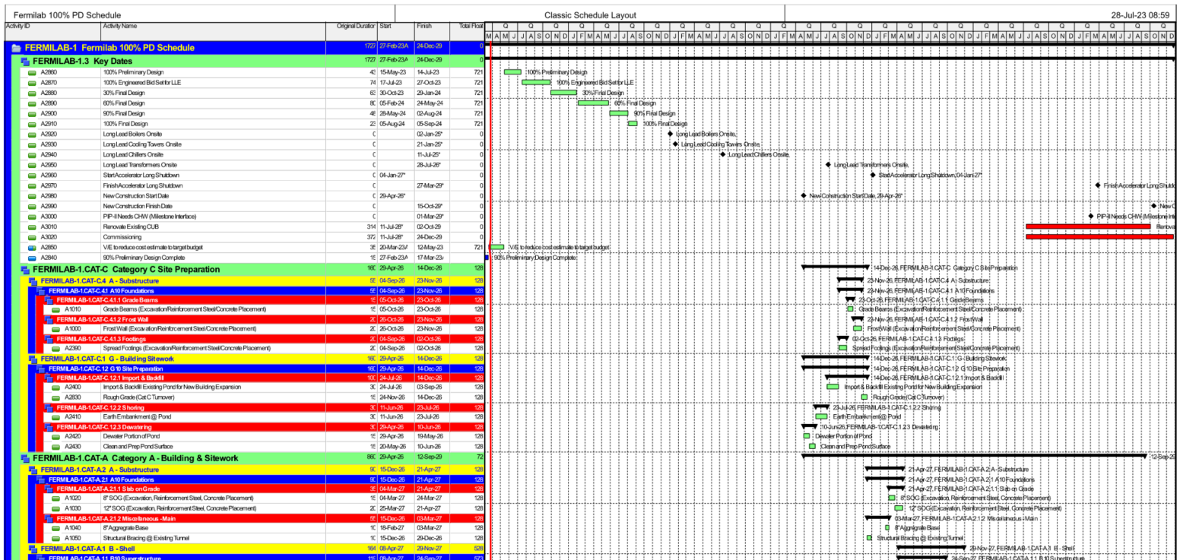
Construction Schedule
The work will be completed by a General Contractor with an anticipated start date of April 29, 2026, and ending on October 15, 2029 (a total 860 construction working days). The construction activities end on September 12, 2029 and there is an allowance for one month of float and closeout time.
The exception to this schedule is Category B (Long Lead Procured Items) which will commence and be completed earlier.
Commissioning services will extend beyond the completion date to 12/24/2029.
It is assumed that all subcontractors will have uninhibited, continuous access to the site to for workers vehicles and construction laydown areas in close proximity to the project site.

Slide 9
Construction Funding Profile
The first jump is for full funding for the Category B (Long Lead Items) in April 2024 in order to purchase all items at that time to maintain delivery schedule of these items.
The second jump is for full funding of the Category C (Site Work) package at the construction start date of April 29, 2026.
The third jump is for funding approximately half of the project construction budget for all activities scheduled between March 2027 and November 2027.
The final jump is for the remainder of the project construction budget for all activities between November 2027 and the final completion date of October 15, 2029.

Slide 10
Risk-Based Contingency
The risk register has been developed using project information gathered through discussions with the project team members.
The risk register includes an assignment of probability and impact for each identified risk. An impact consists of both a capital cost should the risk trigger, as well as an associated schedule impact.​
The capital cost impacts are based on direct costs only. The cost value of a schedule delay was determined by developing a daily schedule burn rate by attributing the sum of indirect and overhead costs to the total number of construction schedule days.
Risk # | Risk Category | Description
40 | Financial and Schedule | Risk existing valves do not hold
42 | Financial and Schedule | Experiencing longer than quoted lead/wait times on products and equipment due to supply chain issues.
38 | Constructability | Risk of dewatering failure
43 | Operations | Vibration from construction impacts on existing beam line and tunnel
18 | Constructability | Risk that earth embankment structure fails
12 | Constructability | Lack of adequate laydown areas in proximity to the site allowing for piping to be assembled.
19 | Constructability | Unforeseen ground conditions during construction
28 | Constructability | Damage to existing tunnel during excavation
31 | Constructability | Exceeding radiation limits during construction
39 | Constructability | Underpinning existing structure due to 5' trenching required for new sanitary line
25 | Constructability | Damage of existing utility lines during construction
35 | Constructability | Risk that minimum operational requirements of existing mechanical & electrical equipment cannot be maintained during construction
34 | Constructability | Accidental damage to existing chemical treatment material currently on site

Slide 11
Risk-Based Contingency
Quantitative Risk Analysis (QRA) was run on the individual risk register line items to simulate the Risk-Based Contingency.
The QRA is a Monte Carlo simulation with 10,000 iterations on the probability and impact of each risk triggering.​
Probability Density Function with Cumulative Distribution
Tornado Chart

Slide 12
Risk-Based Contingency
The P80 confidence level has been utilized for the Risk-Based Contingency value in the Class 3 Estimate.
Confidence Level | Subtotal Construction Value ($) | Risk-Based Contingency Value ($) | Risk-Based Contingency Percent (%)
P50 | $89,452,891 | $1,784,352 | 2.0%
P80​ | $89,452,891 | $3,556,285 | 4.0%

