Slide 1
IOTA Proton Injector Update
Dean (Chip) Edstrom
08/10/2023

Slide 2
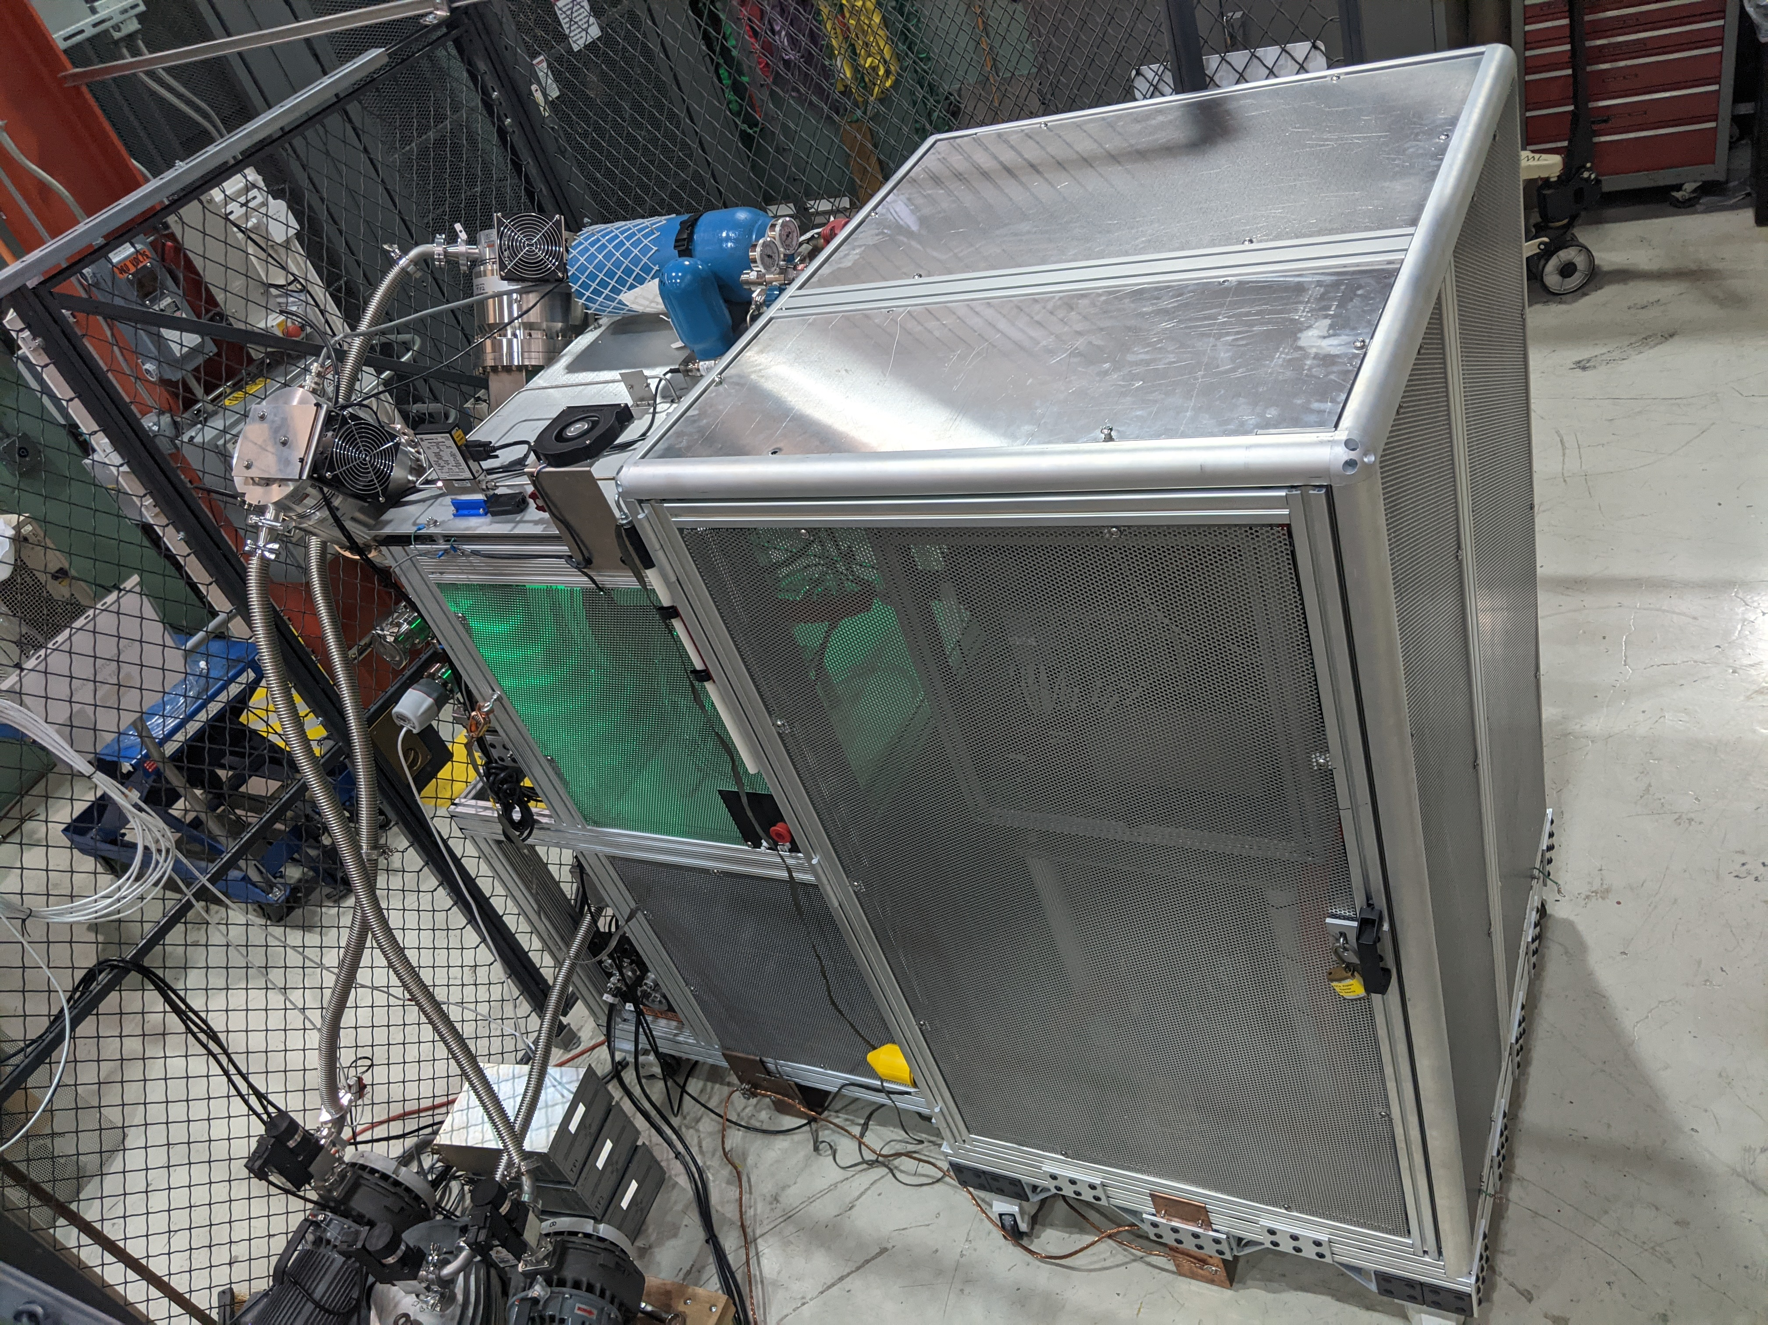
IPI Project Schedule
Action Items:
Source HV Testing (ORC-2176)
Began HV testing… Continuing
Hydrogen Distribution Checkout
HV Enclosure Control Checkout to follow
Mechanical Engineering
Engineering Notes: Steve Wesseln finalizing MEBT stand configuration… Getting help with #3
Variable Coupler Stand Ordered.
15-Deg Bend Chamber Req 346933 – RFP due 08/25 (bidding ends COB)…
Cable Pull / 600A Disconnect
Any Update?
Cancelled 24-Conductor cable due to extreme backorder
Adjusted the cable pull to include more 10-Conductor runs and ordered from Stock room… 2/5 reels in.

Slide 3
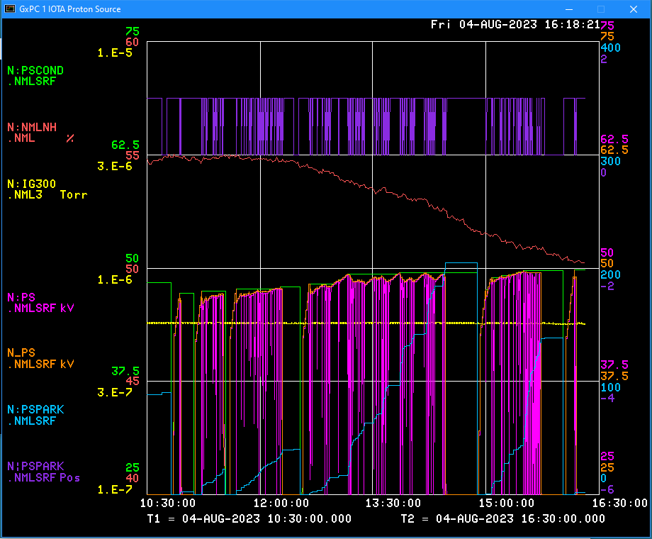
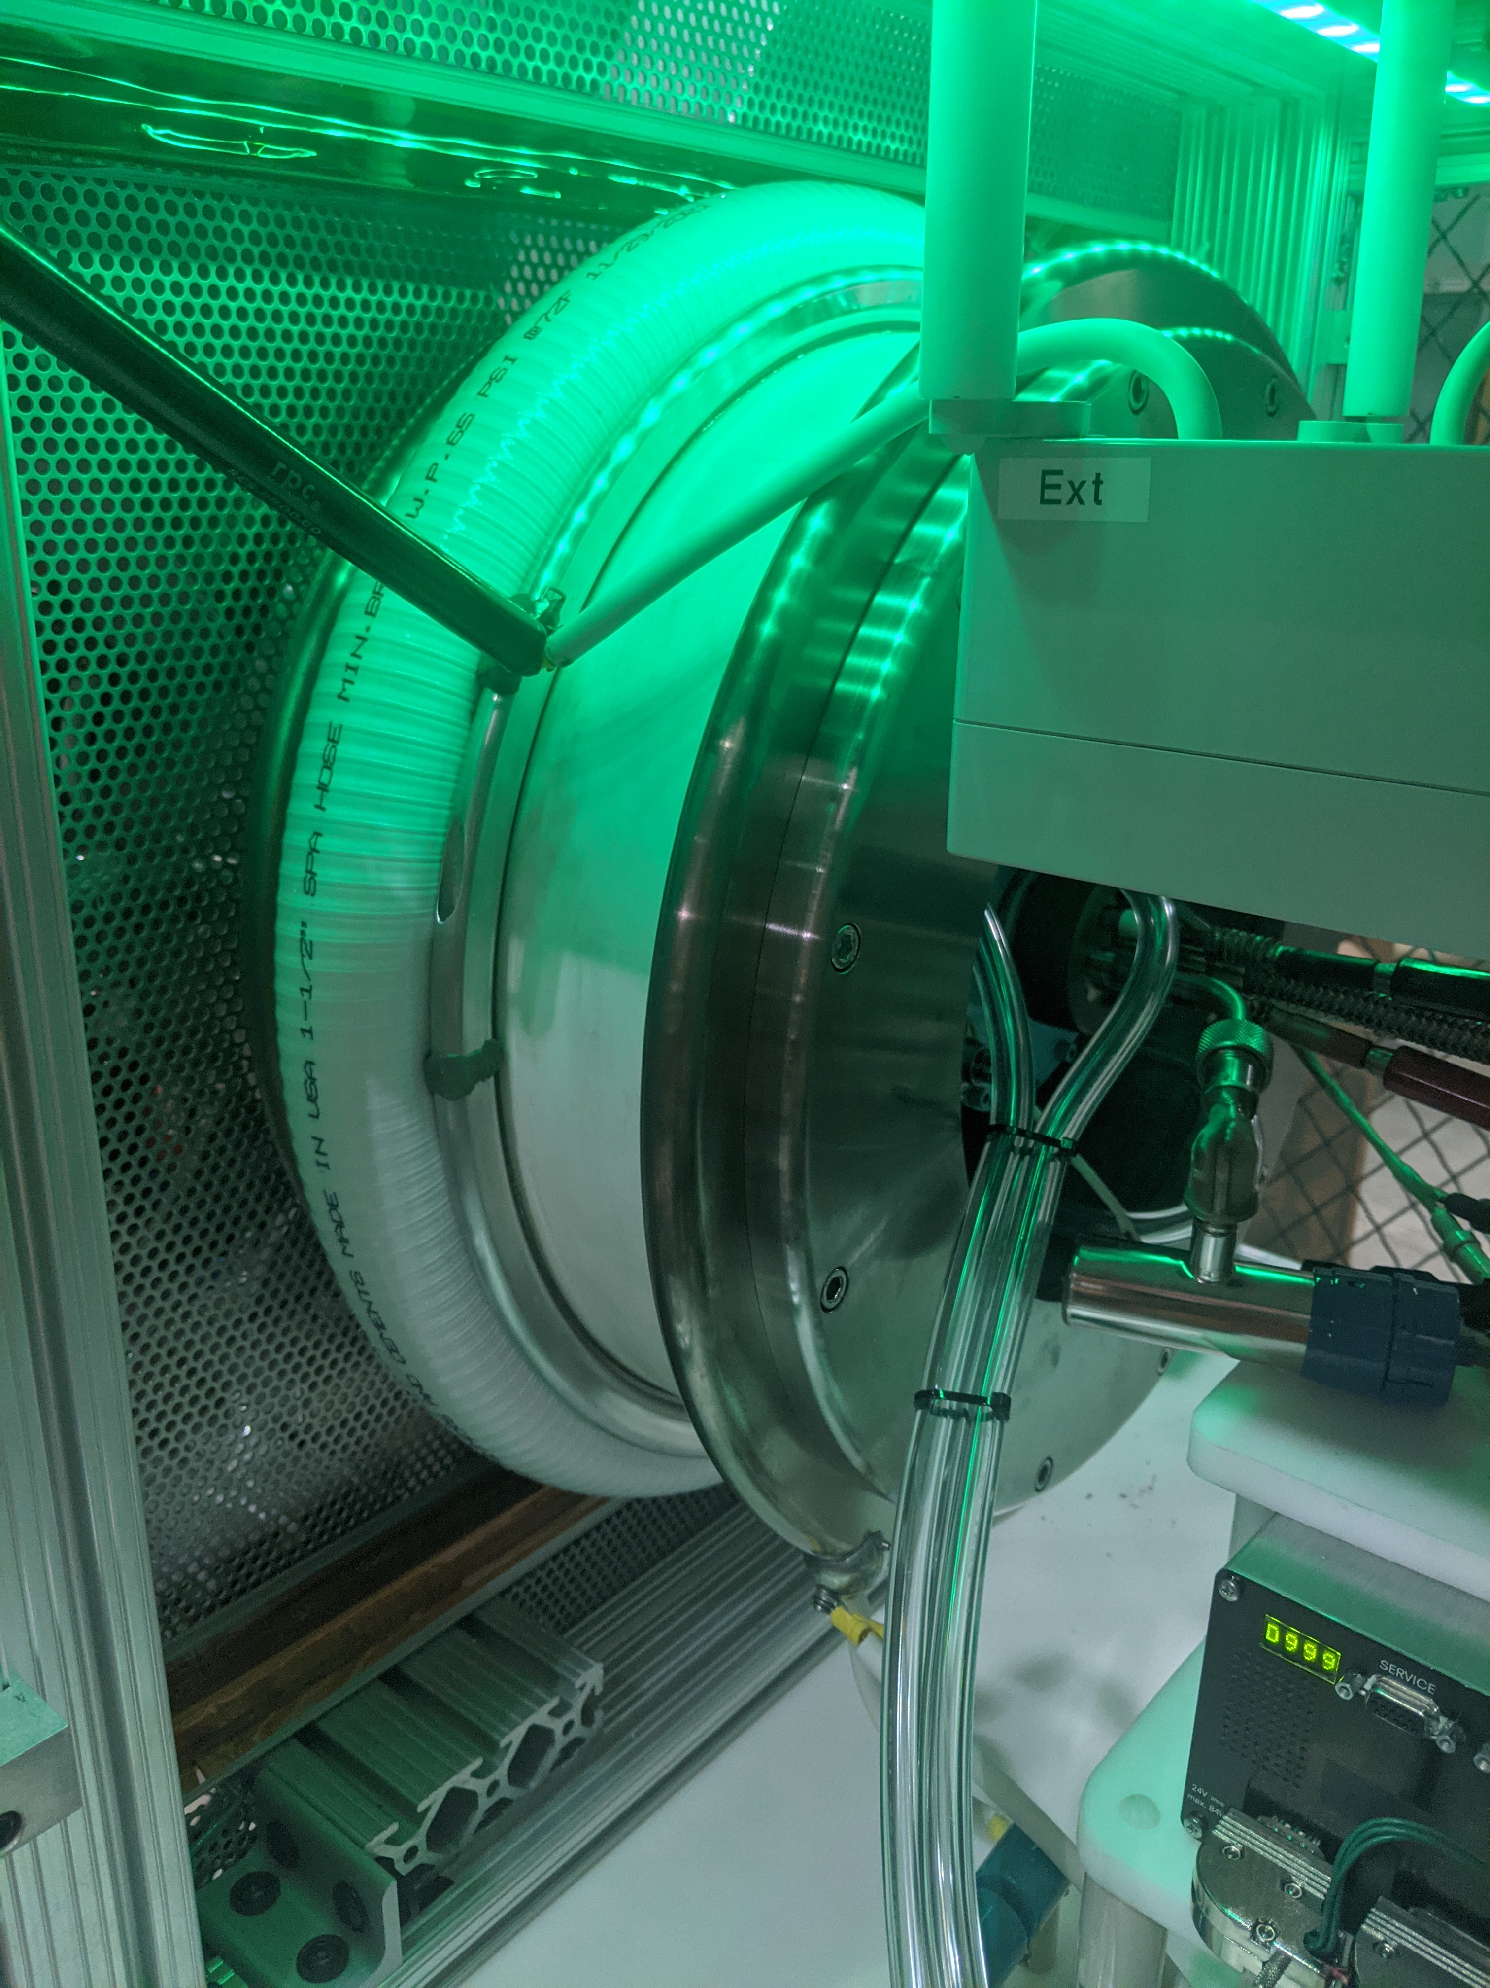
Source HV Test – ORC 2176
Initial attempt (7/19) ran into the Paschen curve (2kV)
Next attempts:
7/20, 41kV max
7/20, 47kV max
Cleaned Ross Relay Contactor and began Configuration Adjustments
8/02, 49.12kV max
8/04, 49.80kV max
Consistent external sparking in contactor & Ext to Gnd
Now focusing on Voltage Divider
MDB Setup Included voltage divider
50 MΩ between HV Common & Extractor
250 MΩ between Extractor & Ground
Extractor power supply running DC in parallel with 50 MΩ resistor in -1:5 ratio with HVPS (e.g. -10 kV for 50 kV common)
Current Pulsed Extractor Needs to be addressed

Slide 4
Other Progress
HLRF Modulator Controls Installation (RR280 / RR281)
Nick Gurley leading the effort
Will require 600A Disconnect installation to conclude
Allison Scanner Controls (RR298)
Andrea Saewert leading the effort
Needed for Source Characterization
LLRF Upgrade (EPICS Interface)
Euclid Techlabs Performing Upgrade Work
Expected complete late August

