Slide 1
Compliance Office APA wires assessment summary and requirements for the restart of production in the UK with LFA wires Compliance Office - 14.08.2023

Slide 2
Various soldered samples of the procured spools are tested at CERN to determine wires material properties (07.08.2023)
No | Sample No | Elastic limit (N) | R_{P0.2} (N) | Fm (N) | Wire type and soldering methods
1 | 1.1 | 21 | 26 | 27.041 | LFA – 390 C– flux KESTER 44 (ROM1)
2 | 1.2 | 21 | 26 | 26.494 | LFA – 390 C– flux KESTER 44 (ROM1)
3 | 2.1 | 21 | 26 | 28.098 | LFA – 290 C– flux Multicore (ROL1)
4 | 2.2 | 21 | 26 | 28.053 | LFA – 290 C– flux Multicore (ROL1)
5 | 3.1 | 21 | 26 | 28.095 | LFA – 290 C– flux Chipquick (REL0)
6 | 3.2 | 21 | 26 | 28.190 | LFA – 290 C– flux Chipquick (REL0)
7 | 5.1 | 16.4 | 20 | 21.970 | AWI – 350 C– flux Multicore (ROL1)
8 | 5.2 | 16.4 | 20 | 21.90 | AWI – 350 C– flux Multicore (ROL1)
9 | 4.1 | 21 | 26 | 28.111 | LFA – 290 – Kester 285 (ROL0)
10 | 4.2 | 21 | 26 | 28.119 | LFA – 290 – Kester 285 (ROL0)
11 | 6.1 | 15.8 | 21 | 22.314 | RST lockers – 290 – Kester 285 (ROL0)
12 | 6.2 | 15.8 | - | 20.752 | RST lockers – 290 – Kester 285 (ROL0)
LFA from PSL spool
Fm : ultimate wire strength
R_{P0.2:} strength for 0.2 %
of permanent plastic deformation
Elastic limit is determined as 75 %of R_{P0.2}
Confirmed by the curves in slide 3

Slide 3
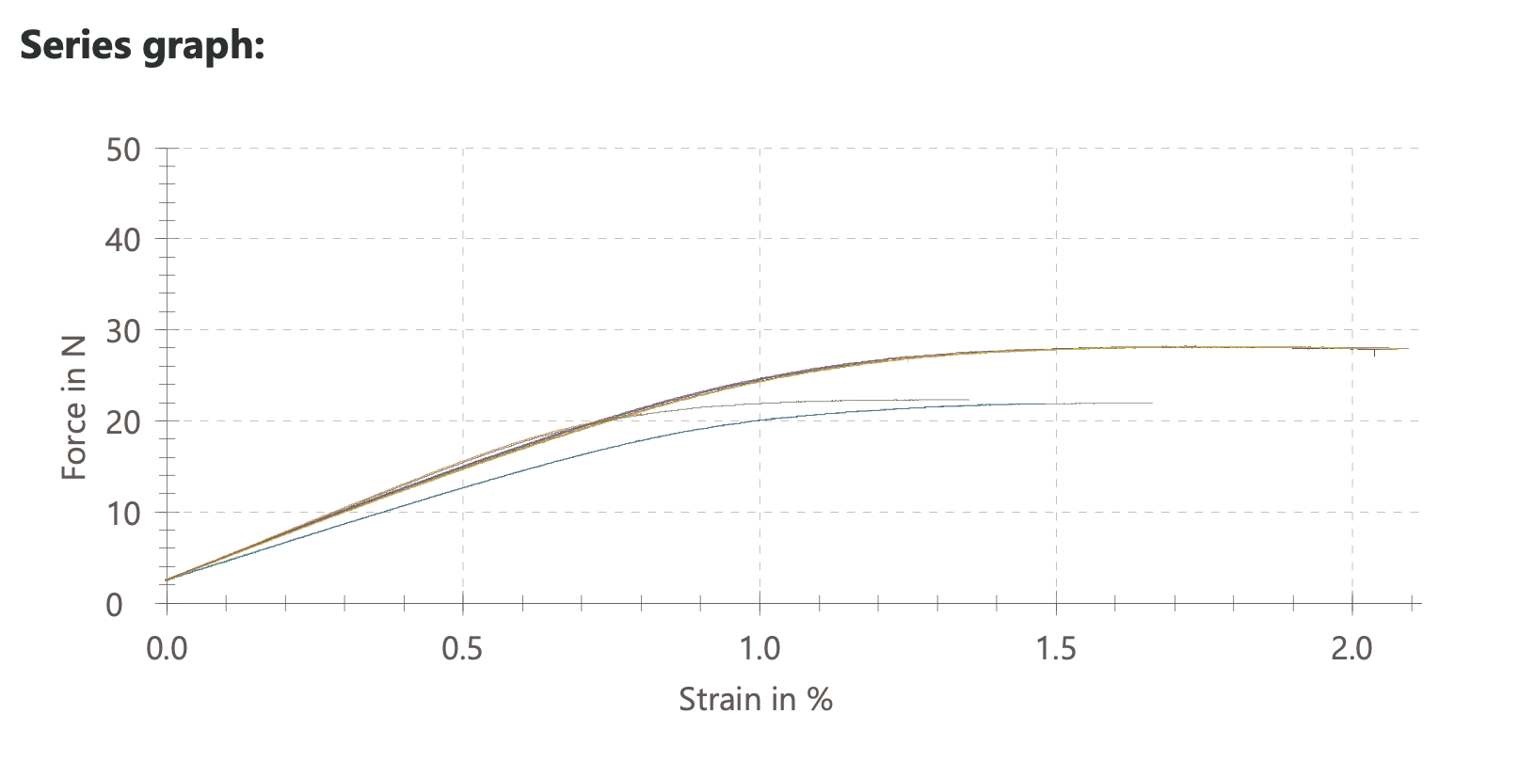
LFAs (390 C) ProtoDUNE II US
LFAs 290 C
RST Lockers
ProtoDUNE II UK APA 1,2,3
AWI - APA 4,5,7,8

Slide 4
It is observed:
the flux have a negligeable influence on the strength
a temperature of 390 C generates an early break at the solder
the measurements are very repeatable
The measured minimum values are :
- LFA wire (290C) : ultimate 28 N
elastic limit 21 N
- AWI (290C) : ultimate 21 N
elastic limit 16.4 N
- RST- Lockers (290C) : ultimate 21 N
elastic limit 15.8 N
The elastic limit of the material is determined as 75 % of Rp0.2. This factor is considered to guaranty that the wire behaviour remain in the elastic domain (see the linear behaviour of the curves on slide 3).

Slide 5
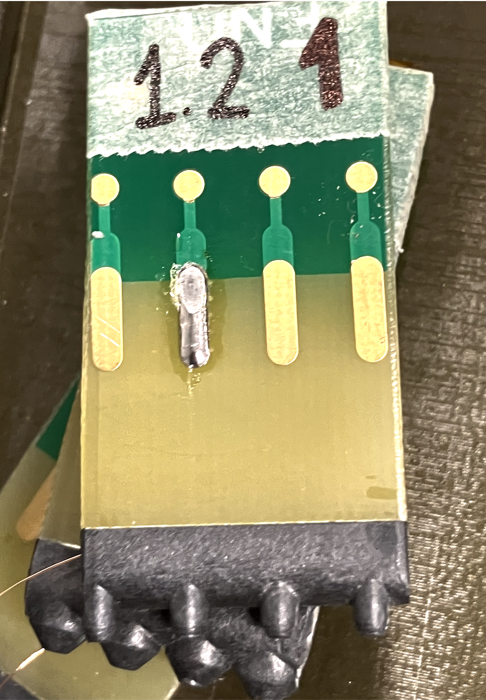
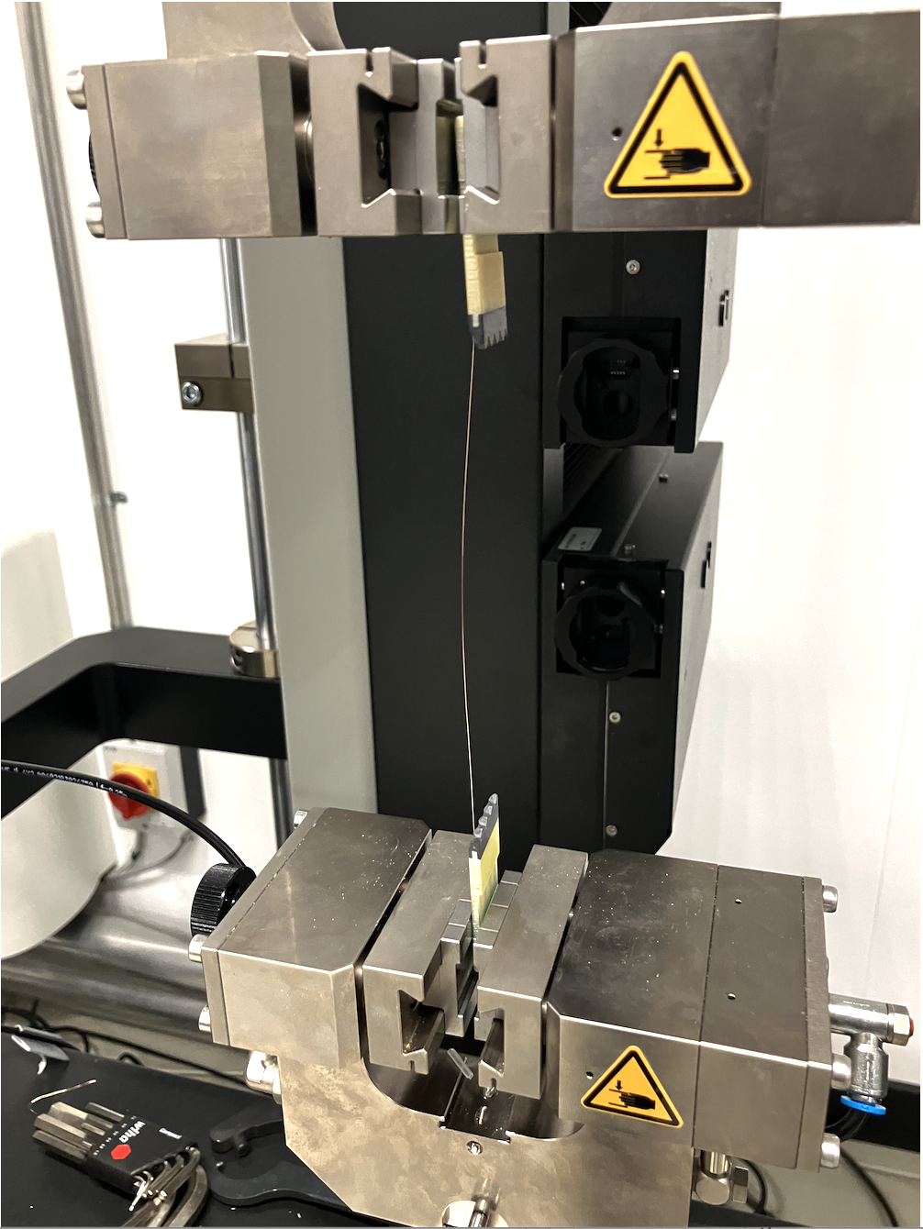
Test at CERN 07.08.2023
LFA 390 C breaks at solder

Slide 6
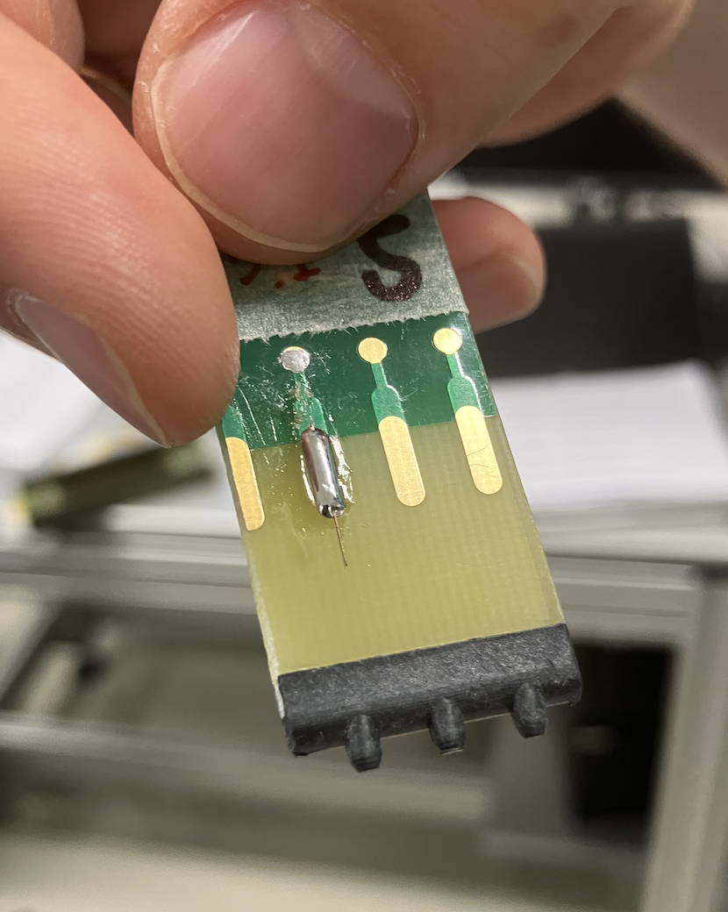
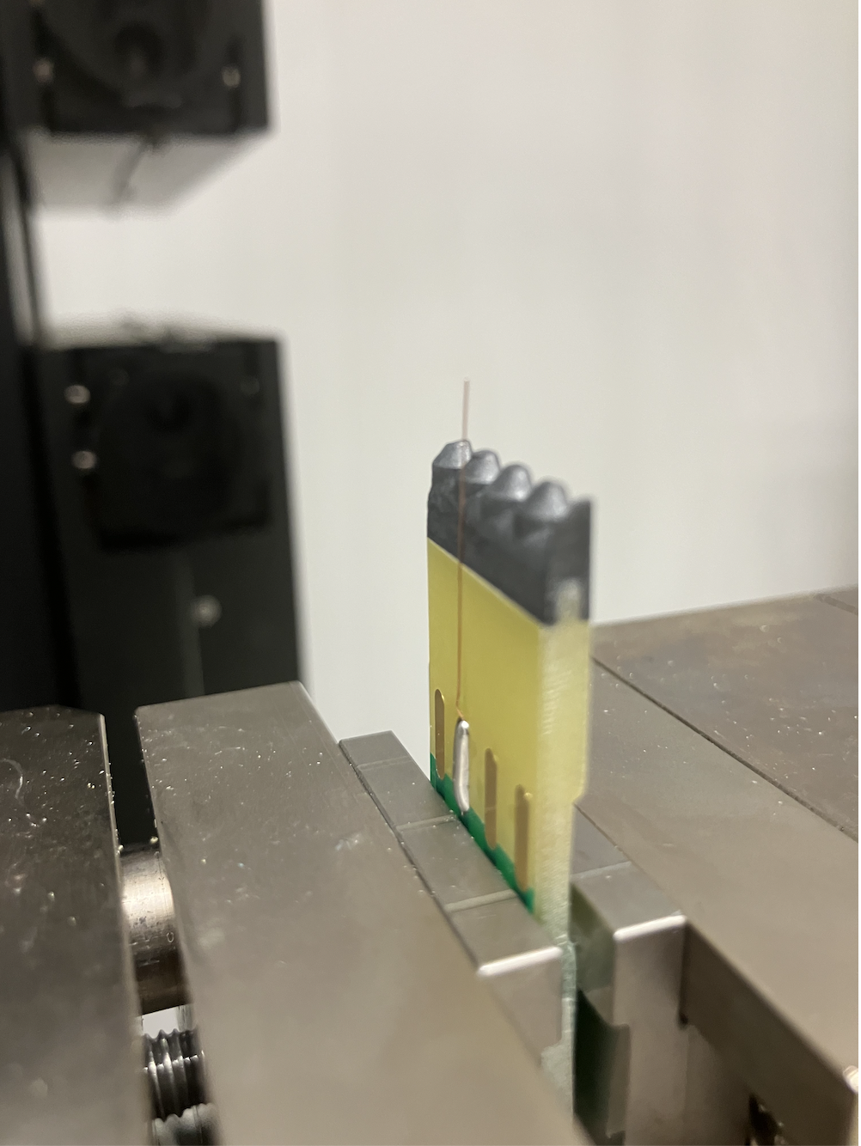
Other temperature breaks close to solder (mixture of solder and wire)
3.1 : LFA – 290 – flux Chipquick (REL0)

Slide 7
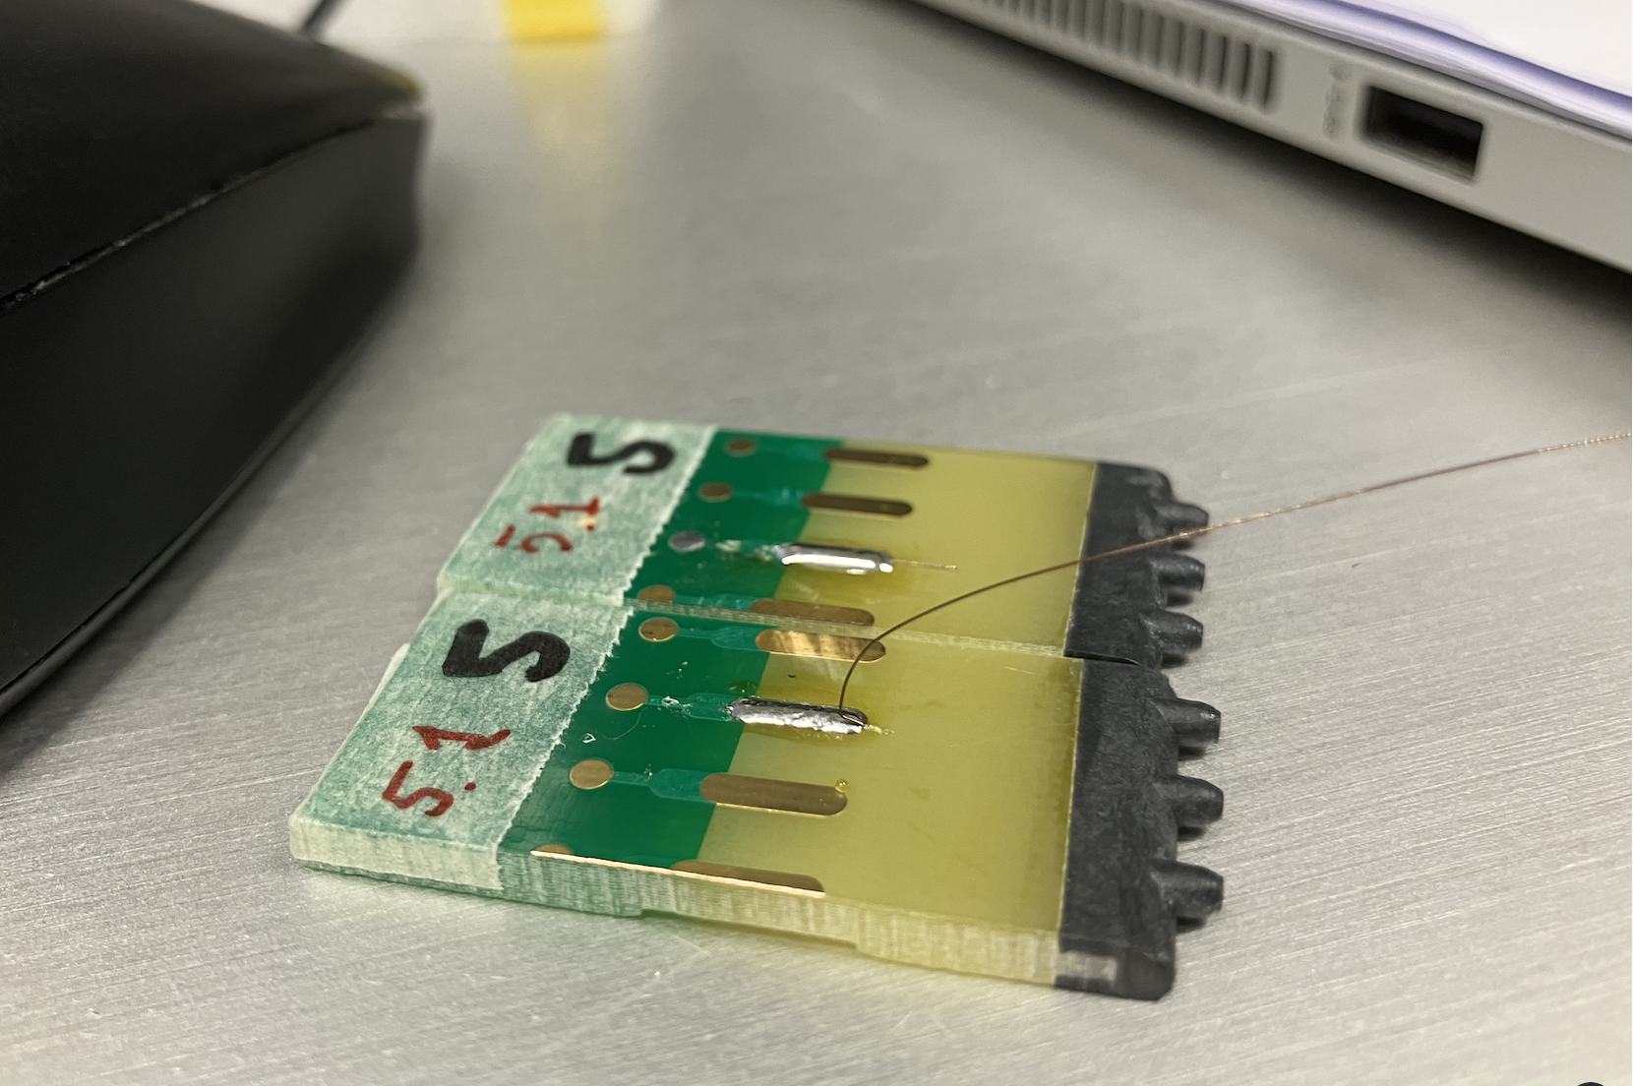
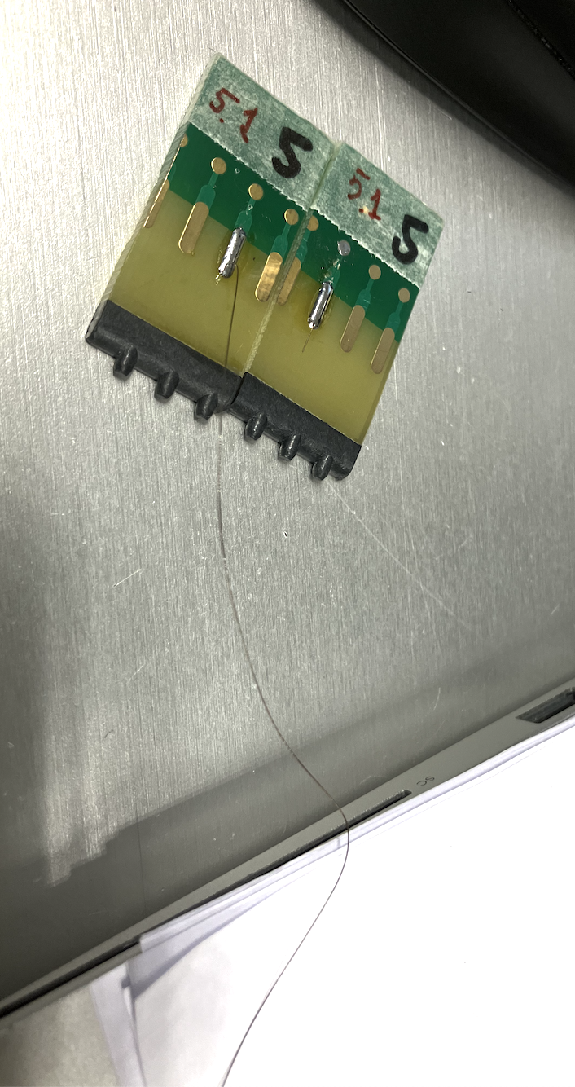
Before break, AWI wires 350 C seems to plastify in various locations (close to solder and in the middle)

Slide 8
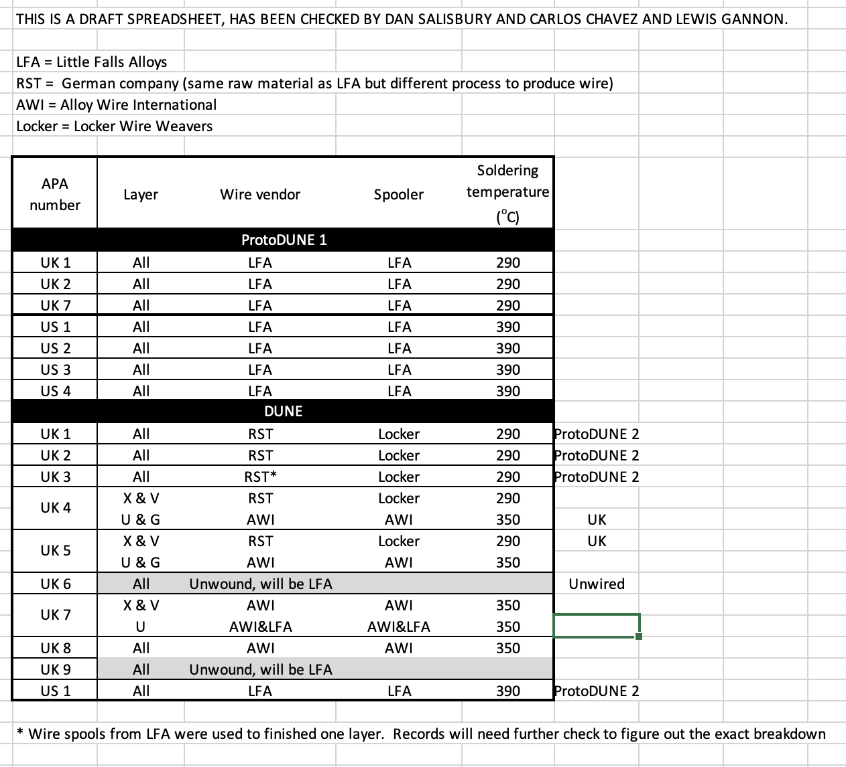
Produced APAs’ wire types

Slide 9
Material Properties –requirements
decision on which type of soldering methods and materials to be used.
Impact of the diameter/section area tolerances :
LFA wire: 152.4 µm +/-5 µm (0.006’ +- 0.0002) (decrease the strength properties by 3.5 %)
AWI wire: 150 µm +/- 8 µm (decrease the strength properties by 10 %)
RST - Lockers : 150 µm +/- 4 µm (decrease of strength by 5 %)
Surface properties – effect observed on AWI (oxidation) – impact unknown on the strength
Residual stress – effect observed on AWI – impact unknown
Comb alignment on wire strength – impact unknown (can we test it ?)
Effect of relaxation of the frames over 4 years (can we test the protoDUNE I APAs ?)
Guide pulley faults (cracks observed and lack of maintenance, over-tension observed but impact unknown)

Slide 10
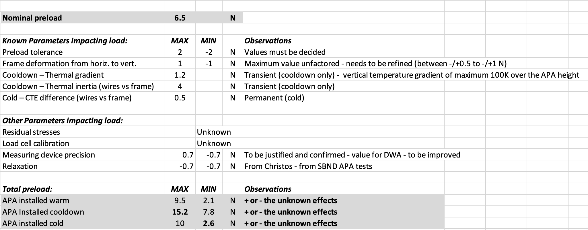
Maximum/minimum tensions expected in the wires
no accidental cases considered
unfactored data and load cases

Slide 11
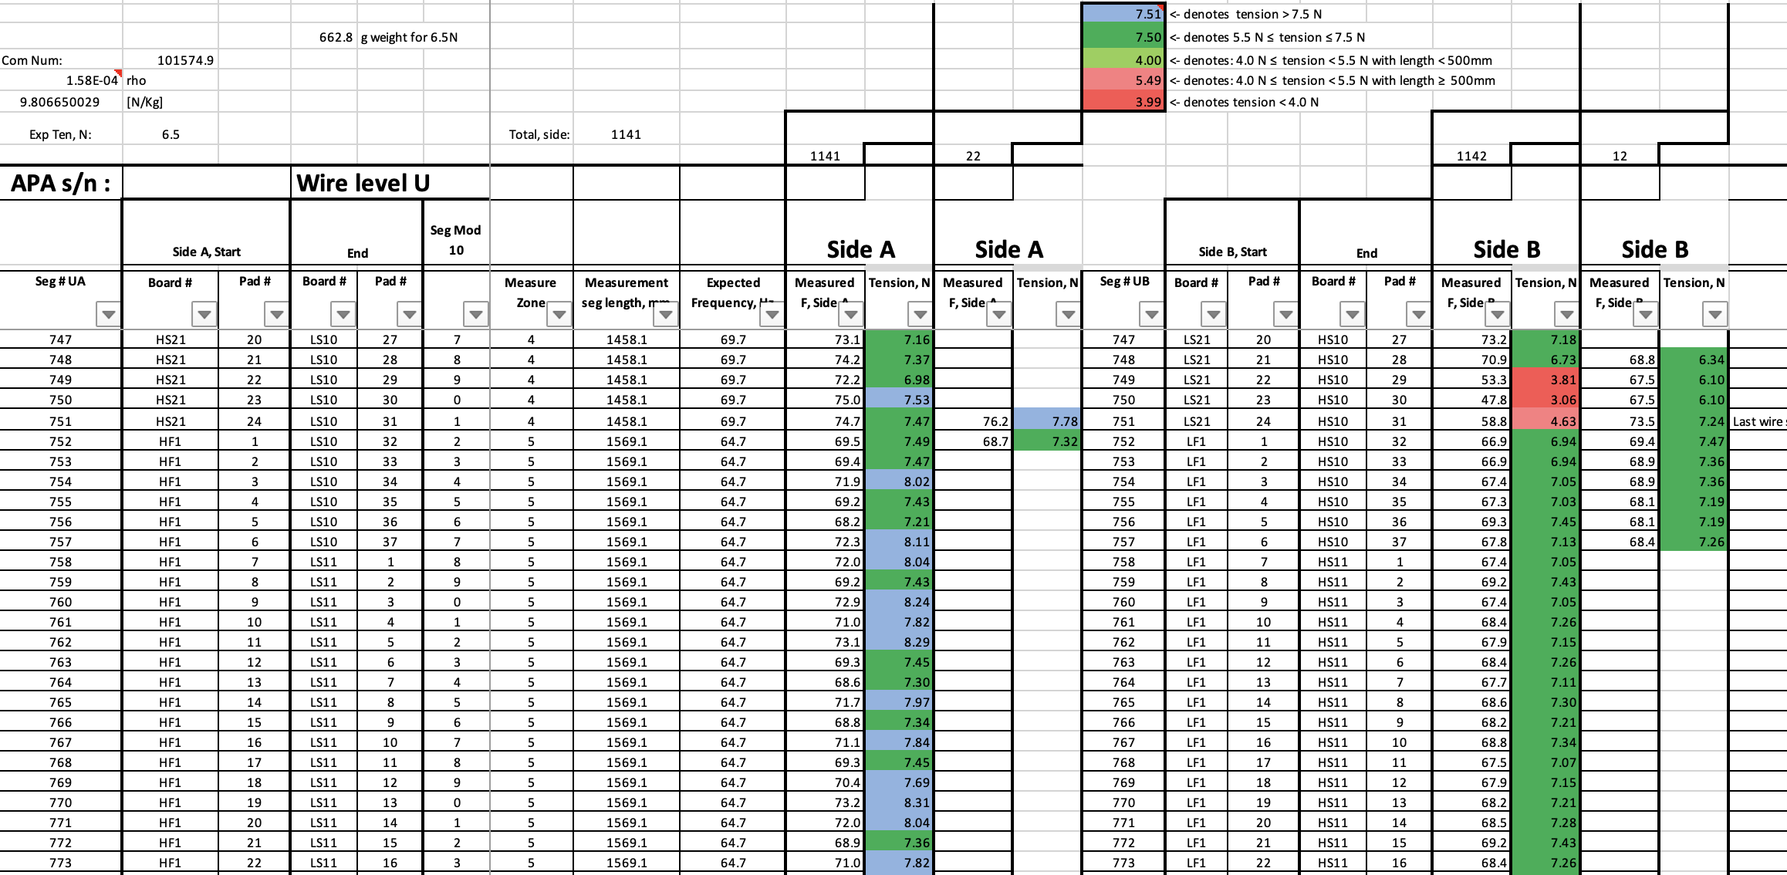
APA retensioning – APA8 (golden)
From Sotiris Vlachos
retension – 5 mns / wire
remeasurement time need to be added

Slide 12
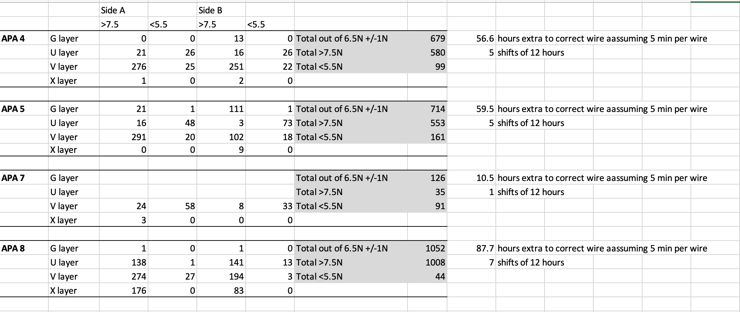
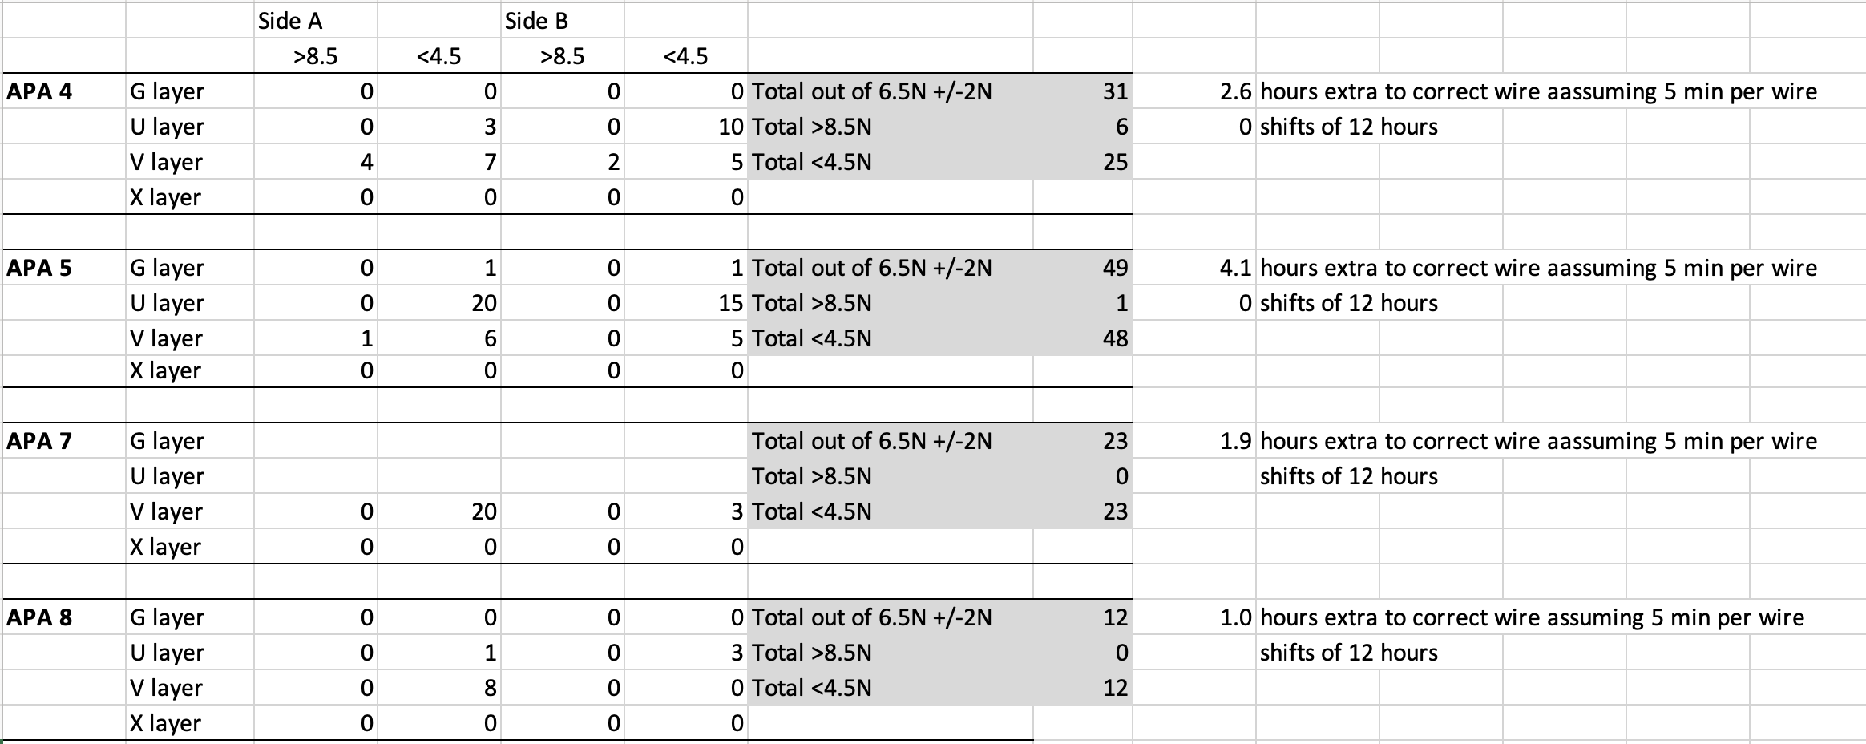
Golden APA : APA 8
G layer : 0 % of fiber above 7.5 N
0.2 % of fiber below 5.5 N
U layer : 12.1 % of fiber above 7.5 N
0.6 % of fiber below 5.5 N
V layer : 20.3 % of fiber above 7.5 N
1.3 % of fiber below 5.5 N
X layer : 11.25 % of fiber above 7.5 N
0 % of fiber below 5.5 N
Out of Spec.
G layer : 0 % of fiber above 8.5 N
0 % of fiber below 4.5 N
U layer : 0 % of fiber above 8.5 N
0.2 % of fiber below 4.5 N
V layer : 0 % of fiber above 8.5 N
0.35 % of fiber below 4.5 N
X layer : 0 % of fiber above 8.5 N
0 % of fiber below 4.5 N

Slide 13
Conclusions:
All APAs should use LFA wires
Temperature of soldering should be 290 C
Flux is not relevant for the wires / solder strenght
All APAs constructed up to now have not enough safety margin
All the wires which are outside the tolerance should be retensionned.
Before restart of production:
We need to decide on the acceptable wire tension tolerances
The production parameters (load cell calibration, guide pulleys proper functioning) which may impact the wire tensions or properties should be provided and justified. A clear maintenance plan and QC of the winders (in particular of the Pulleys) should be provided
The tolerances of measurement devices (Laser or DWA) should be decreased (< 0.1/0.2 N) and justified.
The QC plan should be revised and consolidated (frames, wires, conduit)
We advise to send to CERN for cold test the next two APAs constructed for test (use the frames surveyed at CERN). The APAs must be accompaign by a complete (and verified) QC data (frames, wires, conduits).
We will resurvey at CERN the to determine the effect of relaxation on the frame and wires (complete wire tension measurement should be done at CERN).

Slide 14
Annexes

Slide 15
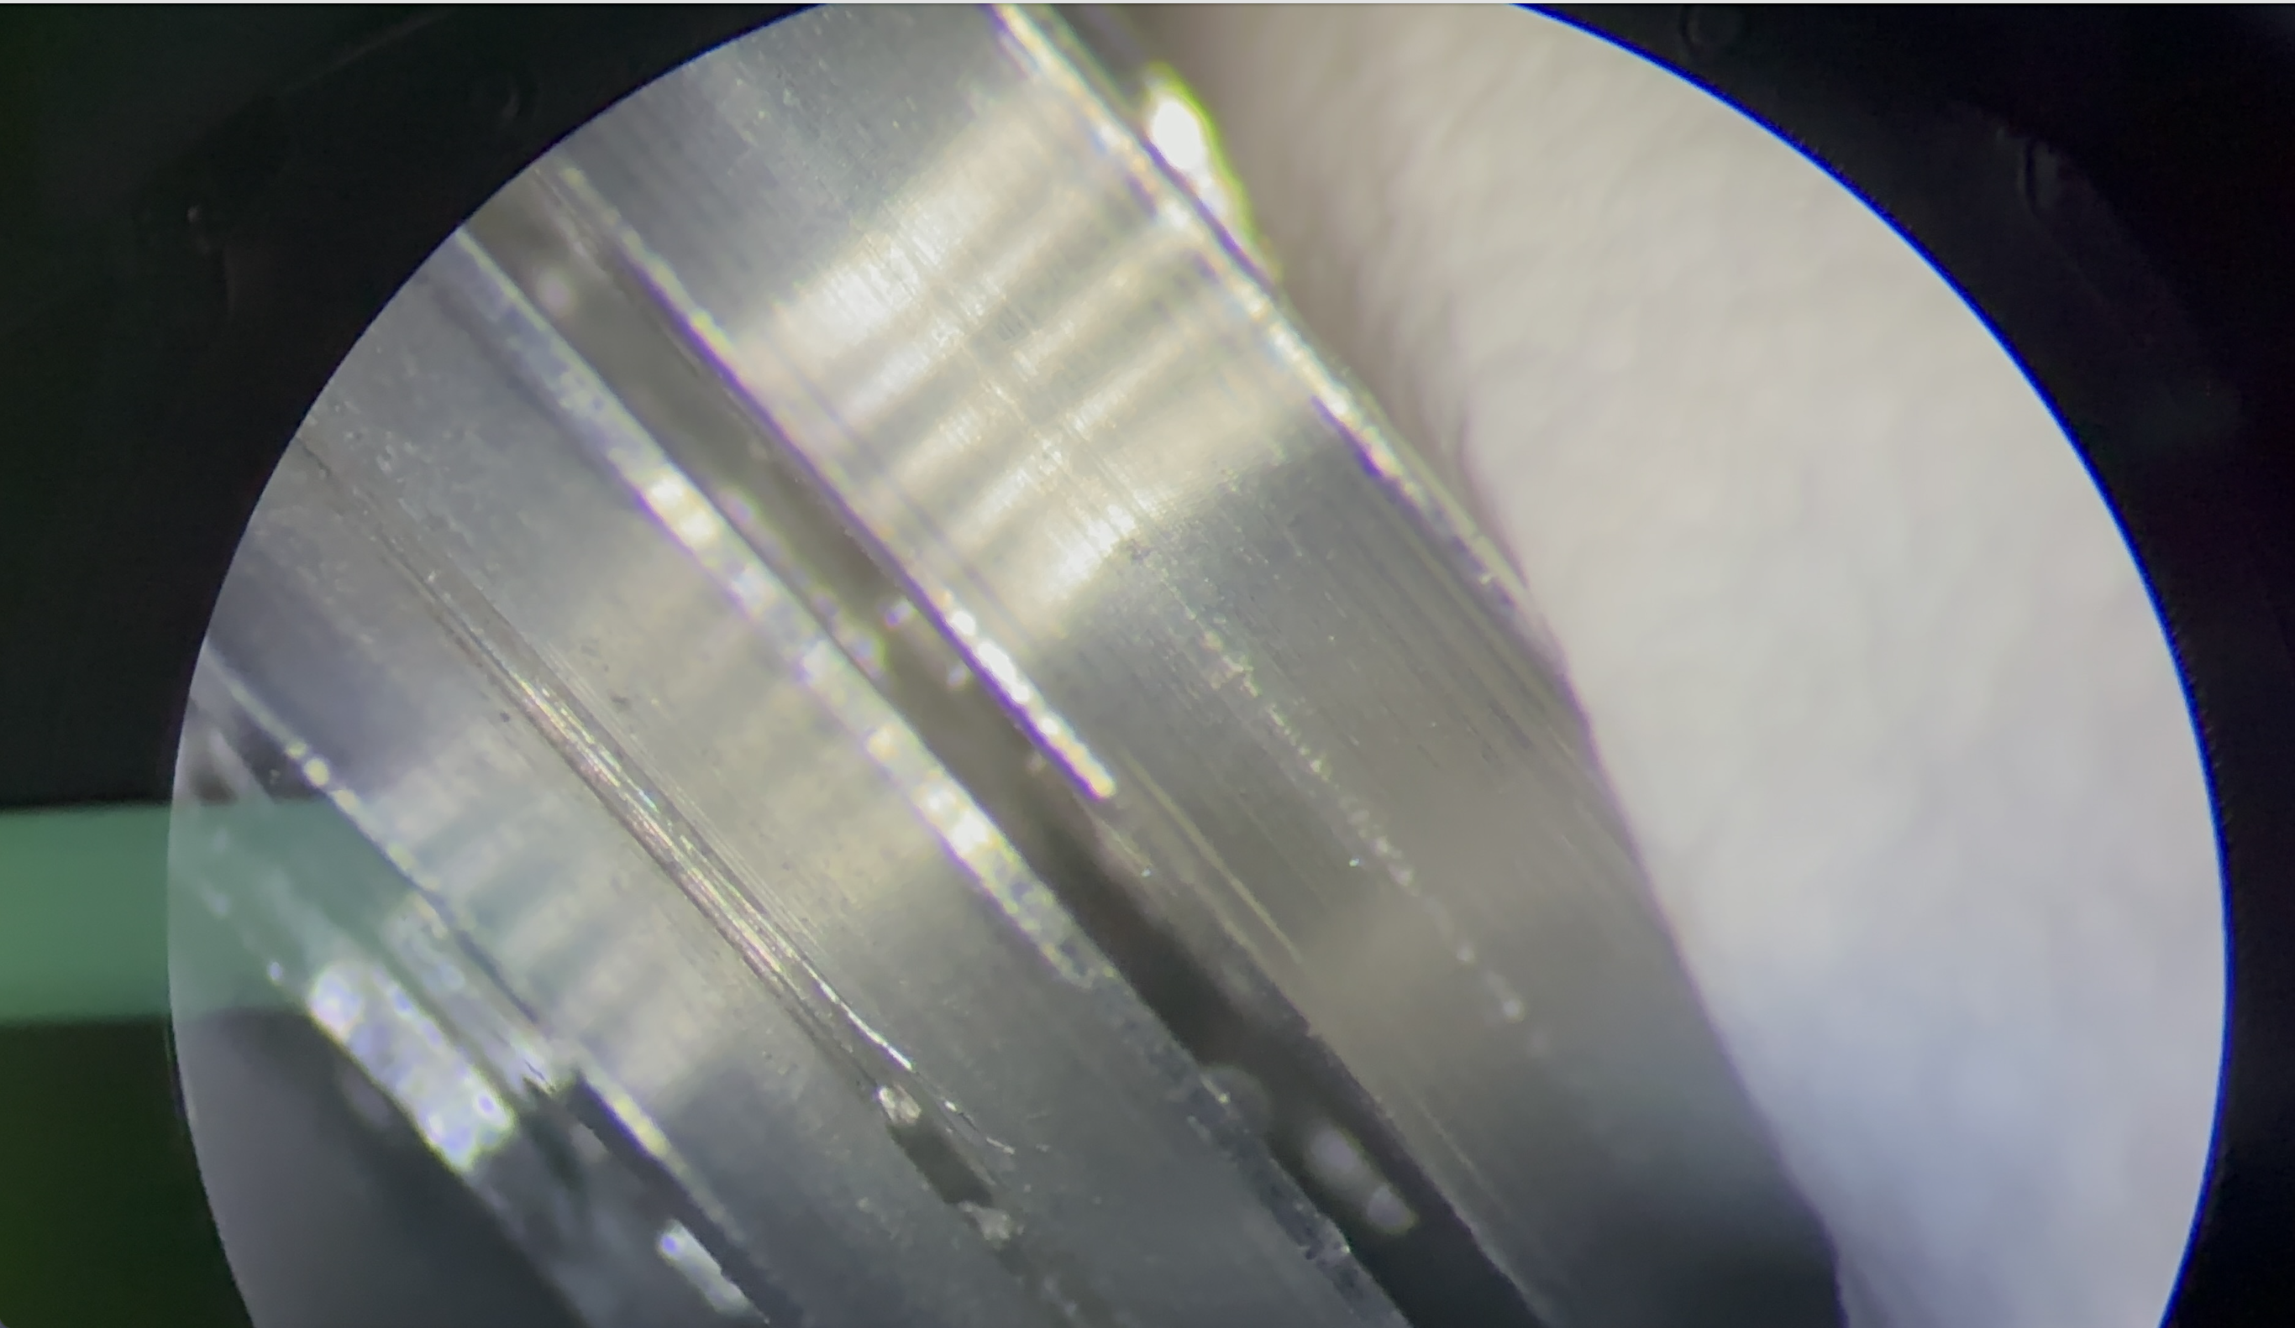
Damaged Pulley UK – April 2023

