Slide 1
Radiation Safety – Weekly Update
ES&H RPO Department
08/18/2023 9am Ops Meeting

Slide 2
Enclosure Briefings
Enclosures with local High Radiation Areas and/or Contamination Areas continue to require enclosure access briefings, for either Controlled Access or Supervised Access.
Contact RSO is you are unable to attend scheduled briefing.
Daily briefings for non-AD available in the Dungeon from 7-10am
+ means Contamination Area
* means High Radiation Area
% means only when shield blocks removed or highly activated items are staged or in movement
Current List:
MTA +
Booster *+
Main Injector
  8 GeV *+
  MI-20—MI-62 *+
  MI-10 *+
NuMI Pre-Target / Target Hall *+%
NuMI Absorber Hall *+
Muon Campus US/DS + - > May down post, still pending wipe results

Slide 3
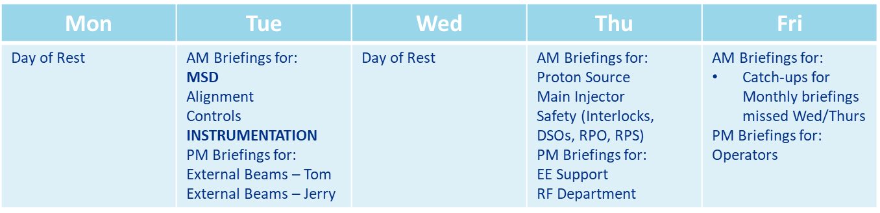
Enclosure Briefings
Enclosures with local High Radiation Areas and/or Contamination Areas continue to require enclosure access briefings, for either Controlled Access or Supervised Access.

Slide 4
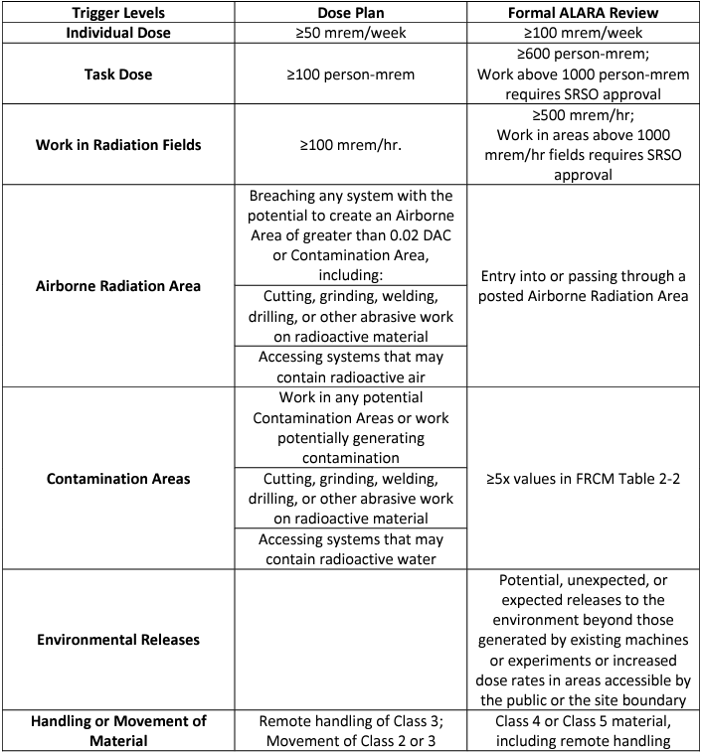
Shutdown ALARA and Dose/Job Plans
Shutdown is HERE, make sure all relevant jobs are reviewed by Radiation Safety. Triggers for a Dose Plan and a Formal ALARA Review are on the right, and a link to the review spreadsheet is below.
http://esh-docdb.fnal.gov/cgi-bin/RetrieveFile?docid=1316

Slide 5
Contacting your Safety Professional!
If you’re unsure which RSO is responsible for your area, or need to reach a wider audience of RSOs, we have a group email.
ESH_RSO@FNAL.GOV
If you’re curious who your assigned RSO is, please use the link below or go to the ESH website, click on Radiological Protection, then click RSO Coverage and Contact Info on the right-hand column:
Link to RSO Responsibilities
Need to contact your DSO?
Link to DSO Page

