Slide 1
Main Injector Shutdown Status
D. Morris
9 o’clock Meeting
August 18th, 2023

Slide 2
General
New tunnel surveys are out = new tunnel briefings.
Preparing for HVAC installation impact
Will maintain networking, CAMAC, Vacuum systems
Will power down correction elements, BPM, BLM systems, and more…
MI-10 and MI-20 start Aug. 21st.
2
MI Department Meeting | D. Morris
8/18/2023

Slide 3
Tunnel Work
Crews are doing vacuum rework in MI-8. Includes replacing LCW header
supports and moving a compressed air line.
Performing final leak check from 810 to 824.
Temporarily removed MW825 guts.
Welding finishing up.
Scheduled power outage Tuesday afternoon.
Q333 (IQB-067) LCW leak. Moved the octupole and adjusted the sextupole
to make more space for welding. Ready for repair.
White hose replacement (MI-50 through MI-60) started Tuesday
3
MI Department Meeting | D. Morris
8/18/2023

Slide 4
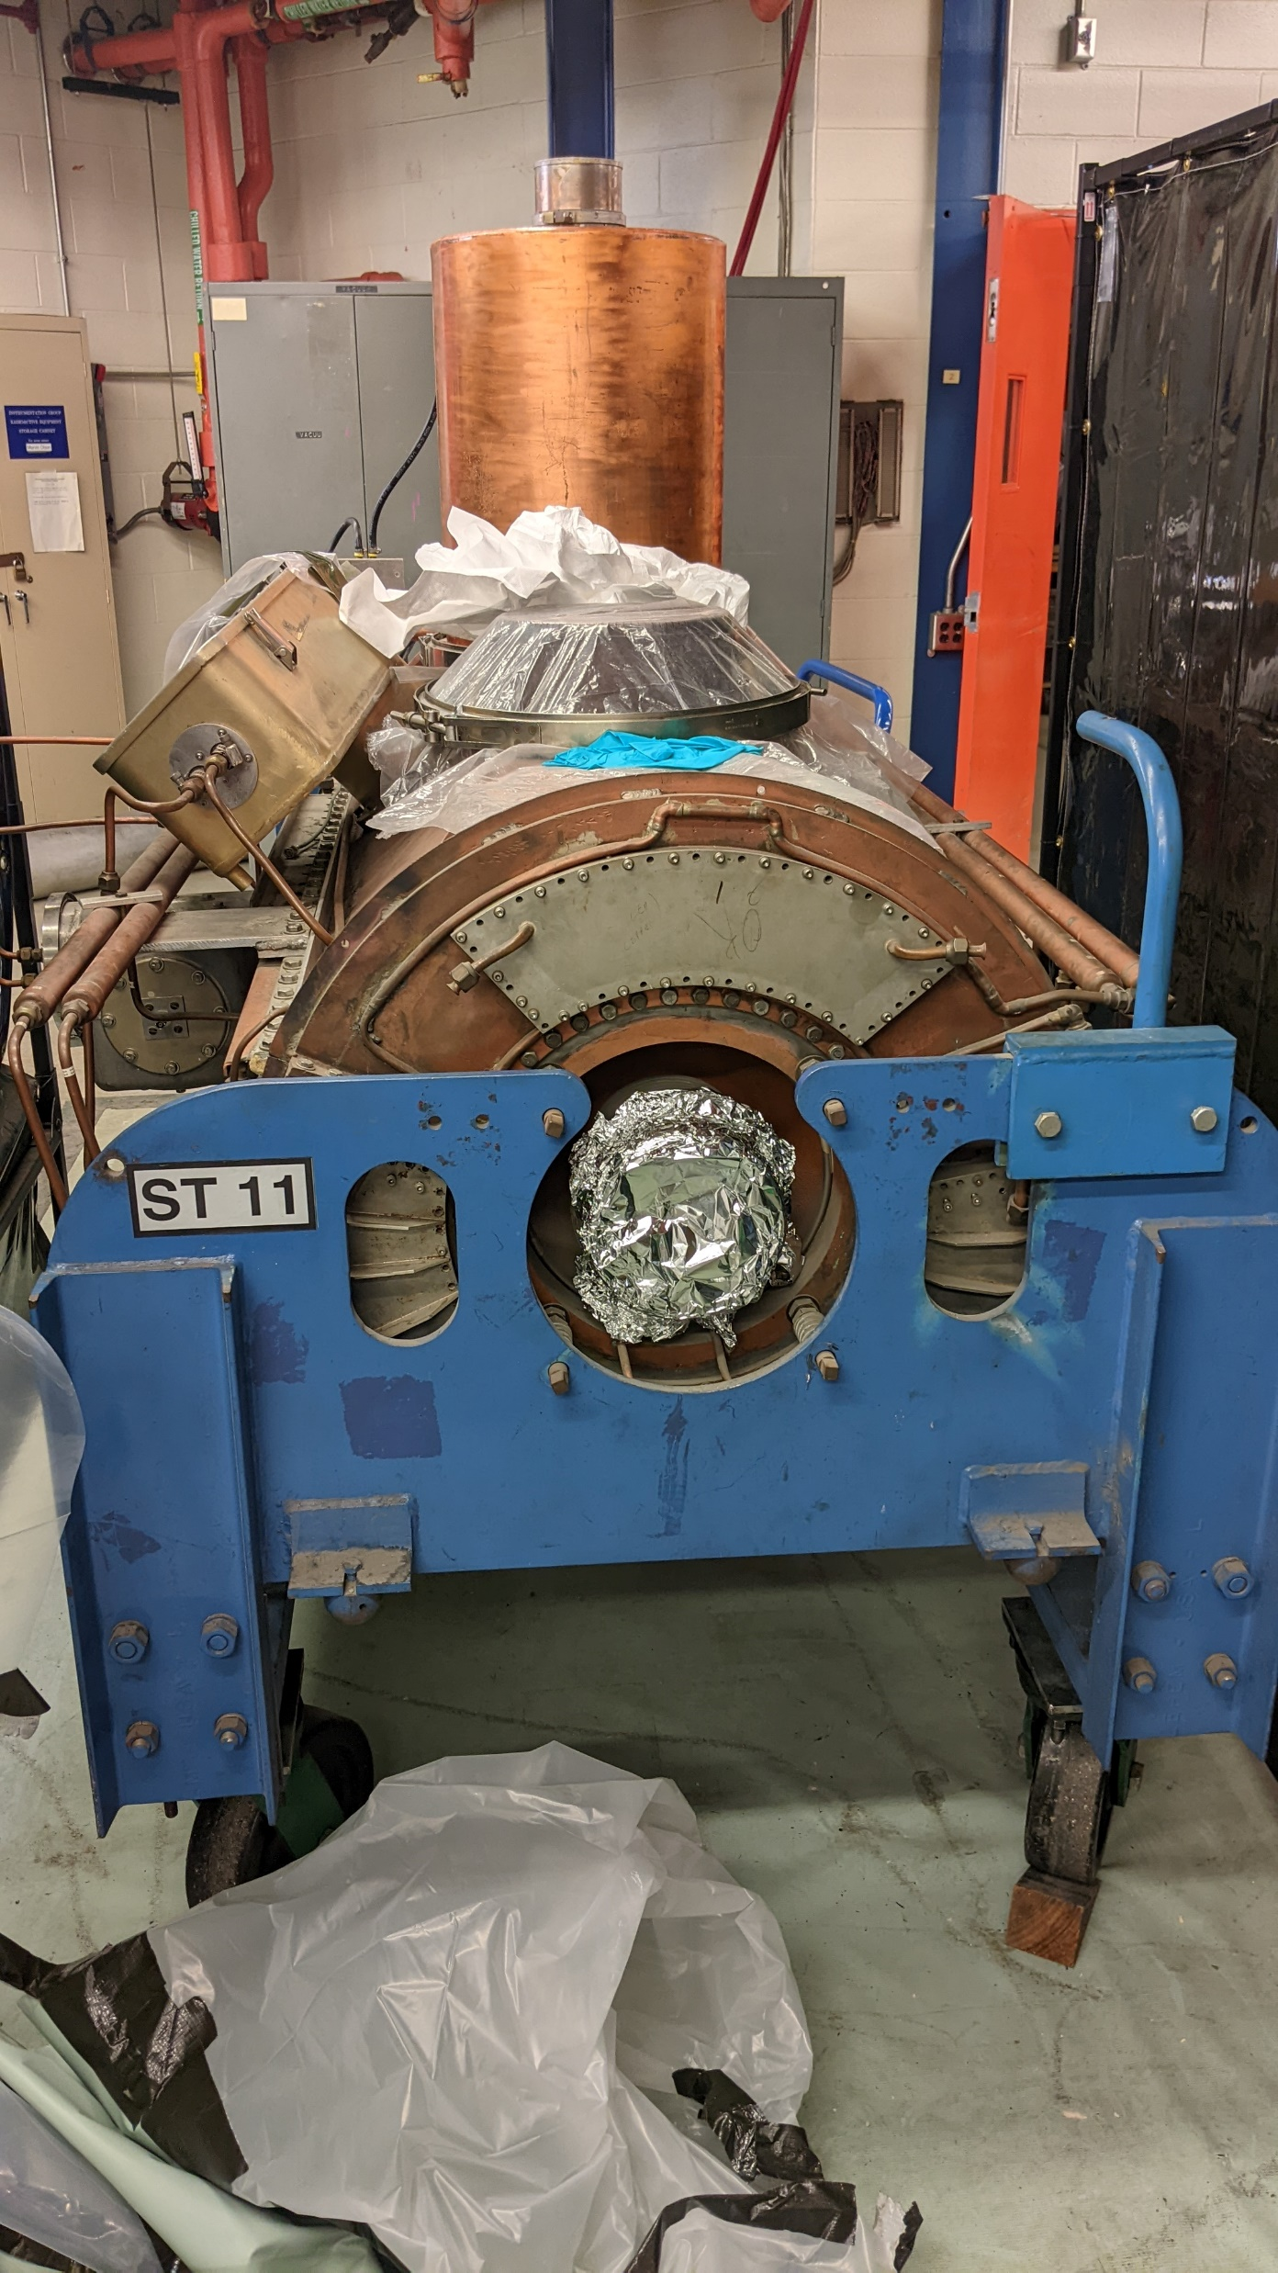
Tunnel Work
MIRF#11 cavity removed for water path rework. RF maintenance continues.
4
MI Department Meeting | D. Morris
8/18/2023

Slide 5
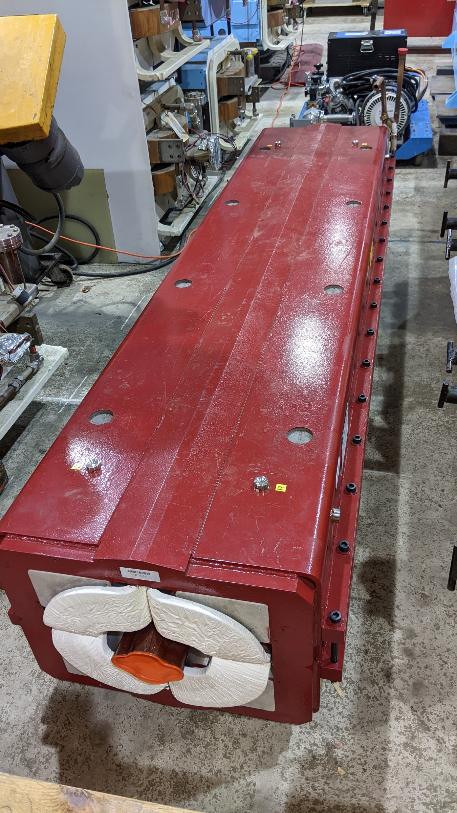
Tunnel Work
Defocusing quad bus ground fault as been isolated to the Q319 (IQC009) quad.
Rebuilt IQCB241-0 has been delivered to MI-60.
5
MI Department Meeting | D. Morris
8/18/2023

Slide 6
Conventional Power Outages
There are no scheduled conventional power outages in MI/RR until next
week.
Please report any MI outages to the MCR.
6
MI Department Meeting | D. Morris
8/18/2023

Slide 7
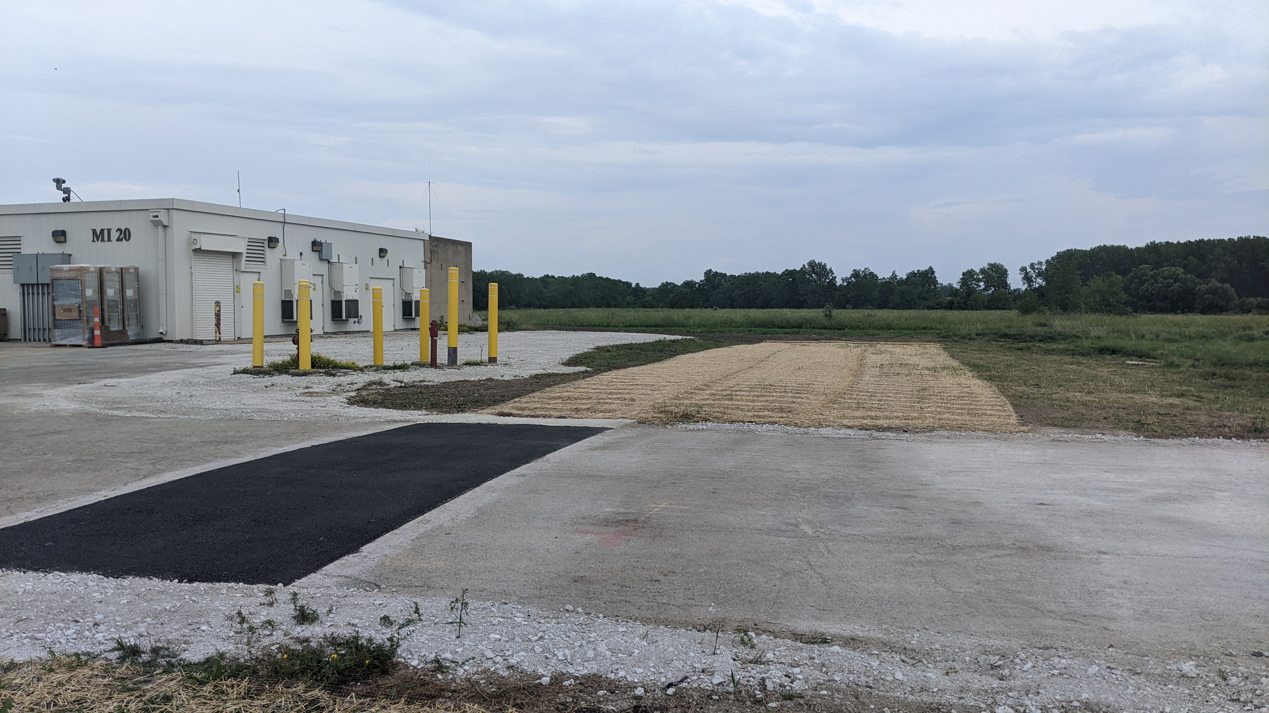
MI-20 Sump Line Repairs
Work is progressing well.
Exterior work is mostly done except for survey/berm final grading.
Stairwell work continues with check valves and “Y” pipe installation.
7
MI Department Meeting | D. Morris
8/18/2023

Slide 8
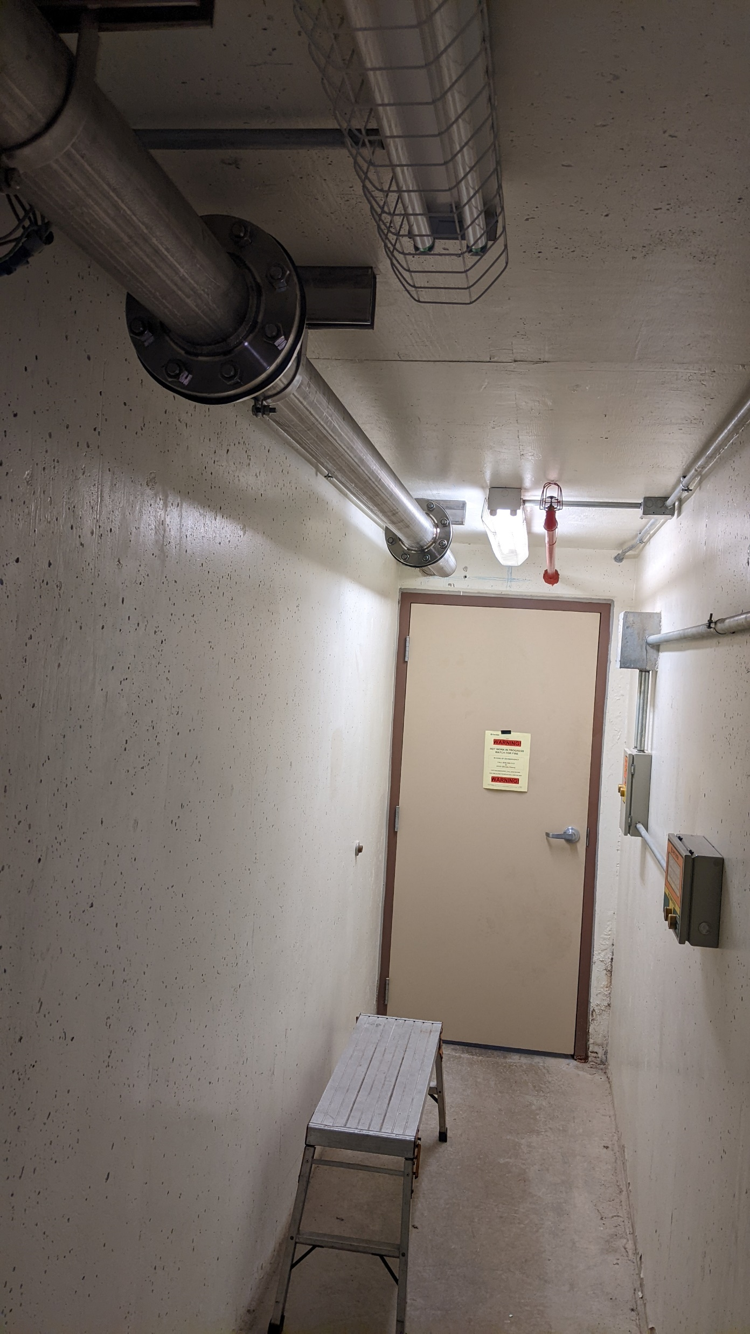
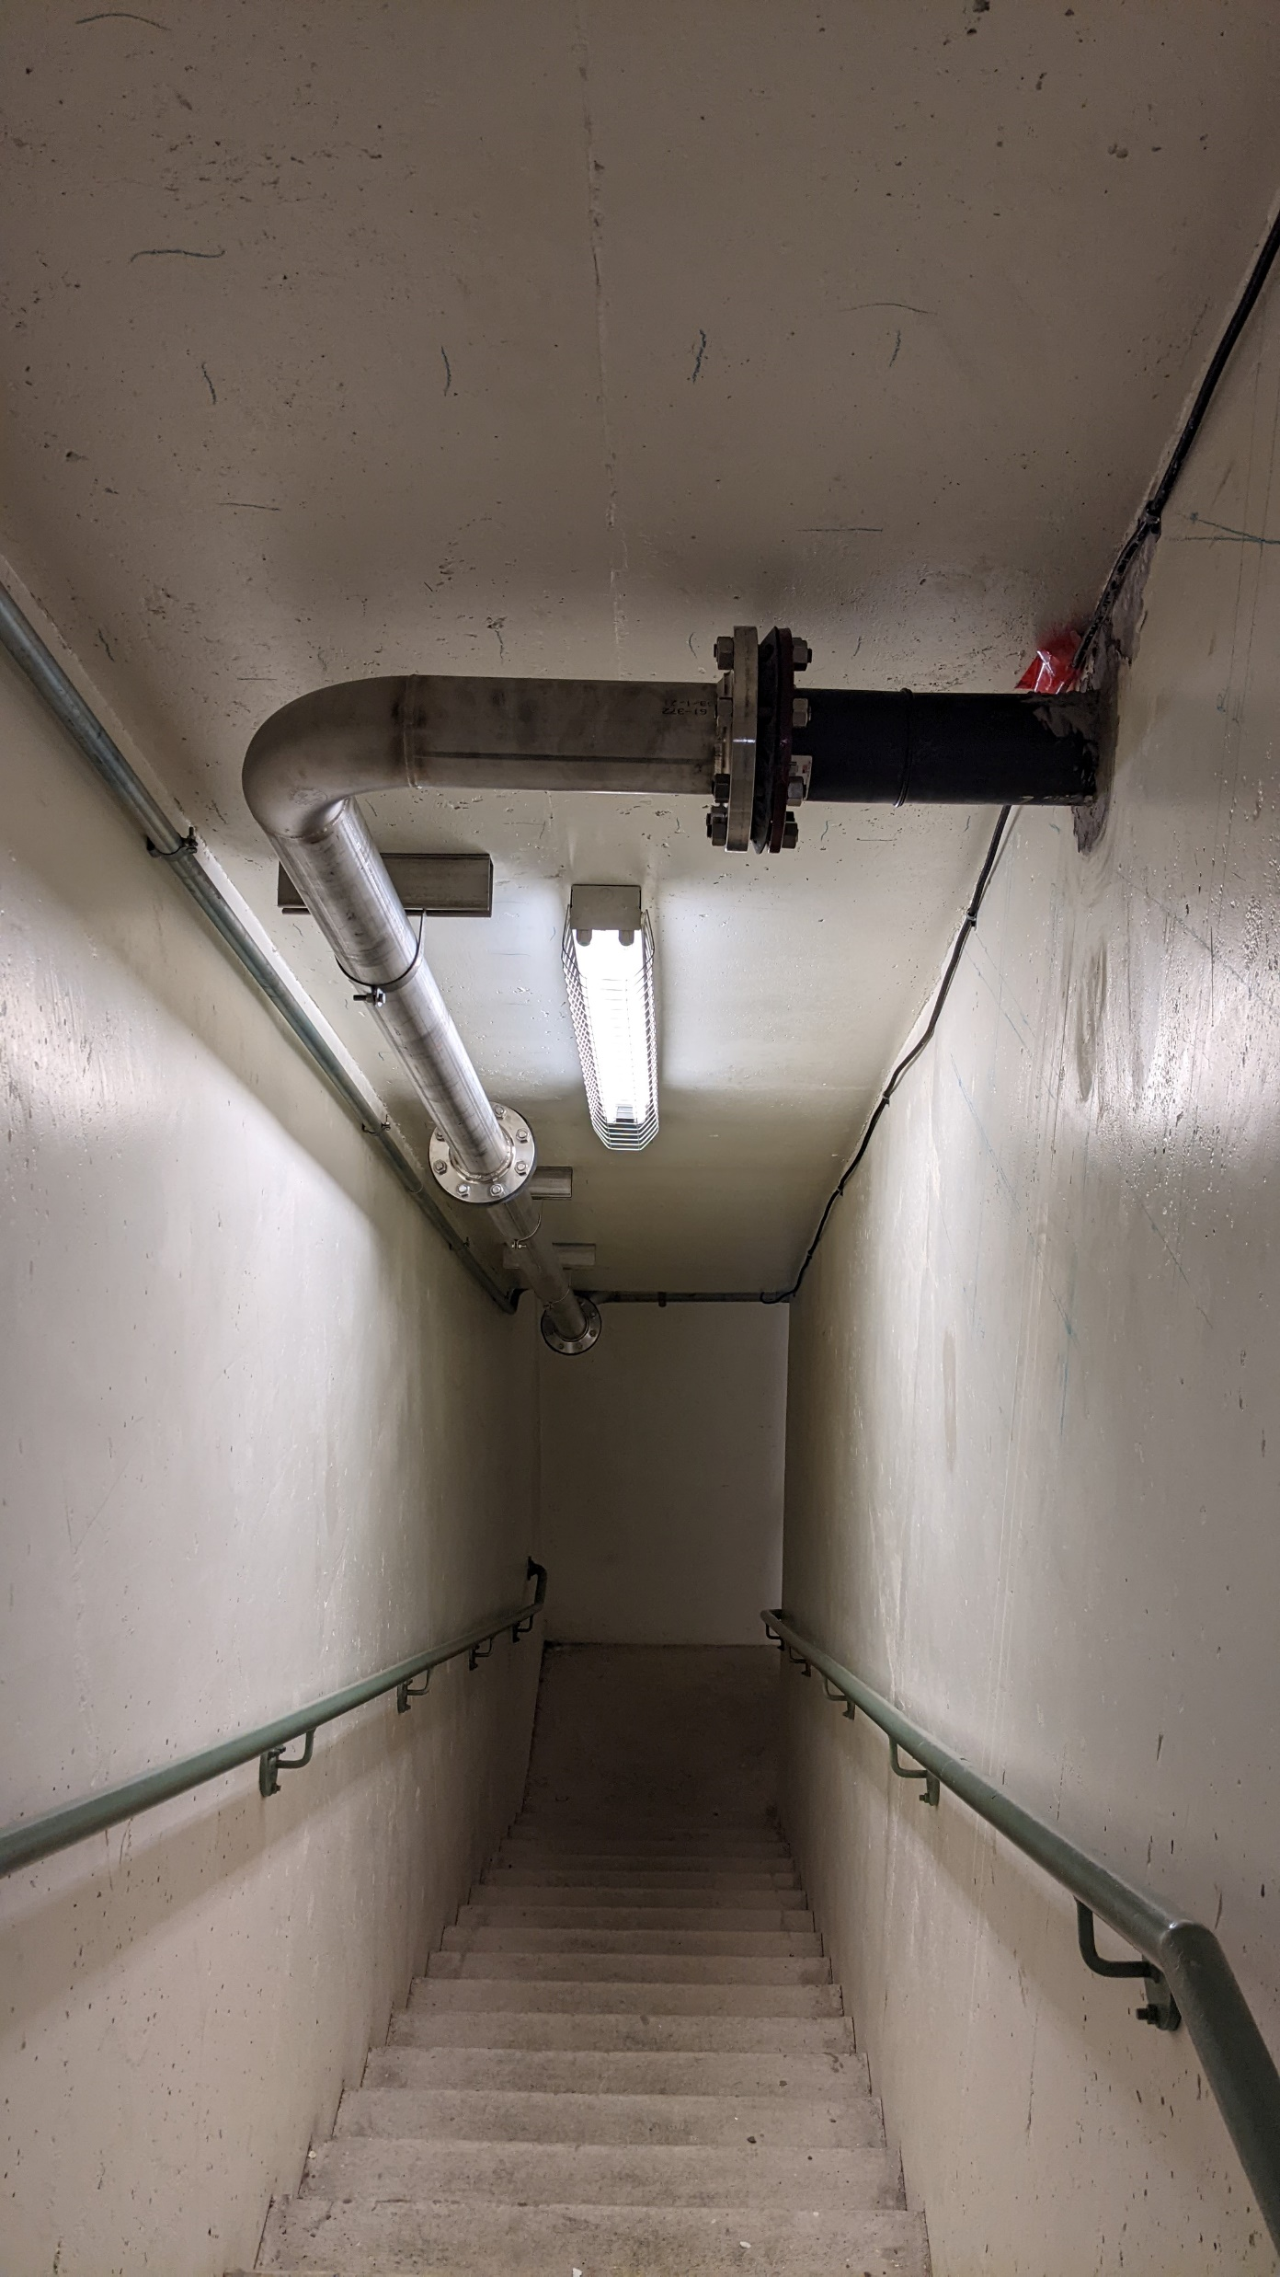
MI-20 Sump Line Repairs
8
MI Department Meeting | D. Morris
8/18/2023

