Slide 1
Muon Campus Operation Report
Jim Morgan
Friday 09:00 Operation Meeting
August 18, 2023

Slide 2
Muon Campus status (week of Aug 11-17)
Finished attempts to condition extraction septa with no improvement
Controls problem with septum settings has not returned
ESS2 was opened for inspection Wednesday
A small speck was identified on the cathode and removed by mechanical technicians
It’s not obvious whether this speck was related to the high ground current, but was in the region where there was high X-Ray emission
The septum is isolated from the ring and back under vacuum
We plan to HV test next week once the vacuum has improved enough
We will stay controlled access until after we HV test ESS2
Controlled access allowed in the DR until at least Sunday
Most day shifts should be available for access
AP0 Air Conditioner Replacement work resumed, but is now paused again
Design change for return air ducting required due to interference from cable tray
System testing was scheduled for 2nd week of September, may now be delayed further
Study – M1-M3 Optics
Study – Alternative M5 optics
KPS5A PFL Repair
MC-1 Controlled Access
G-2 Trolley Run
Intentional Accelerator
Standby Period
<------------Week Days -------------------→

Slide 3
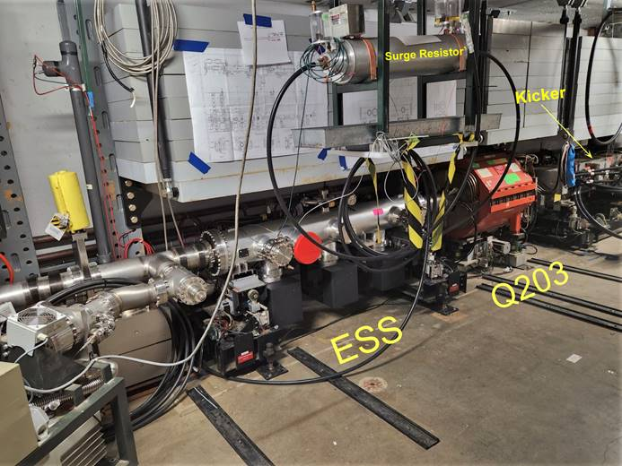
Electrostatic Septum ESS2
Removed for inspection

Slide 4
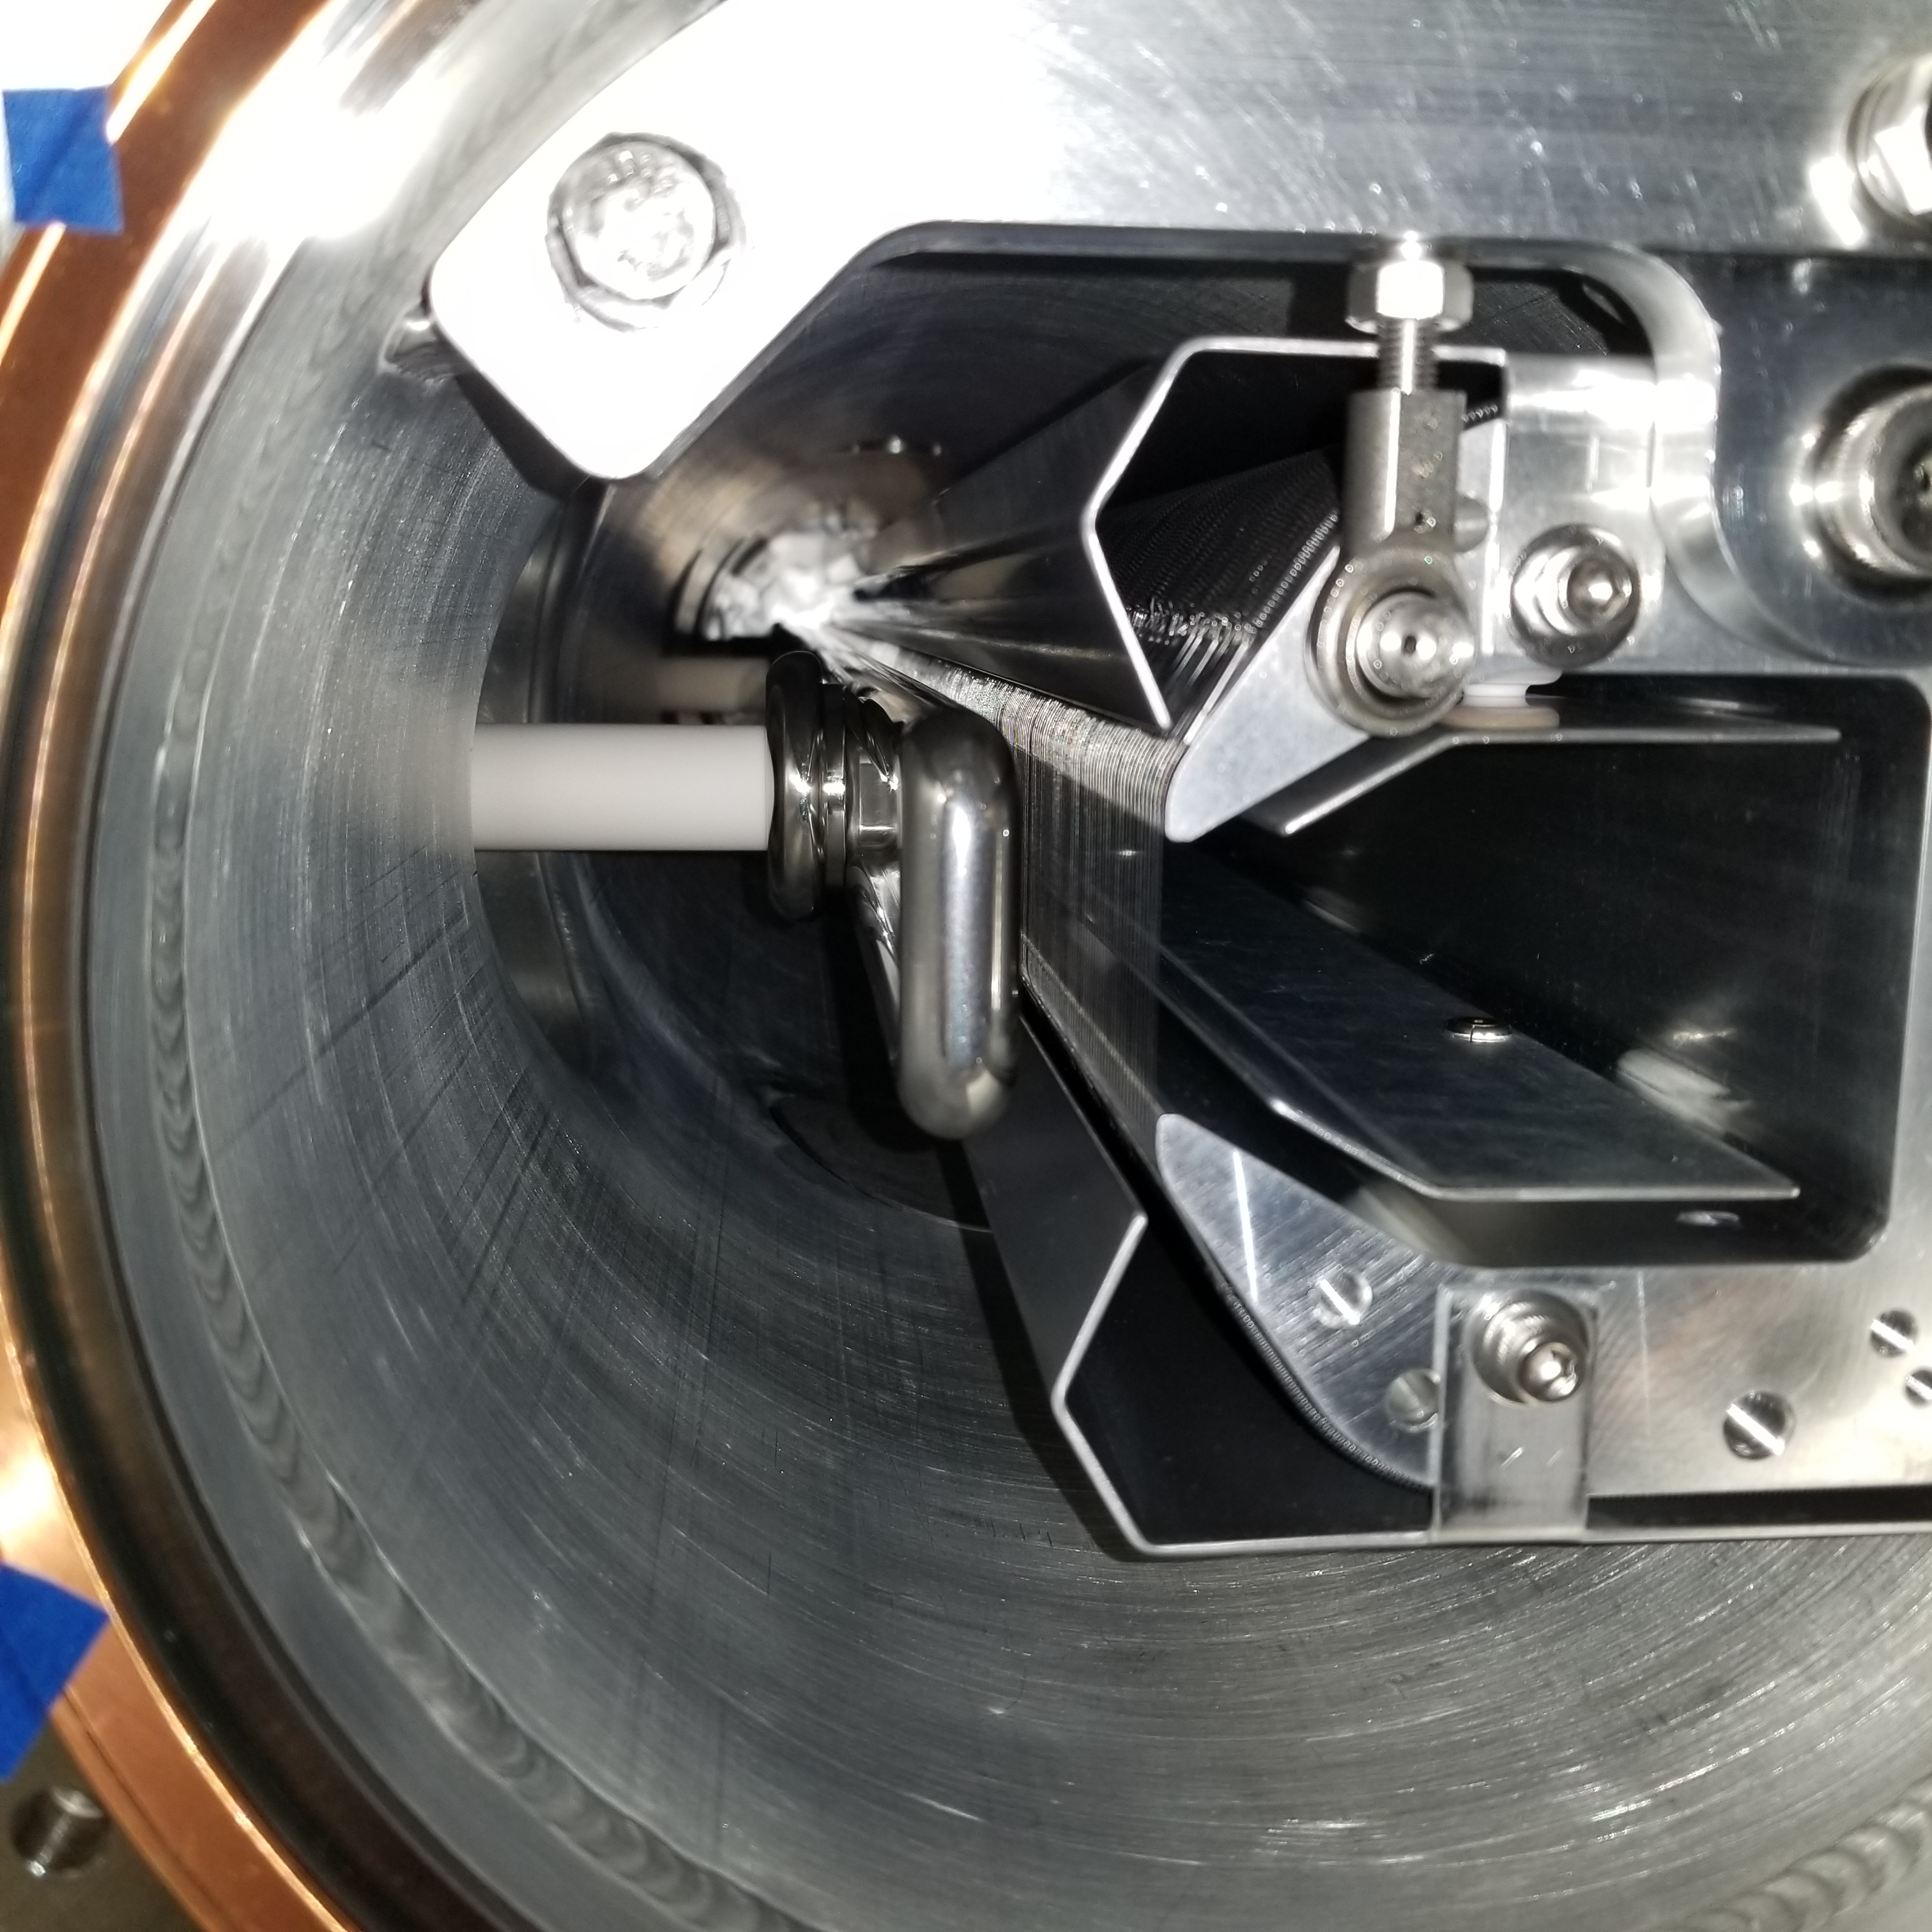
ESS2 cathode and foils
Cathode
Foils

Slide 5
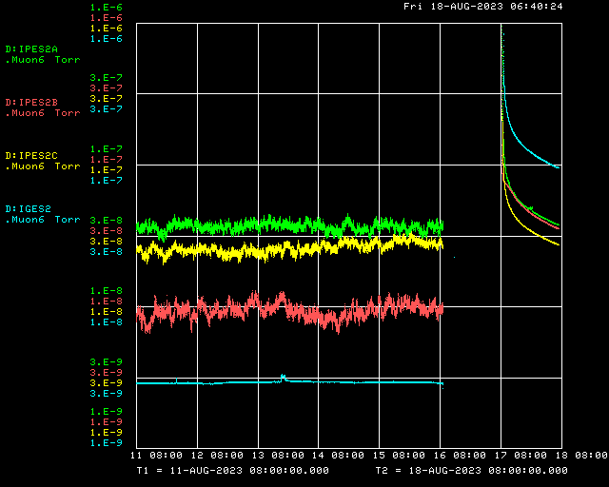
Next week
HV test ESS2 once vacuum improves
Transition DR to supervised access once HV tests are complete
Seal leak in 50 straight
Leak on welded bellows upstream of Q506
Begin work to extract Wall Current Monitor from 10 straight
Will be relocated to the M4 Line to be used as spill monitor

