Slide 1
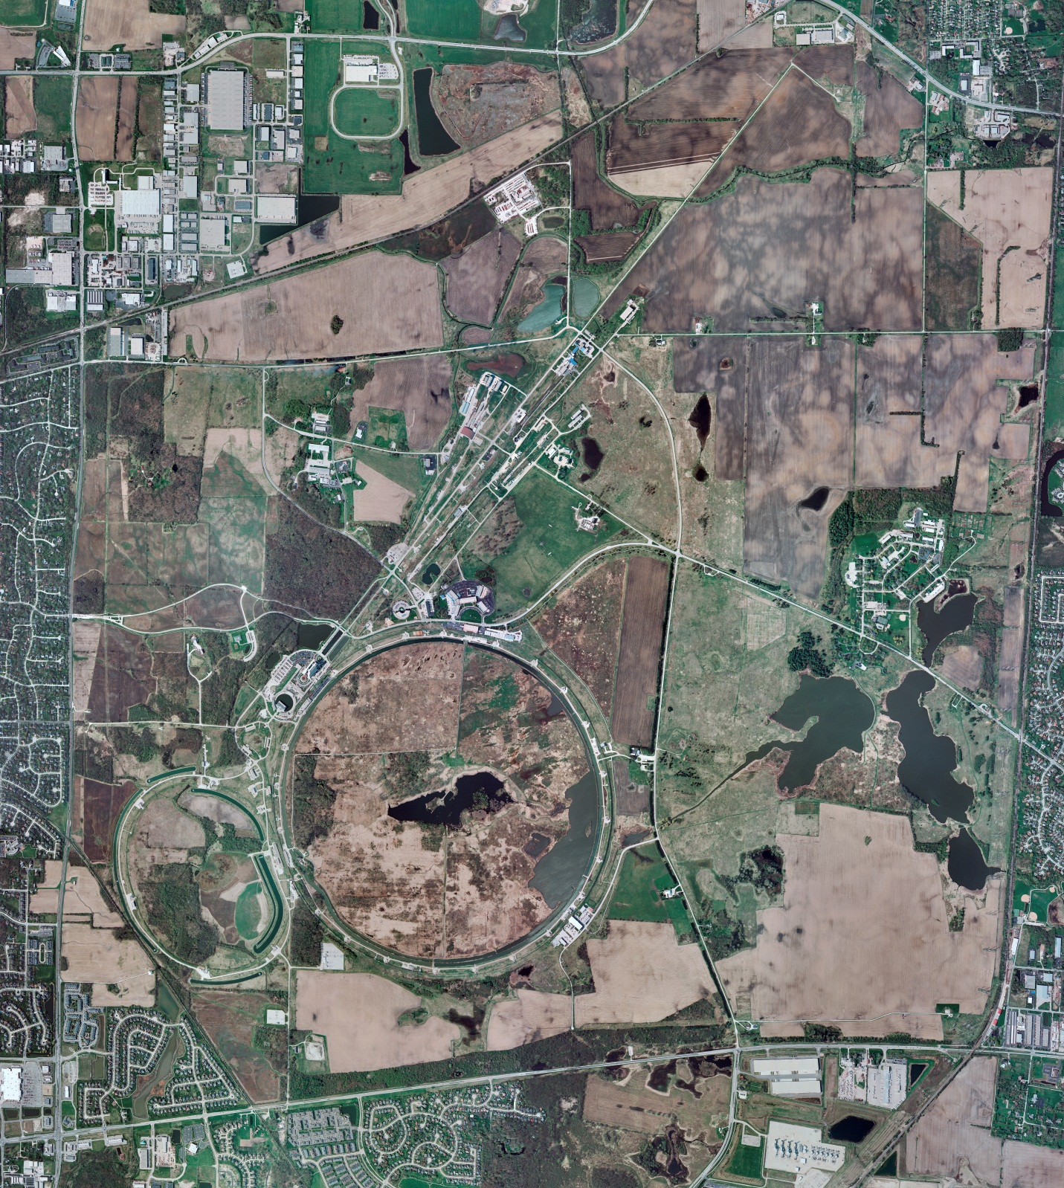
Helium Cryogenics
Status 8/18/2023 J.Makara
CMTF: SCP is cold and operating fine
CMTS: HECM27 installation almost complete thus anticipate cooldown next week
PIP2IT: SSR1 CM at RT, prepping for cooldown
HB650 CM warmup to RT in progress
MCTF: cryo system is cold and running fine
MDB/HTS: at RT
MDB/STC: LB650 Cavity is cold at 2 K though with significant oscillations
MDB Magnet: at RT
NML/FAST: Cryo system is cold but performance is poor
CC1: cold at 2 K
CC2: cold at 2 K
CM: cold at 2 K though losing level
IB1: cryo system is cold and was running fine
Muon Campus: A0 comprs (3) online with MC-1 g-2 cryogenic system at 80 K shutdown; Mu2e subsystems are being cooled down for testing; ACNET/Synoptics interface comm was restored though needs long term solution
Misc:.

