Slide 1
2023 Summer Shutdown Planning
8/18/23
Cons Gattuso

Slide 2
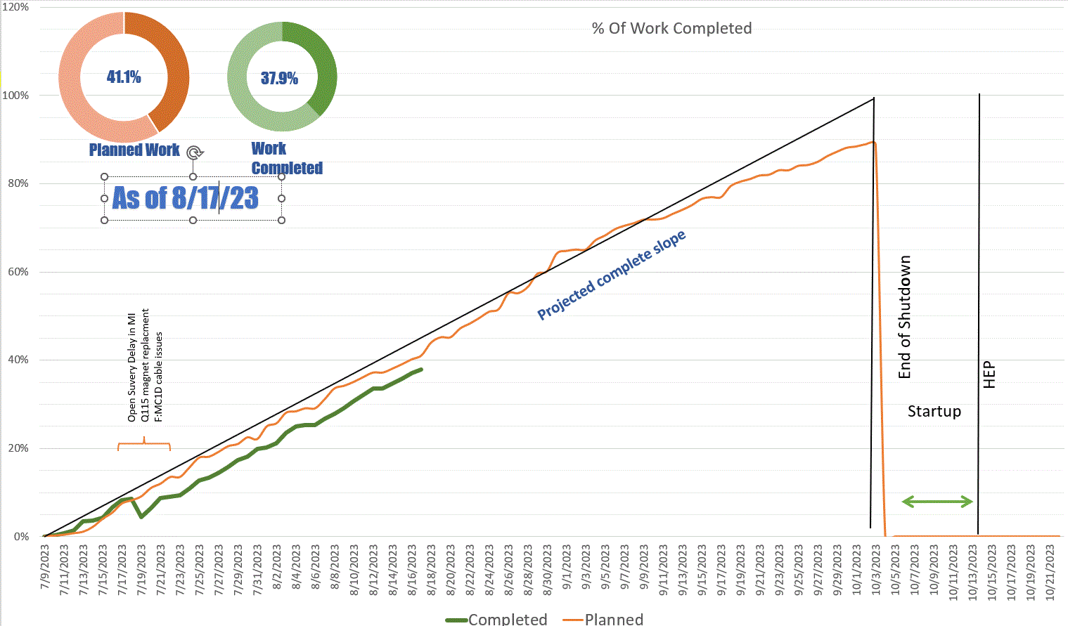

Slide 3
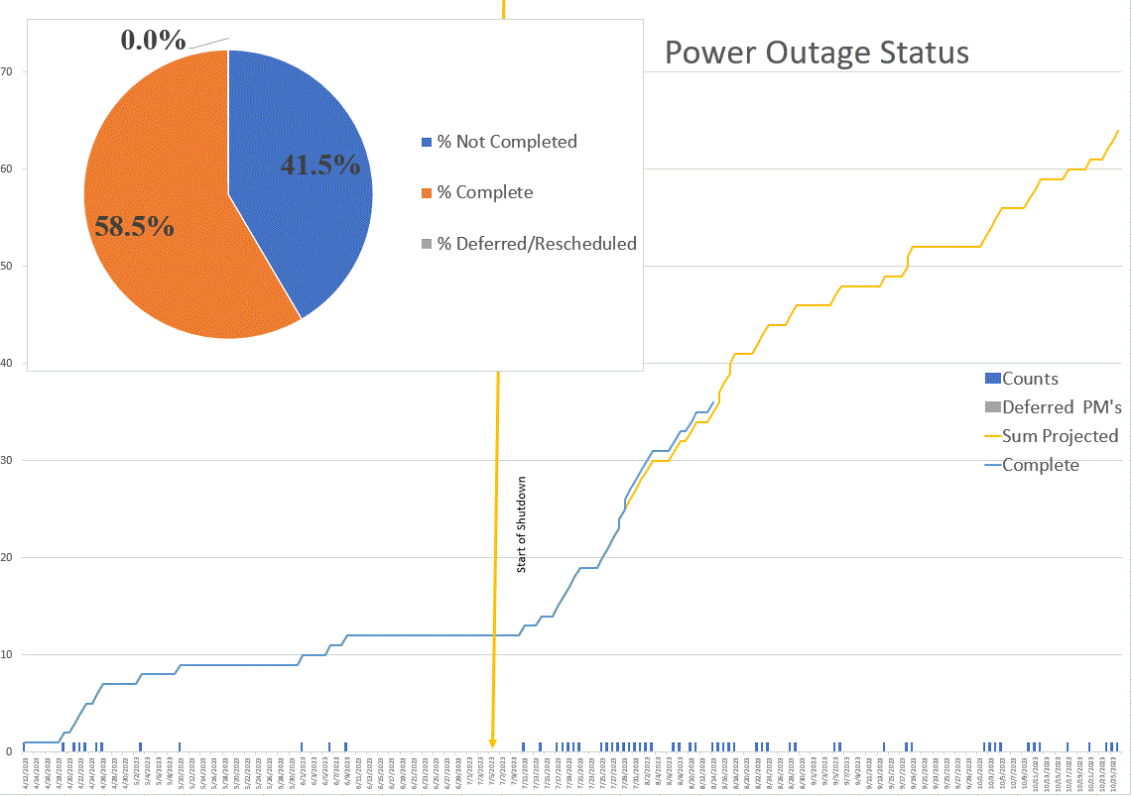

Slide 4
Power Outages
  Week 6 (Aug 14th – Aug18th)
    Friday August 18th
      NS7 & NM2, Feeder 36
        Spans: 08:20 - 16:00 hrs
  Week 7 (Aug 21st - Aug 25th )
    Tuesday August 22nd
      Feeder 43 - All Transfer Gallery
        Spans: 08:20 - 16:00 hrs
      NEW MS3 oil switch Outage (time and date to be finalized)
        Impacts: LLRW (Site 40) and ENTIRE MESON AREA INCLUDING MESON DETECTOR BUILDING, ALL MESON BEAMLINE ENCLOSURES, ALL MESON BUILDINGS INCLUDING MESON CENTRAL CRYO, MESON ASSEMBLY BUILDING, MP9, MW9
    Wednesday August 23rd
      Feeder 43 - SSB, SY, G2, FCC 2&3, Enclosure F1
        Spans: 08:20 - 16:00 hrs
    Thursday August 24th
      MI10,MI12 & SBND Conventional Power
        Spans: 08:20 - 12:00 hrs
    Friday August 25th
      MI20 Conventional Power
        Spans: 08:20 - 16:00 hrs

