Slide 1
LBNE Project Status
Jim Strait
LBNE Project Director
Fermilab
Indian Institutions and Fermilab Collaboration Meeting
26-27 November 2012

Slide 2
Outline
Long-term goals and plans of the LBNE program
A phased approach to LBNE (and Project X)
LBNE Project status and next steps
Conclusions

Slide 3
The Long-Baseline Neutrino Experiment
The LBNE Collaboration plans a comprehensive experiment to fully characterize neutrino oscillation phenomenology using
A high-intensity, broad-band neutrino beam
A sophisticated near detector
A 1300 km baseline
An advanced liquid argon TPC far detector
The goals of this program are:
Determining leptonic CP violation and neutrino mass ordering.
The recent measurement of non-zero θ₁₃ make this a scientifically well motivated, comprehensive, and stunningly beautiful program.
Underground physics, including the exploration of proton decay and supernova neutrinos.

Slide 4
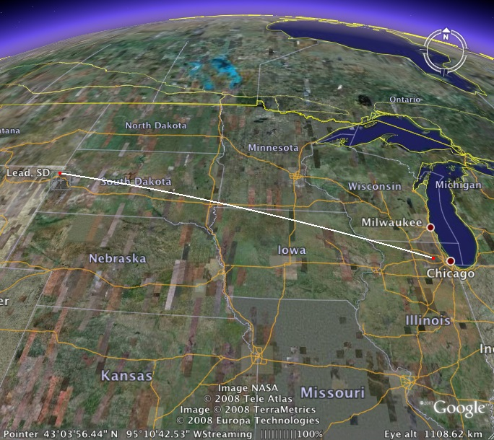
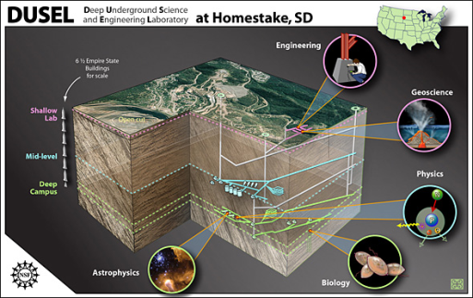
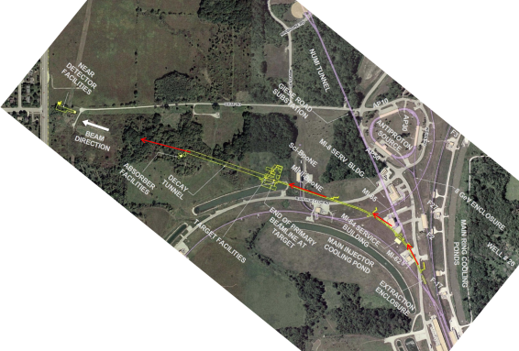
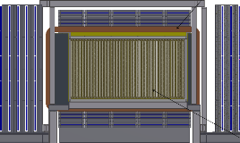
Sample with bullet points
Long Baseline Neutrino Experiment
First Bullet
Second Bullet
More
Yet more
Still more
Less important
Trivial
New Neutrino Beam at Fermilab…
Precision Near Detector on the Fermilab site
Directed towards a distant detector
34 kton Liquid Argon TPC Far Detector at a depth of 4850 feet (4300 mwe)

Slide 5
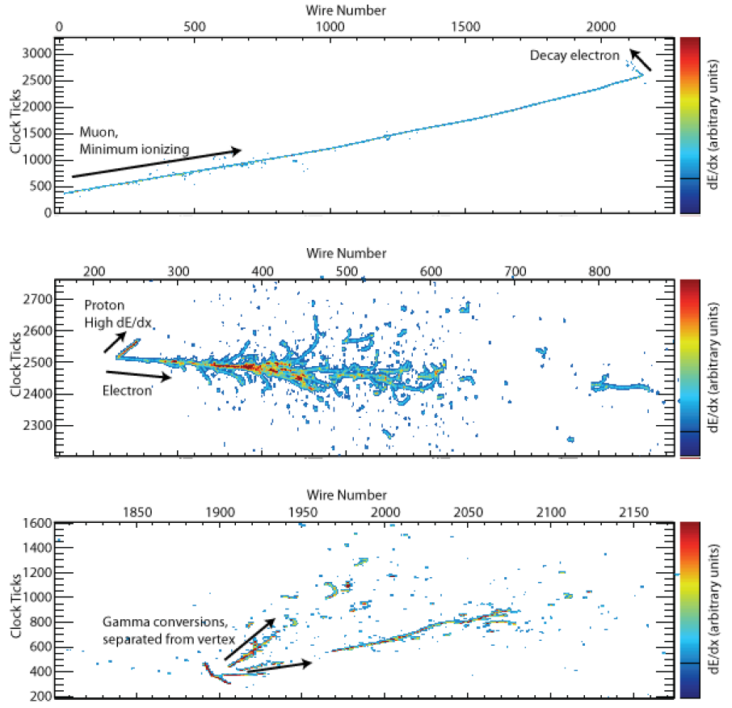
LAr TPC Capabilities
Simulated neutrino events:
CC ν_{μ} interaction with a stopped μ followed by a decay Michel electron
CCQE ν_{e} interaction with a single electron and a proton
NC interaction which produced a π⁰ that then decayed into two γ’s with separate conversion vertices
ν_{μ}
ν_{e}
ν_{x}

Slide 6
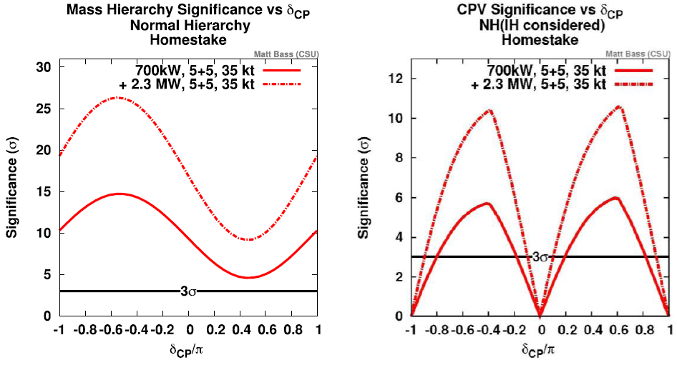
Neutrino Mass Hierarchy and CP Violation

Slide 7
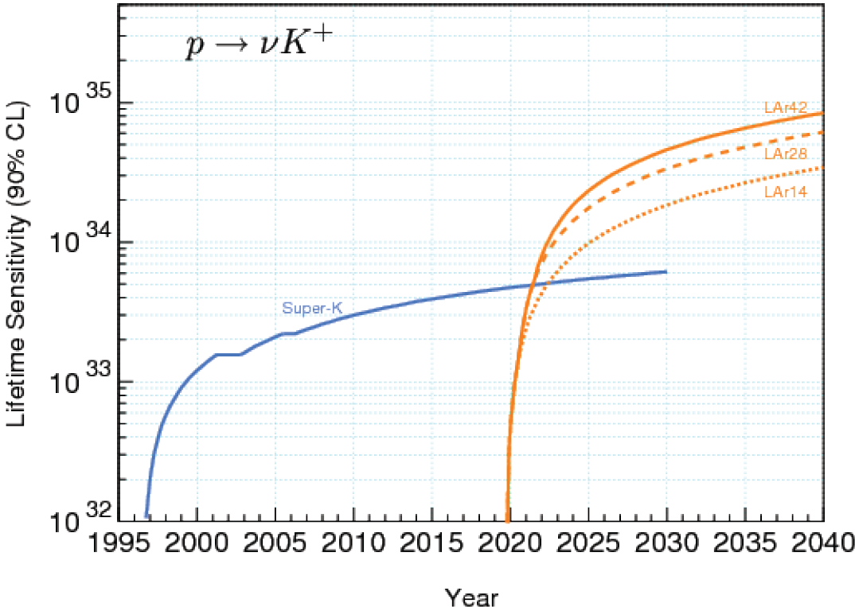
Proton Decay

Slide 8
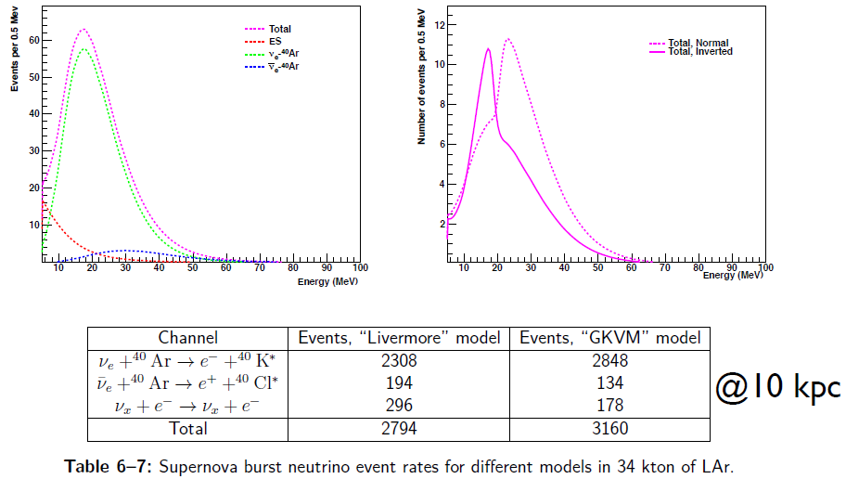
Supernova Neutrinos

Slide 9
LBNE as a Phased Program
The U.S. Department of Energy has stated their intention to carry out this program in a phased manner.
The LBNE Project is the first phase
focuses on accelerator neutrino oscillation physics
includes the beam and a 10 kt fiducial mass liquid argon TPC at the surface, 1300 km from Fermilab
The first phase will focus on long-baseline physics:
determine the sign(Δm²₃₂)
measure δ_{CP},
measure other oscillation parameters: θ₁₃, θ₂₃, and |Δm²₃₂|.

Slide 10
Sample with bullet points
Long Baseline Neutrino Experiment
First Bullet
Second Bullet
More
Yet more
Still more
Less important
Trivial
New Neutrino Beam at Fermilab…
Precision Near Detector on the Fermilab site
Directed towards a distant detector
34 kton Liquid Argon TPC Far Detector at a depth of 4850 feet (4300 mwe)

Slide 11
LBNE as a Phased Program
The U.S. Department of Energy has stated their intention to carry out this program in a phased manner.
The LBNE Project is the first phase
focuses on accelerator neutrino oscillation physics
includes the beam and a 10 kt fiducial mass liquid argon TPC at the surface, 1300 km from Fermilab
Subsequent phases are planned to include:
A highly capable near neutrino detector
A larger far detector, placed deep underground
Higher beam power that will be enabled by Project X
Additional national or international collaborators could increase the scope of the first phase of LBNE or accelerate the implementation of subsequent phases.

Slide 12
Phased Program: Possible Example
1) 10 kt LAr detector on surface at Homestake + LBNE beamline (700 kW)
2) Near Neutrino Detector at Fermilab
3) Project X stage 1 → 1.1 MW LBNE beam
4) Additional 20-30 kt detector deep underground (4300 mwe)
Additional national or international collaborators could help accelerate the implementation of the full LBNE program.

Slide 13
The LBNE Project Approval Status
The next step in the DOE project approval process is “CD-1,” which
Approves the conceptual design and overall cost and schedule.
Releases funds for final design and preparation for construction.
LBNE has been through three recent reviews:
Fermilab Director’s Review 25-27 Sep: Validated the design
DOE Project Review 30 Oct - 1 Nov: Validated the project plan
DOE Cost Review 6-8 Nov: Validated the cost estimate
We expect CD-1 to be granted by the end of December.

Slide 14
Summary
LBNE remains focused on its long-term goals:
Comprehensive program to measure neutrino oscillations - determine the mass hierarchy and look for CP violation - precision measurement of other oscillation parameters - test the validity of the three-neutrino mixing model
Search for baryon number violating processes
Measure neutrinos from astrophysical sources, especially from a core-collapse supernova in our galaxy
Fiscal constraints require us to approach our goals in a phased program
The LBNE Project will build the first phase, and is expecting DOE approval of “CD-1” this year.
New national or international collaborators could add scope to phase 1 or accelerate the implementation of later phases.

