Slide 1
Department of Energy View on Discovery Science Indian Institutions & Fermilab Collaboration
Jim Siegrist
Associate Director
DOE-OHEP

Slide 2
Welcome
On Behalf of the US Department of Energy I welcome you to the 2nd Indian Institutions and Fermilab Collaboration, 1st one was held at RRCAT, Indore in Oct 2010.
Since my appointment to the Associate Director of the DOE-Office of High Energy Physics I have taken keen interest in this collaboration and am doing everything possible to strengthen it.
Science and Technology collaboration is a key element of growing US-India strategic partnership and I am very pleased to co-chair the Basic Science Working group from US side in which the Indian Institutions and Fermilab Collaboration on Discovery Science is number one item from US side.
To further strengthen this collaboration and its management at the highest level possible in the US government
The US-DOE-SC has appointed me as the Principal Coordinator of the US-India Discovery Science Collaboration and Shekhar Mishra as Technical Coordinator.
The US government is committed to make IIFC Discovery Science Collaboration a success
Notes:
I put these as thoughts you may say but may not turn in your slide.

Slide 3
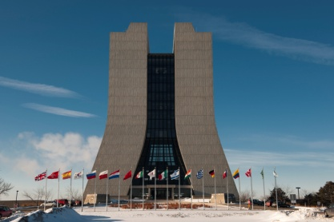
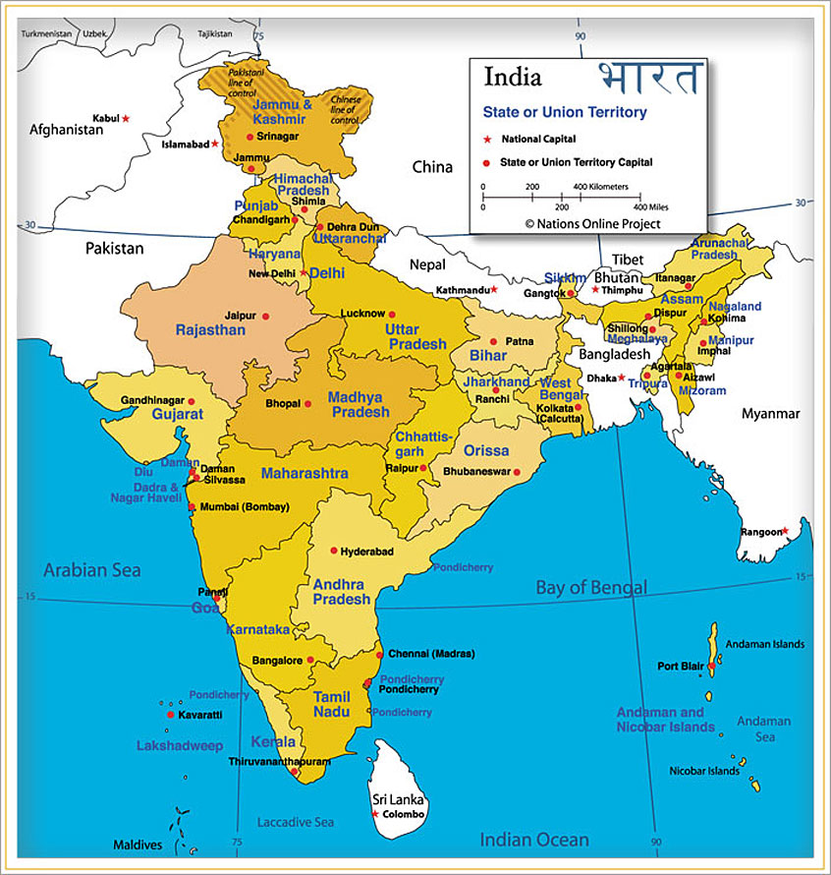
The Discovery Science: Indian Institutions & Fermilab Collaboration
Indian Institutions and Fermilab Collaboration is jointly building infrastructure, accelerator and physics program(s) in India and at Fermilab for the programs of vital interest to both countries.

Slide 4
US DOE-OHEP Committed
The US-Department of Atomic Energy Office of High Energy Physics is committed to make the Indian Institutions and Fermilab Collaboration
a great success
an example for all future international collaboration in US HEP
Since the foundation of this collaboration it is based on the principle of “Joint Collaboration” and “Equal Partnership”
US-DOE strongly supports these principles
US-DOE views that this is the only way future international projects can be built
Where both the host country and collaboration equally benefits

Slide 5
DOE: Fermilab Project X
Fermilab has proposed the construction of a Superconducting Radio Frequency linac to support the High Intensity Physics mission of the US-DOE
Indian DAE laboratories are collaborating in this program

Slide 6
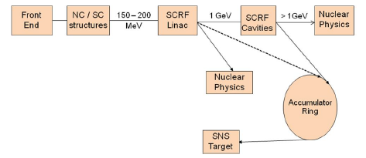
DAE: BARC & RRCAT
DAE laboratories (RRCAT and BARC) in collaboration with other DAE laboratories and Fermilab have proposed
CW SRF Proton Linac for Material Science and Medical Apps.
High Power Proton LINAC Based Spallation Neutron Source
RRCAT
BARC

Slide 7
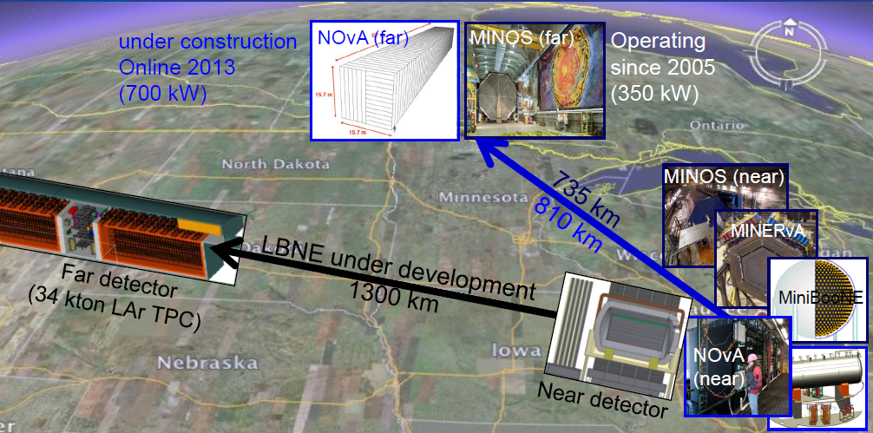
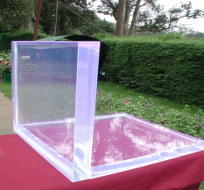
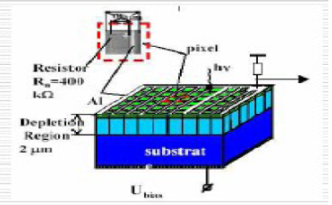
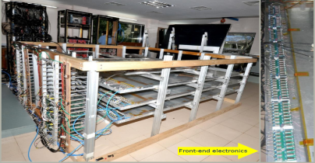
Neutrino Physics Program
Fermilab and the Indian Institutions within the “Discovery Science” collaboration are jointly working on physics research program at Fermilab and at the Indian laboratories,
Focus on neutrino physics (MINOS, NOυA, LBNE)
Joint development of detector and associated technologies
Indian Institutions:
MINOS, NOυA,
LBNE
DAE-DST

Slide 8
Project X → Material Science
Fermilab Project X CW proton beam at 1 MW, 1 GeV would be a unique proposed facility in the world.
High temperature irradiations carried with the Project X proton beam would result in swelling, irradiation induced hardening and embrittlement.
The “Material Science” facility at Fermilab would help design materials with tailored microstructures and compositions.
To obtain optimal value of swelling and irradiation induced mechanical properties.
Measurement of neutron cross section of some of the minor actinides.
93-Np-238, 95-Am-241, 95-Am-242 and 96-Cm-242

Slide 9
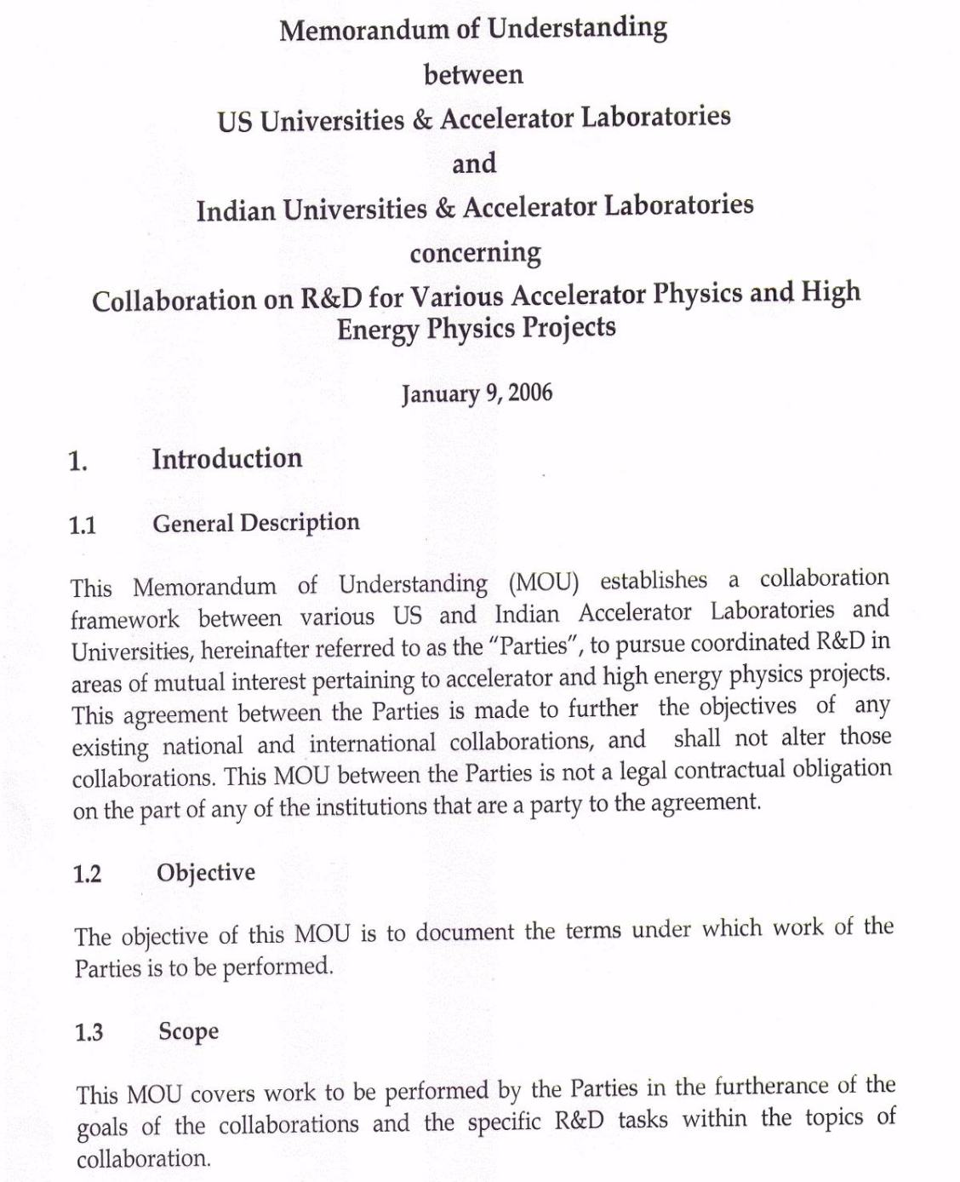
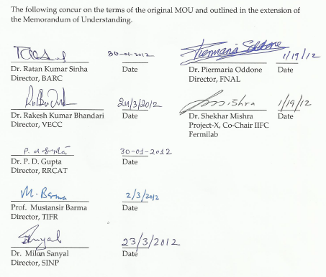
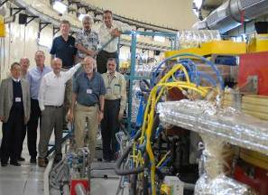
2006: Institutes to Institutes MOU
IIFC

Slide 10
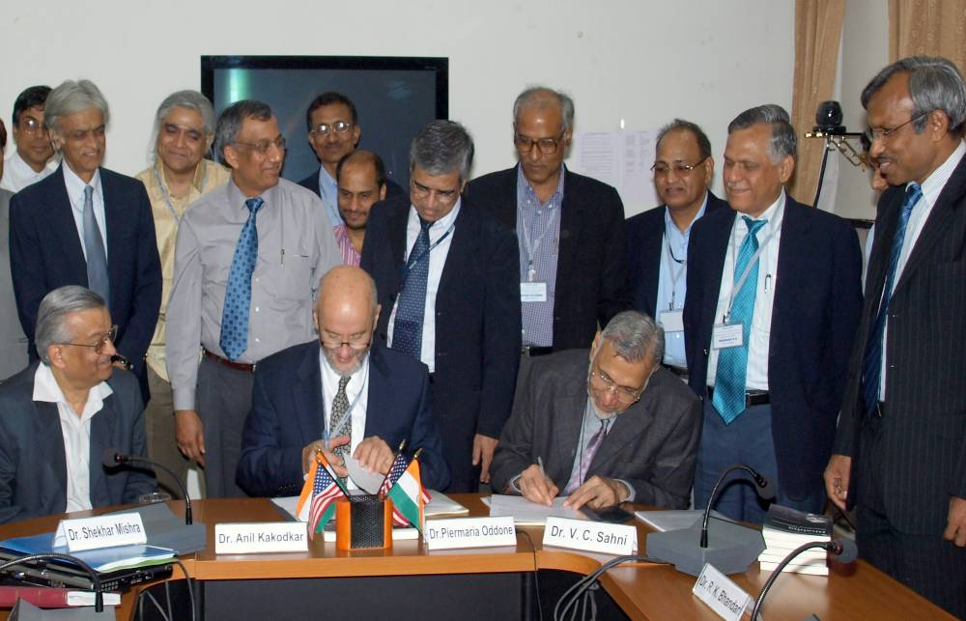
2009: IIFC on Project X
Jan 2009, During the signing of the Addendum MOU III at Indore, Dr. Kakodkar and Dr. Oddone agreed on the
Concept of “Total Project Collaboration”
Fermilab changed the HIPA design to CW
Indian Institutions and Fermilab Collaboration also established MOUs to join Neutrino Physics experiments at Fermilab
MINOS/MINOS+
NOvA
LBNE

Slide 11
2010: Banerjee’s Road Map
May 2010 Banerjee requests US-DOE for a Road Map for the Fermilab collaboration on High Intensity Proton Accelerator
Daniel Poneman, Brinkman, Miller, Banerjee and Meera Shankar, Indian Ambassador met in Washington to discuss this Road Map
Poneman and Banerjee agreed to develop DOE-DAE agreement
The concept of “Discovery Science” collaboration developed
Dr. Banerjee charged the IIFC to prepare a plan that would expand the accelerator collaboration to include physics collaboration with Fermilab.
The program should be rich in Physics
Indian contribution should be significant and DAE-DST Ownership
Contribution should have synergy with interest and expertise in India
Development of Indian manpower, laboratory and industrial infrastructure
Fermilab and Indian-DAE established working groups to develop plans for
Project X and Indian Accelerator Program
Indian Collaboration in Fermilab physics program

Slide 12
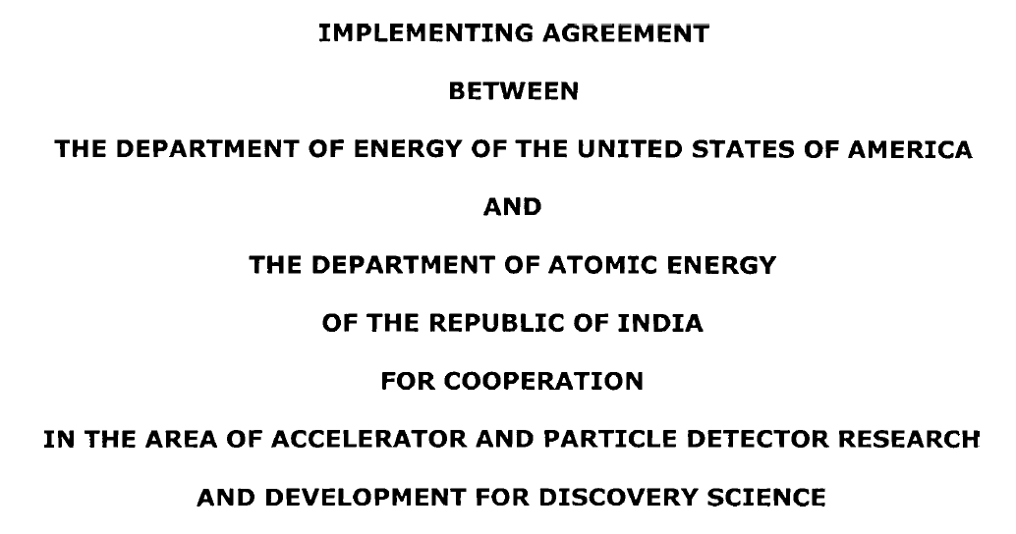
2011: DOE-DAE Implementing Agreement
Discovery Science: The United States’ Department of Energy and India’s Department of Atomic Energy signed an Implementing Agreement on Discovery Science that provides the framework for India’s participation in the next generation particle accelerator facility at Fermilab.

Slide 13
2012: Project Annex I & II
Physics Collaboration Development
Accelerator Collaboration Development
Being Negotiated by DAE and DOE
Major Issues resolved

Slide 14
Project Annex I: Fermilab – DAE Laboratories Accelerator Construction
Fermilab and Indian DAE laboratories are jointly working on all major components of 3 GeV CW linac. In some cases DAE laboratory is leading the R&D with Fermilab specifications.
IUAC:
SSR1
VECC:
SSR1 Dressing,
325 MHz CM components
β=0.6, 650 MHz, Cavity
Dressing, Magnet etc
BARC:
SSR2 and CM components
325 MHz RF Power
325 MHz power coupler
BPM, LLRF
Controls
RRCAT:
β=0.9, 650 MHz Cavity
Dressing, Magnet etc
650 MHz RF Power

Slide 15
Project Annex II: Physics Collaboration
Project Annex II satisfies all the mandate given to the collaboration by Dr. Banerjee and DAE.
It focuses on
Neutrino Physics and Detector Program
Material Science and neutron cross section measurement
Indian Institutions infrastructure development and will support vital Human Resources development
Considers participation in other Fermilab physics program
Opens the possibility of US physicists participation in Indian infrastructure development.

Slide 16
Summary
Fermilab along with its US and Indian collaboration is making significant R&D, infrastructure and industrial progress that could lead to
The Neutrino and Material Science Experiment
Project X construction at Fermilab.
Construction of two vital accelerators in India
Training of next generation of scientists
We have set the foundation of a very strong technical collaboration with Indian Institutions.
US-DOE and Indian DAE are working to finalize two project Annexes for the funding of Fermilab and Indian-DAE programs
Support of all collaborating institutions for this unique collaboration is very strong

