Slide 1
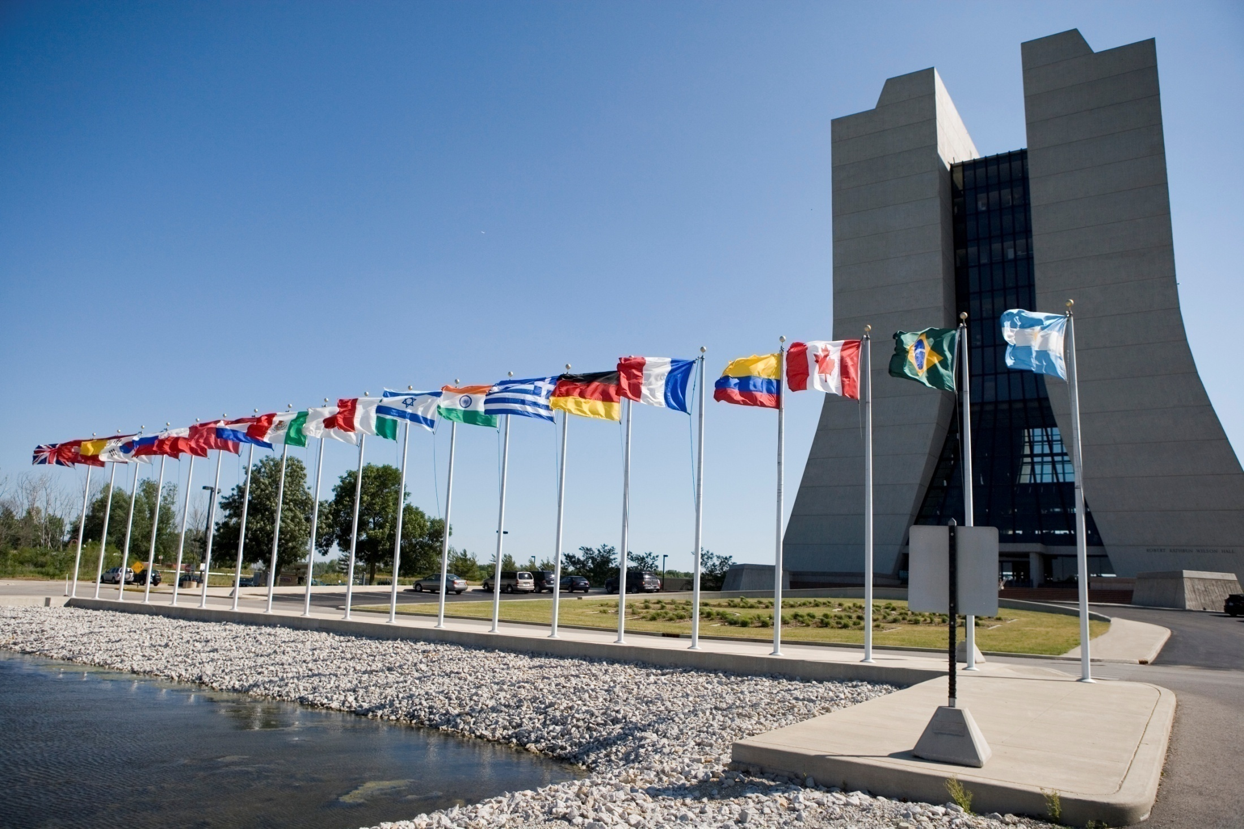
Fermilab Program and Fermilab-India Collaboration
Young-Kee Kim
Deputy Director of Fermilab
Indian Institutions and Fermilab Collaboration
November 26-27, 2012
International laboratory

Slide 2
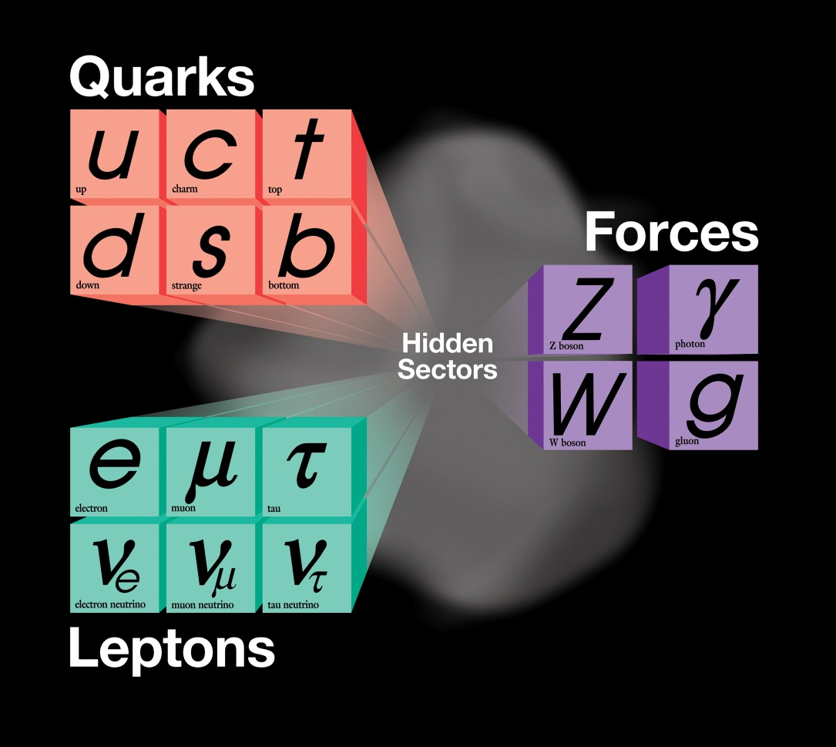
The triumphs………
The present theory is a remarkable intellectual construction
Particle experimental results beautifully fit in this framework
Standard Model
Higgs

Slide 3
……………. and the mysteries
Origin of mass?
Why so many kinds of particles?
Do all forces become one?
What do neutrinos tell us?
What happened to antimatter?
What is dark matter?
Mystery of dark energy?
…..

Slide 4
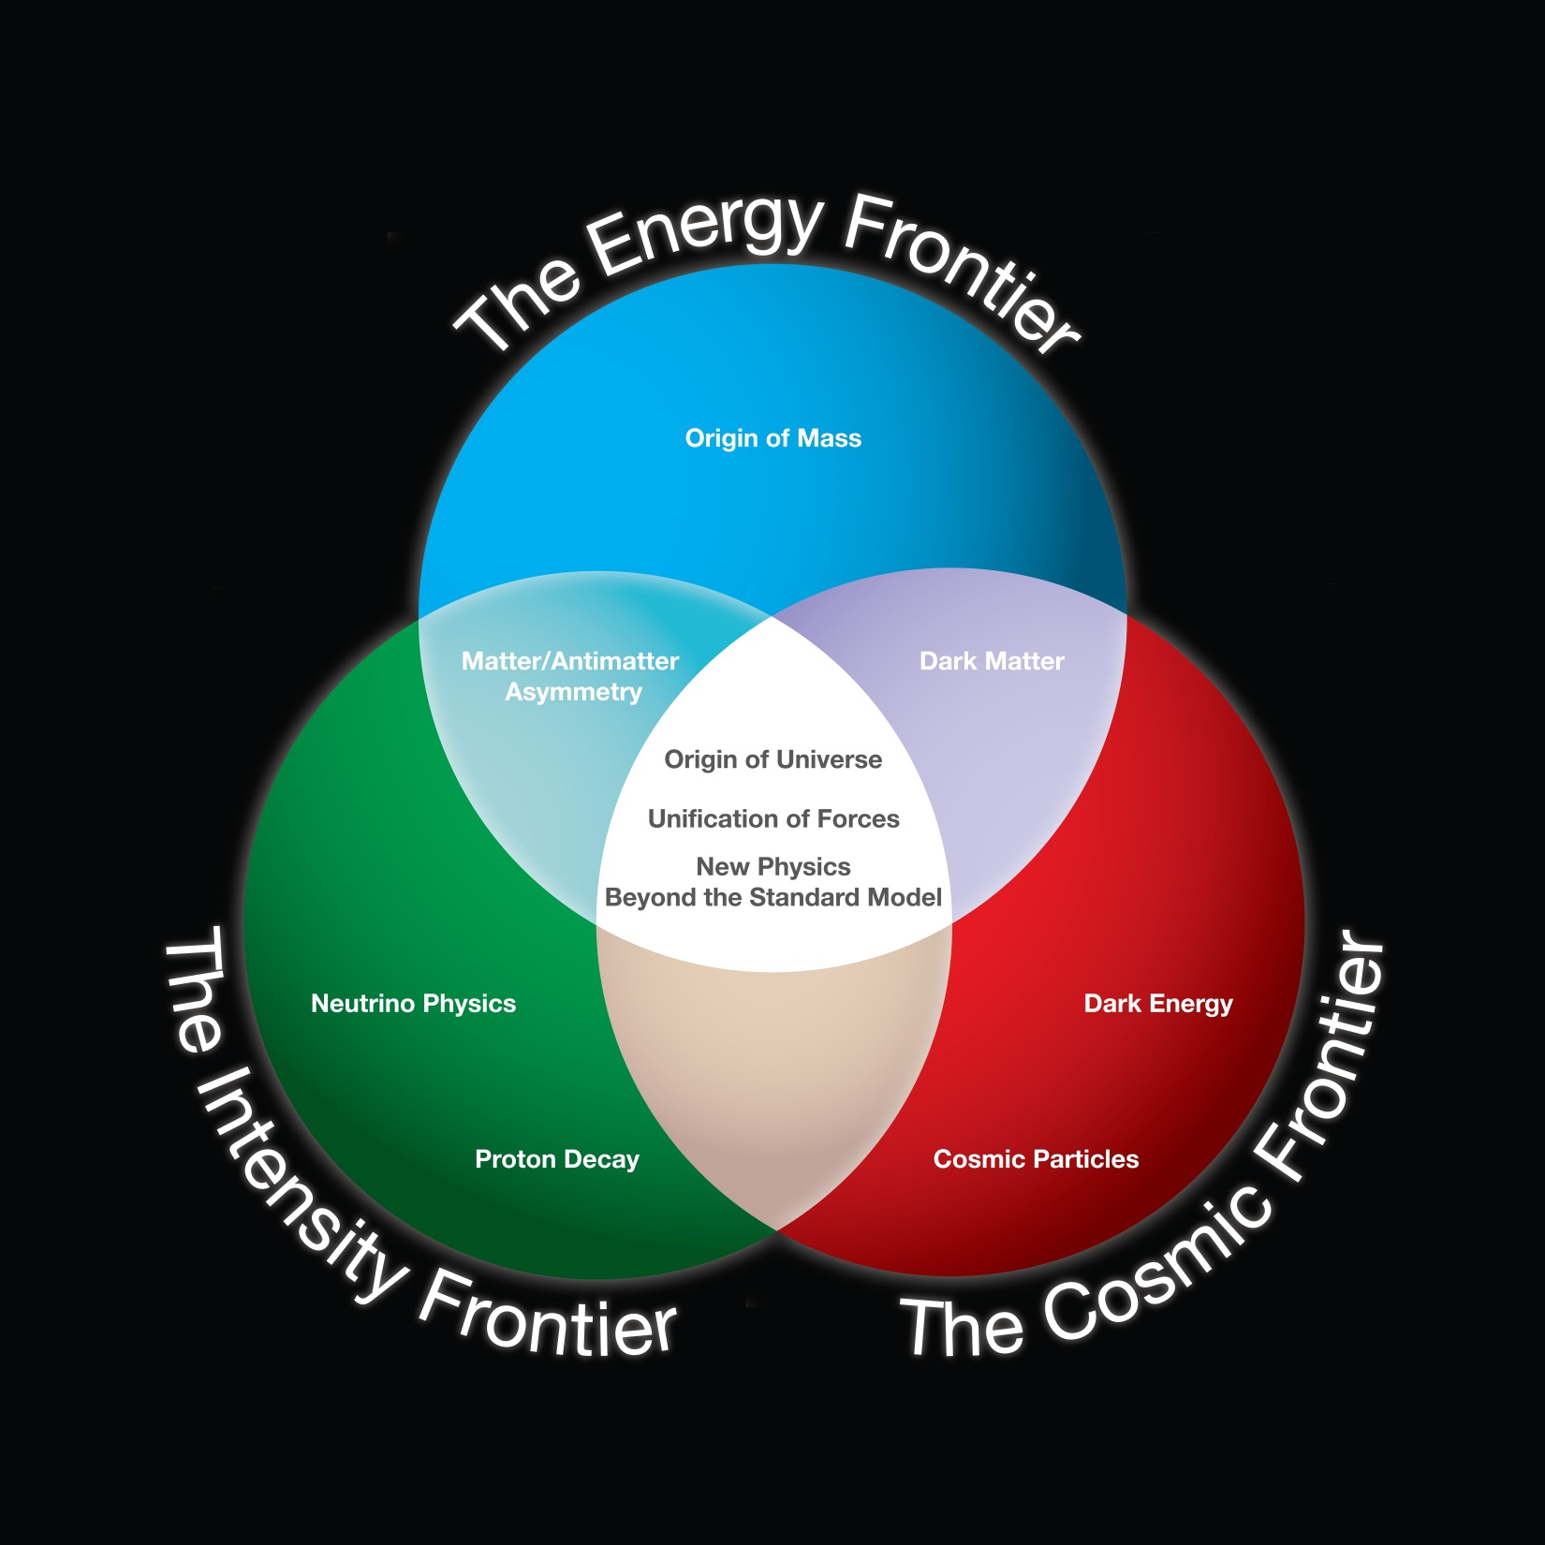
Tools for the Future

Slide 5

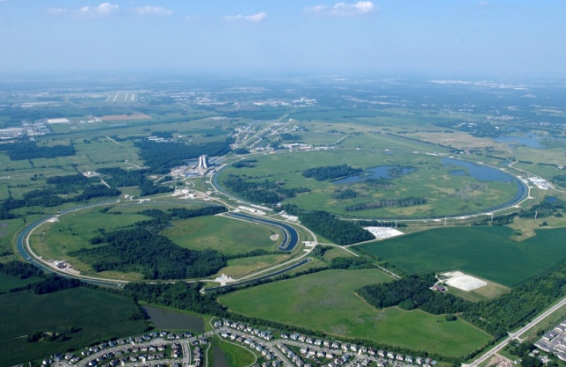
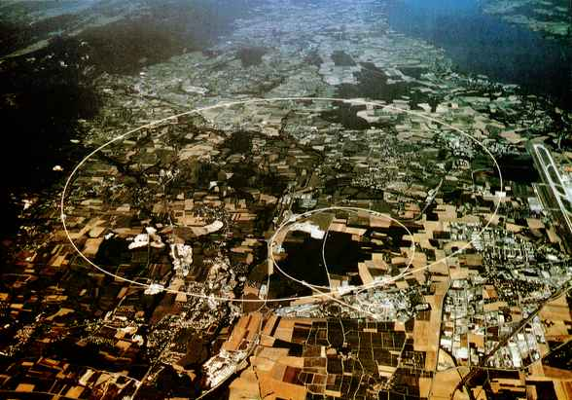

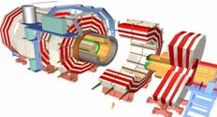
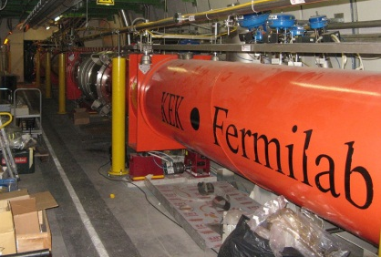
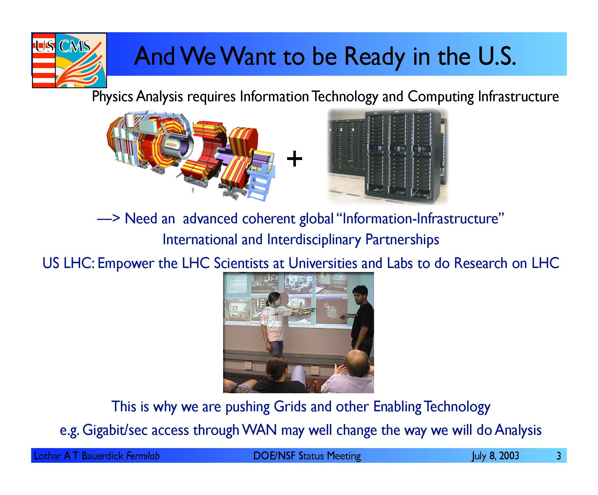
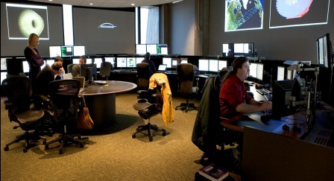
Energy Frontier at Fermilab
Tevatron → (LHC) → future accelerators
Fermilab
CERN
Tevatron
LHC
Future accelerators
R&D

Slide 6
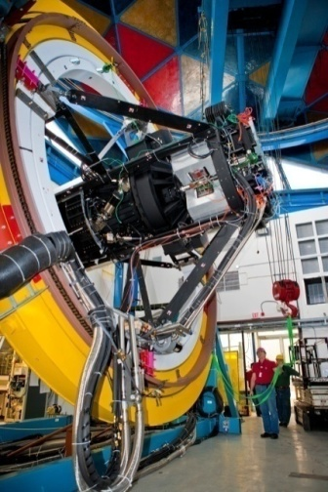
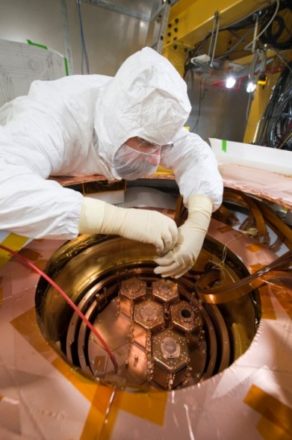
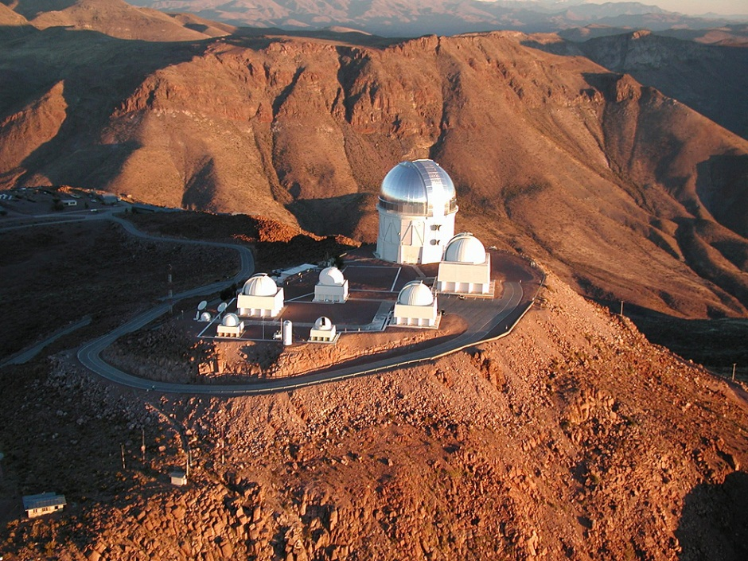
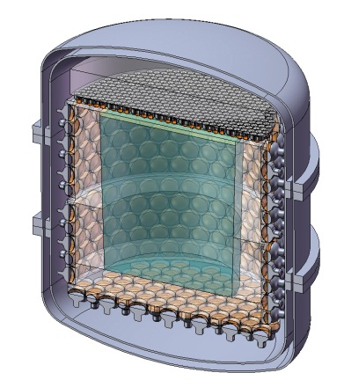
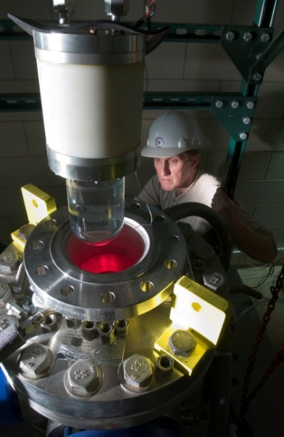
Cosmic Frontier at Fermilab
Dark Matter Detector
Dark Energy
Camera
Dark Matter Particle
570-Megapixel
digital camera
Fermilab (Spring 2012)
Detector
nuclear recoil
Detectors in underground facilities

Slide 7
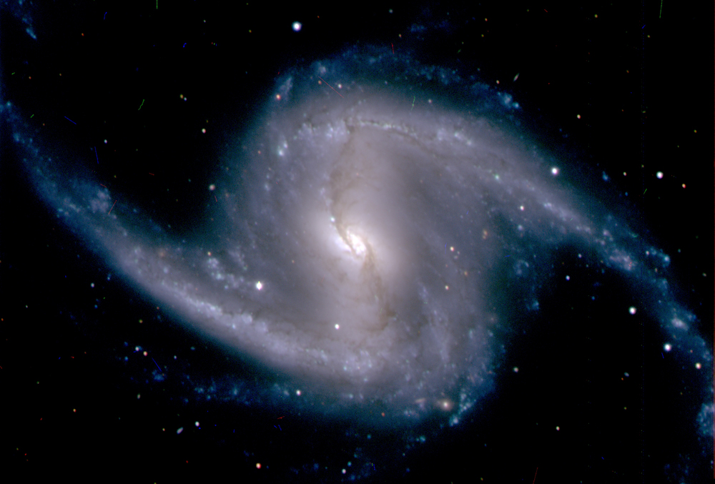
Dark Energy Survey
Galaxy NGC 1365, in the Fornax cluster of galaxies (~60 million light years from Earth)

Slide 8
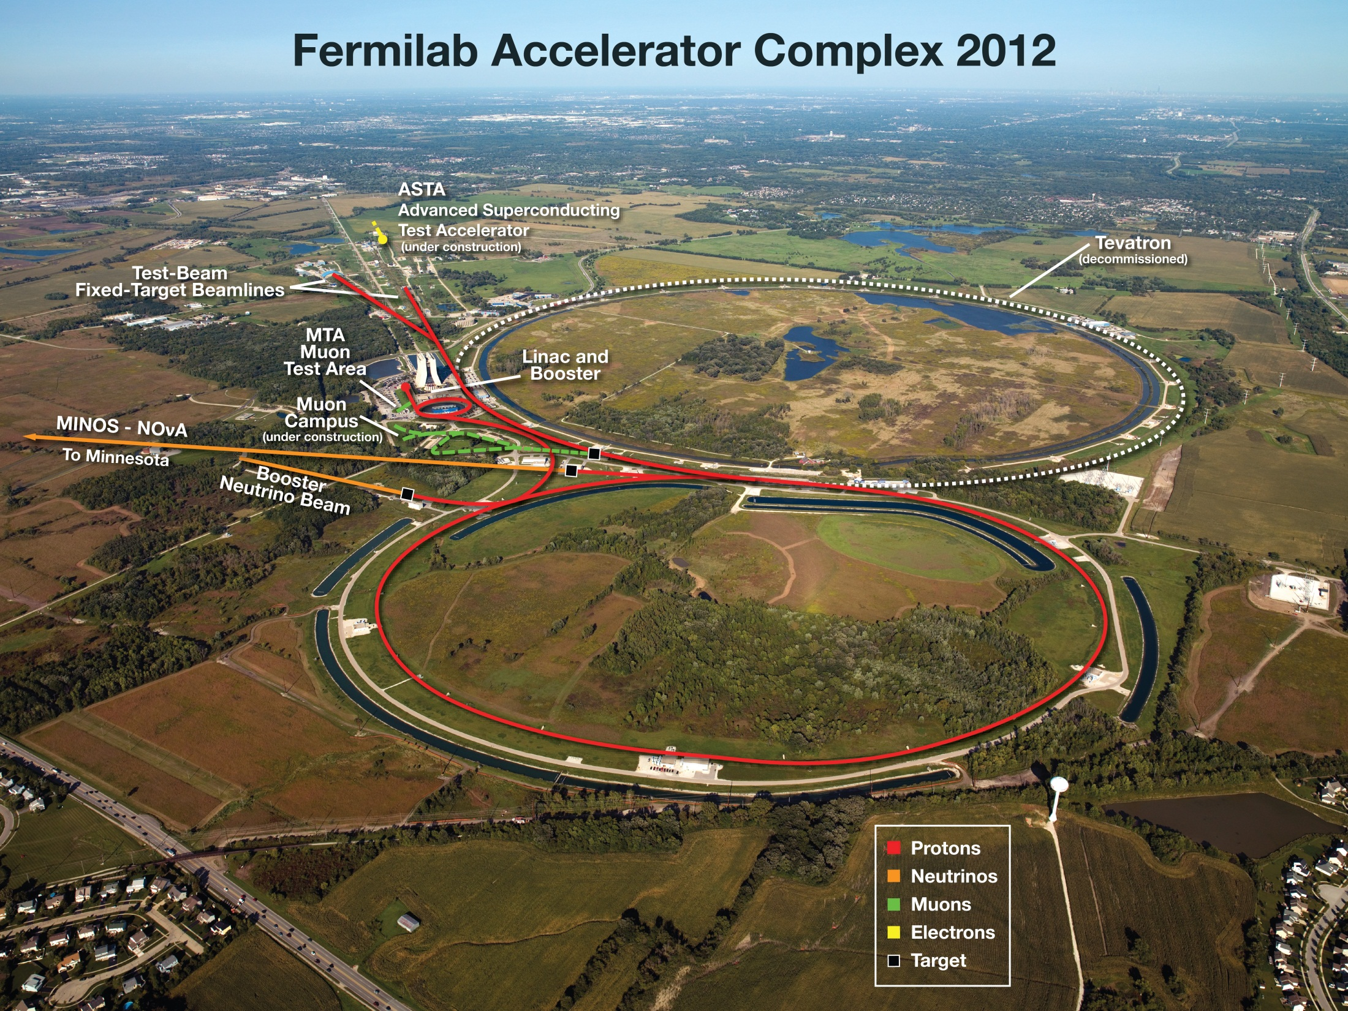
Construction:
NOvA Accelerator Upgrade
Proton Improvement Plan
Muon Campus
Illinois Accelerator Research Center
Superconducting Accelerator Facilities for Project X, …

Slide 9
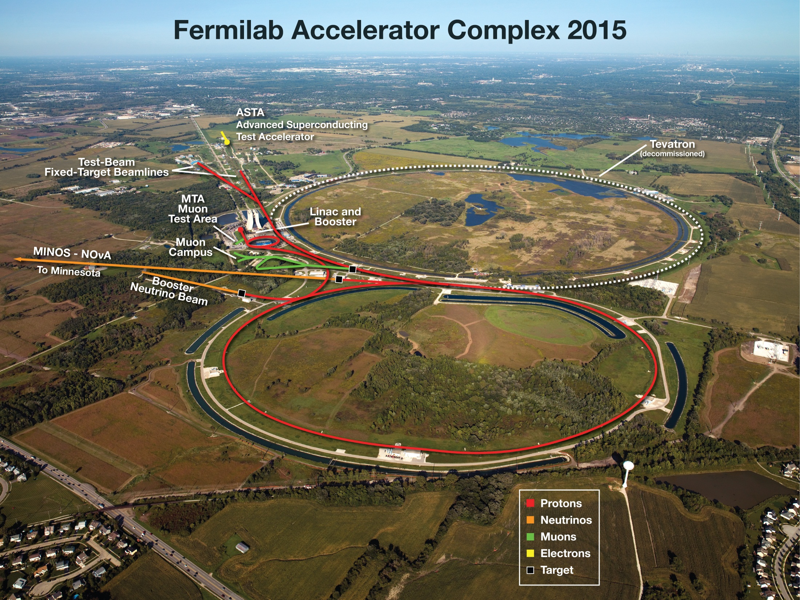
Construction:
Proton Improvement Plan
Muon Campus
Superconducting Accelerator Facilities for Project X, …

Slide 10
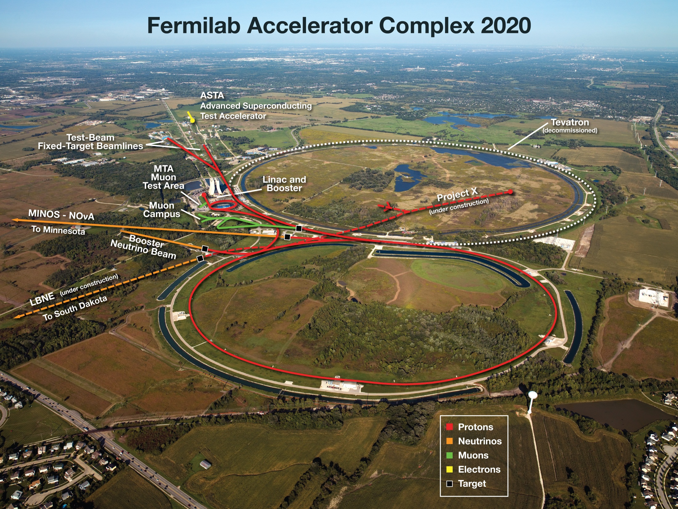
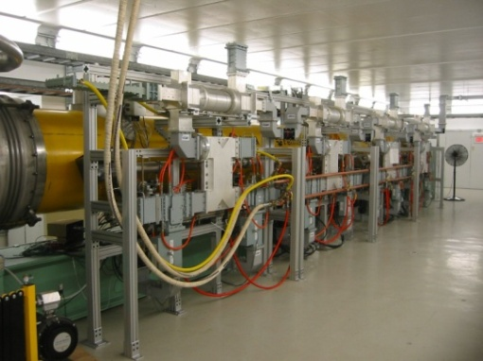
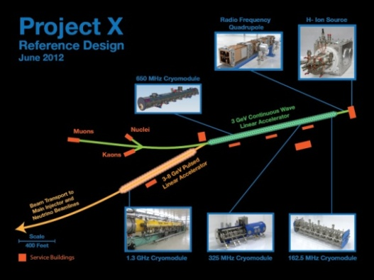
40 years old now
Project X: phased approach
(> 5 MW)
Project X R&D

Slide 11

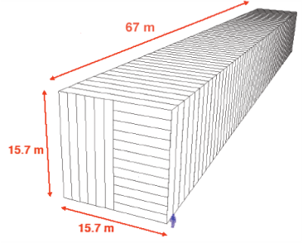
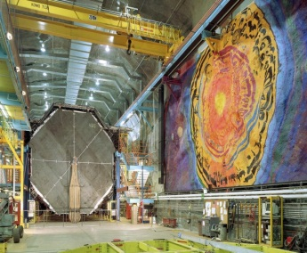
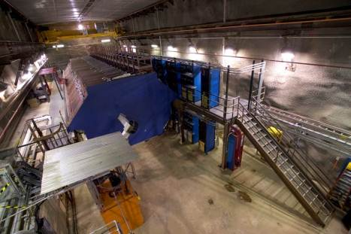
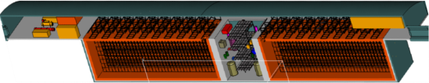
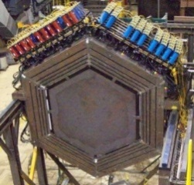

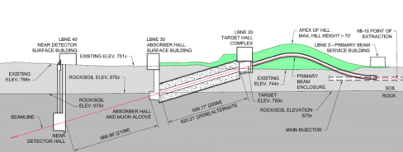
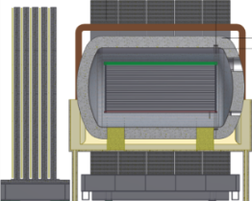
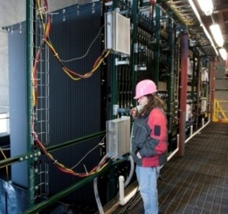
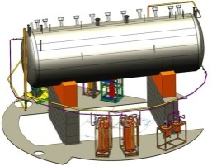
Evolution of U.S. Neutrino Experiments
under construction
online 2013
(700 kW)
NOvA (far)
Surface
14 kton
MINOS (far)
at 2340 ft level
5 kton
operating
since 2005
(350 kW)
MINOS (near)
735 km
810 km
MINERvA
1300 km
LBNE Far detector
at 4850 ft level
34 kton LAr TPC
700 kW → 2.3 MW(Project X)
MiniBooNE
New beamline
Near detector
NOvA
(near)
MicroBooNE (LAr TPC)
under construction
onlline 2014
IIFC has submitted a detailed Project Proposal to DAE for collaboration on LBNE and taking a lead in LBNE-ND

Slide 12
LBNE in two phases
Phase 1:
  Goal:
    beamline + a near detector + 10kton detector underground
  DOE + International collaboration + NSF
  DOE funds alone can afford
    beamline + 10kton detector on surface
    DOE CD-1 Review and Approval
      DOE review: Oct. 30 – Nov. 1, 2012
      CD-1 approval expected in December 2012
  India: IIFC has submitted a detailed Project Proposal to DAE for collaboration on LBNE and taking a lead in LBNE-ND
Phase 2:
  25 kton detector underground

Slide 13
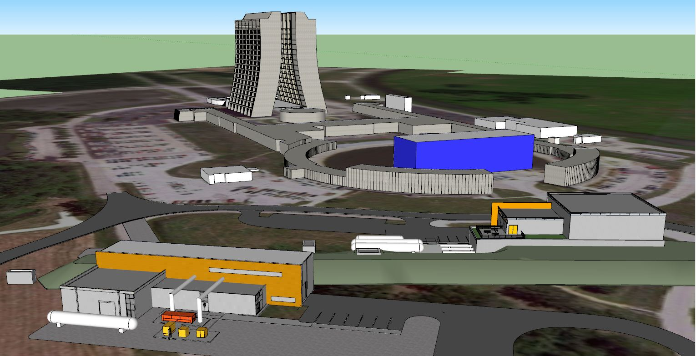
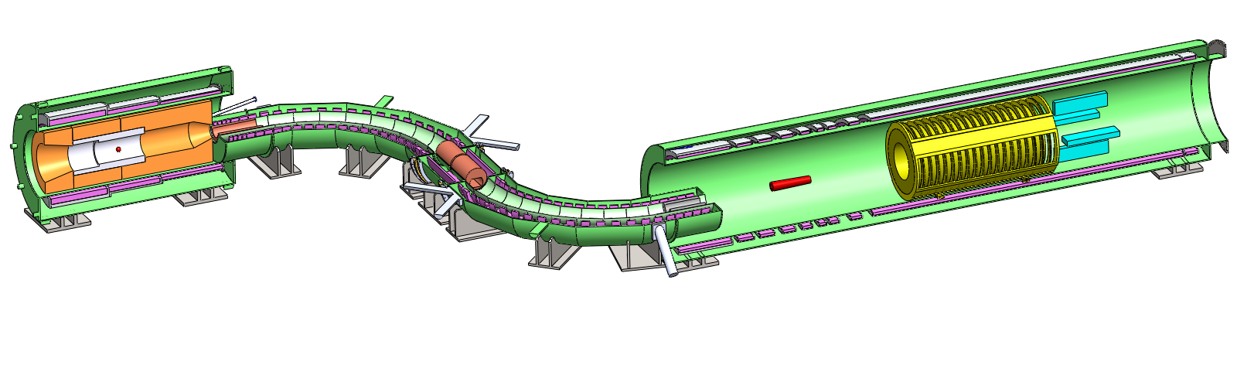
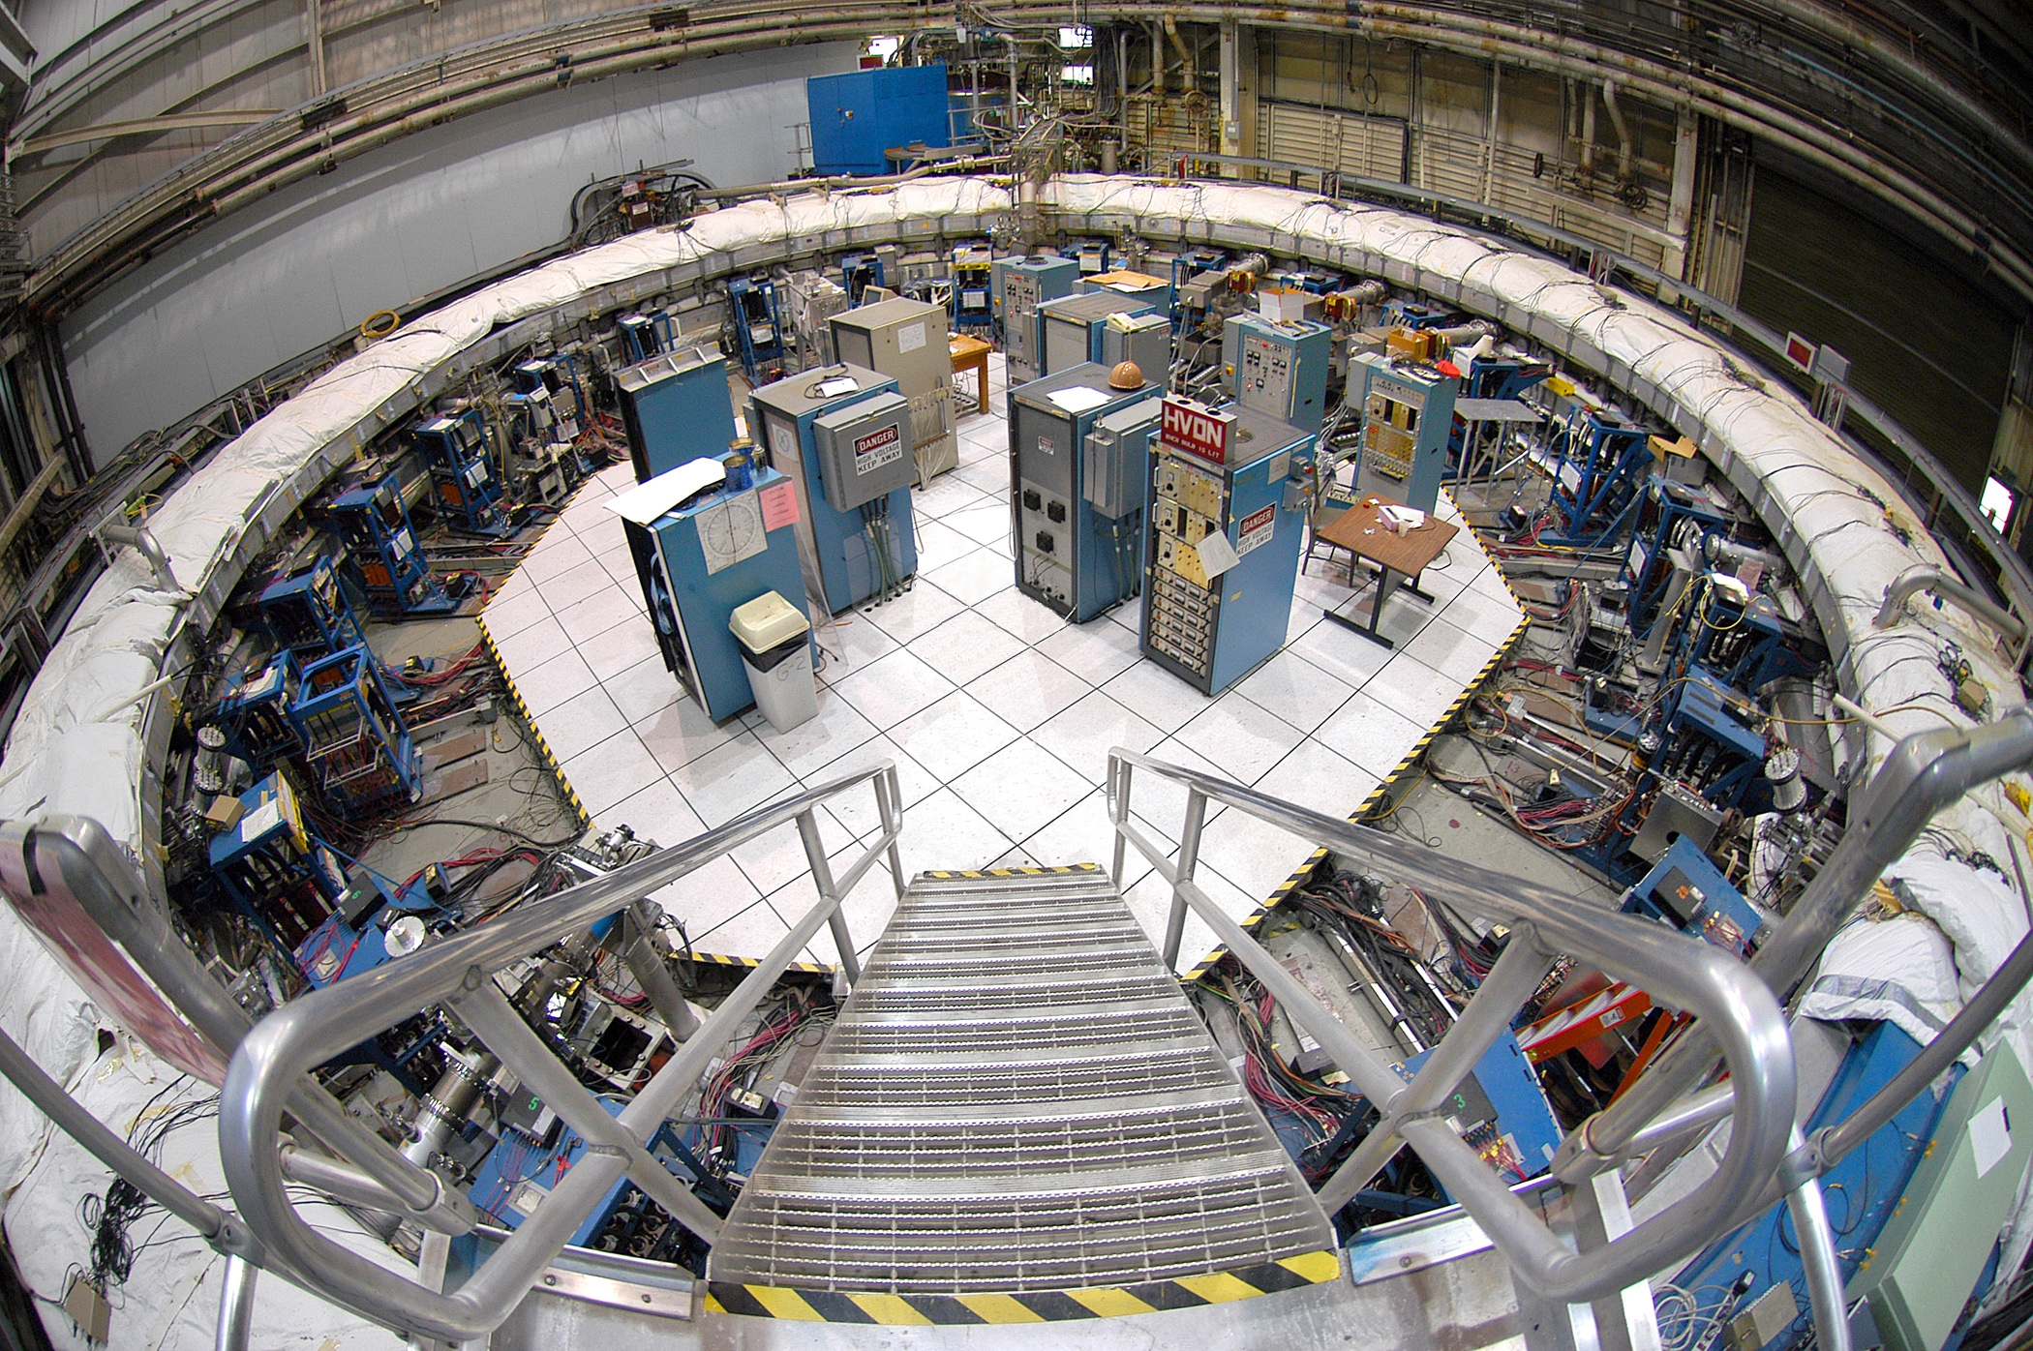
Muon Campus
new cryo
plant
Muon g-2
Mu2e
new tunnel
Mu2e
Muon g-2
13

Slide 14
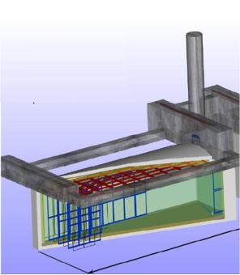
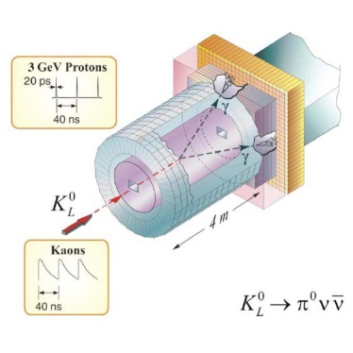
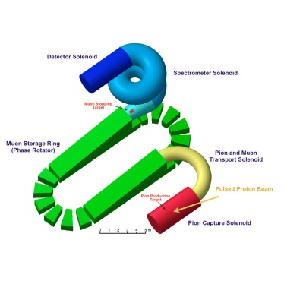
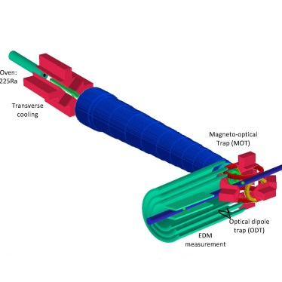
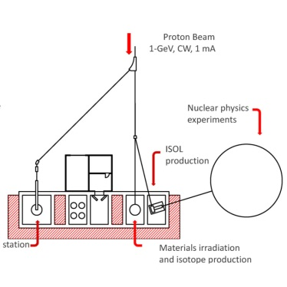
Project X: new experiments
Neutrinos
  Matter-antimatter asymmetry
  Neutrino mass spectrum
  Neutrino- antineutrino differences
  Anomalous interactions
  Proton decay
  SuperNova bursts
Kaons
  Physics beyond the Standard Model
  Elucidation of LHC discoveries
  Two to three orders of magnitude increase in sensitivity
Muons
  Oscillation in charged leptons
  Physics beyond the Standard Model
  Elucidation of LHC physics
  Sensitive to energy/mass scales three orders of magnitude beyond LHC
Nuclei
  New generation of symmetry-test experiments
  Electric Dipole Moments
  Three or more orders of magnitude increase in Francium, Radium, Actinium isotopes
Energy Applications
  Transmutation experiments with nuclear waste
  Spallation target configurations
  Materials test under high irradiation
  Neutron fluxes under various configurations relevant to ADS

Slide 15

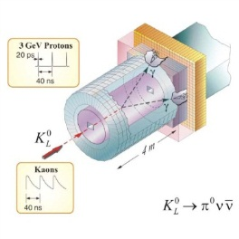

Project X and the big questions
Origin of mass for elementary particles?
Why is matter dominant?
What do neutrinos tell us?
  Do charged leptons oscillate?
  Why three families of quarks and leptons?
  Do the forces unify?
  Will protons every decay?
  Supersymmetry or other new symmetries?
  Extra dimensions?
  What is dark matter?
  What is dark energy?
neutrinos
muons
kaons
Nuclei
(EDMs..)

Slide 16
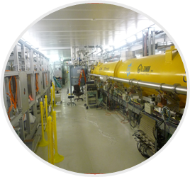
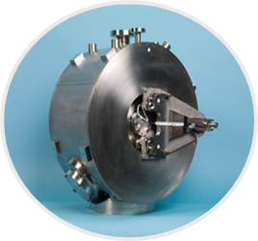
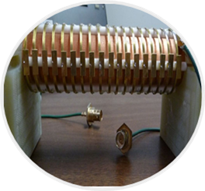
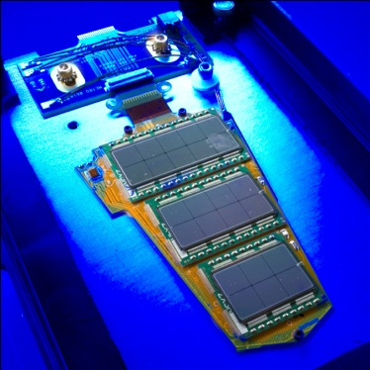
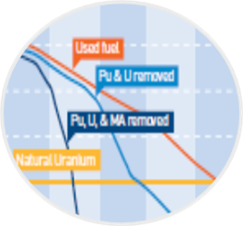
Project X: technology innovation
CW Linac Design
  Multi-MW/high duty factor (continuous wave) proton linac
  First of a kind, all superconductingRF design
  Low beam loss/high reliability
SRF Accelerating Modules
  State-of-the-art performance
  High Q₀/high gradient
  Low-β spoke resonators
  Medium-β elliptical resonators
  U.S. industrial development
Fast Chopper
  Revolutionary concept
  Programmable bunch patterns at 162 MHz
  Applications beyond HEP
Detector Development
  High speed electronics & triggering
  Rad hard detectors
  Large Liquid Argon Time Projection Chambers
  Cryo-electronics
  High power targeting
Transmutation
  MW-class CW beams at 1 GeV
  Technology demonstration
  Benchmarking experiments to validate concepts

Slide 17

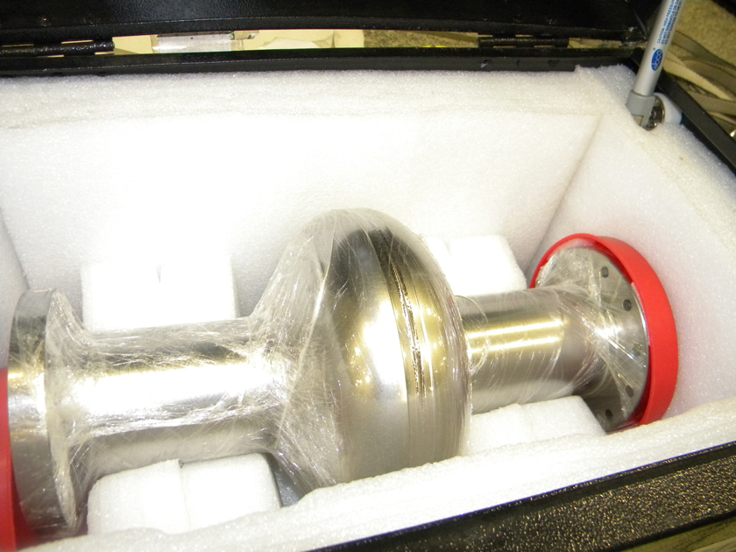
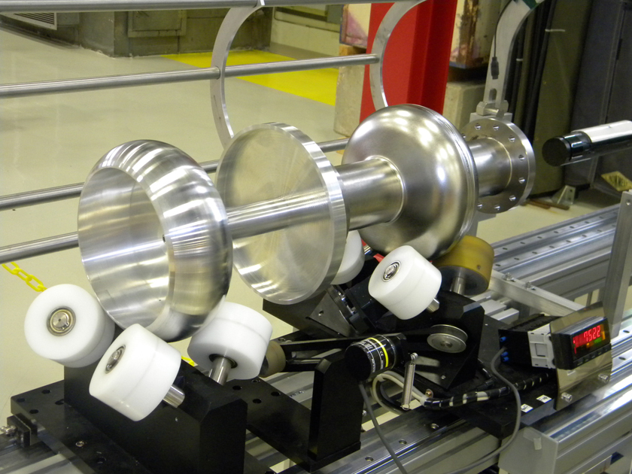
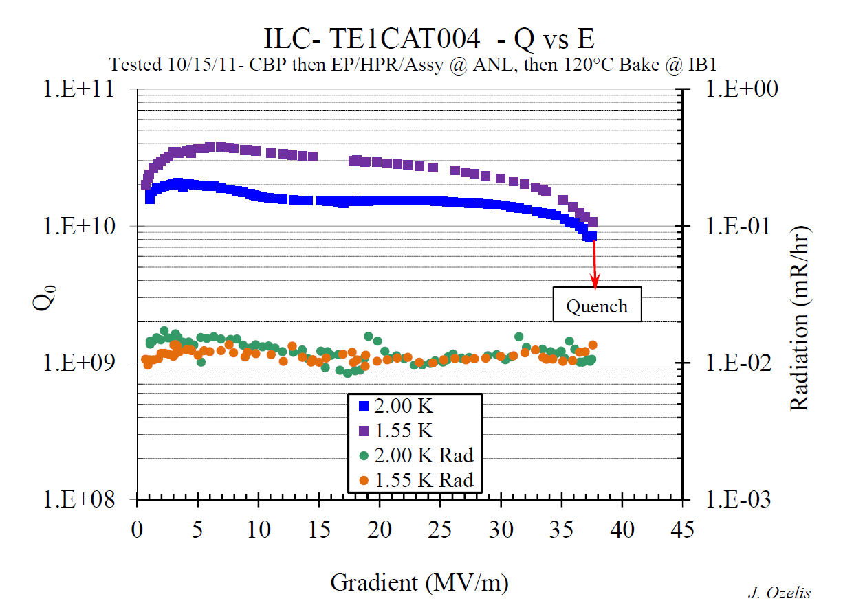
1.3 GHz Cavity Development
Fabrication of cavity at RRCAT in collaboration with IUAC
Processing and testing at FNAL/ANL joint facility
Notes:
Cavity Development

Slide 18
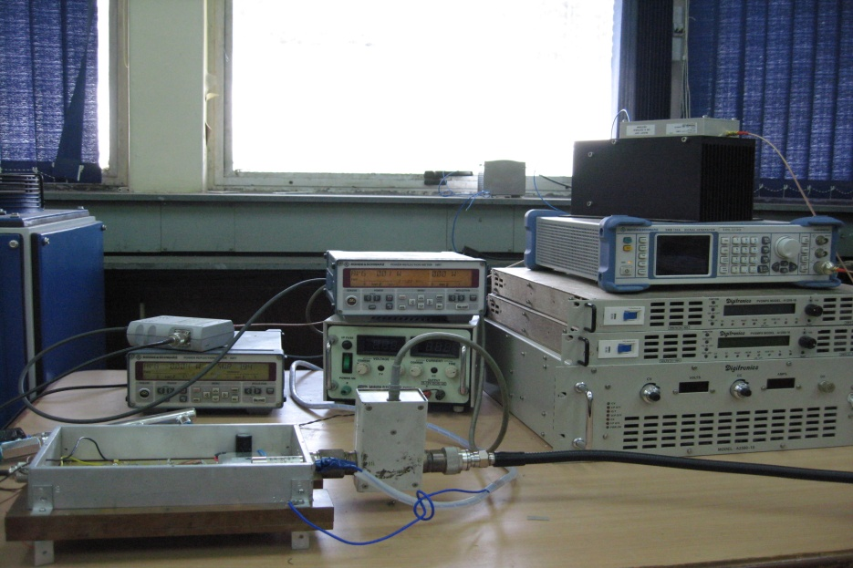
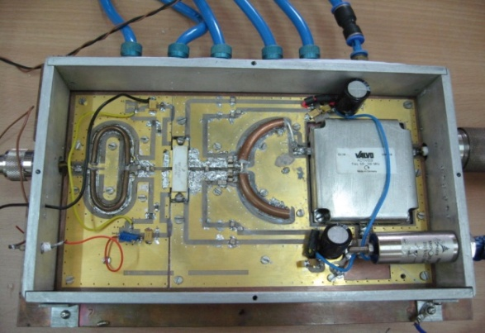
Solid-state Amplifiers at 325 MHz
BARC using the specifications provided by Fermilab is developing 325 MHz RF source for Project X.
Similar development is underway at RRCAT for 650 MHz
Preliminary test results
  Center frequency: 325 MHz
  Power output (CW): 834 W
  Gain: 22.2 dB
  Cooling: Water cooled
  Efficiency (total): 69.7%
1 kW RF module
Notes:
ALD of this will be in audiance

Slide 19
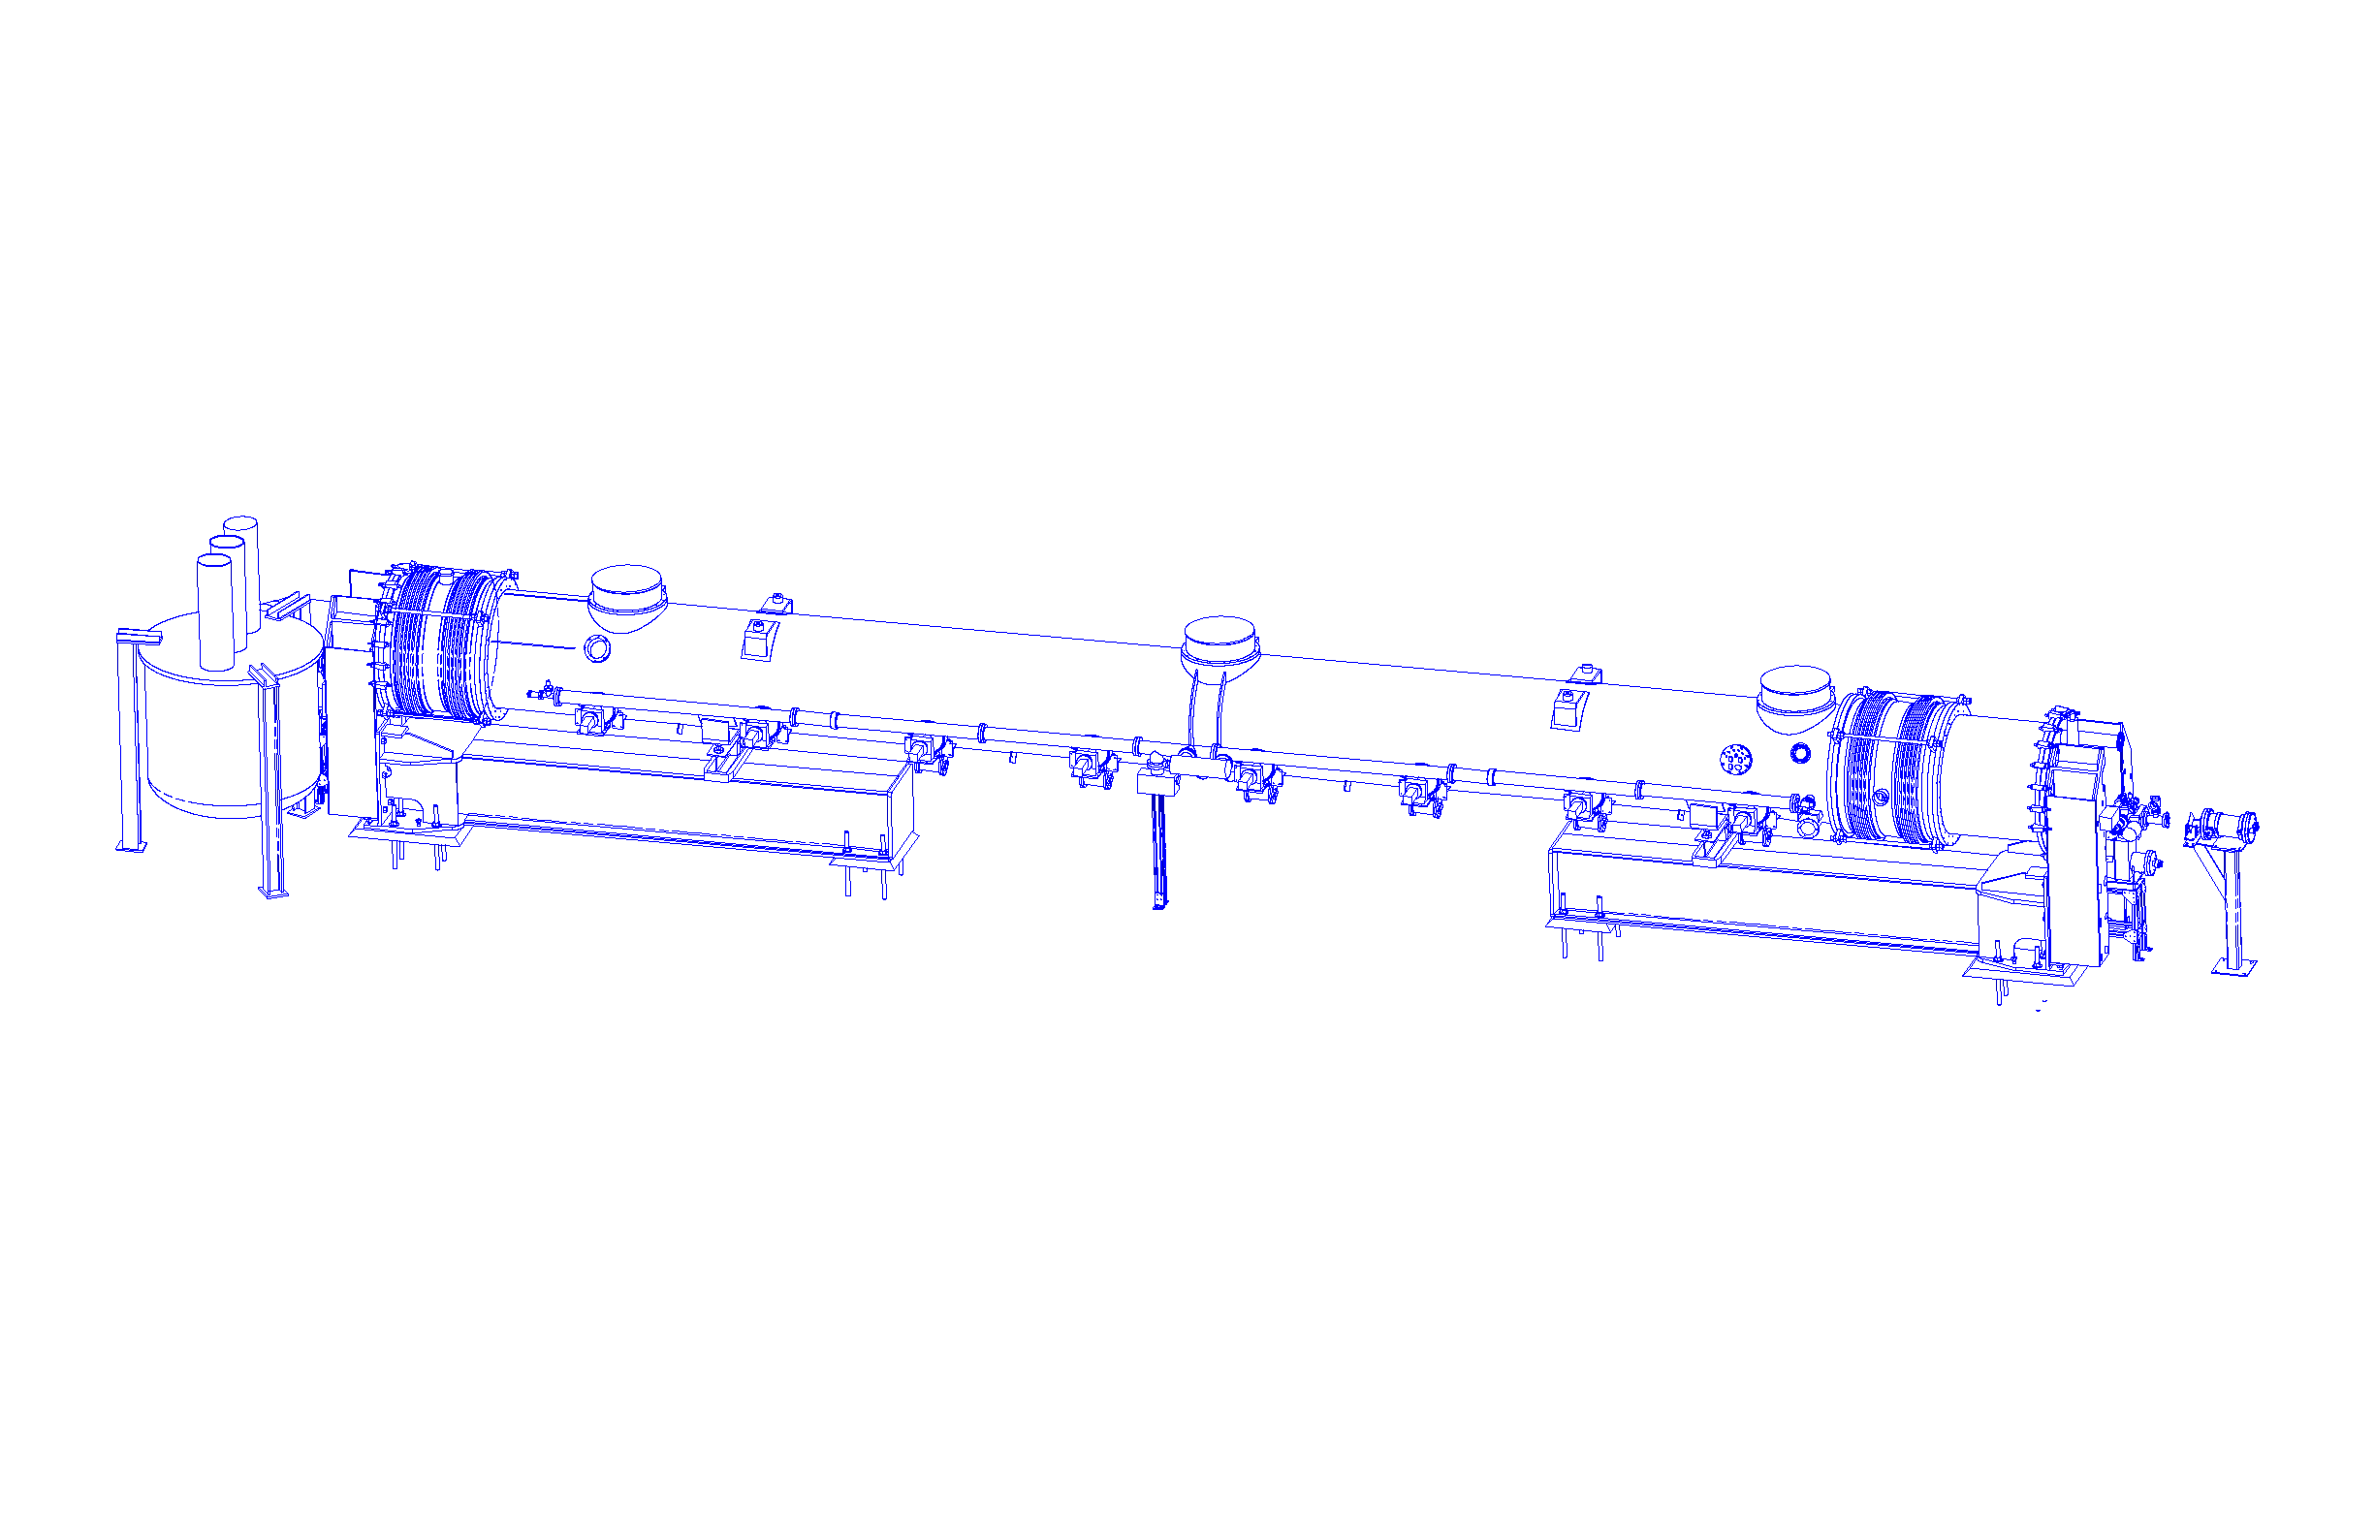
BARC: Cryomodule Test Stand
Conceptual Arrangement of Feed Box, Feed Cap, End Cap & Transfer Lines.
  Status: design and drawing of all three sub assemblies is taken up. Ready to order material
CMTF (FY 2016): 650 MHz CW test stands for project X
  Install shielding, RF, cryo for Project X test stands
  1300 MHz (pulsed) CM test stand (with India)
  650 MHz (CW) CM test facility (with India) ← Integrated system
Transfer line
Feed Cap
Cryomodule
End Cap
Feed Box
Notes:
Head of this division will be in audiance

Slide 20
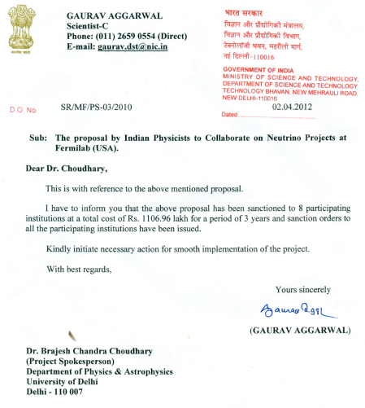

IIFC – ν P
Eight Indian Institutions joined Fermilab Neutrino Phys. Program
  MINOS, MINOS+
  LBNE
  NOvA
Expecting 20 Ph.D. students from India under this program.
  50% funded by Indian Governments
  Faculties participation & infrastructure in India fully funded by India
This collaboration is growing
  We continue to include more institutions
  Recruiting faculties and postdoctoral fellows.
$2.2M M&S
Notes:
Indian DAE/DST are really very supportive of this collaboration. Picture is of people here from India last year, mostly students.

Slide 21

Impressive Technical Work
Eight addendum (institutions-to-institutions MOU)
“Fermilab, RRCAT, BARC, IUAC and VECC Collaboration on ILC Main Linac SRF Accelerator Technology R&D” (Signed on: October 2, 2007)
“SLAC, RRCAT, BARC, IUAC and VECC Collaboration on ILC RF Power Sources and Beam Dump Design R&D” (Signed on: December 3, 2007)
“Fermilab and Indian Accelerator Laboratories Collaboration on High Intensity Proton Accelerator and SRF Infrastructure Development” (Signed on: February 10, 2009)
“US and Indian Institutions Collaboration on Neutrino Physics, Related Experiments and Detector Development” (Signed on: November 10, 2009)
“Fermilab and Indian Accelerator Laboratories Collaboration on RF Power Development for High Intensity Proton Accelerator” (Signed on: August 22, 2011)
“Fermilab and Indian Accelerator Laboratories Collaboration on RF Power Development for High Intensity Proton Accelerator” (Signed on: August 22, 2011)
“Fermilab and Indian Accelerator Laboratories Collaboration on Instrumentation and Control for High Intensity Proton Accelerator” (Signed on: August 22, 2011)
“Fermilab and Indian Accelerator Laboratories Collaboration on Accelerator Physics issues for High Intensity Proton Accelerator” (Signed on: August 22, 2011)
Aug 2011
Covering all aspects of Project X, Indian Accelerators and Fermilab Neutrino Program
Notes:
Eight Addendum institutions to institutions MOU

Slide 22


















Indian Institutions at Fermilab
until 2006
now
Notes:
How this collaboration has grown in last six years from three institutions to 15 and continues to grow.

Slide 23
Summary: Vision of Fermilab
Fermilab is going after the most exciting questions in particle physics, the most interesting questions about the nature and future of our universe.
Fermilab continues to operate most of its existing accelerators with enhanced capabilities and next generation experiments at the Intensity Frontier (operations in 2010s)
Fermilab will build new accelerators and experiments for the future (LBNE and Project X: operations in 2020s and beyond)

Slide 24
Projects and Programs: timeline

Slide 25
Summary: Fermilab-India Collaboration
Indian institutions’ strong participation in Fermilab’s experimental programs
  Science
  Training the next generation of scientists
Fermilab and Indian institutions have established a strong foundation for scientific and technical collaboration and have already made significant R&D, infrastructure and industrial progress. This could lead to
  Neutrino and Material Science Experiment
  Project X construction at Fermilab
  Construction of two vital accelerators in India
  Training the next generation of scientists and engineers

Slide 26
Backup slides

Slide 27
Particle Experiments: Operation Schedule
Accelerator Shutdown
Intensity Frontier
Energy Frontier
Cosmic Frontier
LHC Shutdown

Slide 28


Accelerator Improvement:
Booster, Main Injector, and Recycler

Slide 29




Injection Lamberstons for the New Recycler injection line
Cavity refurbishment
Main Injector (MI50) Vacuum Reconstruction

Slide 30




Construction: NOvA Near Detector
Prototype detector on surface
Near Detector underground (cavern excavation)

Slide 31




Construction: NOvA Far Detector
Block construction: 3 done, 25 to go!

Slide 32





Construction: MicroBooNE (LAr TPC)
Dzero assembly building

Slide 33


Muon g-2
Core drilling 5 weeks ago to verify composition
33

Slide 34


Mu2e
Production Solenoid
Detector Solenoid
Transport Solenoid
Calorimeter
Proton Beam
to Target
Tracker
Stopping Target
μ → e
Solenoid
prototype
Tracker R&D

Slide 35


Illinois Accelerator Research Center

