Slide 1

IIFC Activities at BARC
P. Singh
Head, Ion Accelerator Development Division
Bhabha Atomic Research Centre
Mumbai, India
IIFC Meeting Nov 26, 2012 Fermilab

Slide 2
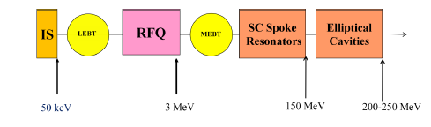
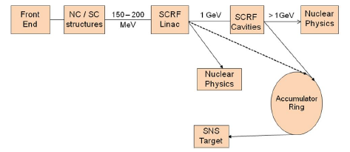
DAE Accelerator Development Program
DAE labs have proposed
  Physics Studies and Enabling Technology Development for Ion Accelerators (BARC)
  High Energy Proton LINAC Based Spallation Neutron Source (RRCAT)
1 GeV
BARC
RRCAT

Slide 3
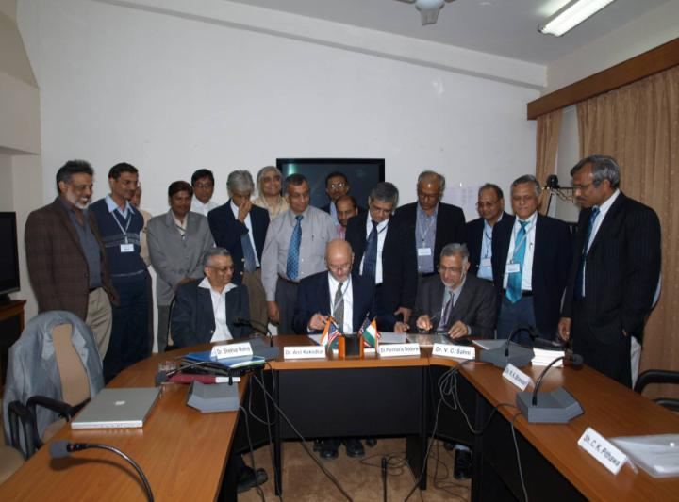
Indian Institutions & Fermilab Collaboration
Addendum III: Fermilab and Indian Accelerator Laboratories Collaboration on
High Intensity Proton Accelerator & SRF Infrastructure Development
RRCAT, Indore
February 10, 2009

Slide 4
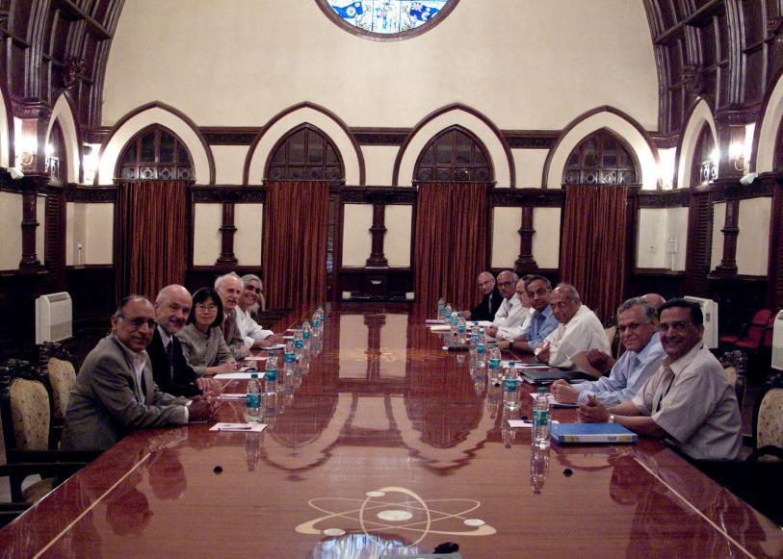
Signing of addendums at Mumbai on Aug 22, 2011

Slide 5
Activities at BARC under IIFC
1. Accelerator Physics (P. Singh)
2. Solid State Power: 1, 3 & 7 kW SSPA
at 325 MHz ( Manjiri Pande)
3. LLRF system, RF protection interlock system,
CMTS control system, Beam Position Monitor
(Gopal Joshi)
4. Design and development of CMTS (A.K. Sinha)
5. RF Couplers (325 and 650 MHz) ( Rajesh Kumar)
6. Magnets for MEBT (S. Malhotra)
7. Design and development of SSR2 ( Rao & Malhotra)

Slide 6
Accelerator Physics
Physics of High Intensity beams
(working together under IIFC)
Beam Dynamics
Cavity design
Halo formation
Space Charge Effects
HOM
Codes writing

Slide 7
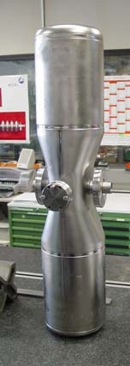
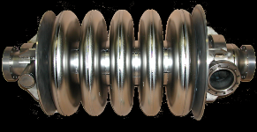
Cavity Details
IS
RFQ
HWR
SR
Elliptic cavities
50 keV
3 MeV
10 MeV
160 MeV
Half-wave resonator
5-cell elliptic cavity
Spoke cavity

Slide 8
Design of Accelerating structures for a high current (tens of mA), 1 GeV, CW proton linac
Study of SC structures like HWR, SSR…
Detailed EM design of the resonators
Optimization of cavity design using MWS, HFSS…
Study and design of multi-cell elliptical cavities at 650 MHz
Detailed EM design studies to decide the transition energy between the structures and geometric beta of cavities
Study of HOM and their minimization by devising appropriate shape of the cavity.
Microphonics

Slide 9
Frequency: 325 and 650 MHz
Scheme for 200 MeV High Intensity Proton Accelerator
(a front end of the 1 GeV Linac)
IS
RFQ
SC Spoke
Resonators
Elliptical
Cavities
Elliptical Cavities
LEBT
MEBT
50 keV
3 MeV
150 MeV
200 MeV
1 GeV
We will go in steps but the design needs to be done for 30 mA

Slide 10
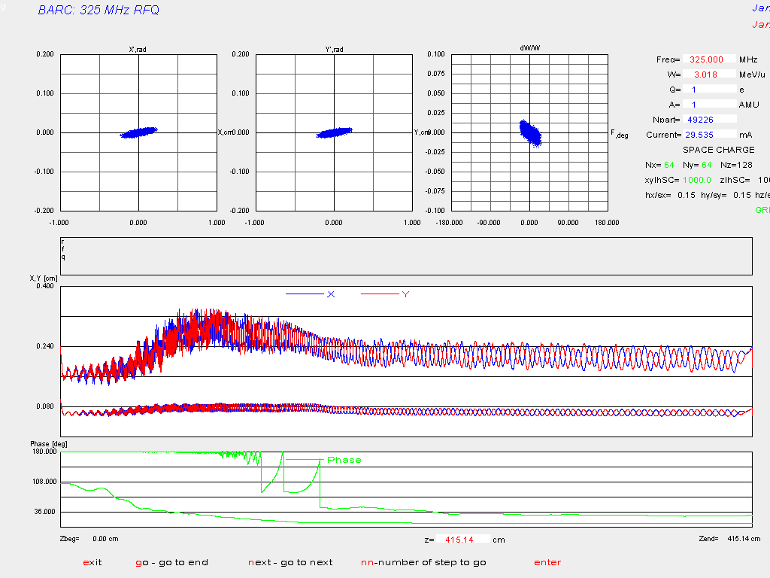
Preliminary Design (200 MeV)
RFQ
Energy | 35 keV-3 MeV
Frequency | 325 MHz
Current | 30 mA
Vane Voltage | 78 kV
Length | 4.15 m
R₀ | 3.634 mm

Slide 11
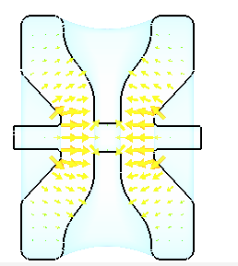
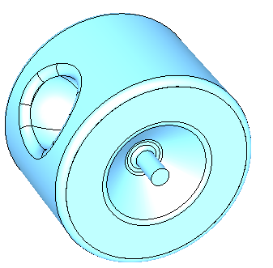
Preliminary Design (200 MeV)
Optimization of SSR2 cavity
Parameter | Values
Geometrical beta | 0.4
frequency | 323.92 MHz
Peak electric field | 9.15 MV/m
Peak Magnetic Field | 13.66 A/m
Radius | 26.13 cm
Cavity Length | 36.81 cm

Slide 12
Elliptical Cavities 650 MHz
Parameters | β_{G} = 0.6 | β_{G} = 0.8
No. of Cells | 5 | 5
Diameter (cm) | 39.34 | 38.54
Dome B (cm) | 2 | 2
Dome A/B (cm) | 1.9 | 2.4
Wall Angle (deg) | 8 | 7
Iris a/b (cm) | 0.8 | 0.6
Bore Radius (cm) | 4.0 | 4.0
Equator Flat (cm) | 0.5 | 1.2
Acc. Gradient (MV/m) | 15 | 15

Slide 13
Beam dynamics of SC linac
IS
RFQ
MEBT
SSR0
SSR1
SSR2
5 cell elliptic cavity
β=0.11
β=0.22
β=0.4
325 MHZ
650 MHZ
Sections | Cavities | Cryomodule | Energy @ end (MeV)
SSR0 | 18 | 1 | 10.98
SSR1 | 20 | 2 | 42.57
SSR2 | 40 | 4 | 160.53
Beta =0.6 | 12 | 2 | 268.41

Slide 14
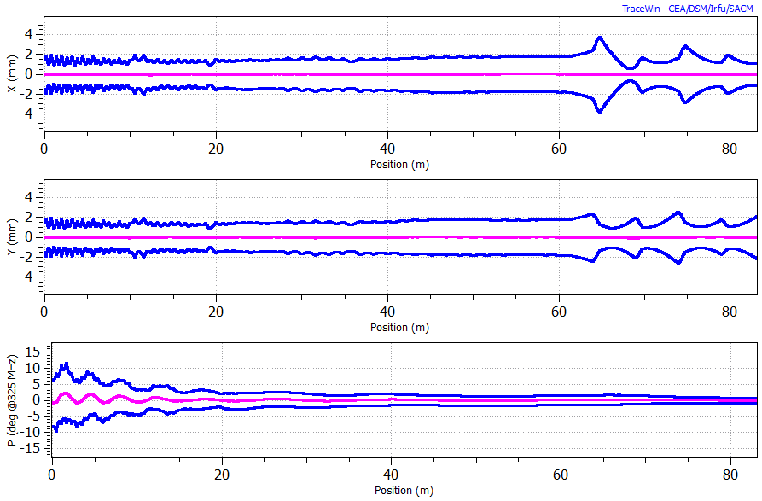
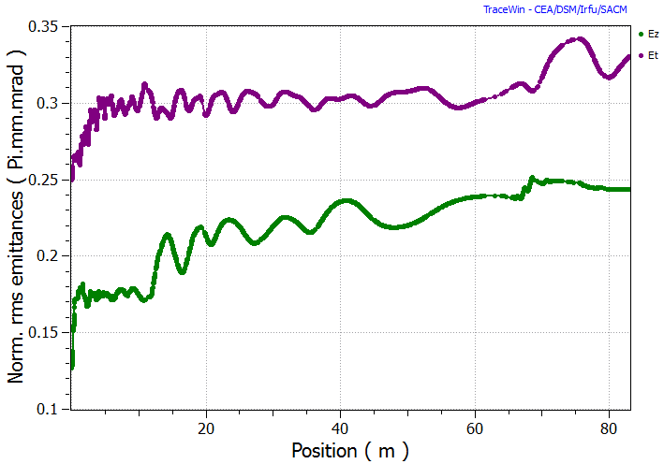
Preliminary Design (200 MeV)
Beam envelope in the SC LInac
Emittance evolution in the SC linac

Slide 15
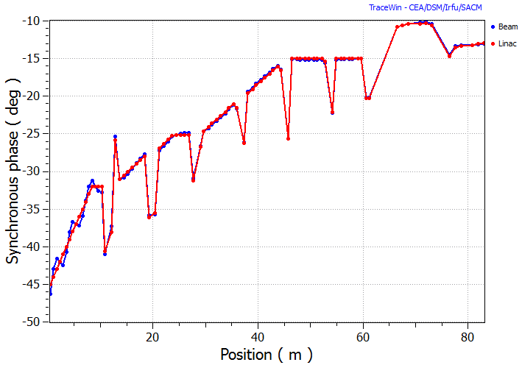
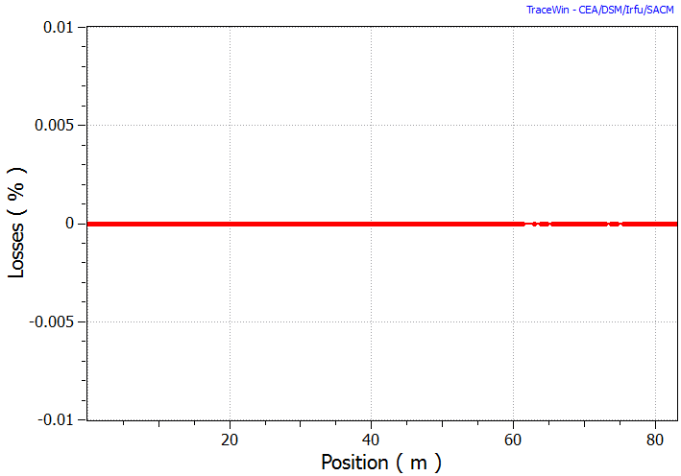
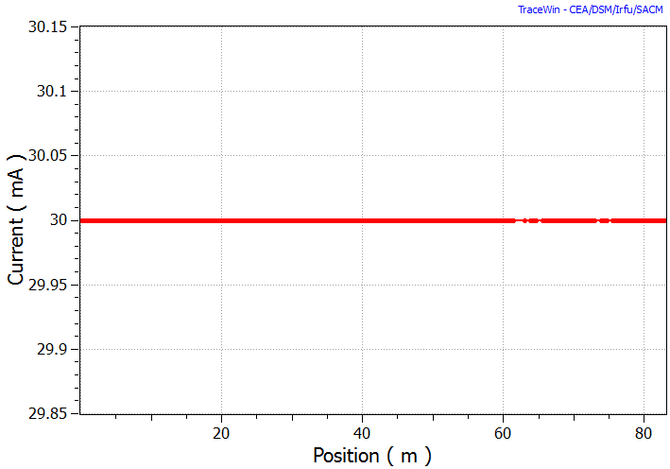
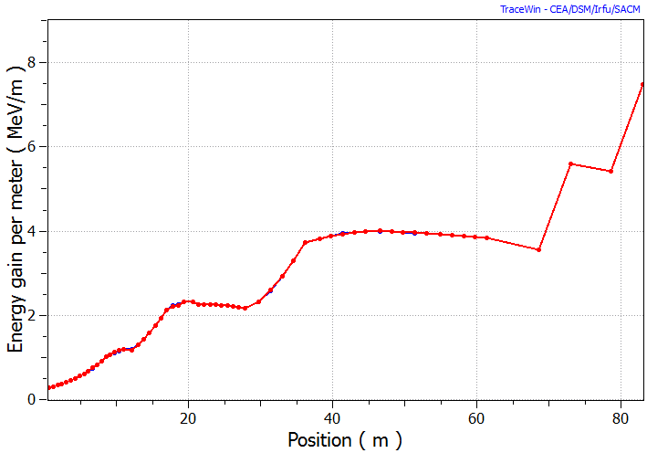
Beam Dynamics
Synchronous phase
Beam losses
Beam current
Energy gain

Slide 16
Solid State RF Power Amplifiers
Development of 325 MHz Solid-State RF Power Amplifiers for Project X,
under Addendum-V of IIFC
Deliverables under IIFC (Addendum V)
1 kW, 325 MHz, solid state power amplifier
3 kW, 325 MHz, solid state power amplifier
7 kW, 325 MHz, solid state power amplifier
Nov , 2012
Manjiri Pande, IADD

Slide 17
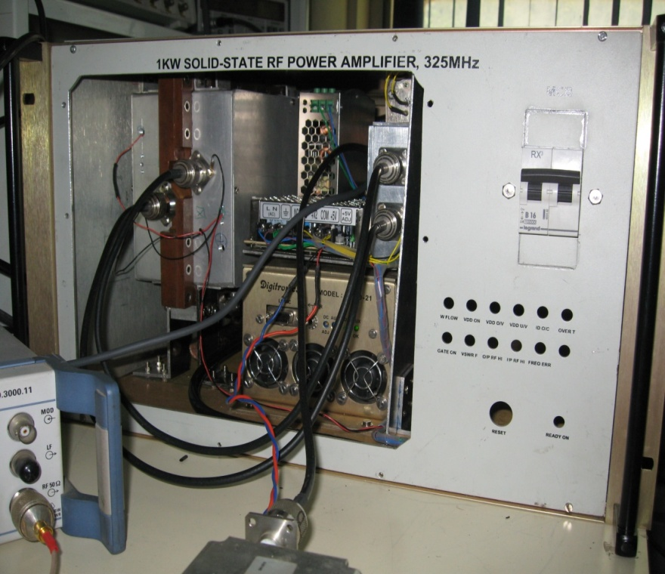
325 MHz, 1 kW Amplifier
1 kW power amplifier assembly with 6 U rack (integration of interlock & protection system is underway)
After three design iterations and their evaluation, basic (1 kW) amplifier module board has been finalized.
The 1 kW whole unit has been tested at 1.2 kW for six hours for three consecutive days.
No deviation was observed in amplifier parameters. Further long term testing and evaluation is underway.
325 MHz, 1 kW unit under testing
Nov , 2012
Manjiri Pande , IADD

Slide 18
Test Results of 1 kW unit
RF Power (kW) | Gain (dB) | Efficiency (DC/RF) (%) | Power @1 dB compression | Harmonics (dBc)
1.0 | 23.1 | 62.5 | -- | 2nd : 41.5 3rd : 52.0
1.4 (max.) | 21.7 | 68.0 | 1.35 kW
Recently same unit has been tested for 1.8 kW for
short duration with some modifications
Nov , 2012
Manjiri Pande, IADD

Slide 19
325 MHz, 3 kW SSRFPA
Detail evaluation of the same will be done. Assembly and overall integration of this SSRFPA is in progress.
Four RF amplifier modules have been tested up to 900 Watt (max). Then, in the combined operation, they are operated at 750 W and 800 W & combined to get 3 kW and 3.2 kW respectively. The combined performance (prototype) is as,
 | Combined Output power (W) | Efficiency (DC/RF) % | Gain (dB) | comments
1 | 3000 | 69.76 | 21.5 | Short term testing
2 | 3200 | 71.27 | 21.5 | Short term testing
Nov , 2012
Manjiri Pande, IADD

Slide 20
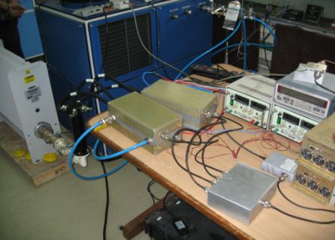
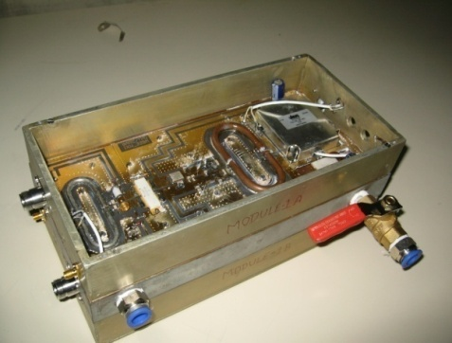
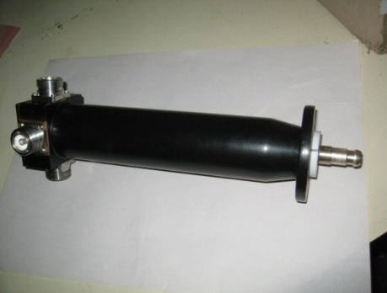
325 MHz, 3 kW unit
Prototype testing of 3 kW RF amplifier
Two 1 kW RF units mounted back to back on heat sink
3 kW power combiner
Nov , 2012
Manjiri Pande, IADD

Slide 21
IIFC: Control &Instrumentation
C&I for CMTS
  RF Protection Interlock System ( RFPI )
  Low Level RF (LLRF) Control System
  CMTS Control System
Beam Position Monitor (BPM)
Two systems taken up for development in the first phase:
RF Protection Interlock System(RFPI)
Low Level RF (LLRF) Control system
Gopal Joshi, ED

Slide 22
Functions for RFPI System
The RF Protection Interlock (RFPI) system continues to monitor the high power RF (HPRF) system during the entire power ON period and protects it by opening the fast switch at the output of LLRF within 1-2 microseconds of detection of any fault condition.
The RFPI system inhibits the modulator in case the same fault is observed on three consecutive pulses, thereby removing the DC power source to the klystron.
Notes:
The RF Protection Interlock (RFPI) system continues to monitor the high power RF (HPRF) system during the entire power ON period and protects it by opening the fast switch at the output of LLRF within 1-2 microseconds of detection of any fault condition.
The RFPI system inhibits the modulator in case the same fault is observed on three consecutive pulses, thereby removing the DC power source to the klystron.

Slide 23
RFPI
Received all the schematics and other technical literature during Gopal’s Visit to Fermilab during Oct -Nov 2011
Detailed technical discussion with Peter and Manfred on the existing system during their visit to BARC in April 2012
Improvements in the existing systems were also discussed during this visit

Slide 24
Progress so far
Mechanical and electrical specifications for Mezzanine card based design was worked out during Paresh Motiwala’s visit to Fermilab during July-Aug 2012
Mechanical design of Cable connect detection assembly has been finalized
Peter has suggested development of new System Control board having all the features of the existing board with additional PMT channel, ADC and memory. The same is in an advanced stage of design.
Development of Multi-trip board based on the mezzanine board approach has been initiated.
Notes:
A brief design report showing block diagram of the proposed system control board with the placement of ADC, RAM, FPGA, PMT and RF leakage channels was submitted to Fermi Lab and was approved by them. The detailed schematics of the new system control board are being prepared which will be reviewed by Fermi Lab before fabrication of the module.
In order to speed up the overall development it was also decided to simultaneously start the design and development of Multi-trip board based on the new mezzanine board approach. This approach consists of a common carrier board accommodating ADC, Memory, VME interface and digital glue logic and a mezzanine board accommodating analog and RF sections that are unique to each module.
Multi-trip module will be fabricated in mezzanine card format to study the performance of the mezzanine bus and evaluate the performance of LVDS v/s parallel bus data transfer.

Slide 25
LLRF Control System
Fermilab has provided technical documentation of the existing boards for NML.
Some of the major specifications such as number of ADC/DAC channels, FPGA and DSP to be used have been formulated.
Current LLRF digital board is of size 6U based on VXI bus. Fermilab has suggested to upgrade to a new bus interface.
It is expected that the Fermilab will soon finalize the bus standard to be adopted for the next generation of LLRF
.

Slide 26
LLRF Control System
BARC has developed digital self-excited loop based RF Control System for super-conducting resonators, which has been successfully tested at BARC-TIFR Linac during a recent run.
Digital LLRF for LEHIPA based on Generator Driven Resonator architecture is in an advanced stage of development

Slide 27
Beam Position Monitor
Exact Specifications are expected from Fermilab
The development of electronics system for the BPM for SPIRAL2, GANIL was also presented to Fermilab team. The design has been reviewed by a team of GANIL experts and is currently under fabrication.

Slide 28
CMTS -2 C&I
Specifications of control system for CMTS-2 are yet to be finalized.
Documents on the existing CMTS at Fermilab can be a good start, if made available.

Slide 29
High power couplers
Rajesh Kumar, IADD, BARC , participated in the following high power coupler related studies during his visit to Fermilab ( 26th June - 20th Aug. 2012)
Electromagnetic design simulations of 30 kW, 325 MHz Project-X (PX 325 ) and 650 MHz, 120 kW Project-X (PX 650)
Multipacting simulations of PX Couplers
Static and dynamic thermal analysis
Discussions towards understanding PX 325 manufacturing drawings and Technical specification document
High power conditioning of 1.3 GHz coupler
Rajesh Kumar, IADD

Slide 30
High power couplers
Proposed to take up fabrication of one prototype each of PX 325 MHz and PX 650 MHz couplers in India.
The design details of 30 kW, PX325 coupler are made available by Fermilab. Fabrication is being taken up (2013).
Complete design details of PX 650 coupler are not available. Needs more discussions (2014).
Present status of prototype fabrication:
Vendor’s for supplying metallized alumina have been identified.
It is planned to take up the fabrication of RF window part first as it is most critical. Vendor’s have been identified for this job.
We are in the process of identifying vendors for TiN coating on alumina.

Slide 31
Cryo-Module Test System
Development
of
Cryo-Module Test System (CMTS-1)
for Fermi Lab
Status: November 2012
S.B. Jawale, CDM

Slide 33
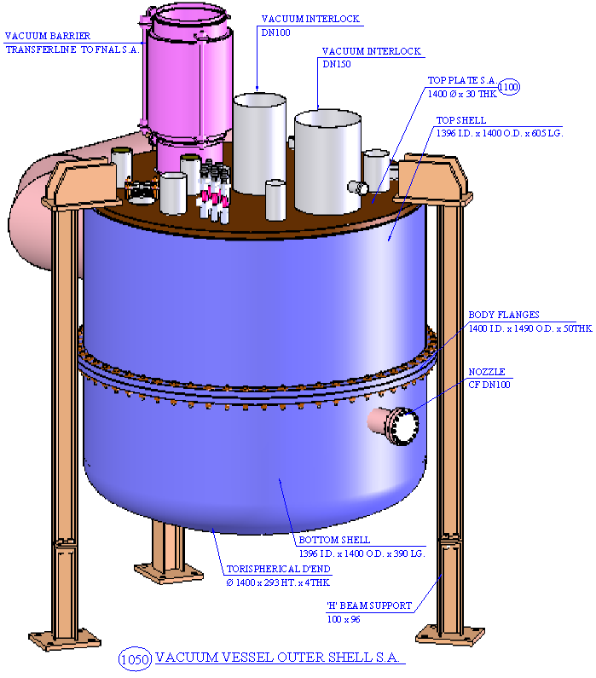
Feed Box (Outer View)
S.B. Jawale, CDM

Slide 34
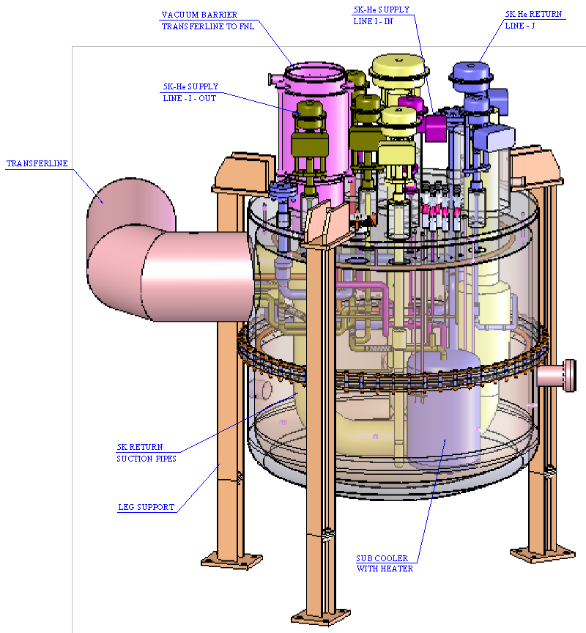
Feed Box (Inner details)
S.B. Jawale, CDM

Slide 35
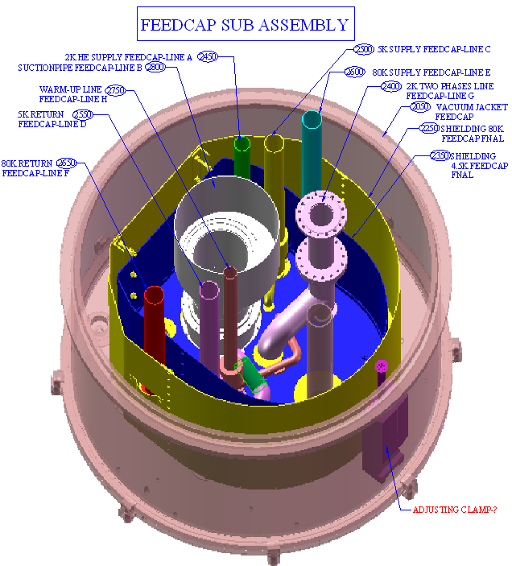
Feed Cap Subassy
S.B. Jawale, CDM

Slide 36
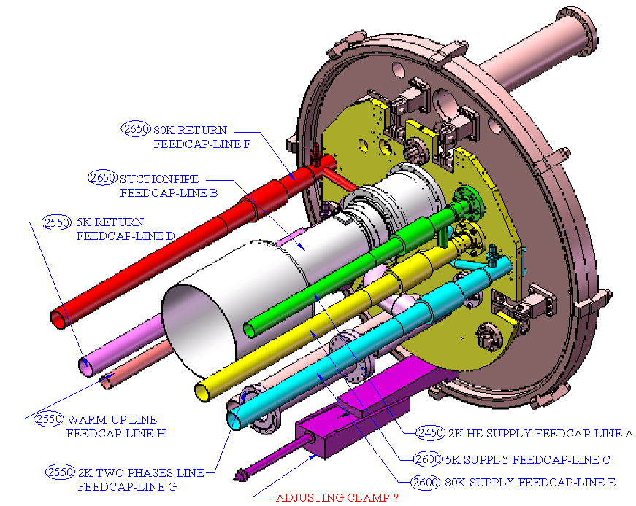
Feed Cap Subassy

Slide 37
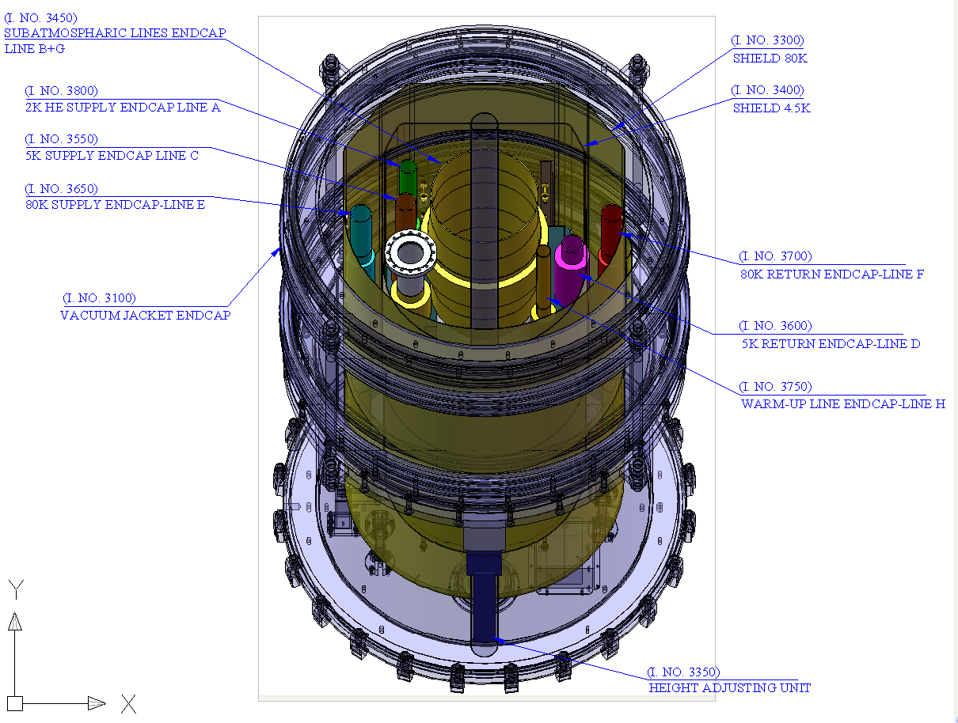
End Cap Subassy
S.B. Jawale, CDM

Slide 38
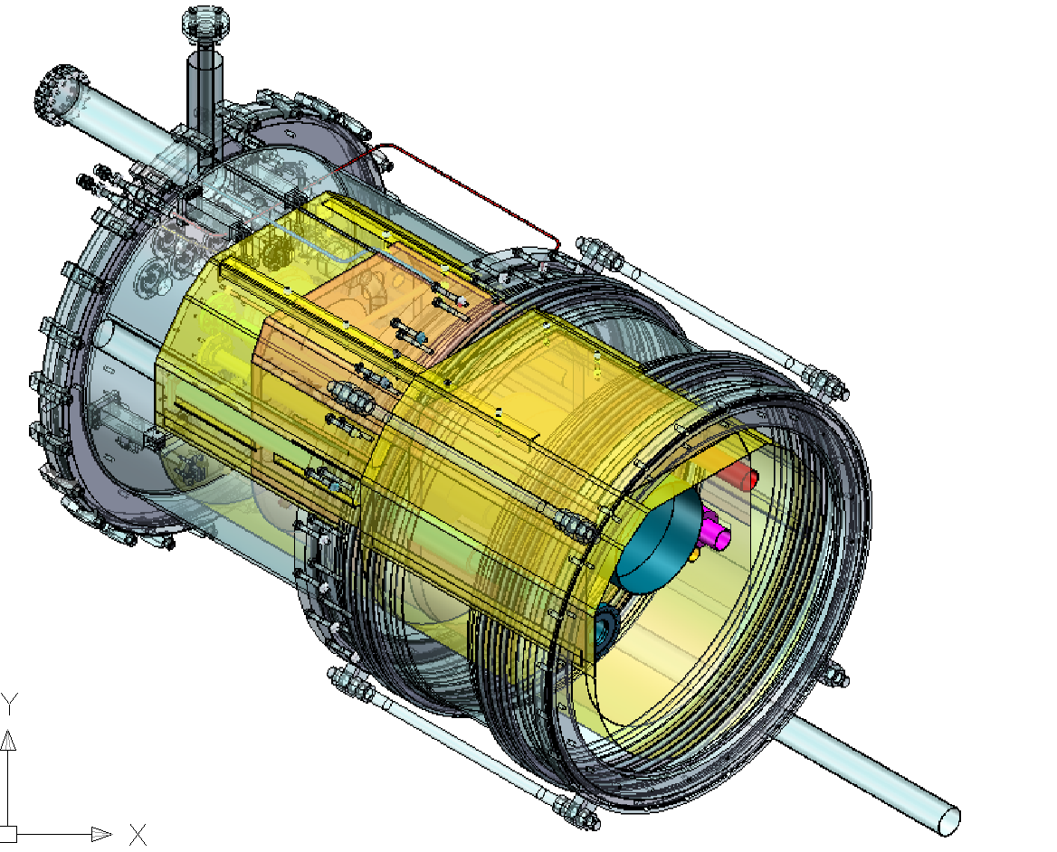
End Cap Subassy.
S.B. Jawale, CDM

Slide 39
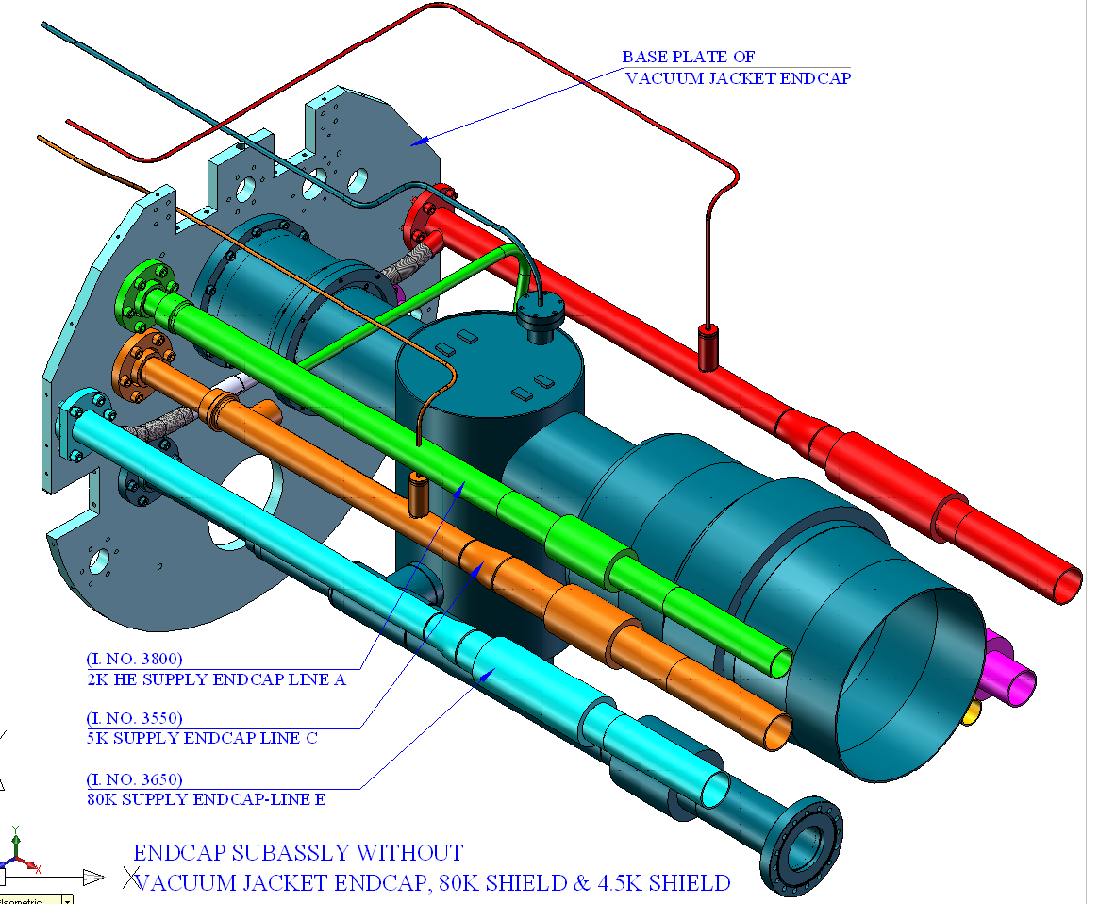
End Cap Subassy.
S.B. Jawale, CDM

Slide 40
Cryo-Module Test System
Specifications for Raw Materials:
  All materials shall be of SS-304/304L.
  Chemical composition shall be as per ASTM A-213 or A-269 for tubes and ASTM A-240 for plates.
  Material shall be in solution annealed condition.
  Tubes shall be pickled, Hydro tested and polished.
S.B. Jawale, CDM

Slide 41
Cryo-Module Test Stand
Specifications for Raw Materials:
  Inter-granular corrosion test (A-262 practice E) shall be conducted in accordance with the supplementary requirement of ASTM-A-269 or A-213 on a sample drawn on each lot of tubes.
  Hardness test: Brinell or Rockwell test on one specimen from two tubes from each heat treated lot. The result shall conform to the hardness requirement table of A-213 or A-269. All 304/304L material shall have Hardness of HRB 90 max.
  Tensile test shall be carried out on a representative sample from each lot.
S.B. Jawale, CDM

Slide 42
Cryo-Module Test System
Specifications for Raw Materials:
  Flattening test shall be carried on specimen from each end of one tube in each lot. The results shall conform to the requirements of ASTM-A-213 or A-269.
  Impact Strength: Material should have impact strength both at room temperature and at cryogenic temperatures as per the requirements of European standards prEN 13445-2 (UFPV-2) ((min. 60 J (44 ft-lb) at -270 ºC (-455 ºF) and prEN 10216-5 (min. 60 J (44 ft-lb) at -196 ºC (-320 ºF).
S.B. Jawale, CDM

Slide 43
Cryo-Module Test System
Status as on 15 Nov 2012 :
3D Models of Feed Box, Feed Cap, End Cap have been uploaded in to SharePoint on 07-08-2012.
Specification of standard valves is uploaded in to SharePoint on 05-07-12. Approval for the same is awaited from FNAL to raise the indent for procurement.
Indents have been raised for procurements of structural raw materials i.e. plates, tubes etc.
S.B. Jawale, CDM

Slide 44
Cryo-Module Test System
Under progress:
First stage 2D assembly and sub-assembly drawings with bill of raw materials are completed. Drawing checking is under progress.
Detailed engineering drawings and drawing checking of all four subassemblies are under progress. Over all progress is 25%.
Preliminary drawings of assembly and subassemblies were uploaded in to share point on 03-08-2012 for initial review only.
Detailed Engineering design is under progress.
S.B. Jawale, CDM

Slide 45
Wedge Cavity Tuner
A prototype Wedge Cavity Tuner has been Designed and
development at Center for Design and Manufacture (CDM),
BARC, Mumbai, India.
Proof assembly was done at CDM, BARC
Mechanical test (without RF) against resistance offered by springs having equivalent stiffness was done both at room temp and at -95 ⁰C and functioning was found satisfactory.
It is being shipped to FNAL to test it in 1.3 GHz Cryo-module.
S.B. Jawale, CDM

Slide 46
Wedge Cavity Tuner
S.B. Jawale, CDM
Work to be done at FNAL
UHV compatible Motor ( one no.) is to be integrated.
UHV compatible Piezo actuators (two nos) are to be integrated.
Drives, Controller and s/w are to be integrated before actual performance testing in 1.3 GHz Cryo-module.

Slide 47
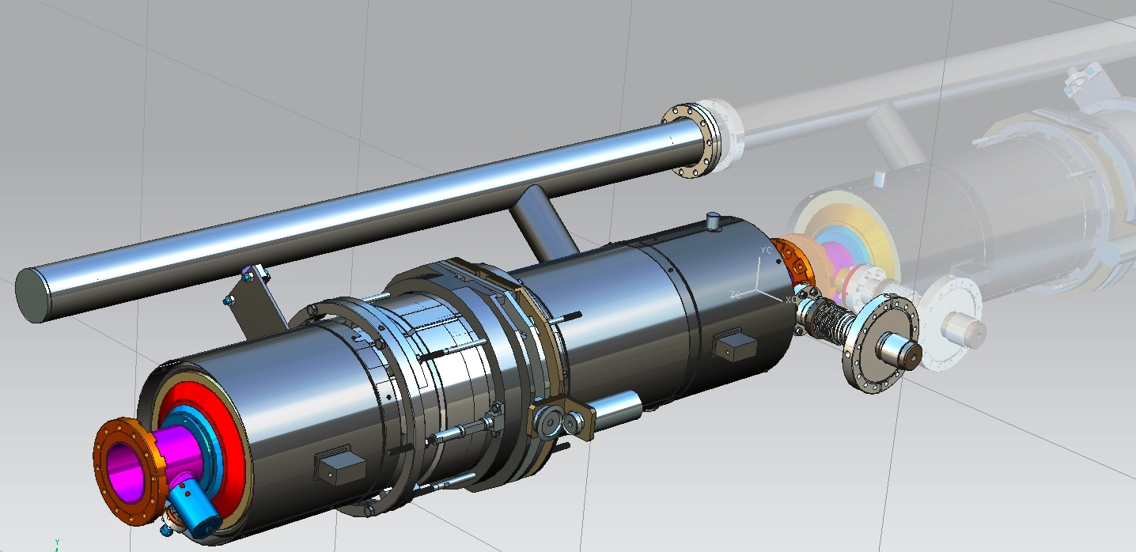
Wedge Cavity Tuner
Wedge Tuner
Tuner installed around Helium Vessel
S.B. Jawale, CDM

Slide 48
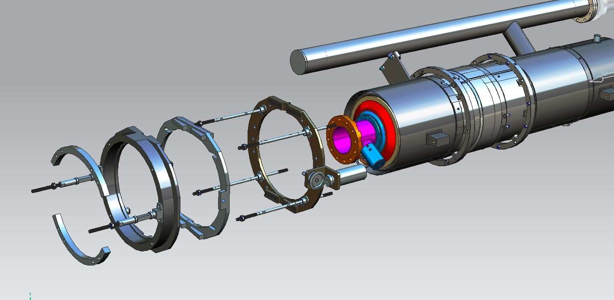
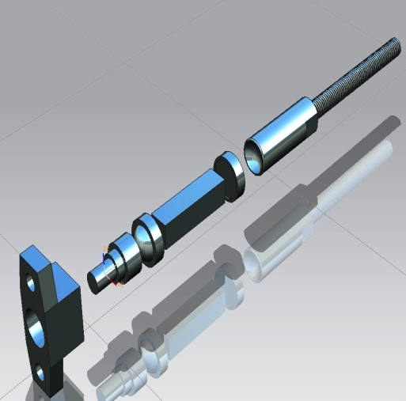
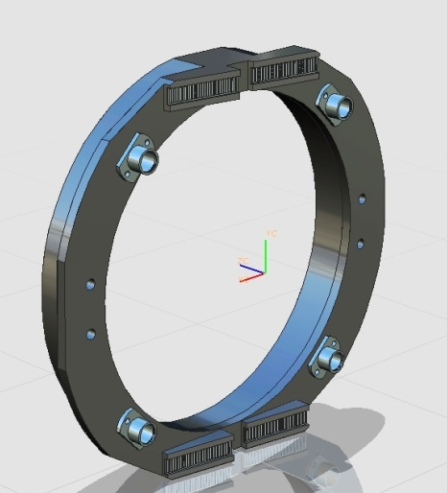
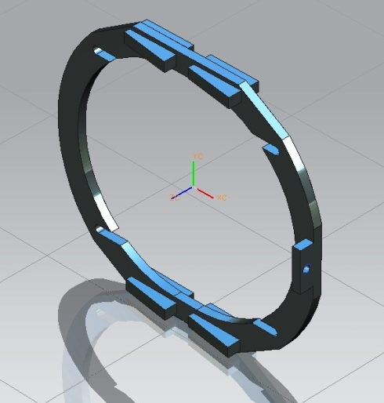
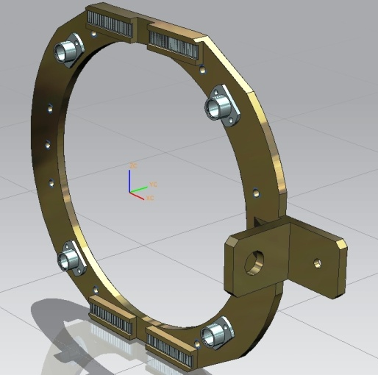
Guide Rods (4 nos )
Interface Ring (2 nos )
Piezo Outer Wedge Plate Sliding Wedge Plate Fixed Flat Plate
sub assembly sub assembly sub assembly sub assembly

Slide 49
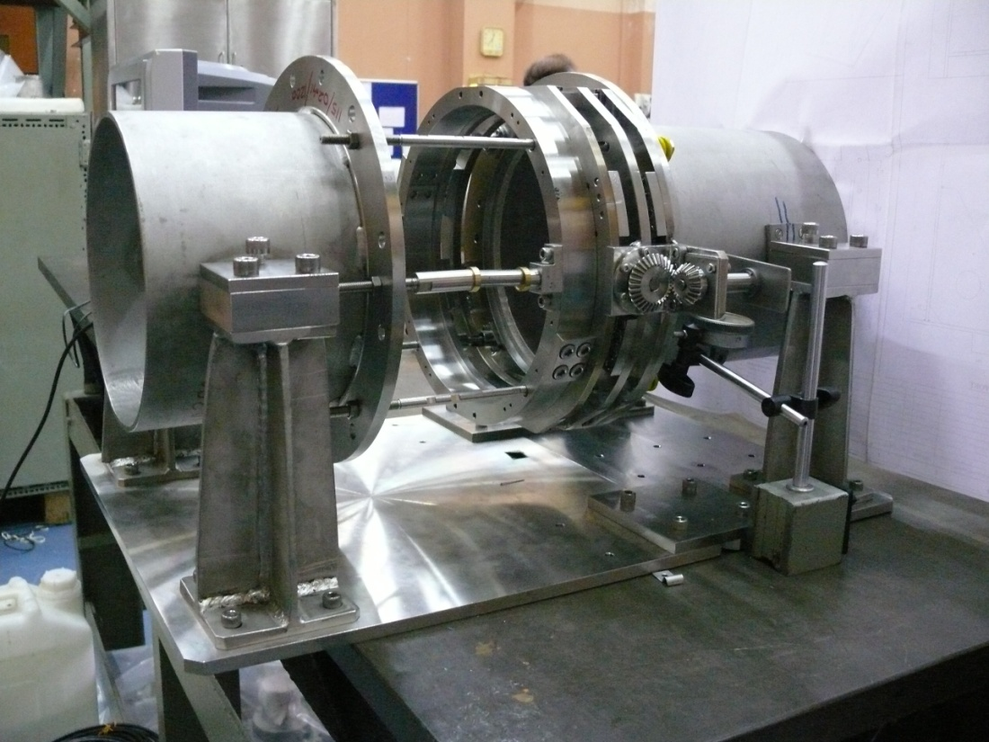
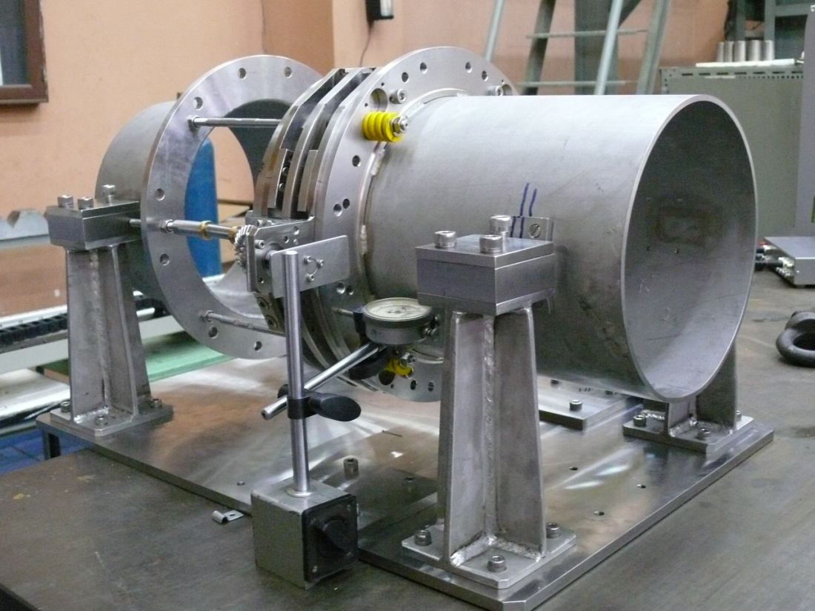
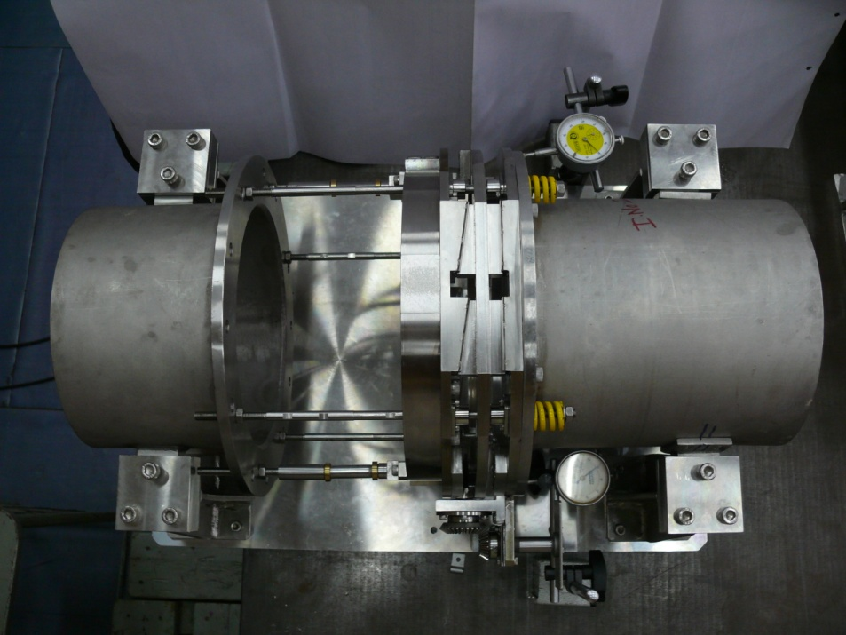
Thank you
Wedge Tuner Mock up Assembly at CDM
S.B. Jawale, CDM

Slide 50
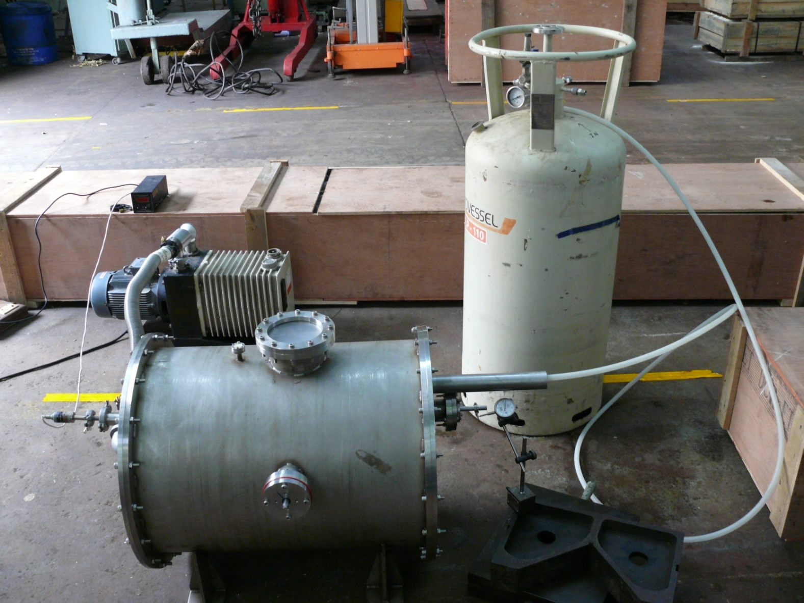
Wedge Cavity Tuner
Thank you
Wedge Tuner setup for testing at LN2 temp
S.B. Jawale, CDM

Slide 51
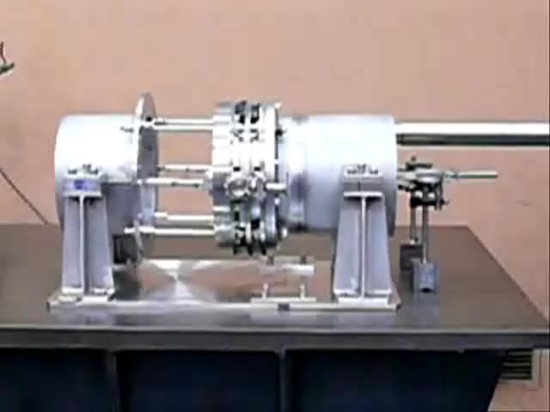
Wedge Cavity Tuner
S.B. Jawale, CDM

Slide 52
Modules of involvement of BARC
H⁻
gun
RFQ
MEBT
HWR
SSR1
SSR2
β=0.6
β=0.9
1.3GHz ILC
CW
Pulsed
RT (~15m)
325 MHz
2.5-160 MeV
650 MHz 0.16-3 GeV
1.3 GHz 3-8 GeV
Quadruple focusing with Dipole field correction coils design and development
SSR 2 cavity and superconducting solenoid magnets

Slide 53
Accelerating Structures
Section | Freq, MHz | Energy(MeV) | Cav/mag/CM | Type
MEBT | 162.5 | 2.1 | 25 + 18 | 2 Quadrupole doublets and 7 Quadrupole triplets. With H and V dipole correction coils
HWR (βG=0.11) | 162.5 | 2.1-10 | 8 /8/1 | HWR, solenoid, 5.26m
SSR1 (βG=0.22) | 325 | 10-32 | 16 /8/ 2 | SSR, solenoid, 4.76m
SSR2 (βG=0.47) | 325 | 32-160 | 36 /20/ 4 | SSR, solenoid, 7.77m
LB 650 (βG=0.61) | 650 | 160-520 | 42 /14*/ 7 | 5-cell elliptical, doublet, 7.1m
HB 650 (βG=0.9) | 650 | 520-3000 | 152 / 19**/ 19 | 5-cell elliptical, doublet, 11.2m
ILC 1.3 (βG=1.0) | 1300 | 3000-8000 | 224 / 28/ 28+ | 9-cell elliptical, quad, 12.6m
Ongoing
Proposed

Slide 54
MEBT Line Specifications
Input beam emittance :
Transverse: 0.16 pi.mm.mrad
Longitudinal: 0.21 pi.mm/mrad
Output beam emittance :
Transverse: 0.16 pi.mm.mrad
Longitudinal: 0.2776 pi.mm/mrad
The primary functions of the PXIE MEBT are to match optical functions between the RFQ and the superconducting HWR cryomodule and to generate arbitrary bunch patterns at 162.5 MHz using an integrated wide-band chopper and beam absorbers, capable of disposing of 4 mA average beam current. In addition, the MEBT will include beam diagnostics to measure the beam properties coming out of the RFQ and into the HWR cryomodule.

Slide 55
MEBT Magnets Specifications
Transverse focusing in the PXIE MEBT is provided by 2 Quadrupole doublets and 7 Quadrupole triplets. The total of 25 Quadrupole are of two types, 11 Quadrupole of Type F and 14 of Type D.
A dipole corrector assembly is mounted downstream of each triplet or doublet (total of 9). Each assembly includes two (H and V) dipole correctors.
Sr. no | Type | Quantity | Integrated Gradient or integrated field | Field homogeneity
1 | Quadrupole F | 11 | 1.5T in GFR 23mm | 1%
2 | Quadrupole D | 14 | 0.85T in GRF 23mm | 1%
3 | H Dipole corrector | 9 | 2.1mT*m in GFR of 23mm | 5%
4 | V dipole corrector | 9 | 2.1mT*m in GFR of 23mm | 5%

Slide 56
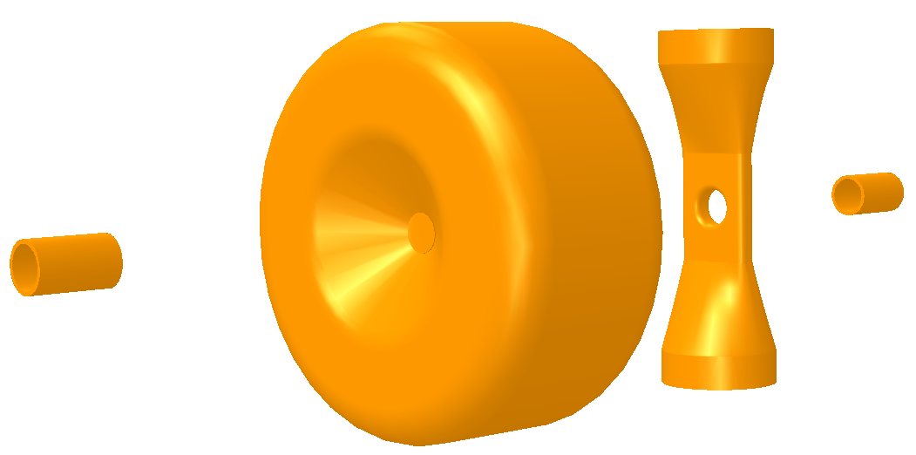
SSR2 & their SC solenoid focusing magnets
Project X :
SSR0/HWR, SSR1 and SSR2. Operate at the same resonating frequency, but different β.
Equal transverse dimensions but different longitudinal dimensions.
Sub-components of SSR2

Slide 57
EM Design and prototype development for MEBT, SSR2 cavities and Superconducting magnets
Electromagnetic design of Quadrupoles, Dipoles and Superconducting solenoids using 3D finite element analysis software
Pole shaping using Poisson and other codes
Beam dynamics studies for MEBT line
Design drawings at BARC; Prototype development in industry
Superconducting magnets fabrication using LTS strands
Qualifications and magnetic measurements on prototypes at BARC and Fermilab
Final development at Indian Industry

Slide 58
Summary and Conclusions
Indian Institution and Fermilab Collaboration is making
good progress
Collaborating in Accelerator Physics, RF power Amplifiers, Couplers, LLRF Control & Instrumentation, Magnets, CMTS, SSR2 (…).
Lots of common ground, similar accelerator programs
Let us work together

Slide 59
Acknowledgements
Support from following is highly appreciated
Dr R.K. Sinha, Chairman, AEC
Dr R.B. Grover, Principle Advisor, DAE
Shri Sekhar Basu, Director, BARC
Dr S. Kailas, Director, Physics Group
Shri G.P. Srivastava, Director, E & I Group
Shri Manjit Singh, Director, DM&A Group
Dr P. Singh, Head, Ion Accelerator Development Division
Shri C.K. Pithawa. Head, Electronics Division
Shri S.B. Jawale, Head, CDM
Thanks to all the colleagues who are participating and contributing to the collaboration.

Slide 60
Thank You !

