Slide 1
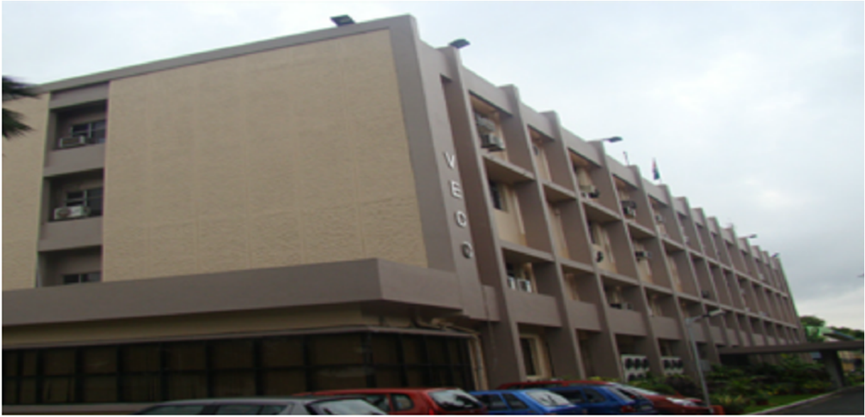
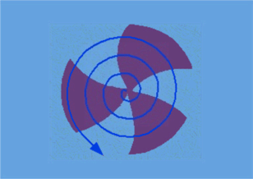
IIFC-VECC OVERVIEW
Sumit Som
Variable Energy Cyclotron Centre
Kolkata, India
IIFC meeting on 26-Nov-2012 held in Fermilab

Slide 2
IIFC-VECC OVERVIEW : OUTLINE
650 MHz, β=0.61, 5-cell SCRF Cavity
    Desin, Simulation
    Longitudinal and Transverse HOMs
    Multipacting analysis
    Structural & Mechanical modal analysis
    Fabrication status of the cavity
    Bead-pull measurement set-up
Helium vessel for 650 MHz, β=0.61, 5-cell SCRF Cavity
    Preliminary design study
Blade tuner and Piezo tuner for 650 MHz, β=0.61,
5-cell SCRF Cavity
    Preliminary design study
Cryomodule for SSR1
    Strong Back 2D analysis
    Strong Back 3D analysis
    Helium vessel structural analysis

Slide 3
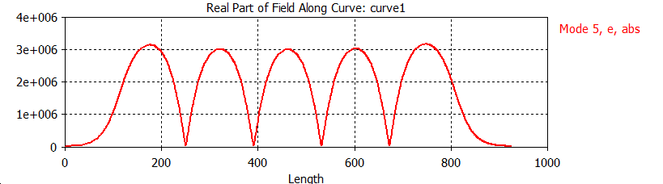
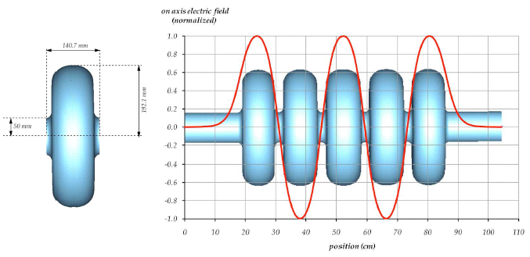
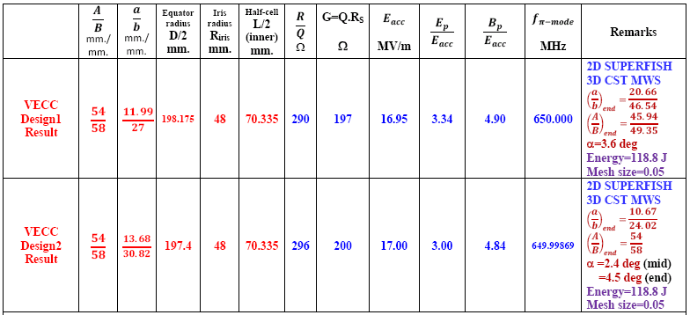
650 MHz, β=0.61, elliptical cavity simulation
Accelerating mode
Field flatness:
Very good!
Data:
Generated by VECC
Results:
Very good!
kc = 1.24%
( Riris=48 mm.)

Slide 4
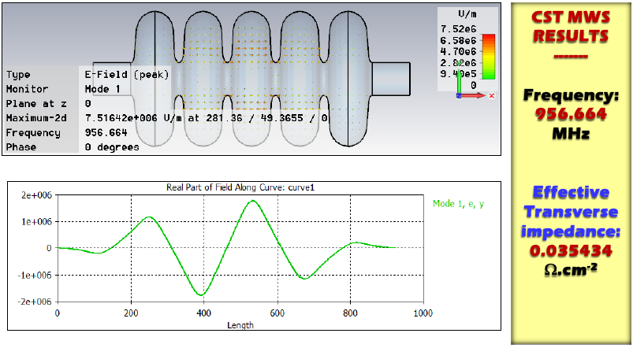
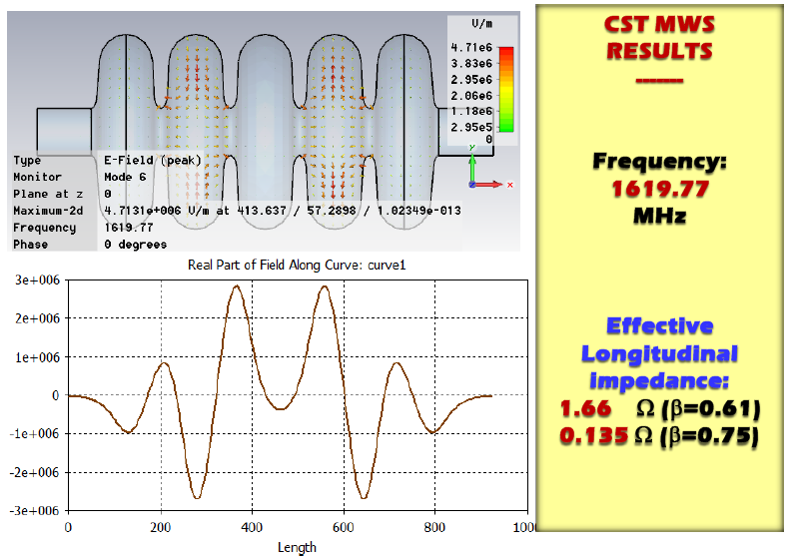
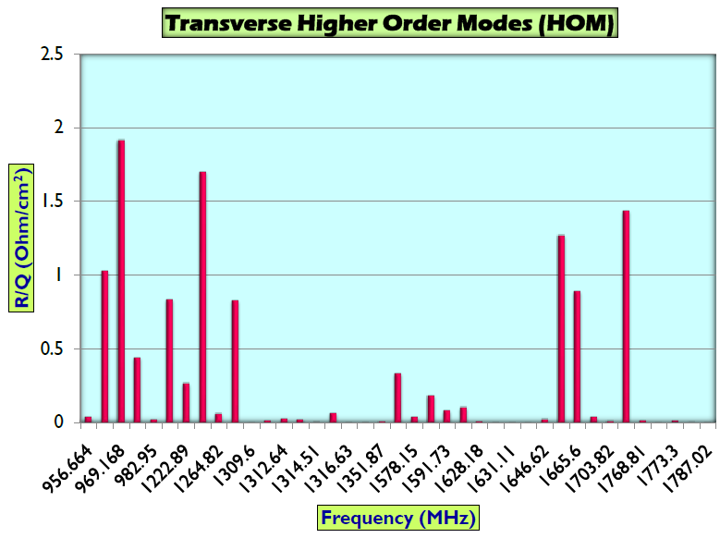
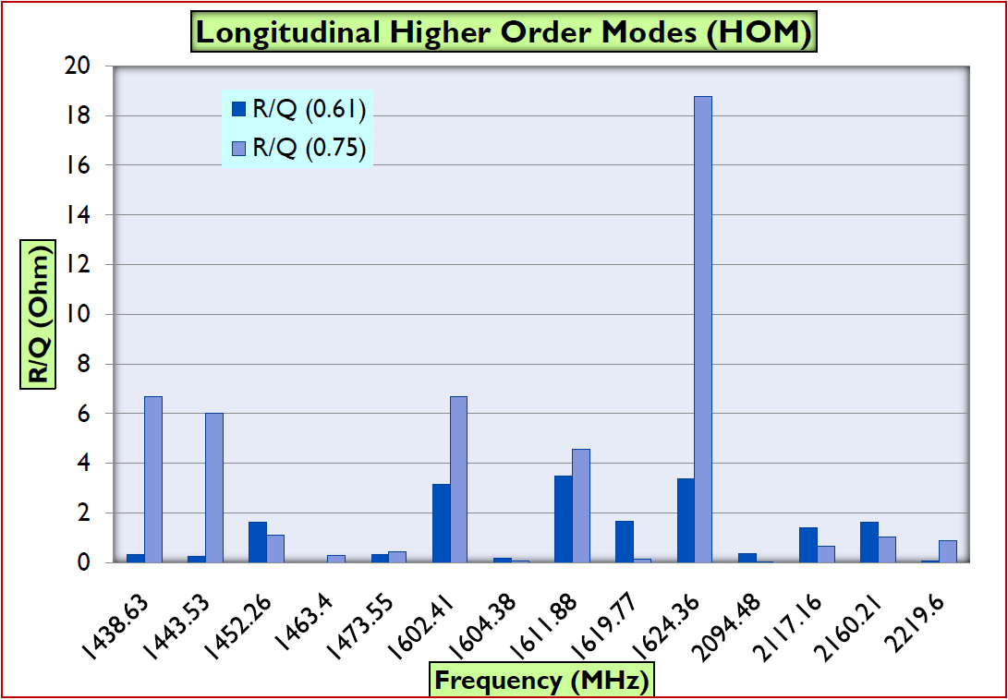
Higher order modes (HOMs)
Transverse and longitudinal HOMs for the cavity at 650 MHz, β=0.61--analysis done
No trapped mode with high effective impedance observed.

Slide 5
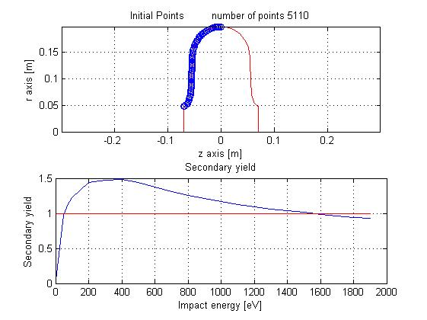
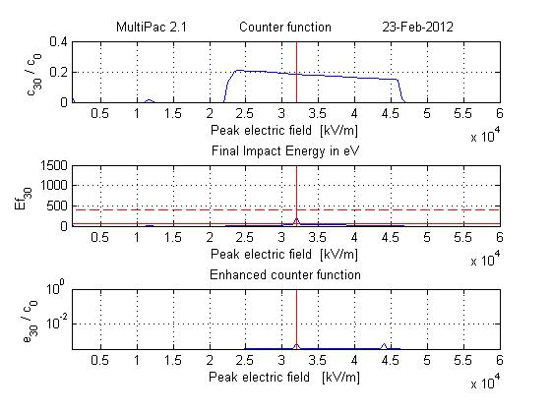
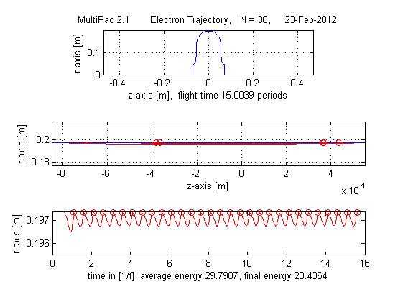
Multipacting Analysis of 650MHz Cavity
A preliminary study of Multipacting Analysis for 650 MHz elliptical cavity has been carried out using 2D software Multipac2.1,windows version
Multipacting analysis is done for both Mid-cells and End -cells
Results for Mid-cell Cavity (Equator)
Input for Mid-cell Cavity
Results for Mid-cell Cavity
c₃₀/c₀ : Counter function - ratio of # of particles after 30th impact to the initial number of
particles (without taking into account the secondary yield);
e₃₀/c₀: Enhanced counter function- ratio of the number of particles after the 30th
impact to the initial number of particles, taking into account the secondary yield
that depends on the impact energy)
Impact Energy: physical condition for multipacting, should be > 50 eV for the
secondary yield > 1

Slide 6
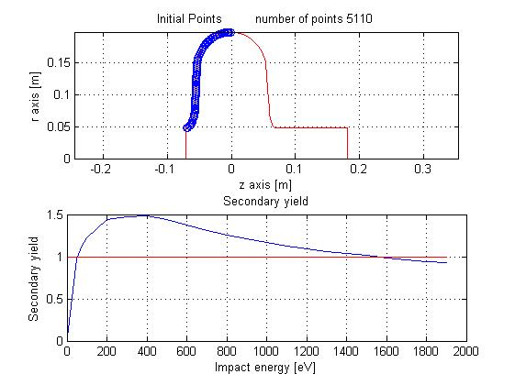
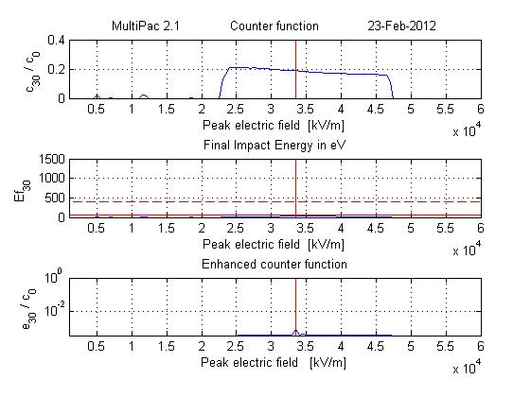
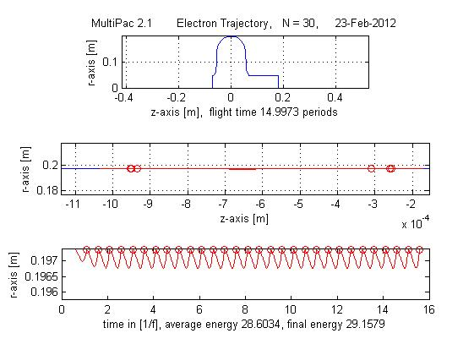
Multipacting Analysis of 650MHz Cavity (……... Contd.)
Input for end-cell Cavity
Results for end-cell Cavity
end-cell Cavity (Equator)
It is observed that impact energy is less than 50 eV for all peak electric fields except a
small region between 30 to 35 MV/m, where it is around 200 eV.
However, we can conclude that no multipacting can take place in the said cavity as the
relative enhanced electron counter function is less than 1 for the whole range of peak
electric field up to 60 MV/m
It is observed for mid-cells and end-cells that even after 30 impacts of electrons at the
equator region (at the radius of 197 mm.) of the cavity, the final impact energy is
28.4364 eV, which is well below 50eV
unlikely to cross secondary electron emission yield for producing multipacting.
Analysis using CST Particle Studio (3D) code is being carried out for further
investigation!

Slide 7
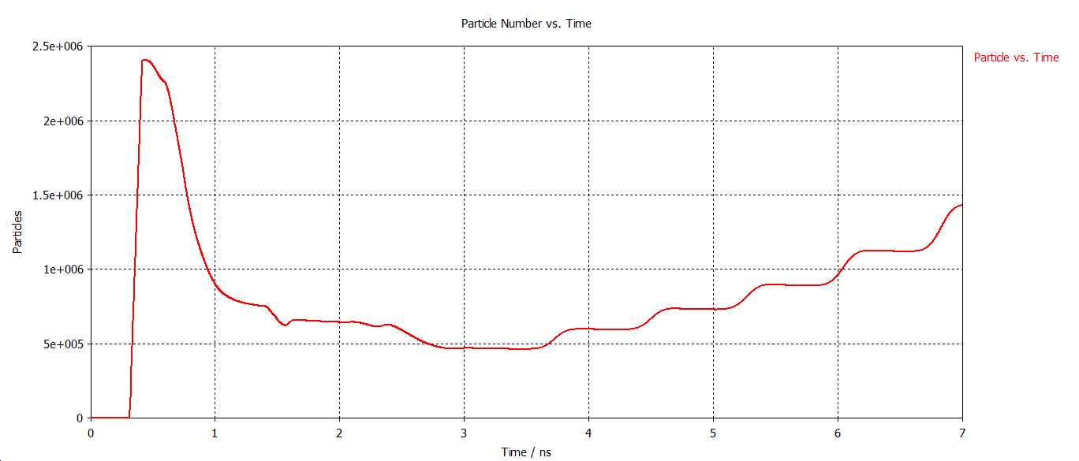
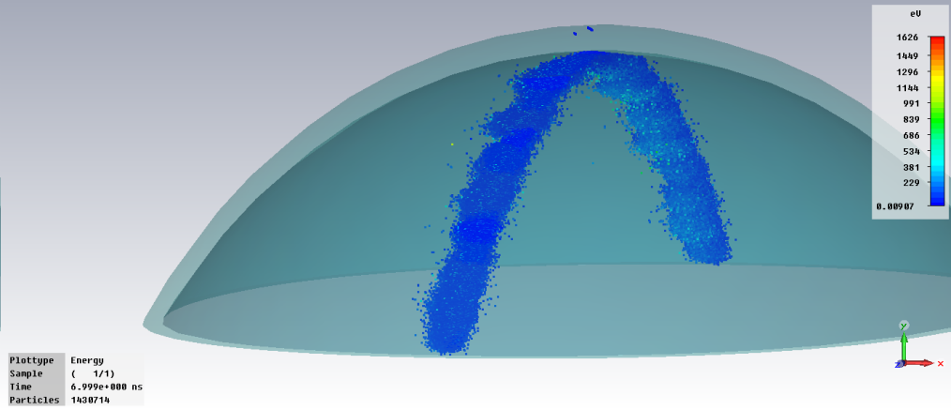
Multipacting simulation data for 650MHz, β=.61Cavity using CST Particle Studio
30 mm. of equator region has been simulated.
Mesh: min 0.37 mm., max 0.74mm.
Multipacting has been found between 5.8 MV/m to 11.5 MV/m
Multipacting rate is very high in the region of 6.8 MV/m.
At 11.6 MV/m, increase in partcle due to multipacting is very low.
Particle vs. time(ns) at 5.8 MV/m
Particles after 7ns at 5.8 MV/m

Slide 8
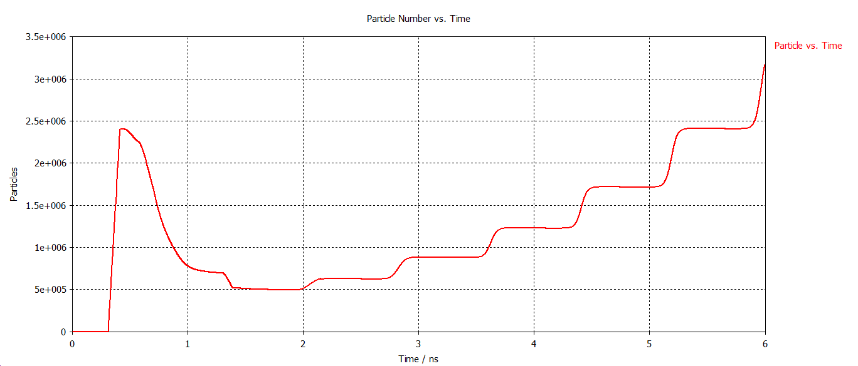
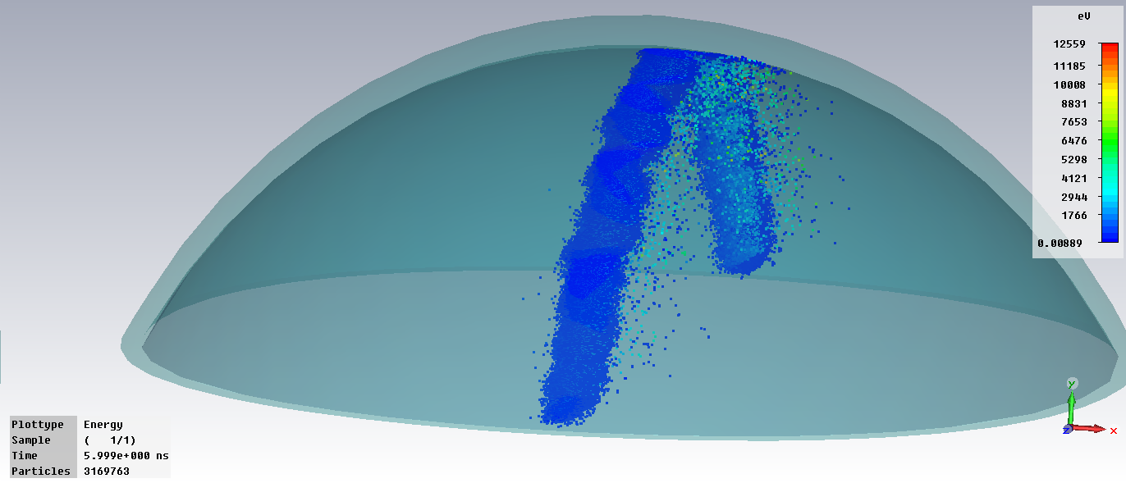
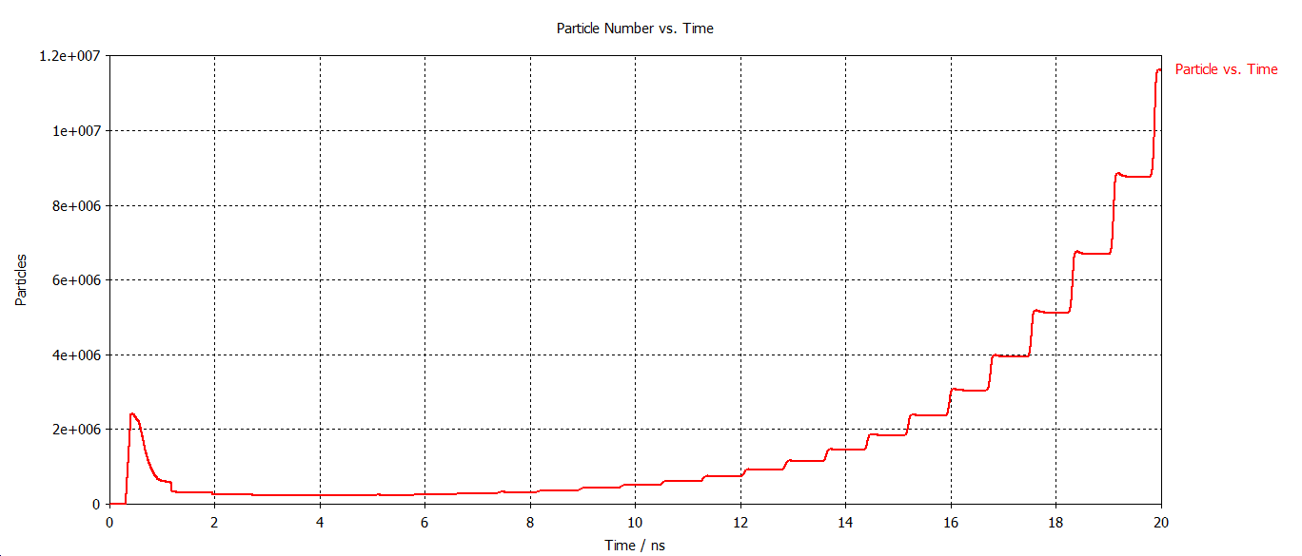
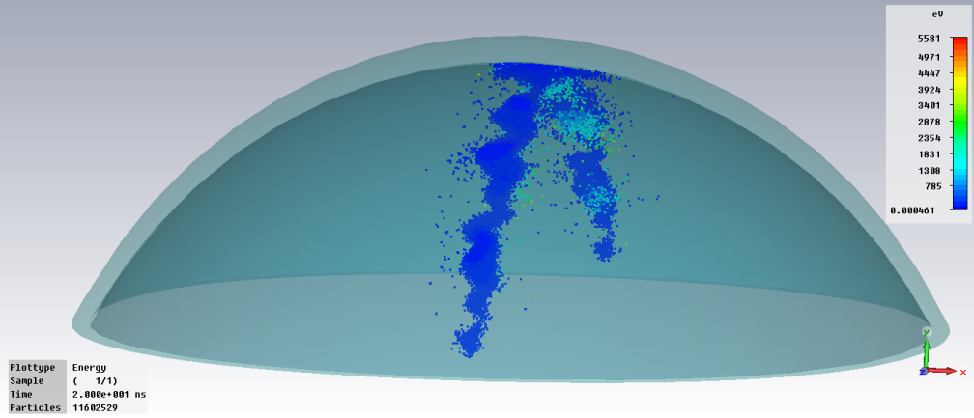
Multipacting simulation result for 650MHz, β=.61Cavity using
CST Particle Studio
Particle Vs time(ns) at 6.8MV/m
(Strong Multipacting)
Particle after 6ns at 6.8MV/m
Particle Vs time(ns) at 9MV/m
Particle after 20ns at 9MV/m

Slide 9
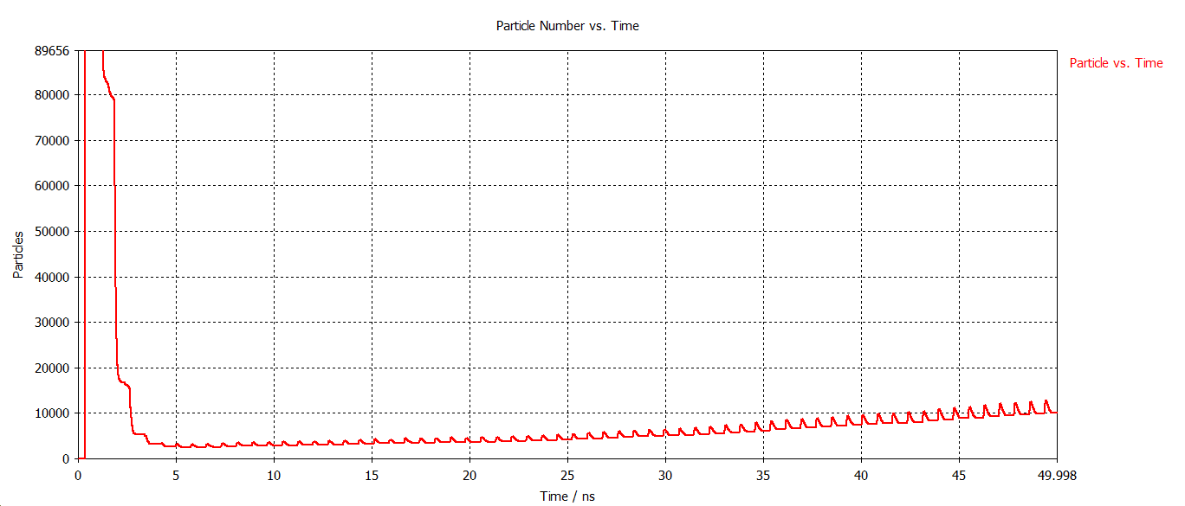
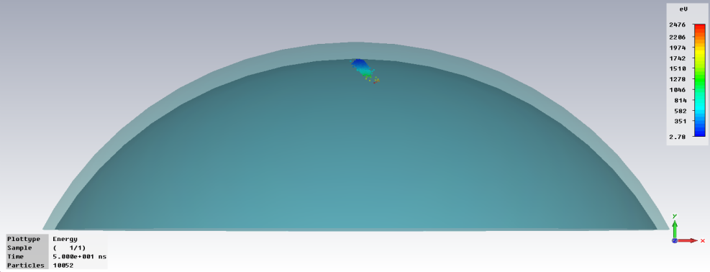
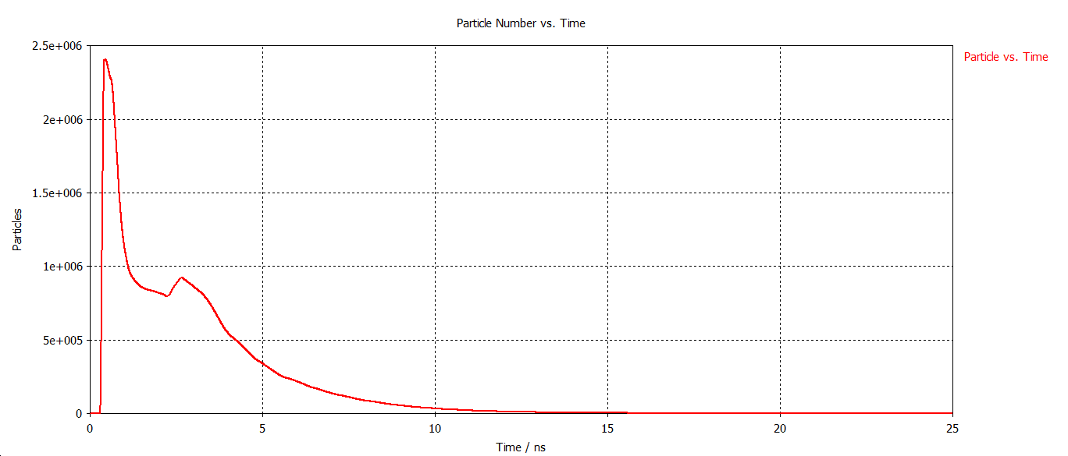
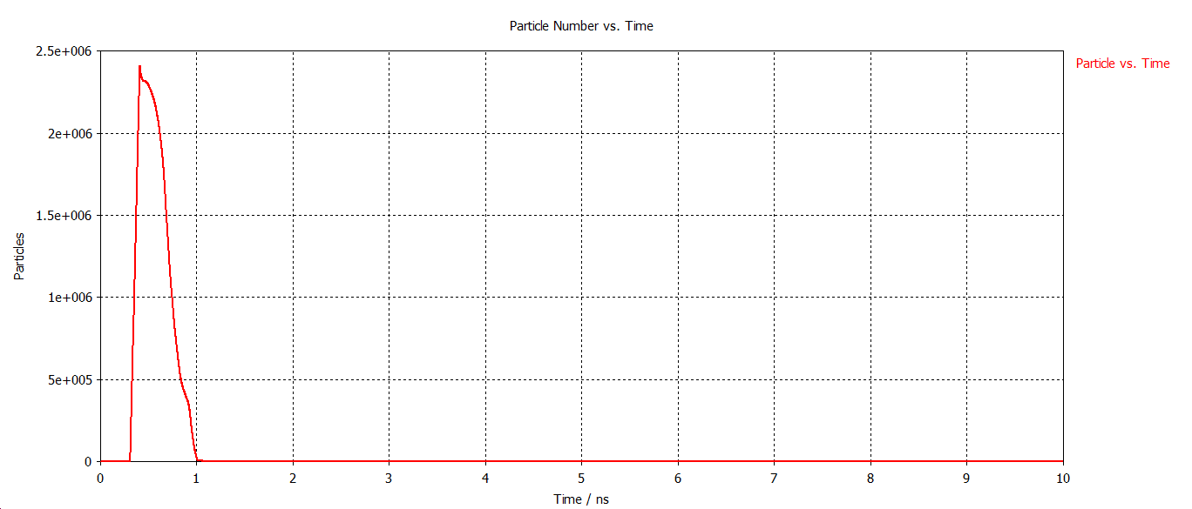
Multipacting simulation data for 650MHz, β=.61 Cavity using CST Particle Studio
Particle Vs time(ns) at 11.5 MV/m
(slow multipacting)
Particle after 50ns at 11.5MV/m
Particle Vs time(ns) at 4.5MV/m
(No Multipacting)
Particle Vs time(ns) at 22.5MV/m
(No Multipacting)

Slide 10
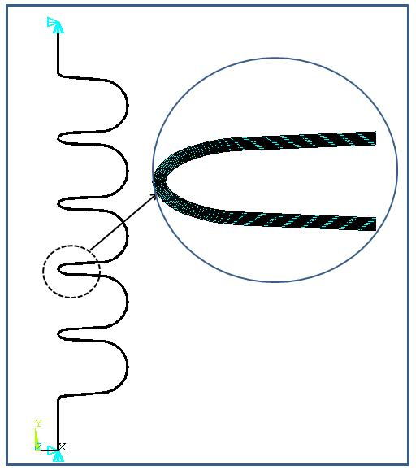
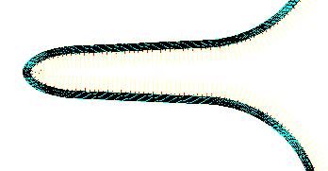
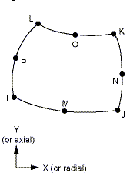
Cavity structural analysis: formulation detail
Model: Axi-symmetric
Loading:
Uniform Temperature=2K
External Pressure=3 atm
Boundary Condition: Both end fixed
Element: Plane 183

Slide 11

Material Propoerties
The following parameters of niobium are used: Young’s modulus E=105000 N/mm², Density =8.57 g/cm³, Poisson number =0.38.
No specific temperature dependent linear thermal expansion co-efficient data has been found in literature for niobium. But data for Titanium whose linear thermal expansion property is very near to Nb is available.
For temperature range from 293 K to 2 K, thermal integral value of linear thermal expansion co-efficient value is available. Dividing the integral value by temperature range, average linear thermal expansion co-efficient value obtained is 5 X 10⁻⁶ ,which is used for analysis.

Slide 12
Results :Different Stress Plot
Hoop Stress
Radial stress
Longitudinal stress

Slide 13
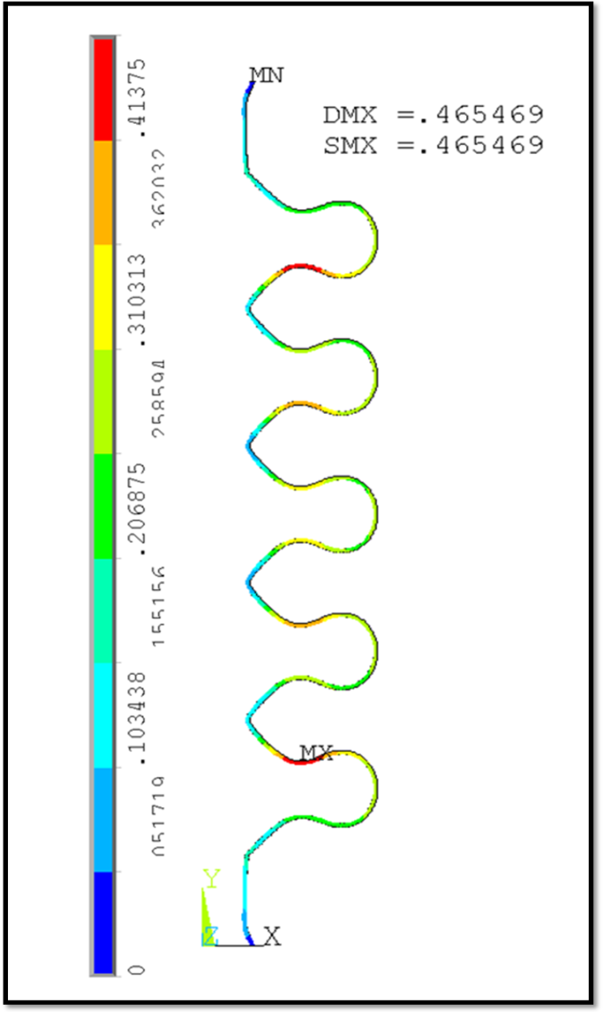
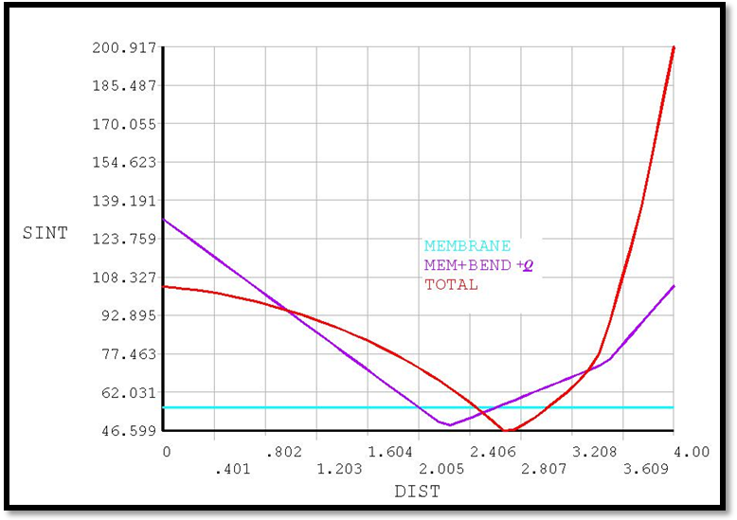
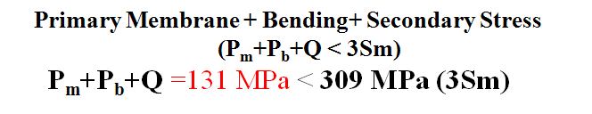
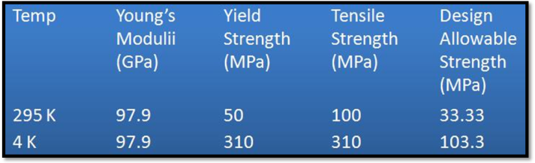
Deformation & Stress comparison
Deformation Plot

Slide 14
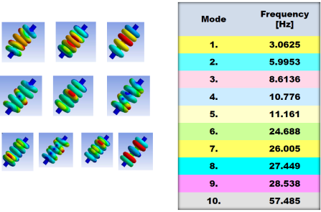
Mechanical modal analysis of 650 MHz SCRF Cavity
Structural analysis carried out using ANSYS 3D code.
Stresses are within the allowable limit.
Mechanical modal analysis (without stiffener) shows frequency within 100 Hz.
Mechanical modal analysis
(without stiffener)

Slide 15
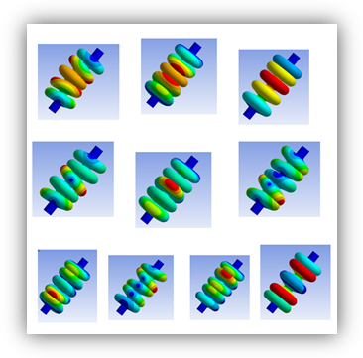
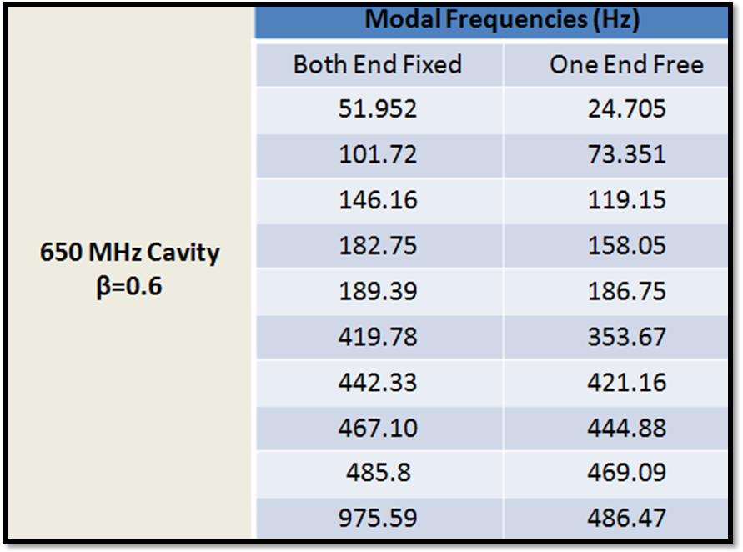
Mechanical modal analysis of 650 MHz SCRF Cavity
The natural frequencies and mode shapes are determined for the 5-cell cavity alone for different end support condition.

Slide 16
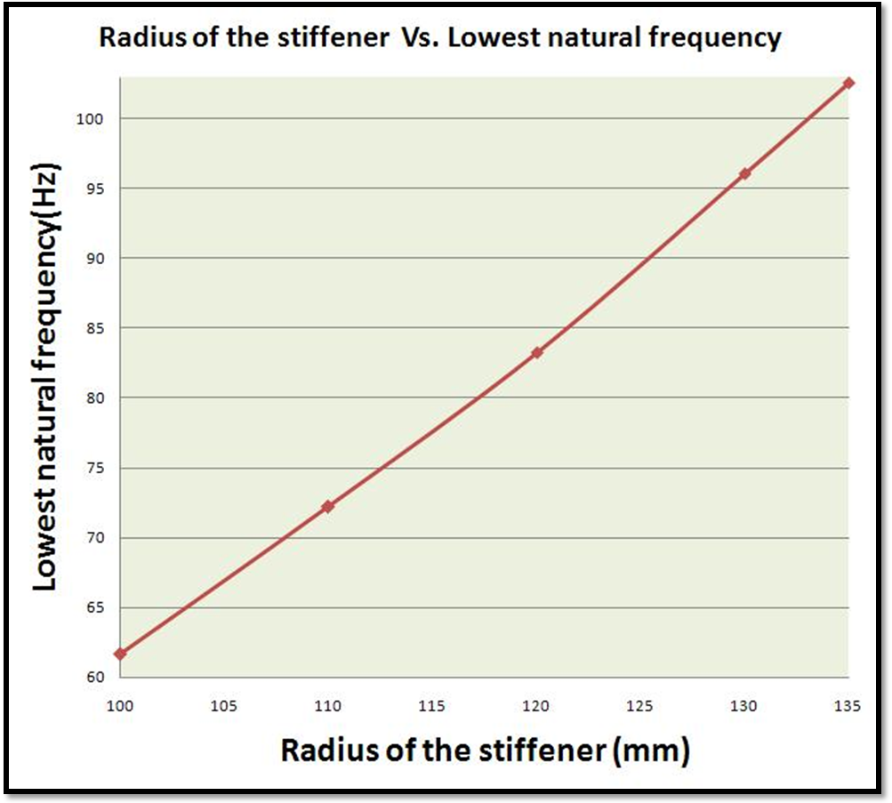
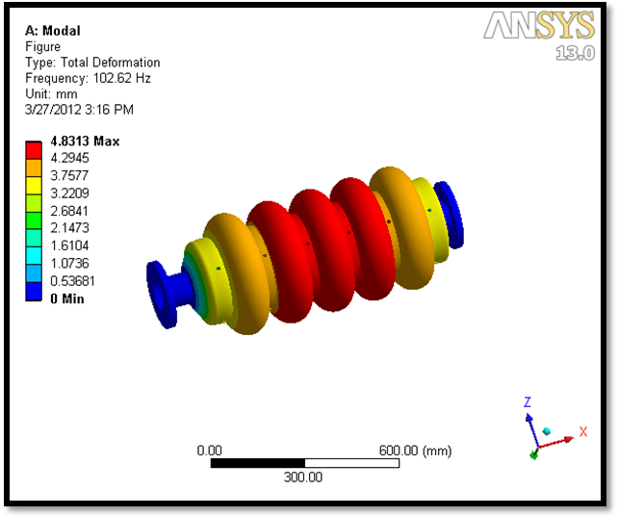
    Stiffened cavity modal analysis

Slide 17
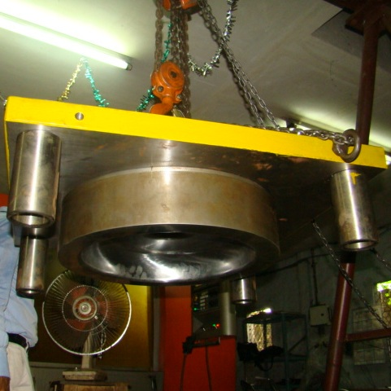
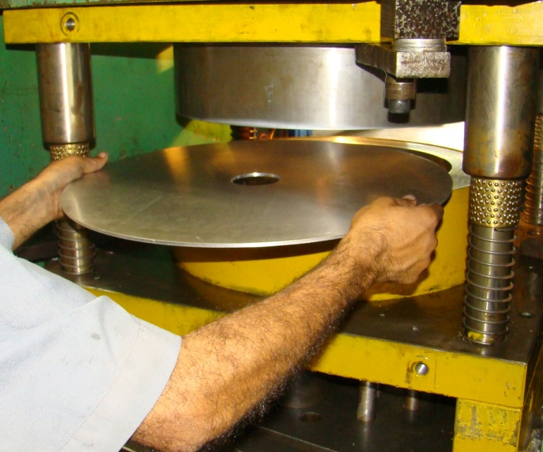
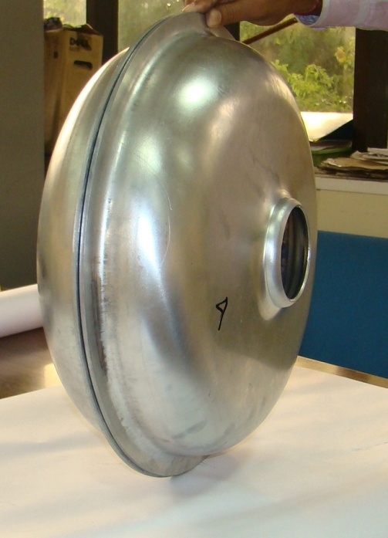
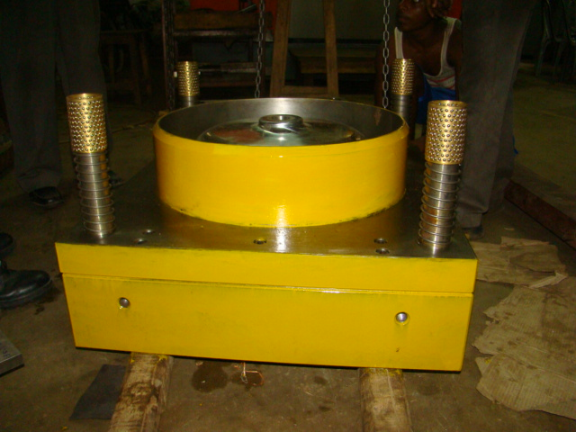
Mechanical Fabrication of 650 MHz Aluminum prototype Cavity
Puchase order for fabrication of prototype aluminum cavity : half-cells for 1-cell & 5-cell (Full scale) has been placed with a local company
Die/Punch assembly developed.
Reasonable Progress has been made. Expected to be completed within Dec’2012.
EB Welding for Aluminum cavity is being explored.

Slide 18
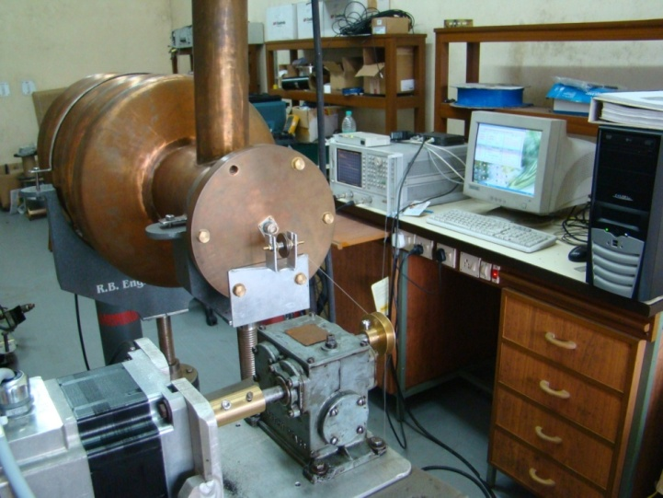
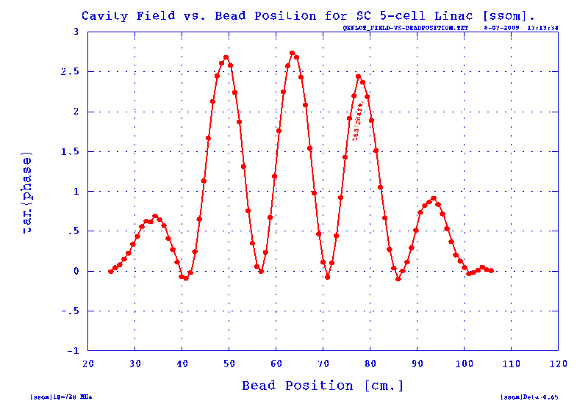
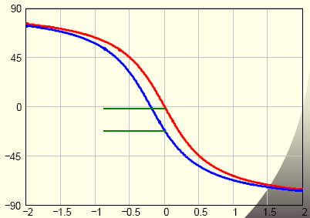
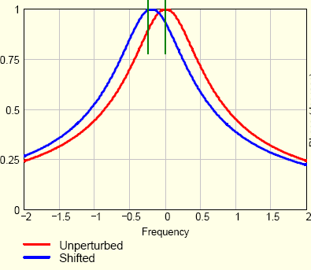
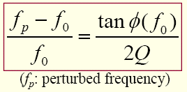

Bead-pull measurement set-up
Using Phase-shift technique instead of frequency-shift
  In manufacturing or tuning multi-cell cavity, it is required to investigate the field profile inside the cavity
  The Field can be sampled by introducing a perturbing object and measuring its change in f₀
  The object must be very small so that the field does not vary significantly over its largest linear dimension: it is a perturbation method
  Phase deviation is much easier to observe than frequency change especially for small perturbation.
PHASE (Degrees)
IMPEDANCE

Slide 19
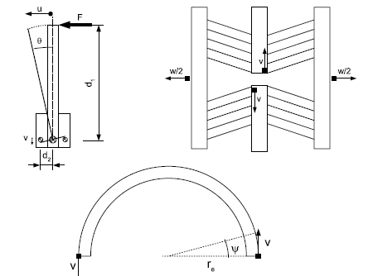
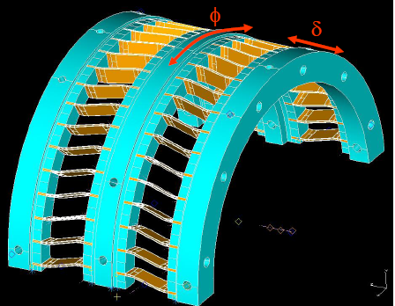
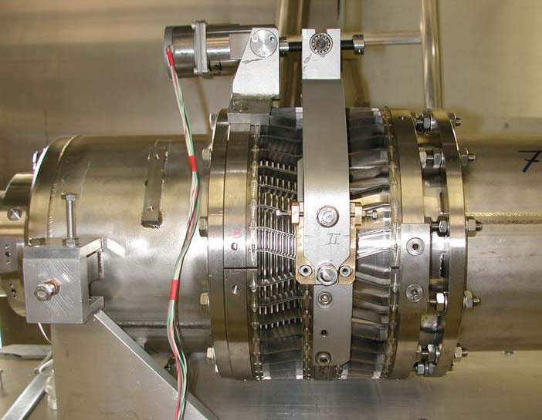
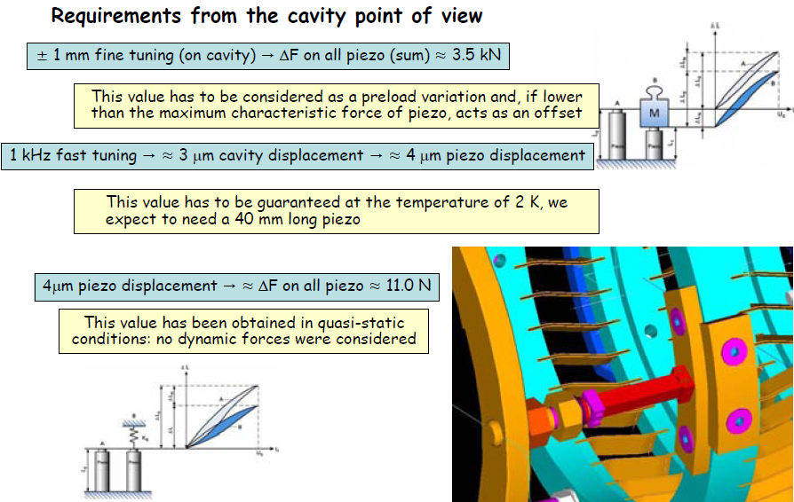
BLADE TUNER 5-cell 650 MHz, β=0.61 SCRF Cavity
Cinematic description of the fine tuning system
PICTURE OF A BLADE TUNER AT INFN
Design requirement:
min. compressive strength:11 kN
min. tensile strength: 14 kN
Slow tuning:0–600 kHz(~1.5 mm)
Fast tuning: 0−1kHz (~4μm)
Need detail information/ drawings!

Slide 20


Piezo actuator (PI-make)
N-216 NEXLINE® High-Load Actuator. Feed motion is realized by piezo stepping motion which allows basically a travel ranges with nanometer accuracy
High-Force PiezoWalk® Drive for Long-Range Nanopositioning
Travel Range 20 mm
Resolutionto 0.03 nm Open-Loop, 5 nm
Closed-Loop
Up to 800 N Holding Force/600N (working)
Self Locking at Rest
Non-Magnetic and Vacuum-Compatible Working Principle
Cleanroom Compatible
Motion mode comparison of a NEXLINE® actuator: The nanostepping mode provides a very smooth motion. Full step mode allows higher speed

Slide 21

    Helium vessel for SCRF Cavity
Missing Links
Final Helium Vessel diameter
+20% ullage
Liquid Helium volume
Heat Load To cryostat
Parametric Formulation is ready
Need detail information/ drawings!

Slide 22
SSR1 Cryomodule: Strongback

Slide 23

Result of the analysis using ANSYS
Temp. of strong back

Slide 24

Analytical solution !
integral Kdt from 300-294 K
integral Kdt from 294 -80 K
First started with assumed T, accordingly Chosen
Kss_DT & KG11_DT;
Finally aimed to match the heat in & Heat out Value for certain T
15 No MLI
Now heat flux
is coming around
1.478W/sqm

Slide 25


Strong Back Temperature distribution: 3D Analysis
Loading Details
Radiation-conduction boundary conditions are applied
Equivalent emissivity between the surfaces are used to include the effect of multilayer insulations.
Average thermal conductivities are used
Non-linear material properties will be included in further analysis

Slide 26


Strong Back Temperature distribution
Details analysis is being done to find out the temperature
Temperature plot shows that the maximum thermal gradient is at the support posts

Slide 27

Strong Back Temperature distribution
Strong back material is taken as Stainless steel
Maximum temperature : 298 K
Minimum temperature : 296 K

Slide 28


STRONG BACK Al Vs. SS
Thermal conductivity of Aluminium is higher than SS.
Hence Al has more uniform temperature distribution.
For the same reason, steady state temperature of Aluminium is very nearer to room temperature.

Slide 29

Structural Analysis
The temperature distribution result of the model has been transported to structural analysis platform for subsequent coupled analysis.
OVC end of the SS support pin is assumed to be fixed.
Conservative approximation of dead load of helium vessel, helium, cavity, solenoid, thermal shield, associated cryogenic piping has been considered for structural analysis. Total approximate load of 24000N will act on 12 nos. of G11 support post having cross section area of 1551 mm². The whole load is converted to equivalent pressure load on each G11 support post and amounts to 1.3 MPa.

Slide 30

STRONG BACK Al vs. SS
Deformation is inversely
proportional to Young's
modulus for mechanical
loading.
For Aluminium 'E' Value is
less than SS.
For thermal loading
deformation is proportional
to thermal expansion co-
efficient, which is high for Al
in comparison to SS.
Hence Aluminium shows
higher total deformation
even though the ∆T is less
for Aluminum.

Slide 31

STRONG BACK Al vs. SS
Stress is because of dead load & thermal loading.
Thermal stress is dependent on E, thermal expansion co-efficient and temperature difference.
For SS though the thermal expansion co-efficient is less than Al, but other two factors are higher, hence stress value is high.
For the above graphs, higher value of stress is due to presence of local holes in the path. Average stress is within safe limit.

Slide 32


Helium vessel for SSR1

Slide 33





CASE-I
CASE-I (2 bar at room temperature during initial cool down)
Case-II (4 bar external pressure+ low temperature, 2K)
Figure: Stress Linearisation of
primary stress:
Pm = 8.8 Mpa < Sm = 33 MPa
Pm+Pb = 17 Mpa < 1.5 Sm = 48 MPa
CASE-II
Figure: Stress Linearisation of primary stress
Pm+Pb+Q = 16 Mpa < 3 Sm = 309 MPa

Slide 34



HIGH POWER RF SOURCE DEVELOPMENT at VECC
(Besides IIFC collaboration activities)
The state-of-the-art technology of Inductive Output tube (IOT Thales-make)-based high power (60 kW) RF amplifier has been developed and energized at 704.4 MHz at VECC (the first of its kind in India!).
It can also be tuned at 650 MHz.
The PC-PLC-based RF interlocks, Control and monitoring of various parameters have also been developed indigenously.
The necessary high voltage power supply (-30 kV, 3.2A) with fast (~microsecond) crowbar protection circuit (ignitron based) also designed and developed.
IOT BASED RF AMPLIFIER ENERGIZED AT VECC

Slide 35
PRESENT STATUS
EM design and analysis, Structural analysis, Mechanical modal analysis of the 5-cell 650 MHz, β=0.61, SCRF cavity has been carried out.
Multipacting analysis carried out with: 2D MultiPact code (No multipacting) and 3D CST Particle Studio code (Multipacting occurs)
Fabrication of die has been done and deep drawing trial of aluminum half-cell is in progress by local vendor.
After successful completion of aluminum prototype, fabrication of Niobium cavity will start.
600 x 600 x 4 mm. Nb sheet (RRR > 300) already procured from ATI Wah Chang.
Electron Beam Welding of Nb Half Cells will be carried out at IUAC, New Delhi (MOU already signed!)
Need detail information / drawings for He vessel & Blade tuners.
For SSR1, Strong Back temperature distribution (3D analysis) has been carried out. Waiting to start fabrication of SS jacketing for SSR1 (Final version of Drawing yet to be received)

Slide 36


