Slide 1
Project X and PXIE Design and Beam Physics
Nikolay Solyak
Fermilab
(on behalf of Project X design team)
IIIFC meeting, FNAL, Nov.26-27, 2012

Slide 2
Outline
Project X: Optics and Beam dynamics overview
PXIE configuration
Summary

Slide 3
Concepts of CW 3GeV and Pulsed Linac
Stage 1
Stage 2
Stage 3
H⁻
gun
RFQ
MEBT
HWR
SSR1
SSR2
β=0.6
β=0.9
1.3GHz ILC
RT
CW
Pulsed
RT (~15m)
325 MHz
2.5-160 MeV
650 MHz 0.16-3 GeV
1.3 GHz 3-8 GeV
Section | Freq, MHz | Energy(MeV) | Cav/mag/CM | Cav&magn. Type, CM length
HWR (β_{G}=0.11) | 162.5 | 2.1-11 | 8 /8/1 | HWR, solenoid, 5.8m
SSR1 (β_{G}=0.22) | 325 | 11-38 | 16 /8/ 2 | SSR, solenoid, ~5.2m
SSR2 (β_{G}=0.47) | 325 | 38-177 | 36 /20/ 4 | SSR, solenoid, 7.77m
LB 650 (β_{G}=0.61) | 650 | 177-480 | 30 /10*/ 10 | 5-cell ellip, doubl, ~4m
HB 650 (β_{G}=0.9) | 650 | 480-3000 | 162 / 27*/ 27 | 5-cell ellipt, doublet, ~9m
ILC 1.3 (β_{G}=1.0) | 1300 | 3000-8000 | 224 / 28/ 28 | 9-cell ellipt., quad, 12.6m
* All doublets and correctors are normal conducting
⁺ Updated Lattice. Main focus to improve performance of front –end (PXIE) and 1GeV Linac

Slide 4
Project X Staging
Stage 1: CW linac: 1 GeV x 1mA = 1 MW
Stage 2: CW linac 1-3 GeV x 1mA;
  upgrade 1GeV linac to 2mA (1mA for 1GeV program and 1mA accelerated up to 3 GeV)
Stage 3: RDR - Pulsed 3-8 GeV linac (5% duty cycle)
  Injection to Recycler/MI (upgraded) --> 60-120 GeV
Stage 4: Beyond RDR,
  Pulsed Linac upgrade to 4MW at 8 GeV

Slide 5
Magnetic Focusing
in MEBT section Normal conducting dublets and triplets are used
In the initial part of the low-energy SC linac (HWR, SSR1, SSR2) focusing is provided by superconducting solenoids (round beam).
In 650 MHz sections (LE & HE), a standard warm FD-doublet lattice is used.
In the Pulsed 1.3 GHz linac SC quads in the middle of CM is used (FODO).
All magnets have built-in dipole correctors and BPM for beam steering.
Cavities and focusing elements are grouped in cryomodules.
  Section HWR SSR1 SSR2 LE650* HE650* ILC
  Focusing period : SR RSR SR² FDR³ FDR⁶ FR⁸DR⁸
Elements: S – solenoid, R resonator, FD – doublet (F and D – quads).
* All doublets in 650 MHz sections are normal conducting (NC)

Slide 6
Configuration of SC cryomodules
Structure of Half-wave SSR1 and SSR2 Cryo-modules:
  HWR: 8cav/8 sol. ( S C S C S C S C S C S C S C S C ). Starts with a solenoid to mitigate H₂ influx from MEBT
  SRR1: 8 cav/4 sol. ( C S C C S C C S C C S C )
  SRR2: 9 cav/5 sol. ( S C C S C C S C C S C C S C )
Structure of 650 MHz Cryo-modules (configuration 3 x 6)
  LE650 : 3cav/CM: (C C C) , short cryomodules
  HE650 - 6cav/CM: (C C C C C C), long cryomodule
Each Focusing element (solenoid, doublet or quad) has:
  Transverse (x, y) correctors
  BPM (X & Y & Z) nearby
  Solenoid polarity is changed in each next solenoid (simplifies orbit correct.)
Cryomodule interface
  CM-to-CM transition goes through room temperature vacuum chamber
    Good from repair points of view but complicates beam dynamics
    Vacuum valves at each end
  Small space allocated (~20 cm in HWR-SSR1, ~2m at 650 MHz CM’s)
    Laser profile monitor, Pumping port , doublet package for 650MHz section

Slide 7
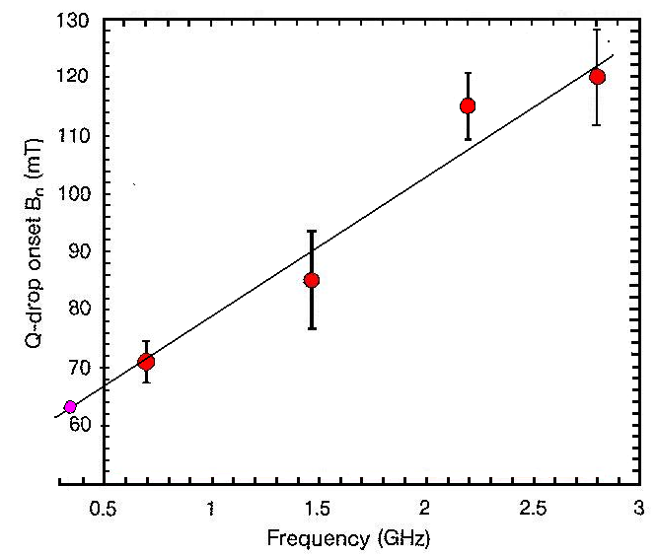
Cavity gradient
Gradient Constraints:
Surface Magnetic field (high field Q-slope onset)
    162.5 MHz: B_{pk} < 60mT
    325 MHz: B_{pk} < 70 mT
    650 MHz: B_{pk} < 70mT
    1300 MHz: B_{pk} < 80mT
Surface Electric Field (Field emission)
      E_{peak} < 40 MV/m
Limitation of Power dissipation @ 2K
  250 W per CM total, including
  < 25 W per cavity (8 cavities/CM)
HF Q-slope onset vs. Freq. (JLAB)
650MHz
325MHz

Slide 8
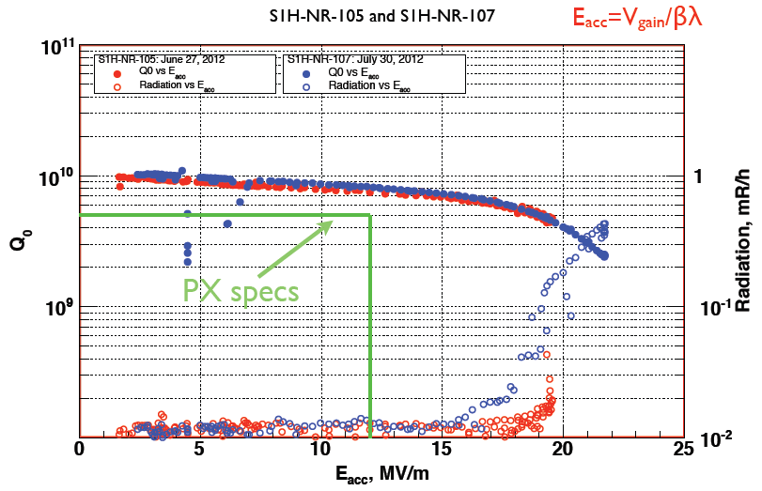
Assumptions for CW Cryogenic Losses
R = R_{res} + R_{BCS} (f,T,E_{acc})
R_{res} ~ (6 - 10) nΩ ; frequency independent
BCS resistance is frequency and field dependent (medium field Q-slope). At ~ 70 mT medium-field Q-slope gives ~30% of Q-reduction.
For 2°K: 162.5 & 325 MHz – total resistance is dominated by R_{res}
  650 MHz – BCS and residual gives comparable contribution
  1300 MHz – BCS resistance is dominated
70 mT
72 mT
CW
Pulsed
SSR1: 325 MHz
Q₀=5∙10⁹ @ 2K
ILC: 1.3 GHz
Q₀=1.5∙10¹⁰ @2K

Slide 9
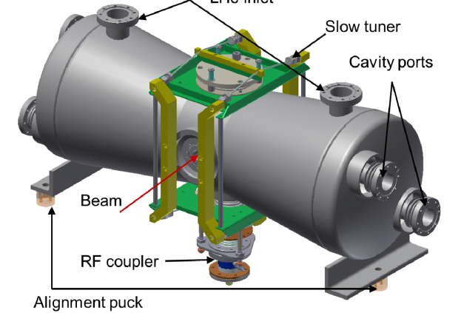
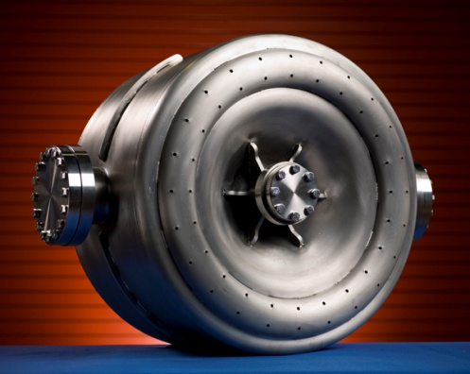
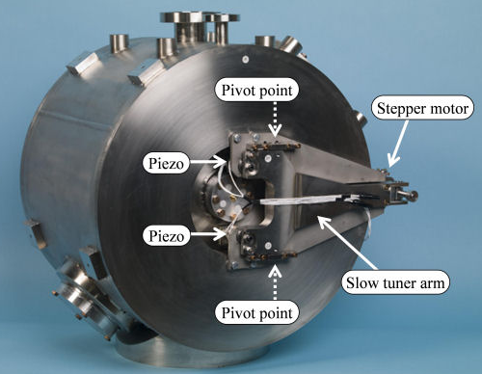
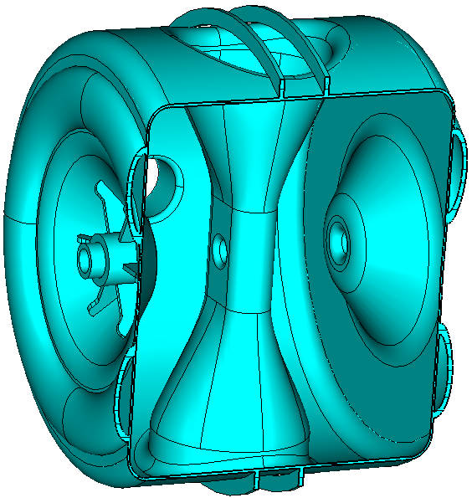
RF Cavities of the Project-X Front-end:
HWR model, 162.5 MHz (ANL)
SSR1 prototypes and tests, 325 MHz (FNAL)
SSR2 model,
325 MHz (FNAL)
cavity type | β_{geom} | Freq, MHz | Beam pipe ø, mm | E_{acc,} MV/m | V_{acc, max} MeV | E_{pk} MV/m | B_{pk} mT | R/Q, Ω | G, Ω | Q_{0,} x10¹⁰ | Power losses W
HWR* | β=0.112 | 162.5 | 33 | 8.2 | 1.7 | 38 | 41 | 272 | 47.7 | 0.5 | 2.1
SSR1⁺ | β=0.215 | 325 | 30 | 12 | 2.4 | 46 | 70 | 242 | 84 | 0.5 | 4.9
SSR2# | β=0.47 | 325 | 40 | 11.4 | 5 | 40 | 70 | 290 | 113 | 0.7 | 12.5
*P.Ostroumovet al., WEPPC039,IPAC12, ⁺T.N. Khabiboulline et.al, WEPPC035, IPAC12; #P.Berrutti, SSR2 report
Assumption for RF power losses at 2K: R = R_{res}+ R_{BCS} : R_{res} =10 nΩ

Slide 10
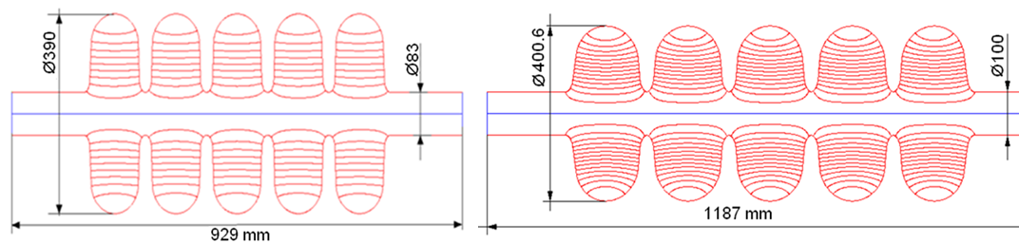
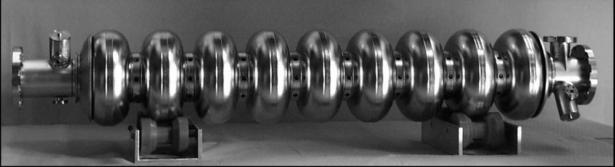
650 MHz and ILC cavities
650 MHz: β=0.61
650 MHz: β=0.9
1.3 GHz ILC
Parameter |  | LE650 CW | HE650 CW | ILC CW/Pulse
β_geom |  | 0.61 | 0.9 | 1
Cavity Length = n_{cell}∙β_{geom}λ/2 | mm | 703 | 1038 | 1038
R/Q | Ohm | 378 | 638 | 1036
G-factor | Ohm | 191 | 255 | 270
Max. Gain/cavity (on crest) | MeV | 11.7 | 17.7 | 17.2/ 25.5
Acc. Gradient | MV/m | 16.6 | 17 | 16.9/25
Max surf. electric field | MV/m | 37.5 | 34 | 34/50
Max surf. magnetic field, | mT | 70 | 61.5 | 72/107
Q₀ @ 2°K | × 10¹⁰ | 1.5 | 2.0 | 1.5/1.0
P_{2K} max | [W] | 24 | 24 | 20/ 5

Slide 11
Project X
Lattice design and Beam Physics

Slide 12
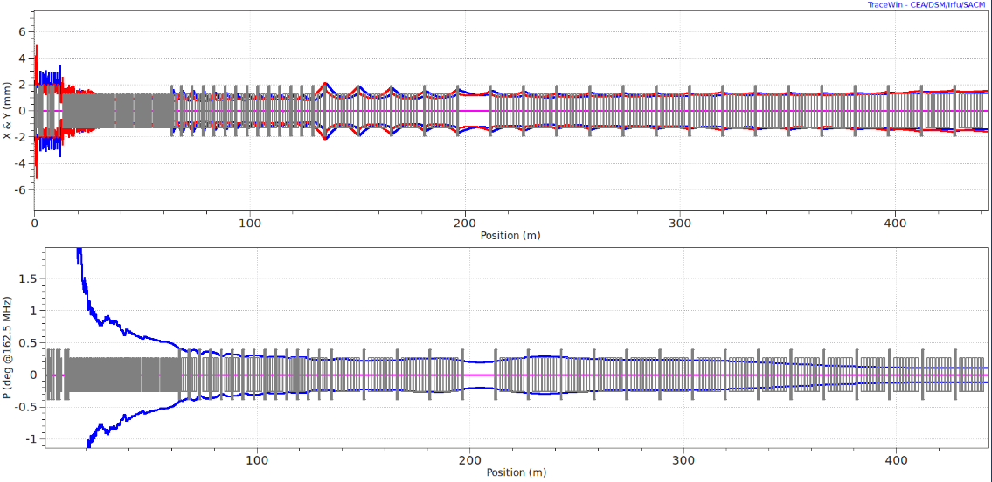
Lattice of CW 3 GeV Linac
1-sigma transverse beam envelopes
Ver. 5.1
SSR1
HWR
SSR2
LB650
HB650
HB650
MEBT
1-sigma longitudinal beam envelopes
~(13-16) m for 1GeV extraction (1CM)

Slide 13
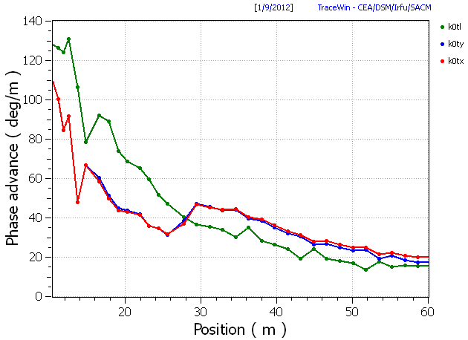
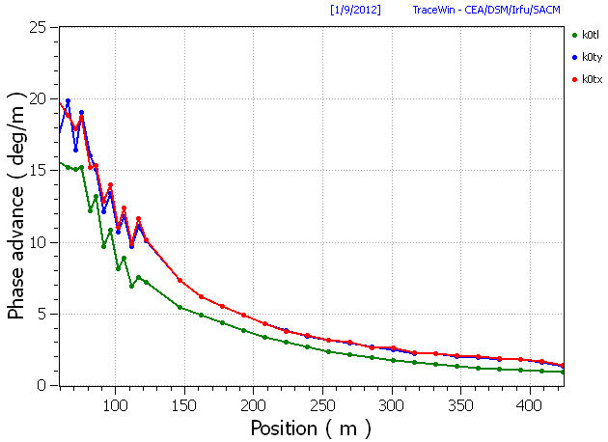
Front End (w/o MEBT)
Phase advance
High energy sections
PXIE
CW, 3 GeV x 1mA (avrg.): Ver.6.0

Slide 14
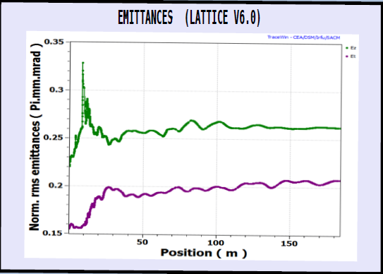
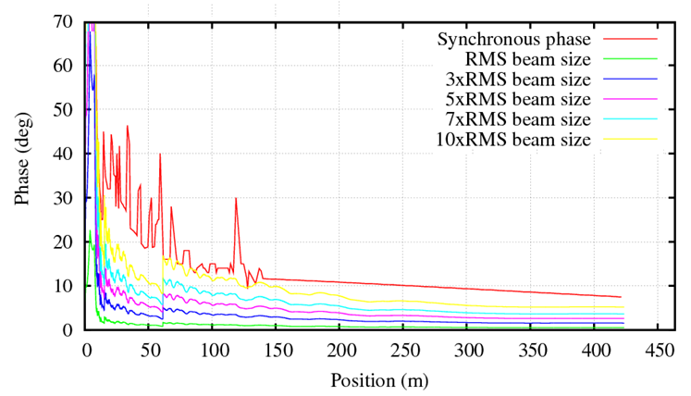
Emittance growth
Initial normalized emittances after RFQ
ε⊥= 0.16 π∙mm∙mrad
ε_{z}= 0.22 π∙mm∙mrad
CW Linac: Ver.6.0 (zoom)
Longitudinal Acceptance
Longitudinal acceptance ~ 8∙σ
Robustness to RF errors and initial mismatch
Synchronous Phase vs. Bunch Length

Slide 15
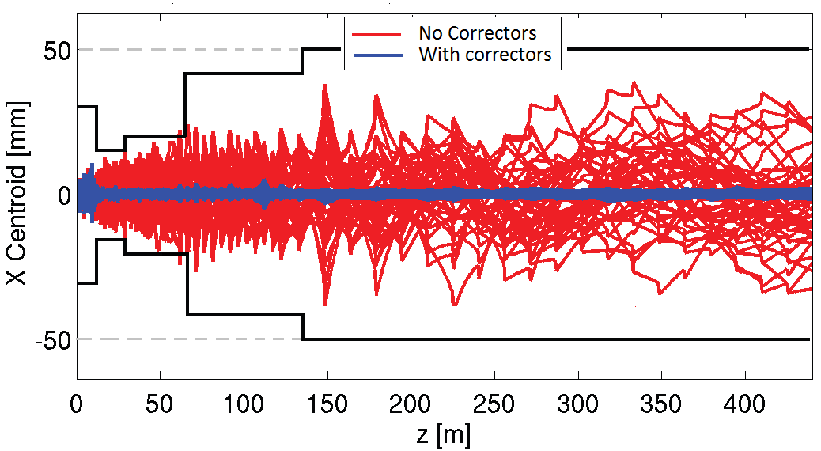
Misalignment of components and RF jitter Studies
RF and Misalignment Errors
TRACK simulations (400 machines) of corrected/uncorrected beam centroid motion along the linac for the set of errors δ_{xy} =1mm for solenoids & cavities, δ_{xy} =0.5mm for quadrupoles, dynamic RF jitter of 0.5⁰ + 0.5% and quad roll of 5 mrad around the z-axis. One corrector and one monitor are used per solenoid and per quadrupole dublet. BPM resolution 30μm. Big losses (> 1W/m) if no correction ; No losses after alignment correction

Slide 16
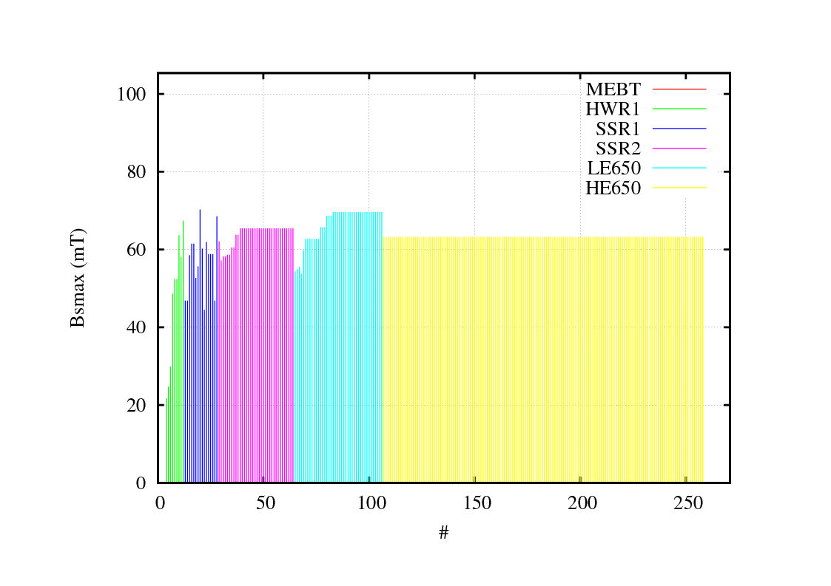
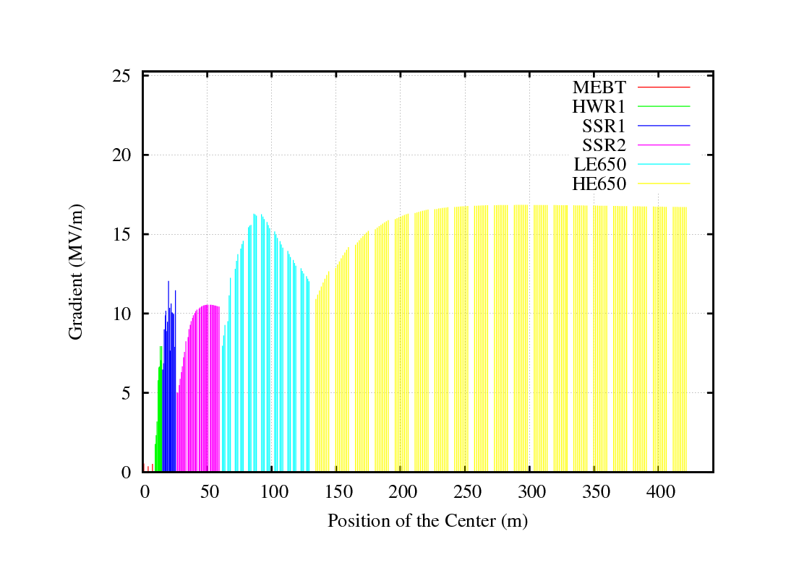
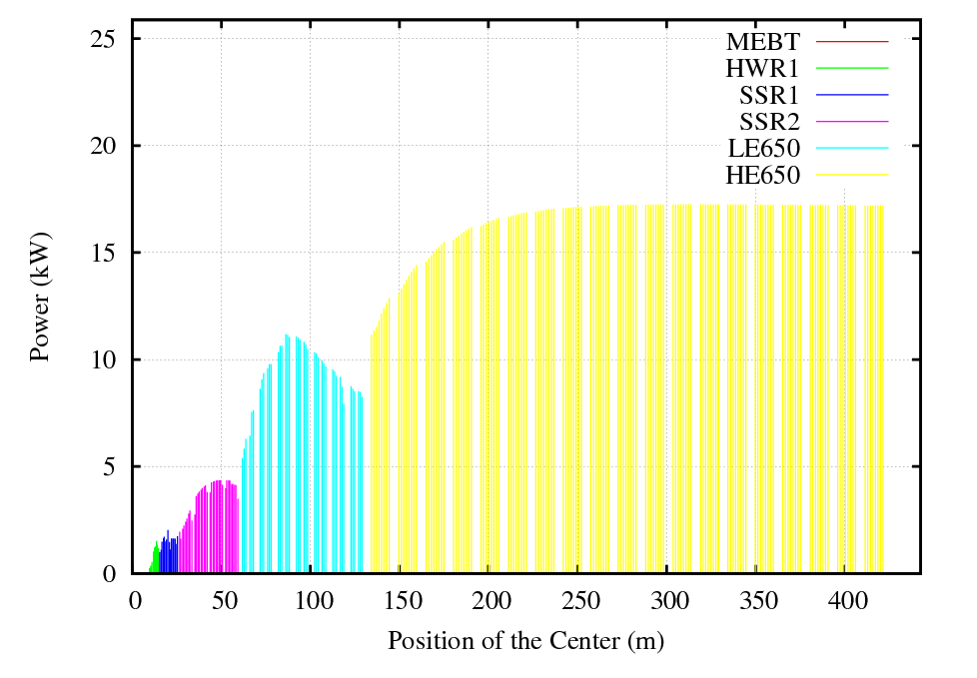
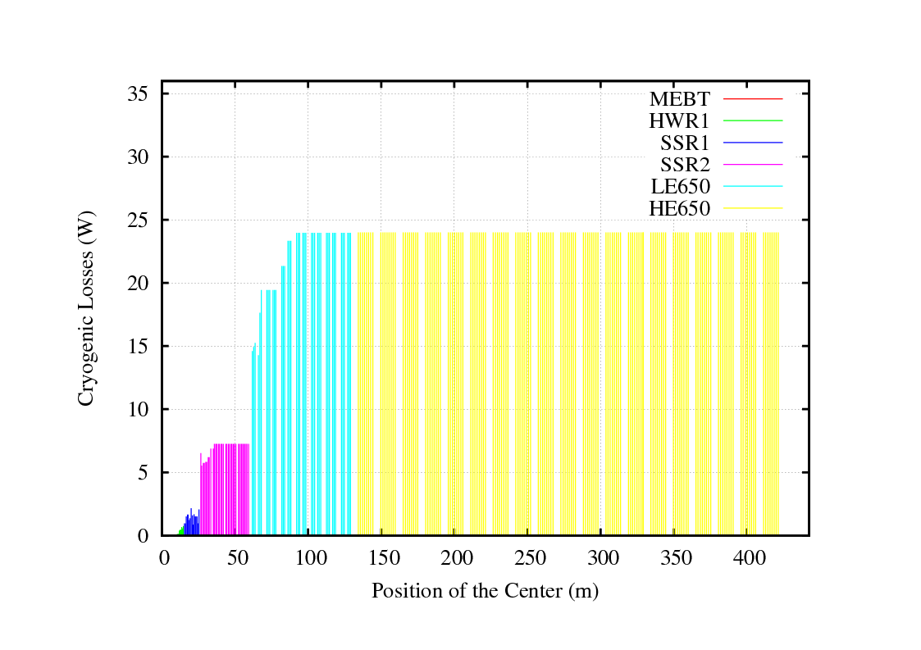
Cryogenic losses
Cavities
Accelerating Gradient*cos(φ)
Surface magnetic field
Beam Power

Slide 17
Segmentation in LB650 and HB 650 sections
Current Lattice
LB650 section
Proposed Lattice
5.1 m
0.8 m
1.0 m
0.9 m
CM
Cav
Cav
Cav
Cav
Cav
Cav
Cav
Cav
Cav
SC Doublet
NC Doublet
NC Doublet
NC Doublet
HB 650 section
1.43 m
CM
CM
Cav
Cav
Cav
Cav
Cav
Cav
Cav
Cav
Cav
Cav
Cav
Cav
Cav
Cav
NC Doublet
14.31 m
NC Doublet

Slide 18
Motivation
Use of only one type of magnet in LB650 section
  Warm magnets (doublet). Option: Permanent magnets with trim coils:
    strength of quadrupoles vary in range ~20%
Two layouts are studied.
  3 cavities and 6 cavities per cryomodule in LB650 and HB650 section respectively (3 x 6 configuration)
  4 cavities and 8 cavities per cryomodule in LB and HB section respectively (4 x 8 configuration)

Slide 19
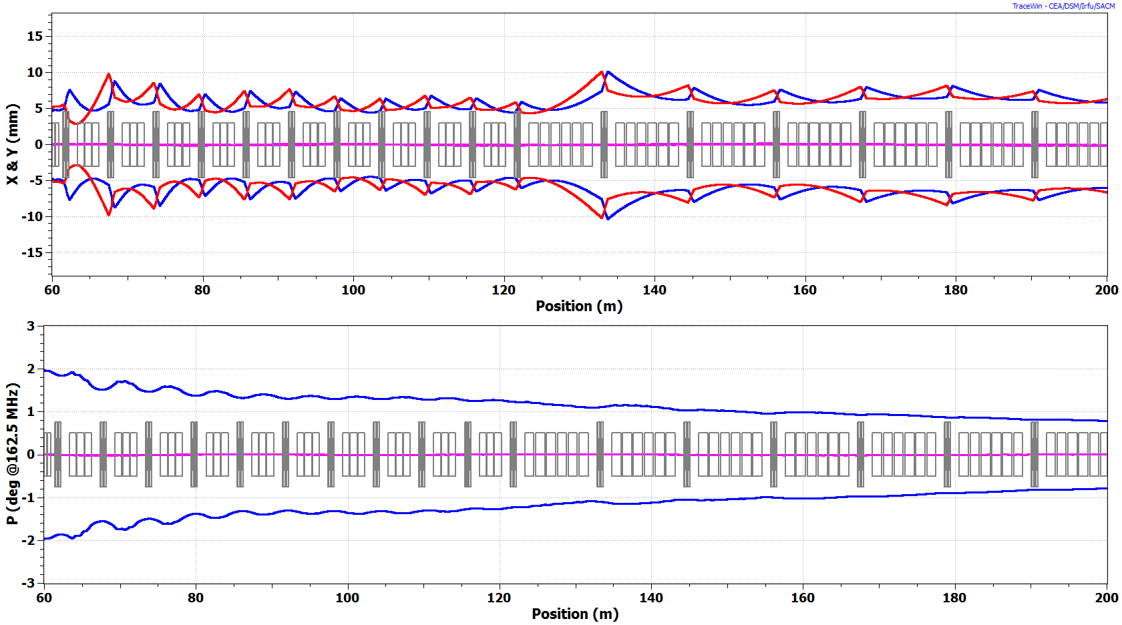
Configuration 3 x 6 (0.48 -1 GeV)
LB 650
HB 650
SSR2
1-3 GeV CW Linac
Beam Envelopes (4rms)
Smooth optics , no emittance growth in the 650 MHz sections

Slide 20
Summary of the cryo-segmentation studies @ 650 MHz section (1GeV)
Sections | Cavity/Mag/CM | Energy
LB 650 | 30/10*/10 | 471 MeV
HB 650 | 42/7*/7 | 1 GeV
Final Long. norm.emit | π ∙mm∙mrad | 0.26
Final Transv. norm.emit | π ∙mm∙mrad | 0.21
CASE 1:
LB650:3cav/CM
B650:6cav/CM
Sections | Cavity/Mag/CM | Energy
LB 650 | 32/8*/8 | 480 MeV
HB 650 | 40/5/5 | 1 GeV
Final Long. norm.emit | π ∙mm∙mrad | 0.255
Final Transv. norm.emit | π ∙mm∙mrad | 0.208
CASE 2:
LB650:4cav/CM
B650:8cav/CM
3 LB cavities and 6 HB cavities per cryomodule
- Short focusing period, good for beam optics, but higher number of CM’s
4 LB cavities and 8 HB cavities per CM is possible, but
  - Further studied are need to verify sensitivity against errors.

Slide 21
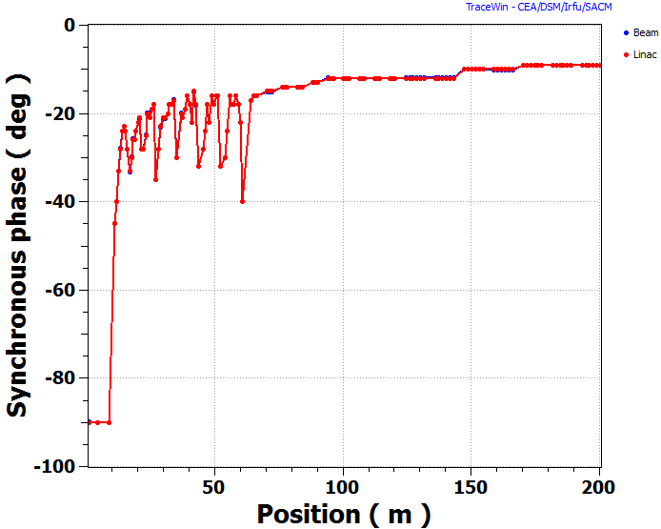
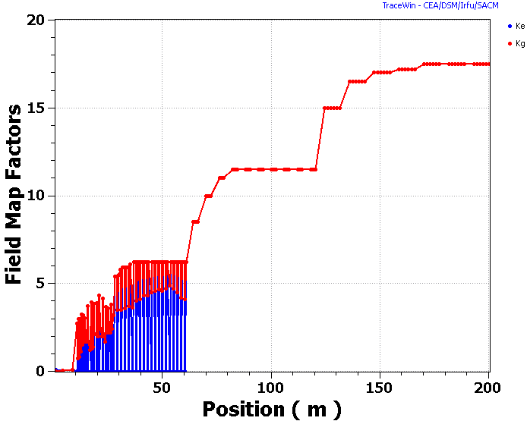
Synchronous phase and Voltage
650 MHz sections
Energy Gain per Cavity

Slide 22


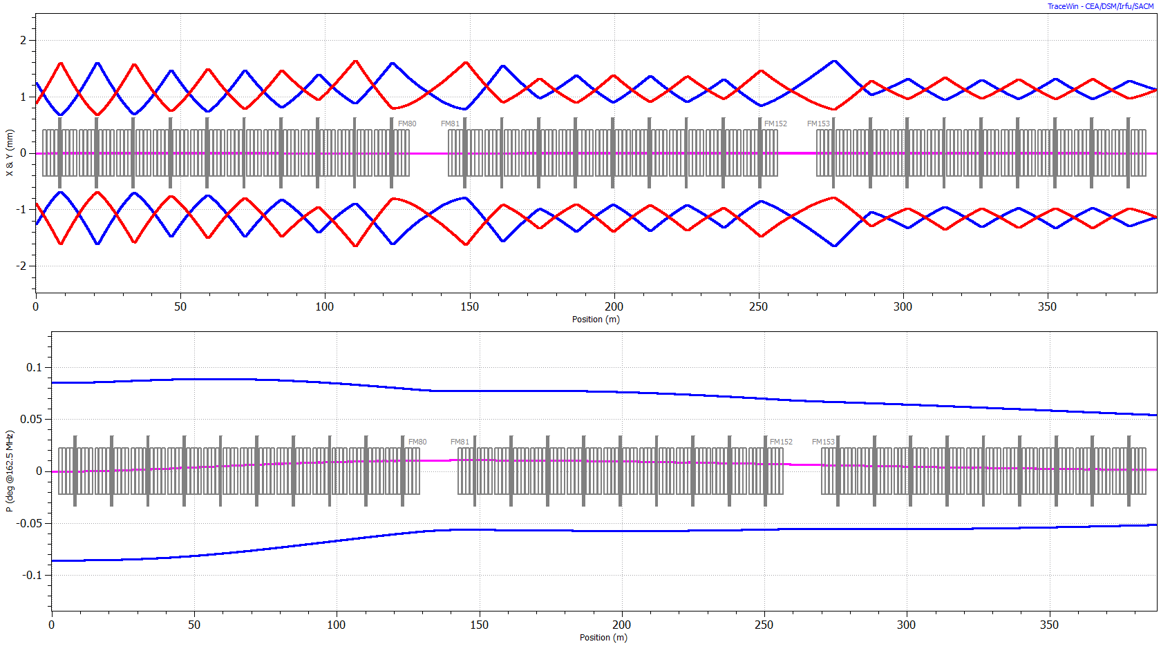
Pulsed 3-8 GeV Linac (5% duty cycle)
Parameter | Unit | Value
Frequency | MHz | 1300
Peak Current | mA | 1
Beam Pulse length | ms | 4.2
Rep. rate | Hz | 10
Filling Time | ms | 3(4)
Average gradient | MV/m | 23.06
Synchronous Phase | deg | -8
Quad. length | mm | 666
Quad aperture (radius) | mm | 35
Quad. Gradient range | T/m | 2.4 - 1.7
Q₀/Q_{load} | - | 10¹⁰/10⁷
RF power per CM | kW | 400
Aka XFEL segmentation.
3 Cryo-Strings separated by RT sections
28 Cryomudules (10-9-9) totals
8 cav. & 1 quad per CM
6 Sevice Cryogenic Boxes (SCB) ~ 2.5m
2 RT sections (7.652m)
Separation between CS: 12.652m (CM)
Simulation result (TraceWin/Partran):

Slide 23
PXIE - Project X Injector Experiment
PXIE – Front-End of the Project X CW linac
PXIE should deliver 1 mA CW beam to ~25 MeV energy
PXIE includes:
  5 mA ion source
  LEBT with pre-chopper
  2.1 MeV 162.5 MHz CW RFQ
  MEBT with bunch-by-bunch chopper and 11 kW beam dump
  Two SC cryo-modules: HW -162.5 MHz & SSR1 – 325 MHz
  Diagnostics Section and 50 kW beam Dump
PXIE schematic layout. The total facility length is about 40 m.

Slide 24
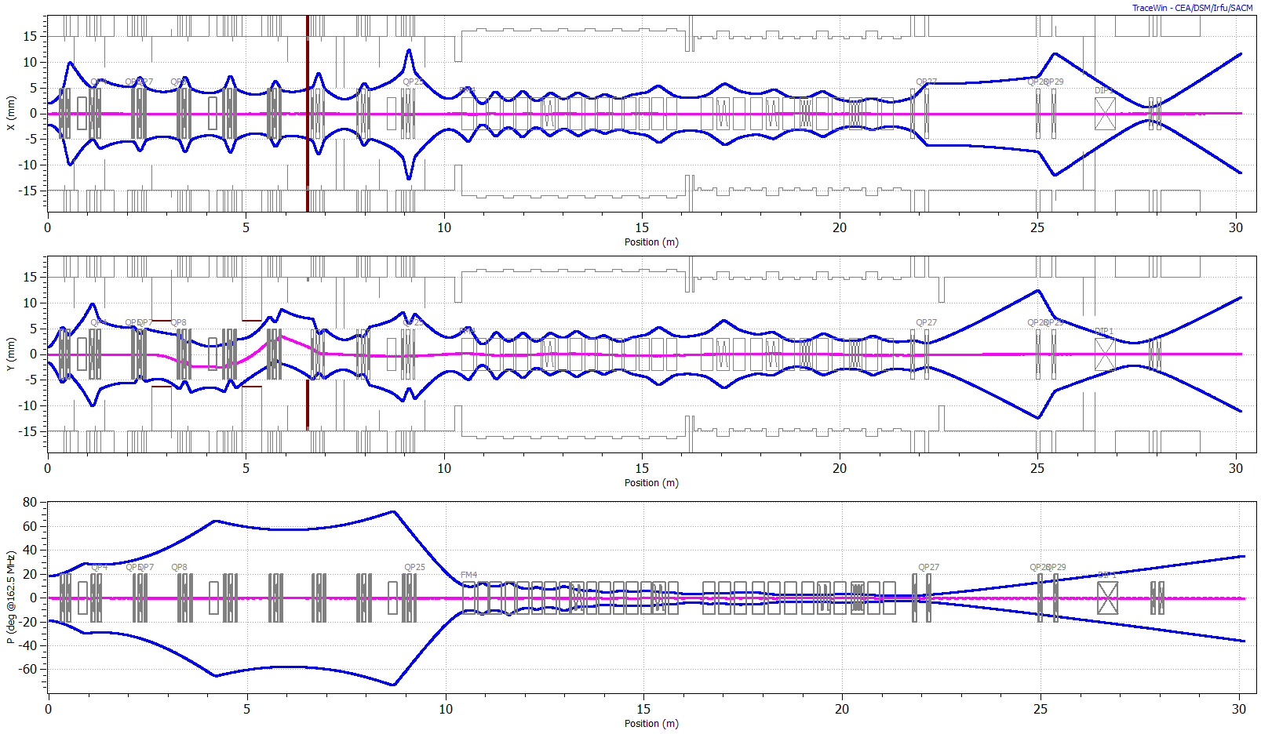
PXIE optics (3-σ envelope)
Beam Dump (50 kW)
RFQ
MEBT
SC
HWR
SSR1
Diagnostics & Dump
8 x (S-C)
4 x (C-S-C)
Kicker polarity in chopper are set for passing beam

Slide 25
PXIE Goals and challenges
Specific technical PXIE program goals are to demonstrate (challenges):
  reliable operation of a CW 2.1 MeV RFQ accelerator,
  a bunch-by-bunch chopper; Arbitrary bunch pattern (5 mA from IS -> 1 mA)
  low-β acceleration in SRF cryomodules
  sufficiently small emittance growth during initial acceleration and
  good particle extinction for the removed bunches (10⁻⁴ – PXIE specs)
PXIE has to operate at full Project X design parameters delivering up to 1 mA average current while accommodating up to 100% chopping of 5 mA RFQ beam.
The beam current upgradability requirement (to 2 mA CW) is determined by possible staging of the Project X and its future upgrades.
The PXIE design and construction is being carried out by collaboration between Fermilab, ANL, LBNL, SLAC and Indian institutions. It is planned to have PXIE operational (at least: 15 MeV, 1 mA CW, 5 mA peak, arbitrary bunch chopping) by the end of 2016.

Slide 26
LEBT
No BEND in current design
Longer LEBT option (3 solenoids):
implementation of several diagnostics, in particular after the chopper.
avoid re-neutralization (and transition effects)
Beam optics in LEBT.

Slide 27
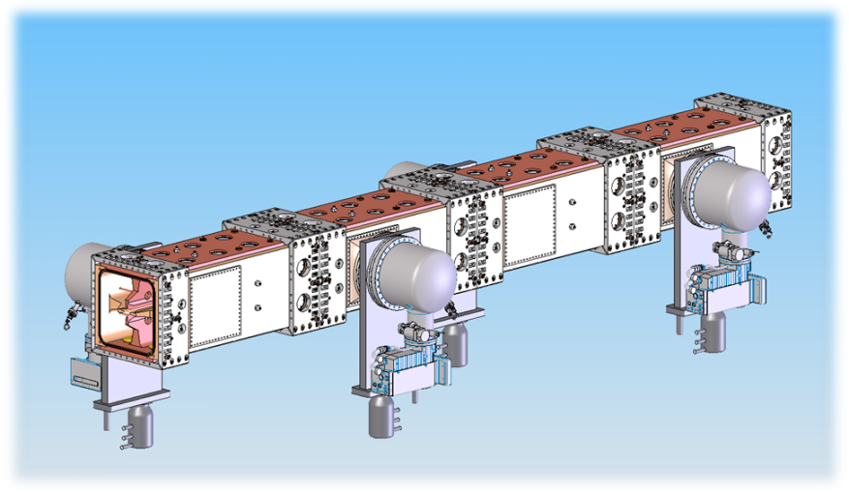
RFQ design (LBNL)
Parameter | Value | Units
Ion type | H-
Beam current (nom/range) | 5 (1-10) | mA
Trans. emitt. (rms, norm) | <0.25 | µm
Long. emitt. (rms) | 0.8-1.0 | keV-ns
Input energy | 30 | keV
Output energy | 2.1 | MeV
Vane-vane voltage | 60 | kV
RF power | 100 | kW
Beam Power | 10.5 | kW
Length | 444.6 | cm
Frequency | 162.5 | MHz
32 pi-mode stabilizers, 4 pairs in each module separate the dipole frequency to 17 MHz above the 162.5 MHz quadrupole frequency
80 tuners, 20 in each quadrant have a diameter of 6 cm, a nominal insertion of 2 cm, and a tuner sensitivity of 170 kHz/cm, all tuners moving together.
J.Staples

Slide 28
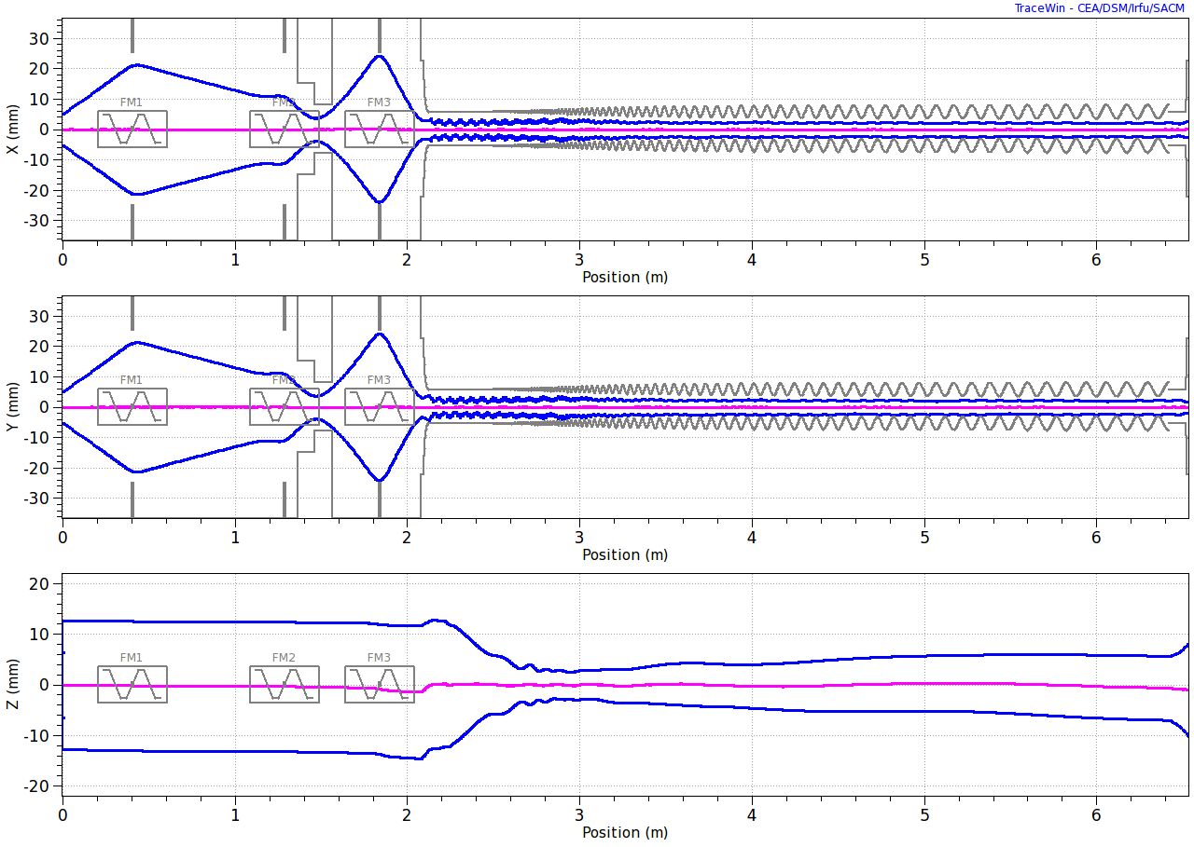
Input = Gaussian Beam, Envelopes (3-sigma)
Beam dynamics in LEBT + RFQ
LEBT
RFQ
Neutralized
un-neutralized
Details in F.Ostiguy presentation, Nov.29,2012

Slide 29
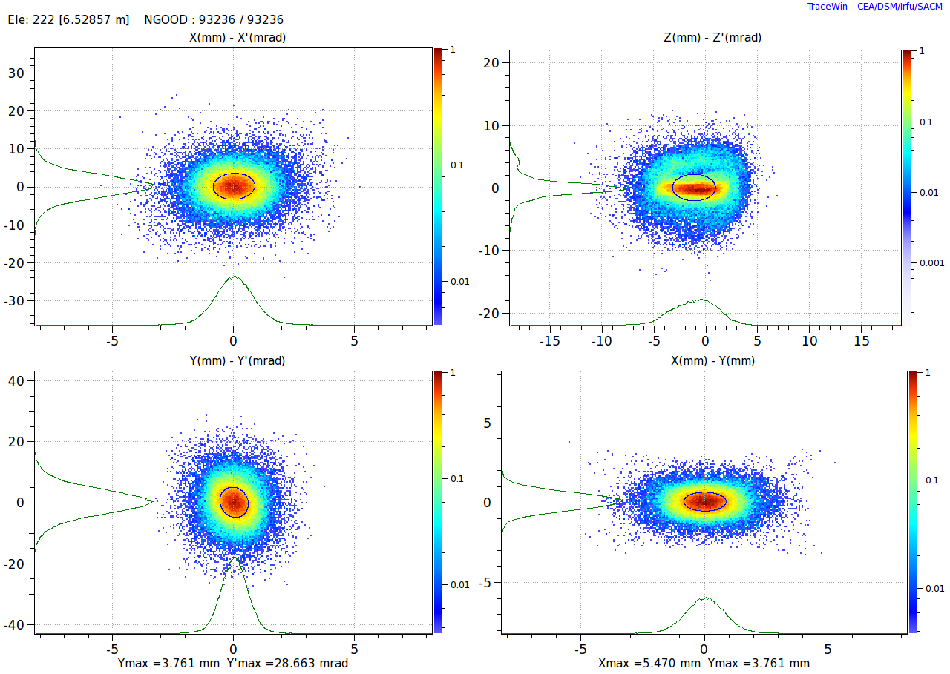
LEBT + RFQ
LEBT Input = Ideal Gaussian Beam
Distributions at RFQ Input
0.198 mm-mrad
0.295 mm-mrad
LEBT tuned to matched beam parameters at RFQ input

Slide 30
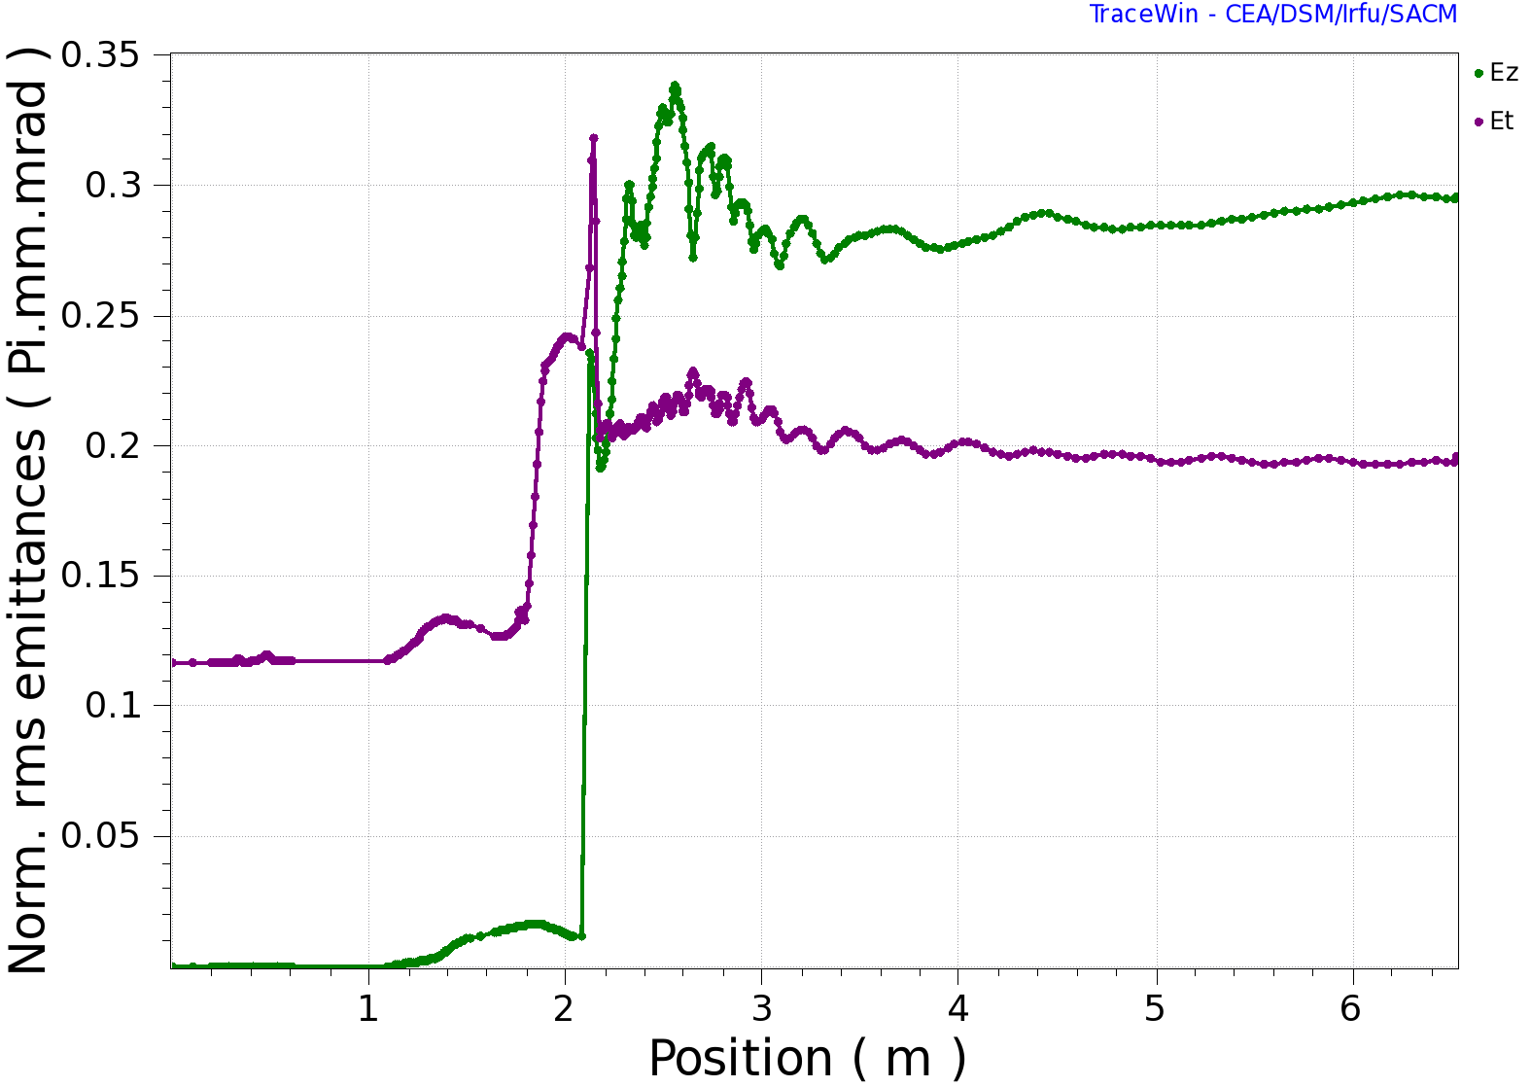
LEBT + RFQ
Input = Gaussian Beam
Emittance Evolution
Longitudinal
Transverse

Slide 31
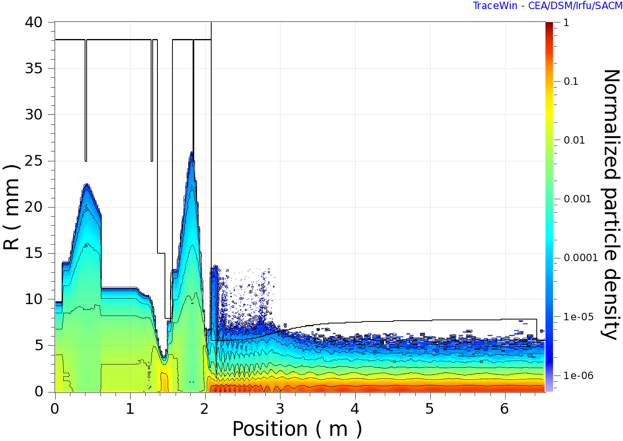
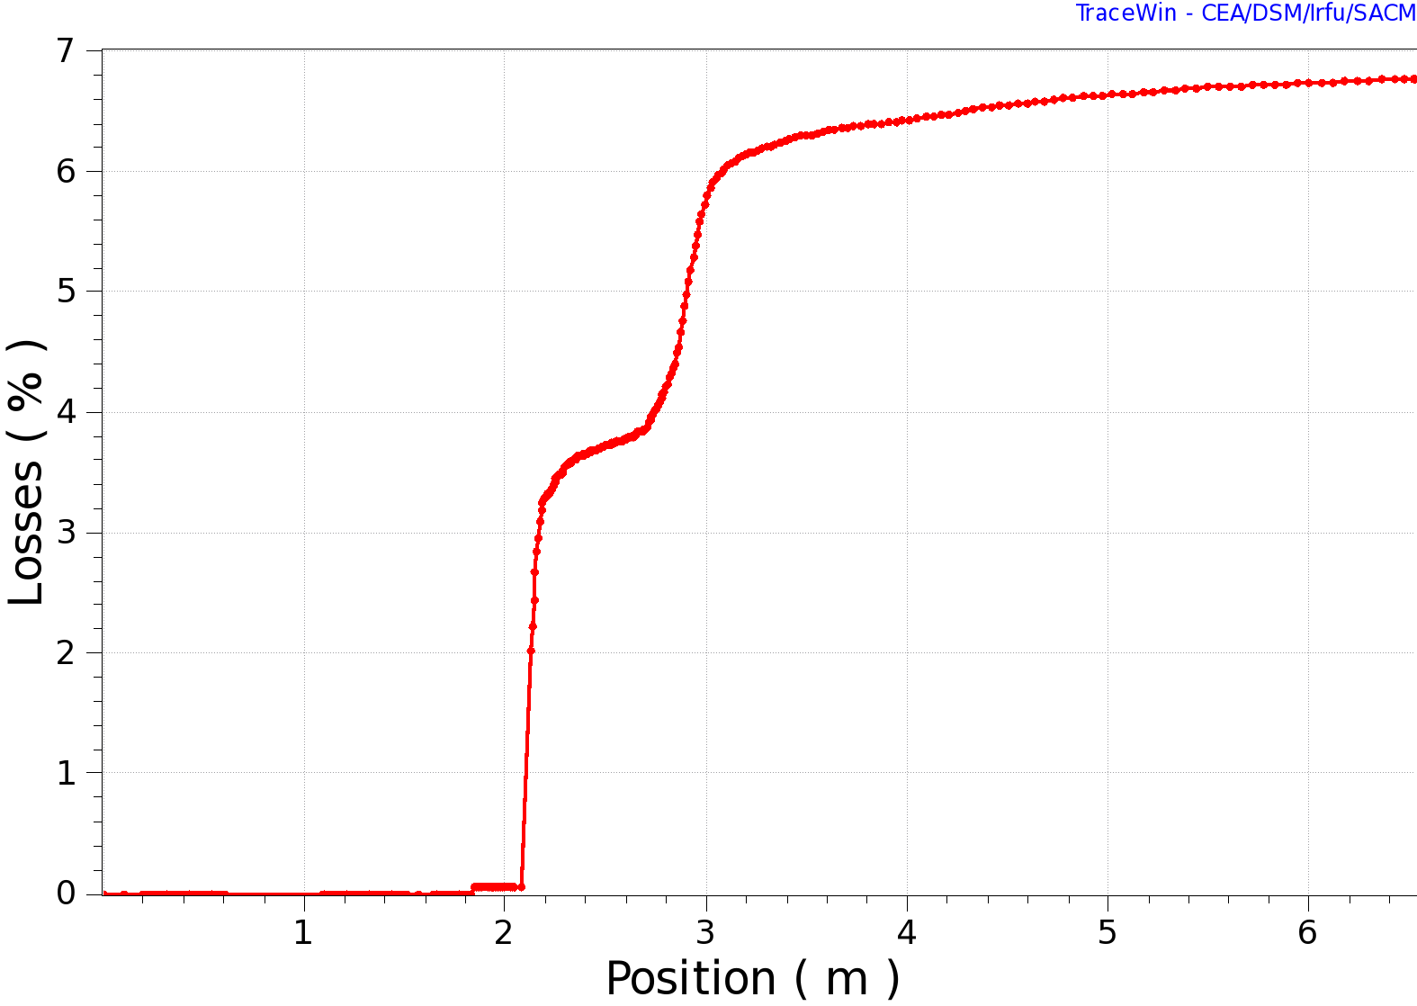
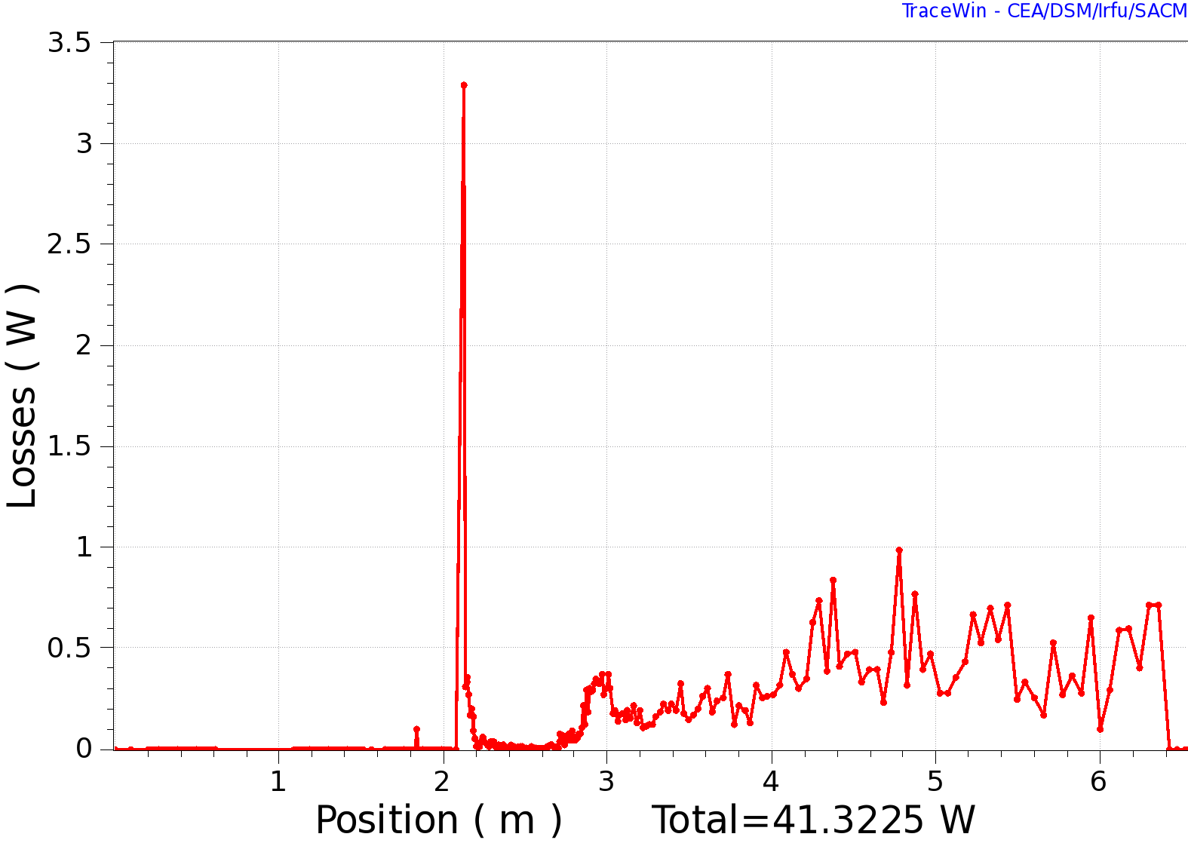
LEBT + RFQ
Input = Gaussian Beam: Particle and Power Losses

Slide 32
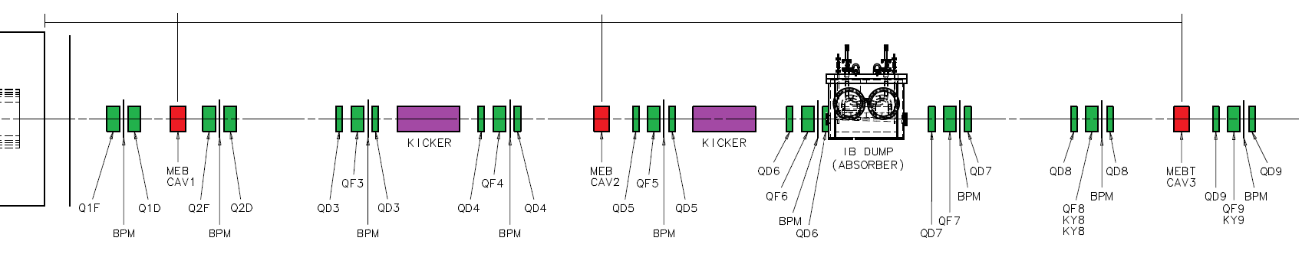
MEBT: Beam chopping & diagnostics
RFQ
All components are room temperature; Length ~10 m
Violet - chopping system: 2 kickers (180° tr. phase adv. and absorber (90°from last kicker).
Blue - bunching cavities 162.5 MHz. + other equipment (scarpers and diagnostics).
Yellow – mainly diagnostics to measure beam coming out of RFQ (#1) and to SRF linac (#8)
Green - vacuum pumps and diagnostics. Start/end– interfaces with the RFQ (left) and HWR

Slide 33
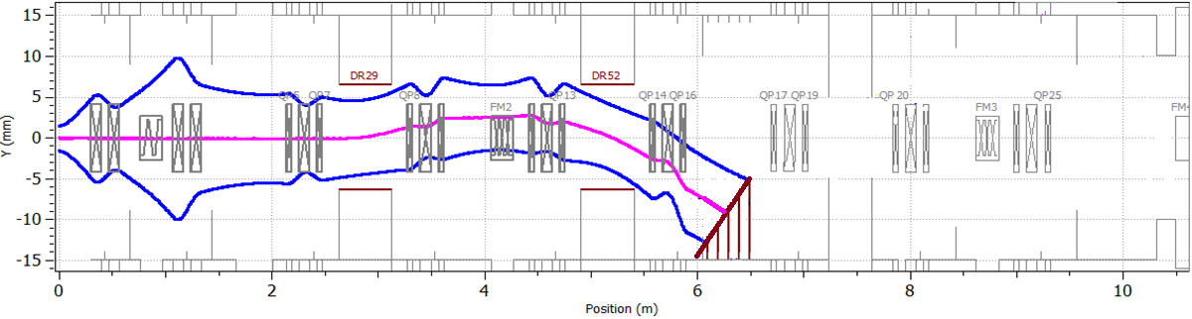
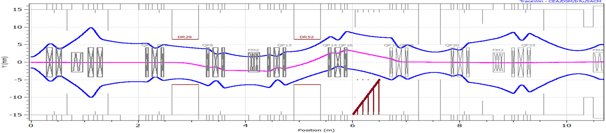
MEBT chopping
Chopped beam
MEBT dump
Passing beam
Use of 2 kickers with 180 deg. phase advance reduces kicker voltage
⇒ ±250 V effective voltage on the kicker, 16 mm gap between plates
DC correctors minimize vertical displacement for passing beam

Slide 34
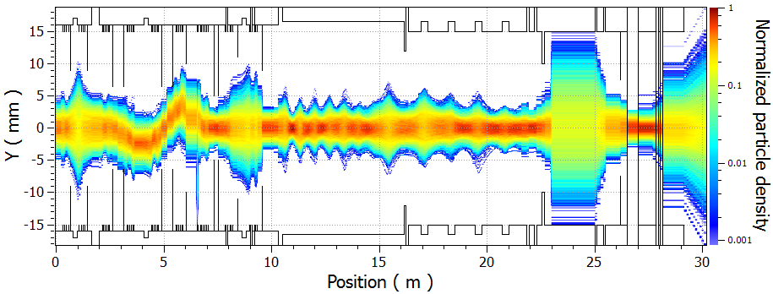
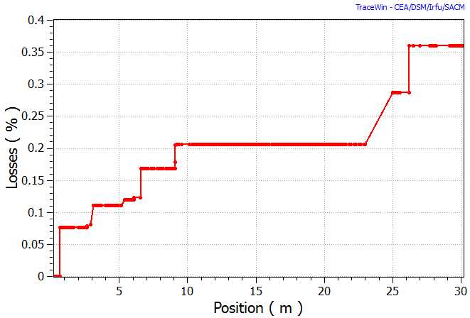
Collimation and Beam Losses
MEBT
SC: HWR+SSR1
Diagnostics
Collimation
Before SCRF
Small losses in SCRF section
MEBT dump
Kicker
Chopped beam are lost at MEBT dump at level 99.94% (6σ Gaussian )

Slide 35
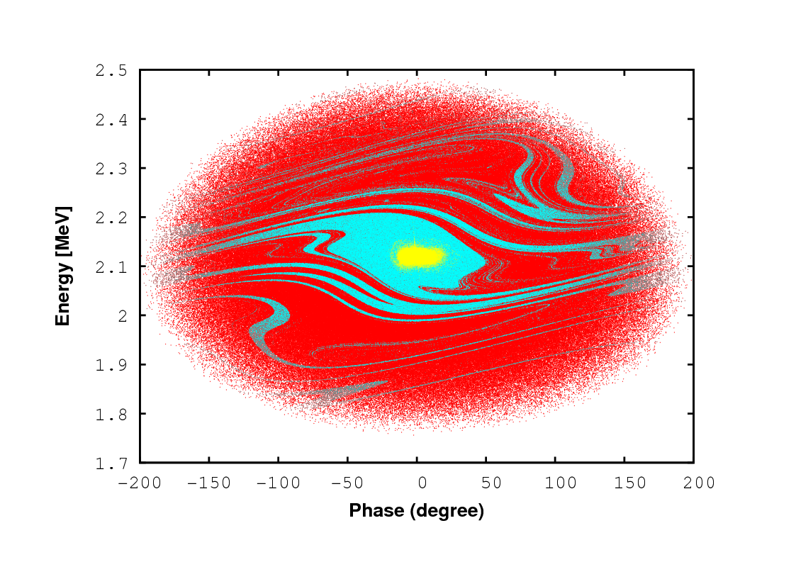
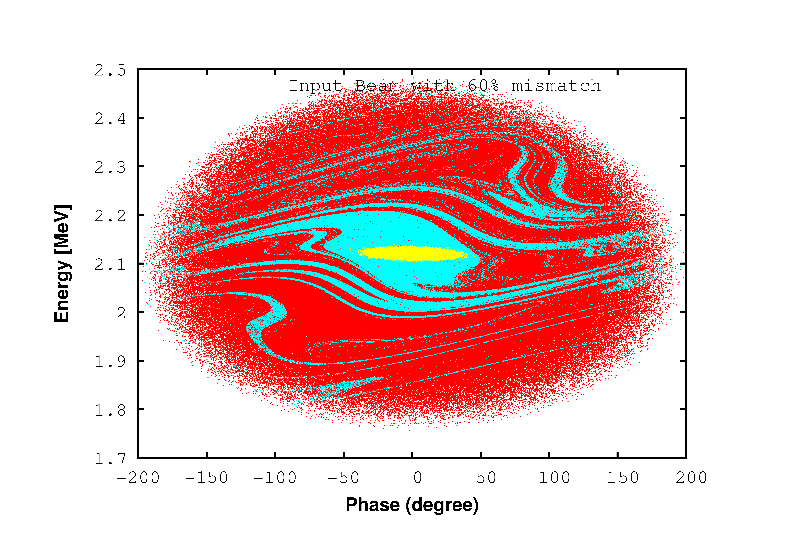
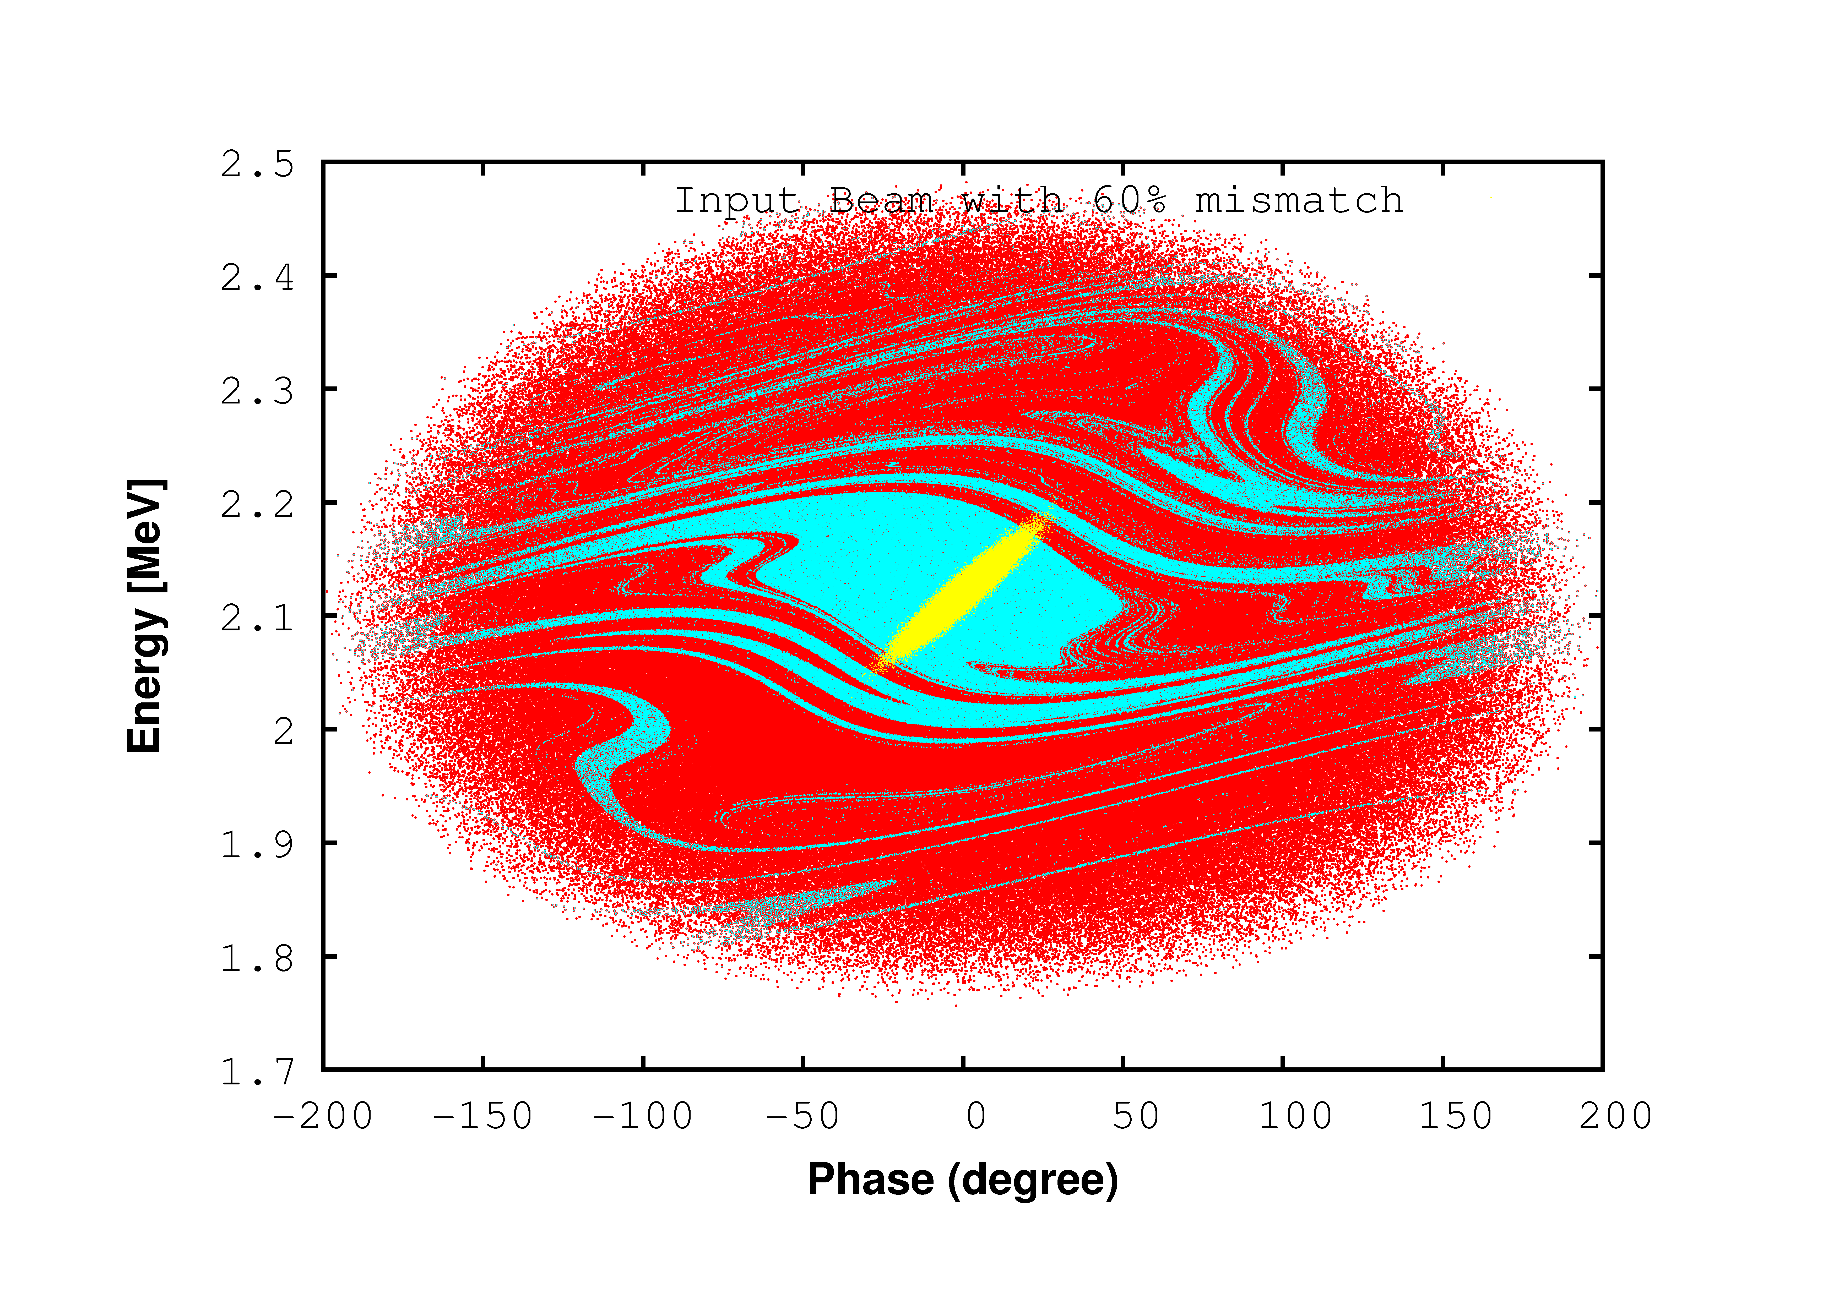
Longitudinal acceptance
Initial distribution
At the end of SSR1 (PXIE)
Acceptance boundary
6σ Gaussian
60 % mismatched input beam @ MEBT entrance
60 % mismatched input beam @ HWR entrance
No mismatched

Slide 36
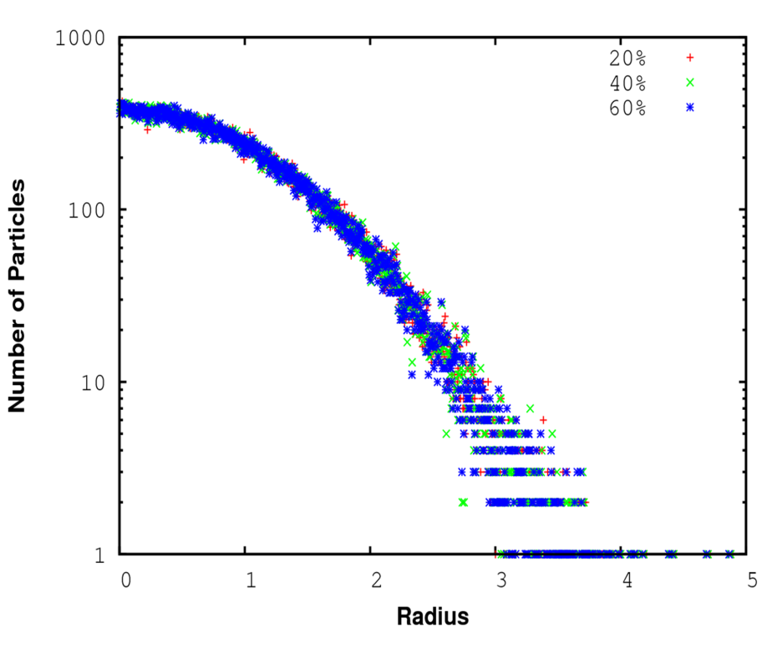
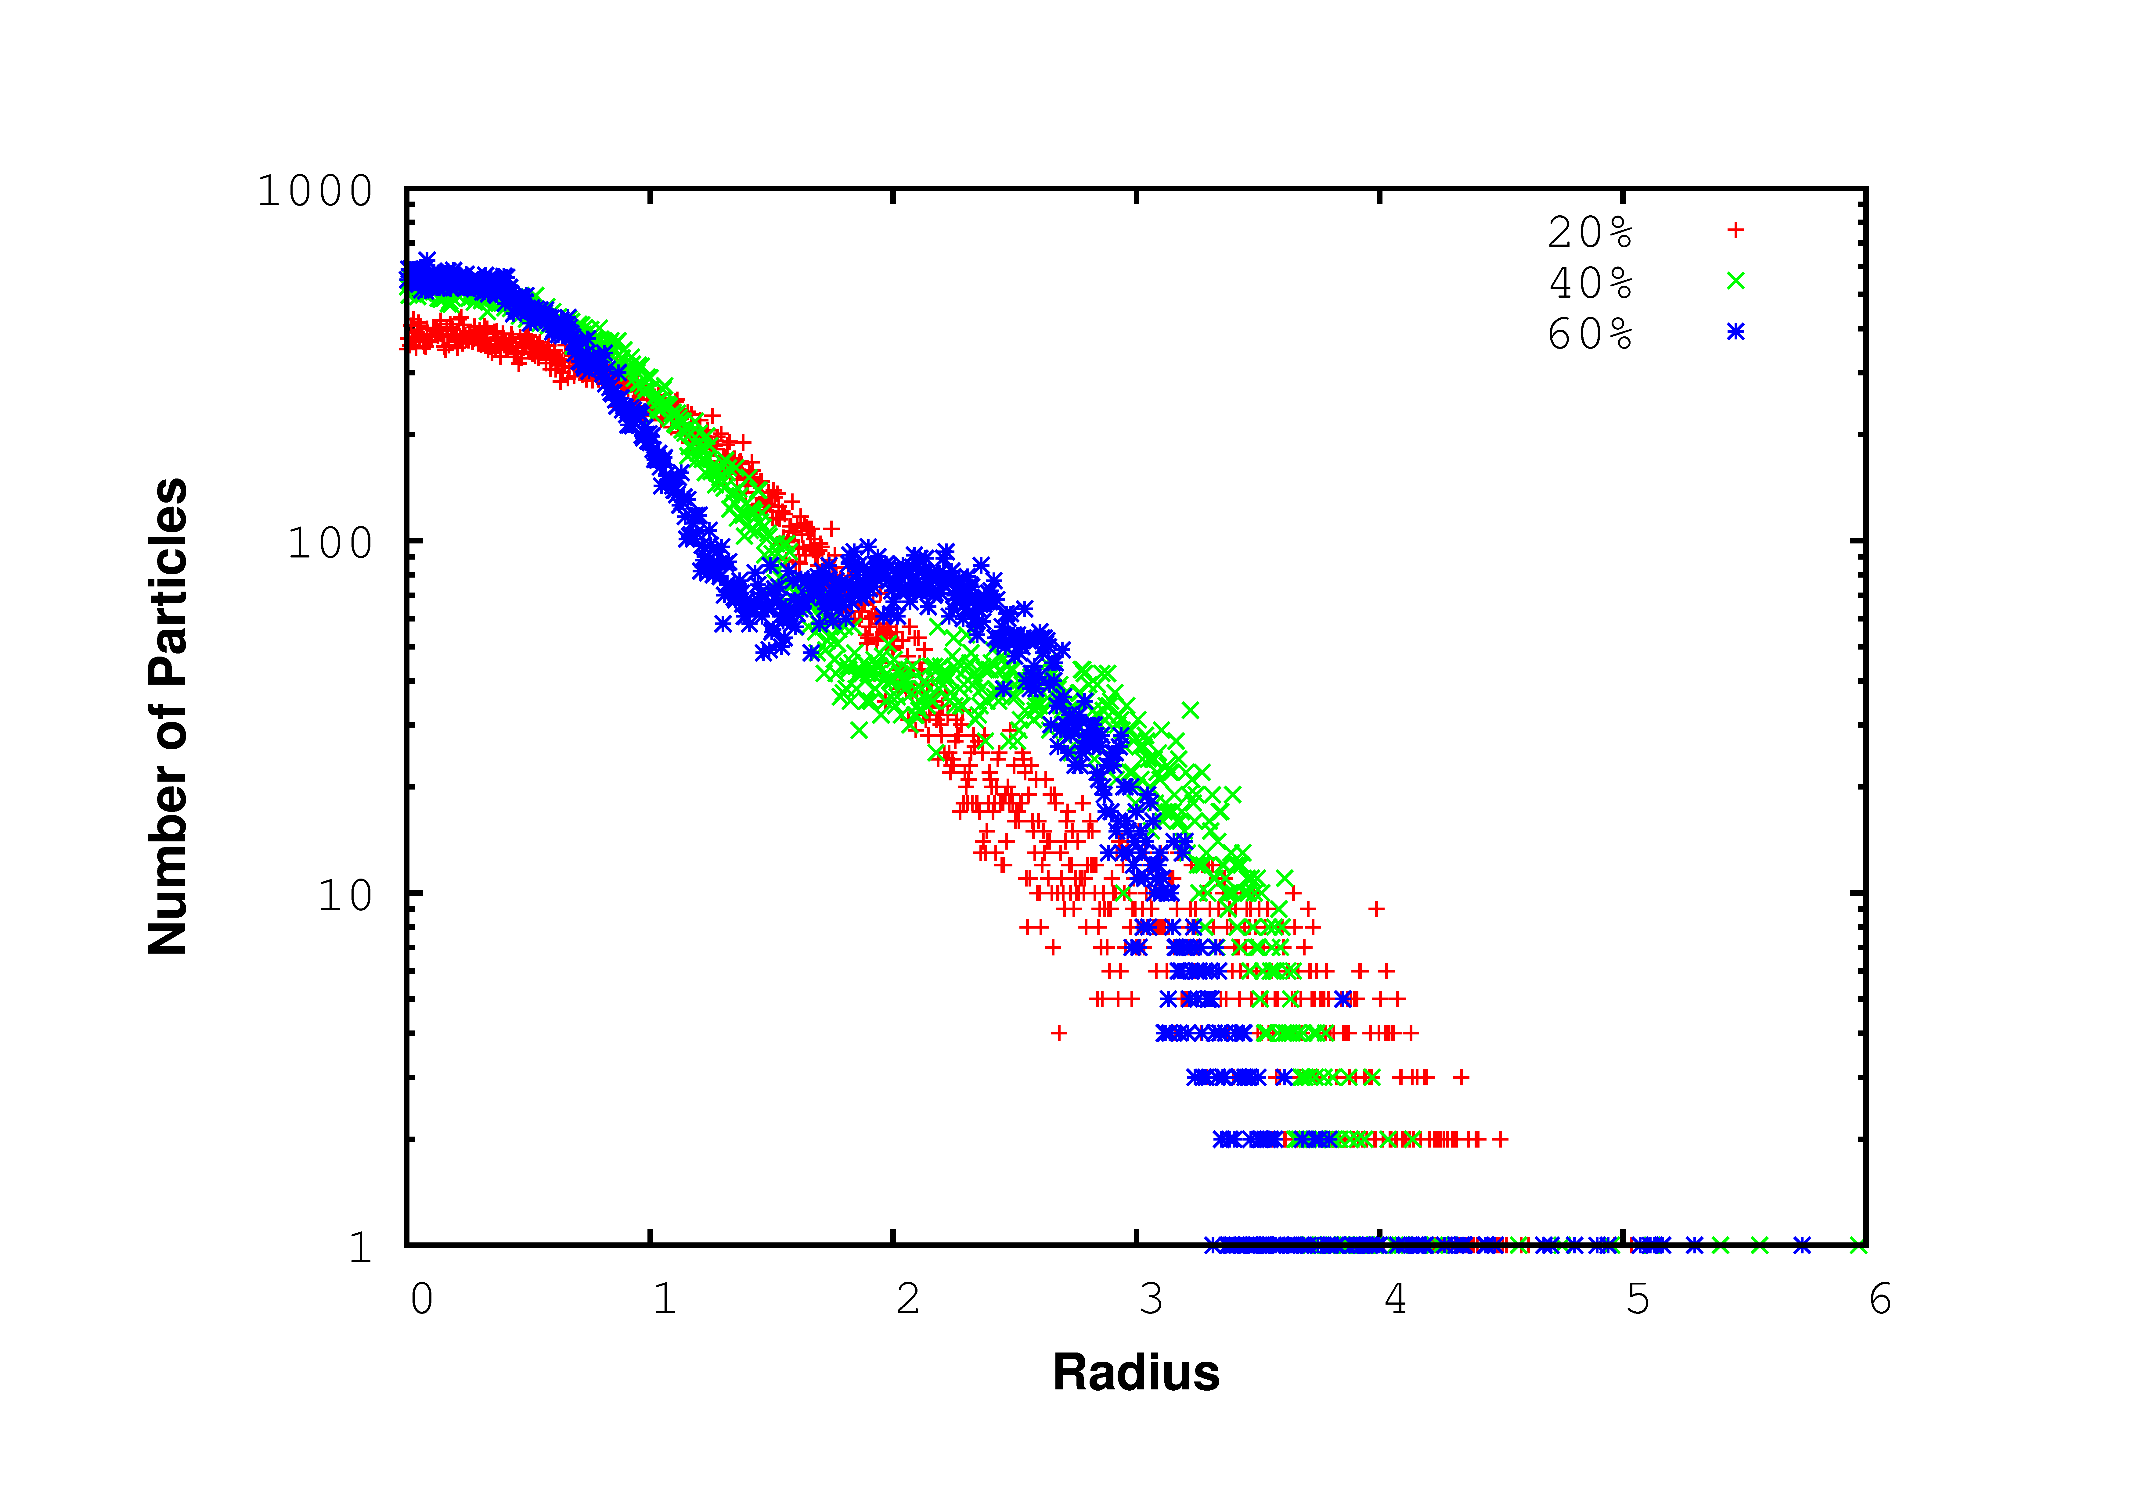
Mismatch effect on Longitudinal profile
R, mm
R/sigma
R/sigma
Input beam @ MEBT entrance
Output beam @end of 1 GeV Linac
Small effect on transverse beam profile

Slide 37
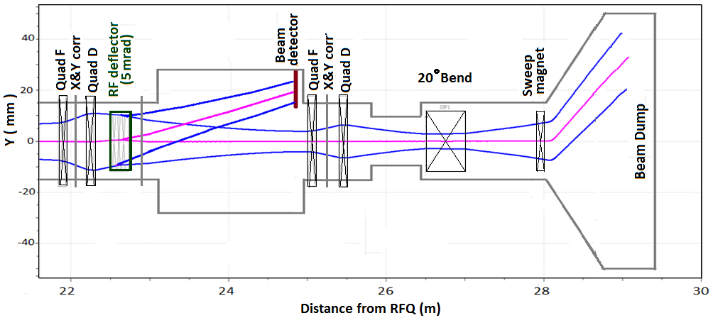
Beam Extinction
Project X will provide beams for different HEP experiments. Some of them (mu2e) have a strict requirement (<10⁻⁹) for beam extinction for removed bunches. An extinction level better than 10⁻⁴ is specified for the MEBT. This number is mainly determined by available in MEBT diagnostics.
DC corrector
Schematic of extinction measurement experiment, 3-sigma envelope for passing and deflecting beams are shown in blue.

Slide 38
Summary
Several iterations of Project X Lattices for CW linac, Pulsed Linac and transport lines were proposed, optimized and studied
  Beam physics studies (cross-check with different codes)
  Halo formation and losses
  Error analysis, including mismatch, misalignments, RF errors
  Failure analysis
  Output➔ Specifications for beam-line components.
Each iteration is result of close work physicists and engineering team of PrX collaboration
PXIE is our nearest goal to evaluate critical technology of the Project X Front-end.

Slide 39
Thank you for your
attention !

Slide 40
Acknowledgments:
Thanks for providing materials for this talk:
S.Holmes, V.Lebedev, S.Nagaitsev, F.Ostiguy, A.Shemyakin, L.Prost, A.Saini, J.P.Carneiro, A.Vivoli, Y. Eidelman, V.Yakovlev, …

