Slide 1
650MHz Cavity, Helium Vessel, and Tuner Status at Fermilab
Chuck Grimm
IIFC POC 650MHz Cavities
Fermilab
(Avinash Puntambekar RRCAT)

Slide 2
Introduction
Single Cell Cavities
Current Cavity Orders
Vertical Test Results & Testing Plans
5-Cell Cavities
Current Cavity Orders
Possible “Future” Design Changes
Spin Forming Seamless Beam Tubes
Helium Vessel
Design Progress
Spin Form Seamless Vessel Tubes
Roll and Seam Weld Vessel Tubes
Stainless Steel to Titanium Flanged Connection
Automatic TIG Welding
Tuners
Blade Tuner
Lever Tuner
Wedge Tuner
Motors

Slide 3
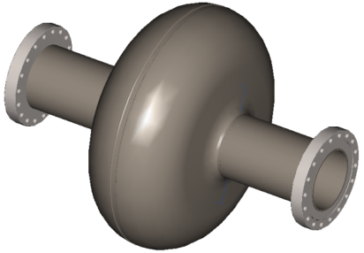
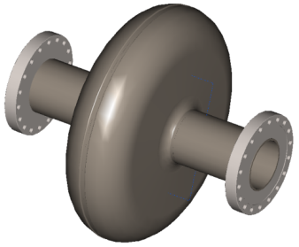
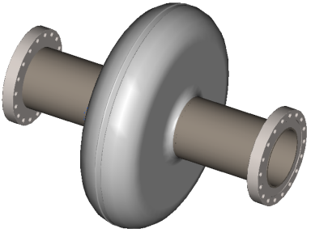
Single Cell Cavities
β= 0.9
β= 0.61 Fermi Design
β= 0.61 J-Lab Design
Current Fabrication Status
Advanced Energy Systems (AES) * (6) β=0.9 cavities; complete in-house
PAVAC Industries * (5) β=0.9 cavities; ordered
Jefferson National Lab (J-Lab) * (2) β=0.61 cavities; complete in-house (part of MOU)
Research Instruments (RI) * (3) β=0.61 Fermi design, (3) β=0.61 J-Lab design; ordered
Test Results
One J-Lab built cavity was vertically tested at FNAL, reached 12 MV/m limited by Q-drop
The 6 AES cavities are scheduled for VTS in early December.

Slide 4
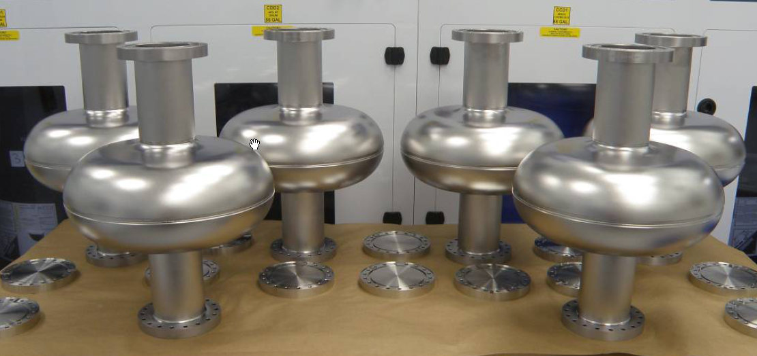
Single Cell Cavities
Six β=0.9 cavities produced by AES and delivered to FNAL in 2012

Slide 5
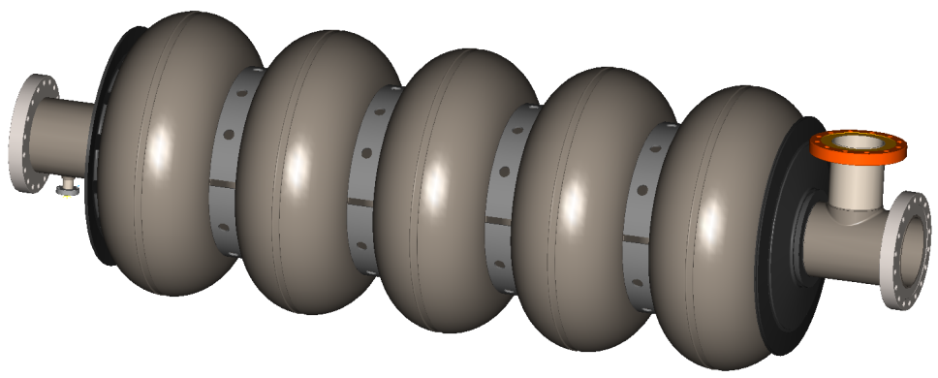
5-Cell Cavities
β= 0.9
Current Fabrication Status
AES * (4) β=0.9 cavities; ordered
PAVAC * (5) β=0.9 cavities; ordered
RI * No multi-cell cavities on order
Future Design Changes?
Larger beam tube diameter and iris
Longer beam tube to accommodate a lever tuner?
Transition spool re-design for cost reduction

Slide 6
5-Cell Cavity Design Challenges
β= 0.9
Considerations for Future Changes Based On:
Low Bandwidth
CW Operation
Tough Requirements For Microphonics
Small dF/dP (self-compensating and self-tuning schemes)
Good Tuneability ( small load for piezos and tuner motors)
Good Efficiency of Tuning (stiffening ring optimization)
No Limitations in Longitudinal Size but Limitations in Transverse Size
Problems with Lorentz Detuning
Compact, Simple and Reliable Course Tuner w/o Backlash
Inexpensive Cavity Design (design for cost cutting)??

Slide 7
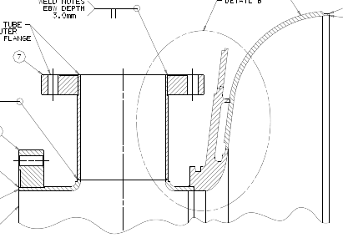
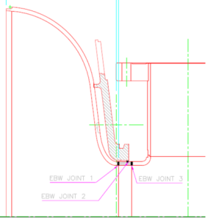
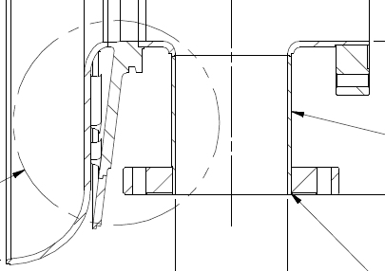
5-Cell Cavity Transition Spool
J-Lab Design
Fermilab Design
RRCAT Design
(A. Puntambekar)
Transition Spool Redesign (Cost Reduction)
Raw Material Cost for RRR niobium ~20K
Multi-Piece Fabrication
Mixture of RRR Niobium and Reactor Grade Niobium

Slide 8
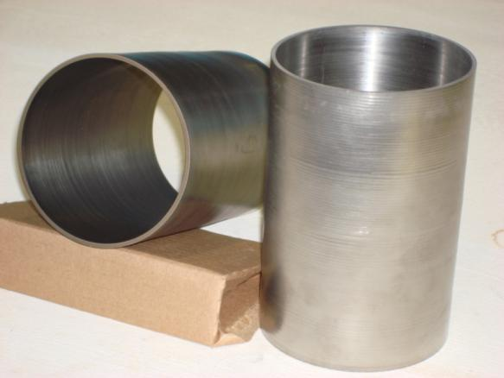
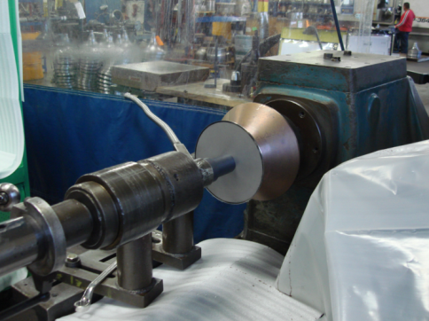
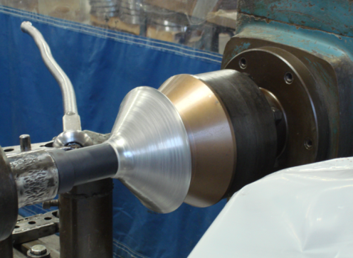
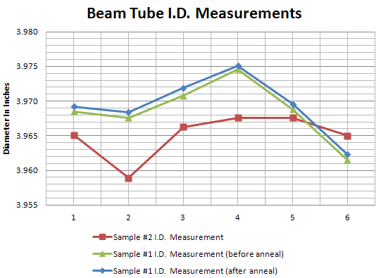
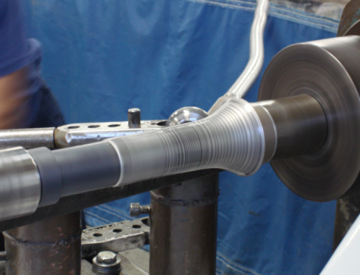
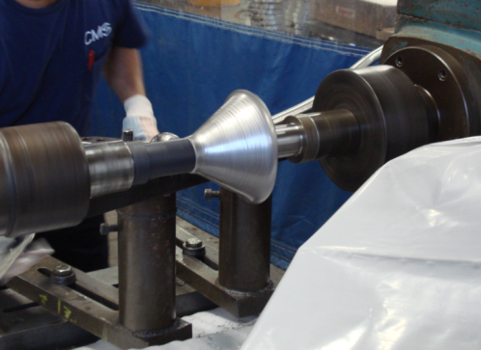
5-Cell Beam Tubes

Slide 9
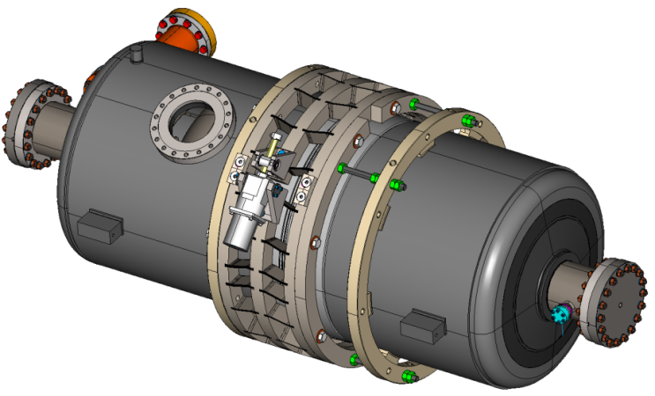
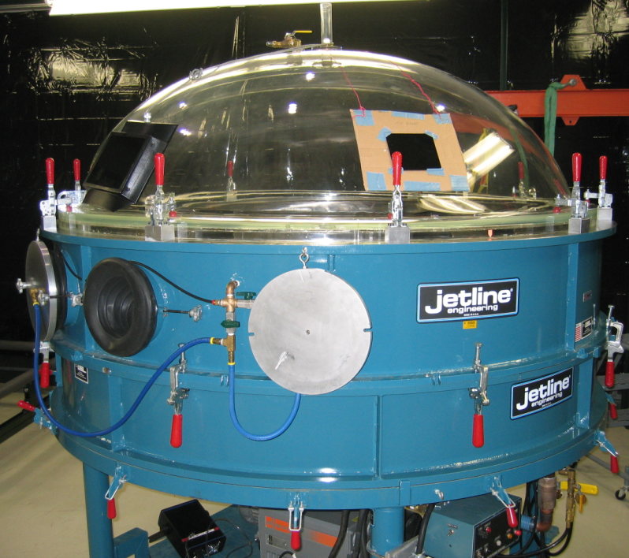
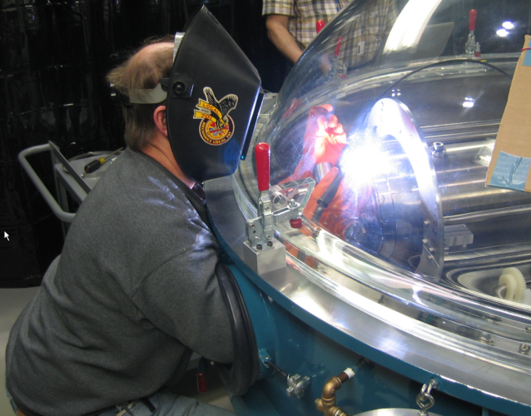
Helium Vessel
Design of helium vessel (Baseline) – Considerations
Spin form seamless vessel tubes
Roll and seam weld vessel tubes
2-phase pipe connection of He vessels
Tuner type
Automatic TIG welding machine for cavity dressing
Moving out of the (glove) box

Slide 10
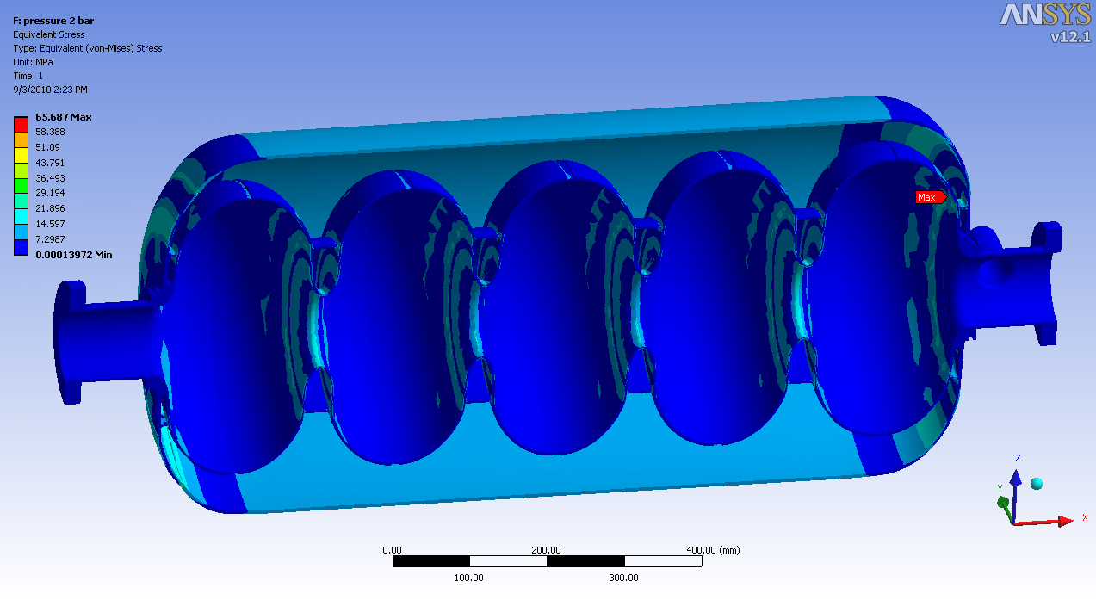
Helium Vessel Analysis
Preliminary analysis at 2 Bar pressure at room temperature shows no stresses above 30 Mpa (By Serena Barbanotti)

Slide 11
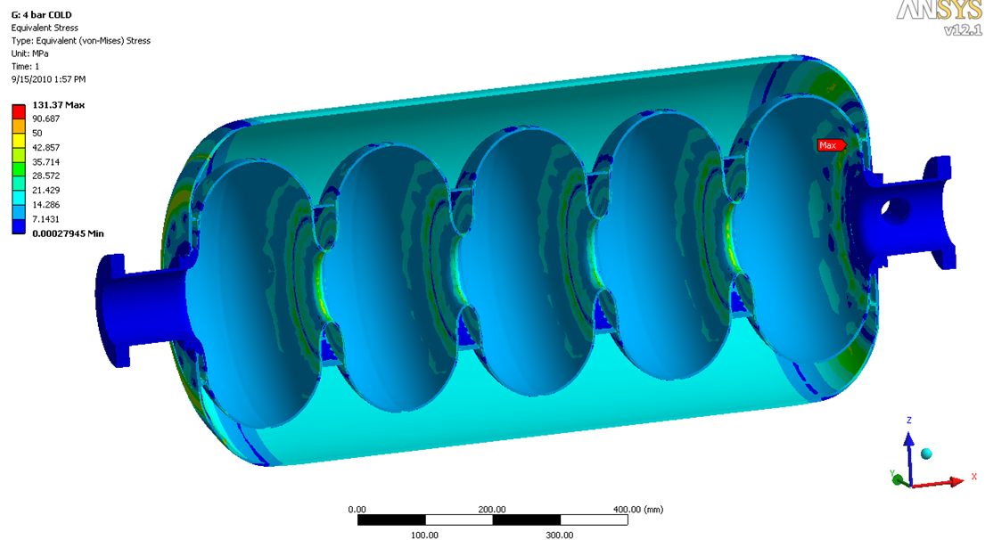
Helium Vessel Analysis
Preliminary analysis at 4 Bar pressure cold (2K) shows no stresses above 40 Mpa (By Serena Barbanotti)

Slide 12
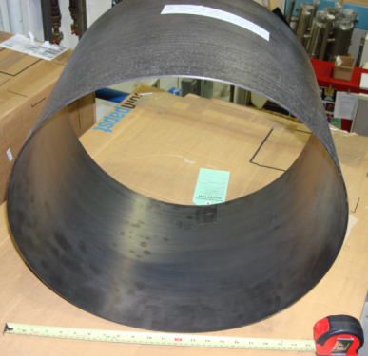
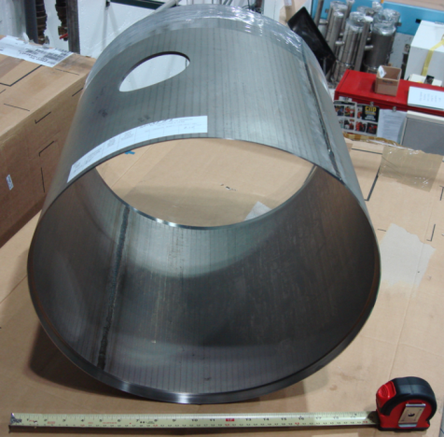
Helium Vessel
Spin form seamless vessel tubes
Leak check – good
Dimensional QC – good
Pull-out test – next
Roll and seam welded vessel tubes
Leak check – good
Dimensional QC – good
Continue prototype fabrication - next

Slide 13
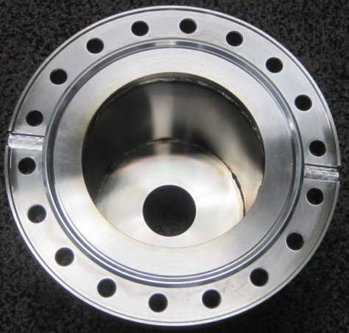
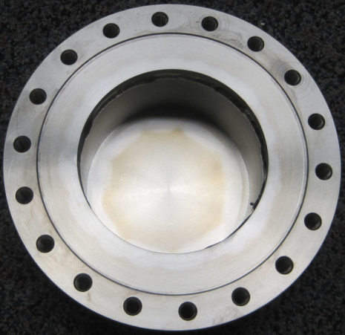
Flange Connection
316L Stainless Steel
Grade 2 Titanium
Flange test assemblies were fabricated to replicate the helium vessel to cryomodule connection
Grade 2 titanium connection is the same as the beam flange and will use a common hex seal
316L stainless steel 2-phase connection uses a groove socket to hold seal in place for an inverted connection (seal shown in photo)

Slide 14
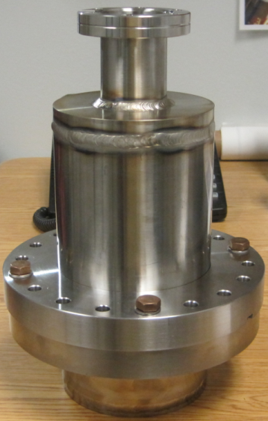
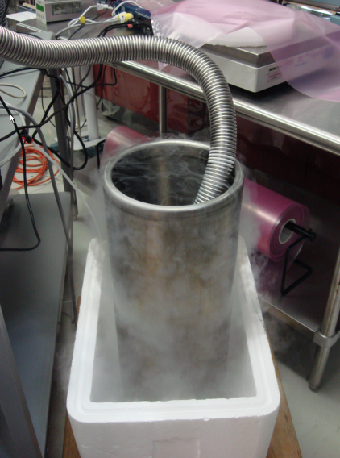
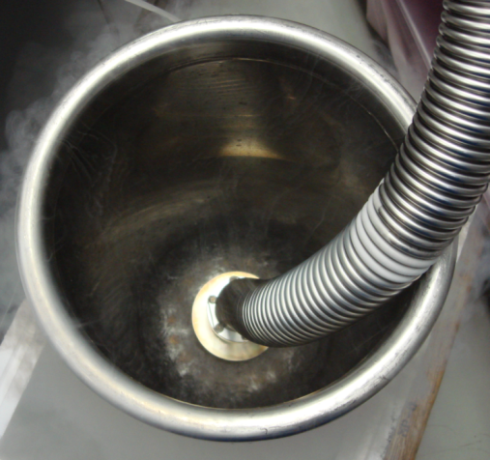
Flange Connection Cold Shock
Flange assembly was leak checked prior to cold shock testing
No detectable leaks were found
Flange assembly was submerged in LN2 while system was actively pumping
Assembly was removed once boiling activity stopped

Slide 15
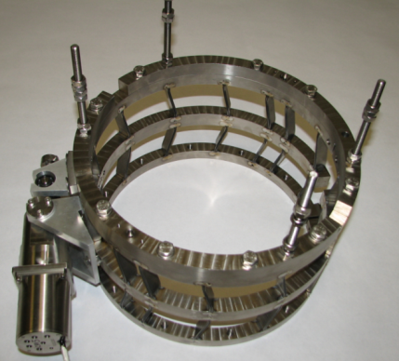
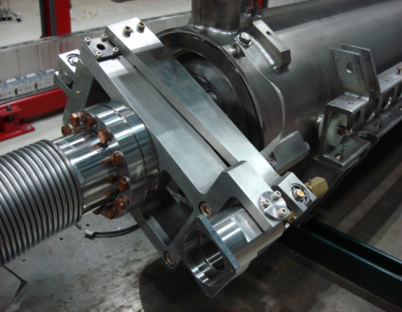
Tuners
?
Lever Tuner
Indian
Wedge Tuner
(Currently being shipped to
Fermilab from India)
Blade Tuner
(Baseline Design)

Slide 16
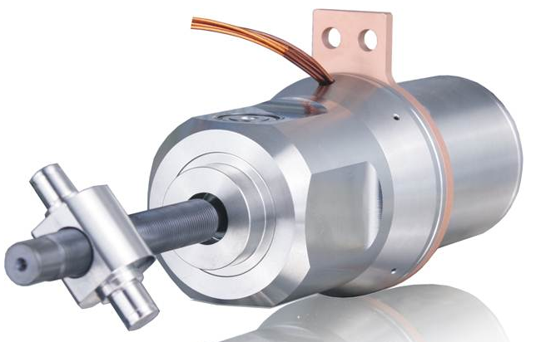
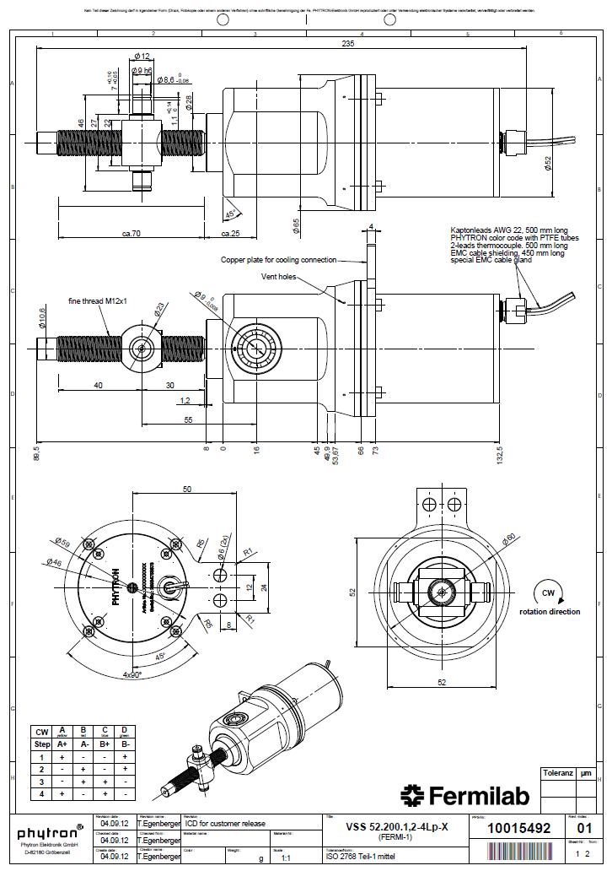
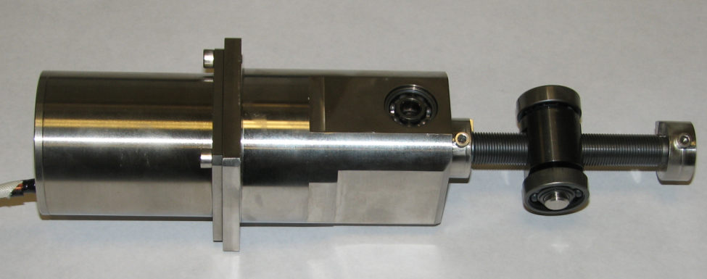
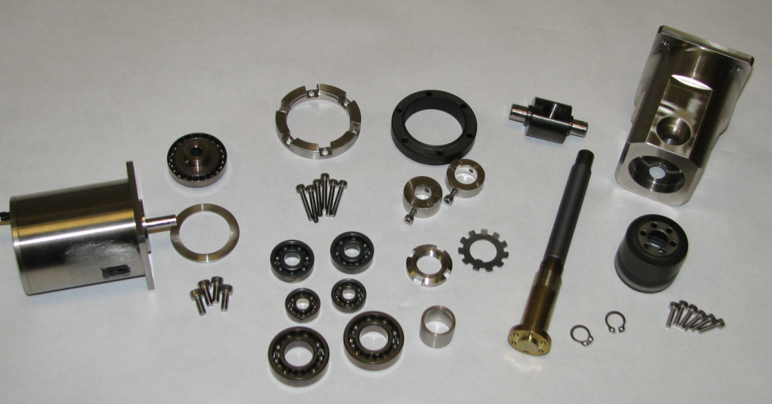
Tuner Motors
Purchase complete assembled
units from Phytron
Planetary gears
Lifecycle study at Fermilab
Common design for 325, 650, &
1300MHz cavities
About the same cost as current
design

Slide 17
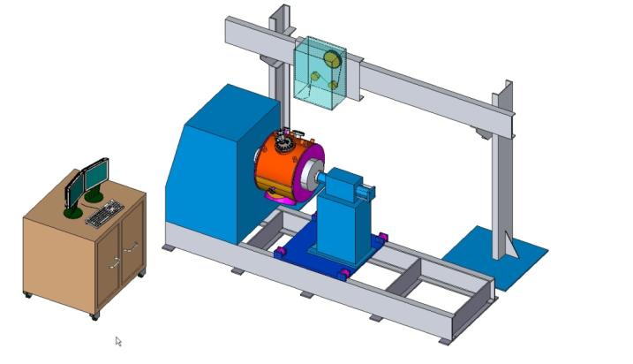
Cavity Dressing – TIG Welding
325 MHz Cavity
650 MHz Cavity
Design features
Movable overhead boom for wire feed system & external purging system
Movable pre-loading tailstock for various cavity lengths
Headstock with internal purging capabilities
Automatic joint tracking system
Duel monitors offer live welder adjustment capabilities

Slide 18
What’s Next?
Process single and 5-cell bare cavities
Test in VTS
Centrifugal Barrel Polishing (Tumbling)
HPR, EP, BCP…….Etc.
Continue fabrication of baseline prototypes
Bladetuner
Helium vessel
Assembly and welding fixtures
Dress 5-cell cavity
VTS tests
Room temperature tests
Mechanical test of tuner(s)
Eventual HTS

Slide 19
Thank You!

