Slide 1
Project X Beta = 0.9, 650 MHz Cryomodule Status
Yuriy Orlov and Tom Peterson (Fermilab)
for the cryomodule design team

Slide 2
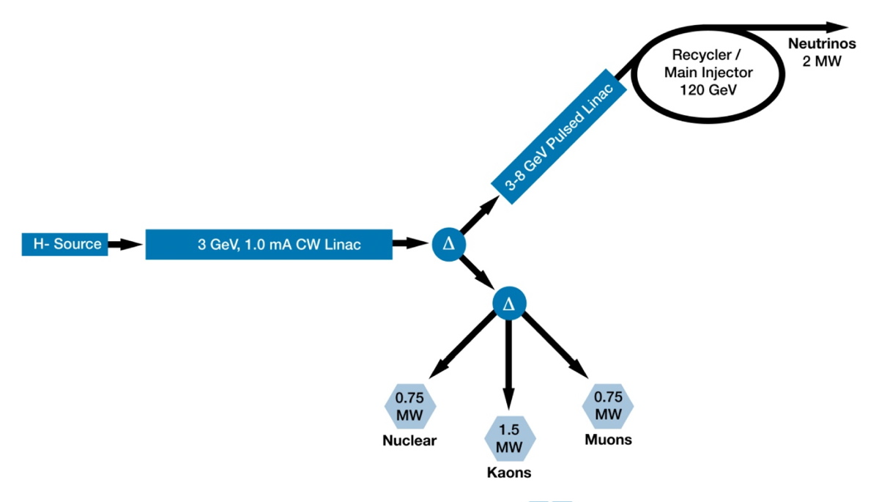
Project X Reference Design
Cryomodules for CW linac

Slide 3
SRF Linac
Technology Map
β=0.11
β=0.22
β=0.4
β=0.61
β=0.9
β=1.0
CW
Pulsed
162.5 MHz
2.1-10 MeV
325 MHz
10-160 MeV
650 MHz
0.16-3 GeV
1.3 GHz
3-8 GeV
Section | Freq | Energy (MeV) | Cav/mag/CM | Type
HWR (β_{G}=0.1) | 162.5 | 2.1-10 | 8/8/1 | HWR, solenoid
SSR1 (β_{G}=0.22) | 325 | 10-42 | 16/8/ 2 | SSR, solenoid
SSR2 (β_{G}=0.47) | 325 | 42-160 | 36/20/4 | SSR, solenoid
LB 650 (β_{G}=0.61) | 650 | 160-460 | 42 /14/7 | 5-cell elliptical, doublet
HB 650 (β_{G}=0.9) | 650 | 460-3000 | 152/19/19 | 5-cell elliptical, doublet
ILC 1.3 (β_{G}=1.0) | 1300 | 3000-8000 | 224 /28 /28 | 9-cell elliptical, quad

Slide 4
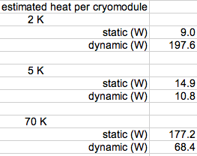
Design approach
CW cavities and cryomodules with as much as 25 W per cavity at 2 K and tight constraints on cavity frequency present some different problems from TESLA/ILC cryomodules
  Over 200 W at 2 K per cryomodule (Project X beta=0.9) as opposed to about 12 W at 2 K per cryomodule (ILC estimate)
We have (draft) requirements documents and fundamental CM parameter lists
Analyses, modeling, and reviews of various concepts based on existing designs
The main parameters from Tom Peterson presentation
for WebEx meeting, 11Apr2012

Slide 5
Cryomodule style and segmentation
Very high heat flux (over 200 W per CM) and relatively short linac (not large quantities nor multi-km long strings) ==>
  Need separated liquid management over one or a few cryomodules
  Prefer small heat exchangers, distributed with cryomodules
  Prefer stand-alone cryomodules, allowing warm magnets and instrumentation between cryomodules like at SNS
Stand-alone CM ==>
  “300 mm” pipe is unnecessary for helium flow
  “300 mm” pipe or equivalent may, however, be beneficial as vapor buffer to help pressure stability
  May combine “300 mm” pipe function and 2-phase pipe function
Not need 300 mm pipe for helium flow ==>
  Empty 300 mm pipe may serve as support “backbone” or
  Different support structure (posts, tension rods, space frame)

Slide 6
Summary from cryomodule requirements document
1.1 The baseline design concept includes cryomodules closed at each end, individual insulating vacuums, with warm beam pipe and magnets in between cryomodules such that individual cryomodules can be warmed up and removed while adjacent cryomodules are cold.
1.2 Provide the required insulating and beam vacuum reliably
1.3 Minimize cavity vibration and coupling of external sources to cavities
1.4 Provide good cavity alignment (<0.5 mm)
1.5 Allow removal of up to 250 W at 2 K per cryomodule
1.6 Protect the helium and vacuum spaces including the RF cavity from exceeding allowable pressures.
1.7 Intercept significant heat loads at intermediate temperatures above 2.0 K to the extent possible in full CW operation
1.8 Provide high reliability in all aspects of the cryomodule (vacuum, alignment stability, mechanics, instrumentation) including after thermal cycles
1.9 Provide excellent magnetic shielding for high Q0
1.10 Minimize cost (construction and operational)

Slide 7
Cryomodule requirements -- major components
Eight (8) dressed RF cavities
Eight RF power input couplers
One intermediate temperature thermal shield
Cryogenic valves
  2.0 K liquid level control valve
  Cool-down/warm-up valve
  5 K thermal intercept flow control valve
Pipe and cavity support structure
Instrumentation -- RF, pressure, temperature, etc.
Heat exchanger for 4.5 K to 2.2 K precooling of the liquid supply flow
Bayonet connections for helium supply and return
Nominally 5 K to 8 K thermal intercept helium circuit
Nominally 40 K to 80 K thermal radiation shield and intercepts

Slide 8
Design considerations
Page 8
Updated heat load estimates
Cooling arrangement for integration into cryogenic system
  Selection of operational temperatures and pressures
Pipe sizes for steady-state and emergency venting
  Low steady-state vapor velocities
  Venting within maximum allowable working pressures
Pressure stability factors
  Liquid volume, vapor volume, liquid-vapor surface area as buffers via evaporation or condensation for pressure change
  Valve and pipe positioning to avoid oscillations
Thermal intercept arrangements and optimal flow strategy
Alignment and support stability
Thermal contraction and fixed points with closed ends
Etc.

Slide 9
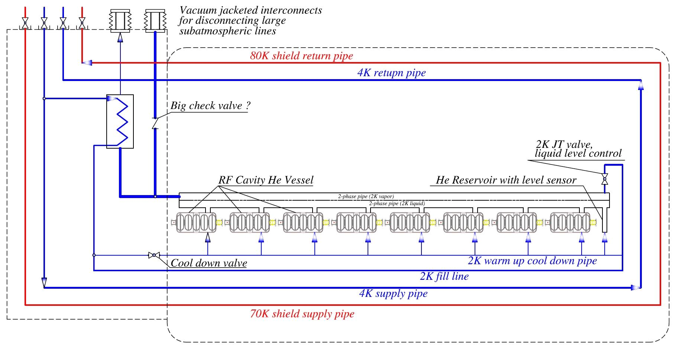
650 MHz Cryomodule cooling scheme
HX

Slide 10
Stand-alone CM pipe sizes, by Tom Peterson

Slide 11
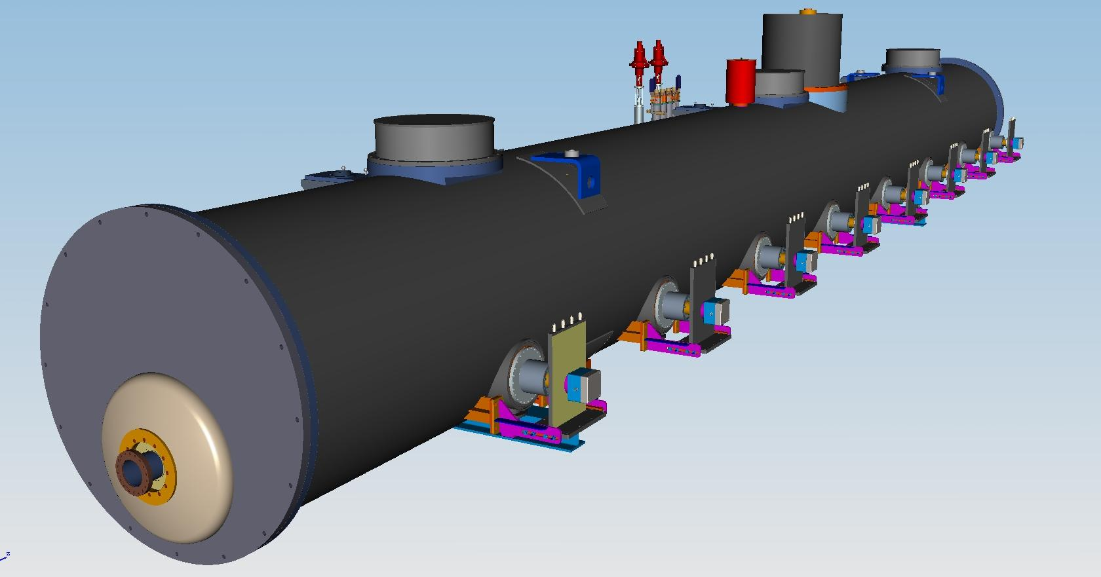
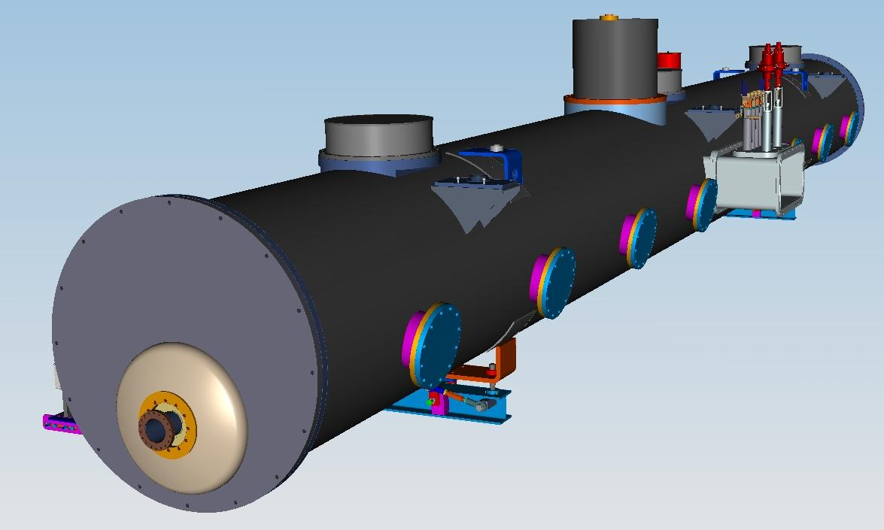
650 MHz Cryomodule
(Desy Style, stand alone)
Heat Exchanger
Cryogenic stuff:
bayonets connections (He supply and
return), Cryogenic valve
control system
Power couplers
Support posts (1-fix, 2-sld)
Vacuum Vessel
(pipe: 48”-OD, .375”-wall)
Ports for access Tuner
motors
Beam pipe

Slide 12
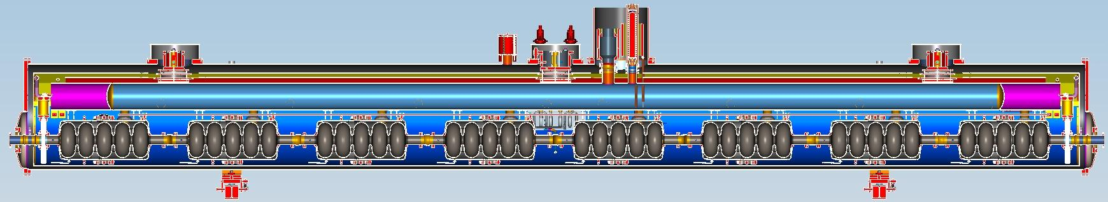
650MHz Cryomodule Layout
(Desy Style, stand alone)
Overall length (CS-Flange to Flange)-12250mm
Number of Cavitis-8
Distance between couplers-1468.9mm
Interconnection bellows length-135.5mm
Beam pipe ID-100mm
1 gate valve for each end of Beam Pipe (cold)
Number of Support posts-3 (1-Fix, 2-Sliding)
300mm pipe (concept) serves as strong back, as the 2-phase helium pipe, also providing a large vapor buffer volume.
Heat exchanger
Insulation Vacuum Relief valve

Slide 13
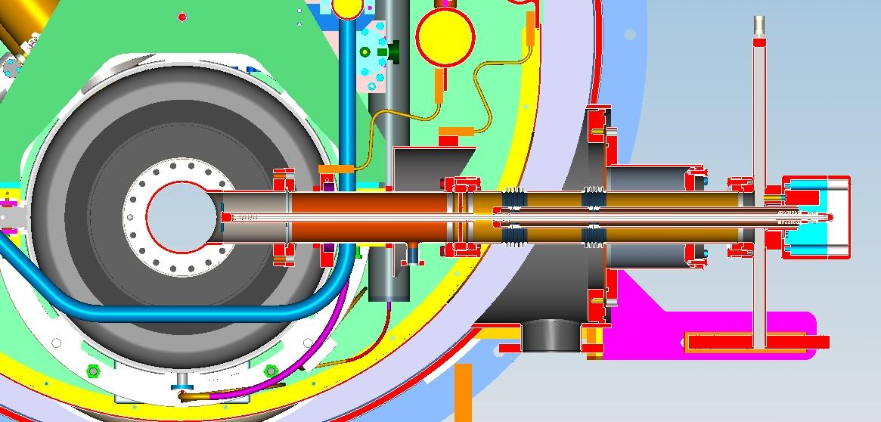
650 MHz Input coupler
-CW power-120kW
-One ceramic window
5K
80K
-3d model is done
-drawings in progress
Cold MC
Warm MC

Slide 14
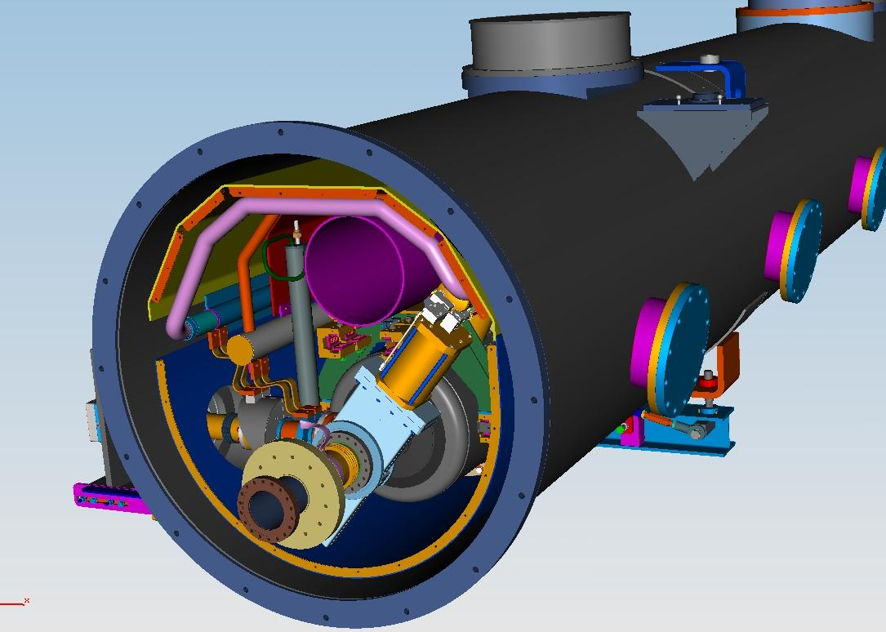
650 MHz Cryomodule. End view
Tuner-motor access ports
Cryomodule align. Support
80K shielding
300mm pipe
5K piping with intercepts
Gate-Valve (cold)

Slide 15
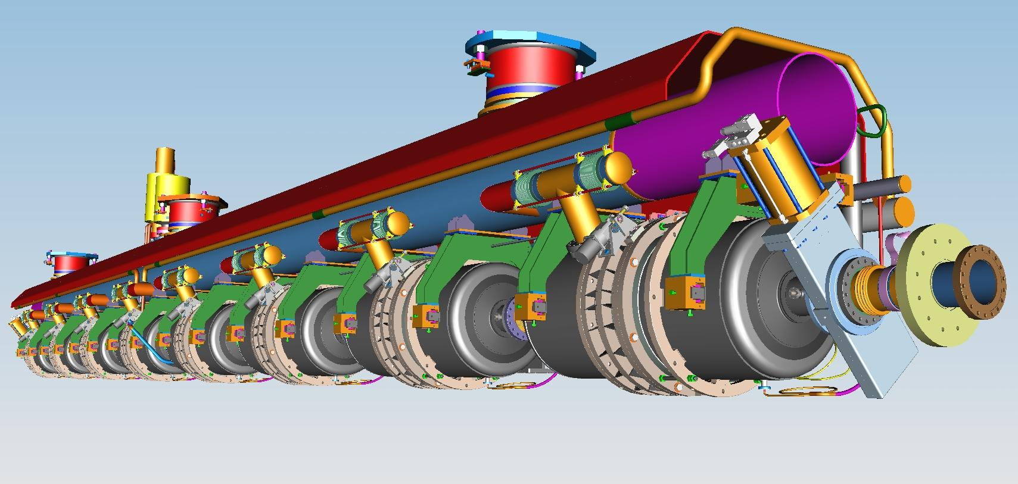
650MHz Cryomodule. Cold Mass
-80K shield with Al extrusions not shown
-5K piping with thermal intercepts
-300mm pipe with support bearing system for Cavity string
-invar rod (next slide)
-thermal shrinkage compensator (next slide)
-cavity string with Gate valves (cold)

Slide 16
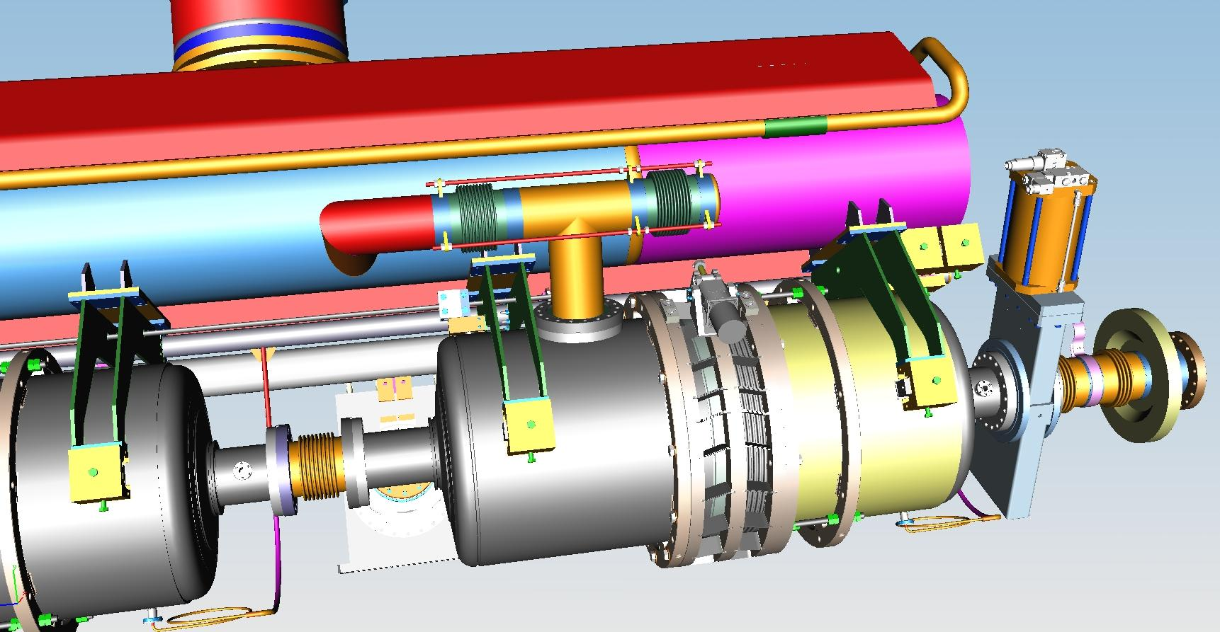
650 MHz Cavity with Blade Tuner
-Cavity He Vessel (Ti)
-Blade tuner (End Tuner?)
-Invar rod (keeps Z distance between cavities
when system is cool down)
-He connection compensator to 300mm Tube
-Flange connection to He Vessel
(Ti-St. Steel transition?)

Slide 17
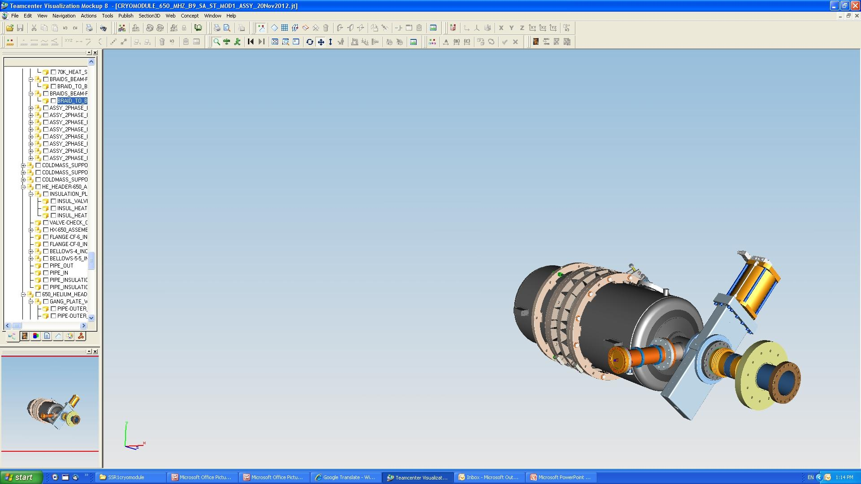
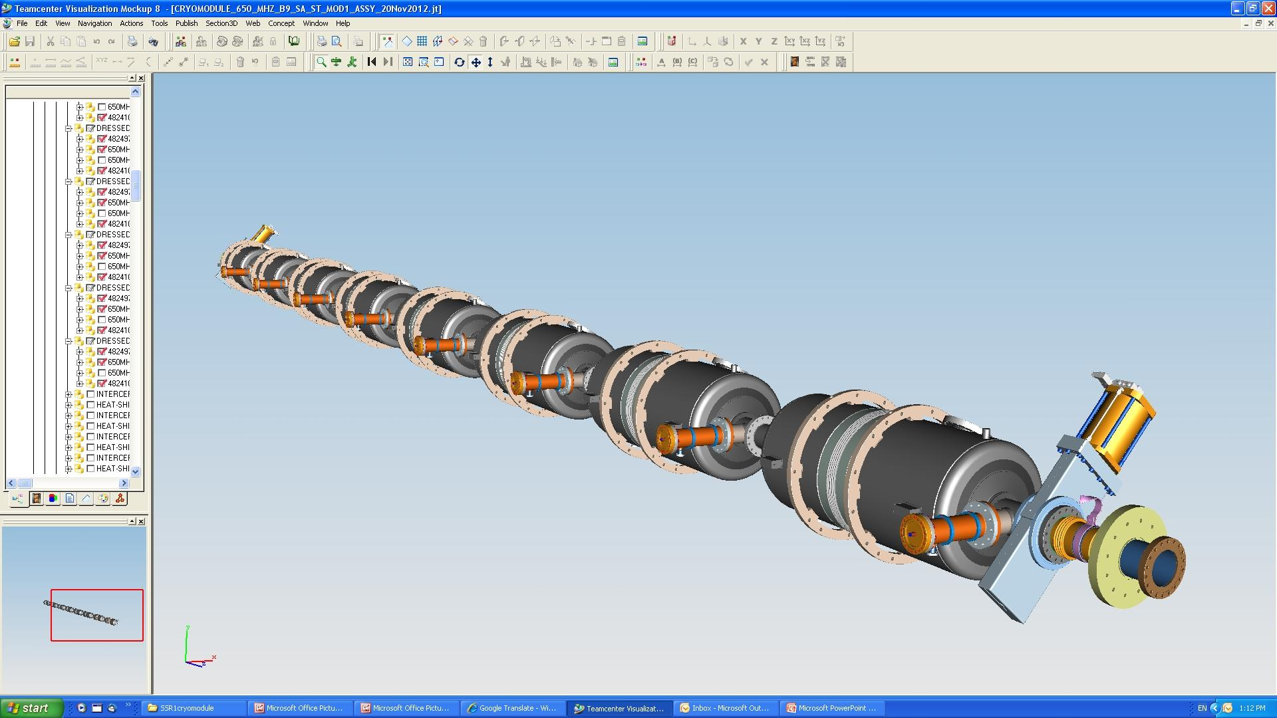
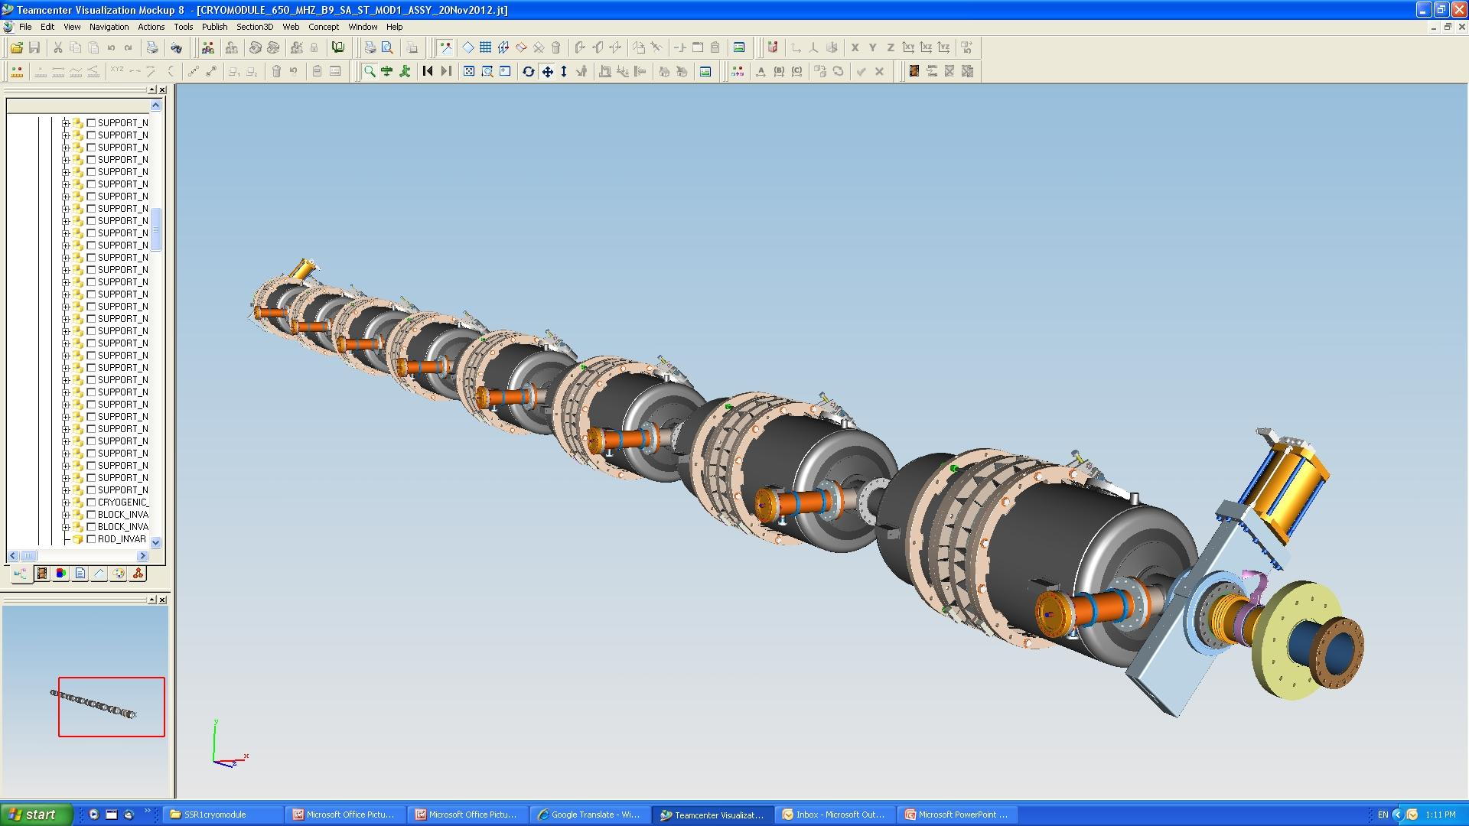
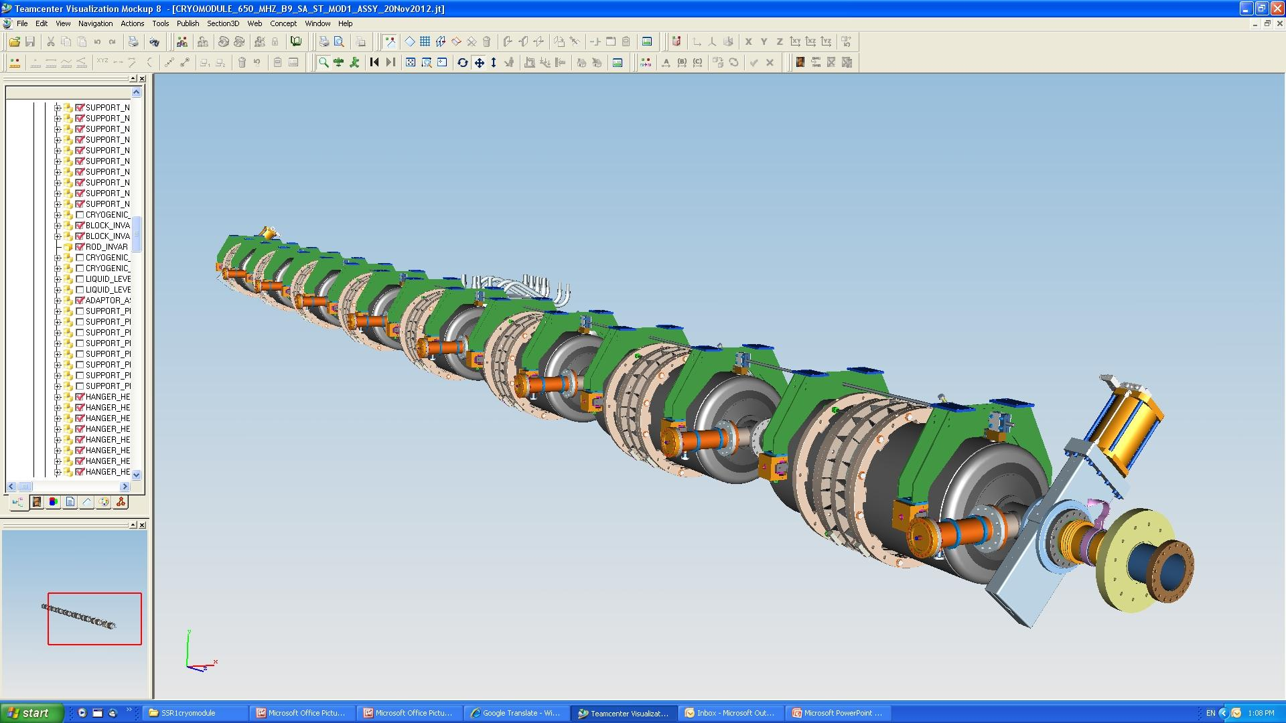
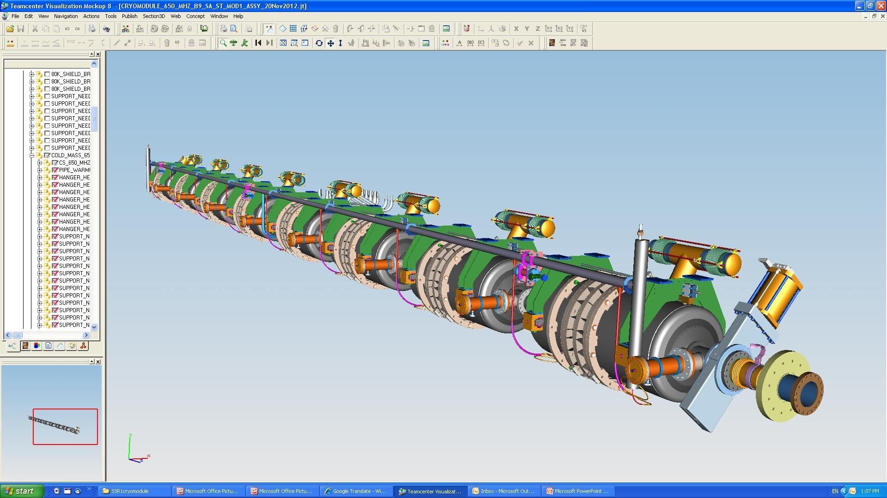
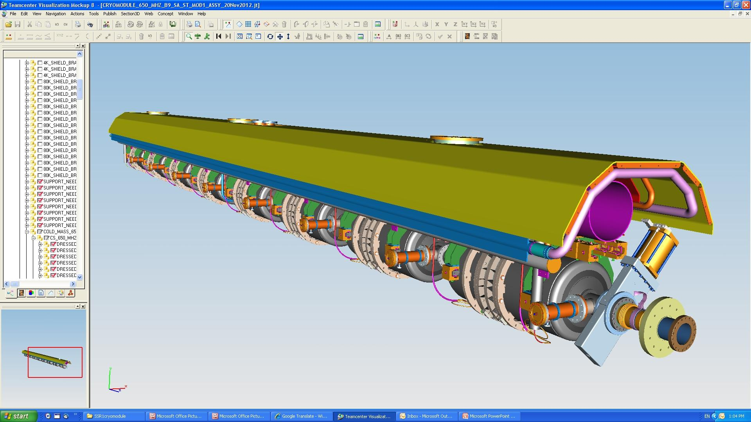
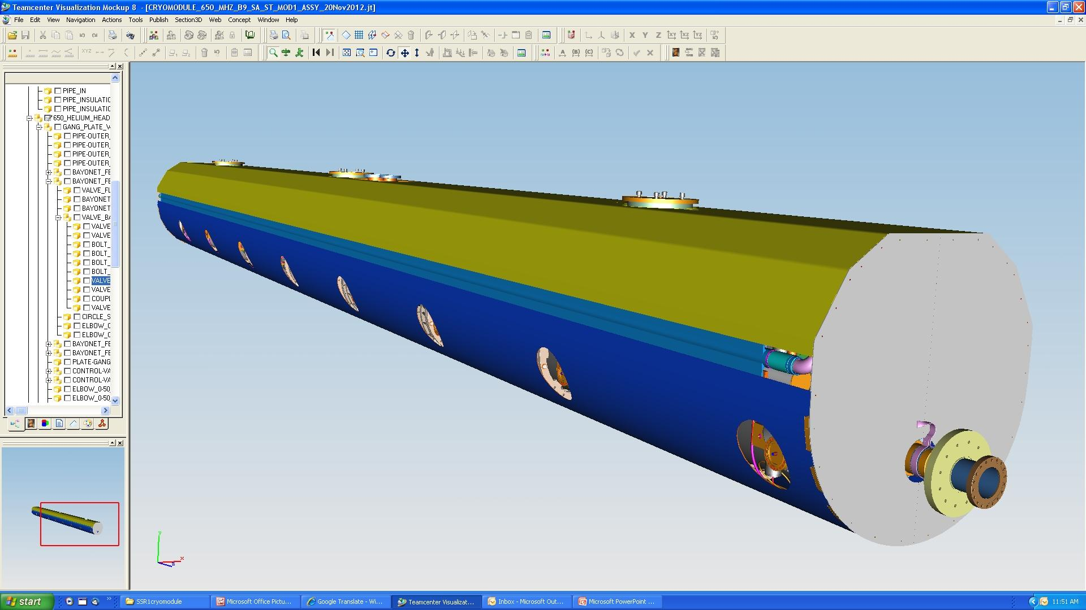
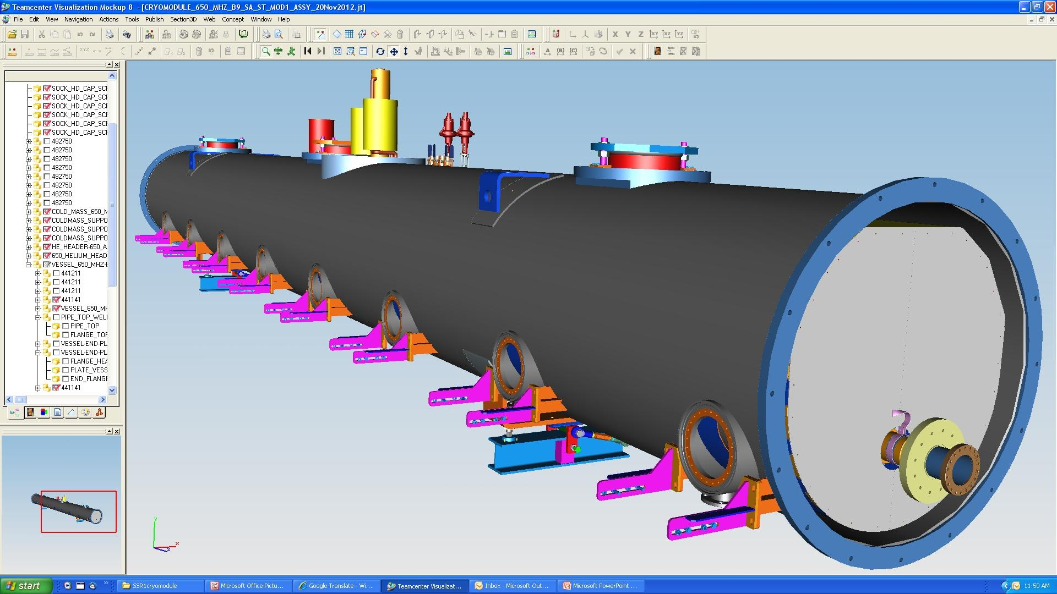
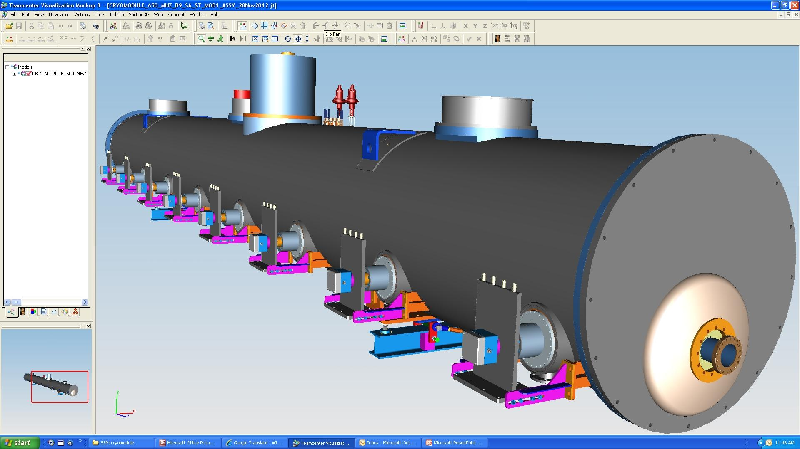
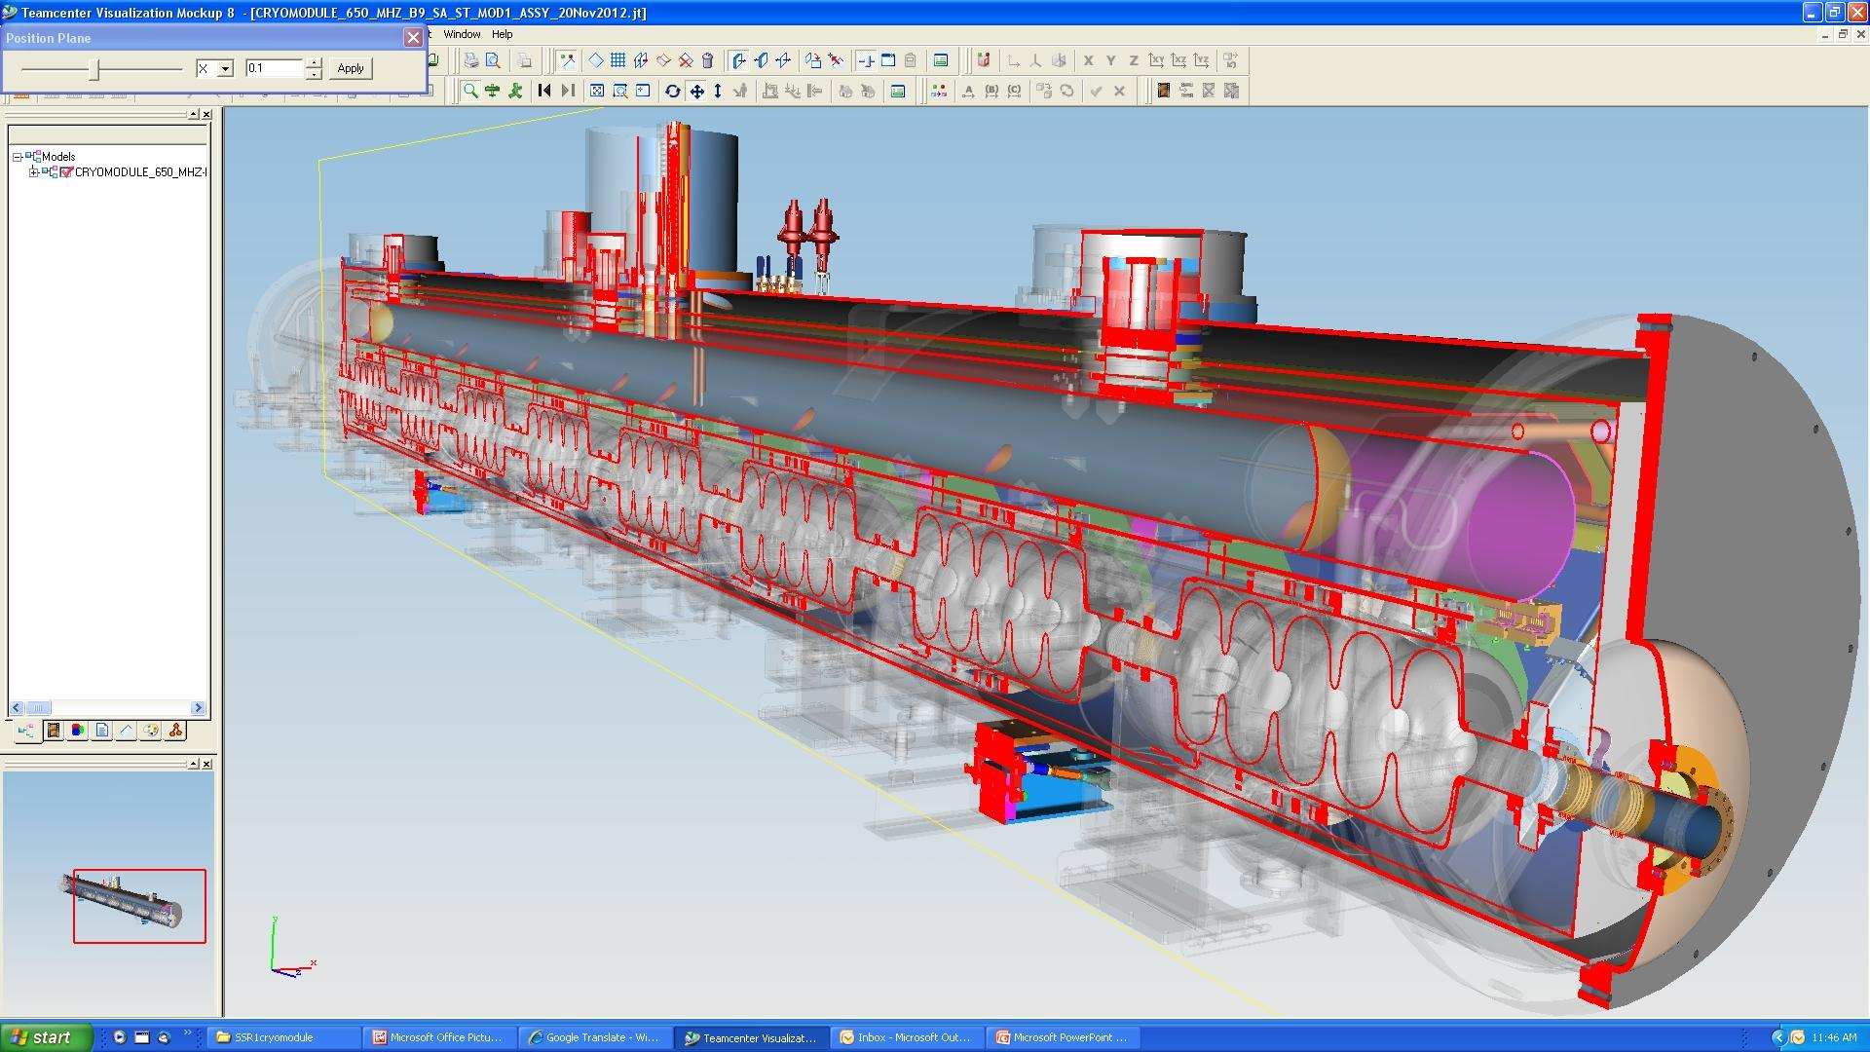
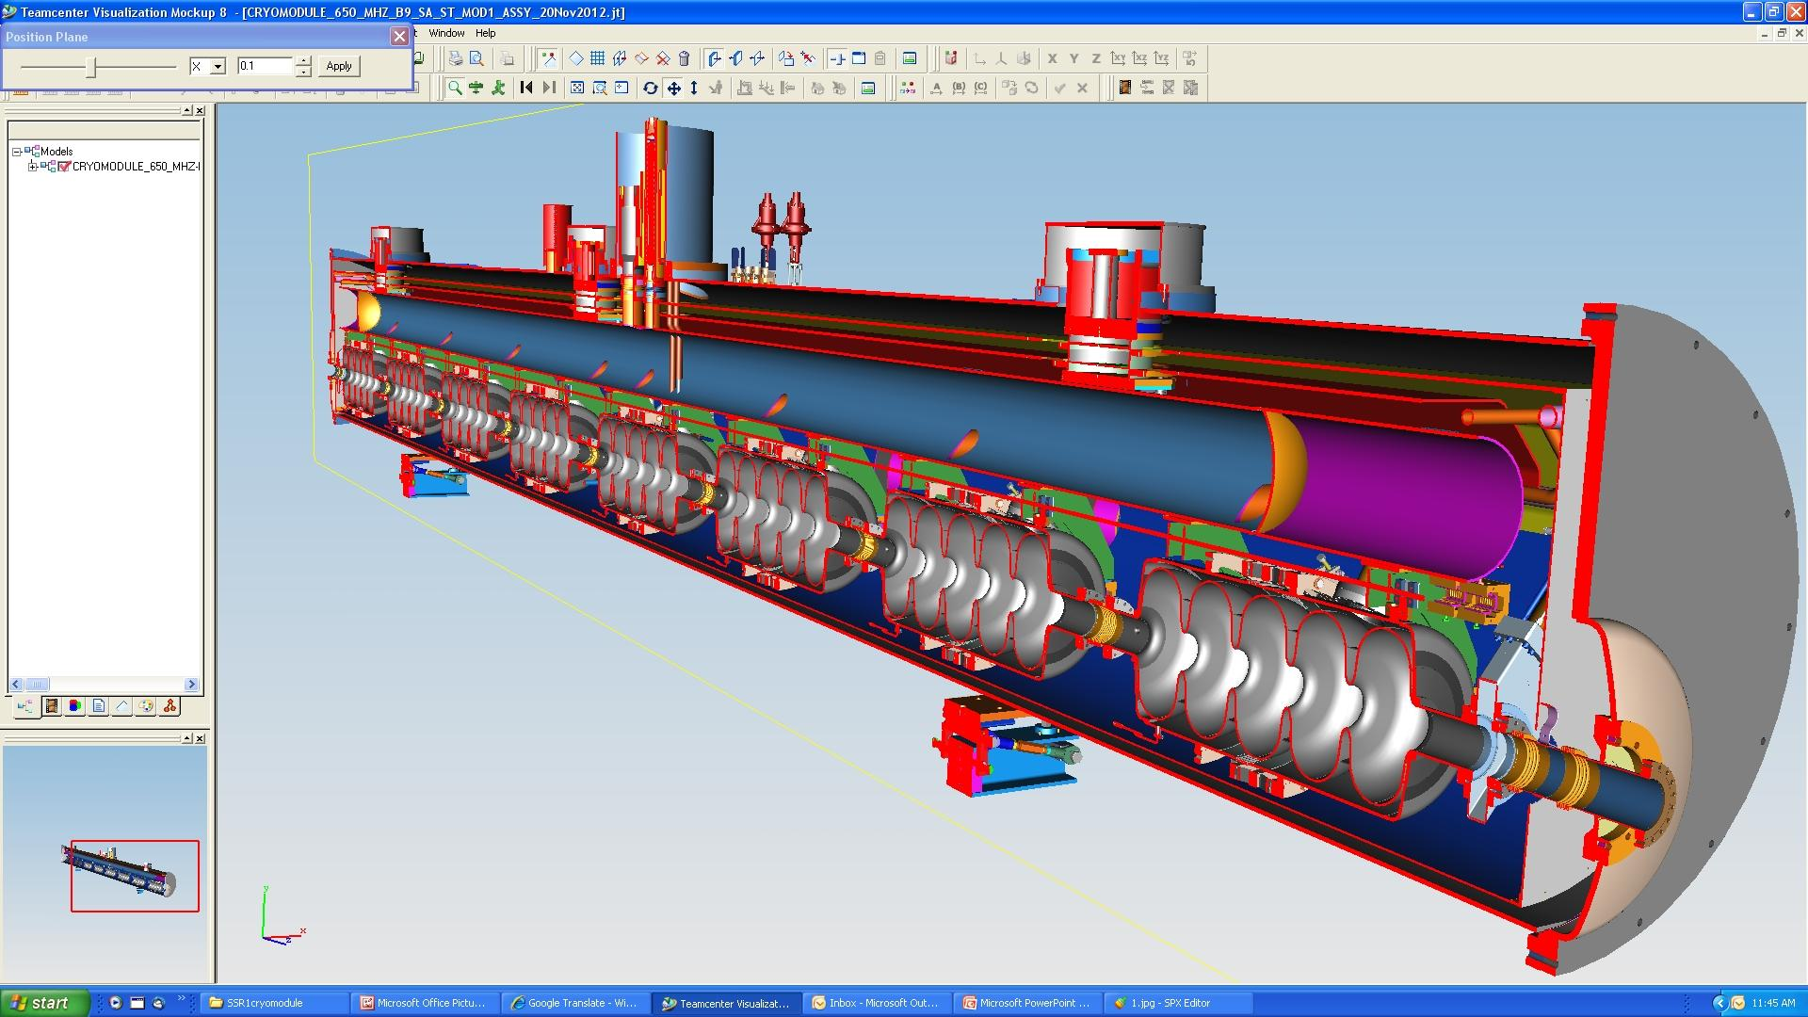
CM650 MHz Design

Slide 18
Summary
We have prototype beta = 0.9, 650 MHz niobium cavities at Fermilab (single cell) and in fabrication (5 cell)
  Cavity design still being optimized for stiffness, df/dP and tunability
Helium vessel details depend on some remaining design decisions
  Tuner style (end or blade tuner)
  Verification of RF power input coupler
  Integration into cryomodule, connection to 2-phase pipe
Requirements imply (in our opinion) stand-alone cryomodules
  Separated insulating vacuum
  2 K cooling of the cavities with heat exchanger at the cryomodule
  Single temperature level of thermal radiation shield, two temperature levels of thermal intercepts
  Warm magnets between cryomodules

Slide 19
Backup Slides

Slide 20
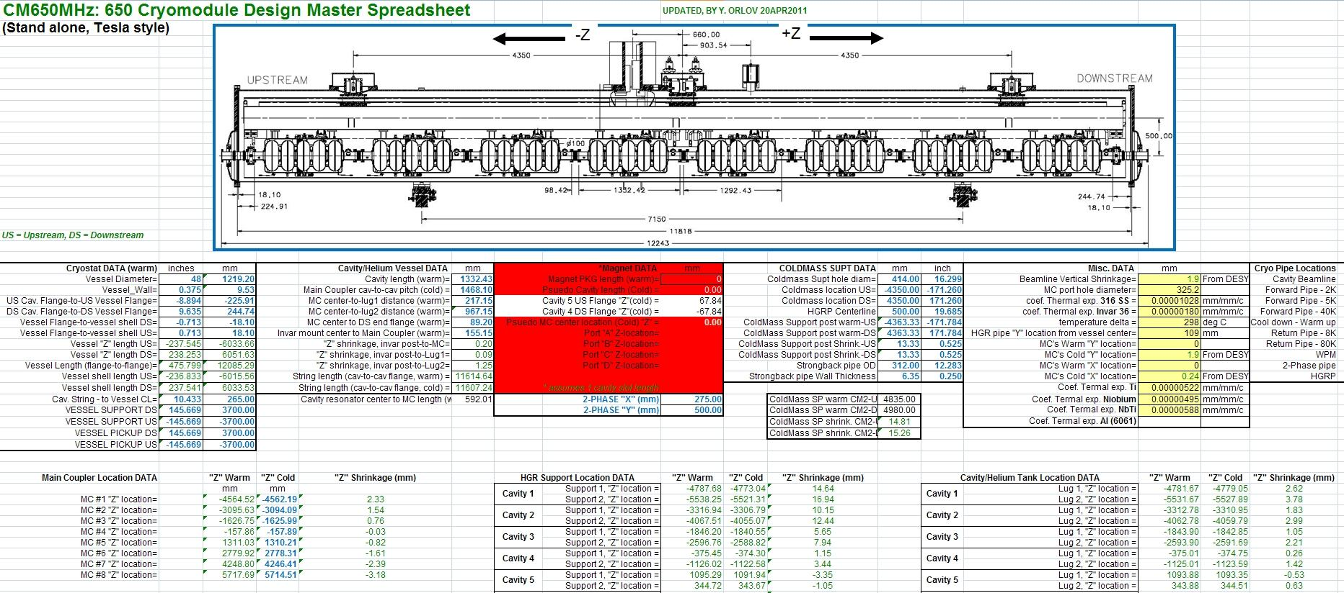
Master Excel spreadsheet->Coordinate system--I-Deas Modeling

