Slide 1
IIFC C&I - Present Status
Electronics Division
BARC

Slide 2
IIFC: Areas of C&I Collaboration
C&I for CMTS
RF Protection Interlock System
LLRF
Cryogenic Temperature Monitoring System
Software for the integrated operation of the CMTF
Beam Position Monitor (BPM)

Slide 3
RF Protection Interlock System
Received schematics and other technical literature during Gopal’s Visit to Fermilab during Oct -Nov 2011
Detailed technical discussions with Peter and Manfred during their visit to BARC in April 2012
Improvements in the existing systems were also discussed during this visit

Slide 4
RF Protection Interlock System
RF Power Source
(klystron, solid state amp)
RF Power Coupler
PMT
Circulator
PMT
RF-In
GaAs-Switch
Video-Pulse,
or RF
FWD
REFL
FWD
REFL
FEP
Modulator
Enable
RF Interlock System Controller
Multi-Trip
module
PMT
Module
FEP
Module
Reset
RF Enable
Notes:
RF Protection interlock system consist of
Multi Trip card: - it measures the forward and reflected power at various locations in the system.
Photomultiplier Tube card: - Photomultiplier tubes are mounted at strategic locations in the RF system for capturing a light discharge in the system
Field Emission Probe card: - The Langmuir probes are mounted at strategic locations in the RF system for measuring the rapid build-up of excessive ionization in the system
RF Leakage detection card: - This module monitors leakage of RF energy from the RF system to ambient.
Analog and Digital I/O card: - This card monitors the status of various field parameters like temperature, flow rate, pressure, contact status, alarm status. This can also interface to various status signals from a PLC. The trip logic is dependent on nature of the signal and is implemented in FPGA.
System Control Card: - This card is heart of the RF Protection Interlock system. It generates all the timing signals for starting and synchronizing various state machines running on protection cards. It monitors the trip request from various cards and blocks the LLRF output or trips the modulator depending on the nature of the request.

Slide 5
RFPI - functions
The RF Protection Interlock (RFPI) system continues to monitor the high power RF (HPRF) system during the entire power ON period and protects it by opening the fast switch at the output of LLRF within 1-2 microseconds of detection of any fault condition.
The RFPI system inhibits the modulator in case the same fault is observed on three consecutive pulses, thereby removing the DC power source to the klystron.
Notes:
The RF Protection Interlock (RFPI) system continues to monitor the high power RF (HPRF) system during the entire power ON period and protects it by opening the fast switch at the output of LLRF within 1-2 microseconds of detection of any fault condition.
The RFPI system inhibits the modulator in case the same fault is observed on three consecutive pulses, thereby removing the DC power source to the klystron.

Slide 6
IIFC
The existing RFPI system at Fermilab

Slide 7
RFPI - subsystems
PMT Trip Module
FEP Trip Module
Multi-Trip Module
Relay /Contact Module
System Control Module
Digitiser Module
EPICS based IOC MVME5500 controller running VxWorks RTOS
Notes:
PMT Trip Module monitors arc in waveguide, klystrons, ceramic windows and power coupler
FEP Trip Module monitors excessive field emission which may lead to plasma formation
Multi-Trip Module monitors forward and reflected power from klystron and circulator
Relay /Contact Module monitors Digital/contact Input signals from field instrumentation, Analog signals being monitored by PLCs
System Control Module generates the final trip to LLRF /Klystron
Digitiser Module digitizes selected trip signals from various modules and sends to user via VME bus
VxWorks RTOS running on MVME5500 controller
EPICS based UI provides the graphical interface on the console

Slide 8
Fast Signal Conditioning
RFPI – System Architecture
High Power RF System
GaAs Switch
From LLRF
AMP
KLYSTRON
RF_INH
Interlock Signals
Reset
VideoPLS
Reset
VideoPLS
Reset
VideoPLS
Reset
VideoPLS
System Control
RF_INH
MODINH
PMT
FEP
Contacts
& TTL
FWR/REFL
RF_INH
MODINH
RF_INH
MODINH
MOD_EN
GUN VOLTAGE
Notes:
All the modules of a similar type have two carry-in input, which is connected to the RF Inhibit and Modulator Inhibit outputs of the previous stage. The signal is ORed internally to generate the RF Inhibit and Modulator Inhibit outputs of the current stage.

Slide 9
RFPI - Features
RFPI operations are independent of VME64 bus activity.
Programmable trip limits
The Set point and other control actions are dependent on VME Interface. In case of a link failure, interlock operations will continue as on board FPGA stores the DAC reference Value.
Fail-safe mode of operation is built into the design
Fast and deterministic response
Cable connect detection on all analog signals
Analog signals digitized and displayed through control system.
Notes:
LOCAL OPERATION, a trip point is set via a FRONT panel POT.

Slide 10
RFPI - Low Speed signals
Waveguide Pressure
Coupler Temperature
Coupler and Cavity Ion gauge controller
Coupler and Cavity Vacuum pump controller
Klystron parameters
These signals are handled through a PLC which sends a TTL active low level to the RFPI system to inhibit RF

Slide 11
VME64 -TRANSITION BOARD ARCHITECTURE
VIDEO PULSE
ANALOG
SIGNALS
To Digitizer
RESET
P2 Port
ANALOG
SIGNALS
INPUT
RF_INH
MOD_INH
VME64 card
Rear I/O card
Notes:
All the analog signals are fed through Front Fascia. All the control and output signals are through rear I/O card connected on to P2 connector

Slide 12
VME64 BACKPLANE INTERCONNECT SCHEME
P1 CONNECTORS BACKPLANE VME BUS
MVME5500
12 CH Digitizer
P2 RF INTRLK INTERCONNECT
SYSTEM
CNTL MODULE
FWR
REFL PWR
MODULE
PMT
MODULE
FEP
MODULE
Notes:
Interlock system operates exclusively via P2 port, independent of VME operations.
The Set point and other control actions are dependent on VME Interface. In case of a link failure, interlock operations will continue as on board FPGA stores the DAC reference Value.
ADC on digitizer card, mounted in a separate VME slot digitize the signal and send it to user via VME backplane and VME controller(MVME5500)

Slide 13
IIFC
New proposed RFPI system

Slide 14
Proposed Modifications
Provision of on-board digitiser- Eight channels of 14bit, 10-80MHz ADC and 64 MWord DDR2 RAM on each board will eliminate the need of a separate digitiser card and allow capture of longer duration events.
Remote update of FPGA via VME Bus
VME64X slave interface: Full feature VME64X slave interface supporting multiple interrupts, DMA, block transfer
Modifications in analog sections-
FEP Trip Module: use of higher supply voltage JFET amplifier thereby eliminating DC/DC convertor stage.
PMT Trip Module: Dark current detection stage is used only for cable connect confirmation. Can it be removed if a reliable cable sense mechanism is developed?
No of input channels to be increased to sixteen in Relay /Contact Module

Slide 15
Proposed Modifications cont.
Mezzanine board approach-
Common VME64X carrier Board: One carrier board for all modules, handling VME64X interface and digital logic common to all cards.
Analog section unique to each module can be on Mezzanine board
The challenge here is accommodating RF connectors on Mezzanine card facia and shielding within one slot width of card.
Feasibility of integrating Relay/ contact module with System Control Module to be studied.
Mechanical arrangement for cable sense logic: The mechanical arrangement for cable connect detection logic to be improved for more reliable operation.

Slide 16
Proposed Modifications Cont.
VME64X /VXS: All the boards will be VME64X compliant. The FPGA selection and board layout will be done keeping in VXS requirement, allowing VXS interface to be added in future.
General purpose analog signal conditioning modules and low speed ADC are required for eliminating the PLCs.
Eliminating interconnect cables among module: Open collector logic based FRC cable interconnect on the rear I/O card for additional functionality. Can be used for adding more signals to the Interlock.
Eliminates cable and expensive LEMO connector?

Slide 17
Progress so far
Peter has advised to take up the development of new System Control board with all the features of the existing board with additional PMT channel, ADC and memory, in the first phase.
A brief design report showing block diagram of the same was submitted to Fermi Lab and was approved by them.
The detailed schematics of the new system control board is in final stage of preparation. The same will be sent to Fermilab for review before fabrication.
The mechanical arrangement of cable connect detection assembly has been finalised.
Development of Multi-trip board based on the mezzanine board approach has been initiated.
Notes:
A brief design report showing block diagram of the proposed system control board with the placement of ADC, RAM, FPGA, PMT and RF leakage channels was submitted to Fermi Lab and was approved by them. The detailed schematics of the new system control board are being prepared which will be reviewed by Fermi Lab before fabrication of the module.
In order to speed up the overall development it was also decided to simultaneously start the design and development of Multi-trip board based on the new mezzanine board approach. This approach consists of a common carrier board accommodating ADC, Memory, VME interface and digital glue logic and a mezzanine board accommodating analog and RF sections that are unique to each module.
Multi-trip module will be fabricated in mezzanine card format to study the performance of the mezzanine bus and evaluate the performance of LVDS v/s parallel bus data transfer.

Slide 18
On Board Digitizer
LTC 2173-14 four channel 14 bit 80MSPS ADC
ADC provides 2 LVDS output per channel
LTC6406 single ended to differential driver
FPGA de-serializes the ADC Data
128 MB of DDR2 memory Interfaced to FPGA
8M word per channel: stores 100mS @ full speed
Pre trigger and post trigger information is available
The pre trigger to post trigger ratio can be adjusted using software

Slide 19
Modified System Control Board
Notes:
Shown above is the block diagram of system control view

Slide 20
RF leakage channel

Slide 21
PMT output processing channel
Notes:
Can the dark current measurement section be removed if we have a reliable cable connect detection arrangement?

Slide 22
Why Mezzanine card?
The VME board is common, once proven, it can be used with all mezzanine modules.
Migration to VXS or cPCI platform is very easy, we need to develop new base board only.
Mix and match approach can improve board utilization – cost saving
Maintenance is easy, module level replacement at site
ADC can be tailored as per application requirements as it is located on Mezzanine card
Noise mitigation more convenient

Slide 23
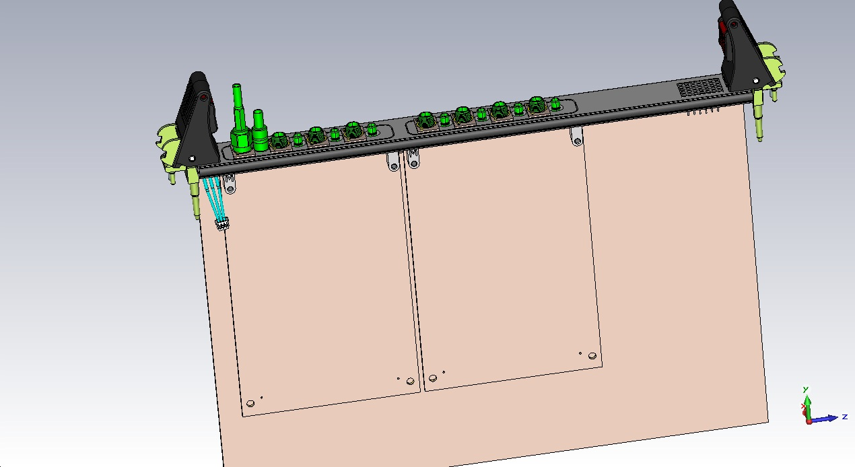
Mechanical details of Mezzanine card
SMB Connector
SMA Connector
Mezzanine card
Base Board
Notes:
Shown above is the isometric view of the Mezzanine card. The VME base board can accommodate two mezzanine cards.
Each mezzanine cars has 4 SMA and 4 SMB connectors.
The SMA connectors are used for feeding the signal to the mezzanine card and hence have a cable sense arrangement.
The SMB connectors are for monitoring output and hence are used during diagnostic only.
The SMB cable needs to be pulled out for tightening and unscrewing of SMA Plug.

Slide 24
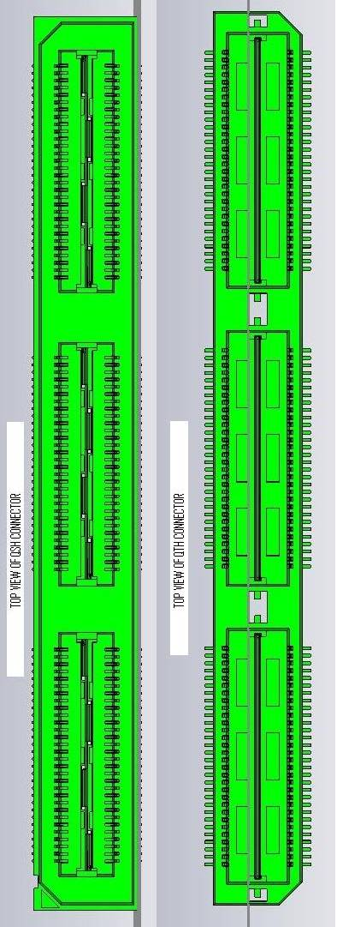
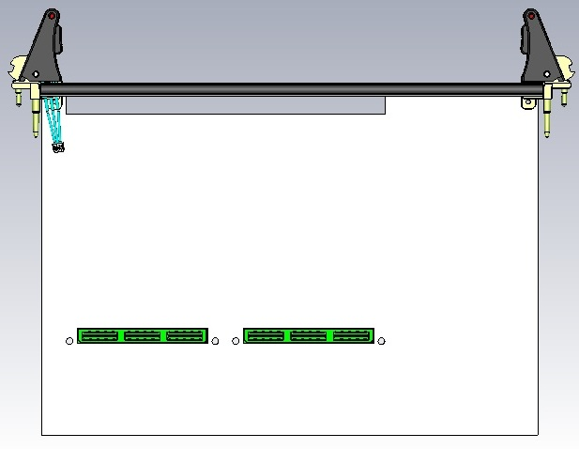
Various views of Mezzanine card
QTH-90-01-LDA on mezzanine board
Base Board
QSH-90-01-LDA on Base Board
5mm Spacing
Notes:
Shown above is the mounting location of the Mezzanine connector used for interconnections.
Samtec (www.samtec.com) make QSH-90-01-LDA connector for VME64X board socket and QTH-90-01-LDA for HS-ADM card Header are used as HS-ADM connectors.
The gap between VME base board and Mezzanine board is 5mm.
The samtec connector has a total of 180 pins, out of which 157 pins are signal pins, one pin is reserved for PSNTn (card insertion sense) pin, 22 pins are for power and power pins, and 12 ground pins.
The power pins are located in-between two pairs of signal pins.
The connectors are rated for 8GHz 3dB bandwidth and are optimised for 100 Ohms differential signals.
The connector I/O pins are rated for 125VAC@ 1A current capacity. The contact resistance is 30mOhms.

Slide 25
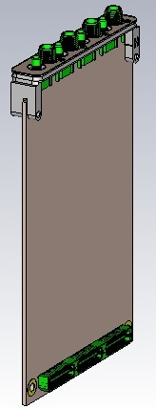
Mezzanine card
78 mm
Standard PMC bezel
65 mm
120mm
Notes:
the mezzanine card is 78 mm height (along the facia) and 120 mm depth. The mezzanine card bezel is flushed with main card facia so that EMI shielding integrity is maintained. The rear side view of the Mezzanine card is also shown.
The mounting holes are provided on the mezzanine cards as well as the host boards for mechanical support to the mezzanine card installed on the host board.

Slide 26
Cable Sense Assembly
Notes:
The figure on top is an isometric view of the cable sense assembly. The figure below shows the front view. The cable sense PCB consist of a small annular contact ring around the SMA connector which is mounted on to the bezel via three screws. A size 10 gasket is sandwiched between the bezel grove and PCB for positive pressure. The small yellow circle with a green hole is the solder contact which connects the PCB to cable sense electronics. The PCB is pulled down when it

Slide 27
Cross-section view of Bezel
PCB
Size 10 O-Ring

Slide 28
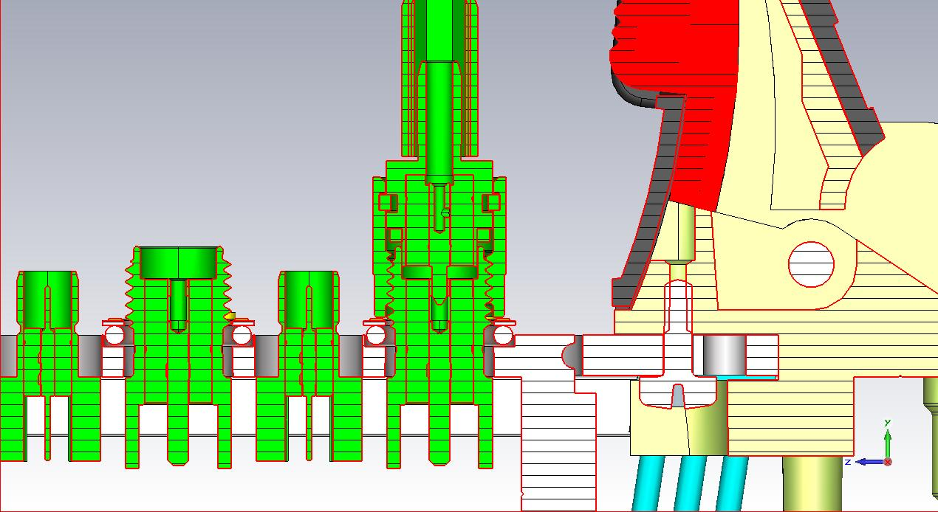
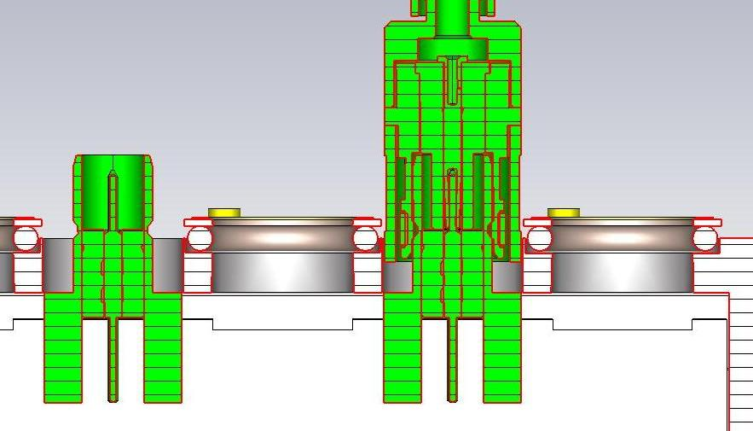
SMA and SMB Connections
Positive Contact

Slide 29
LLRF STATUS
Fermilab has provided technical documentation of the existing boards
Current LLRF digital board is size 6U based on VXI bus
Some of the major specifications such as number of ADC/DAC channels, FPGA and DSP to be used have been tentatively formulated
Fermilab has suggested to upgrade to a new bus interface
During Paresh’s visit various bus standards such as VME64, VXS, VXI4.0, PXI, CPCI, ATCA, MTCA (xTCA), MTCA.4 (also called as MTCA for Physics) have been discussed.
It is expected that the Fermilab will soon finalize the bus standard to be adopted for the next generation of LLRF
Based on the discussions with Fermilab design of the digital board has been initiated
BARC suggests the use of CPCI bus for LLRF system. Fermilab may kindly comment.

Slide 30
THANK YOU

Slide 31
Specififations of Samtec Connector
QSH-90-01-LDA connector for VME64X board socket
QTH-90-01-LDA for Mezzanine card
The connector pins are rated for 125VAC, having 1A current capacity
The contact resistance is 30mOhms
The connector is rated for 8GHz 3dB bandwidth
The connector is optimised for 100 Ohms signal
The connector has a total of 180 pins out of which 157 pins are signal pins
The Connector has 3 ground strips in the centre for improved shielding
The Mezzanine card provides all the VME power supplies

Slide 32
Electrical Details of Mezzanine card
32 LVDS pairs
2 LVDS Clock pairs
20 LVTTL lines
5 LVTTL Clock lines
24 LVTTL I/O lines
4 Single Ended Analog lines
8 Differential Analog lines
3 SPI channels with 8 slaves each
1 I2C/SMB channel
1 JTAG channel
1 PSNTn for card insertion detection
The LVDS and TTL lines have 100 Ohms /50Ohms Controlled Impedance

