Slide 1
2023 Summer Shutdown Planning
8/24/23
Cons Gattuso

Slide 2
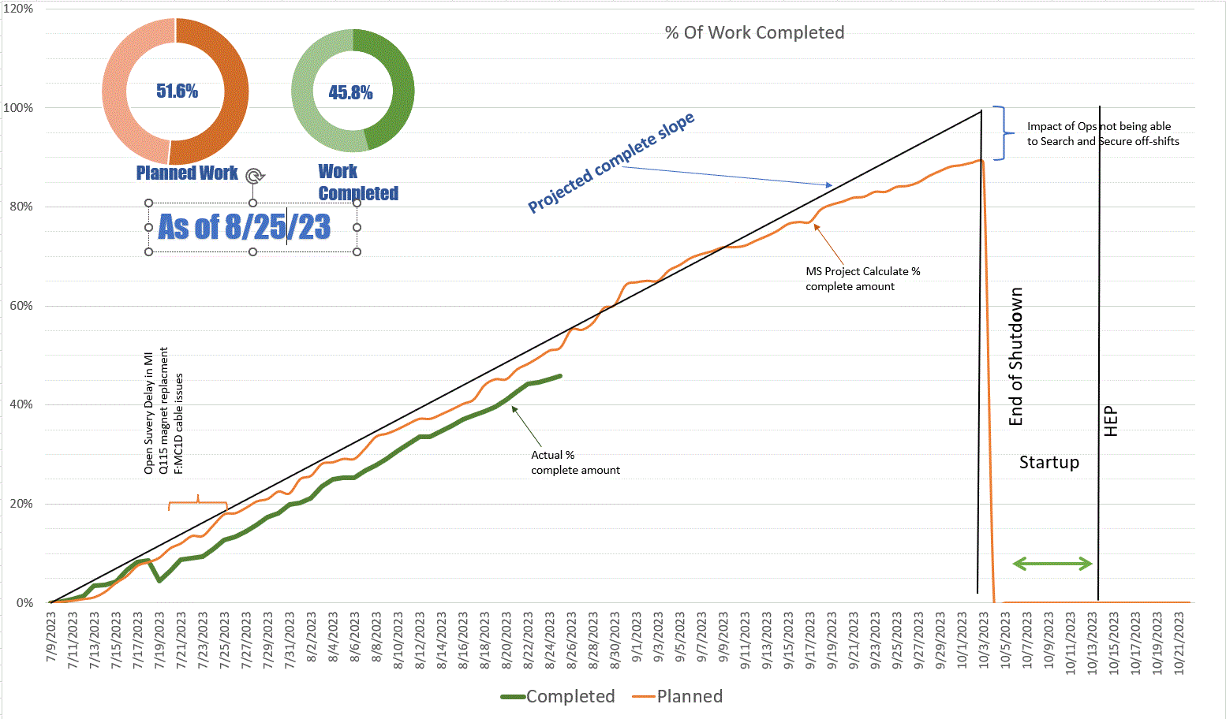

Slide 3
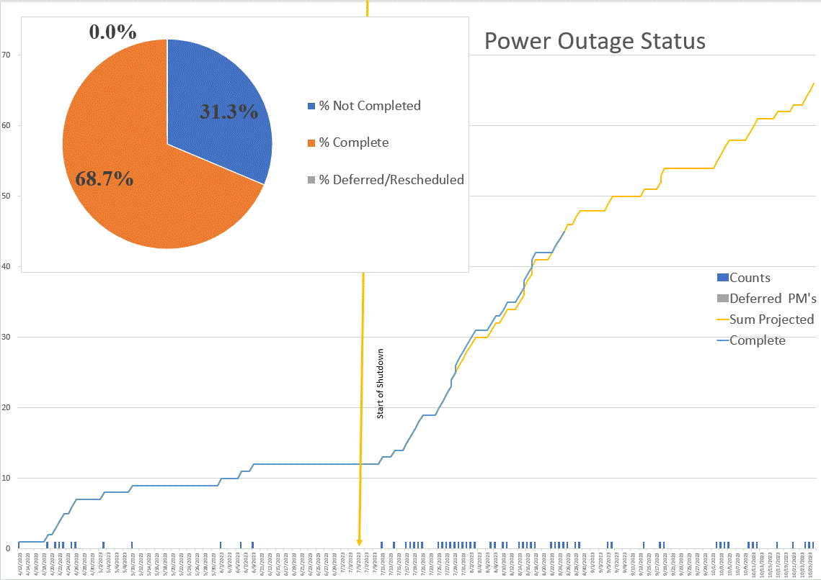

Slide 4
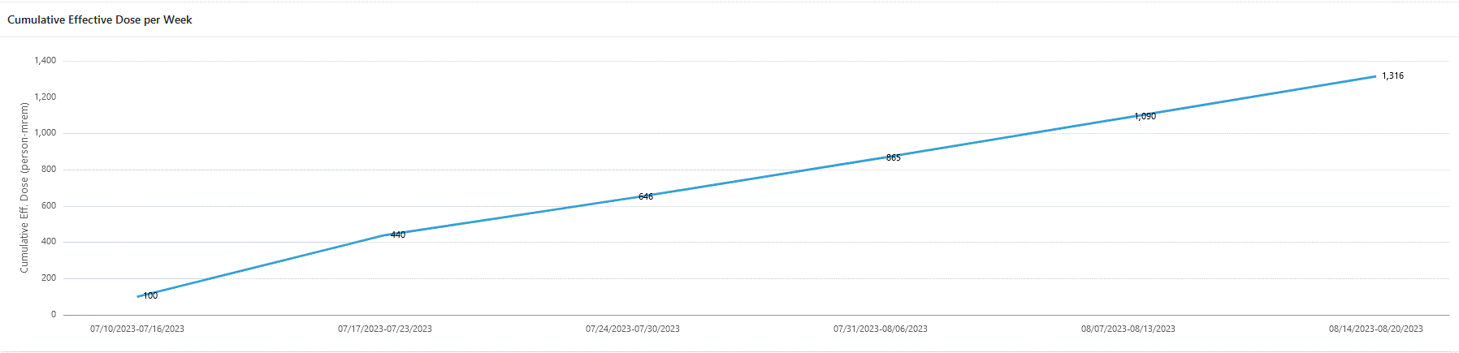
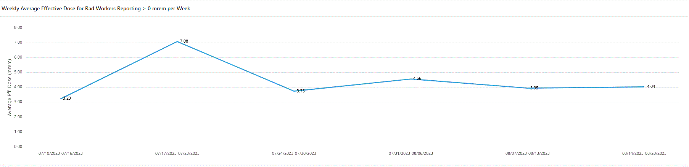
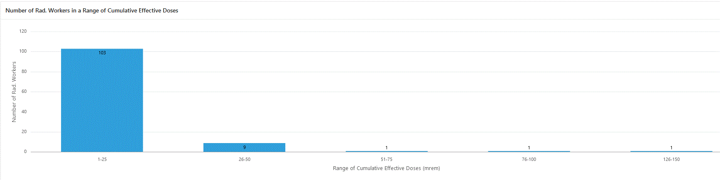
Dose for Summer Shutdown
1316 person-mrem

Slide 5
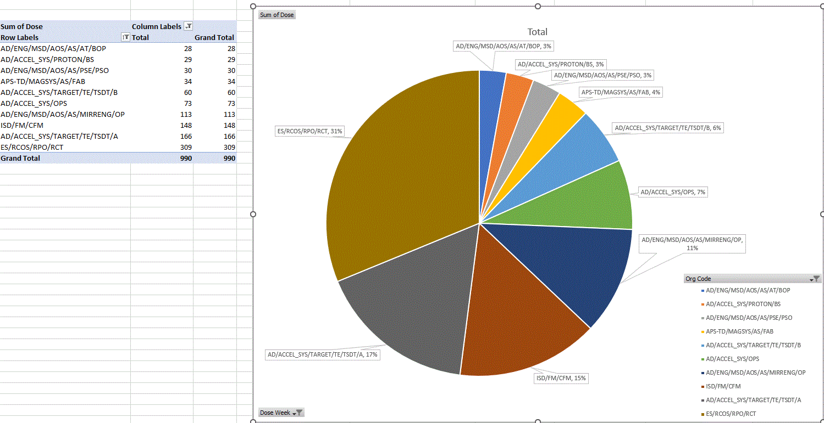
Dose Distrubution (Top 10)

Slide 6
Power Outages
  Week 7 (Aug 21st - Aug 25th )
    Friday August 25th
      MI20 Conventional Power Feeder 73 (MI20 pulse power)
        Span from 8:20-16:00 hrs
  Week 8 (Aug 28th - Sept 1st )
    Monday Aug 28th
      KRS De-Engerized to Swop load to Master sub
        MI service buildings, SBND, and A0 Cryo
        Spans: 08:00-08:30
    Tuesday August 29th
      NEW MS3 oil switch Outage (time and date to be finalized)
        Impacts: LLRW (Site 40) and ENTIRE MESON AREA INCLUDING MESON DETECTOR BUILDING, ALL MESON BEAMLINE ENCLOSURES, ALL MESON BUILDINGS INCLUDING MESON CENTRAL CRYO, MESON ASSEMBLY BUILDING, MP9, MW9
      Feeder 94/95, (F0, F1, F2, F3, F4 Pulse power), F23
        Spans: 2 days Aug 29th 8:20 - Agu 30th 16:00 hrs
    Wednesday August 30th
      Feeder 94/95, (F0, F1, F2, F3, F4 Pulse power), F23
        Spans: 2 days Aug 29th 8:20 - Agu 30th 16:00 hrs
    Thursday August 24th
      MI30 and MI31 Conventional Power Feeder 61 (MI30 pulse power)
        Spans: 08:20 - 12:00 hrs

Slide 7
Linac 8/28 – 9/1
!
RF Maintenance
Water System Maintenance (Should be Completed Today)
  Grease Motor
  Change filter
  Back wash sand filter
  Change oxy Soak and Algae cartridge.
  Change DI bottle
Fan coil PM a few skipped due to Fall protection issue (Dependent on ISD availability )
Preparing for LRF5 Water leak repairs
  Week before we on opening up the tank and complete as much prep work that can be done
  Looking on site the Sept 25th to equipment shipping issues
    This shift has effectively taken up the Linac contingency week and this process will impact the Linac Startup date that was to occur the week of the 25th

Slide 8
Booster 8/28 – 9/1
  Clean power upgrade in West gallery
    7/24/23 -9/1/23
    Access to the West gallery will be limited
      Sept 7th Tinners retune
      Construction zone until Sept 15th
        Schedule creep on this task has shifted us 2 week
  General RF Maintenance
    East Gallery and Tunnel
  Ion Pump replacement/Upgrade (8)
    400MeV (Done), 8GeV (staged), MP02 L3 (HRA) walkthrough has been done
  Power Supply Maintenance
    Both in the gallery and the Tunnel
      West gallery RF and Power supply will not start until Clean power upgrade is complete. Start the week of September 15th
Choke 12-1 electrically ready to be pulled
Gasket water replacement on period 7 valve

Slide 9
BNB 8/28 – 9/1
Remaining Shutdown Work
  Water leak repair on 874
  DI Bottle change out
  Switching back from Chiller back to MI LCW heat exchanging
  Texas Wire Removal (2–3-day job) treating this as filler work
    Needs to be schedule
  House keeping will take place today and into next week

Slide 10
MI/RR/MI8 8/28 – 9/1
Ring
  White LCW Hose Replacement
    Moved into the 60-sector section
  Q319 Magnet replacement (new magnet at MI60)
    Prep work for replacement magnet is making its way through the system
  Q333 leak repair
    Pressure testing
    Reconnect BPM
    Reposition elements and Alignment
      This will not occur until mid next week Due to Alignment issues
  MI20 Sump Repair
    New check valves
      Scheduled to arrive this last Tuesday
      We hope that they will get here today
  Mechanical
    Water/Vacuum issues
    RF
      Maintenance will continue
  MI-8
    Will be finishing up early next week
Marv Air unit replacement Building | Start | Finish | Status
MI-10 | 8/21/2023 | 8/25/2023 | Underway
MI-20 | 8/22/2023 | 8/31/2023 | Underway
MI-30 | 8/28/2023 | 9/6/2023
MI-40 | 9/1/2023 | 9/12/2023
MI-50 | 9/7/2023 | 9/18/2023
MI-62 | 9/13/2023 | 9/19/2023

Slide 11
NuMI – TSD 8/28 – 9/1
  Target Hall
    Munters switch replacement when available
    Continued PM’s Inspections of underdrain etc.
    Pull R block by the end of next week.
      Being held off due to fall protection issues
        Inspection of thermal couples
        Sign holder installation with the chase
        General inspection
  Pre Target
    Q115 Inspection/Work Planning
      Cut and cap
    Q118 Manifold replacement / rework (in place)
      Full manifold replacement both ends.
      Experts are gathering parts

Slide 12
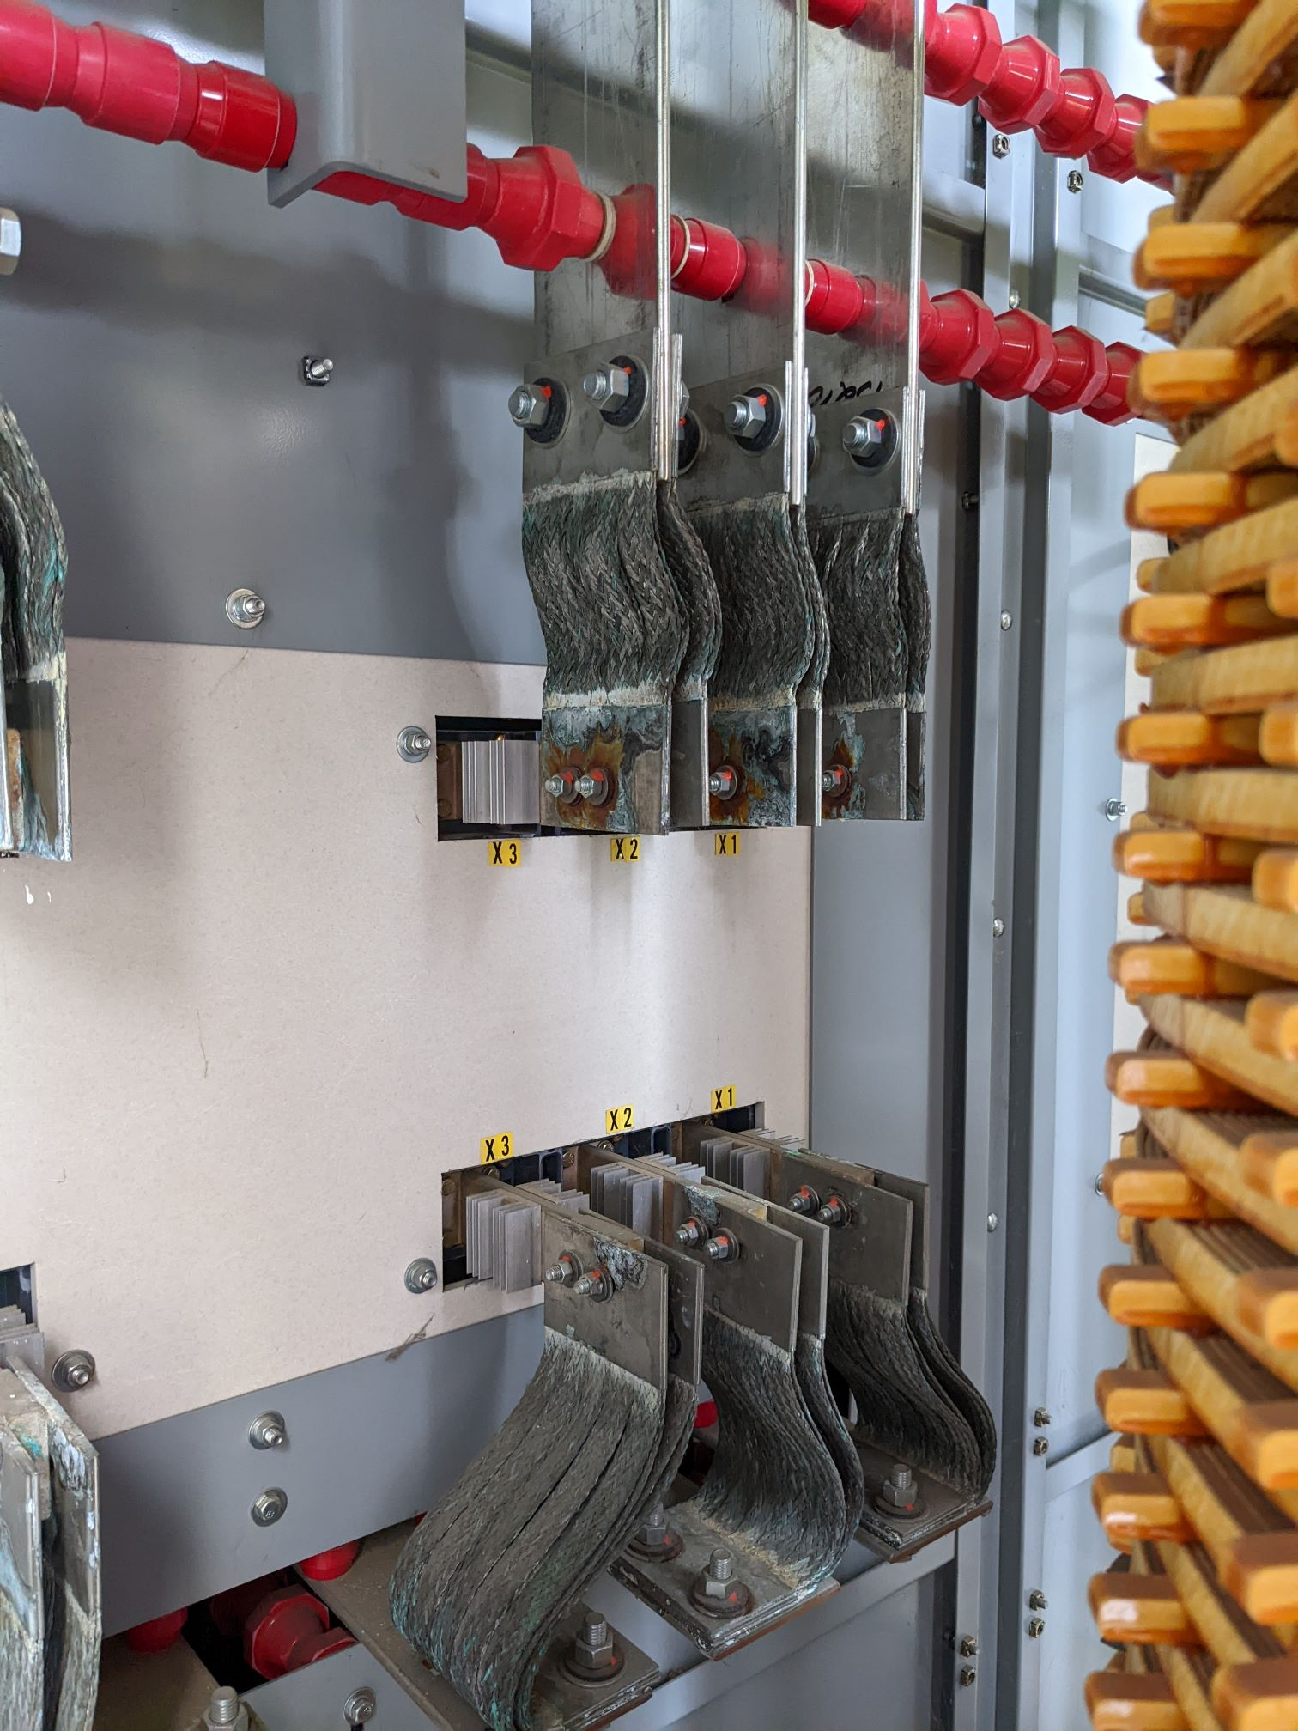
External Beam Delivery Department 8/28 – 9/1
Muon Campus
  AP30 power outage has been postponed until much later in the shutdown (at a convenient time). The Braided connections fabrication is underway.
  AP0 AC work has resumed but now is paused
    Design change for return air ducting required due to interference from cable tray
    System testing was scheduled for 2nd week of September, may now be delayed further
  Vacuum Leak in AP50 found on bellows that was replaced last year.
    Testing aerosol approach for future repairs s
  Preparing to remove Resistive Wall Monitor from the 10 straight (it gets moved to 907 in the M4 line).
  ESS2 testing
    No noticeable improvement too the vacuum response of the tank.
  Monday August 28th
    We would like the Delivery Ring, Extraction and the M4 line to be re-cored to shutdown Core.
      We are working with Rad safety as to the timing of this

Slide 13
Switchyard
Switchyard
  SWIC Change out
    Due manufacturing issues the following SWIC will not be going in this shutdown.
      S105/S202/S208
  Water leak repairs
    On going
  Vacuum Maintenance
    M02, 03, and 05 that electrical work to get these pumps up and running.
  F3 Manhole
    Remove from the Beam line M00U3
  Tev F3 Pond Pump replacement
    Crane will on site next week Friday Sept 1st

Slide 14
F:M00U Cable Replacement
  While completing a Job walkthrough It was discovered that our Interlock System for M01 has expired and we will need to retest and certify the interlock system prior to the test occurring.
  The Plan
    Friday August 25th (today)
      A mock secure of the F3 manhole and the M01 enclosure will be done
        This is being done so if a problem is encounter with the system, it can be address today and minimize delays on Monday
    Monday 28th
    Between 09:00 -10:00 hrs. Ops will complete a valid secure of the F3 manhole and the M01 enclosure
    ~10:30- 12:30 Interlock a group will test F3 manhole and M01 enclosures
    ~13:00- 15:00 we will take leads off the magnet and power supply
    ~15:00 – 16:00 hrs. HI pot the cable
  Tuesday August 29th
    MS3 oil switch will be replaced. This will impact the entire Meson line

Slide 15
ISD Maintenance
Was planned week of Aug 28th 2023
Monday -Thursday (any day)
  Asset# 360 Linac Fan Coil
    It has not been done
  Asset# 367 Linac Fan Coil
    There is Equipment in the way but just need a day notice to remove.
  Asset# 364.1 Linac Fan Coil
    This unit will not be done since it’s need more planning. There is fall prevention concerns. Will coordinate with P/S.
Monday Aug 21st
  Meson, There is 5 Work Orders
Monday-Thursday
  Muon and APO. 9 Work Orders
Monday-Thursday
  In the afternoon, Re-Lamping Transfer Hall so the crane can be inspected.
Monday-Thursday
  Corrective exist in many areas
Tasks not scheduled due to availability
  Asset# RS1214 Main Ring RSF4 Strainer
  Asset# RS1210 Main Ring RSF3 Strainer
  Asset# RS1205 Main Ring RSF4 Strainer
The Process
1st Pass
General inspection
Determine what problems Order parts
2nd Pass
Corrective actions

Slide 16
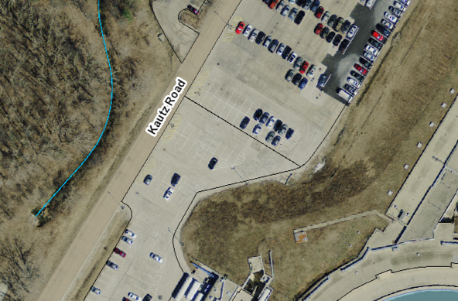
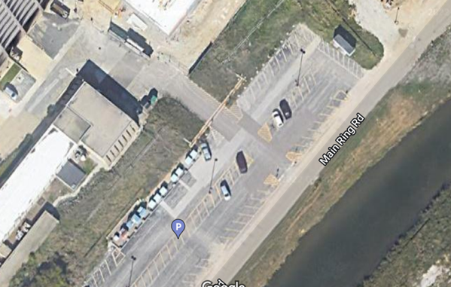
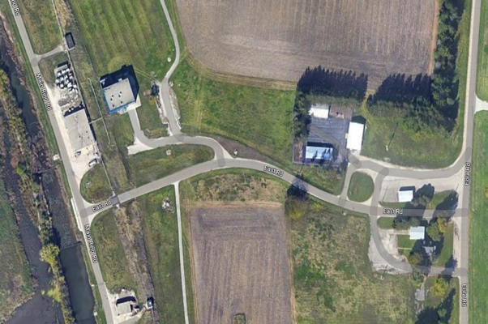
Gate access
Gates equipped with:
  Badge readers – so authorized personnel can pass through
  Intercoms – so deliveries and other persons can be assisted by security
Emergency vehicles will have an override
All gates engineered so all highway-legal traffic (including tankard trucks) can pass through an open gate
Gates are located at:
  Kautz Road (1) near the end of the linac
  SE corner of Wilson Hall (2) before connecting to Main Ring Rd.
  E Road (3) near Main Ring Rd. (at C0)
1
Guard booth
Chain-link fence
Jersey barrier
2
3

Slide 17
ISD Engineering
Fences
Wilson Hall East gate (2)
Willson Hall West Gate (1)
Tev C0 gate (3)
This project has an expected completion date of Oct 30th
Various location impact operations due to work on in near the berm.
MI12
AP0
Booster West
tower

Slide 18
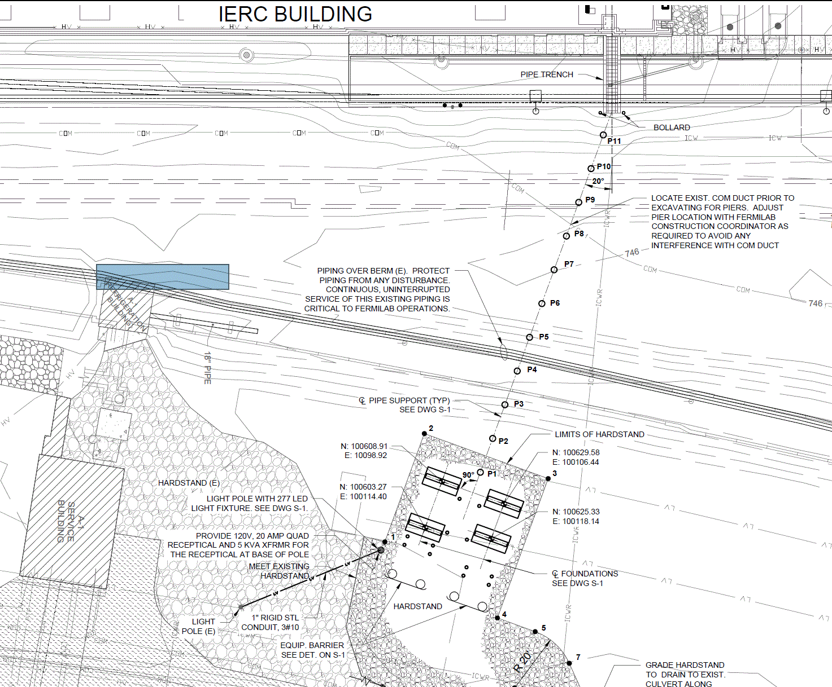
A1 Dewar installation for IERC Building
Approximate Berm locations
Contractor will mobilize next week
Task that impacts the berm should be done by Oct 3rd

