Slide 1
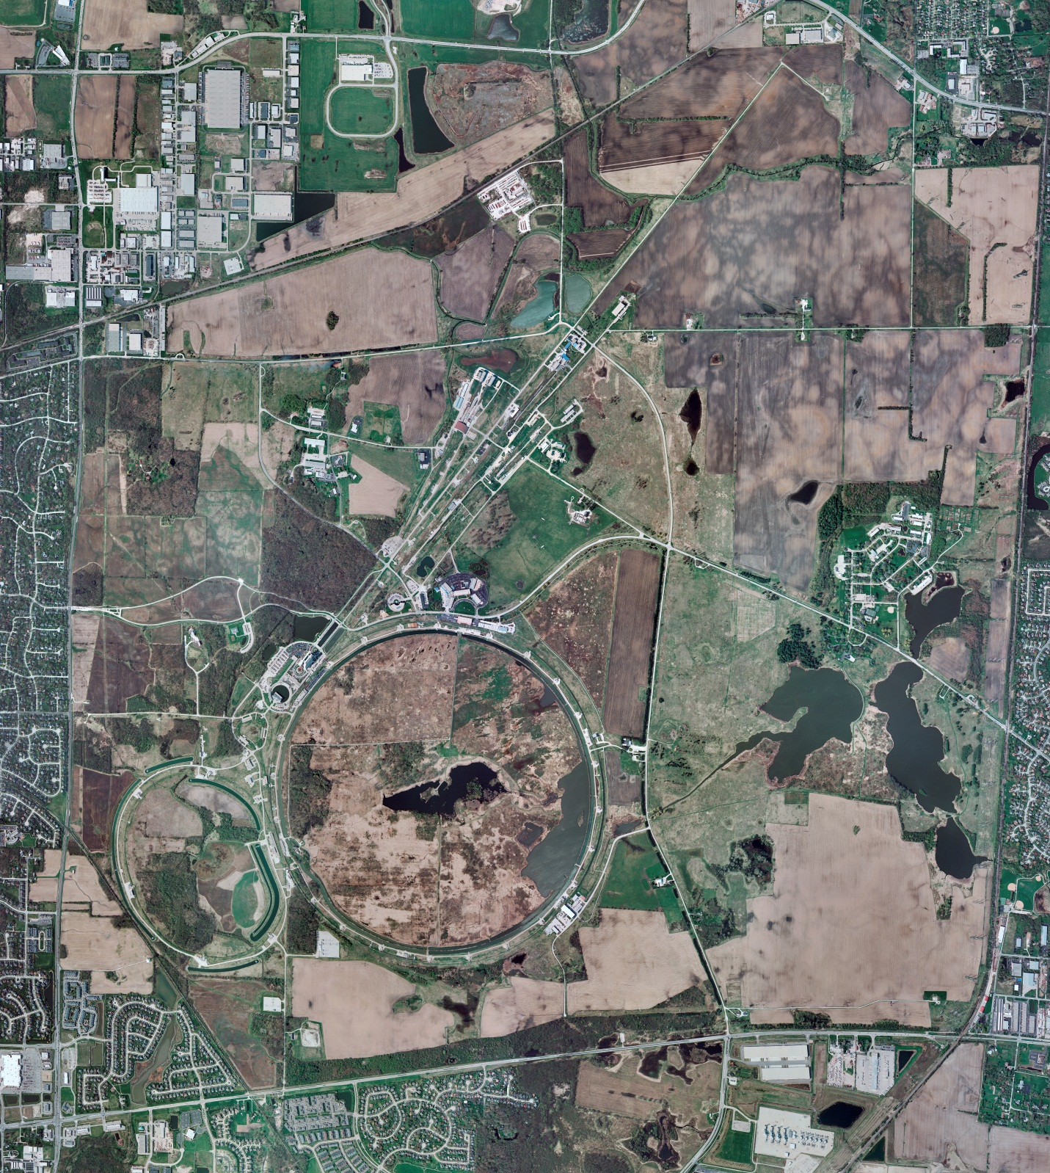
Helium Cryogenics
Status 8/25/2023 J.Makara
CMTF: SCP is cold and operating fine
CMTS: HECM27 CM was cooldown in progress, anticipate to be at 2 K by Monday for RF testing
PIP2IT: SSR1 CM at RT, prepping for cooldown
HB650 CM warm at RT, LOTOed, and removal in progress
MCTF: cryo system is cold and running fine
MDB/HTS: at RT
MDB/STC: LB650 Cavity testing complete and warmup to RT to commence
MDB Magnet: at RT
NML/FAST: Cryo system is cold but performance is poor
CC1: cold at 2 K
CC2: cold at 2 K
CM: cold at 2 K but empty LHe
IB1: cryo system is cold and was running fine
Muon Campus: A0 comprs (3) online with MC-1 g-2 cryogenic system at 80 K shutdown; Mu2e subsystems were cooled down with LHe in 3kL LHe dewar; testing to continue after Monday’s power outage
Misc:.

