Slide 1
Muon Campus Operation Report
Jim Morgan
Friday 09:00 Operation Meeting
August 25, 2023

Slide 2
Muon Campus status (week of Aug 11-17)
ESS2 was isolated and pumped back down after a small speck was removed from the cathode
On Tuesday, a front-end reboot caused septum ion pumps to turn off
The current vs voltage curve is the same now as it was before
Repair attempts have ended, DR has been switched to supervised access
ESS1 foil plane installed in vacuum vessel yesterday
The Delivery Ring Wall Current Monitor has been removed from the 10 straight and will be moved to the M4 extraction line.
Instrumentation not needed for Mu2e has been removed from the 10 straight (two Proportional Wire Chambers and one Ion Chamber)
Attempt to repair Q506 bellows leak with VacSeal was not successful
Booster group has noticed a correlation between tunnel leaks and Muon Campus LCW pressure, we will help determine if this is the cause
AP-0 Air Conditioner Replacement work is paused
A simple design change has been proposed for the return air ductwork and work could resume in a week or two if there are no objections
Pre-Target exhaust blower EF1 has a bad VFD controller that needs to be replaced
Study – M1-M3 Optics
Study – Alternative M5 optics
KPS5A PFL Repair
MC-1 Controlled Access
G-2 Trolley Run
Intentional Accelerator
Standby Period
<------------Week Days -------------------→

Slide 3
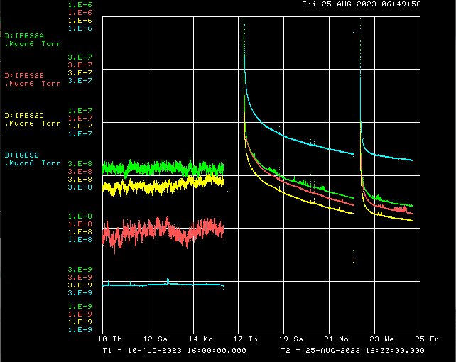
ESS2 Vacuum over 10 days
Vacuum Isolation
Front-end Reboot

Slide 4
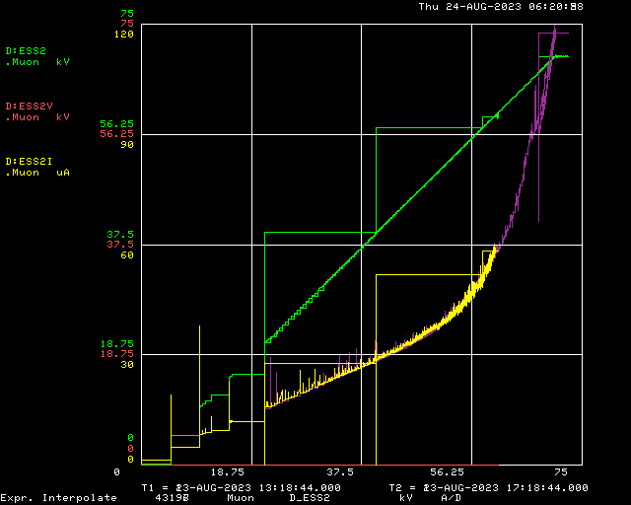
ESS2 current vs voltage
Current on August 13
Current on August 23

Slide 5
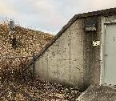
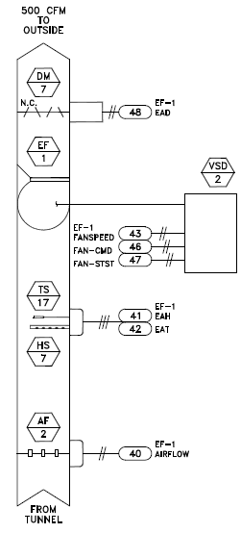
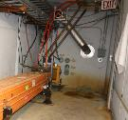
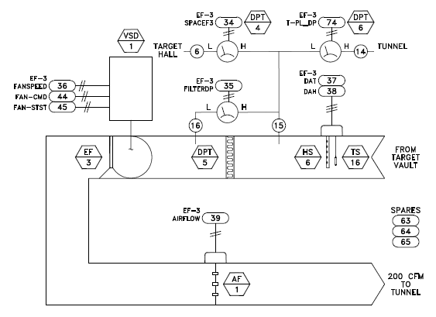
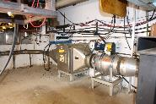
AP-0 Air Handling Systems
Dampers for outside air, building relief and
return air regulate AP-0 at 0.1 W.C (.0036 psi).
Building relief damper near north roll-up door
Outside air intake
behind grating near
south entrance
Air Handler above south entrance
Tunnel
ventilation
Bathroom
exhaust fan
Air handling unit AHU3 is
above Target Vault, A/C
units are behind building,
recirculates air within AP-0
AP-0 to outside
differential pressure
AP-0 to outside
differential pressure
Diff. pressure
AP-0 to outside
Pre-Target Stack
Recirculated and cooled
Building air
500 CFM
Penetrations
From F-23
to Pre-Vault
Penetrations
From AP-0
to Pre-Vault
Diff. pressure
AP-0 to outside
Pre-Target Stack
Diff. pressure
AP-0 to Pre-Vault
Diff. pressure
AP-0 to HEPA
Damper, open when EF-3
(Pre-Vault) is running
Tunnel
ventilation
Vault temperature
and humidity
Diff. pressure
Pre-Vault to HEPA
Vault
Differential pressure
across HEPA filter
ACCU – Air-Cooled Condensing Unit
AF – Air flow
AHU – Air Handling Unit
DPT – Differential Pressure Transducer
DM - Damper
EF – Exhaust Fan
HS – Humidity Sensor
TS – Temperature Sensor
VSD – Variable speed drive
HEPA filter
Pre-Target
200 CFM
Transport
Pre-Vault

Slide 6
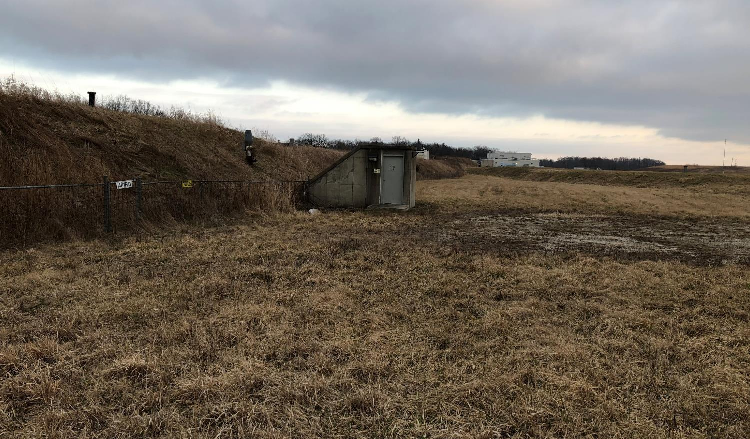
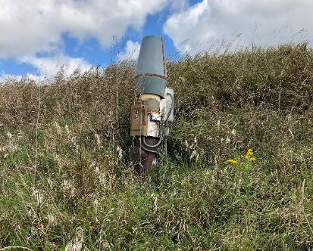
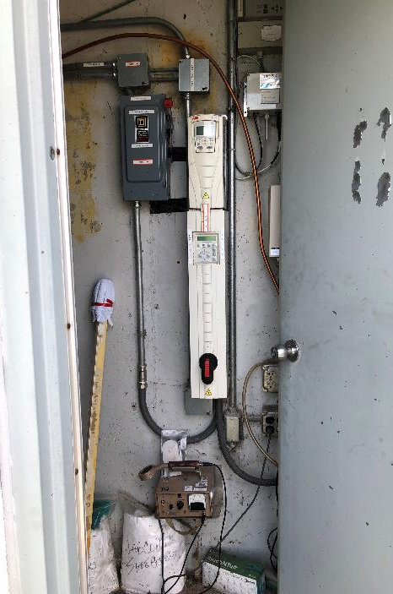
Pre-Target tunnel entrance
Pre-Target exhaust Stack (EF1)
EF1 VFD controller

Slide 7
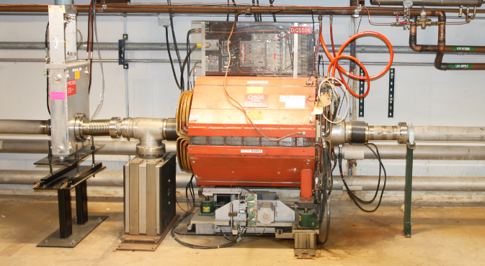
Next week
Switch to shutdown keys for Delivery Ring, Extraction, and M4 enclosures
Run 2 LCW pumps over the weekend and monitor Booster tunnel water leak
Leak Check 10 straight after removal of Wall Current Monitor, PWCs and Ion Chamber
1st Extinction Collimator in extraction line will be removed for modification
Begin installation of Wall Current Monitor in extraction line in Extinction Collimator slot
Replace leaking welded bellows upstream of Q506

