Slide 1
Main Injector Shutdown Status
D. Morris
9 o’clock Meeting
August 25th, 2023

Slide 2
General
HVAC installation underway at MI-10 and MI-20.
Will maintain networking, CAMAC, Vacuum systems
Will power down correction elements, BPM, BLM systems, and more…
Follow worksite access rules (HA, PPE etc.).
MI-30 HVAC work starts 8/31 (Monday) MI-40 HVAC work starts 9/1 (Friday)
2
MI Department Meeting | D. Morris
8/25/2023

Slide 3
Tunnel Work
Crews are doing vacuum rework in MI-8. Includes replacing LCW header
supports and moving a compressed air line.
Leak tight 810 to 824. High humidity has moved them to other jobs until next week.
Q333 (IQB-067) LCW leak.
Repair made.
Hydo testing permit in approval process
Q319 faulted quad replacement planning in progress
As-Found scheduled for Wednesday
White hose replacement (MI-50 through MI-60) started last week.
MI50 and MI-60 sectors. Already completed most of 50 sector.
3
MI Department Meeting | D. Morris
8/25/2023

Slide 4
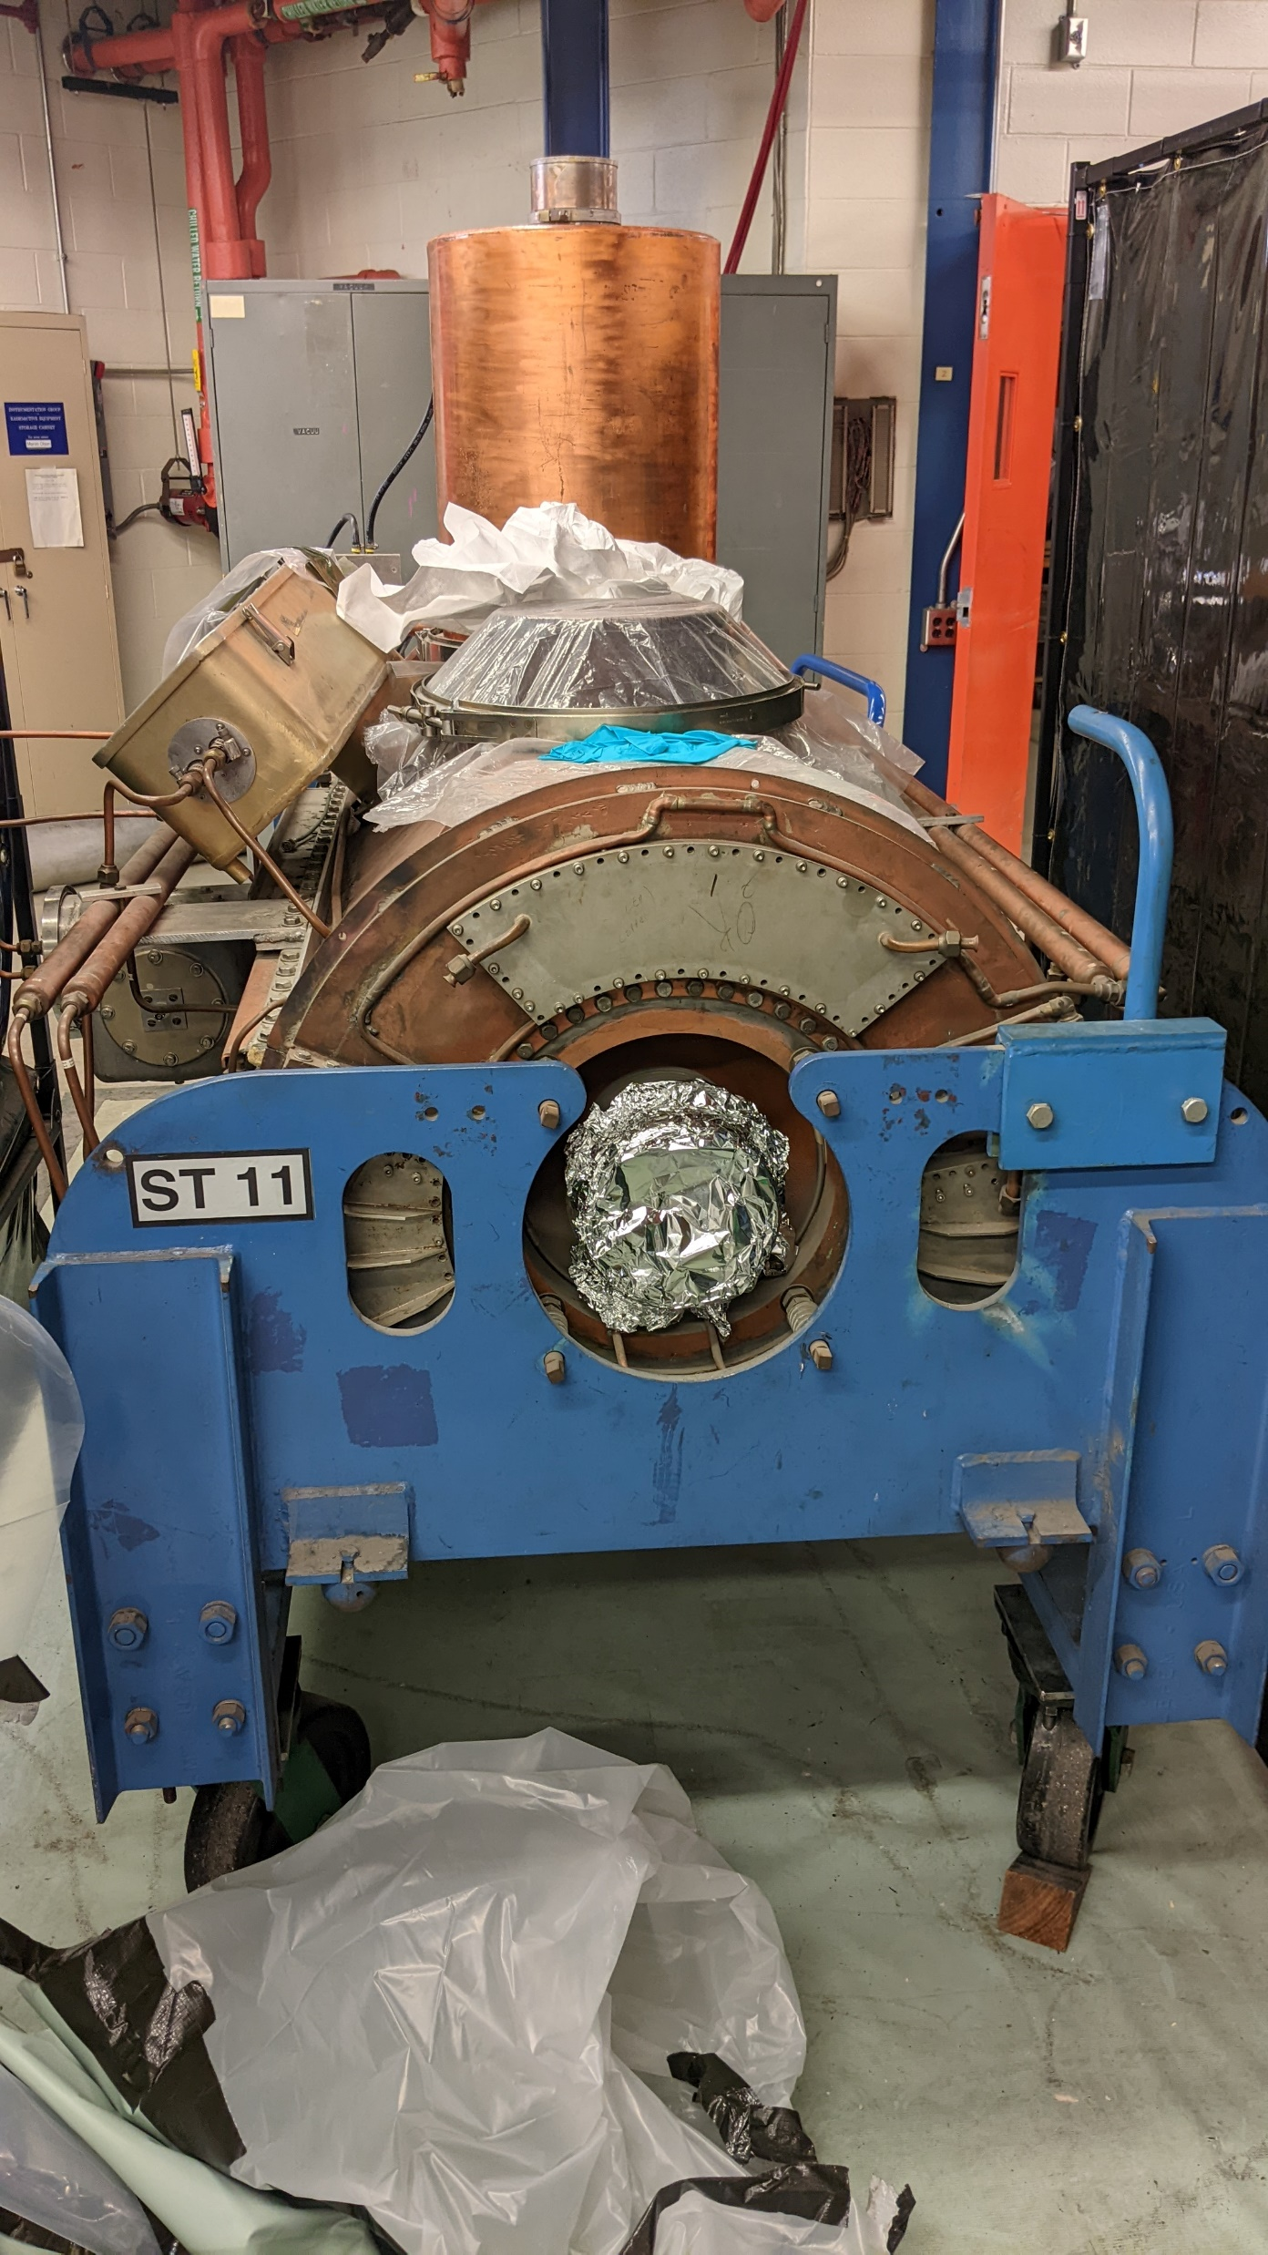
Tunnel Work
MIRF#11 cavity removed for water path rework. RF maintenance continues.
Replaced 600 L/s ion pump at 606.
4
MI Department Meeting | D. Morris
8/25/2023

Slide 5
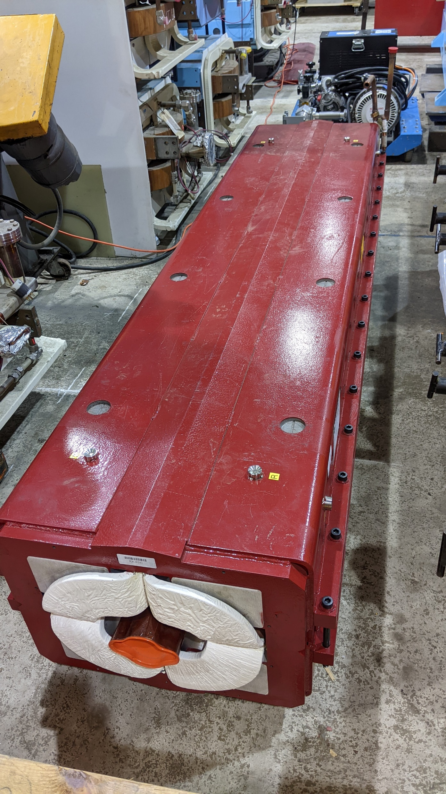
Tunnel Work
Defocusing quad bus ground fault as been isolated to the Q319 (IQC009) quad.
Rebuilt IQCB241-0 has been delivered to MI-60.
Need to verify IQCB241 and confirm IQC009.
5
MI Department Meeting | D. Morris
8/25/2023

Slide 6
Conventional Power Outages
There are no scheduled conventional power outages in MI/RR until next
week.
Please report any MI outages to the MCR.
6
MI Department Meeting | D. Morris
8/25/2023

Slide 7
MI-20 Sump Line Repairs
Work is progressing well.
Exterior work is mostly done. Waiting on results from berm topo.
Work in the stairwell is complete. Waiting on check valves for final
“Y” pipe installation.
7
MI Department Meeting | D. Morris
8/25/2023

