Slide 1
Multimode Bosonic Codes
Leonardo Pierattelli
Doǧa Murat Kürkçüoǧlu
Henry Lamm
8/23/2023

Slide 2
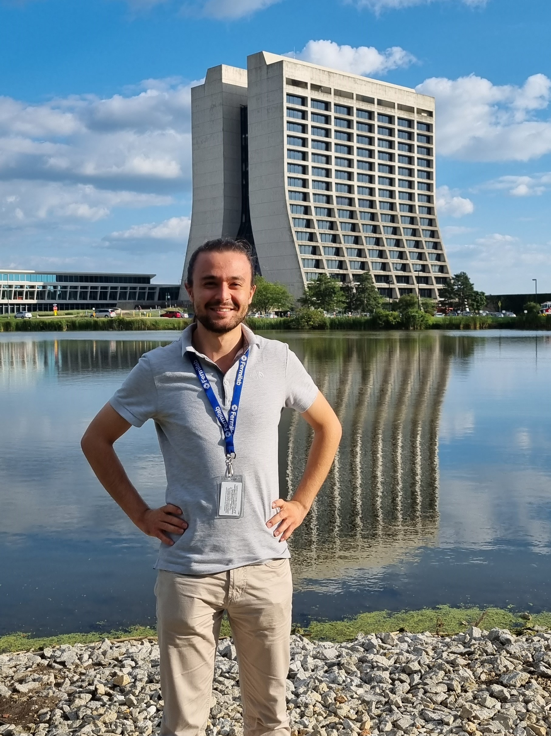
Leonardo Pierattelli
School: University of Pisa
Why I’m interested in Quantum Computing/Sensing: Because I want to do my part in the Second Quantum Revolution
Why I applied for the SQMS internship: To learn how to do research in Quantum Information Science, in one of the best places to do so.
Focus Area: Multimode Bosonic Codes
Supervisor(s): Doǧa Murat Kürkçüoǧlu, Henry Lamm

Slide 3
Introduction
Context: Quantum computers are better than classical ones in investigating quantum systems
Chemical compounds
Quantum materials
HEP
Discretization is the first step anyway
Lattice Field Theory

Slide 4
Simulating Lattice Field Theory
Discretize spacetime (3+1 dimensions)
Define fermionic fields in the vertices, bosonic fields in the links
In a Quantum Computer we need only space discretization
However, it is always necessary to discretize bosonic fields’ values, too

Slide 5
Discretization of Bosonic Fields
Main choice:
Assume the field can take a finite number of values
Not all discretizations are suitable!
For SU(2) (weak interaction):
Binary Tetrahedral (BT or 2T): 24 elems.
Binary Octahedral (BO/2O): 48 elems.
Binary Icosahedral (BI/2I): 120 elems.

Slide 6
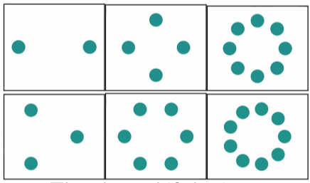
Choice of Hilbert Space
EM cavities are the best to host large numbers of equivalent states
Encode the bosonic field state in one qudit
Best to work with many modes:
Cat codes…
…Z(n)…
…U(1)!
What qudit?
Cat codes?

Slide 7
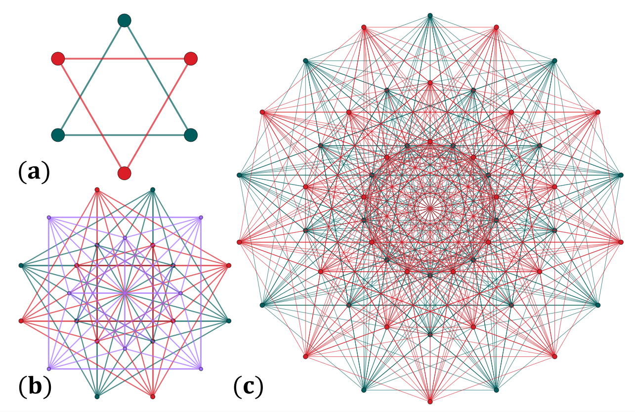
Higher-Dimensional Cat Codes
Multimode Bosonic Codes
To represent higher dimensional groups…
Focus on Quantum Spherical Codes:
$\{C_{k}\}_{k=1}^{K}$ codeword constellations
Usually uniform superpositions of coherent states (maximally entangled states)
Codespaces among many modes
Shubham P Jain, Joseph T Iosue, Alexander Barg, and Victor V Albert. Quantum spherical codes. arXiv preprint arXiv:2302.11593, 2023

Slide 8
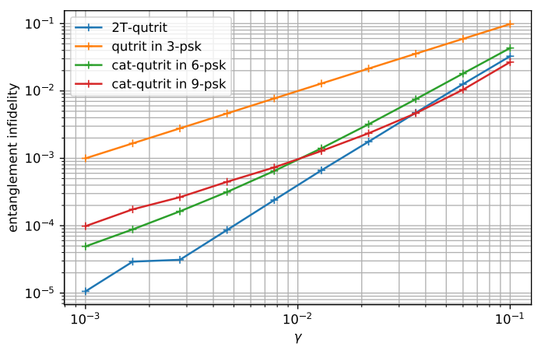
Multimode Bosonic Codes’ Properties
Specific choices of codes can lead to easier calculations
Can offer different error tolerance performances
Possible explanation: group-like properties between basis elements
Aurélie Denys and Anthony Leverrier, “The 2T-qutrit, a
two-mode bosonic qutrit,” Quantum 7, 1032 (2023).

Slide 9
Objectives
Long term:
To find a 24n/48n/120n-dimensional codespace
For SU(2) discretization and error coding
Must be chosen by varying the number of coherent states and EM modes
Choose a codespace offering multiplicative group structure
For improved error tolerance
Find the best encoding
And evaluating performance
Short term:
What are the best characteristics for codespaces and codewords?
Abelian or non-Abelian group structure?
2T = Q ⋊ Z(3)
Q is non-Abelian, Z(3) is abelian
In the literature, codespaces with Z(3) group structure have been analyzed, with codewords having Q group structure.
What if 2T = Z(3) ⋊ Q?
Does having Abelian codewords strengthen or hinder error tolerance?
What about encoding 2T $⊂$ 2O?

Slide 10
In detail…
ToDo: proper group element – Hilbert space’s basis element correspondence
For 2T-constellation:
Each coherent state $→$ quaternion

Slide 11
Finding a Quoctit, and More
What if we want to encode a quicosotetrit (24 states) into the larger 2O group?
If group structure is important, no advantage!
Codewords themselves would not have a group structure…
2O = 2T ⋊ ??? 2T $⊂$ 2O…

Slide 12
Thank you for listening!

