Slide 1
Lost Muons analysis for the Muon g-2 experiment at FermiLab
Francesco Confortini

Slide 2
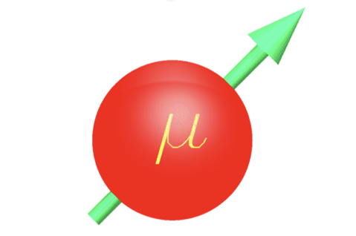
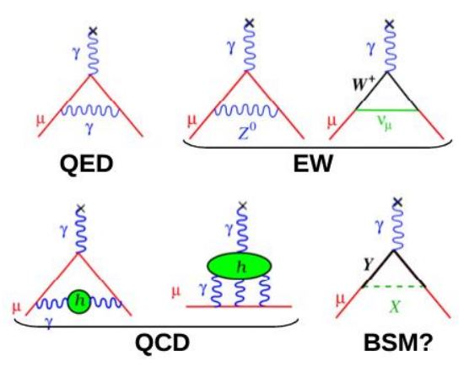
Muon magnetic moment
Muons are point like particles, like electrons, with a magnetic moment of:
$$\vec{μ}=g\frac{q}{2m}\vec{S}$$
Dirac theory predicts that the g-factor of an elementary particle is 2 but higher order corrections shift this value by the muon anomaly defined as
$$a_{μ}=\frac{g−2}{2}≈{10}^{−3}$$
All high order loops contribute to $a_{μ},$ even the ones of particles that we haven’t discovered yet. For that a precise comparison beetwen the theorical value and expermiental measurment is a good test for the Standard Model in Physics.

Slide 3
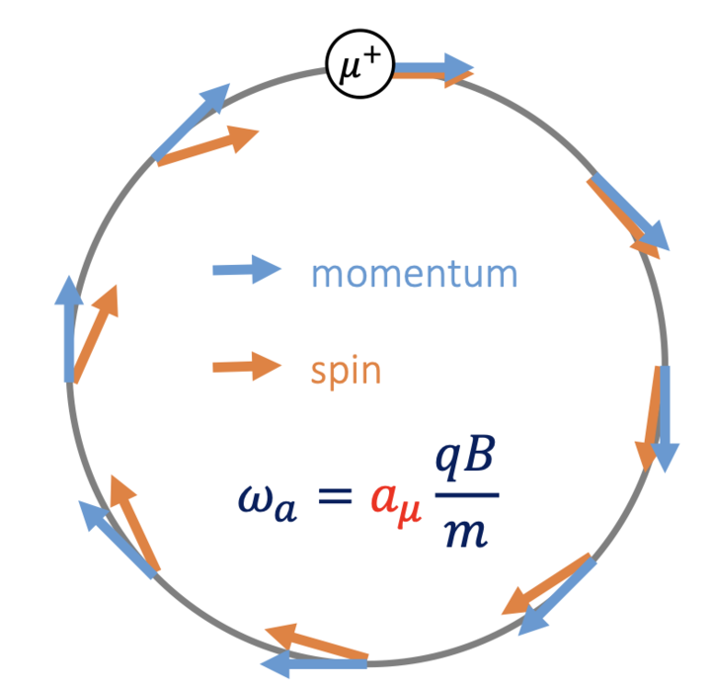
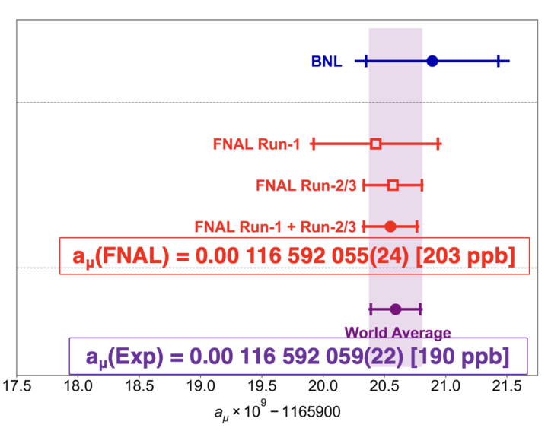
Muon precession
In a magnetic field the muon spin frequency $ω_{s}$ precess at a rate greater than the cyclotron frequency $ω_{c}$
The anomalus precession frequency is given by:
$$\vec{ω_{a}}=\vec{ω_{s}}−\vec{ω_{c}} ≈a_{μ}\frac{e\vec{B}}{m}$$
Hence the ingredients to measure $a_{μ}$ are polarized muons beam stored in a magnetic field and a precise measure of
$ω_{a}$ and B
Goal of the Muon g-2 collaboration is to measure $a_{μ}$ with a 140 ppb uncertainty using this technique
On August 10th the collaboration published its second result based on Run2 and Run3 confirming the previous measurmeant based on Run1 and reaching $≈$ 200ppb

Slide 4
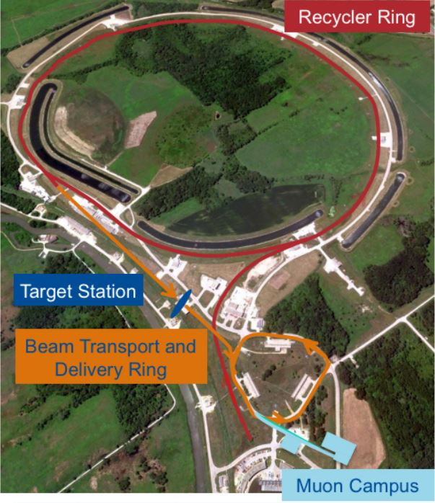
Production of muon beam
Recycler Ring: 8 GeV protons from Booster are divided in 4 bunches
Target Station: $p$-bunches are collided with a target and $π^{+}$with 3.1 GeV/c ($±10\%)$ are collected
Beam trasport and Delivery Ring: magnetic lenses select $μ^{+}$ from pion decay mode then $μ^{+}$ are separeted from $p$ and $π^{+}$ in a circular ring
Muon campus: the polarized $μ^{+}$ beam are ready to be injected into the storange ring

Slide 5
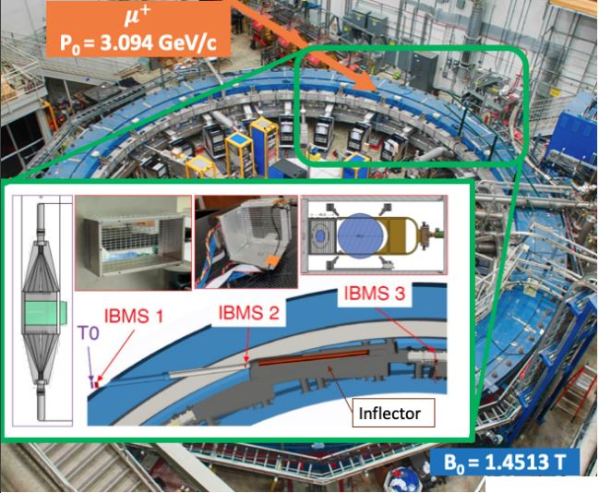
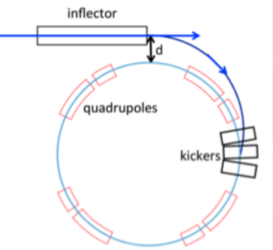
Injection and storange
Polarized $μ^{+}$beam enters the ring trough 2.2 m hole in the iron yoke
Inflector magnet provides nearly free field free region for the muons to enter the storange ring
Injected beam is 77mm from the storange region center
Kicker magnets produces a strong and short magnetic pulse to put the muons in the right orbit
Beam focused vertically by the eletrostatic quadrupoles (ESQ) that cover four sections of the ring (43%)

Slide 6
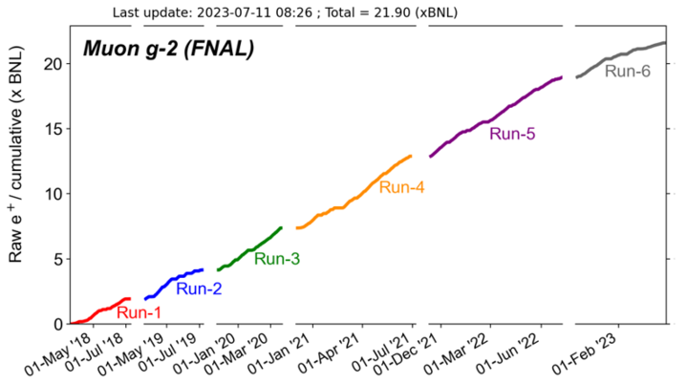
Final formula
The $a_{μ}$ formula is
$a_{μ}=\frac{ω_{a}}{\tilde{ω_{p}^{′}}{(T}_{r})} \frac{μ_{p}^{′}(T_{r})}{μ_{e}(H)} \frac{μ_{e}(H)}{μ_{e}} \frac{m_{μ}}{m_{e}} \frac{g_{e}}{2}$
Ratio of the frequencies $R_{μ}$ mesured by collaboration
Fundamental factors
(uncertainity of about 25 ppb)
$ω_{a}:$ muon anomalus precession extracted from the positrons decay
$\tilde{ω_{p}^{′}}{(T}_{r})$: magnetic field B in terms of shielded protons precession frequecy and weighted by the muon distribution.

Slide 7
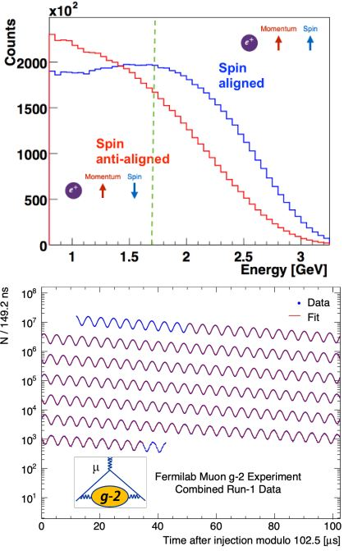
Measurments of $ω_{a}$ and B
While circulating in the storange ring muons decay:${ μ}^{+}→e^{+}+ν_{e}+\overline{ν_{μ}}$.
Energy and Angular distributions of the emitted positrons are highly correlated to the muon spin direction in its rest frame (parity violation of week decay)
Hence $ω_{a}$ can be measured fitting the rate of high energy $e^{+}$ with:
$N\left(t,E\right)=N_{0}e^{−t/τ}[1−A(E)\cos{(ω_{a}+φ)}$]
Energy and the decay time of the positrons are measured using 24 calorimeter stations located around the ring.
B is mapped using NMR probes fixed in the yoke and also carried inside the ring by a trolley

Slide 8
Master formula
$C_{e}:$ eletctric field correction
$C_{p}:$ pitch correction
$C_{pa}:$ phase-acceptance correction
$C_{dd}:$ differential decay
$C_{ml}:$ muon loss correction
$f_{clock}:$ blinded clock
$ω_{a}^{meas}:$ measured precession frequency
$$ω_{a}$$
beam dynamics corrections
$$R_{μ}=\frac{\overbrace{f_{clock}{⋅ω}_{a}^{meas}}(1+\overbrace{C_{e}+C_{p}+C_{ml}+C_{pa}+C_{dd})}}{\underbrace{f_{calib}{⋅ω}_{p}^{′}(x,y,φ)⨂M(x,y,φ)} ∙(1+\underbrace{B_{k}+B_{q})}}$$
$$\tilde{ω_{p}^{′}}(T_{r})$$
Field corrections
$f_{calib}:$ absolute magnetic field calibartion
$ω_{p}^{′}\left(x,y,φ\right):$ field maps
$M\left(x,y,φ\right):$ muon beam distribution
$B_{k}:$ transient field from eddy current in the kicker
$B_{q}:$ transient field from quad vibration

Slide 9
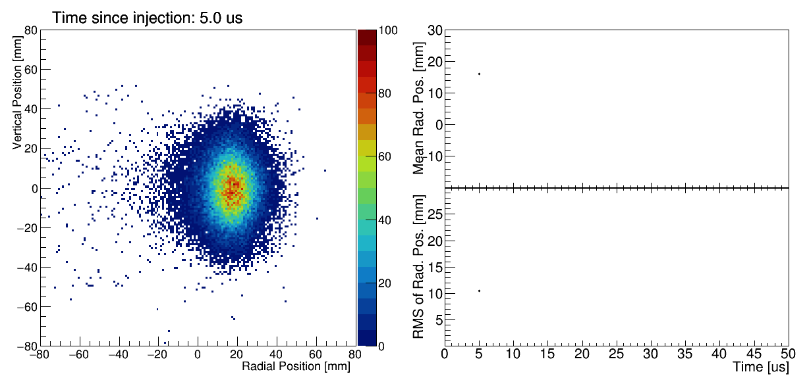
Beam dynamics
If the muons were monoenergetic, and none of momentum is in vertical direction, then that muons will live in the «storange orbit». But the motion and path of the muons in the real beam is changed by several factors
The resulting presence of an electric field and a vertical betatron oscillations neccessitate «beam dynamics» corrections that must be applied to $ω_{a}^{meas}$ in order to obtain $ω_{a}$
$C_{e}:$ eletric field correction
$C_{p}:$ pitch correction
$C_{pa}:$ phase-acceptance correction
$C_{dd}:$ differential decay
$C_{ml}:$ muon loss correction
Lost muons are the subject of my work

Slide 10
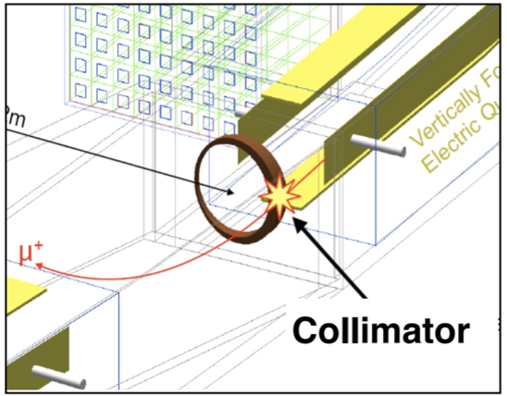
Lost muons
Before decaying lost muons are muons that during their path into g-2 are lost.
Several driving mechanism can lead to loss muons during the storage but most of them are lost because of their interaction with collimators
This effect can be taken into consideration in the final $ω_{a}$ fit including and additional factors $Λ(t)$
$$Λ(t)$$
$$N\left(t\right)=N_{0}e^{−\frac{t}{τ}}Λ\left(t\right)[1−A\cos\left(ωt+φ\right)]$$
The goal of lost muons analysis is the determination of the lost muons spectrum $L\left(t\right)$ and of its exponetally weighted integral:
$$J\left(t\right)=\int_{0}^{t}{L\left(t^{′}\right)e^{t^{′}/τ} dt^{′}}$$
In general this is obtain using data-driven techniques, my goal is to evalute it with the simulation

Slide 11
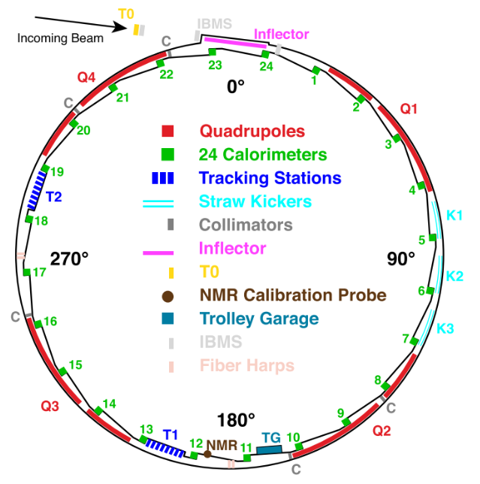
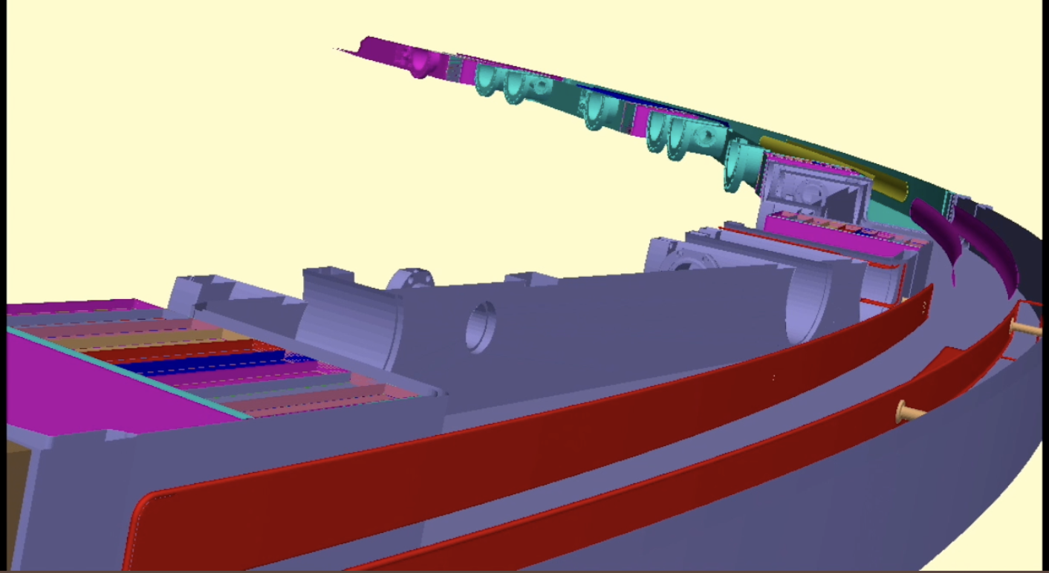
GM2RingSIM
Based on GEANT4 implemented within the ART framerwork
Simulates injection into storange ring and interactions with materials and fields
Some input parameters, e.g. T0 distribution, kicker pulse and fields are taken from data others are tuned comparing with IBMS and tracker data
Include Ghost Detector wich are used to track the particle’s position in the ring
Includes several particle guns, in particular the lost muons gun which it is used to produce high statistics simulation samples of lost muons.

Slide 12
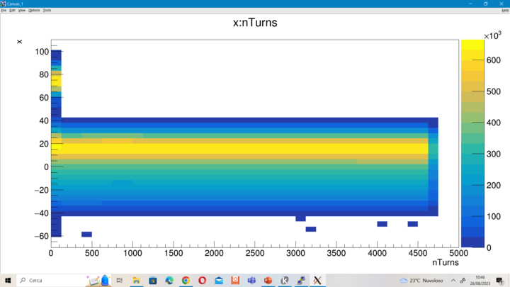
Lost Muons Gun
Selects only the muons that have high probability to hit a collimator before decaying (e.g. muons that are not stored)
Requires to be tuned using as input parameters the Twiss parameters (characteristic beam parameters) appropriate for each Run
Using them the gun evaluates which is the maximum radius inside the storage ring that the muon will reach and select only the muons with $r_{max}$ > $r_{collimator}$
First part of my work was to extract these parameters using the full beam simulation with Run2 settings/tune.
Lost muons
Qui
Stored muons
Lost muons
Preliminary

Slide 13
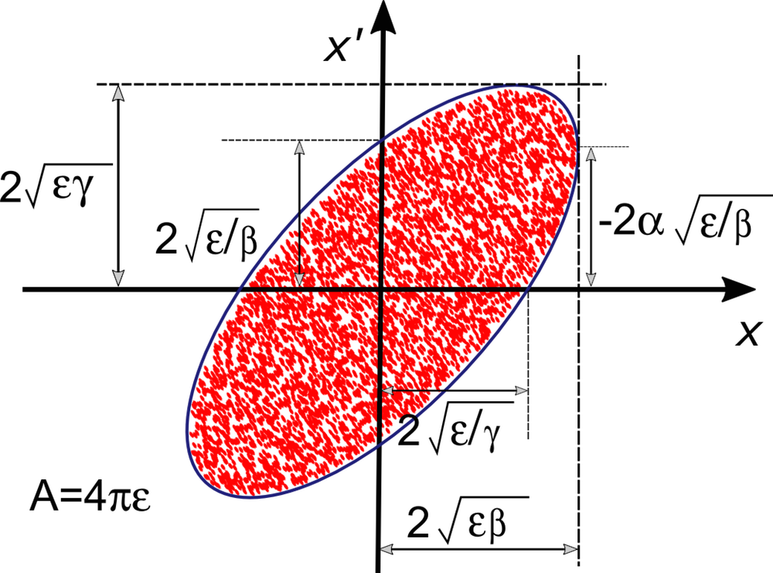
Twiss parameters
A good approximation for the beam shape in phase space is an ellipse.
The equation for the beam ellipse, with our Twiss parametrization can be written as:
$$γx^{2}+2αxx^{′}+βx^{′2}=ε$$
And the ellipse has area:
$$\int{ⅆx{ⅆx}^{′}=πε}$$
$ε=$beam emittance
The beam emittance is the phase space area of the beam.

Slide 14
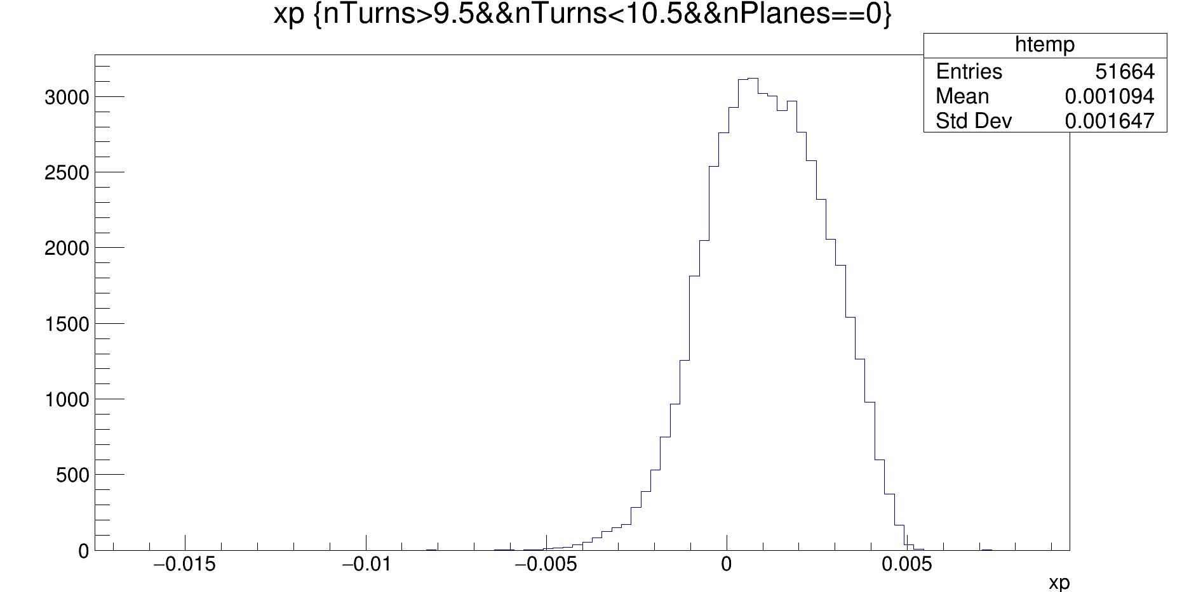
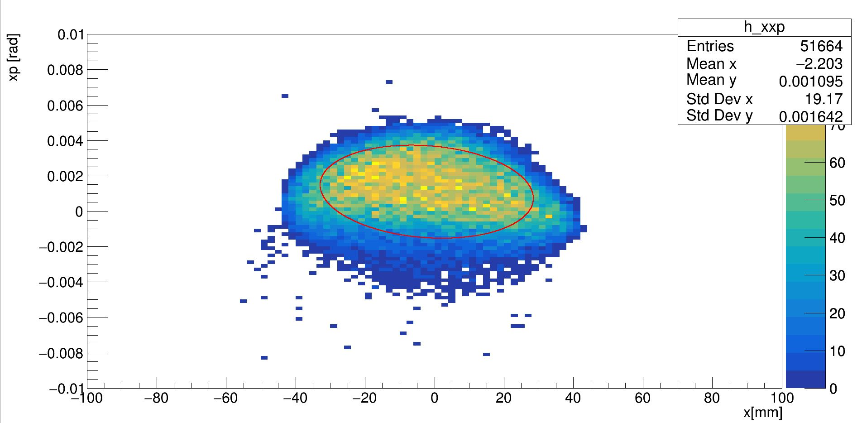
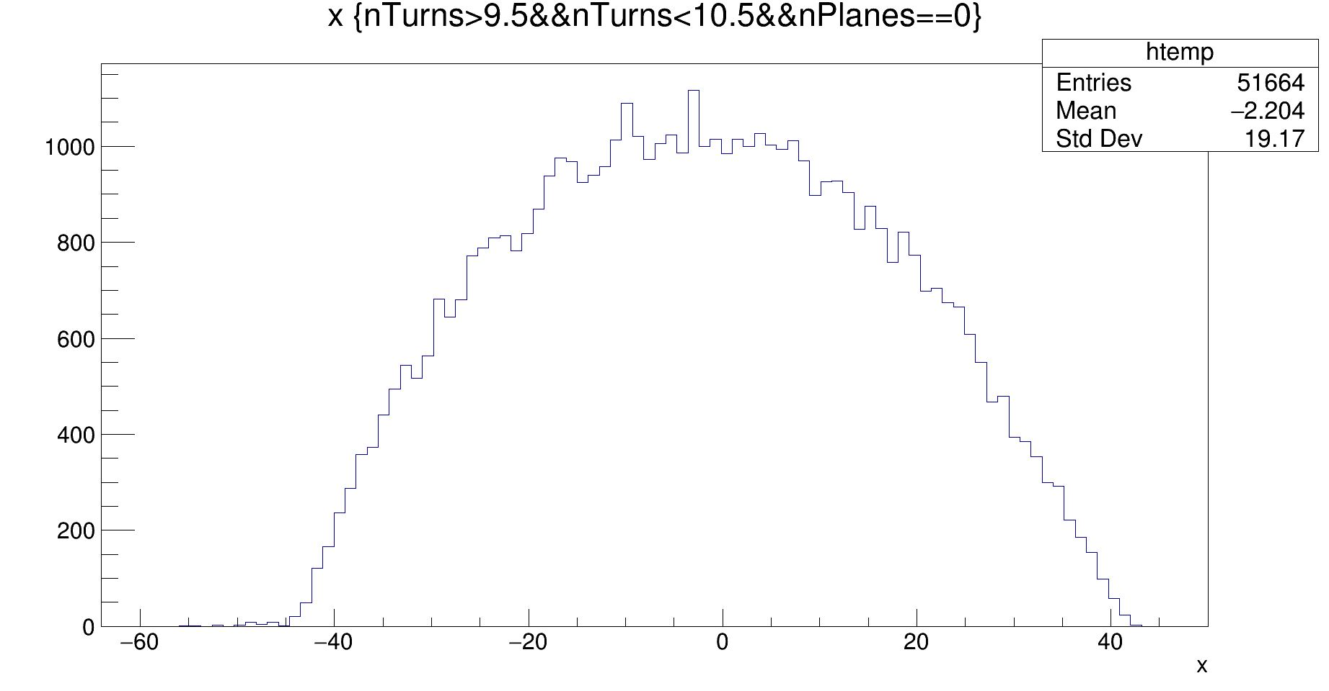
Twiss parameters according Gm2SIM
Preliminary
Twiss parameters for the radial phase-space
$$β_{x}=\frac{σ_{x}^{2}}{ε_{xRMS}}$$
$$ε_{xRMS}=\sqrt{\left\langle x^{2}\right\rangle \left\langle x^{′2}\right\rangle −{\left\langle x∙x^{′}\right\rangle }^{2}}$$
$$γ_{x}=\frac{σ_{x′}^{2}}{ε_{xRMS}}$$
$$x^{′}=\frac{p_{radial}}{p_{logitudinal}}$$
Preliminary
$$α_{x}=\sqrt{β_{x}γ_{x}−1}$$
$$γx^{2}+2αxx^{′}+βx^{′2}=ε$$
Preliminary

Slide 15
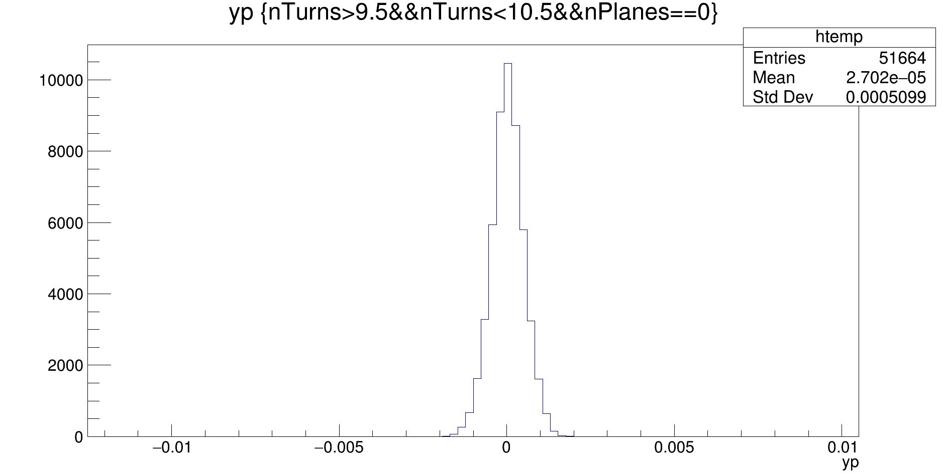
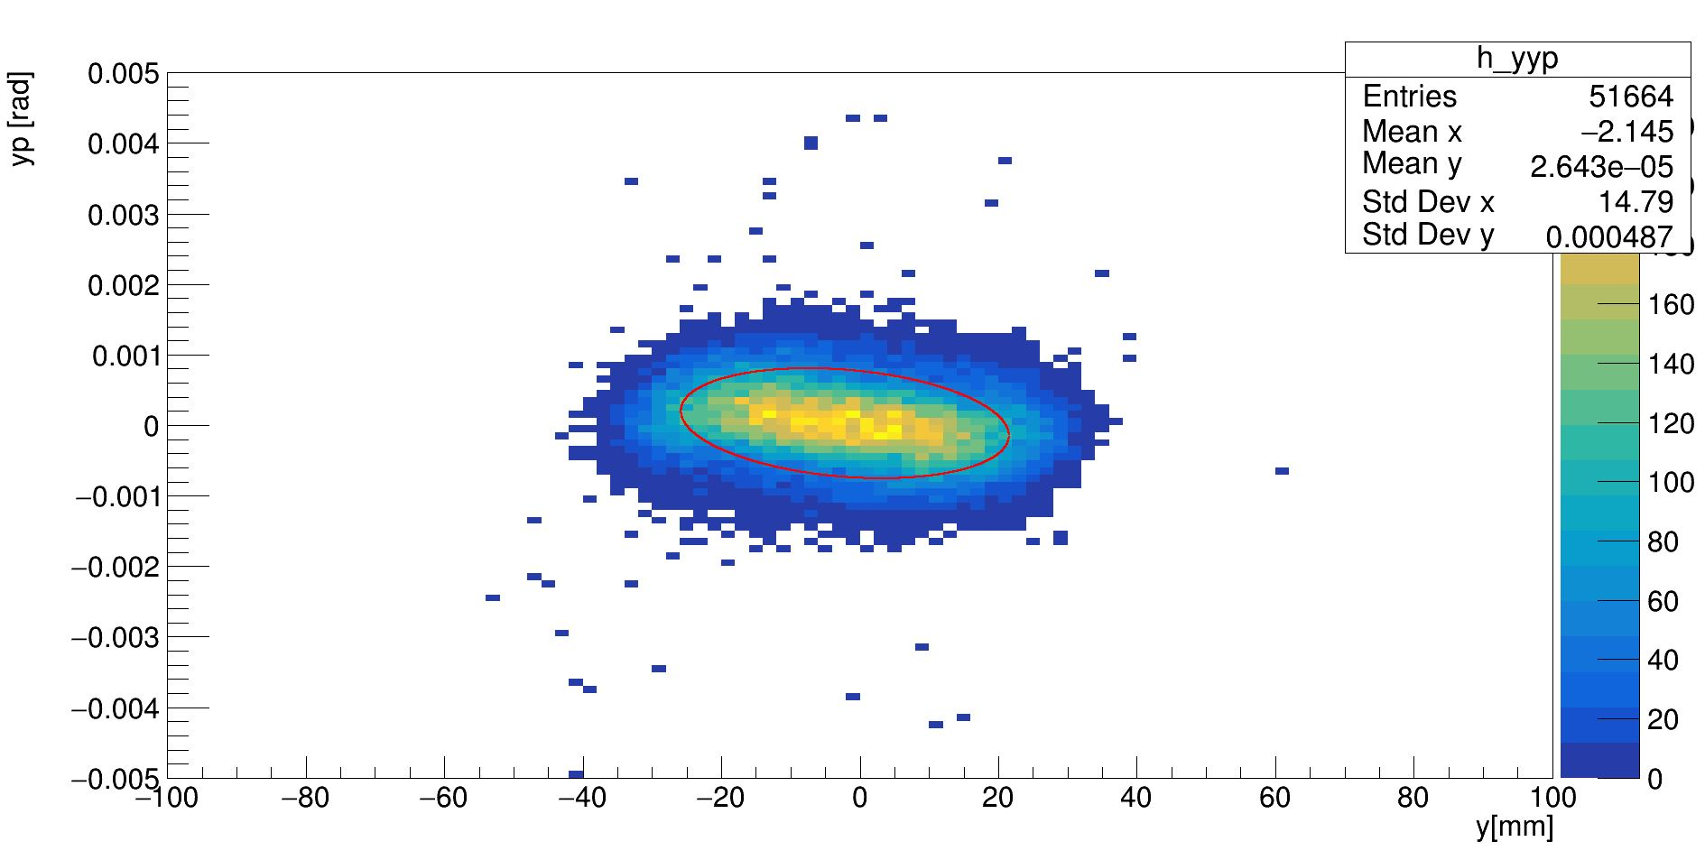
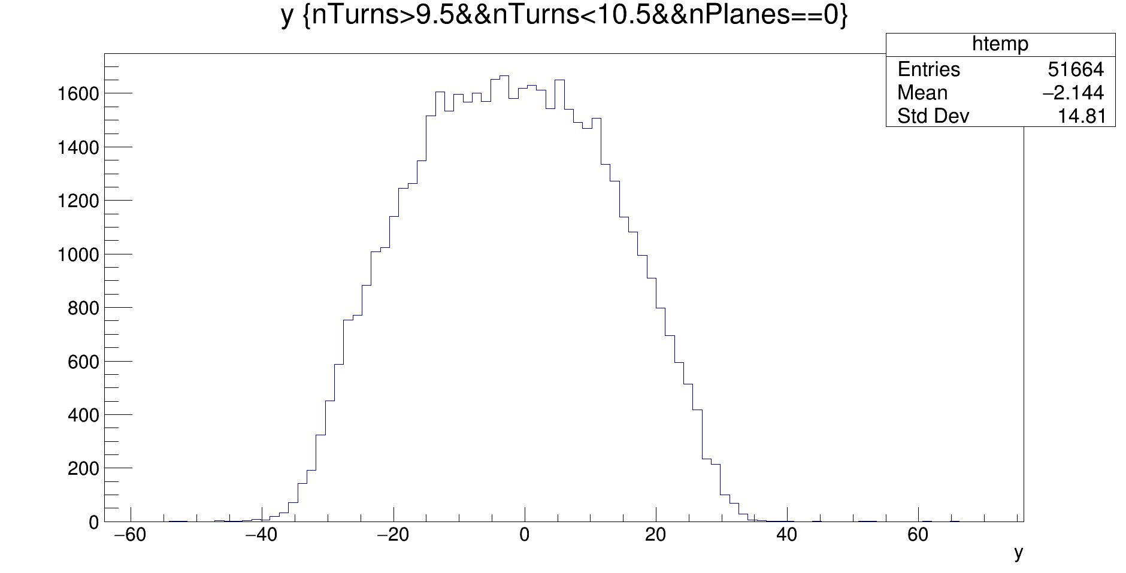
Twiss parameters according Gm2SIM
Preliminary
Twiss parameters for the y phase-space
$$β_{y}=\frac{σ_{y}^{2}}{ε_{yRMS}}$$
$$ε_{yRMS}=\sqrt{\left\langle y^{2}\right\rangle \left\langle y^{′2}\right\rangle −{\left\langle y∙y^{′}\right\rangle }^{2}}$$
$$γ_{y}=\frac{σ_{y′}^{2}}{ε_{yRMs}}$$
$$y^{′}=\frac{p_{y}}{p_{logitudinal}}$$
$$α_{y}=\sqrt{β_{y}γ_{y}−1}$$
$$γy^{2}+2αyy^{′}+βy^{′2}=ε$$
Preliminary
Preliminary

Slide 16
Next steps
Extract the twiss parameters for other experimental conditions
Generate lost muons samples
Quality checks
Extraction of the lost muons distribution and compare with the data

Slide 17
Thank you for the attention

Slide 18
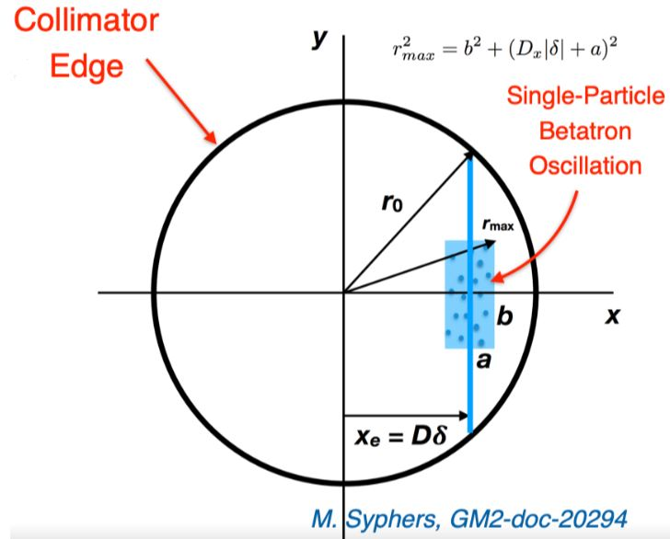
Lattice Function
With the twiss parameters the trasfer matrix for one turn can be expressed as:
From wich we can calculate the betatron tunes and select muons that are most likely lost

Slide 19
Lost Muon Gun
In the future I will select «edge» muons ($r_{max}≥44mm)$ at 10° turn and simulate in gm2ringsim.
From that I can costruct the muon loss function, $Λ\left(t\right).$

Slide 20
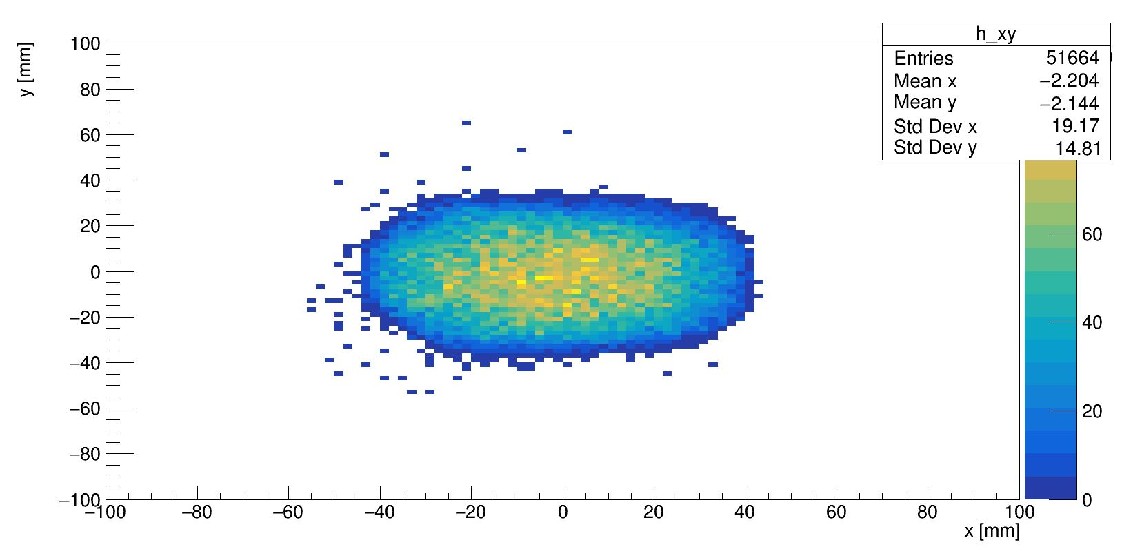
Twiss parameters according Gm2SIM
Using the gm2RingSim we can find the twiss parameters
$$β_{x}=\frac{σ_{x}^{2}}{ε_{RMS}}$$
$$γ_{x}=\frac{σ_{x′}^{2}}{ε_{RMs}}$$
$$α_{x}=\sqrt{β_{x}γ_{x}−1}$$

Slide 21
Injection and storange
Sixteen individual bunches of muons are injected every 1.4 s cycle in two sequence of eight with 10 ms separation and 267 ms between the start of each sequence
The storange ring is designed to accept the muons in narrow momentum range around the storange momentum $p_{0}$. In particular, the muon bunch enters the ring trough a nerly field-free corridor provided by the supercoducting inflector magnet.
At this point the muon beam is in a orbit tangent to the storange ring, magnetic kickers (K1, K2 and K3) produces a strong and short magnetic pulse to put the muons in the right orbit

Slide 22
Measuring the precession
Polarized $μ^{+}$ beam:
Are produced from 8-GeV protons bunches striking a target in AP0 building
$π^{+}$
from pion decay are injected into 15 m diameter supercoductive magnetic storage ring with a magnetic dipole field $B≅$1.45T
The positive muons are created from bunches of 8 Gev protons that strikes a target in the AP0 building of
Muon Campus.
The positive particles of 3.1 Gev/c are extracted and trasported trough the M2/M3 FODO beam line: alternatig focusing and decofusing quadropole
The purified and polarized muon bunch is then directed along the M4 and M5 beam lines and into the storage ring

Slide 23
Lost muons
Befor decaying lost muons are muons that during their path into the g-2 are lost.
Several driving mechanism can lead to loss muons during storage but most of them are lost beacause of their interaction with collimators.
This effect can be taken into consideration in the final $ω_{a}$ fit by including an additional factors $Λ\left(t\right).$
$$N\left(t\right)=N_{0}e^{−\frac{t}{τ}}Λ\left(t\right)[1−A\cos{(ωt+φ)}$$
$$Λ(t)$$
$$N\left(t\right)=N_{0}e^{−\frac{t}{τ}}Λ\left(t\right)[1−A\cos{(ωt+φ)}$$
The goal of lost muons analysis is the determination of the lost muons spectrum $L\left(t\right)$ and of its exponetally weighted integral:
$$J\left(t\right)=\int_{0}^{t}{L\left(t^{′}\right)e^{t^{′}/τ} dt^{′}}$$
In general this is obtain using data-driven techniques, my goal is to evalute it with the simulation

