Slide 1
Bridging the gap between cosmological simulations with Graph Neural Networks and Domain Adaptation
Andrea Roncoli
Midterm Report 2023
29th August 2023
Supervisor: Aleksandra Ćiprijanović

Slide 2
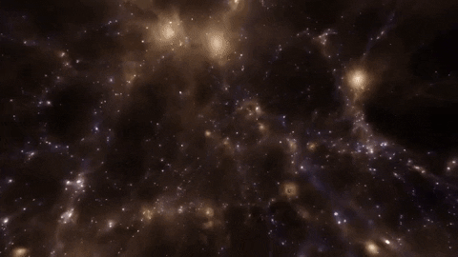
Inferring Cosmology from Simulations
Current approaches for inference of cosmology are mainly based on summary statistics (e.g. power spectrum).
Neural Networks and other Deep Learning approaches may be able to extract more (non-linear) information from complex datasets and outperform current methods.
Dataset: CAMELS

Slide 3
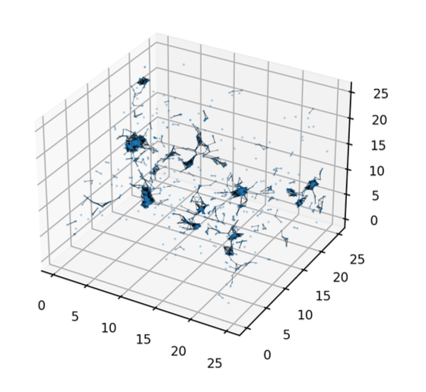
Constraining Cosmology with Graphs
Visualization of graph constructed by the data loading routine
Graphs are a very informative way of representing universes and galaxy clusters as datapoints.
In our project we use the CAMELS dataset galaxy catalogues.
Edges encode topological information of the simulated universe
Nodes encode galaxy properties
For these reasons, we are using Graph Neural Networks (GNNs) which can deal with such graphs as input.

Slide 4
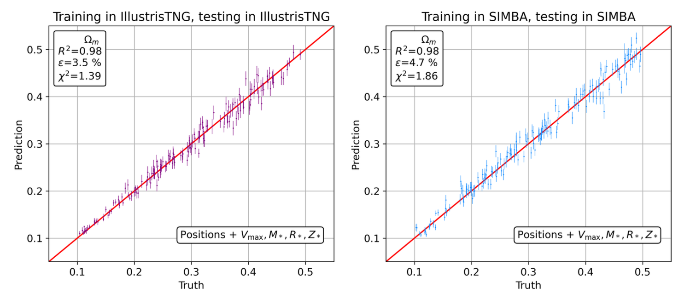
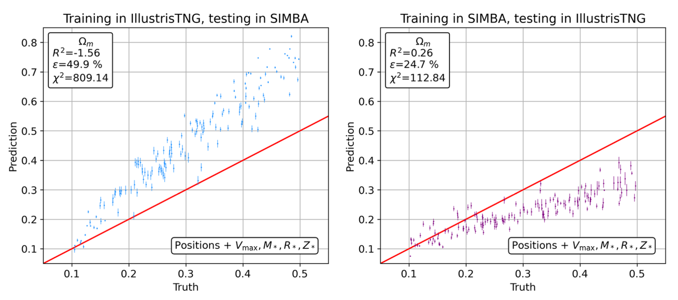
The Domain Generalization Problem
Domain generalization struggle by CosmoGraphNet (Villanueva et al 2023)

Slide 5
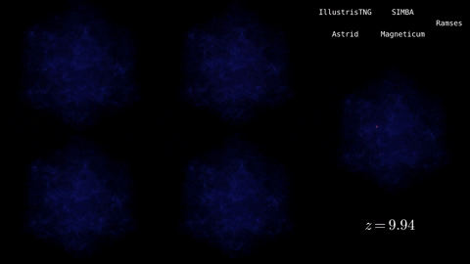
The Domain Generalization Problem
The problems with models trained with no domain adaptation is they are unable to generalize beyond the simulation they are trained in.
Models tend to ”learn the simulation”, and are fragile to a change in the simulation because of:
Different subgrid physics
Different numerical approximations, code for hydrodynamic equations resolution
Simulations evolved from same initial conditions in different suites (indicated on the top right)

Slide 6
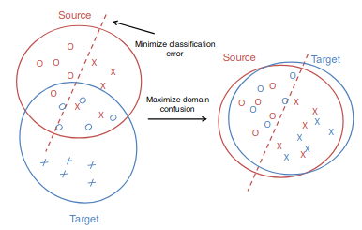
Domain Adaptation
Domain Adaptation is a technique to improve the performance of a model on a target domain containing insufficient annotated data by using the knowledge learned by the model from another related domain with adequate labeled data.
Many ways to align different domain distributions:
Distance-based methods
Adversarial methods
…

Slide 7
Maximum Mean Discrepancy
Smola et al. (2007)
Gretton et al. (2012)

Slide 8
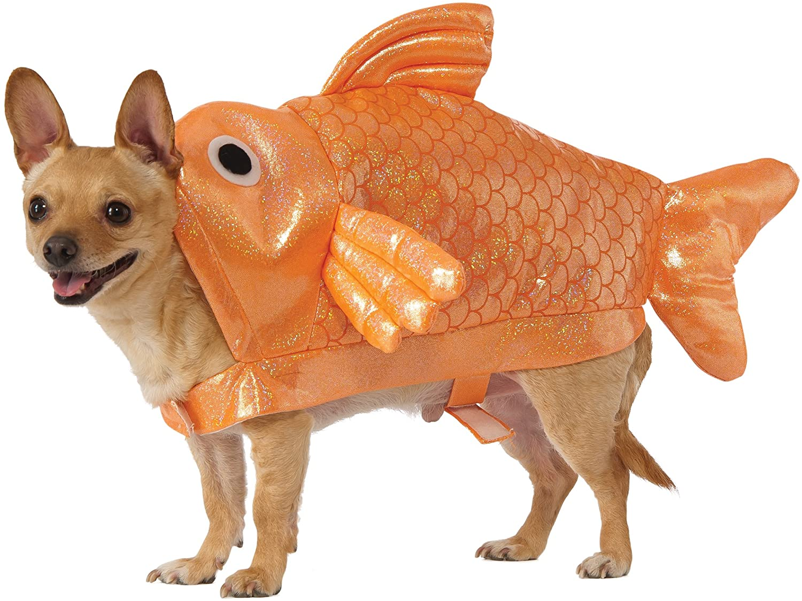
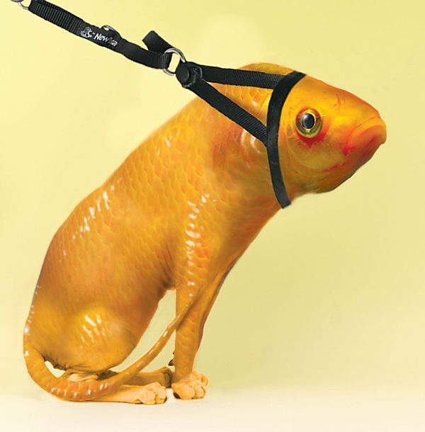
Maximum Mean Discrepancy
Smola et al. (2007)
Gretton et al. (2012)

Slide 9
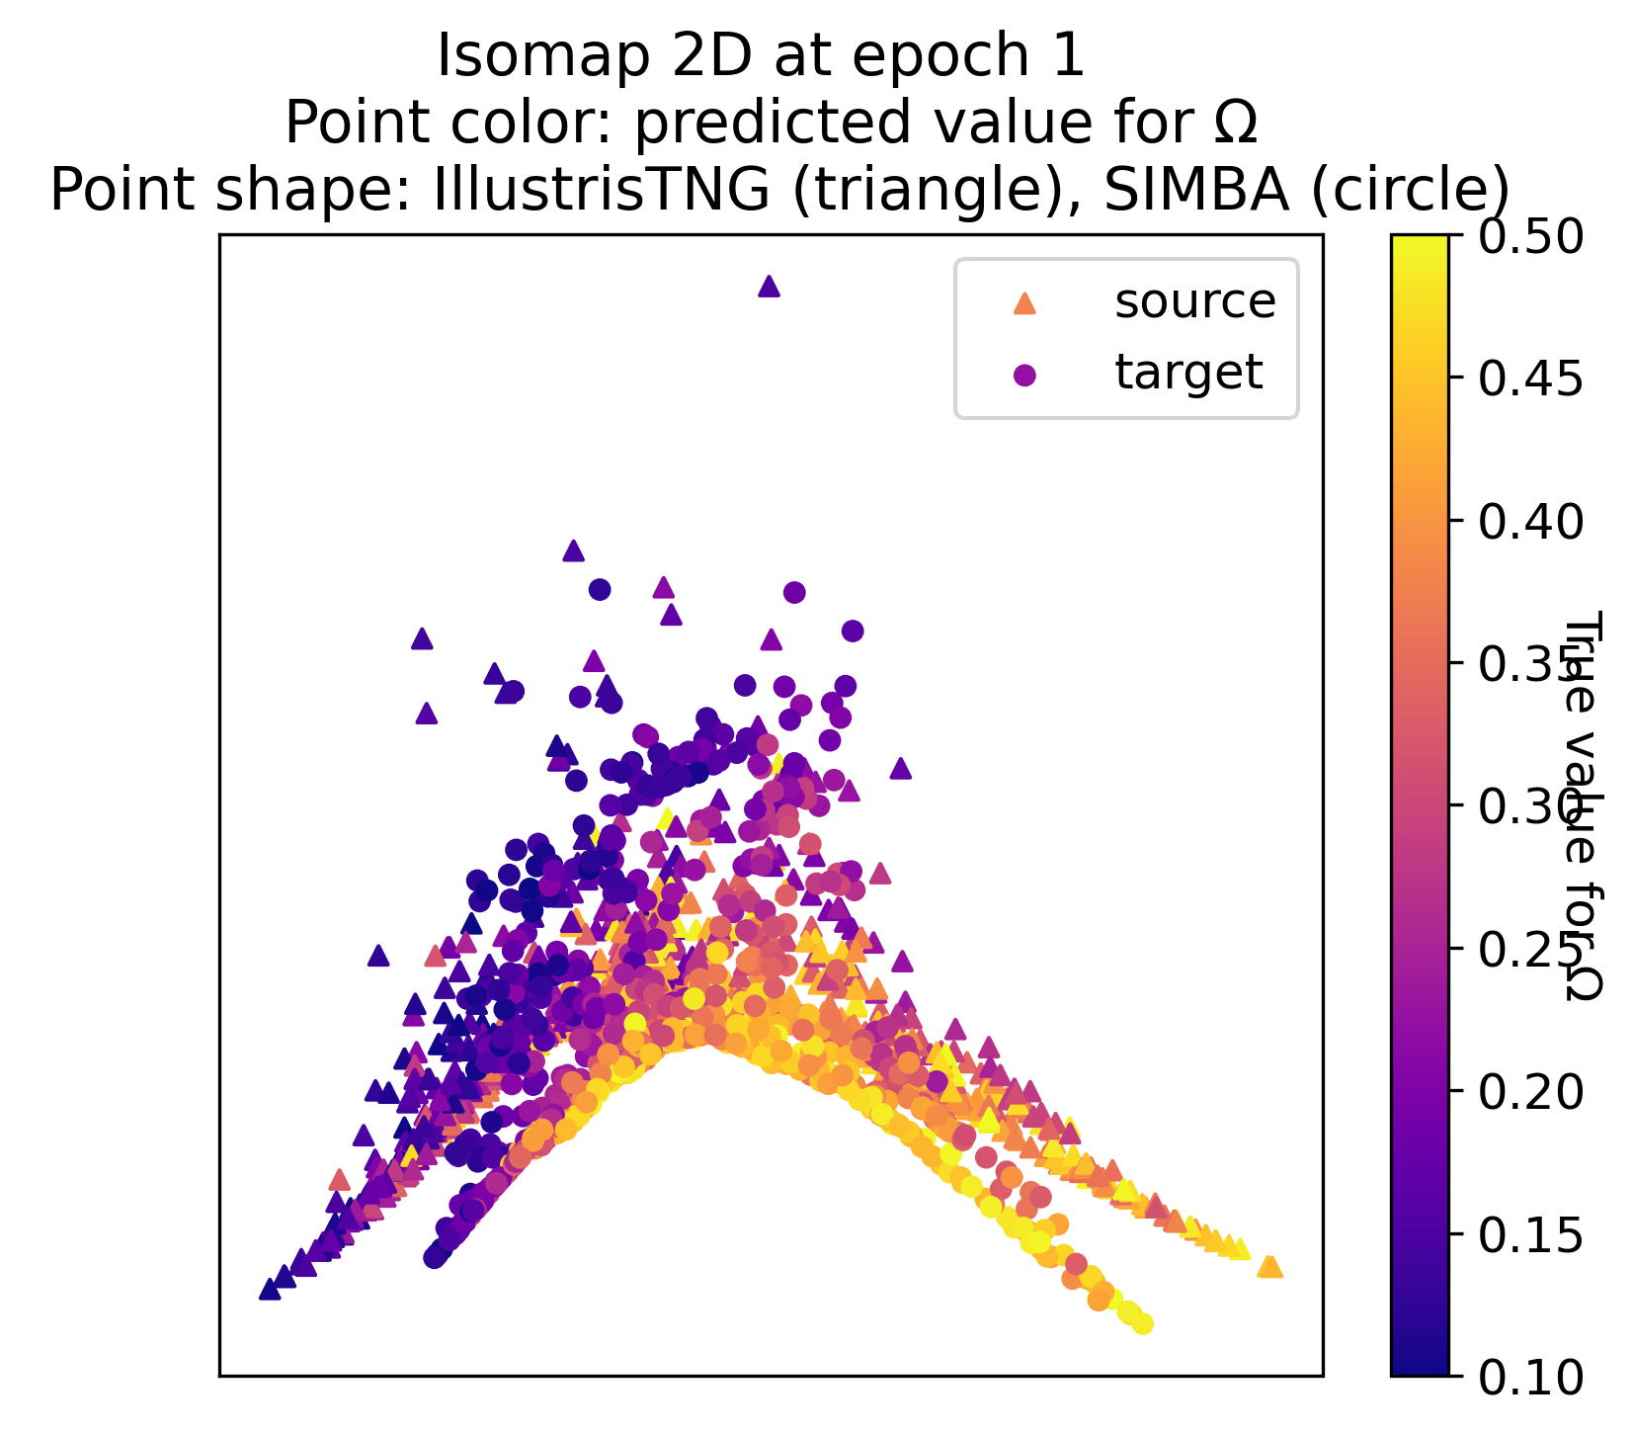
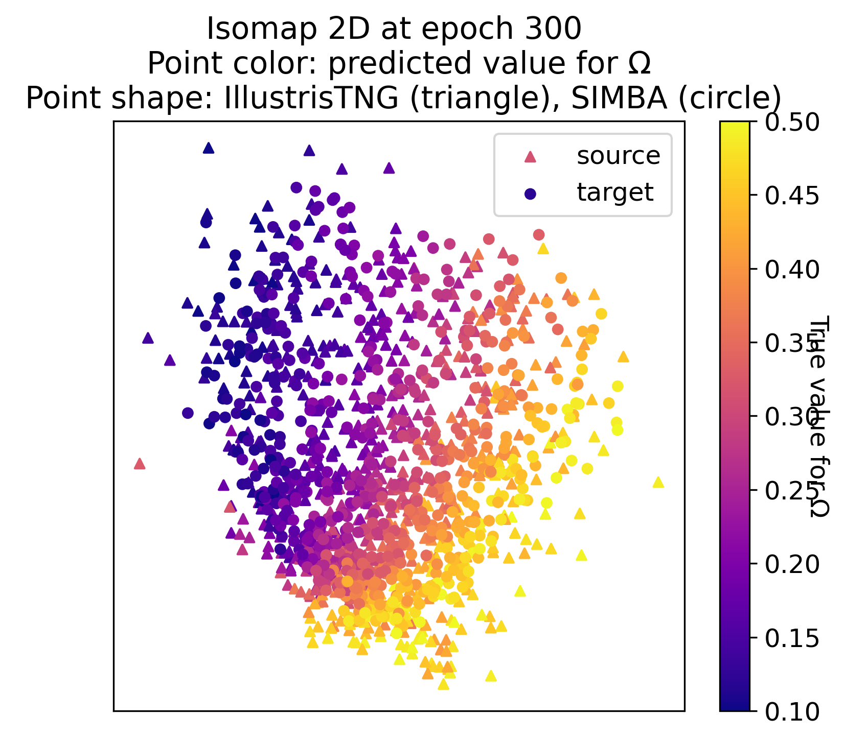
MMD Effect on Latent Space
Reorganization of latent space throughout the training with MMD loss;
on the left at epoch 1, on the right at the end of training at epoch 300.

Slide 10
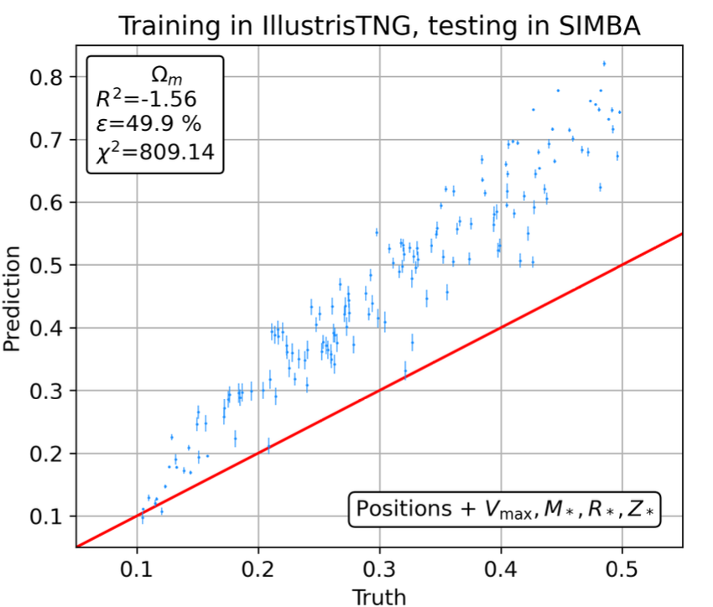
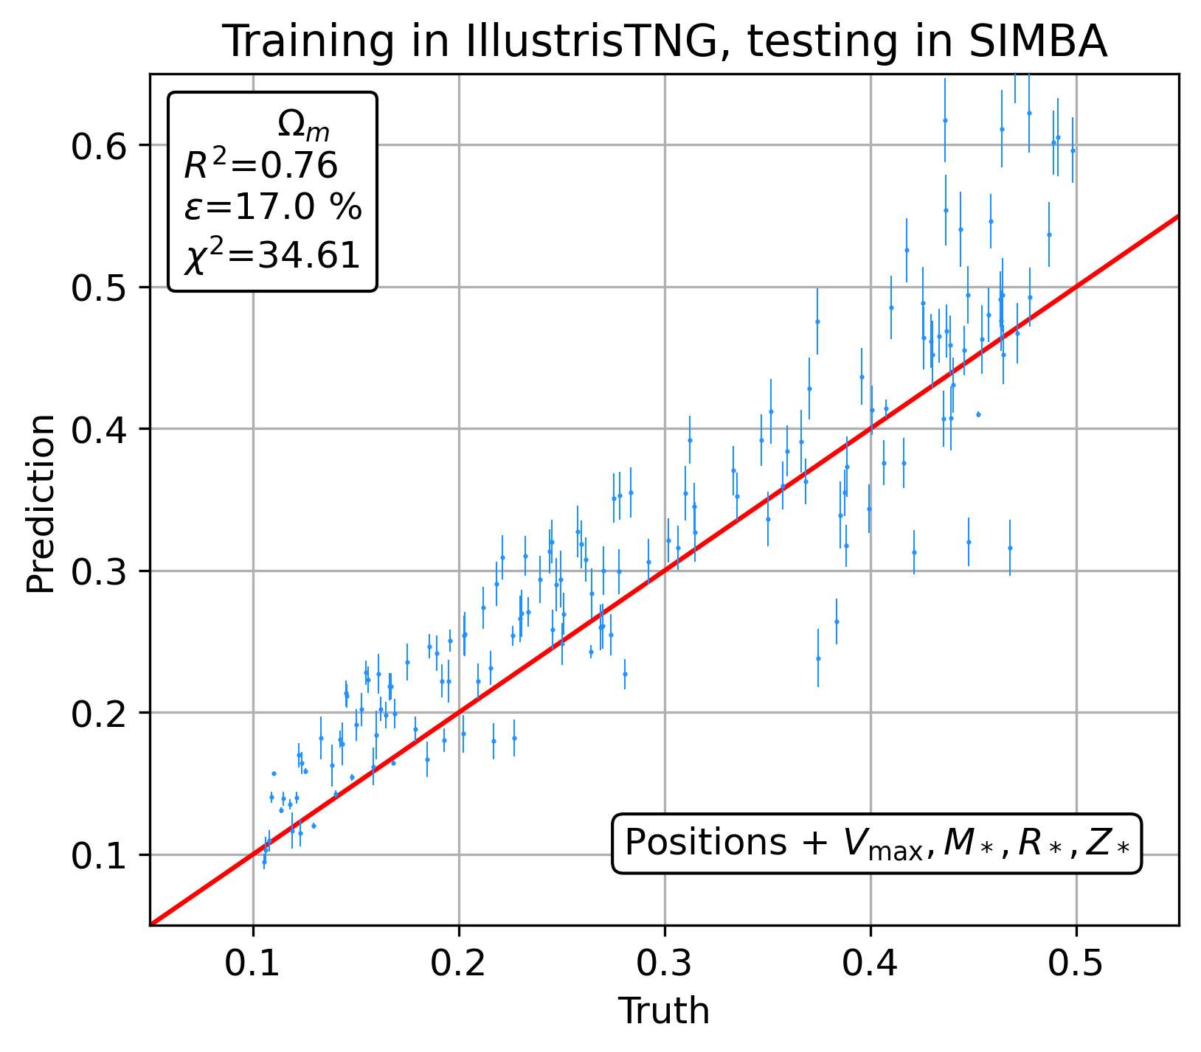
Current Results on Cross-Domain Performance
Current results; on the left, the performance of the original CosmoGraphNet, on the right, our implementation of CosmoGraphNet with MMD-based domain adaptation

Slide 11
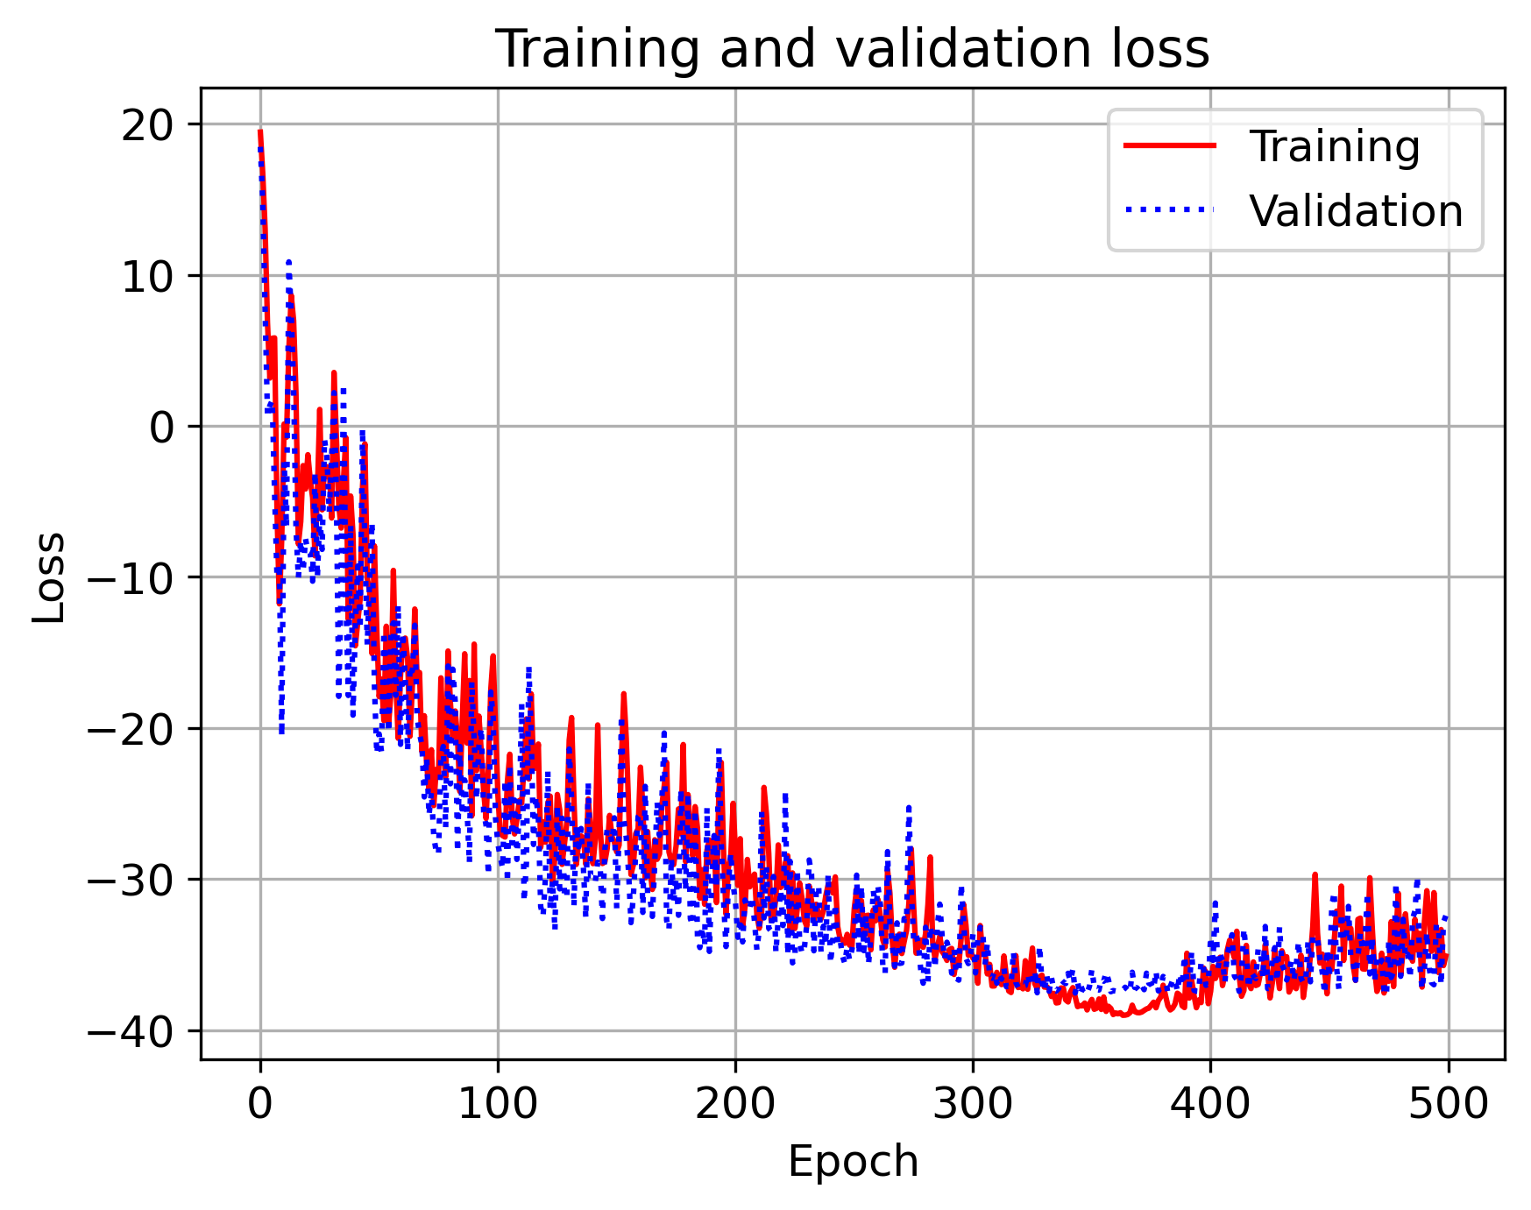
Future Work
Understanding some seemingly wrong (or currently misunderstood) behaviors of the code/training.
Writing abstract to submit to conferences.
Improve performances via extended optimization searches.
If project is successful, write paper.
If successful try training with just galaxy positions (without any astrophysical properties) – this will be crucial for applications to real data!
Strange loss analysis for fixing mistakes, code bugs

Slide 12
Thank you!
Andrea Roncoli
Midterm Report 2023
29th August 2023
Supervisor: Aleksandra Ćiprijanović

