Slide 1
DGaaS: GPU as a service on distributed computing system
Sara Mazzucato
Midterm Report
29th August 2023
Supervisors: Marco Mambelli, Bruno Coimbra
Notes:
Buongiorno,
Il mio Progetto riguarda la creazione di un distributed computing system basato su GPU.
-scientific computing, caso particolare e’ uso GPU dagli algoritmi → importanza GPU
-glideinWMS e’ Sistema per facilitare calcolo scientifico. Idea e’ estenderlo per gestire workflow con GPU
-descrizione Sistema: glidein componente principale perch’ permette set up nodi quindi accedere e condividere gPU. Mi occupo modificare parte di test e set up mettendo uno script che Lancia triton server e lo rende disponibile ai jobs.
Future development: ora glinedin e’ in un singolo noto. In future si vuole essere in grado di gestire glidein anche in cluster remote: si vuole che I jobs possano usare GPU di altri noti permettendo l’accesso del glidein ad altri jobs. Forse creando un proxy.
20 totali.
Slides fino 10 modello+slides 16 nel glidein e’ eseguito il job. Il glidein permette di effettuare fasi: set up si prepara il Triton server.
Next aims:prima del job c’e’ test e setup. Si fa partite via apptainer (cioe’ da un container)
via apptainer start of Triton server in portable containet + make it available to user job
Nello stesso glidein possono girare piu’ cose
Container con triton
Job dall’utente che si collegano al trito server
Script fa partire il triton e permette poi al glidein di continuare a accettare I jobs da eseguire
Nvidia triton server
Definition: script to

Slide 2
Computing resources as support to HEP experiments
Scientific data stored at Fermilab:
266 Petabytes!
CMS, 89.69 Petabytes
NOVA, 53.65 Petabytes
uBoone, 28.48 Petabytes
….
Going towards the era of Big Data!
Notes:
Importance of the Big data
Foto: CMS, muoni

Slide 3
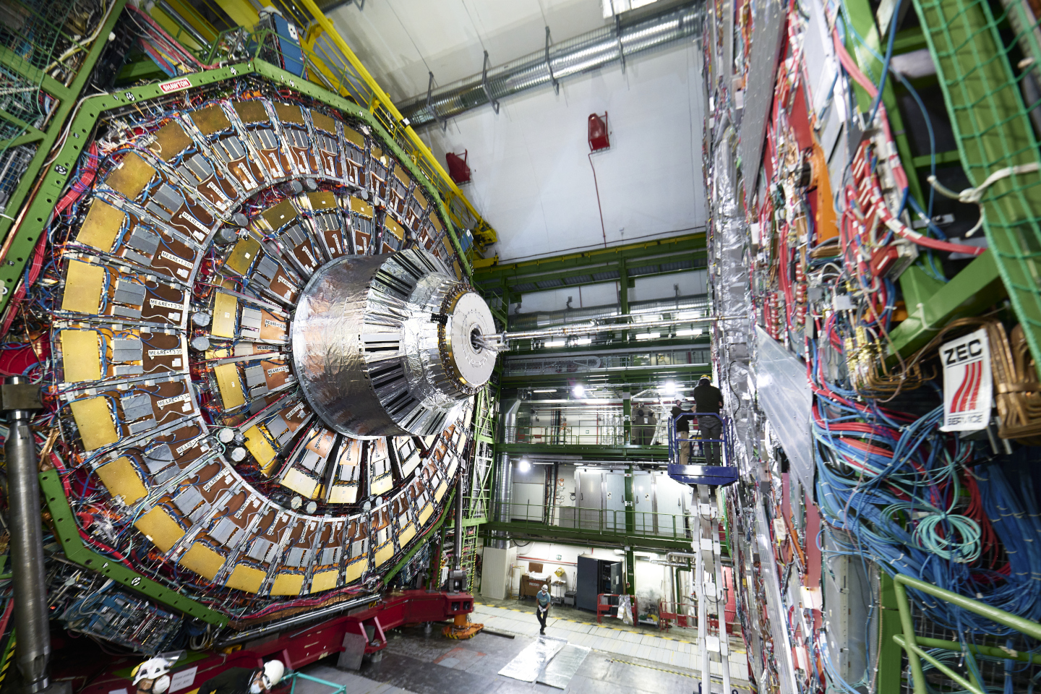
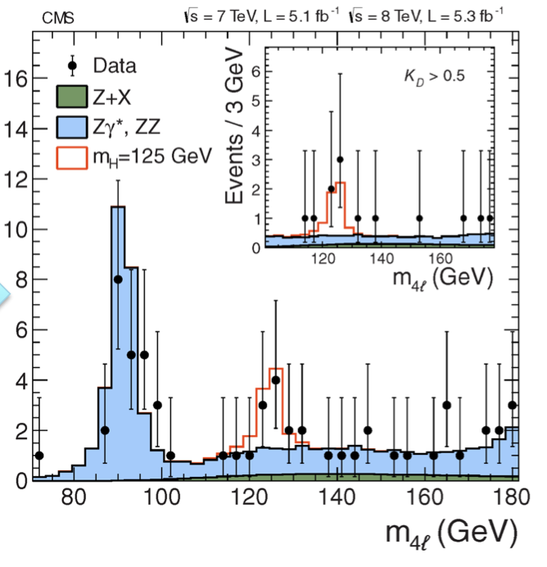
Computing resources as support to HEP experiments
It would take
287 years…
Raw Data
Reconstructed Data
Data
Analysis
Reduced
Data
Notes:
Explain the flow of the computing system and the problem of time

Slide 4
HEP experiments require computing!
Accelerator and detector simulations
Data reconstruction
Data analysis
Supercomputer
Cluster (Batch Systems)
Grid
Cloud
When one computer is not enough
Notes:
Computing is required, one computer is not enough.
HEP=High Energy Physics
High Throughput Computing
use of many computing resources over long periods of time to accomplish a computational task

Slide 5
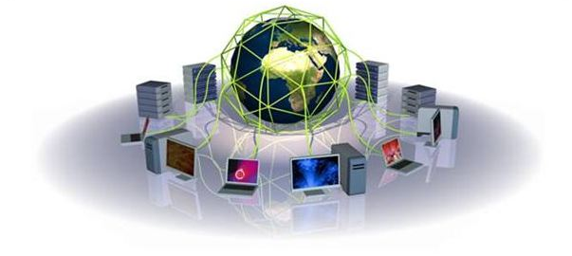
Computing resources as support to HEP experiments
Solution: leveraging multiple computers, often geographically distributed but connected by networks, to work together to accomplish joint tasks.
Grid Computing can incorporate grid sites (batch systems) in universities and labs across the world into one grid, enabling distributed high-throughput computing.
GlideinWMS
Used by CMS, DUNE, and other Fermilab experiments!
Notes:
Computing support HEP esperiments: a possible solution is use multiple computers to work together (this means grid computing). It is used from different experiments in Fermilab like CMS, DUNE.
High Throughput Computing
use of many computing resources over long periods of time to accomplish a computational task
Need for more resources
Scale to more jobs
Access more resources
Simplify the management
Less structured resources and infrastructure
Multiple organizations
Different systems
Less infrastructure
Different authentications

Slide 6
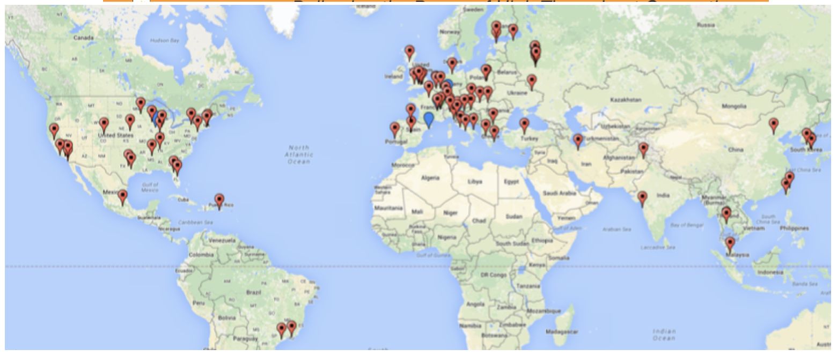
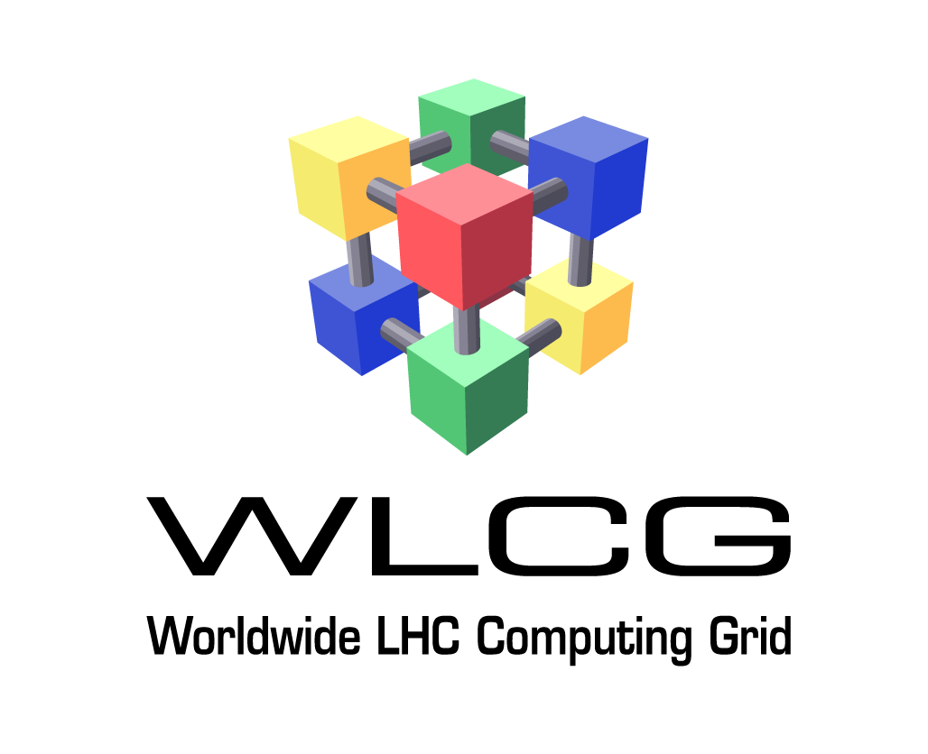
Worker nodes
A worker node is a machine managed by a resource manager characterized by its resources (CPU, RAM, Disk, etc.).
CMS Global Computing Grid
120+ sites, 2M+ CPU cores.
Notes:
Il nodo e’ visto come come astrazione (dal punto di vista logico) delle risorse, un worker node e’ un computer che esegue un lavoro per noi.
In the image there is the CMS Global Computing grid, that has more than 120 sites and 2M CPU cores. On the left there are other example of worker nodes.

Slide 7
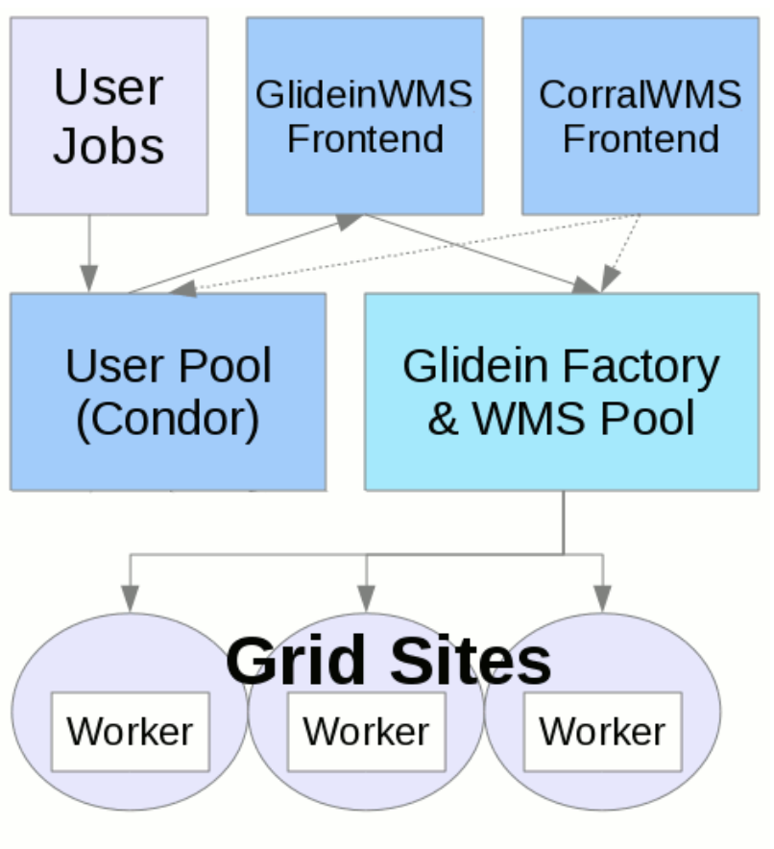
GlideinWMS
GlideinWMS is a Glidein Based Workload Management System that works on top of HTCondor.
It is a pilot based resource provisioning tool for distributed High Throughput Computing.
GlideinWMS is made of several services and its purpose is to provide a simple way to access Grid resources, submitting pilots to unreliable heterogeneous resources.
The result is that users can submit regular HTCondor jobs and the computing resources will be provided behind the scenes.
Notes:
GlideinWMS e’ un sistema per facilitare il calcolo scientifico.
Lo scopo di questo Progetto e’ estenderlo per gestire un workflow basato sull’uso e condivisione di GPUs.
GlideinWMS is based on HTCondor that is a Workload Management System i.e.: batch system or Local Resource Manager.
Scouts for resources and validates the Worker node
Cores, memory, disk, GPU, OS, software installed, CVMFS, …
Customizes the Worker node
Environment, GPU libraries, Starting containers (Apptainer, …)
Provides monitoring and audit
Run one or more jobs in parallel or sequentially via HTCondor
Pilot (e.g. VO Group) credentials storage and use
Safely receive and store Job credentials
HTCondor is a Workload Management System
i.e.: batch system or Local Resource Manager
Open-source batch system implementation
Fault tolerant
Robust feature set
Flexible
Local Center for High Throughput Computing (UW Madison)
E.g. When running on always on a local cluster we may rely on a file system or on a special software that is not available in general
Mentioning later special cases of jobs using multiple nodes (e.g. MPI or HTC resources)
It provides
Job queueing mechanism
Scheduling policy
Resource monitoring
Resource management
Can be used directly
HTCondor
Integrates well in hybrid systems
OSG-Connect
FermiGrid
Used by workload/workflow managers:
JobSub
ProdAgent, CRAB
POMS
Pegasus
HEPCloud

Slide 8
GlideinWMS
Job: task, program that needs to be executed by the user running the experiment.
E.g. data analysis’ script working on clinical data
User Pool: set of jobs that a user wants to be run.
GlideinWMS Frontend & Factory: main services behind GlideinWMS.
Worker nodes: machines part of the Grid where jobs will be actually executed.
Notes:
Describe components

Slide 9
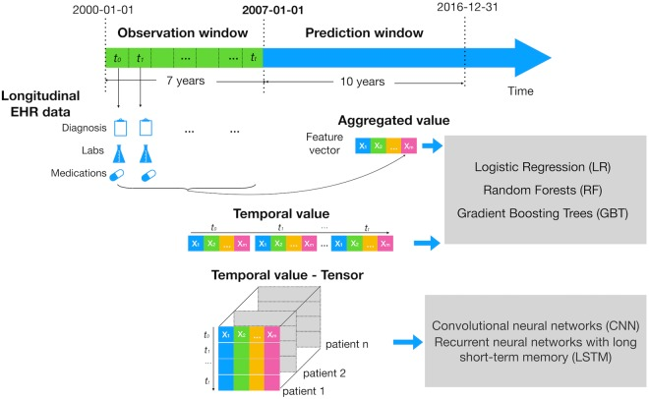
Why GPUs
GPU's Crucial Role in Accelerating ML and Scientific Computing
Parallel Processing: GPUs excel at handling massive parallel tasks.
Complex Calculations: Ideal for simulations, data analysis, and optimization.
Speed and Efficiency: GPUs significantly reduce processing time.
Rapid Evolution of ML Techniques:
Training Deep Neural Networks
Data Analysis
AI Applications: GPUs enhance predictive modeling and decision-making.
Zao. et al., Scientific Report, 2019
Notes:
Nello scientific computing un caso particolare e’ l’uso GPU per gli algoritmi → indiscussa e’ quindi l’importanza GPU per accelerare lo SC.
Tre applicazioni sono in figura.
Glidein
Gpus (importance in ML, example workflow (Diabetes), importance distributed)
Rapid Evolution of Machine Learning (ML) Techniques
GPU's Crucial Role in Accelerating ML and Scientific Computing
GPU's Role in Scientific Computing:
Parallel Processing Power: GPUs excel at handling massive parallel tasks.
Complex Calculations: Ideal for simulations, data analysis, and optimization.
Speed and Efficiency: GPUs significantly reduce processing time.
Machine Learning Impact:
Training Deep Neural Networks: GPU's parallel processing accelerates model training.
Data Analysis: Faster data preprocessing and feature extraction.
AI Applications: GPUs enhance predictive modeling and decision-making.
Interdisciplinary Advantages:
Cross-Disciplinary Benefits: Physics, chemistry, biology, and more.
Customization: GPUs adaptable for various research needs.
Research Acceleration: GPUs expedite time-consuming simulations.

Slide 10
Triton server
Triton Inference Server is an open source inference serving software that streamlines AI inferencing.
Notes:
Nel Sistema distriubuito centrale e’ il ruolo del Triton server, definite come un open source inference serving software.
E’ usato relativamente alle GPU.
Il server prende possesso della gou e permette accesso a gpu da altro (programmu). Inoltre renfe possibile usarle la gpu in remote.

Slide 11
Triton server
Triton enables teams to deploy any AI model from multiple deep learning and machine learning frameworks, including TensorRT, TensorFlow, PyTorch, ONNX, OpenVINO, Python, RAPIDS FIL, and more.
Triton supports inference across cloud, data center on NVIDIA GPUs, x86 and ARM CPU, or AWS Inferentia.
Triton delivers optimized performance for many query types, including real time, batched, ensembles and audio/video streaming.
https://github.com/triton-inference-server/tutorials/tree/main/Conceptual_Guide
Notes:
Triton permette condividere gpu e usarla quando disponibile da parte dei processi (locali o remote, cloud, clusters) che ne fanno richiesta.

Slide 12
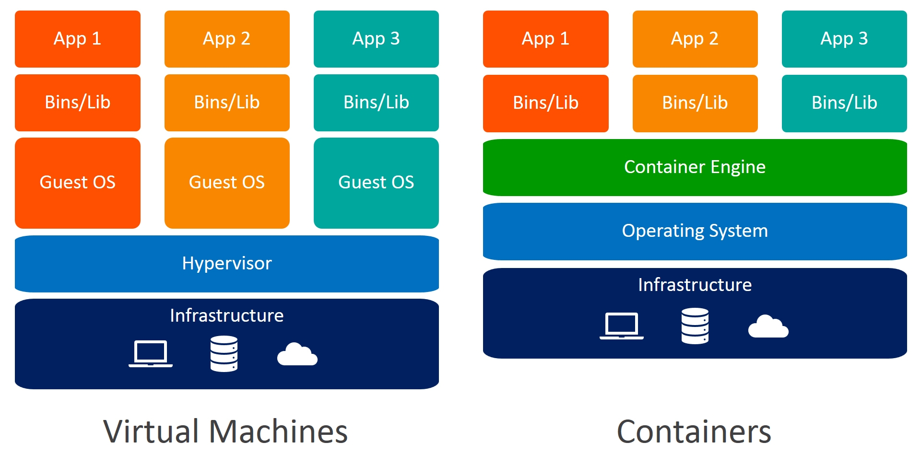
VM and Containers
Virtual machines (VM): isolated software environments that mimic physical computers
Containers: lightweight, portable packages holding applications and their dependencies.
Both enhance efficiency, enabling easy software deployment
Apptainer: Orchestrates container clusters for scaling, and management, streamlining app distribution across diverse environments with simplicity
Notes:
Tutti I worker nodes sono diversi, quindi c’e’ la necessita’ di usare vm e container per uniformarli. Preferibilmente c
Definition + consentono isolare servizio e incapsulare programma e sue dipensenze per renderleo trasportabile facilmente.
VM piu’ diffusa ma container piu’ leggeri computazionalmente, quindi preferiti per la nostra applicazione.
Apptainer fornisce support per far girare container. Vantaggio che girano in modo non privilegiato.
Virtual machines (VM): isolated software environments that mimic physical computers, running multiple operating systems on a single hardware.
Containers: lightweight, portable packages holding applications and their dependencies.
Both enhance efficiency, enabling easy software deployment, resource optimization, and seamless scaling in modern computing landscapes.
Apptainer: Orchestrates container clusters for scaling, and management, streamlining app distribution across diverse environments with simplicity

Slide 13
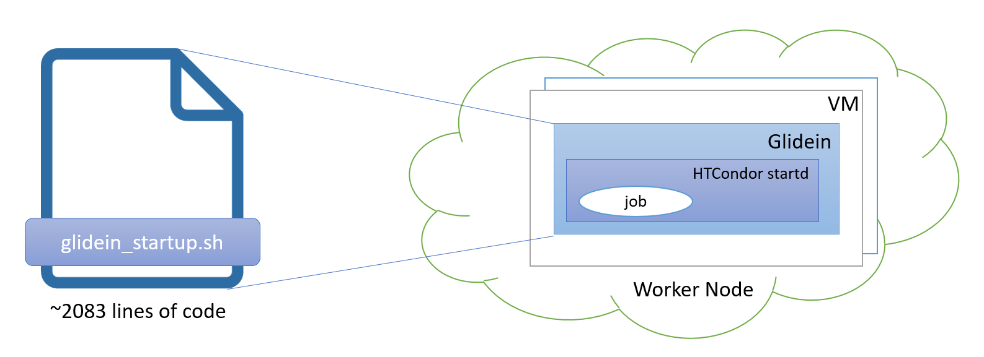
Glidein
A Glidein is a pilot submitted on the worker node that acquires and prepares the resources where the job will run.
They are requested by the Frontend, launched by the Factory and they join the virtual cluster.
Notes:
Glidein e’ un pilot job, permette l’inizio del processo. Permette di far partire la simulazione inviata dallo user.

Slide 14
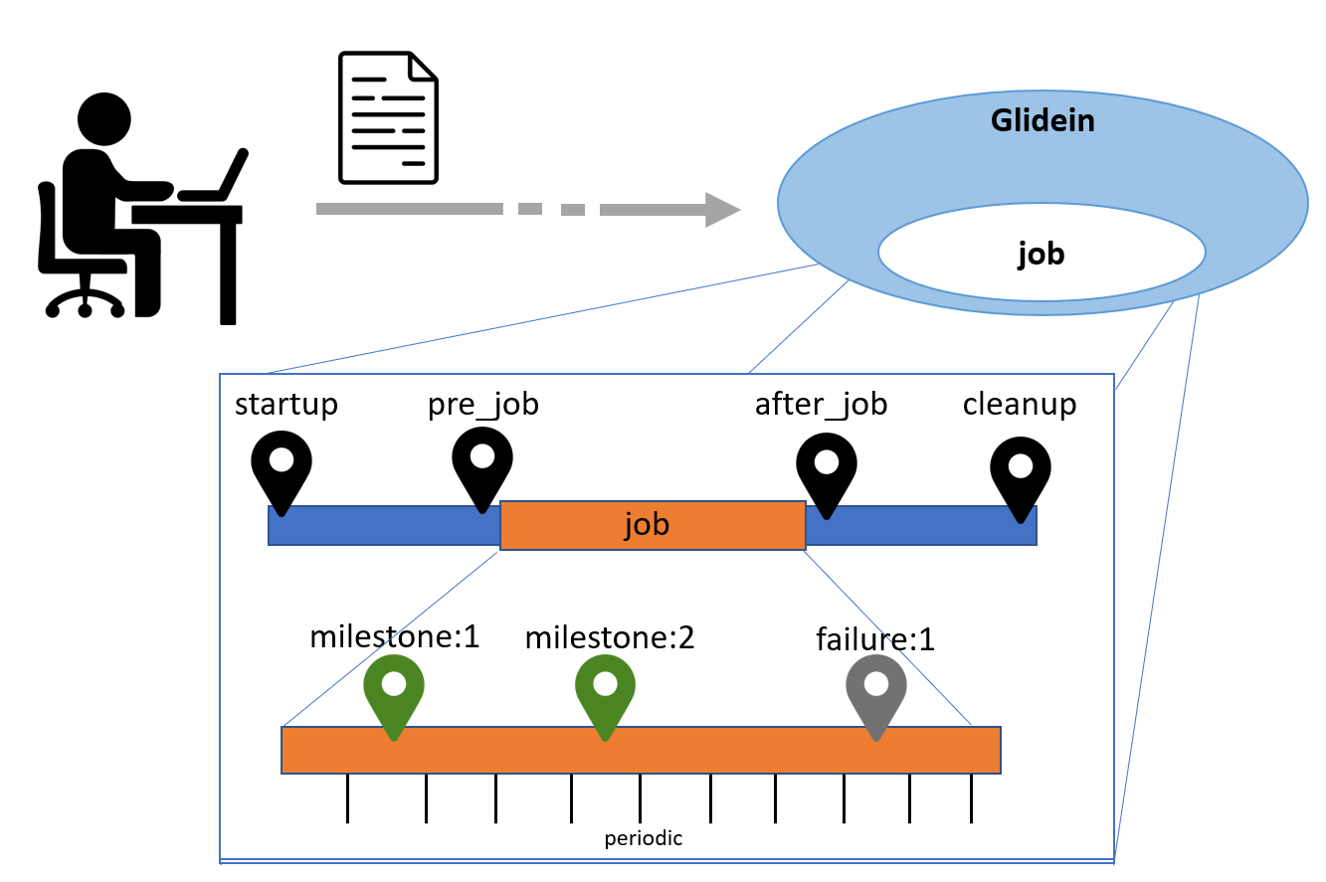
Lifecycle phase execution
<files>
<file … time="startup"… />
<file … time="cleanup,after_job,milestone:1"… />
…
</files>
Notes:
Il processo di esecuzione dei programmi (chiamati custom script) all’interno del Glidein prevede 4 momenti o fasi: startup, pre or after job and cleanup.
Nella configurazione component glidein c’e’ sezione file dove specificare programmi per test e setup del nodo.
Noi ci focalizziamo nella prima fase di setup per far partire Triton server
----
This is a machine (worker node, host, node, resource), managed by a (Local) Resource Manager
More frequently virtual than not
Characterized by its resources (dimensions):
CPUs (or total number of cores)
RAM (memory)
Disk
There can be other special resources that the node provides: GPUs, access to devices, software, …
The Glidein will receive all the node or part of it
Sometime is not easy to identify everything used by a job

Slide 15
Glidein execution
Focus on the startup phase
Via apptainer start the Triton server in a portable container
Script to launch Triton and allow the Glidein to accepts executable jobs continuousy sharing the same GPU.
Make the server available to more user jobs
Allow to run in the same Glidelin:
Container with Triton server and script to launch Triton
Connect user jobs with Triton server
startup pre_job after_job cleanup
job
Test
Setup
periodic
Notes:
Noi ci concentriamo nella prima fase, quella di startup che fa partire il Triton server usando apptainer (quindi da un portable container).
Consideriamo ora per iniziare l’esempio che glinedin sia in un singolo nodo.
Durante startup ci sono tanti script che fanno
test per verificare worker node funzioni bene
fanno set up, preparano il wn per eseguire il lavoro.
Possono esserci piu jobs: glidein puo farli girare in parallelo o sequenza!
Make the container or the server available?
Mio Script esegue start up (1 possibilita’) e fa partire Triton
Next aims:prima del job c’e’ test e setup. Si fa partite via apptainer (cioe’ da un container)
via apptainer start of Triton server in portable containet + make it available to user job
Nello stesso glidein possono girare piu’ cose
Container con triton
Job dall’utente che si collegano al trito server
Script fa partire il triton e permette poi al glidein di continuare a accettare I jobs da eseguire
--
ora glinedin e’ in un singolo noto. In future si vuole essere in grado di gestire glidein anche in cluster remote: si vuole che I jobs possano usare GPU di altri noti permettendo l’accesso del glidein ad altri jobs. Forse creando un proxy.

Slide 16
Expected deliverable (1)
Local environment
GLIDEIN
TRITON
JOB
GPU
.
.
.
CPU
JOB
CPU
JOB
CPU
Notes:
V1: tutta locale., in un nodo c’e glidein e diversi job gestiti dallo stesso triton

Slide 17
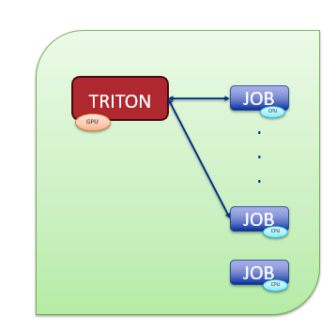
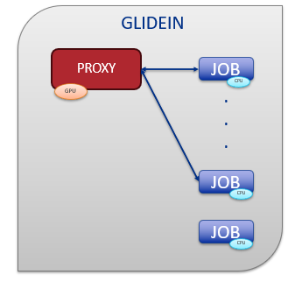
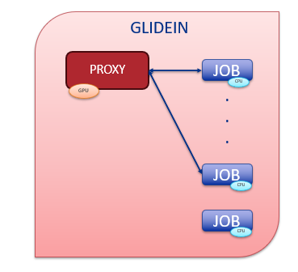
Future work/ stretch work
Remote connection
UCHICAGO
WILSON
GLIDEIN
GLIDEIN
GLIDEIN
Proxy?
UNI TORONTO
Notes:
In futuro si vuole essere in grado di gestire glidein anche in cluster remote: si vuole che i jobs possano usare GPU di altri nodi permettendo l’accesso del glidein ad altri jobs. Forse creando un proxy.
Glidein con jobs che si collegano tra di loro.
Si possono usare altri glidein in diversi cluster, anche con collegamenti remoti.
Difficota’:
Trovare triton server
Accedere in modo sicuro da remote
---
Poi vederlo su una appligazione (es rete neurale), gia’ possible con la v1 in locale. Qui si puo’ Vedere tempistiche

Slide 18
Expected deliverable (1)
Local environment
GLIDEIN
PROXY
JOB
GPU
.
.
.
CPU
JOB
CPU
JOB
CPU
Notes:
V1: tutta locale., in un nodo c’e glidein e diversi job gestiti dallo stesso triton

Slide 19
Expected deliverable (1)
Local environment
GLIDEIN
TRITON
JOB
GPU
.
.
.
CPU
JOB
CPU
JOB
CPU
Notes:
V1: tutta locale., in un nodo c’e glidein e diversi job gestiti dallo stesso triton

Slide 20
Conclusions
Scientific computing requires a lot of computing
GlideinWMS is a pilot based resource provisioning tool for distributed High Throughput Computing
Provides reliable and uniform virtual clusters
Submits Glideins to unreliable heterogeneous resources
Glidein can be used to start the Triton Server
GPU
Sharing thanks to Ttiton server: Glidein can have different destinations
Good distribution of the system and virtualization helps efficiency
References
https://github.com/glideinWMS/glideinwms
Thanks to Marco Mambelli, Bruno Coimbra and all the HEPcloud team for their constant support!
Notes:
Generalizzare e rendere portabile cio’ che fa TS: rendere possible che usando Gliedin si sfruttino GPU disponibili per le simulazioni. Glidein porta struttura nelle risorse esistenti e future.

Slide 21
GlideinWMS components
FRONTEND | FACTORY
Controlled by VO Operators Main task is to look for user jobs and ask the Glidein Factories to provide glideins, if needed Decides which glidein Factory should submit the pilot Jobs and how many of them Configuration xml file: /etc/gwms-frontend/frontend.xml | Controlled by Factory operators (OSG) Advertises itself, listen for requests from Frontend clients and submit glideins Can handle multiple kinds of glidein Configuration xml file: /etc/gwms-factory/glideinwms.xml
GLIDEIN
Requested by the Frontend, launched by the Factory and joins the virtual cluster Property configured execution node submitted as a Grid job. Defines how multi-core glideins should split their resources Pilot jobs may run multiple user Jobs glidein_startup.sh configures and starts the condor startd daemon
Notes:
Factory operators?

Slide 22
Distributed
N-to-M relationship
Each Frontend can talk to many Factories
Each Factory may serve many Frontends
Multiple User Pools
High Availability replicas
S.Timm - FNAL-UK Planning Meeting GlideinWMS

Slide 23
HTC problem: Growing needs and Trends
High Throughput Computing
use of many computing resources over long periods of time to accomplish a computational task
Need for more resources
Scale to more jobs
Access more resources
Simplify the management
Less structured resources and infrastructure
Multiple organizations
Different systems
Less infrastructure
Different authentications
Notes:
Just HTC
Traditionally OSG had Compute Elements, all resources and users had x509 certificates
Campus resources not in the Grid
Certificate-less authentication

Slide 24
Distributed resources
Test1: execute a script inside a container
01
Test2: use a script to load a server in background as an istance inside a container
02
Test 3: apply the Test 2 to Triton server to manage a system with distributed GPUs
03

Slide 25
Summary
Scientific computing requires a lot of computing
GlideinWMS is a pilot-based resource provisioning tool for distributed High Throughput Computing
Provides reliable and uniform virtual clusters
Submits Glideins to unreliable heterogeneous resources
GPUs are very useful for important workflows, especially in AI/ML
Only few resources (Worker Nodes) have GPUs and the use of GPUs is not uniform
We will start NVidia Triton server in containers to share the use of GPUs
In a Worker Node, to all Jobs managed by a Glidein
And possibly also across different resources by proxying in the Glidein the access to remote Triton servers

Slide 26
External files management
The user can provide some external files of different types in order to be used in different phases of the lifecycle of the glidein with different priority.
I want them to be executed at the startup of the job with high priority!
GlideinWMS

