Slide 1
Fast Ramping Accelerator Dipole Models for Fermilab’s Booster Upgrade and Muon Colliders
Stefano Mannucci
Midterm Report
28 August 2023
Supervisor: Alexander Zlobin, Emanuela Barzi

Slide 2
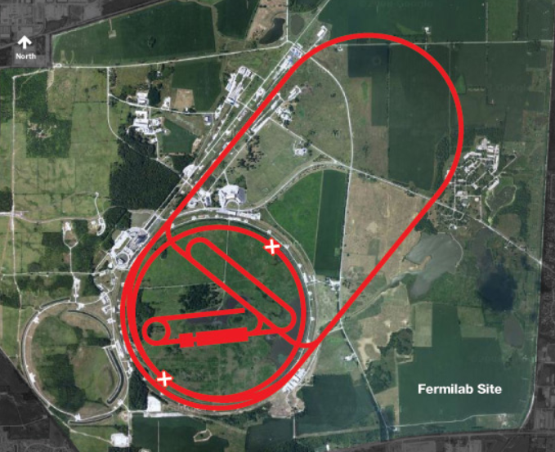
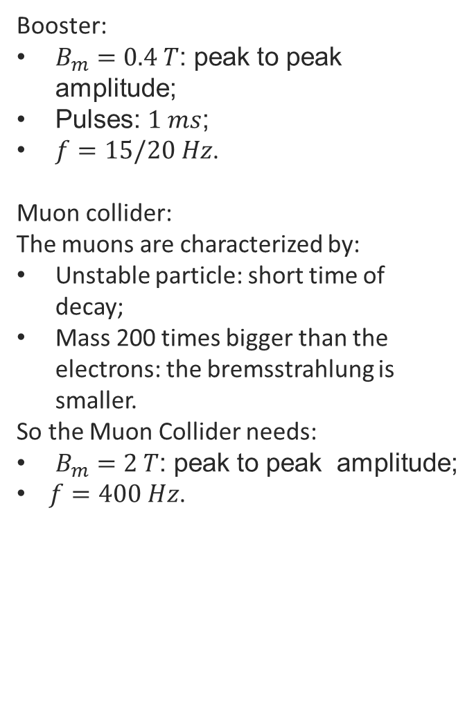
Why Fast Ramping Magnets?
Booster:
$B_{m}=0.4 T$: peak to peak amplitude;
Pulses: $1 ms$;
$f=15/20 Hz$.
Muon collider:
The muons are characterized by:
Unstable particle: short time of decay;
Mass 200 times bigger than the electrons: the bremsstrahlung is smaller.
So the Muon Collider needs:
$B_{m}=2 T$: peak to peak amplitude;
$f=400 Hz$.
Dual-bore HTS-based accelerator magnet design with warm core and cold conductor coil.

Slide 3
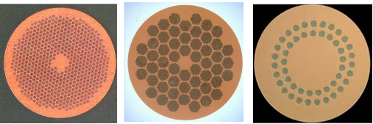
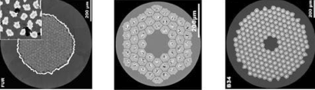
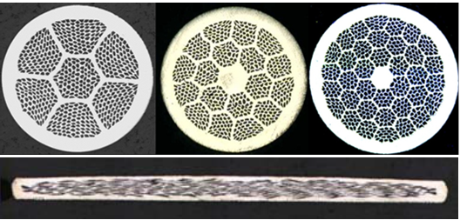
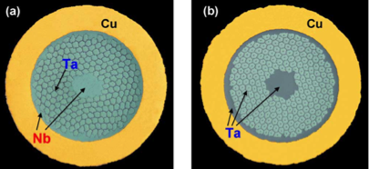
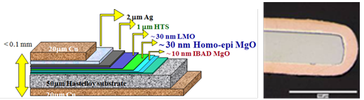
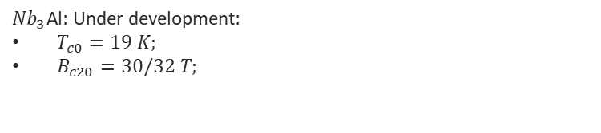
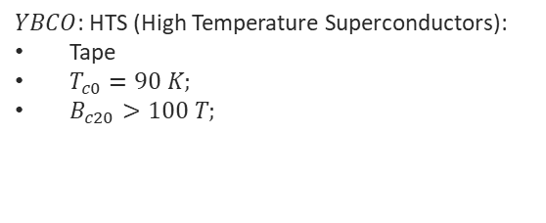
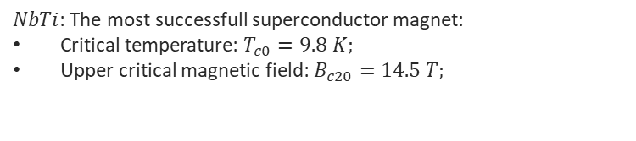
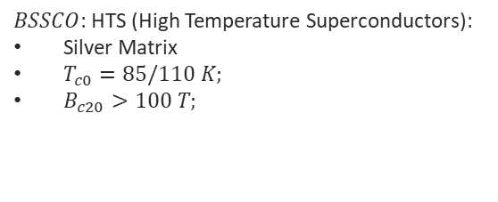
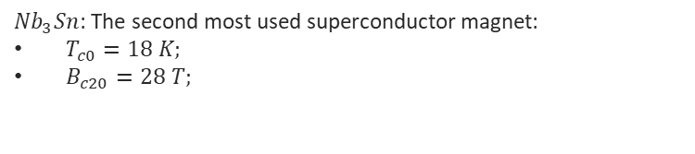
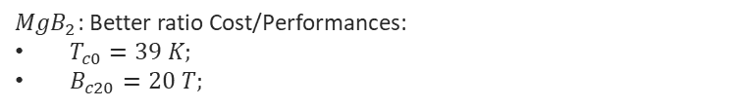
Practical composite superconductors
$NbTi$: The most successfull superconductor magnet:
Critical temperature: $T_{c0}=9.8 K;$
Upper critical magnetic field: $B_{c20}=14.5 T;$
${Nb}_{3}Sn$: The second most used superconductor magnet:
$T_{c0}=18 K;$
$B_{c20}=28 T;$
${Nb}_{3}$Al: Under development:
$T_{c0}=19 K;$
$B_{c20}=30/32 T;$
$BSSCO$: HTS (High Temperature Superconductors):
Silver Matrix
$T_{c0}=85/110 K;$
$B_{c20}>100 T;$
$YBCO$: HTS (High Temperature Superconductors):
Tape
$T_{c0}=90 K;$
$B_{c20}>100 T;$
${MgB}_{2}$: Better ratio Cost/Performances:
$T_{c0}=39 K;$
$B_{c20}=20 T;$

Slide 4
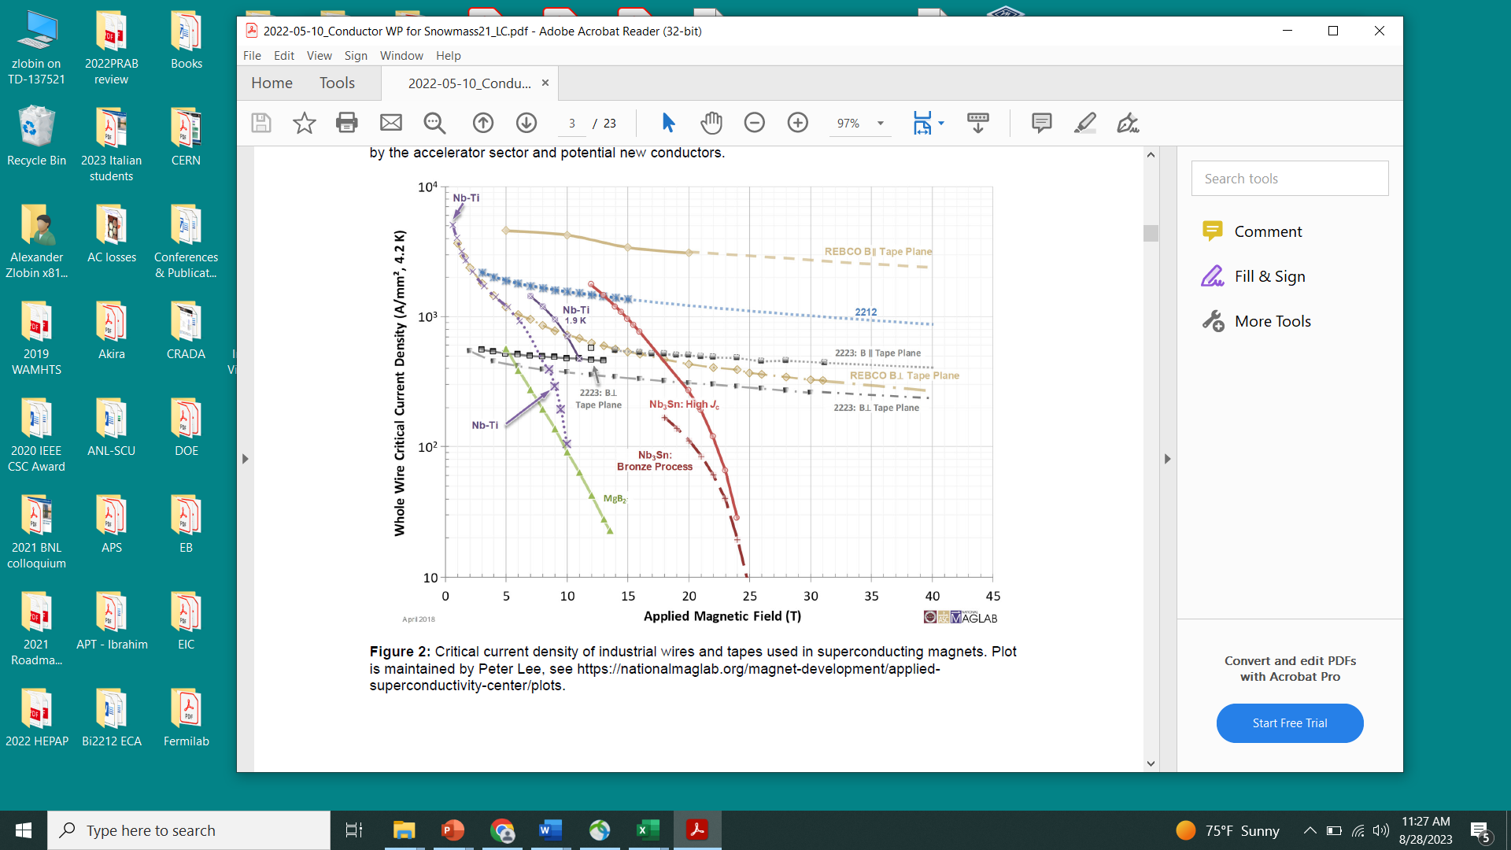
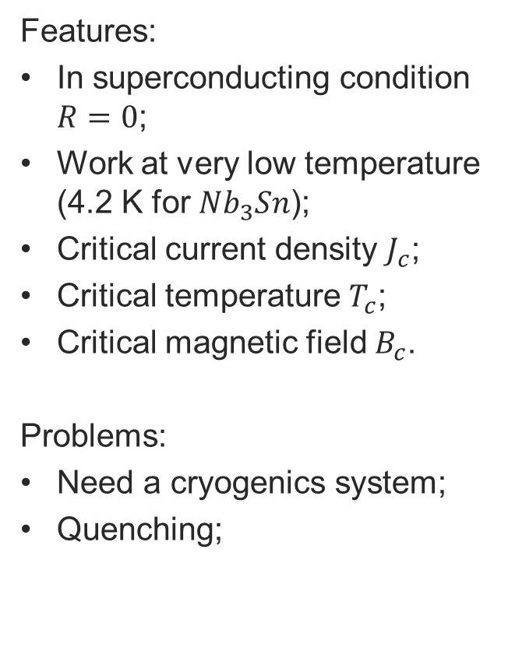
Superconductor critical parameters
Features:
In superconducting condition $R=0$;
Work at very low temperature (4.2 K for ${Nb}_{3}Sn$);
Critical current density $J_{c}$;
Critical temperature $T_{c}$;
Critical magnetic field $B_{c}$.
Problems:
Need a cryogenics system;
Quenching;

Slide 5
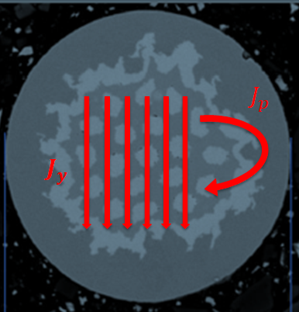

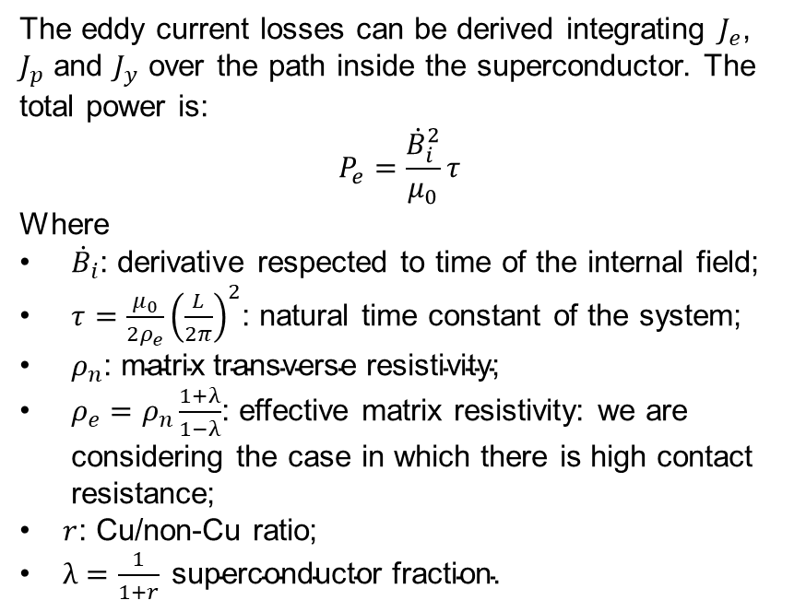
AC losses: Eddy Currents Power
The magnetization inside the superconductor creates the AC losses. It is possible to develope a model that considers two components: The hysteresis losses and the eddy current losses.
The eddy current losses can be derived integrating $J_{e}$, $J_{p}$ and $J_{y}$ over the path inside the superconductor. The total power is:
$$P_{e}=\frac{{\dot{B}}_{i}^{2}}{μ_{0}}τ$$
Where
${\dot{B}}_{i}$: derivative respected to time of the internal field;
$τ=\frac{μ_{0}}{2ρ_{e}}{\left(\frac{L}{2π}\right)}^{2}$: natural time constant of the system;
$ρ_{n}\text{: }\text{matrix} \text{transverse} \text{resistivity}\text{;}$
$ρ_{e}=ρ_{n}\frac{1+λ}{1−λ}$: effective matrix resistivity: we are considering the case in which there is high contact resistance;
$r$: Cu/non-Cu ratio;
$λ=\frac{1}{1+r} \text{superconductor} \text{fraction}\text{.}$

Slide 6
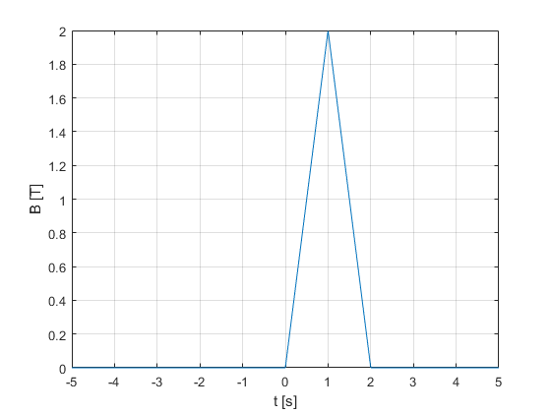
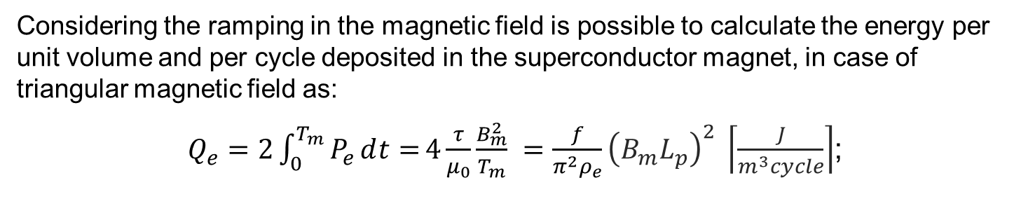
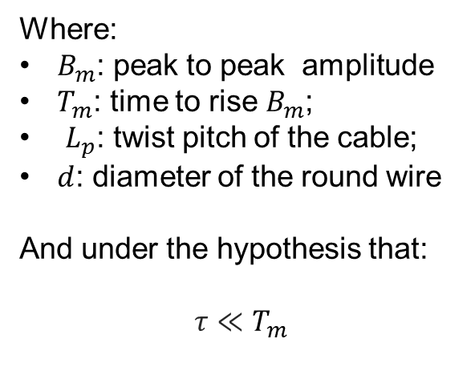
Eddy Current Energy Loss
Considering the ramping in the magnetic field is possible to calculate the energy per unit volume and per cycle deposited in the superconductor magnet, in case of triangular magnetic field as:
$Q_{e}=2\int_{0}^{T_{m}}{P_{e}ⅆt=}4\frac{τ}{μ_{0}}\frac{B_{m}^{2}}{T_{m}} =\frac{f}{π^{2}ρ_{e}}{\left(B_{m}L_{p}\right)}^{2} \left\lceil \frac{J}{m^{3}cycle}\right\rceil$;
Where:
$B_{m}$: peak to peak amplitude
$T_{m}$: time to rise $B_{m}$;
$L_{p}$: twist pitch of the cable;
$d$: diameter of the round wire
And under the hypothesis that:
$$τ≪T_{m}$$

Slide 7
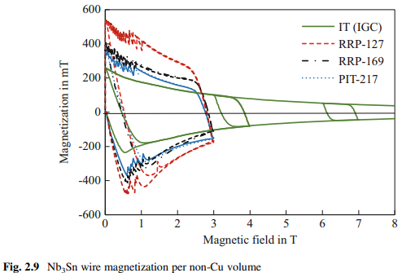

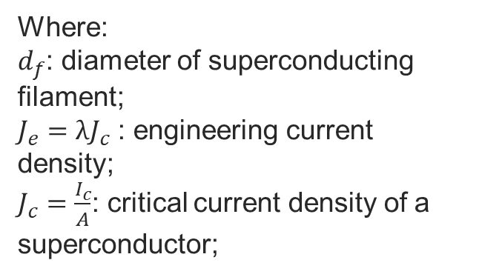
Hysteresis loss in the superconductor
The hysteresis losses are created from the magnetization of the superconductor in a magnetic field. This phenomenon creates the magnetization currents inside the wire. With approximation is possible to obtain that:
$P_{h}≅\frac{8}{3π}J_{e}d_{f}B_{m}f$;
And so:
$Q_{h}=2\int_{0}^{T_{m}}{P_{h}ⅆt}≅\frac{8}{3π}J_{e}d_{f}B_{m}$;
Where:
$d_{f}$: diameter of superconducting filament;
$J_{e}=λJ_{c}$ : engineering current density;
$J_{c}=\frac{I_{c}}{A}$: critical current density of a superconductor;

Slide 8
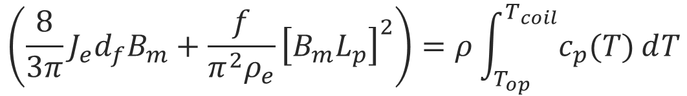
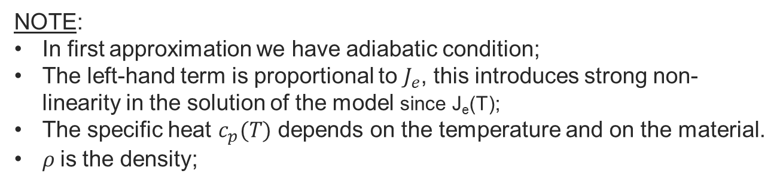
Thermal analysis
The superconductor must be designed to maintain the superconductive state during the normal operation. The cryogenic system is fundamental for that purpose. The aim of this study, in particular, is to find the critical frequency at which the superconductor can reach the critical temperature. It is possible to do that considering:
$$\left(\frac{8}{3π}J_{e}d_{f}B_{m}+\frac{f}{π^{2}ρ_{e}}{\left[B_{m}L_{p}\right]}^{2}\right)=ρ\int_{T_{op}}^{T_{coil}}{c_{p}(T)ⅆT}$$
NOTE:
In first approximation we have adiabatic condition;
The left-hand term is proportional to $J_{e}$, this introduces strong non-linearity in the solution of the model since J_{e}(T);
The specific heat $c_{p}(T)$ depends on the temperature and on the material.
$ρ$is the density;

Slide 9
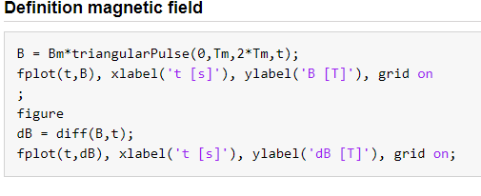
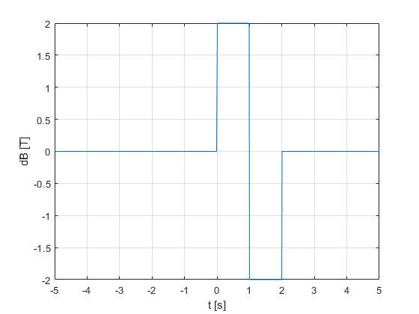
The Matlab File
The code calculates the AC losses considering every possible shape of the magnetic field. In particular in this study, we are interested in the fast ramping.

Slide 10
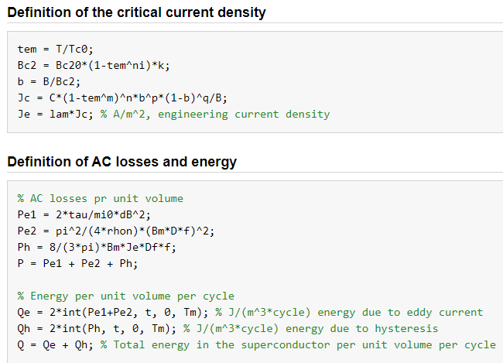
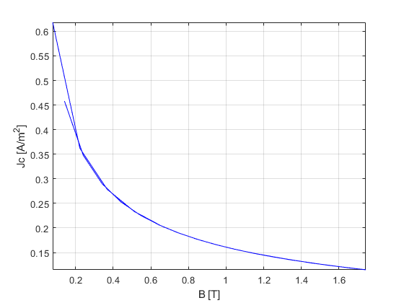
The Matlab File
The model of the critical current density is designed to be general, in particular maintaining the dependencies on temperature and on the magnetic field.

Slide 11
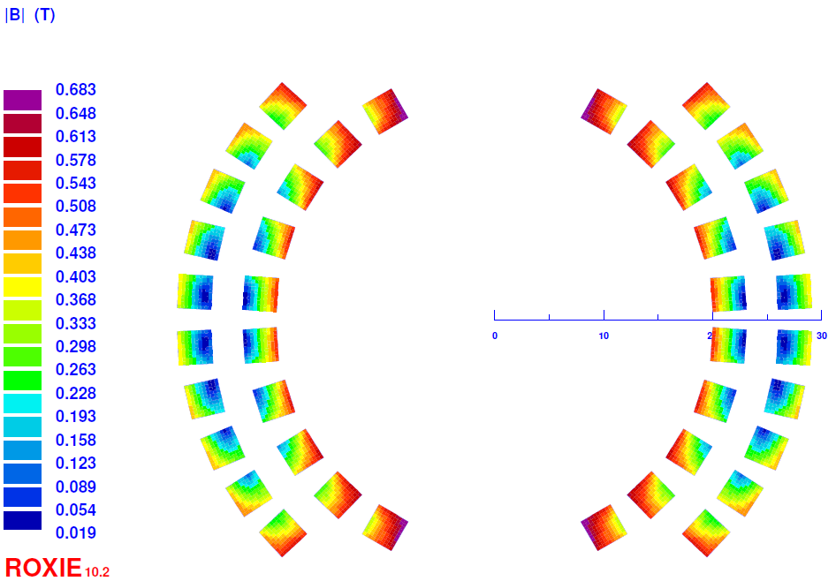
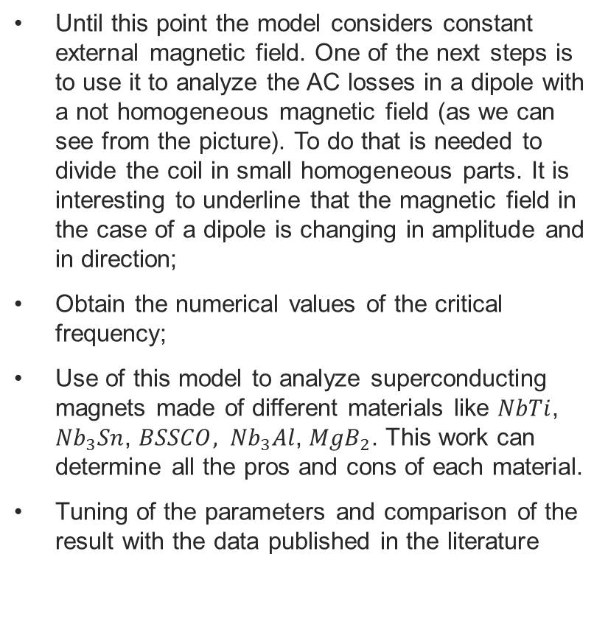
Application to magnets
Until this point the model considers constant external magnetic field. One of the next steps is to use it to analyze the AC losses in a dipole with a not homogeneous magnetic field (as we can see from the picture). To do that is needed to divide the coil in small homogeneous parts. It is interesting to underline that the magnetic field in the case of a dipole is changing in amplitude and in direction;
Obtain the numerical values of the critical frequency;
Use of this model to analyze superconducting magnets made of different materials like $NbTi$, ${Nb}_{3}Sn$, $BSSCO, {Nb}_{3}Al$, ${MgB}_{2}$. This work can determine all the pros and cons of each material.
Tuning of the parameters and comparison of the result with the data published in the literature
THANK YOU FOR THE ATTENTION

Slide 12
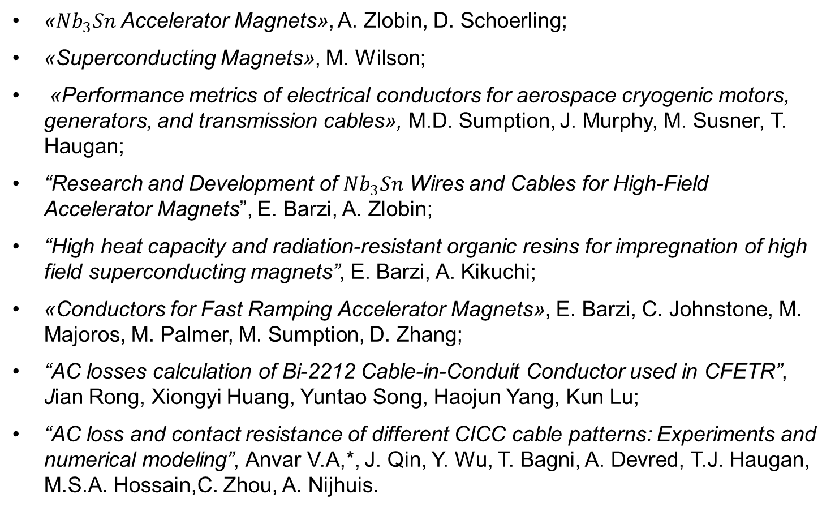
Bibliography
«${Nb}_{3}Sn$ Accelerator Magnets», A. Zlobin, D. Schoerling;
«Superconducting Magnets», M. Wilson;
«Performance metrics of electrical conductors for aerospace cryogenic motors, generators, and transmission cables», M.D. Sumption, J. Murphy, M. Susner, T. Haugan;
“Research and Development of ${Nb}_{3}Sn$ Wires and Cables for High-Field Accelerator Magnets”, E. Barzi, A. Zlobin;
“High heat capacity and radiation-resistant organic resins for impregnation of high field superconducting magnets”, E. Barzi, A. Kikuchi;
«Conductors for Fast Ramping Accelerator Magnets», E. Barzi, C. Johnstone, M. Majoros, M. Palmer, M. Sumption, D. Zhang;
“AC losses calculation of Bi-2212 Cable-in-Conduit Conductor used in CFETR”, Jian Rong, Xiongyi Huang, Yuntao Song, Haojun Yang, Kun Lu;
“AC loss and contact resistance of different CICC cable patterns: Experiments and numerical modeling”, Anvar V.A,*, J. Qin, Y. Wu, T. Bagni, A. Devred, T.J. Haugan, M.S.A. Hossain,C. Zhou, A. Nijhuis.

Slide 13
Acknowledgment
Fermi National Accelerator Laboratory;
Supervisor:
  Alexander Zlobin;
  Emanuela Barzi;
Summer Student at Fermilab:
  Simone Donati;
  Marco Mambelli;
  Giorgio Bellettini;
University of Pisa.

