Slide 1
Proposal pre-tensioning of the APA wires during production
Compliance Office 27.08.2023

Slide 2
We have estimated a possible scenario of wire pre-tensioning at factory.
Obviously, the wires are LFA wires with thermal treatments (as the ones you sent to us at CERN).
Note that :
For each spool the wire strength should be determined/checked and recorded on QA-QC documents together with the LFS certificates provided.
Any measurement device used in the process must be calibrated.
Wire strength should be determined on several samples and with the Eurocode statistical methodology.
We propose the following wire pretensions:
Nominal 7 N, tolerance +1.5 N and 10% accepted between 8.5N and 9N. Nominal 7 N, tolerance -1.5 N and 10% accepted between 5.5 N and 5 N.
The wire tension should never go below 4.5 N in Cold.

Slide 3
The reasoning is the following:
7 N as nominal tension (in order to help to increase the lowest tension, to be determined later for physics)
+ 1.5 N (in order to limit the amount of re-tensioning and to avoid adding delays unnecessary on the time of construction)
(These values of tension are determined by keeping an acceptable safety factor on the frame : 1.3 instead of 1.4 as required by the US standards).
Then we looked at the previous APAs data and we see that when they try to reach nominal, for U and V layer typically
10 % of the wires are above nominal + 1.5 N. So we propose that we accept a similar %.
The possible maximal wire tension in this scenario is compatible with the elastic limit of the soldered LFA wires at 21 N.
We have a maximal utilisation ratio of 80 % (acceptable considering the unknowns)
The proposed pretensions must not be exceeded.
The elastic limit of the wires used should not be below 21 N.
Note that the lower values are a proposal that must be confirmed from physics point of view.
Please take into account the possible unknowns and relaxation effects.

Slide 4
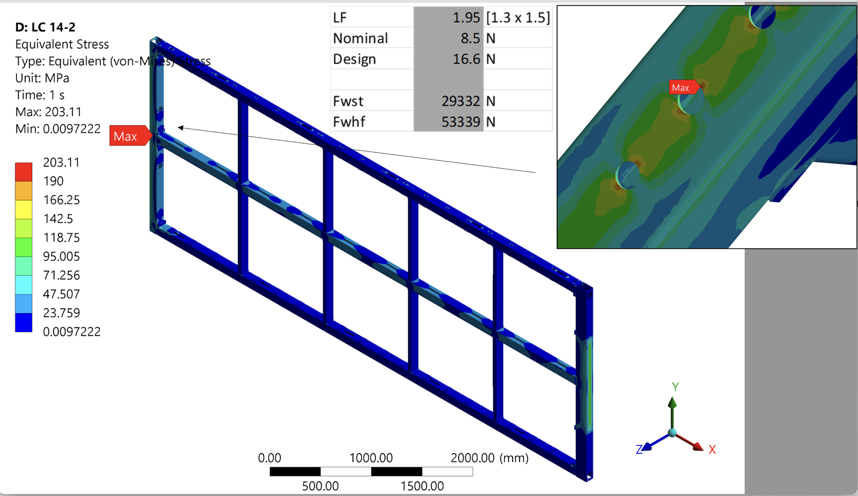
Stresses are acceptable
Load case 14.2 : cool down – thermal inertia of the wires vs frame
SF: 1.3
Pre tension in wires: 8.5 N + 50 % (thermal inertia of the frame/wires)

Slide 5
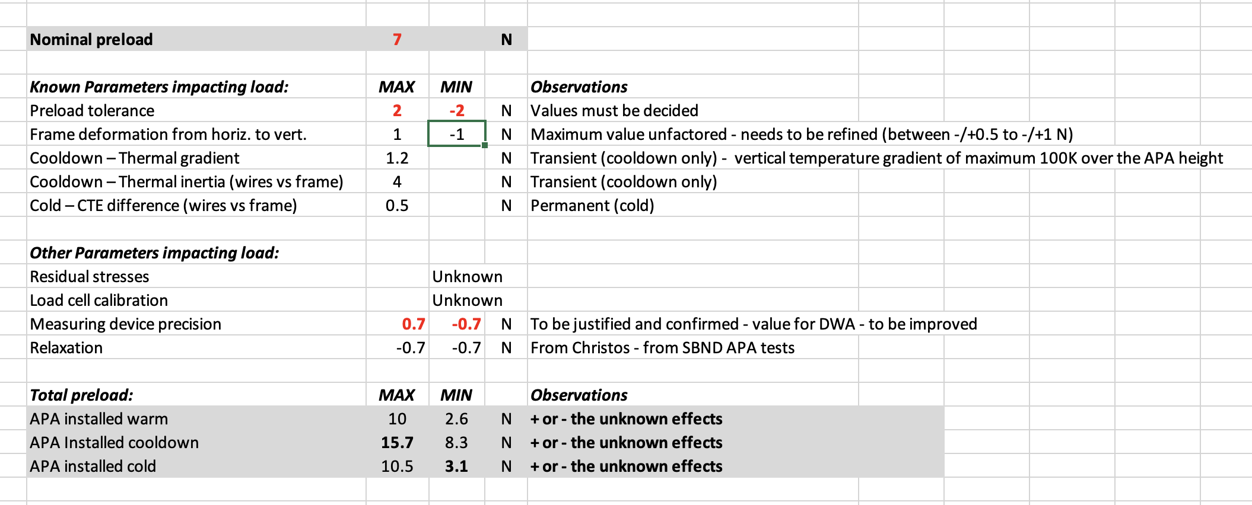
7 N +- 1.5 N
10 % between 8.5 N and 9 N
10 % between 8.5 N and 9 N
Upper value is fine
Lower value ?
If the production measurements are performed with laser system we gain 0.4 N ?

Slide 6
And :
In order to decrease the uncertainties, we insist that the tolerances on the DWA or or the laser measurements are not higher than 0.2/0.3 N (all factors included). We need to receive a written justification of this.
DWA measurements should be performed at all stages of transport in the same configuration (inside ASF)
(proposal: at factory at the end of production, at warehouse before transport, at CERN when appropriate, at US storage site, in the SURF caverns before installation)..
We will update EDMS 2816926 - Compliance Office QA/QC requirements for the Anode Plane Assembly, and the QA-QC
document summary accordingly to all the above.
Finally, we will try to assess better the frame relaxation from the protoDUNE I APAs. We will come back to you with request of data if required.

