Slide 1
Accelerators: evolution of facilities

Slide 2
Contents:
Introduction
Survey: Europe, Asia
Evolution

Slide 3
Introduction
Accelerator facilities: evolution

Slide 4
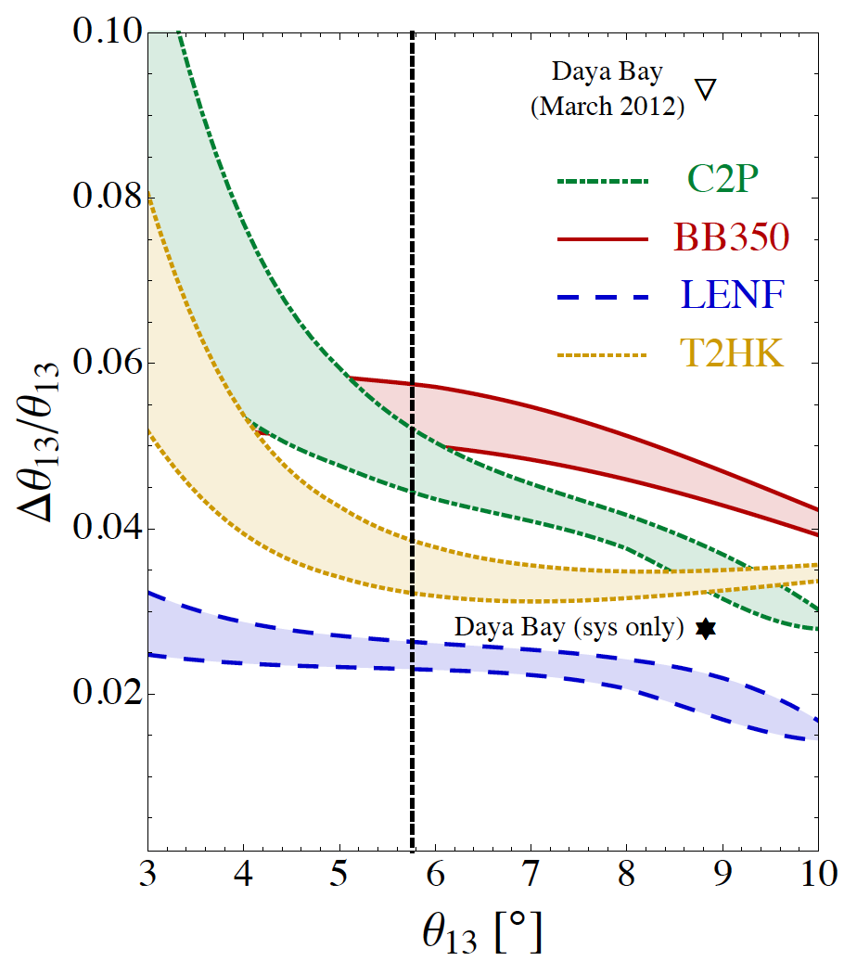
The SνM measurement programme:
Looking beyond MINOS, T2K,
NOνA, DChooz, Daya Bay, Reno, …
  θ₁₃ will be very well known
Therefore future programme
must:
  Complete the “Standard
  Neutrino Model” (SνM):
    Determine the mass hierarchy
    Search for (and discover?) leptonic
    CP-invariance violation
  Establish the SνM as the correct
  description of nature:
    Determine precisely the degree to which θ₂₃ differs from π/4
    Determine θ₁₃ precisely
    Determine θ₁₂ precisely
  Search for deviations from the SνM:
    Test the unitarity of the neutrino mixing matrix
    Search for sterile neutrinos, non-standard interactions, …
arXiv:1203.5651
Notes:
Peroration:
Goals of the presentation:
Show sensitivity and precision of the beta beam and neutrino factoru
Show maturity of R&D
Demonstrate that there are short-term contributions, especially nuSTORM

Slide 5
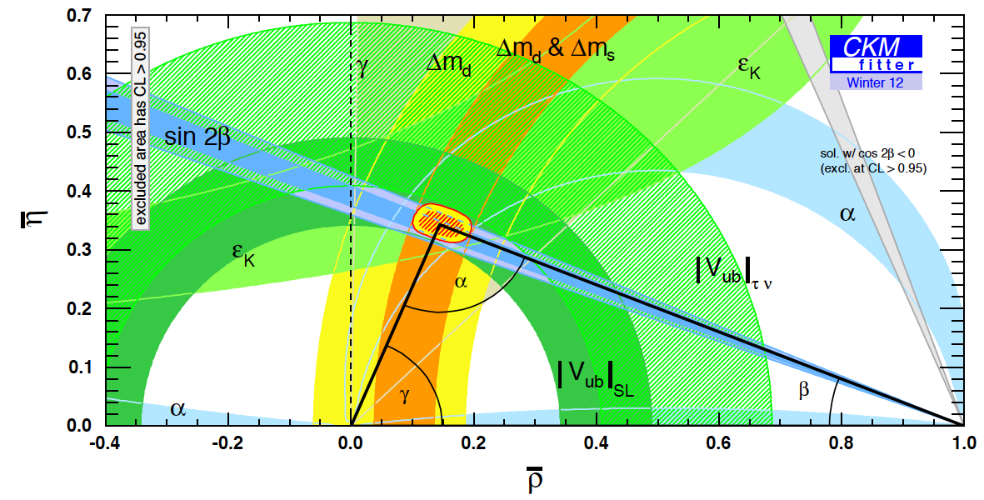
The case for precision:
What determines the goal for sensitivity and precision?
  Sensitivity:
    Definitive discovery!
      Must have sensitivity of “~5σ”
      To resolve the LSND/miniBooNE “suite of anomalies” may set the bar higher!
  Precision:
    Field presently led by experiment;
      Too many, or too few, theories;
    Goal to determine parameters with a precision comparable to that with which the quark-mixing parameters are known
PDG
Notes:
Peroration:
Goals of the presentation:
Show sensitivity and precision of the beta beam and neutrino factory
Show maturity of R&D
Demonstrate that there are short-term contributions, especially nSTORM

Slide 6
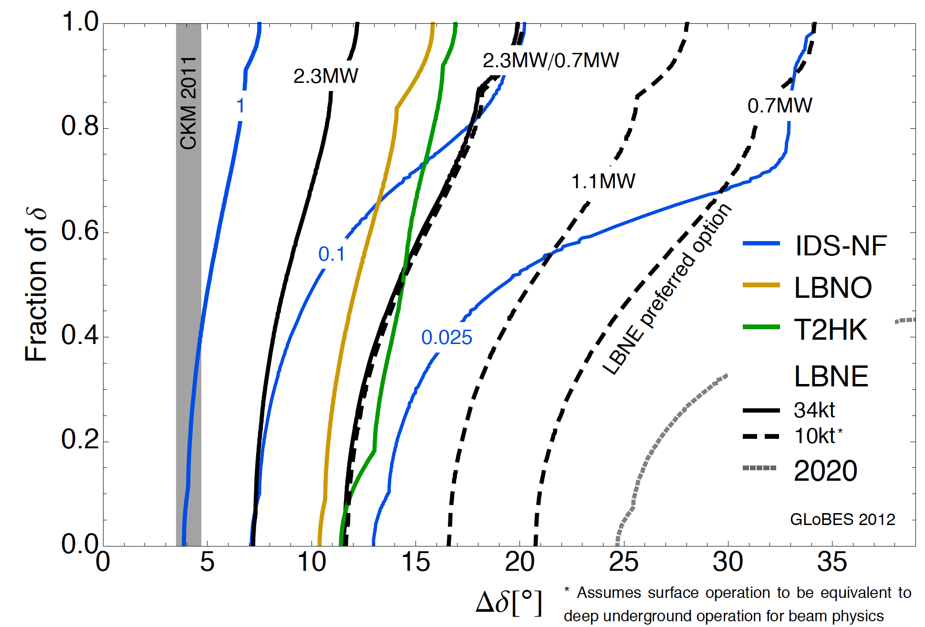
Comparison:
Coloma, Huber, Kopp, Winter
arXiv:1209.5973
Benefit of luminosity:
  Solid blue lines show effect on precision of scaling luminosity from baseline 10²¹ decays per year
  Potential for definition of staged upgrade programme

Slide 7
Observations:
Elucidation of the physics of flavour will require precise measurement of neutrino oscillations
The “ultimate” tool is the Neutrino Factory which meets the precision and sensitivity requirements
  Risk:
    Stored muon beams have not yet been demonstrated to be capable of serving a world-class neutrino programme
  Opportunity:
    Long-term strategy should maintain path towards the Neutrino Factory as the ultimate tool
Substantial investment will be required:
  Points to an incremental programme encompassing:
    Most effective exploitation of existing beams;
    Determination of MH and initial survey of CP; and
    R&D required to implement the subsequent increment
Integration of the required resources seems to imply definition of a long-term, internationally-coordinated strategy
  We all contribute infrastructure or equipment to ensure access to the best programme overall

Slide 8
Survey: Europe, Asia
Accelerator facilities: evolution

Slide 9
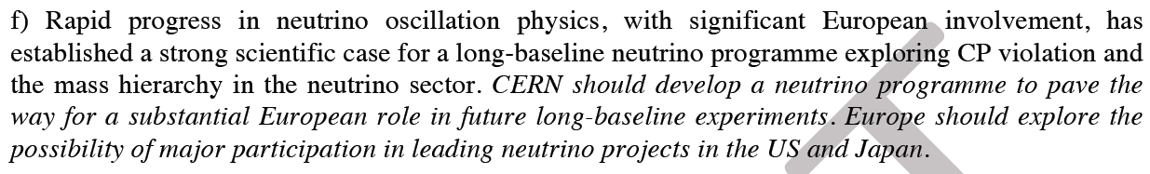
Neutrinos in the European Strategy for PP:

Slide 10
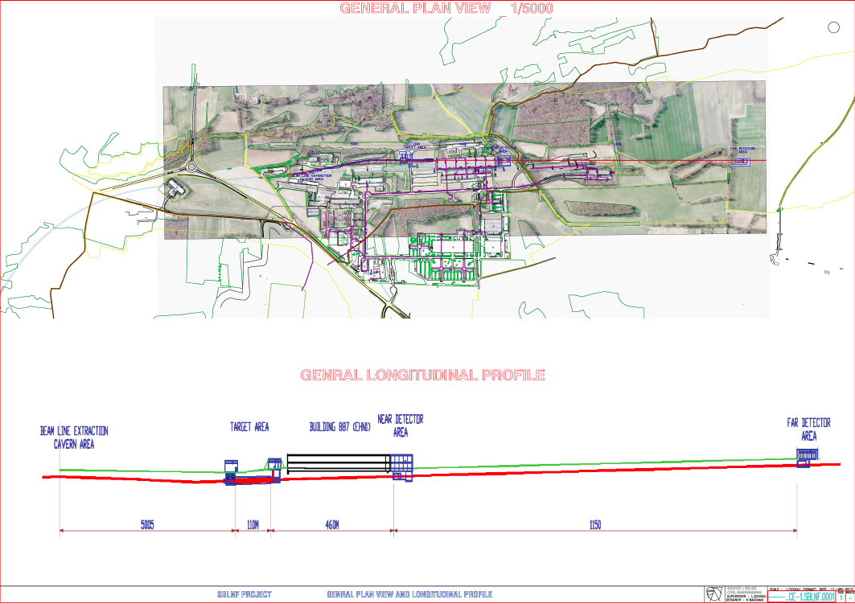
CERN Neutrino Facility (CENF):
https://edms.cern.ch/nav/P:CERN-0000096725:V0/P:CERN-0000096728:V0/TAB3

Slide 11
CERN Neutrino Facility (CENF):
Goals are:
  To serve:
    ICARUS/NESSiE sterile neutrino search
    LAGUNA-LBNO LAr detector development
  To be compatible with future long-baseline neutrino programme
Accelerator development:
  Fast extraction at 100 GeV from the SPS, transport over ~550 m to a fixed target
  A target complex including horn-focused pion/kaon collection
  A near-detector experimental area, 1000 m², at ~456m, housing at least 3 detectors
    ICARUS-150T, NESSIE, LAGUNA prototype
  A far-detector experimental area at 1600 m housing two large detectors:
    ICARUS-600T and NESSIE.

Slide 12
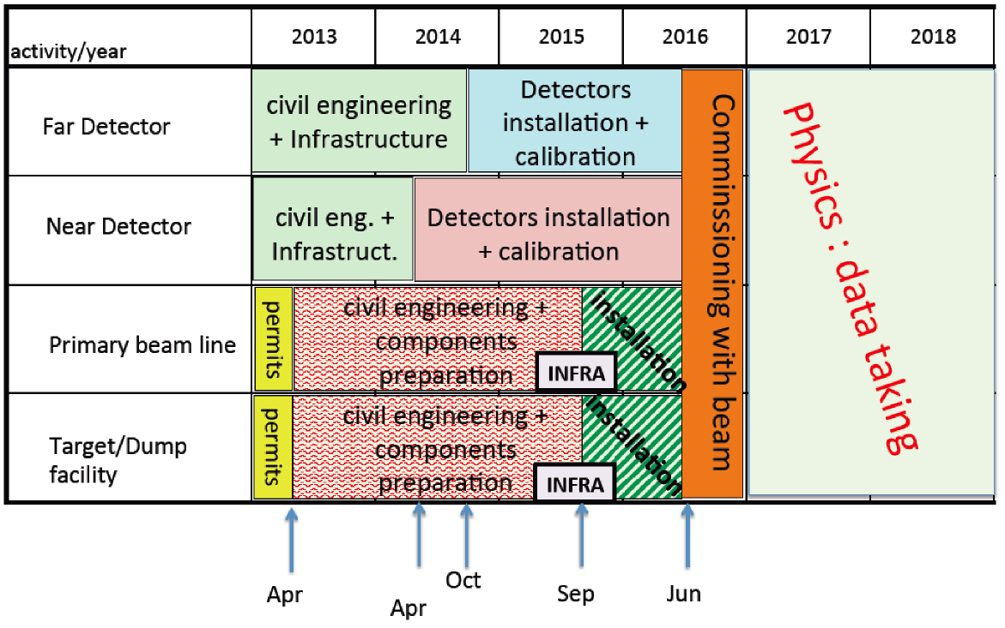
CENF: proposed timeline:
https://edms.cern.ch/nav/P:CERN-0000096725:V0/P:CERN-0000096728:V0/TAB3

Slide 13
Neutrinos at ESS:
M. Dracos
5 MW at 2.5—3 GeV: ~300 MeV neutrinos
  Linac delivers 3 ms spill of 700 MHz bunches
    OK for super-beam application
    Would require accummulator/compressor ring for development into Neutrino Factory

Slide 14
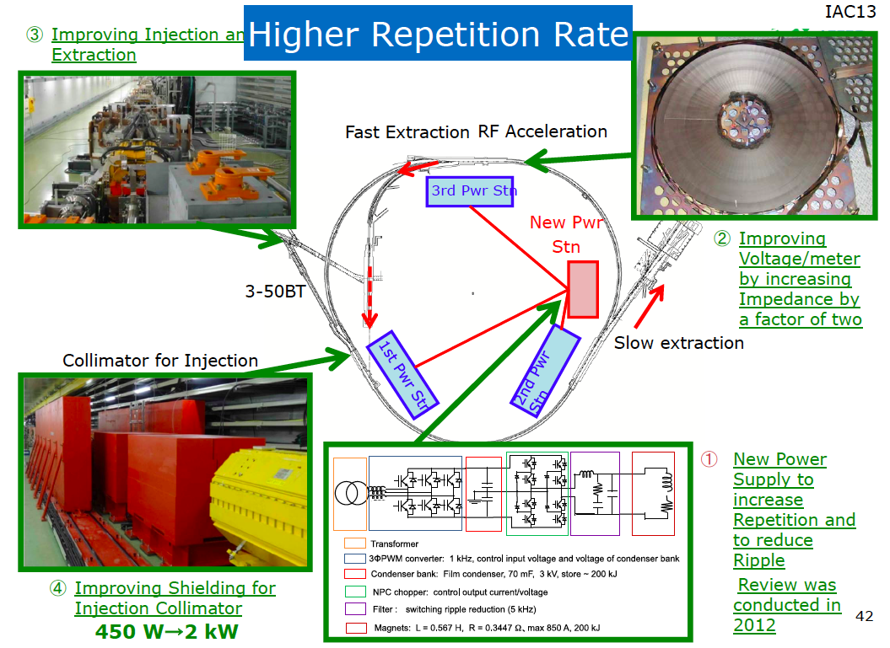
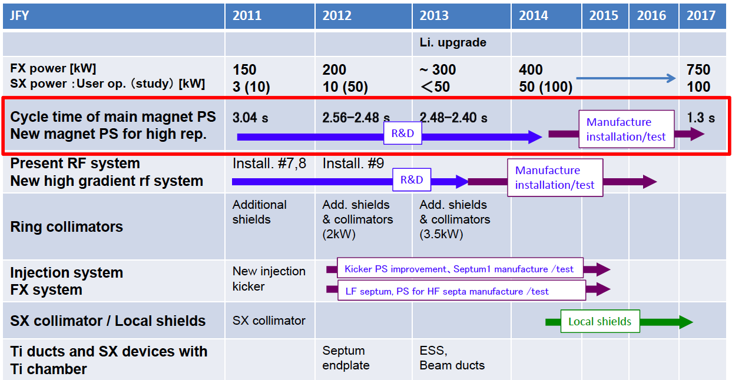
Development of J-PARC [1]:
Upgrades of main ring to provide 750 kW fast extracted beam:
  Increased rep rate
  New RF system
  New kickers and septum
  Upgraded collimators and shielding
K. Hasegawa
K. Hasegawa

Slide 15
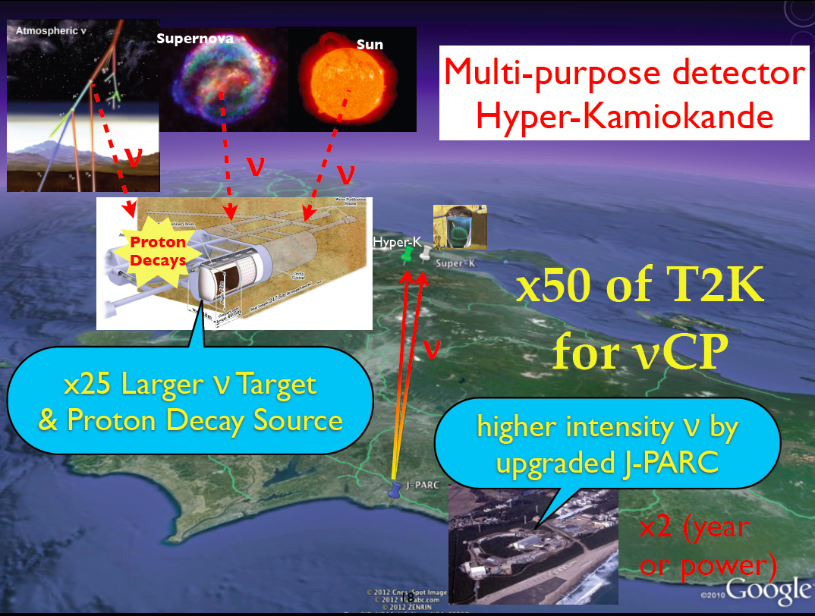
Development of J-PARC [2]:
M. Yokayama

Slide 16
Evolution
Accelerator facilities: evolution

Slide 17
Option thumbnails:
Conventional super-beams:
  Wide-band, long baseline: e.g. LBNE, LBNO
    <E_{μ}> ~ 2—3 GeV; matched to LAr or Fe calorimeter;
    Long-baseline allows observation of first and second maximum
    Near detector exploited to reduce systematic errors
  Narrow-band, short baseline: e.g. T2HK, SPL, ESS, nuSNS, …
    <E_{μ}> ~ 0.5 GeV; matched to H₂0 Cherenkov;
    Short-baseline allows observation of first maximum
    Near detector exploited to reduce systematic errors
Beta-beam, short baseline: e.g. CERN γ=100;
  <E_{μ}> ~ 0.5 GeV; matched to H₂0 Cherenkov;
  Short-baseline allows observation of first maximum
  Requires short-baseline super-beam to deliver competitive performance
Neutrino Factory: IDS-NF baseline E_{μ}=10 GeV;
  Uniquely well known flux (flavour content and energy spectrum);
  Baseline 1500—2500 km
  Requires a magnetised detector
  Identified by EUROnu as the facility for the high-precision programme

Slide 18
Critical issues:
Conventional and generic:
  High-power (multi-MW), pulsed, proton source
    And particle-production target to match
  High-gradient acceleration and high-field magnets
  Affordable, large mass detectors
Neutrinos from muons:
  Phase-space compression of muon beams:
    Short muon lifetime requires novel technique:
      Ionization cooling: proof-of-principle experiment, MICE
  Rapid acceleration:
    Exploit time dilation to suppress muon decay
    Fixed Field Alternating Gradient Acceleration
      Novel magnet technology allows acceleration without magnet ramp
      Proof of principle:
        EMMA
  Affordable, large mass magnetised detectors

Slide 19
Accelerator challenges:
Proton driver:
  High power, pulsed, short bunches
  Linac (CERN, FNAL, ESS) and ring (RAL, JPARC)
Pion-production target:
  Super-beam: solid; capture with horn
  Neutrino Factory: liquid mercury jet
  Progress: particle shielding, magnetic lattice
Muon front end:
  Chicane (new) to remove secondary hadrons:
    Bent solenoid transport & beryllium absorber
  Buncher & rotator:
    Progress: lattice revision in response to engineering study
  Cooling:
    Baseline: solenoid transport, LiH absorber
    Options: bucked coils or high-pressure H2
    Progress: lattice revision in response to engineering study
Rapid acceleration:
  Two options considered for acceleration to 10 GeV:
    Linac, RLA I and RLA II;
    Linac, RLA I and FFAG
  Choice based on cost and performance estimates
Proton driver:
  Development of high-power, pulsed proton source
    FETS; PIXIE; [R&D programme outlined by Prebys]
      Large charge, very short bunches
Pion-production target:
  MERIT experiment at CERN proved principle of mercury jet target
    Need to distinguish pre-construction development from proof of principle
Muon front end:B
  MuCool programme at FNAL:
    Study of effect of magnetic field on high-gradient, warm, copper cavities;
    Critical programme
  MICE experiment at RAL:
    Proof of principle of ionization-cooling technique
    Critical programme
  RF power sources (e.g. Diacrode) at LANL:
    Some work at LANL, however, cost driver for the Neutrino Factory
      Deserves more attention
Rapid acceleration:
  EMMA experiment at DL:
    Proof of principal of non-scaling FFAG technique;
      Novel technology allows circular acceleration without magnet ramp
  Superconducting, 201 MHz resonators at Cornell:
    Some work at Cornell, however, significant part of cost of muon acceleration
      Deserves more attention

Slide 21
Comparison:
Coloma, Huber, Kopp, Winter
arXiv:1209.5973
Benefit of luminosity:
  Solid blue lines show effect on precision of scaling luminosity from baseline 10²¹ decays per year
  Potential for definition of staged upgrade programme

Slide 22
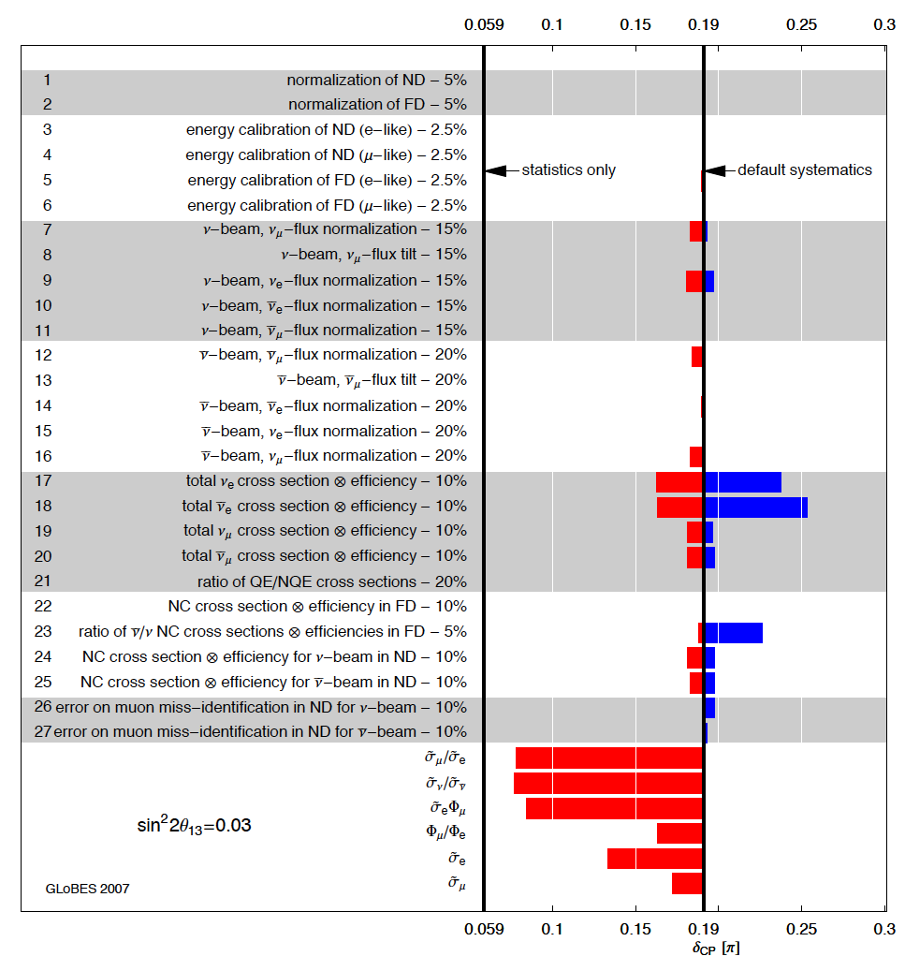
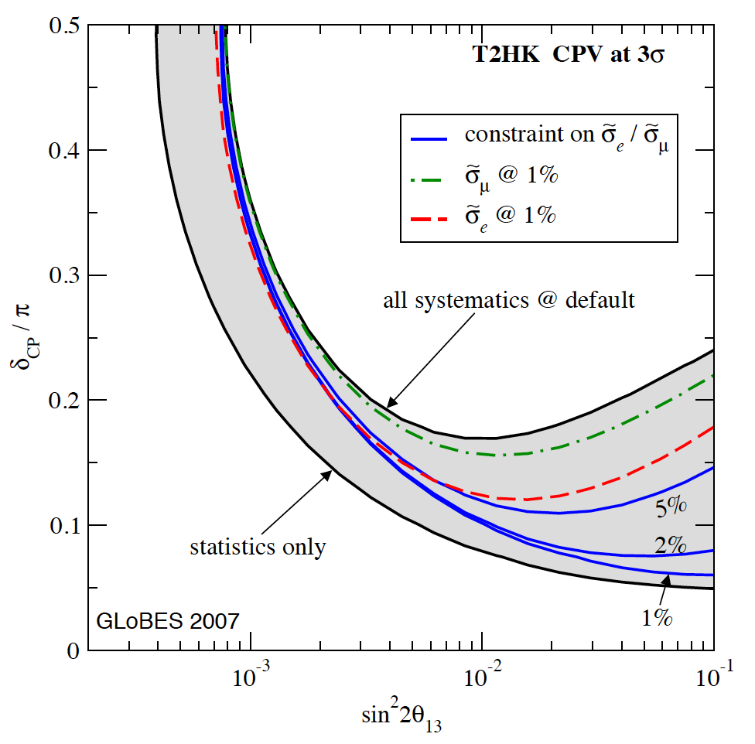
Systematic uncertainties:
T2HK, a case study:
[applicable to, e.g. C2CF, …]
  Narrow-band beam
  Near and far detector
— critical at large θ₁₃
Huber, Mezzetto, Schwetz,
arXiv:0711.2950v2

Slide 23
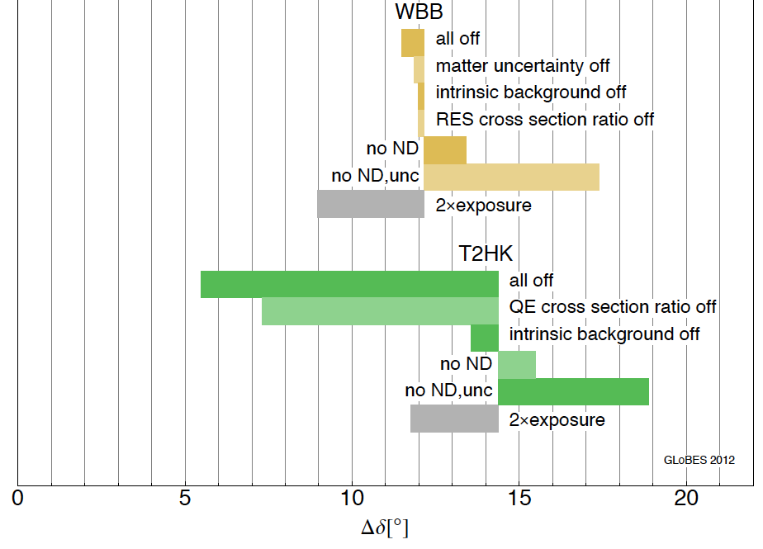
Systematic uncertainties:
P. Coloma, P. Huber, J. Kopp, and W. Winter
arXiv:1209.5973v1

Slide 24
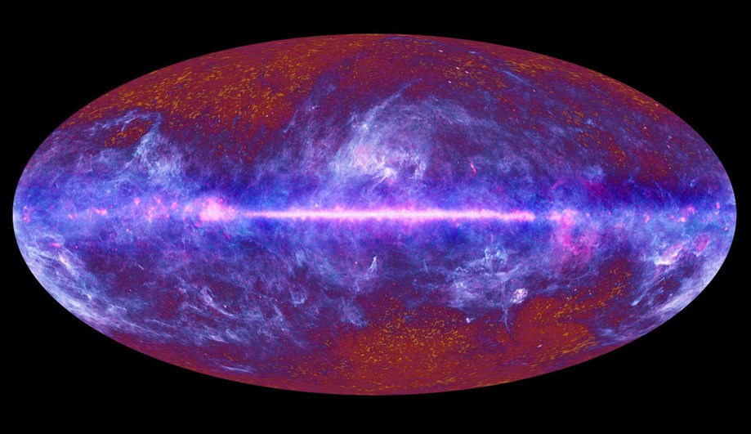
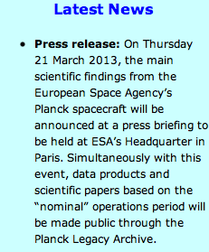

Slide 25
In the first instance, a combination of long-baseline (wide-band beam) experiments (e.g. LBNE/LBNO) and short baseline experiments (e.g. T2HK) offers an attractive way forward
However, in such an approach:
  CP reach is limited by systematic effects;
  Hints of CP violation require follow up by the Neutrino Factory
The Neutrino Factory will be needed to make the detailed and precise measurements required to elucidate the physics of flavour:
  Recognise that the Neutrino Factory:
    Meets the sensitivity and precision goals;
    Is mature; key issues addressed, or being addressed;
  Give priority to the incremental development of the facility

