Slide 1
Report from Nu 6
Astrophysical and Cosmological
Neutrinos
Conveners:
Kara Hoffman
Cecelia Lunardini
Nikolai Tolich

Slide 2
Organization
Neutrino Telescopes are increasingly evolving into multipurpose detectors with physics reach well beyond the design goals.
In addition to neutrino astronomy, neutrino observatories are addressing:
Indirect searches for dark matter
Neutrino properties and oscillation physics (including sterile neutrinos)
Geoneutrinos
Cosmic ray physics
Exotica (i.e. magnetic monopole searches)
Violations of Lorentz Invariance
Neutrino cross sections….
The physics addressed by any facility is determined by the energy range, thus we decided to organize our document according to energy.

Slide 3
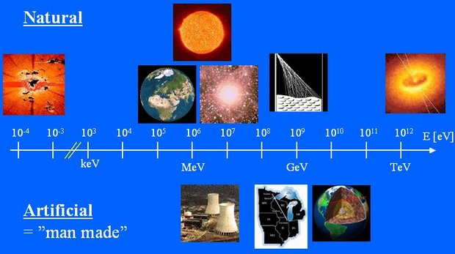
Outline
Ultra low energies (CνB)
Low energies (MeV scale)
Medium energies (GeV)
High energies (TeV-PeV)
Ultra high energy (>PeV)
Impact of laboratory based measurements on astronomical observables.

