Slide 1
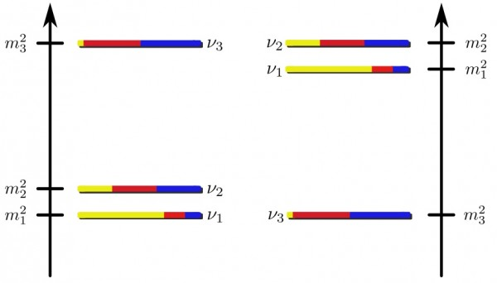
Determination of Mass Hierarchy from Man-Made Neutrino Sources: Future Projects: LBNE and Daya Bay II
Xin Qian
Caltech
Normal MH
(NH)
Inverted MH
(IH)
Mass Hierarchy (MH)

Slide 2
The ABCs of Mass Hierarchy (MH)
One of three remaining unknowns in the new standard model
Important role in determining the nature of
Determination of MH (5-σ rule) :
Given data, reject the unfavored MH hypothesis (relative to the favored one) by 5σ
Unlike sin²2θ₁₃ (a continuous fundamental parameter), MH is a 0 or 1 problem
Competition stops at 5σ
Need consistent results from >= 2 experiments

Slide 3
Access MH from Man-Made Neutrinos
Channel
First generation | Noνa/T2K
Next generation | LBNE-Phase I, LBNO, T2KK | Daya Bay II, RENO50, Hanohano
Beyond next generation | LBNE-Phase II with Project-X |  | Neutrino Factory
MC study of the MH experiments indicate reduced confidence given Δχ²
XQ, A. Tan, W. Wang, J. J. Ling, R. D. McKeown, C. Zhang PRD86, 113011 (2012)
5σ MH sensitivity → ~0.6% of experiments give incorrect answer (instead of 6e-7)
Notes:
In this talk

Slide 4
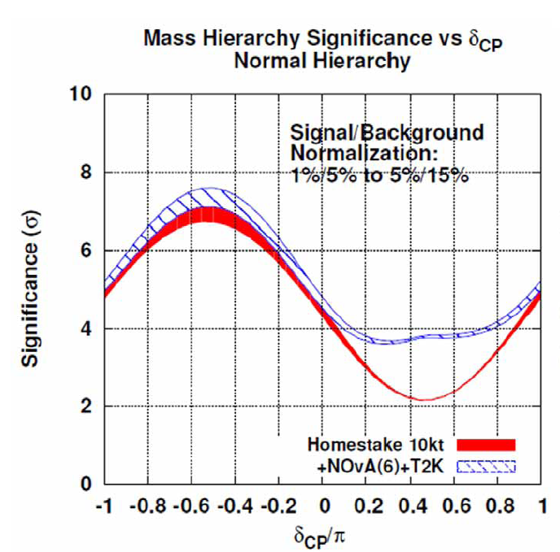
LBNE:
Determine the MH by measuring CP violation resulting from the matter effect: a few GeV neutrino beam + 1300 km
Advantage: not only MH, but also CP phase δ
Price paid: reduced MH discovery potential due to unknown δ

Slide 5
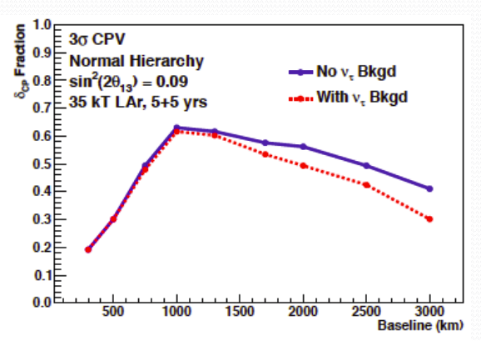
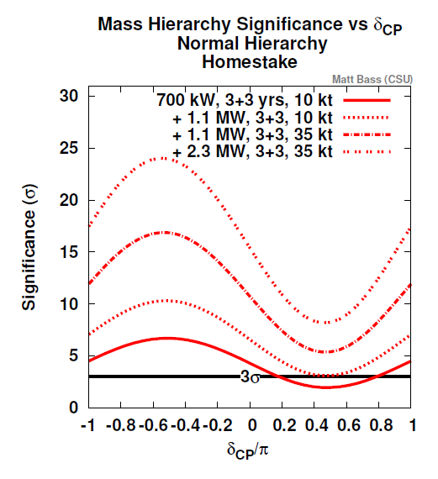
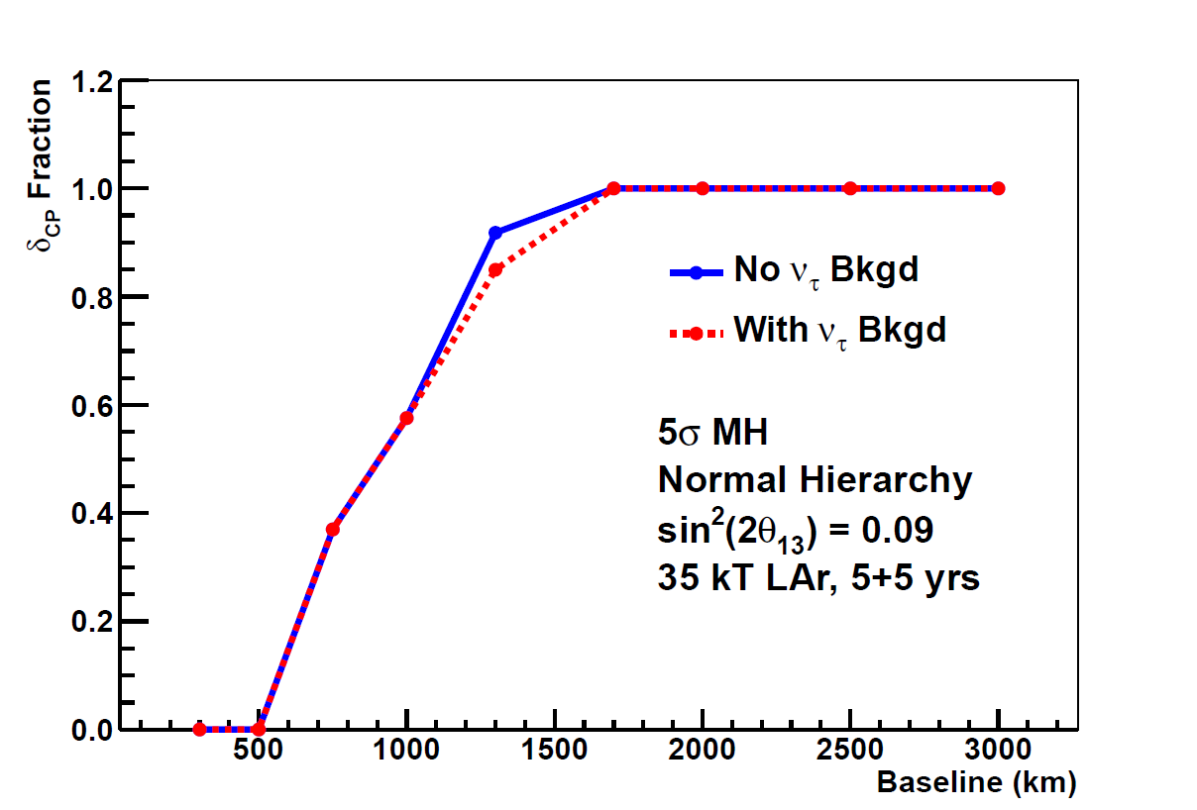
How to Enhance MH Sensitivity?
More mass and more flux LBNE-phase I is stat. limited!
Go to longer baseline?
http://if-neutrino.fnal.gov/whitepapers/lbne-lbl.pdf
1300 km is a very good choice for δ and a good choice for MH!

Slide 6
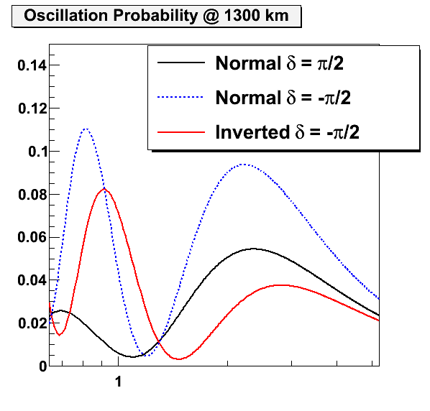
Alternatives to Enhance MH Sensitivity
Neutrino oscillation ~ L/E, matter effect ~ L
At fixed L/E (1st oscillation maximum), combine with experiments at different baselines: Nova/T2K
Include the 2nd maximum:
LBNE covers both 1st and 2nd
Improve on the 2nd maximum:
2nd detector to enhance the MH discovery potential in LBNE
Low energy running with project-X
http://if-neutrino.fnal.gov/whitepapers/qian-offaxis.pdf
http://if-neutrino.fnal.gov/whitepapers/worcester-lowepx.pdf

Slide 7
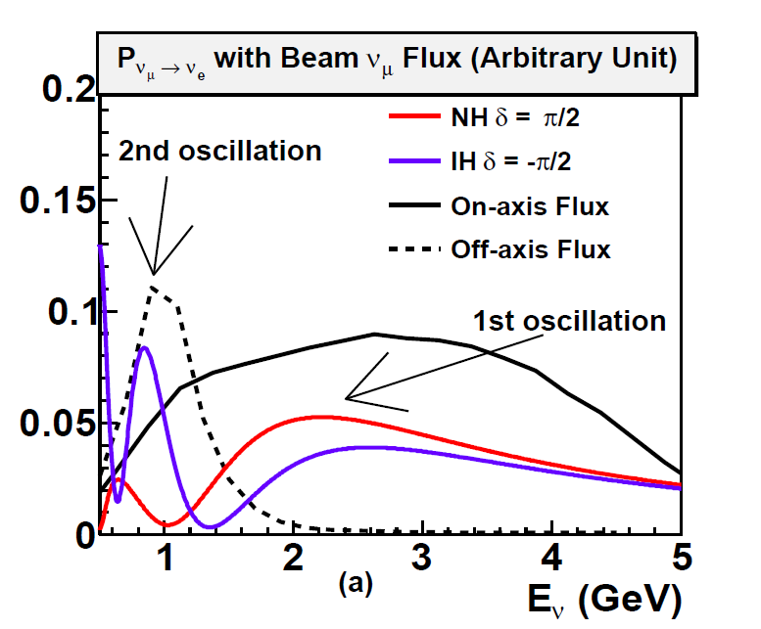
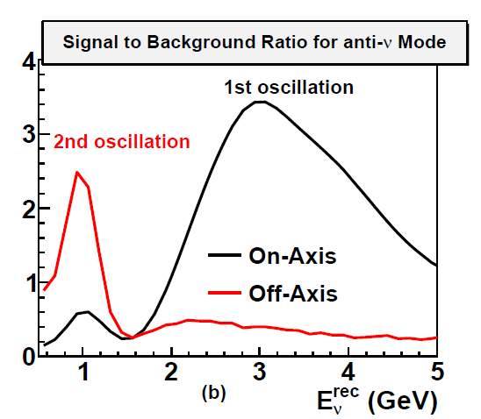
2nd detector off-axis?
Natural narrow band beam at off-axis due to 2-body kinematics in pion decay
~ 0.8 GeV (large quasi-elastic cross section) suitable for water Cherenkov detector (WCD)
Fast detector (WCD) + beam timing information → possible surface running with modest shielding to reduce cost
e.g. E889 @ BNL
Gains comparing to on-axis
1. More neutrino events @ 2nd oscillation
2. Better signal to noise ratio

Slide 8
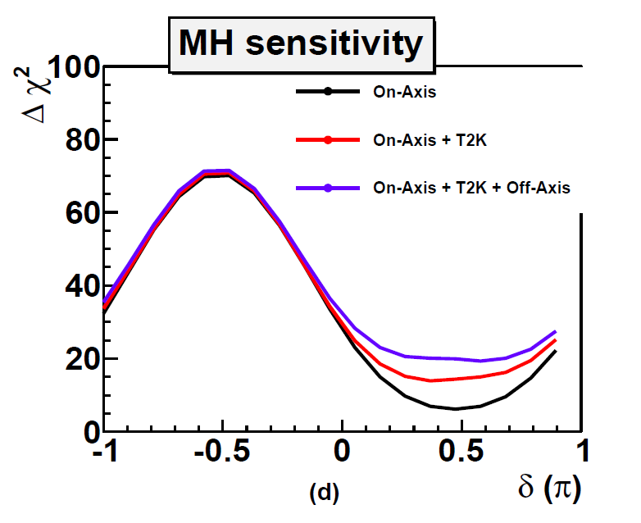
2nd detector as an insurance?
Comparison with T2K’s impact at bad δ region, Nova will further increase the MH sensitivity in the good δ region
35 km off-axis with 1300 km
Enhance MH discovery potential in LBNE phase-I → Strengthen the measurement of CP phase δ
Take advantage of LBNE WCD R&D and build 10 kT WCD off axis
Expected to be < $50 M
10 kT WCD (off-axis) is equivalent to an additional 10 kT Lar (on-axis) for the MH sensitivity at worst δ → Cost effective
Expect a ~2.5 additional enhancement with optimization

Slide 9
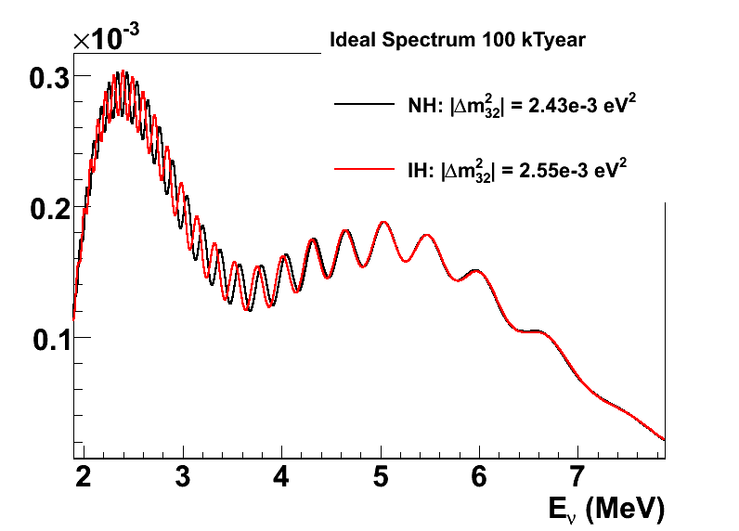
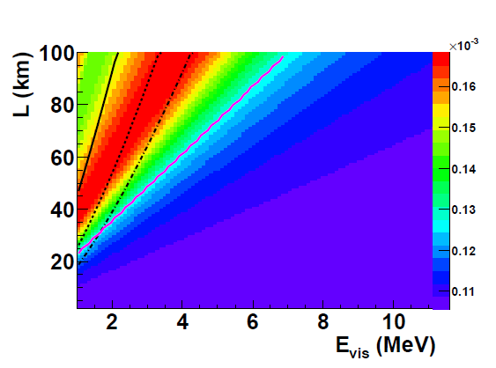
Mass Hierarchy by Reactor
Fast Oscillation
Frequency @ 60km
Resolution Lines: 3%, 5%, 7% @ 1 MeV
MH can be determined by comparing Δm²_{eff} at different energies.
Good energy resolution is crucial!
Choubey, Petcov, and Piai PRD68,113006 (2003)
Learned et al. PRD78, 071302R, (2008)
Zhan et al. PRD78, 111103R (2008)
Zhan et al. PRD79, 073007 (2009)
XQ et al. arXiv:1208.1551 (2012)
http://if-neutrino.fnal.gov/whitepapers/johnson-reactor.pdf
Notes:
2 measurements: 1 CP, 1 precision measurements
One of normal and One of inverted plots

Slide 10
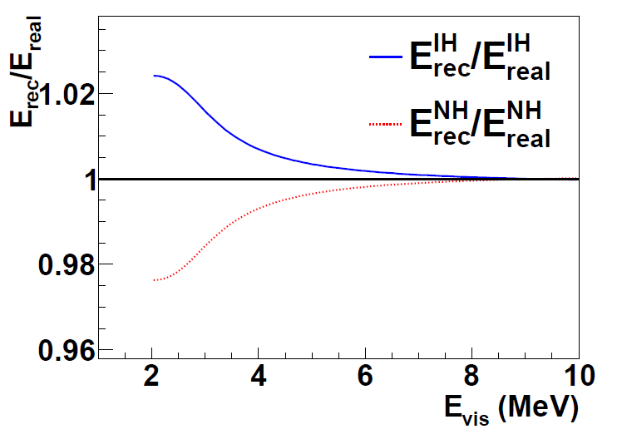
Importance of Absolute Energy Scale
In reality, we measure instead of
Energy nonlinearity:
scintillator quenching
electronics
position dependence …
Require ~ 0.2% absolute energy scale
Comparing to 2% (state-of-art from KamLAND)
XQ et al. PRD 87, 033005 (2013)
Risks can be hedged by a 2nd detector → Trade requirement in absolute energy scale to relative energy scale

Slide 11
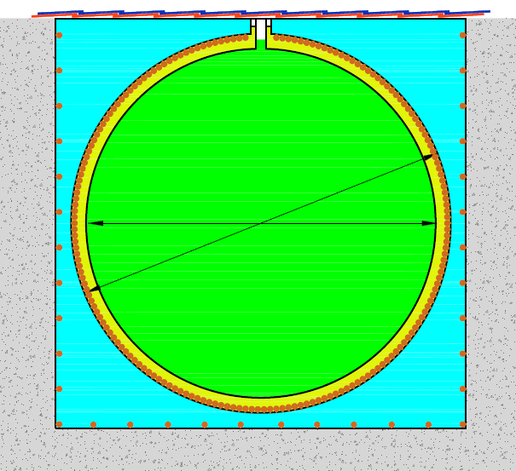
Daya Bay II
Water
20 kt fiducial volume
Liquid scintillator
20 kt detector at 55~60 km
~ 40 GW_{th} power
~700 m underground
< 3% resolution @ 1 MeV
~0.2% energy calibration
Acrylic tank：Φ34.5m
Stainless Steel tank ： Φ37.5m
 | Current | Daya Bay II
Δm²₁₂ | 3% | 0.6%
Δm²₂₃ | 5% | 0.6%
sin²θ₁₂ | 6% | 0.7%
sin²θ₂₃ | 20% | N/A
sin²θ₁₃ | 14%➔ 4% | ~ 15%
MH can be determined to Δχ²>25 in 6 years!
Preliminary cost: ~ $300 M with Chinese accounting standards
Expect ~15% contribution from outside China
Also excellent Super-Nova detector
Notes:
One of the conceptual designs

Slide 12
Site Selection
 | Daya Bay | Yangjiang | Taishan
Status | running | Construction | construction
power/GW | 17.4 | 17.4 | 18.4
Daya Bay
Current site
Hong Kong
Taishan
Yangjiang
From Y. F. Wang

Slide 13
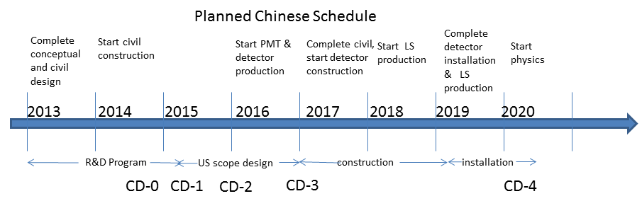
Overall Schedule & R&D plan
Calibration: ~ 0.2 % absolute energy scale
Understanding liquid scintillator properties
Understanding electronics effects
Simulation & design of calibration system
Energy resolution: R&D on scintillator, PMT

Slide 14
Summary
Neutrino MH is one of the next big goals for the neutrino oscillation experiments
appearance (LBNE, LBNO, T2KK) and disappearance (Daya Bay II, RENO50, Hanohano …) provide two complementary paths with man-made neutrinos
It won’t be easy, but it will be worth it

Slide 16
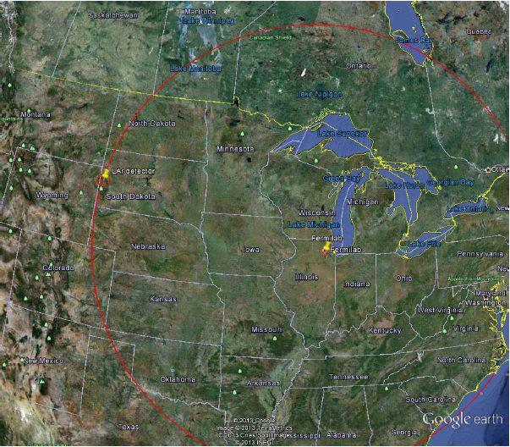
Off-axis location

Slide 17
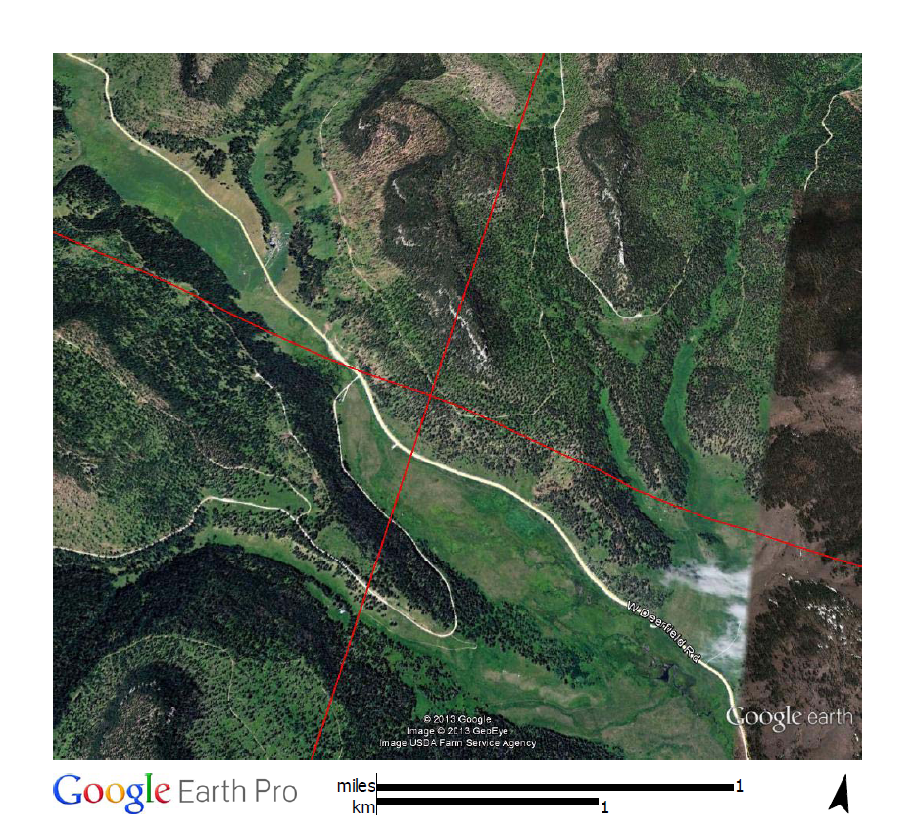
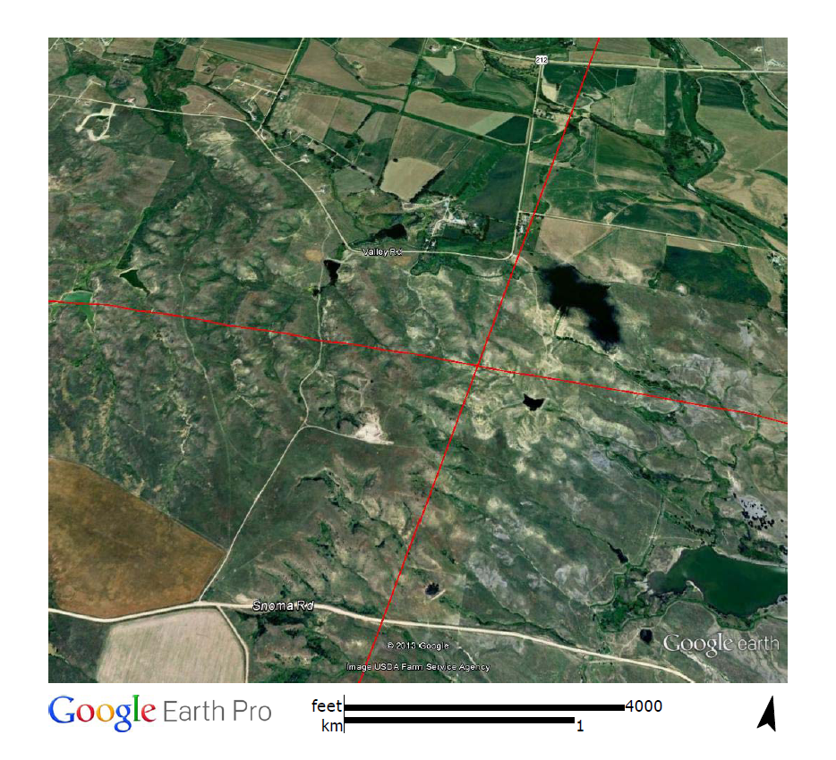
Possible Locations
On surface running → lots of freedom
With ~ 1300 km

Slide 18
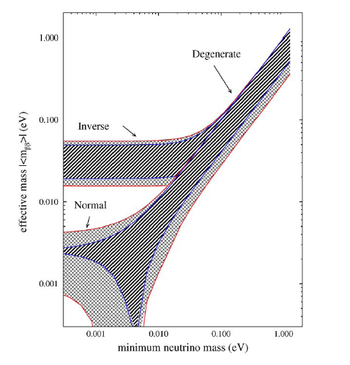
Double Beta Decay
Discovery of the DBD can not determine the MH
One need more information from the minimum neutrino mass
Cosmological limit

Slide 19
Traditional Procedure
Assume Asimov data set given one model
Assume measured counts are exactly the expected counts
Essential statistical fluctuation is neglected (Also see db-6535 B. Lundberg)
More sensible to quote distance to the middle point (e.g. 1.5 σ)
Compare “data” with two (groups of) models
Calculate χ²_{NH} and χ²_{IH}
Define Δχ²=χ²_{IH}- χ²_{NH}
Report $σ=\sqrt{∆χ2}$ as sensitivity
3-σ

Slide 20
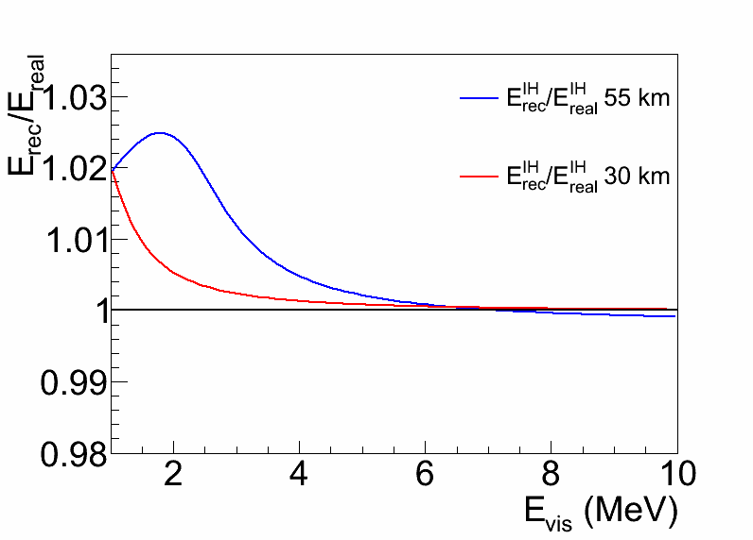
Double Detectors?
The requirement on the absolute energy scale (~0.2% for a single detector) can be largely mitigated by including a 2nd detector at medium baseline (~30 km)
Ciuffoli, Evslin, Wang, Yang, Zhang, Zhong arXiv:1211.6818
Trade the requirement on the absolute energy scale with the relative energy scale (~0.2% achieved in Daya Bay)

Slide 21
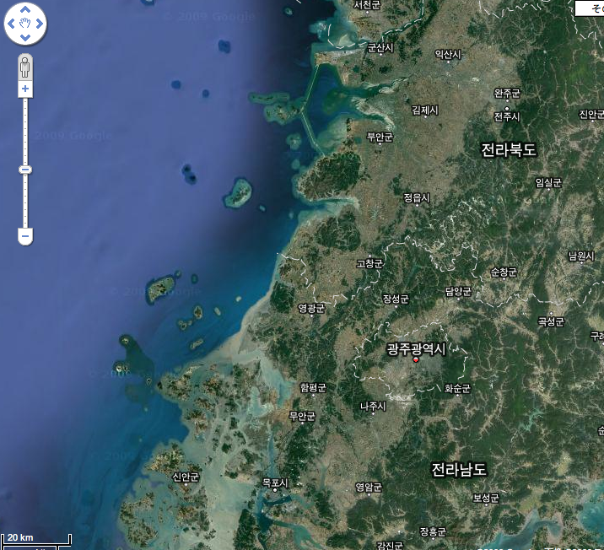
RENO-50 (2018~ )
From Soo-Bong Kim
Large θ₁₂ neutrino oscillation effects at 50 km + 5kton liquid scintillator detector
RENO can be used as near detectors. → Precise (~0.3%) reactor neutrino fluxes
Dedicated to YG → negligible contribution from other nuclear power plants.
500 10” OD PMTs
Water
Possible sites :
- Mt. Byungpoong (822 m, 43.9 km)
- Mt. Choowol (729 m, 51.9 km)
LAB -LS (5 kton)
6000 10” PMTs
25 m
20 m
Mt. Choowol
Yonggwang
Mt. Byungpoong
20 m
25 m

Slide 22
More photons, how and how many ?
Highly transparent LS:
Attenuation length/D: 15m/16m → 30m/34m × 0.9
High light yield LS:
KamLAND: 1.5g/l PPO → 5g/l PPO
Light Yield: 30%→ 45%; × 1.5
Photocathode coverage :
KamLAND: 34% → ~ 80% × 2.3
High QE “PMT”：
20” SBA PMT QE: 25% → 35% × 1.4
or New PMT QE：25% → 40% × 1.6
Both： 25% → 50% × 2.0
4.3 – 5.0 ➔ (3.0 – 2.5)% /√E
Other contributions： 0.5% constant term & 0.5% neutron recoil uncertainty
From Y. F. Wang

