Slide 1
Electrostatic and Sag Considerations for Wire Tension
Aseet Mukherjee
5 Sep 2023

Slide 2
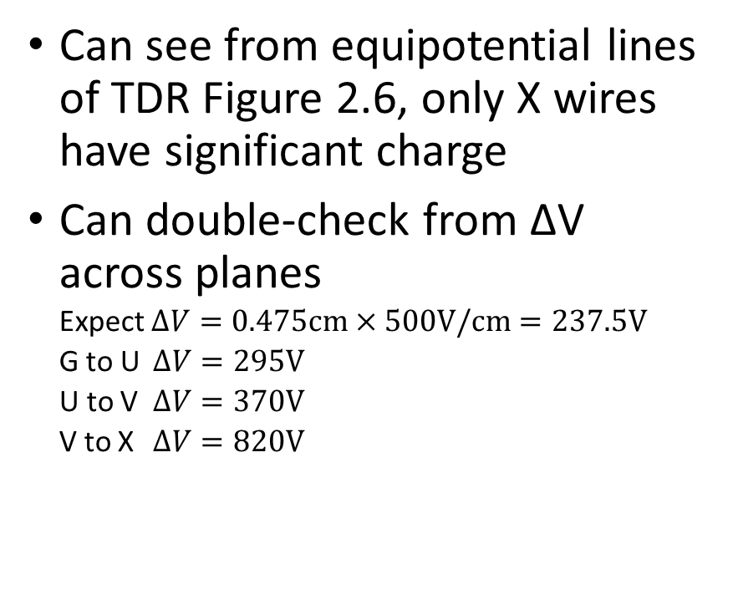
Electrostatics
Can see from equipotential lines of TDR Figure 2.6, only X wires have significant charge
Can double-check from ΔV across planes
Expect $∆V=0.475\text{cm}×500\text{V}\text{/}\text{cm}=237.5\text{V}$
G to U $∆V=295\text{V}$
U to V $∆V=370\text{V}$
V to X $∆V=820\text{V}$

Slide 3
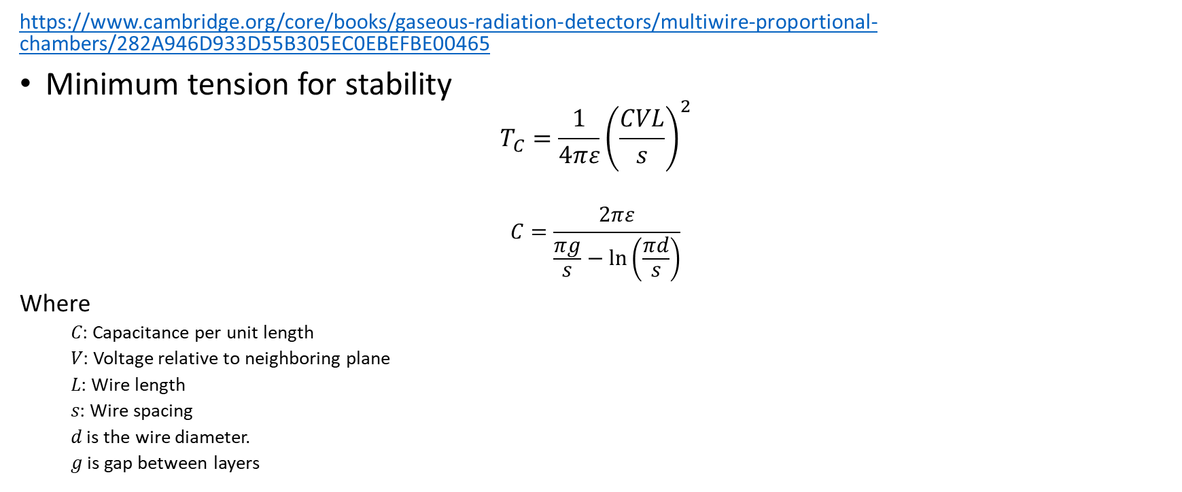
Electrostatic Stability
https://www.cambridge.org/core/books/gaseous-radiation-detectors/multiwire-proportional-chambers/282A946D933D55B305EC0EBEFBE00465
Minimum tension for stability
$$T_{C}=\frac{1}{4πε}{\left(\frac{CVL}{s}\right)}^{2}$$
$$C=\frac{2πε}{\frac{πg}{s}−ln\left(\frac{πd}{s}\right)}$$
Where
  𝐶: Capacitance per unit length
  𝑉: Voltage relative to neighboring plane
  𝐿: Wire length
  𝑠: Wire spacing
  𝑑 is the wire diameter.
  𝑔 is gap between layers
ε₀ | 8.854E-12 | F/m
ε_{LAr} | 1.3281E-11 | F/m
s | 4.79 | mm
g | 4.75 | mm
d | 0.0152 | mm
C | 1.08041E-11 | F/m
V | 820 | V
L | 1500 | mm
T_{C} | 0.046118824 | N

Slide 4
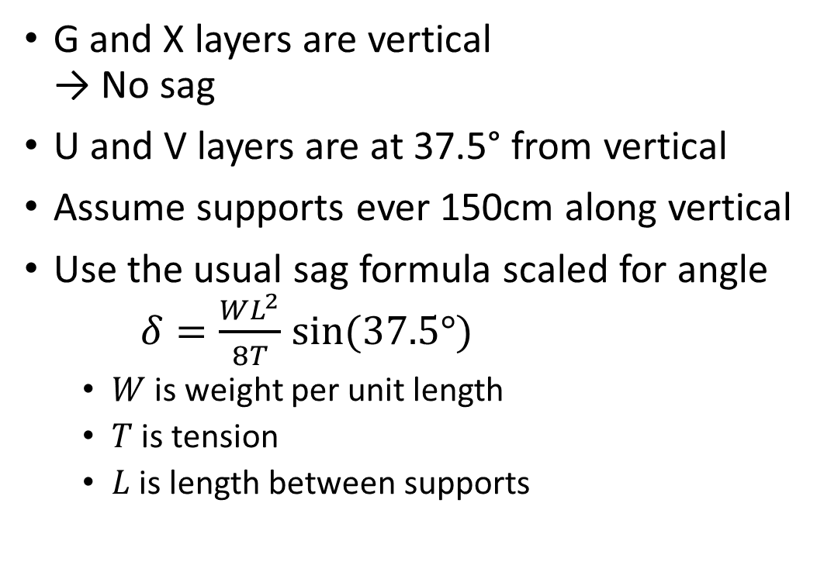
Gravitational Sag
ρ | 8.35 | g/cm³
d | 0.01524 | cm
W | 1.4942E-05 | N/cm
L_{x} | 150 | cm
θ | 37.5 | degrees
L | 155.120023 | cm
δ·T | 0.0273595 | cm·N
T | 6 | N
δ | 0.00455992 | cm
G and X layers are vertical
→ No sag
U and V layers are at 37.5° from vertical
Assume supports ever 150cm along vertical
Use the usual sag formula scaled for angle
$δ=\frac{WL^{2}}{8T}sin⁡(37.5°)$
  $W$ is weight per unit length
  $T$ is tension
  $L$ is length between supports
There must be other contributors to the final 0.5mm tolerance
Still… 6N seems unnecessarily high

Slide 5
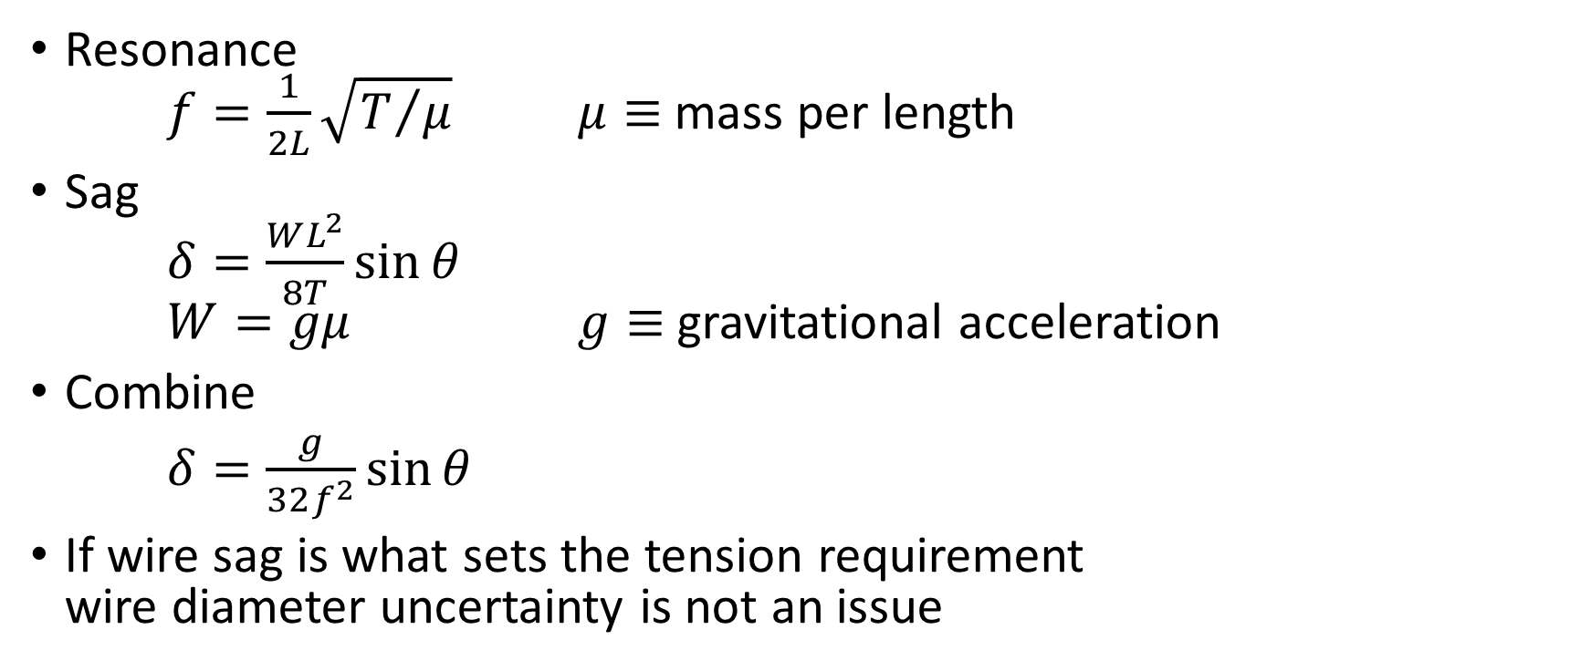
Wire Diameter Uncertainty
Resonance
$f=\frac{1}{2L}\sqrt{T/μ}$ $μ≡$ mass per length
Sag
$δ=\frac{WL^{2}}{8T}\sin{θ}$
$W=gμ$ $g≡$ gravitational acceleration
Combine
$δ=\frac{g}{32f^{2}}\sin{θ}$
If wire sag is what sets the tension requirement
wire diameter uncertainty is not an issue

Slide 6
Other consideration?
Signal collection?
Noise? From TDR
A further complication from very low-tension wires might be an increase in noise level, introduced by wire vibrations, which can lead to vortex shedding.

