Slide 1
Cross-coupling Test
Jixia Li, Cong Zhang, Fengquan Wu
2023/8/22

Slide 2
Measurement Setup
$50Ω$
$50Ω$
Obs. Time 2100 sec
All in analog device room.
Analog
Device
Room
LNA
LNA
Optic
Optic
Optic Recv,
Freq Down,
LO
Chn1
Chn2
Correlator
Measurement diagram

Slide 3
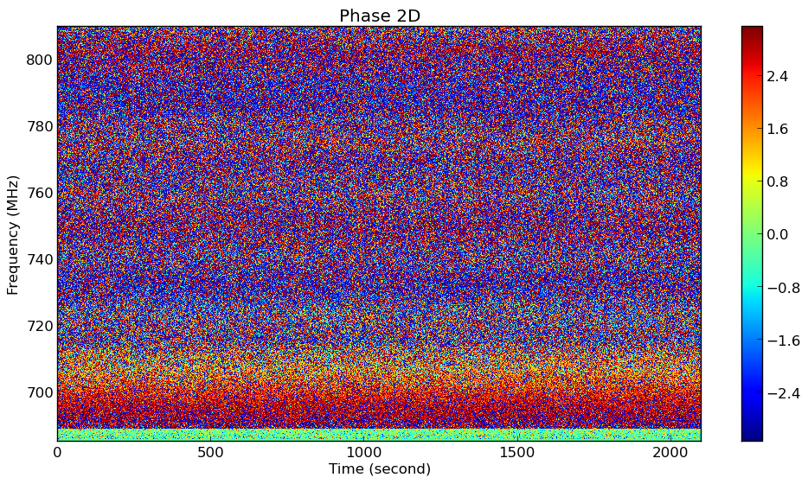
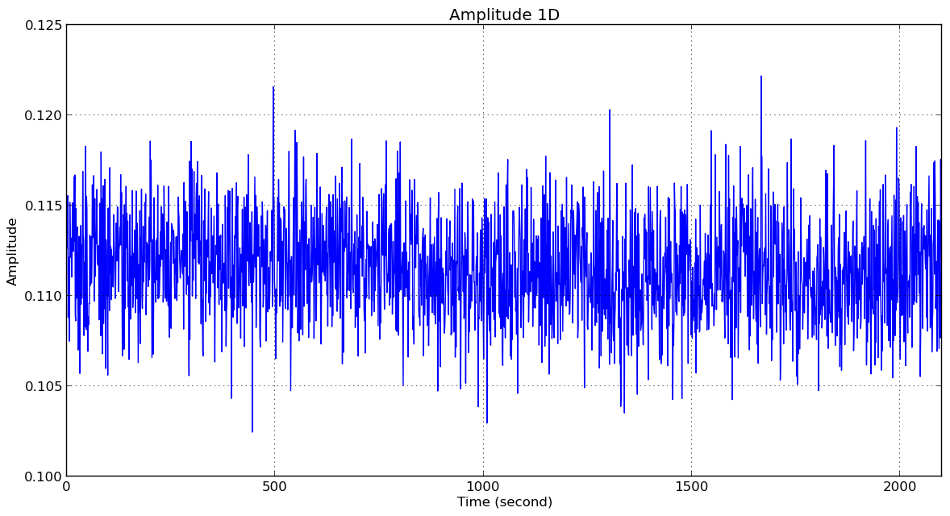
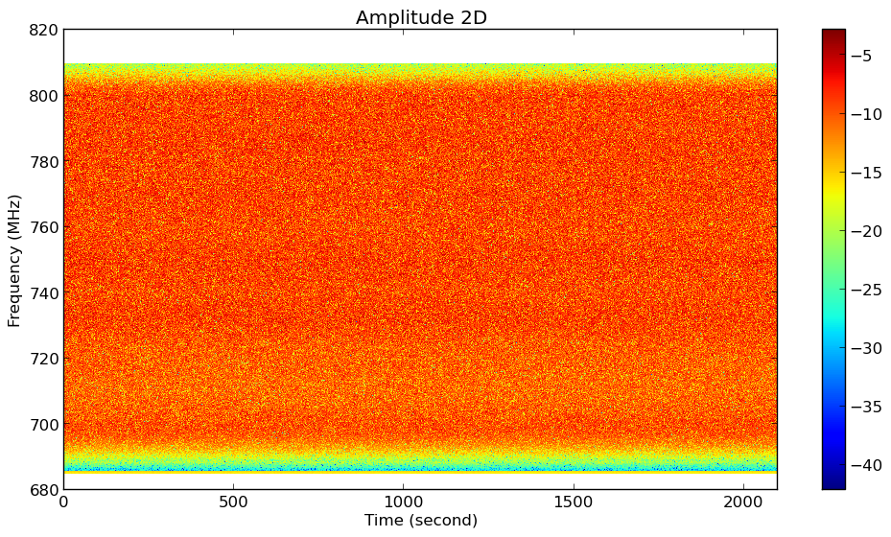
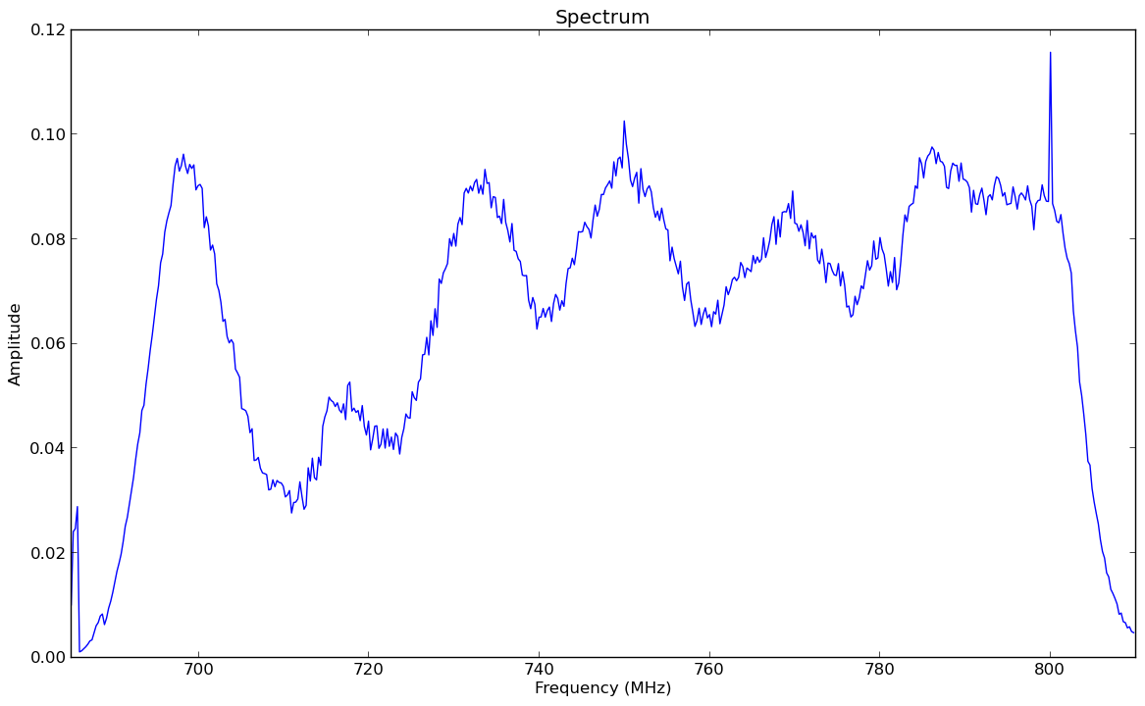

Slide 4
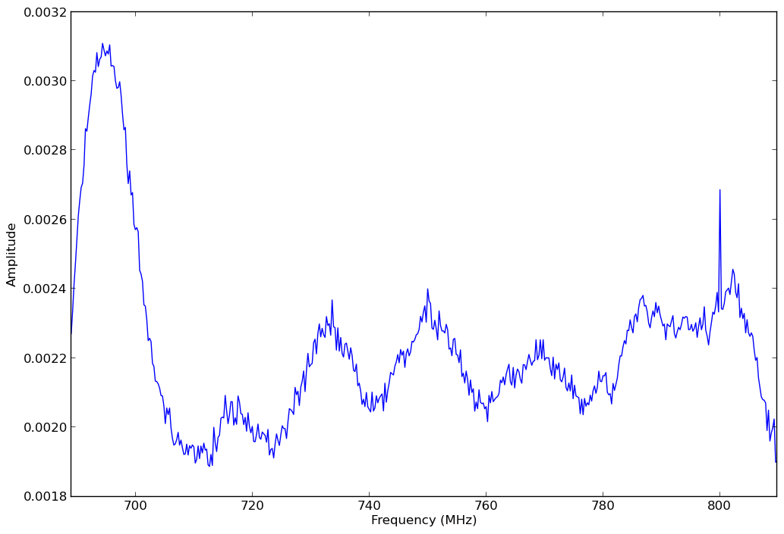
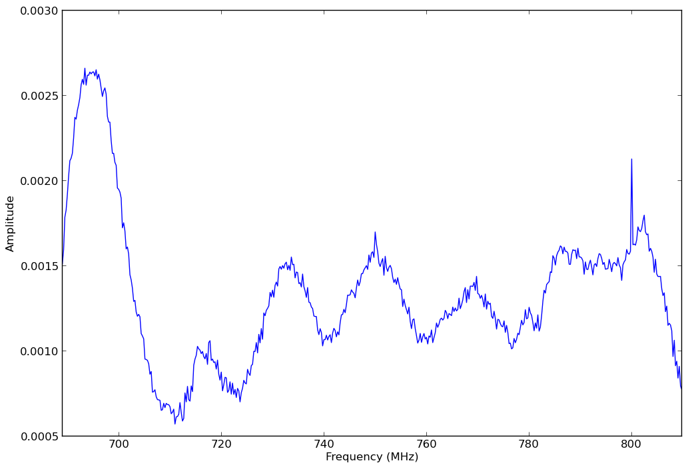
$\frac{\overline{\left|V_{ab}\right|}}{\sqrt{\overline{\left|V_{aa}\right|}⋅\overline{\left|V_{bb}\right|}}}$
Time averaged modulus of visibility
$\frac{\left|\overline{V_{ab}}\right|}{\sqrt{\left|\overline{V_{aa}}\right|⋅\left|\overline{V_{bb}}\right|}}$
Modulus of time averaged visibility

