Slide 1
Preliminary results on PDE measurement of the VD-XA in Napoli
F. Di Capua, N. Canci, G. Matteucci, G. Grauso, Y. Suvorov, R. Calabrese, G. Fiorillo
Università di Napoli and INFN
A. A. Machado, E. Segreto
Campinas University
G. Valdiviesso
Universidade Federal de Alfenas
F. Terranova, C. Cattadori, C. Gotti, L. Meazza, A. Minotti
Milano Bicocca & INFN MI
D. Warner, K. Francis, Z. Rautio
Northern Illinois University
Notes:
Write “many thanks to …” on corresponding slides

Slide 2
Outline
Experimental setup for PDE Measurement
Cryostat LAr filling
Argon purity evaluation
SPE (Single PhotoElectron) measurement
Simulation
Preliminary result for PDE

Slide 3
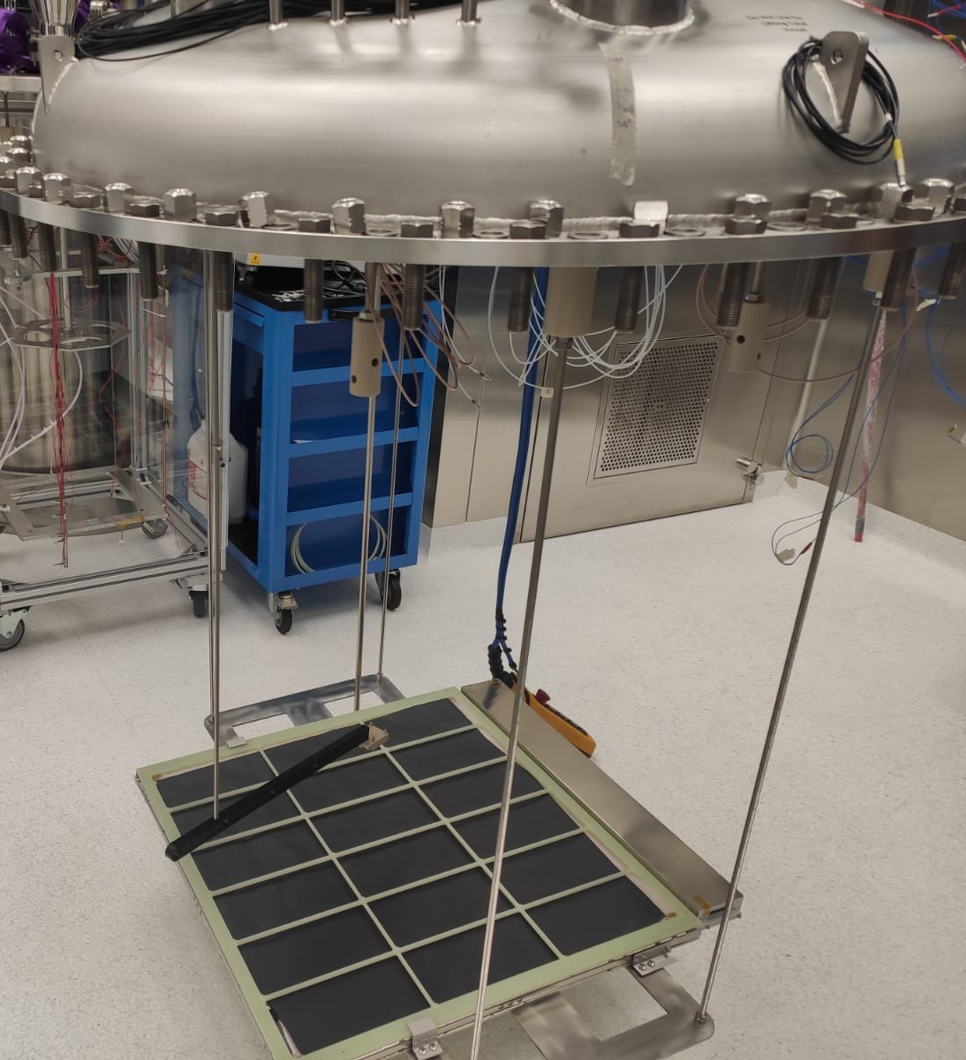
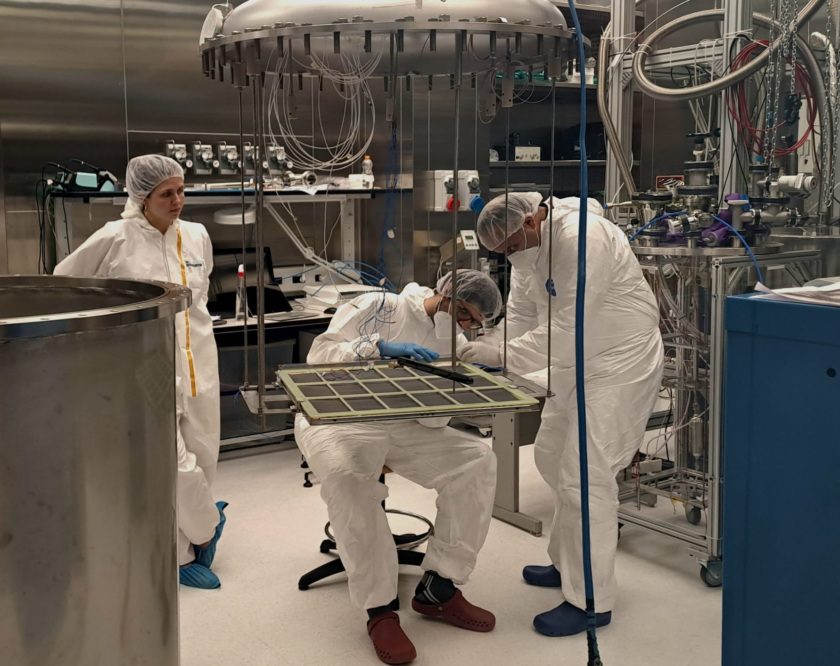
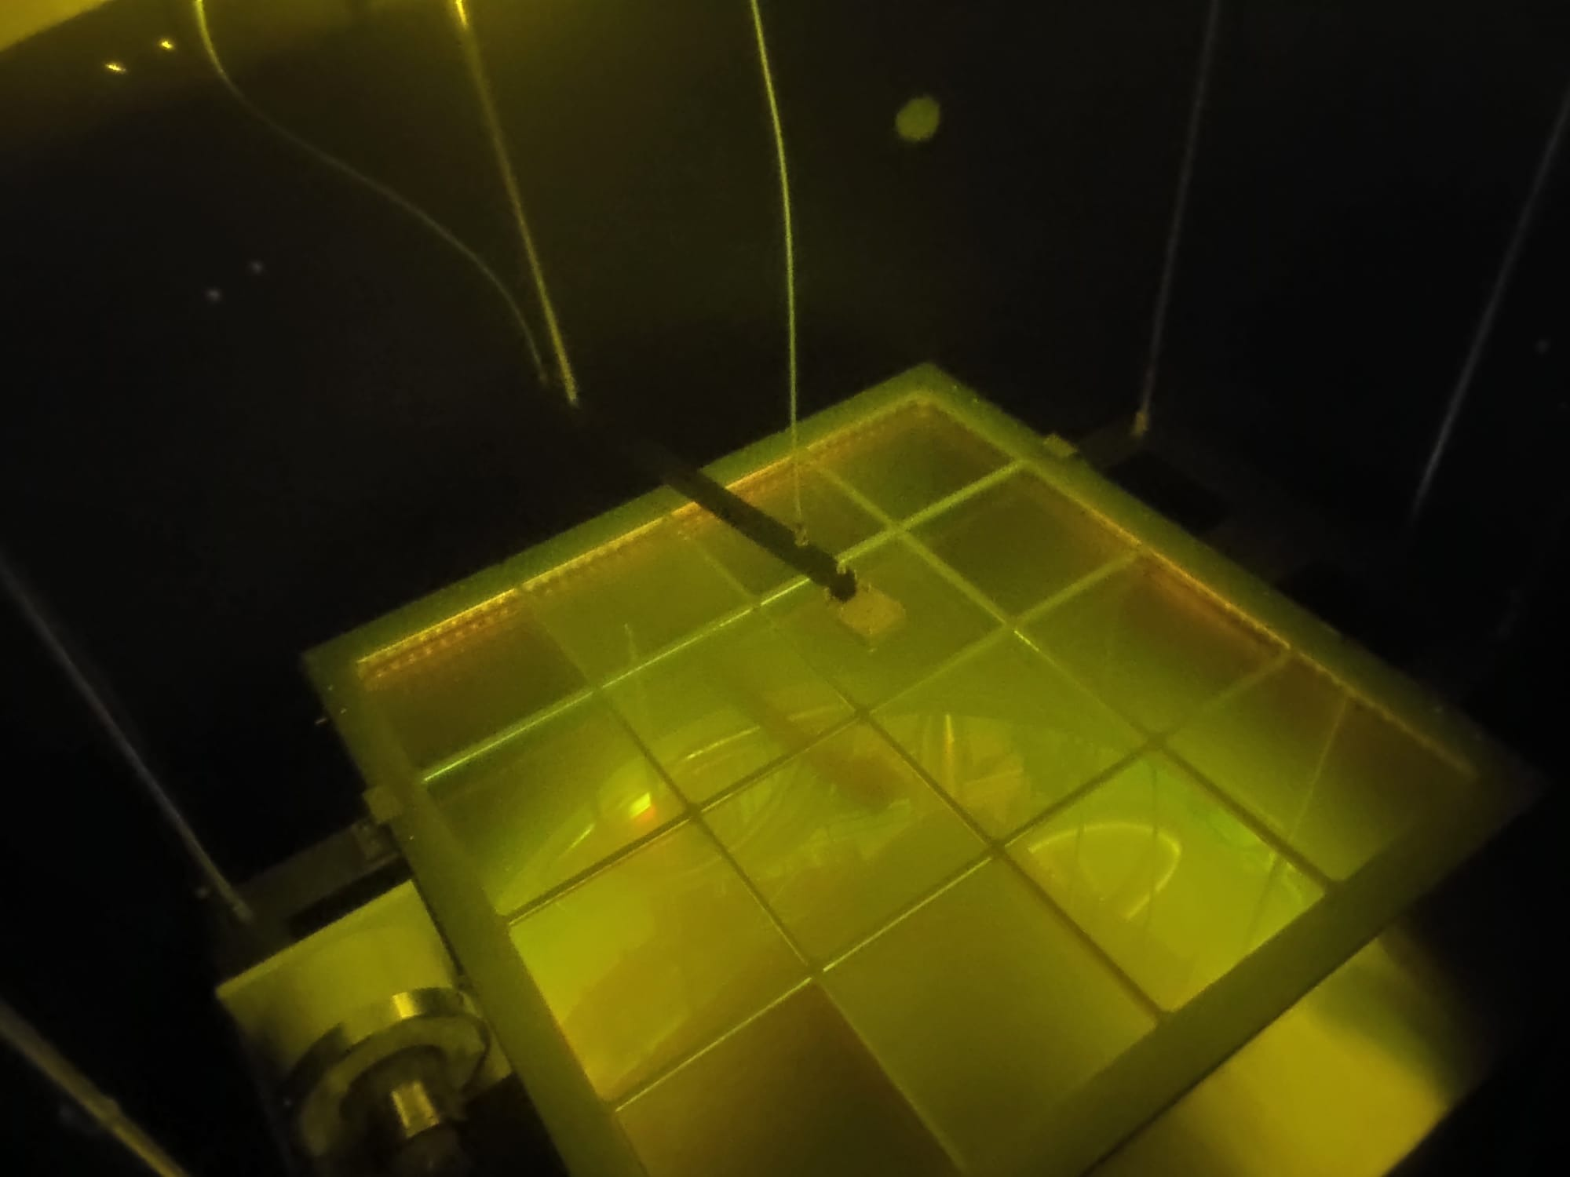
XA-VD measurement setup
Megacell on mechanical structure connected to dome
²⁴¹Am source in Peek frame holder and connected to roto-translator
Inside the cryostat has been inserted a black shielding made by Delrin along the cryostat mantle and on the top cover
²⁴¹Am source

Slide 4
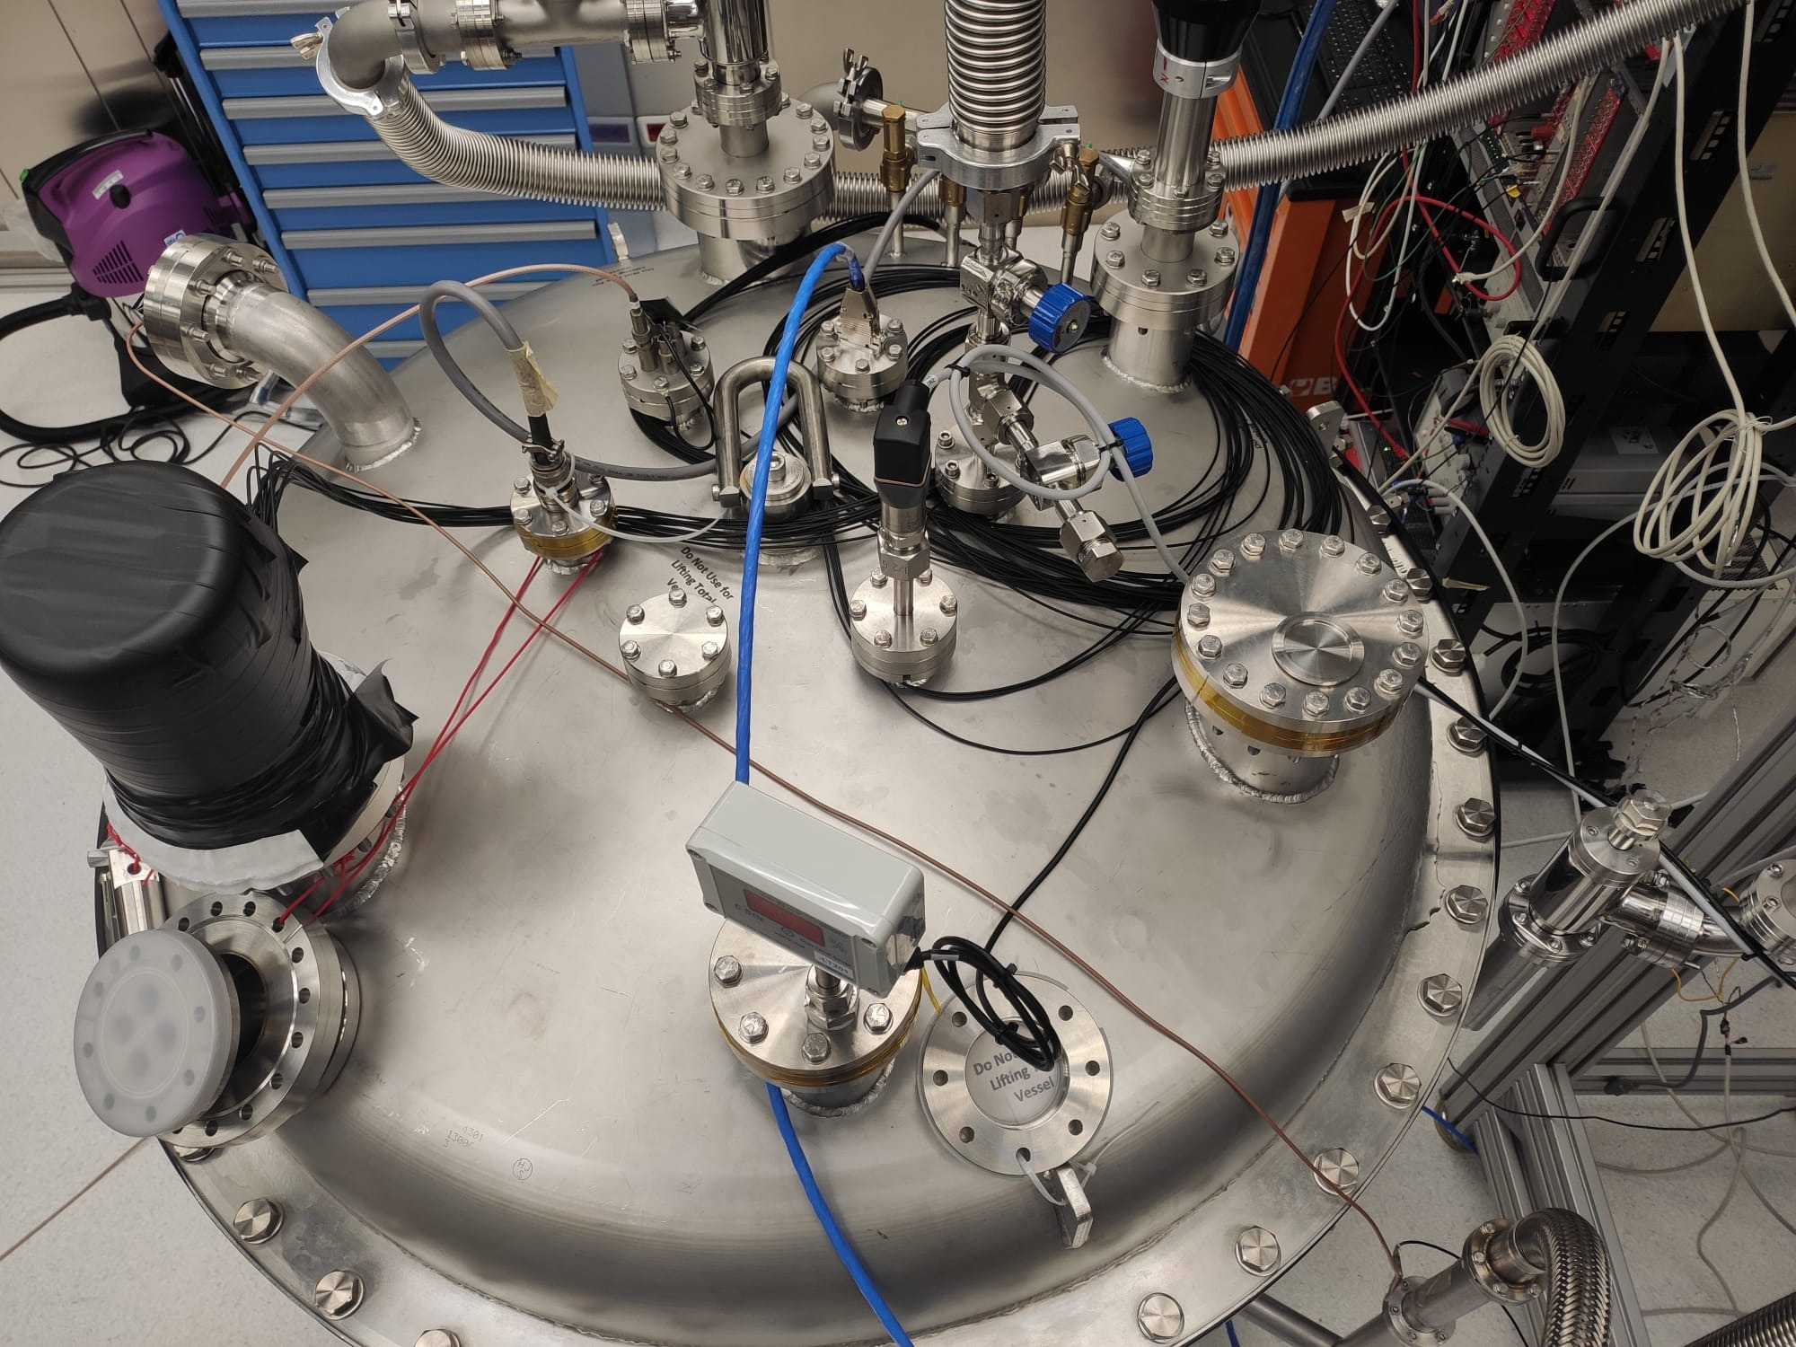
XA-VD measurement setup
Source manipulator
Vacuum pump connection
PMT signal
PMT HV
LAr vent line
Optical feedthrough
Megacell DB15 electrical connection
LAr filling line
LAr level meter

Slide 5
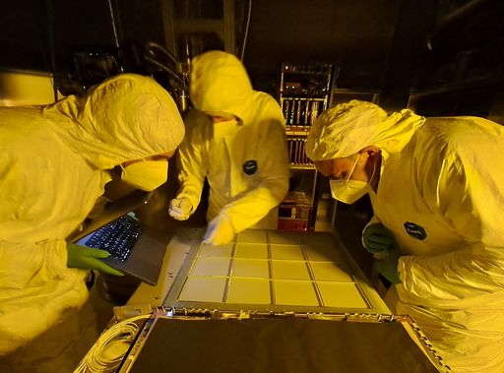
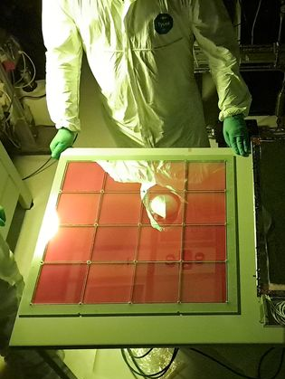
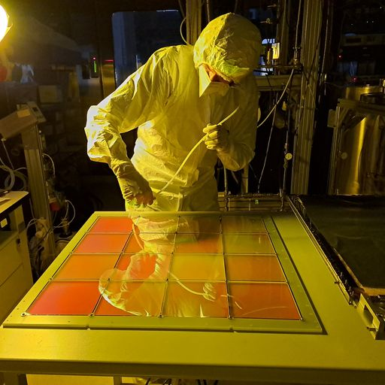
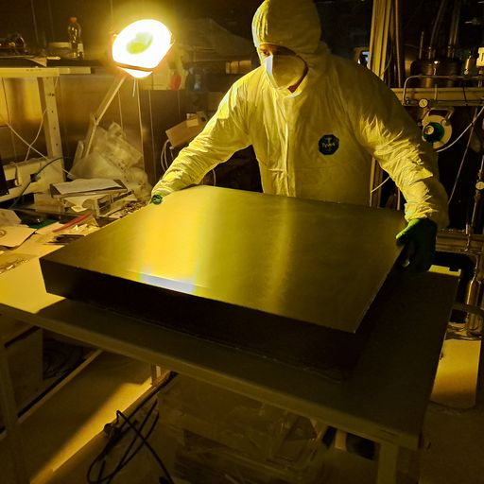
Dichroic filters mounting
ZAOT filters evaporated in Campinas
Mounted in Napoli clean room
Light UV shielded during operations

Slide 6
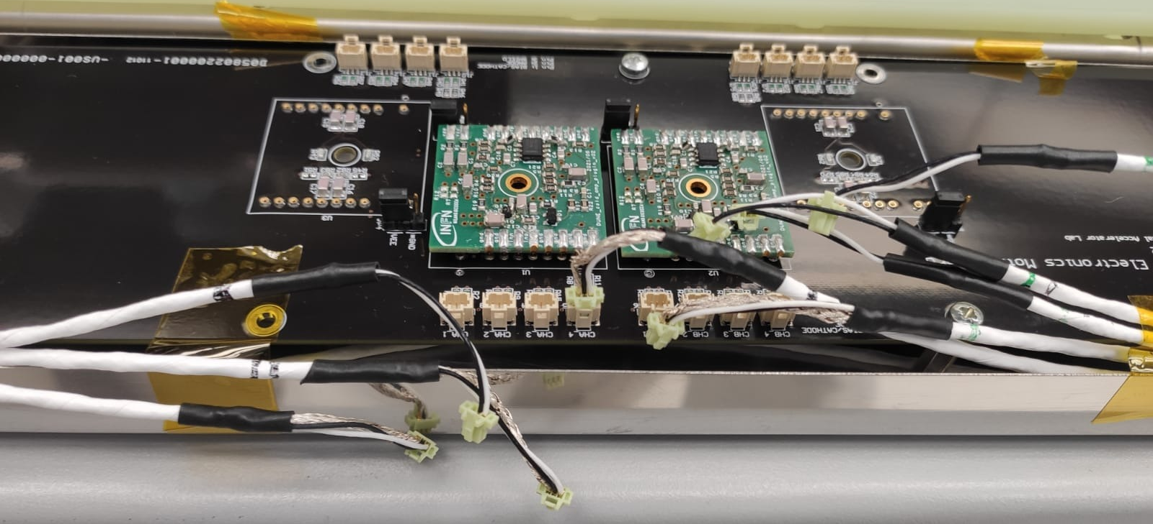
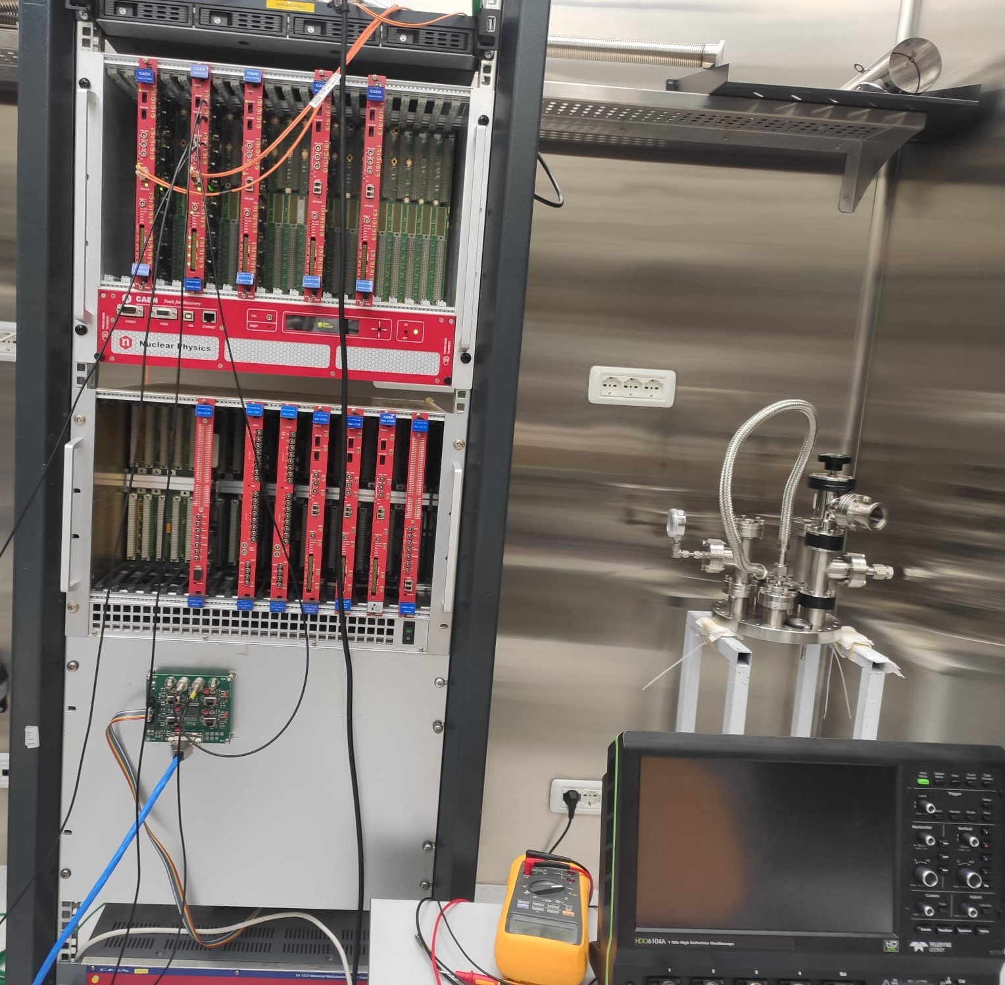
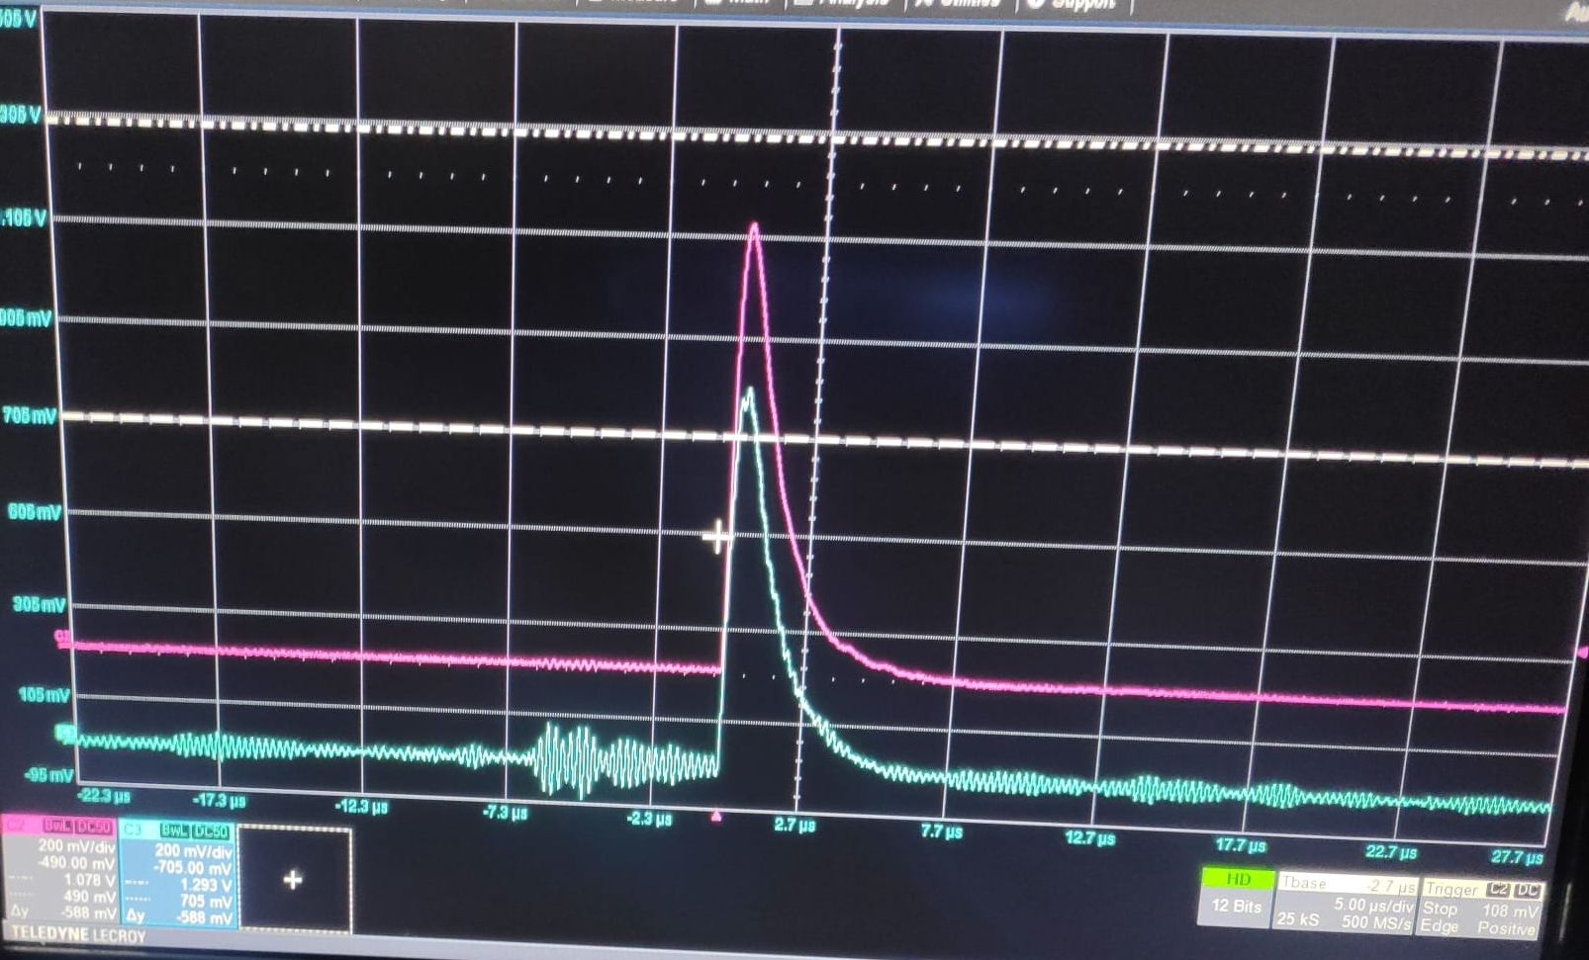
Electrical connection and DAQ
DMEM with two cold amplifier: preliminary tested in LN₂ : both channels working
just before to close the cryostat one of two signal is not present: we changed position of one cold amplifier
After LAr filling discovered that one channel is very noisy
Output signals from second stage amplifier sent to CAEN V1725B digitizer
Cold amplifier
Warm second stage amplifier

Slide 7
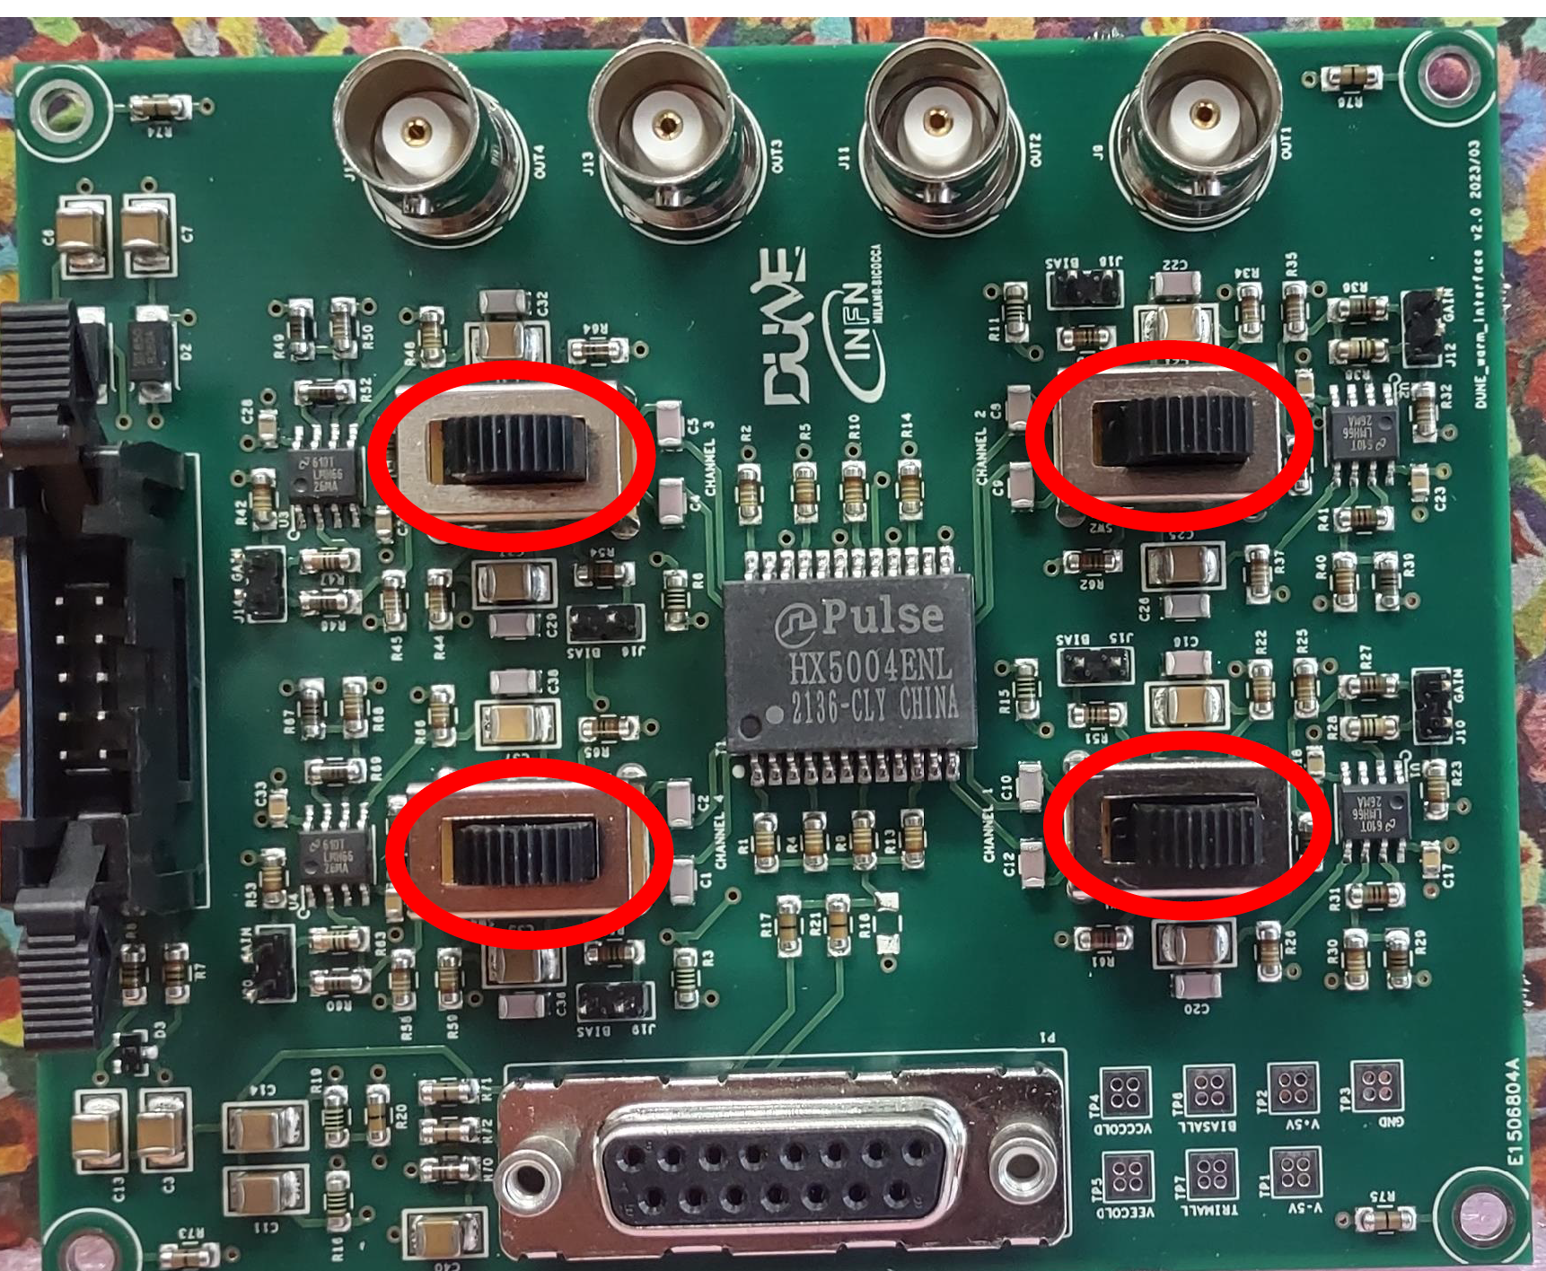
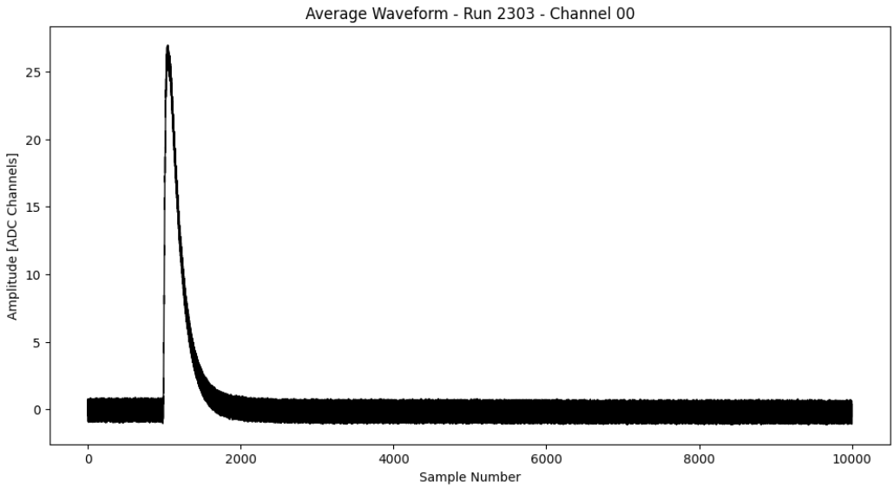
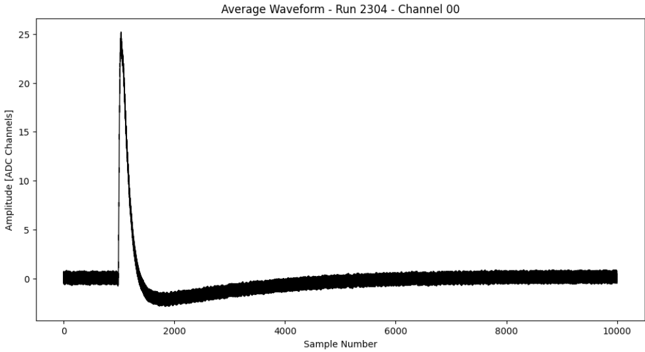
Warm amplifier
Switches to choose differential to single-ended conversion circuit
Switch towards the center of the board = With transformer
Switch towards the edge of the board = No transformer
Low/High gain mode through lateral jumpers
Our prefered conditions was low gain without transformer
without transformer
with transformer

Slide 8
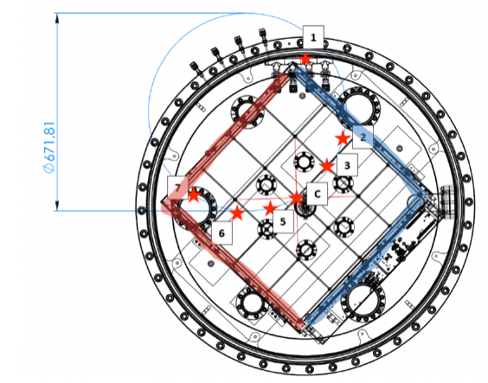
Measurement positions
Ch1: square dimples
Ch2: cylindrical dimples
PMT for purity monitoring
PMT
Ch. 1
Ch. 2
Electronic box

Slide 9
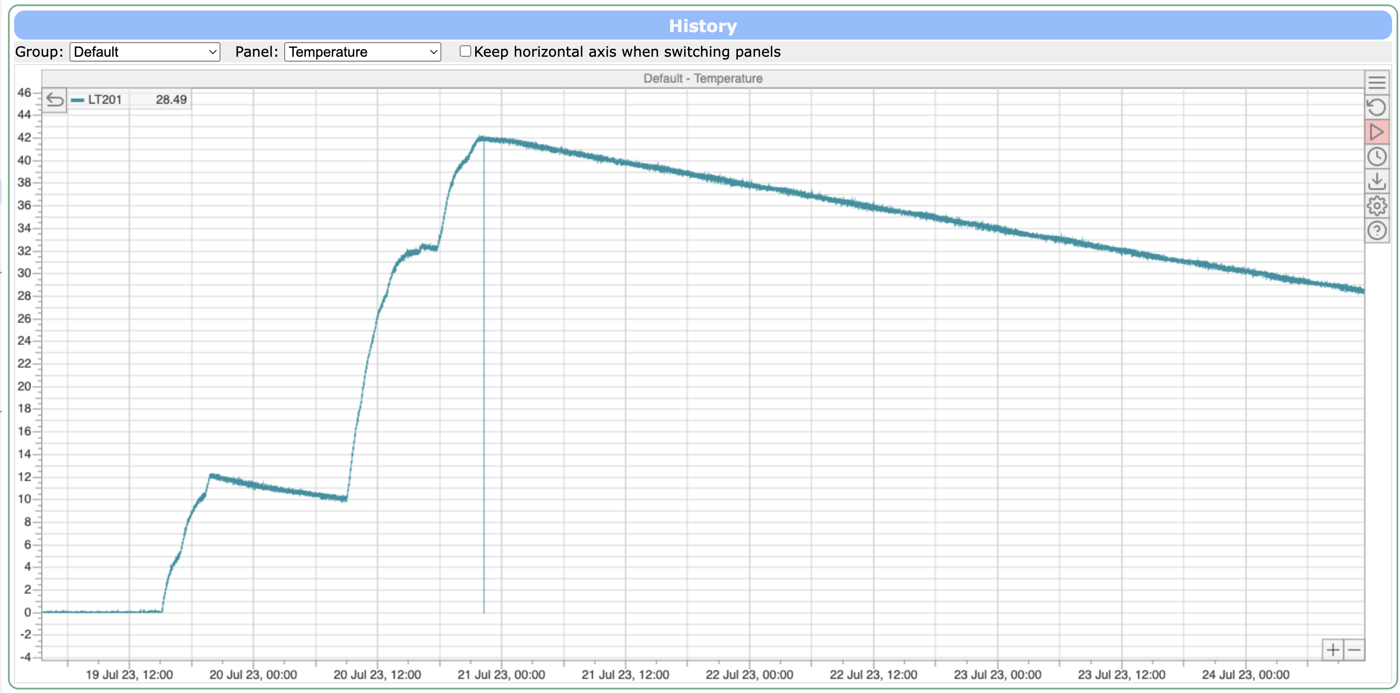
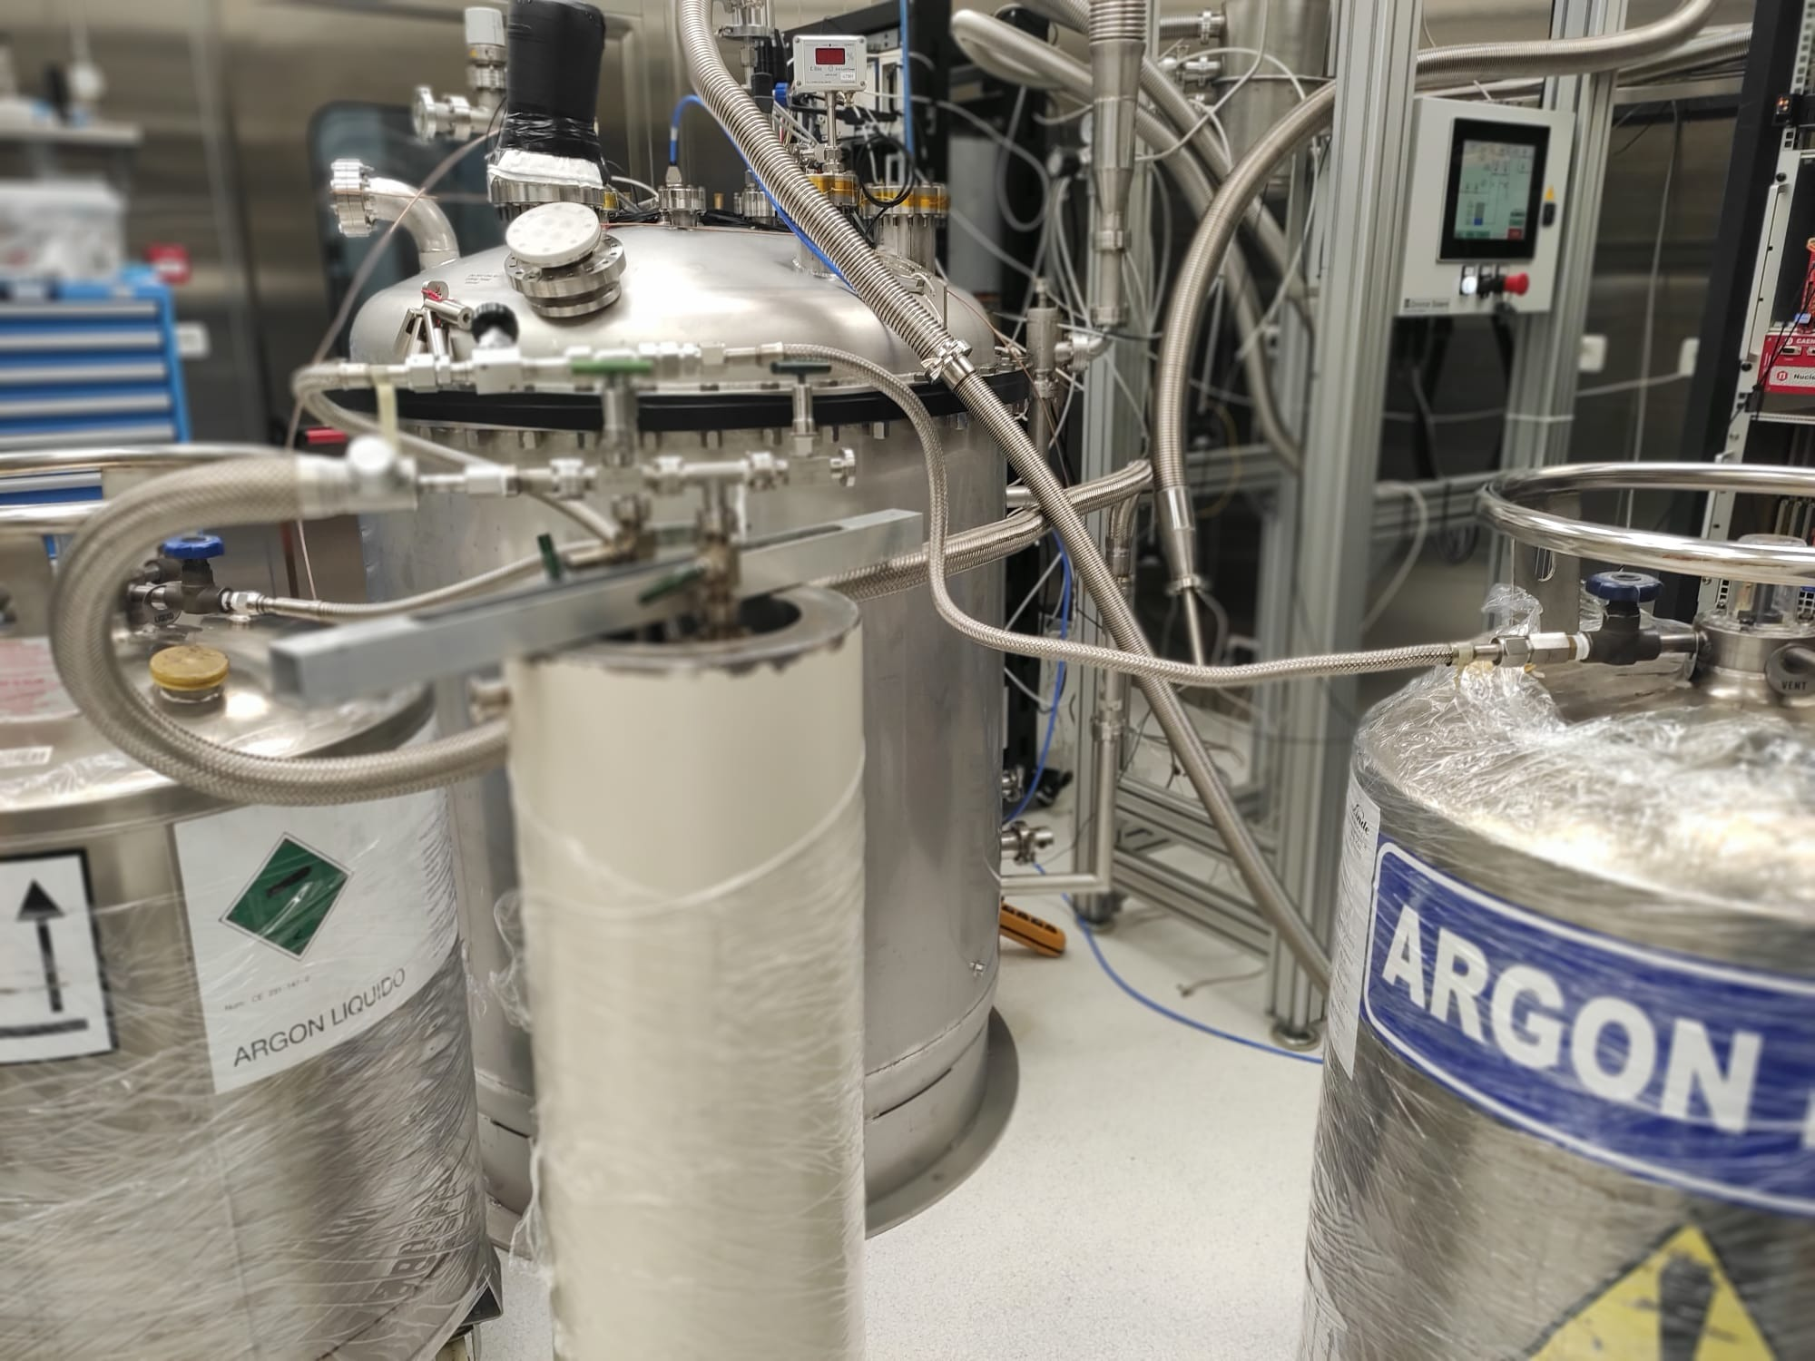
Vacuum operations and LAr filling
Pump and purge cycles before filling
Due to large amount of materials vacuum level not better than 10⁻⁴ mbar
The cryostat has been filled with LAr5.0 filtered by an in-line Trigon (Engelhard Q5-Cu0226)
During all measurement operations cryostat is in overpressure (1.2 atm) with respect to external pressure
Capacimeter level: the maximum correspond to 25 cm of LAr above Megacell
Evaporation rate 4 cm/24h
Trigon filter

Slide 10
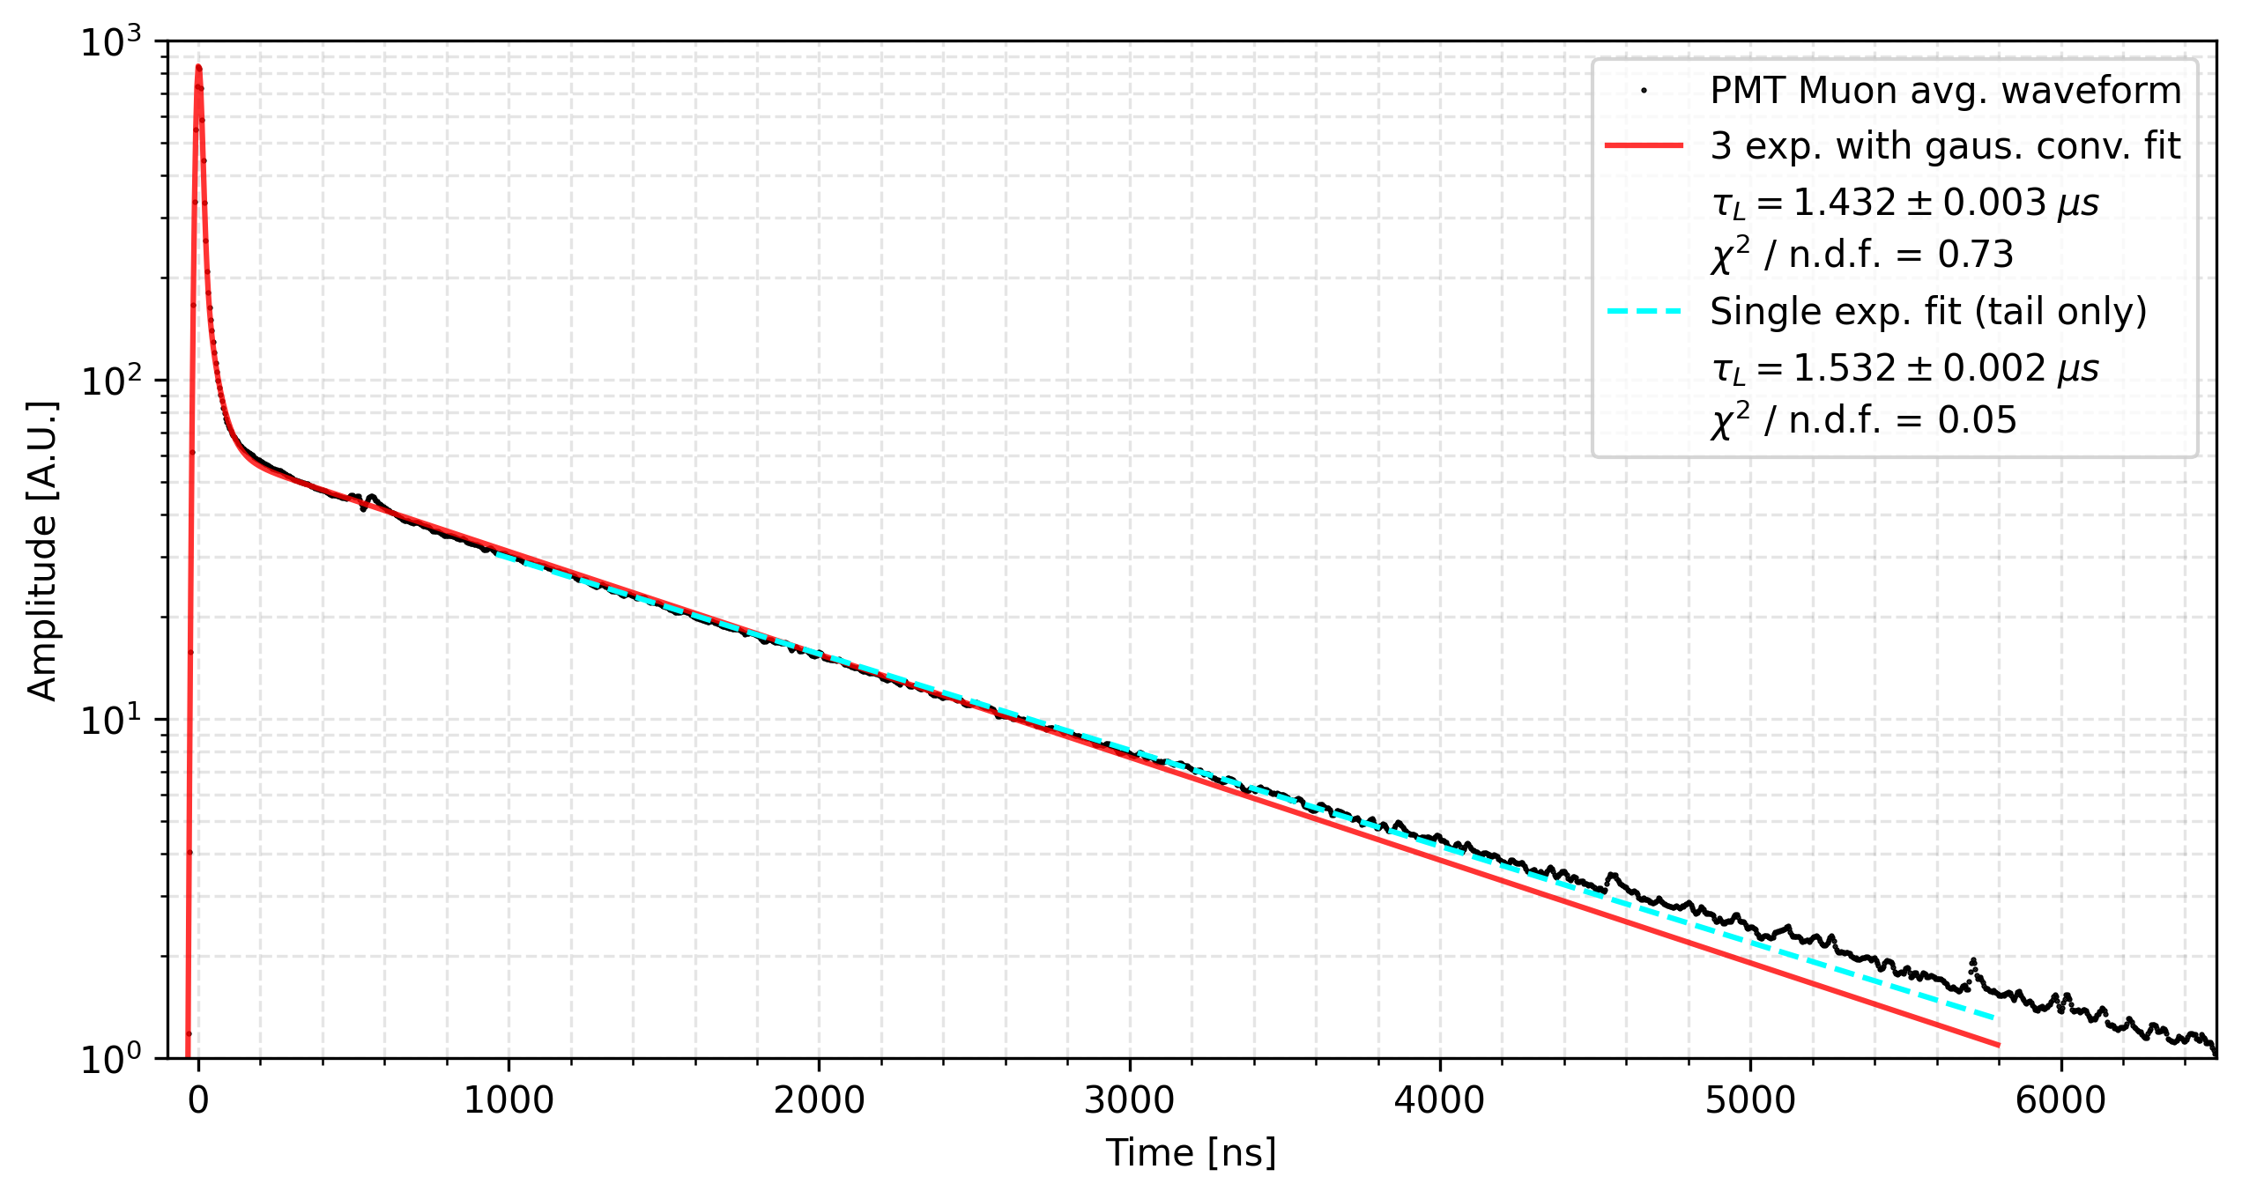
LAr purity estimated with PMT
Two fitting procedures_
3 exp. + gaussian
Single exp (tail only)
Result of long tau component between 1.4-1.5 us
Fit executed on muon sample

Slide 11
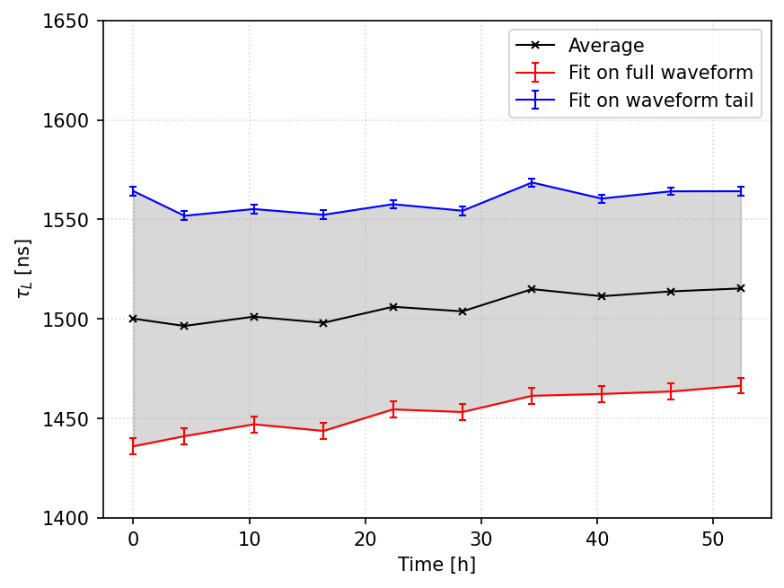
Monitoring of stability of LAr purity
Purity is found stable in all the measurement period
No purity correction to the measurement are required

Slide 12
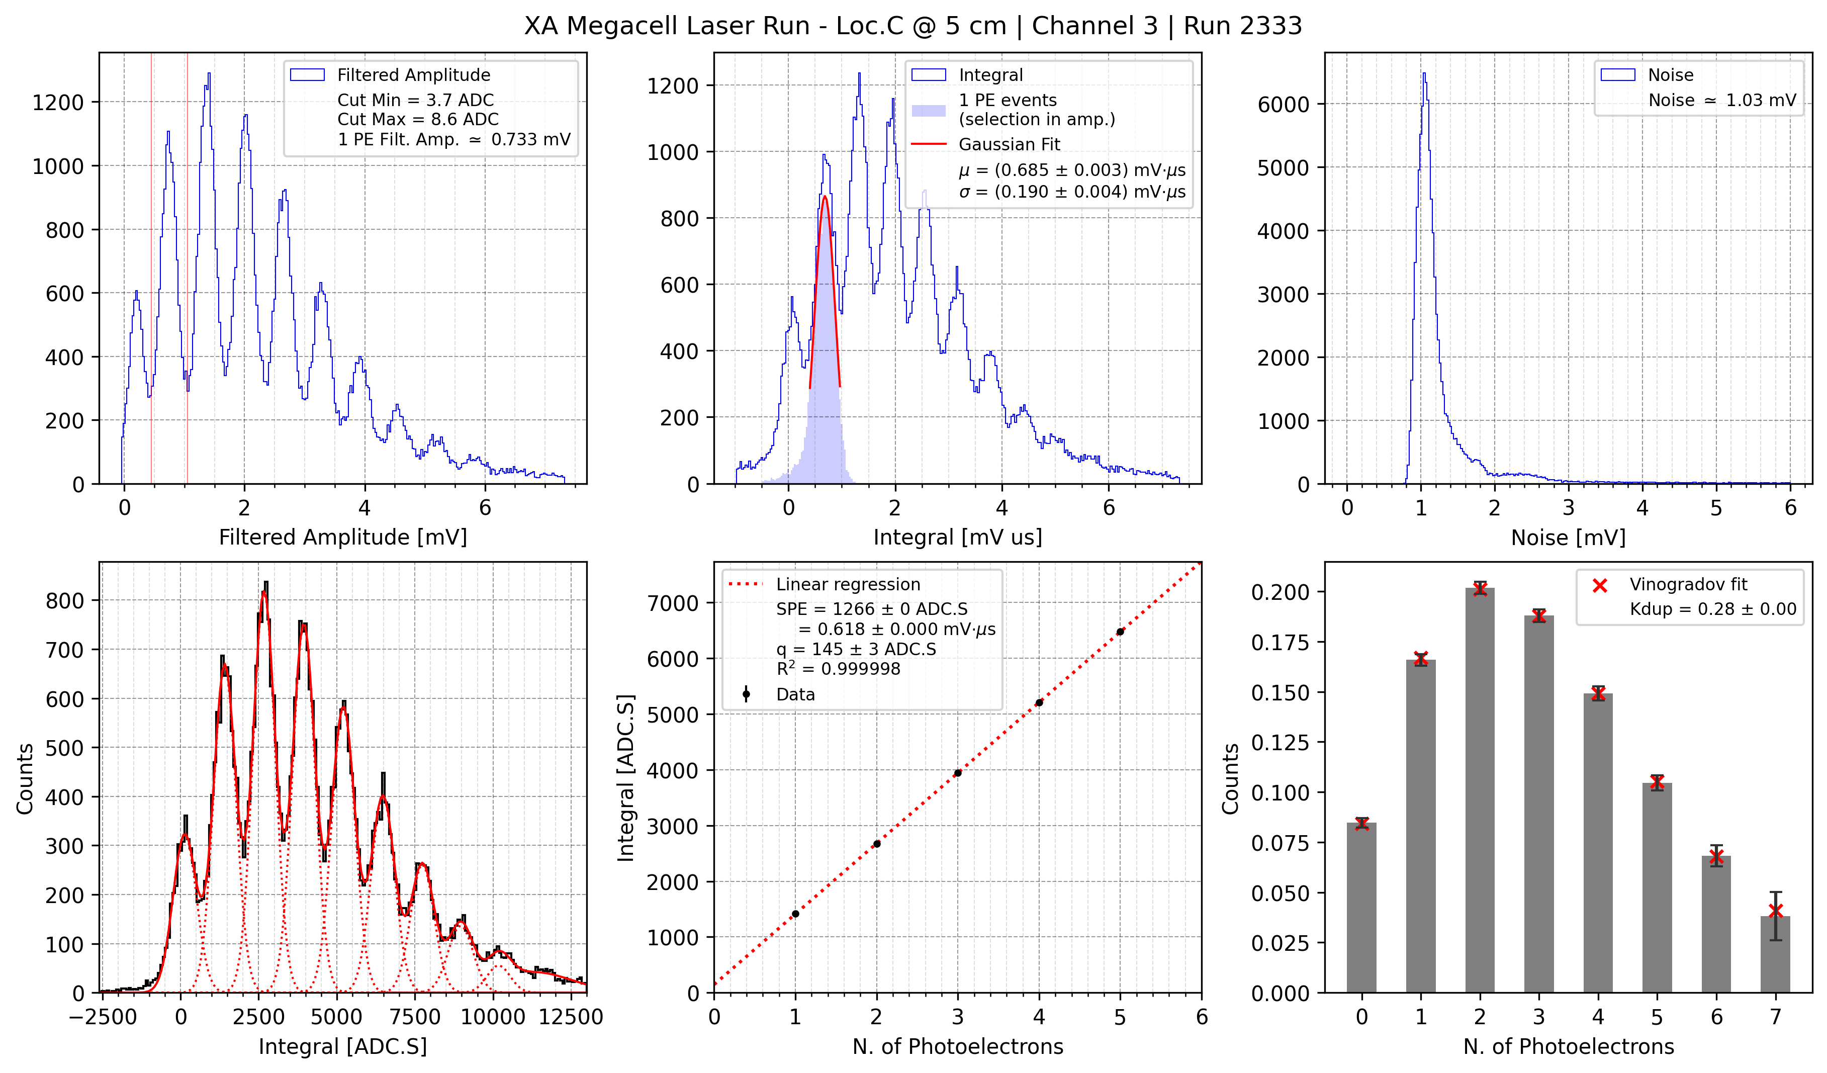
SPE response at OV=4.5V
Channels: 1,2
Filter moving average
Channel 1 very noisy → impossible to retrieve SPE
Channel 2 is ok
Charge spectrum integration 1.2 us
Vinogradov fit to photon statistics
duplication factor 0.28
f_{CTAP}=1.28

Slide 13
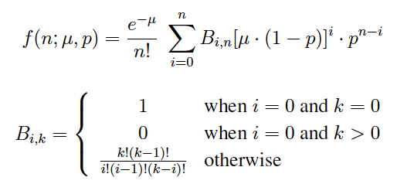
Secondary pulses estimated with Vinogradov model
Composite Poissonian to describes the joint effect of cross-talk and afterpulses
Two parameters μ e p
p: probability to generate a secondary correlated avalanche
μ: poissonian mean
K_{dup} = p / (1-p) duplication factor
K_{dup} = 0.28
p=22%
From independent FBK single SiPM characterization data we have:
p=16% (PDE=45%)

Slide 14
Alpha signal waveforms
Channel 1 noisy
Trigger on Channel 2

Slide 15
4.8 us baseline
6.4 us integration windows

Slide 16
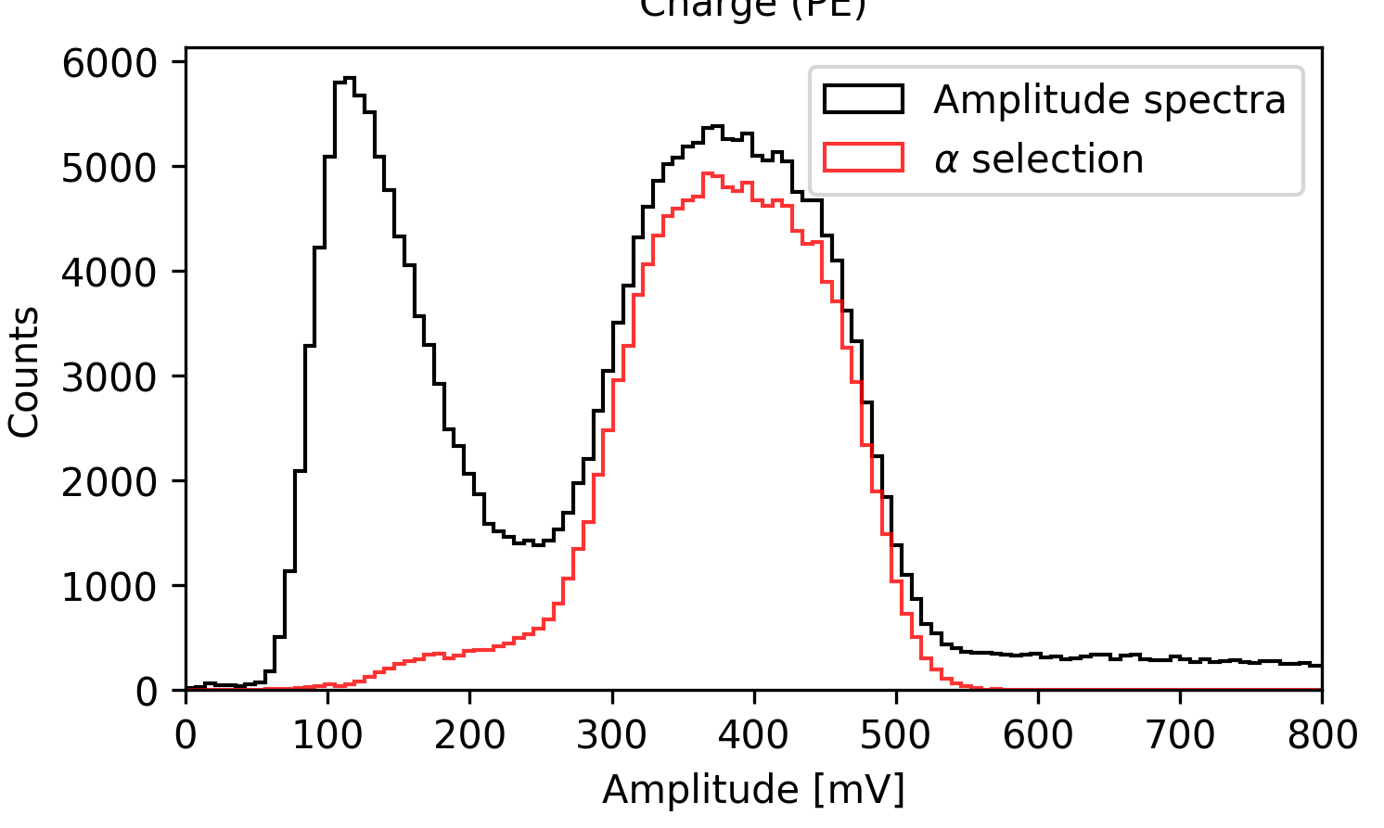
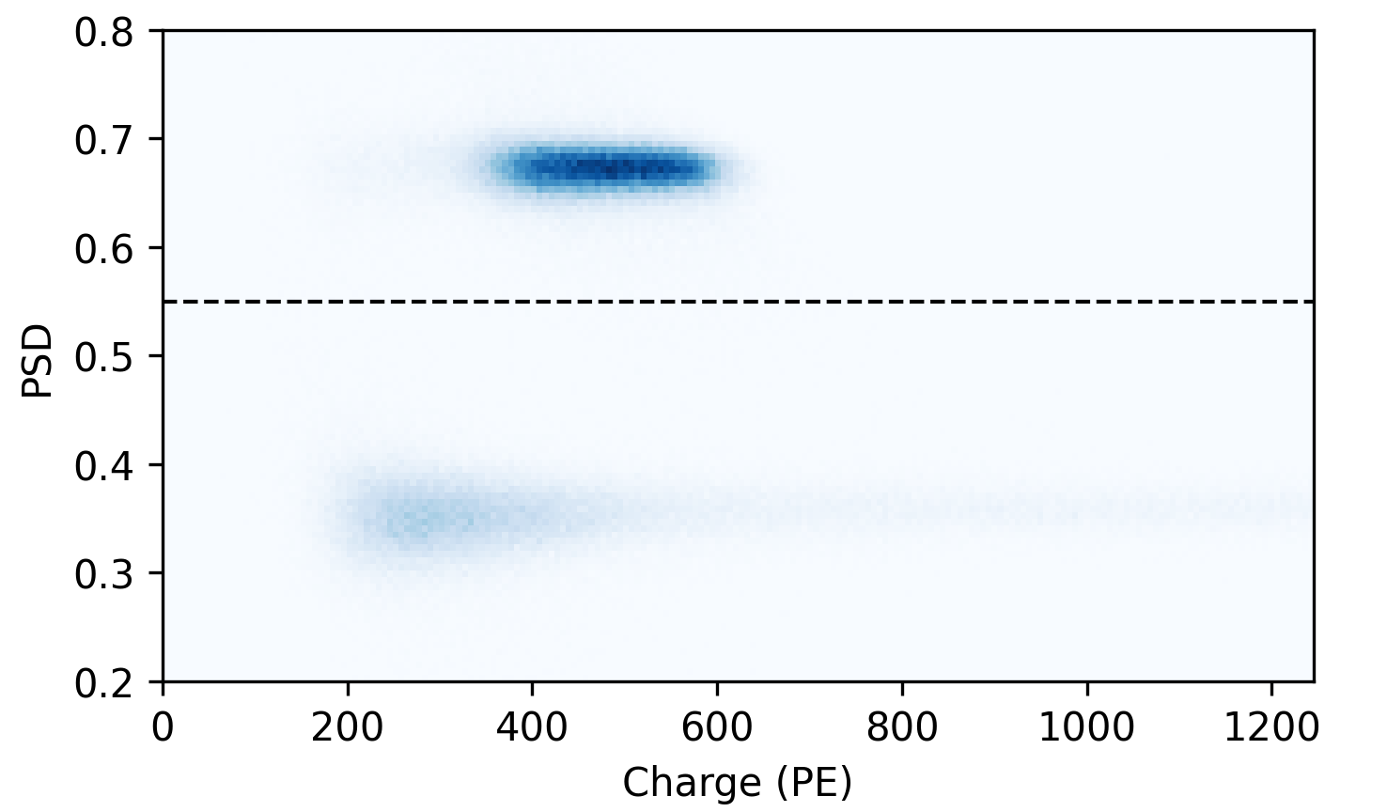
Alpha source events
alpha selection
muons
Non-gaussian shape of the amplitude spectrum
Most likely this the effect of self-shielding of the source holder

Slide 17
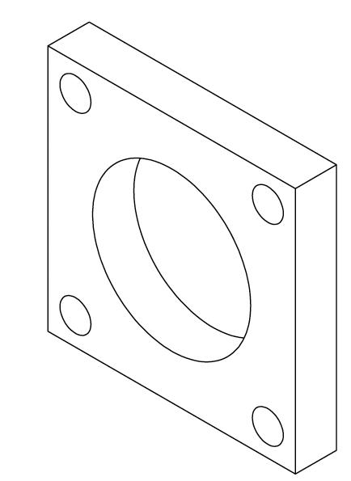
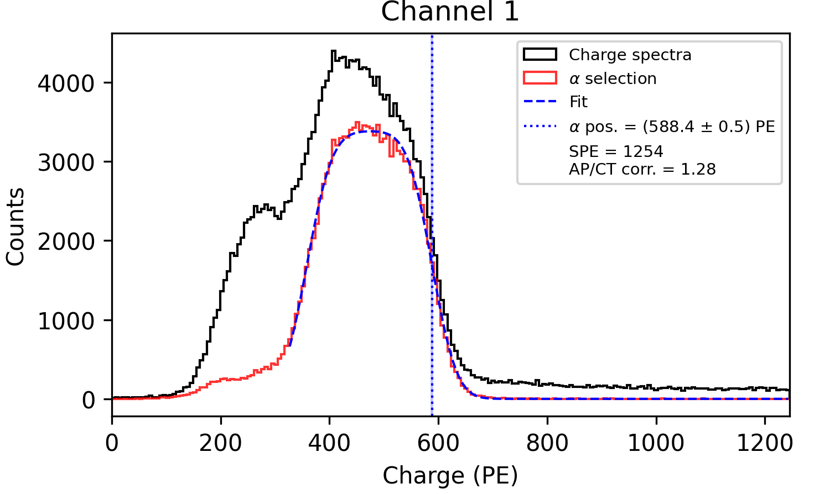
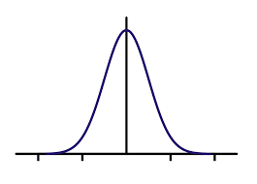
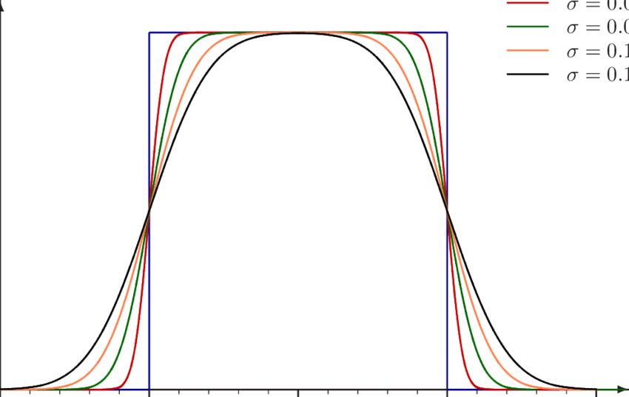
Source holder geometry
Source holder window is 23 mm diameter
Thickness of the holder edges is 6 mm: this induce a shielding of alpha particles
Due to the holder shielding the alpha spectrum becomes flat
Charge spectrum fitted with the convolution of a box function and a gaussian
Alpha yield: 50% of right tail
Alpha Spectrum has been corrected for secondary pulses (AP/CT)
6 mm
$$⨂$$
$$=$$

Slide 18
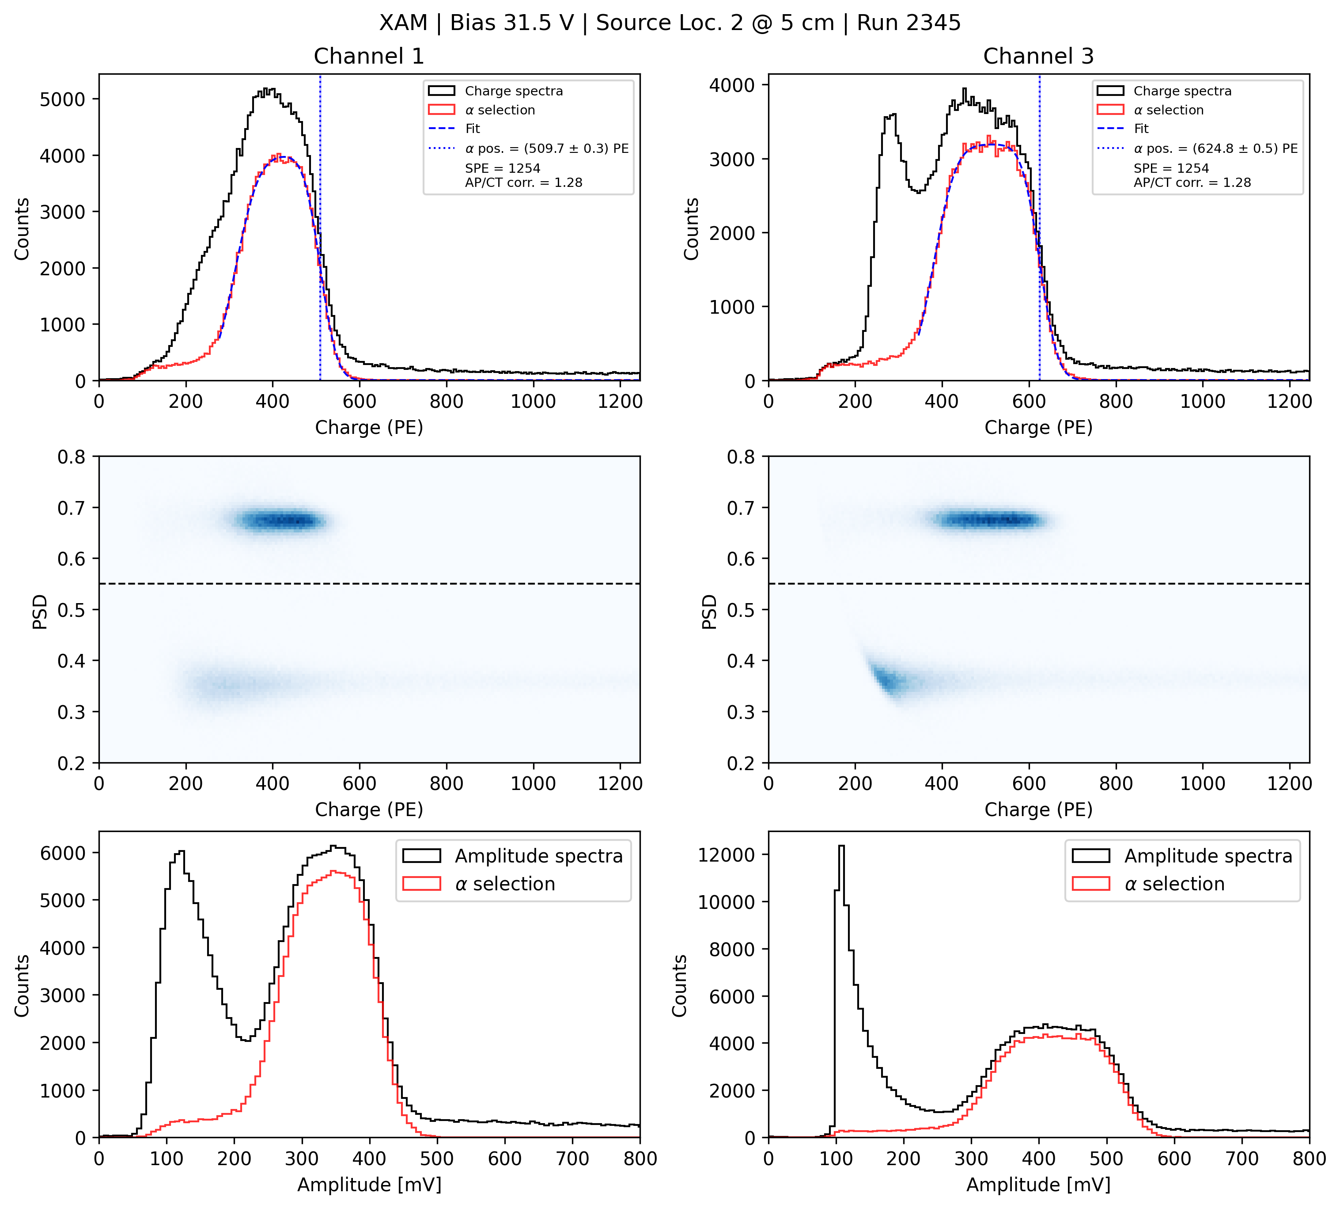
Alpha spectrum: OV=4.5 V
ch1
ch2
Trigger on ch2 due to lower noise
Charge spectrum: integration
Alpha events selected via prompt light (PSD)
Alpha distribution appears non-gaussian due to source holder shielding
Alpha yield = fitted tail with the convolution of constant + gaussian distributions=50% of the maximum on the right tail
Measurement in six different locations for the source
Error (systematic) estimated by varying cuts

Slide 19
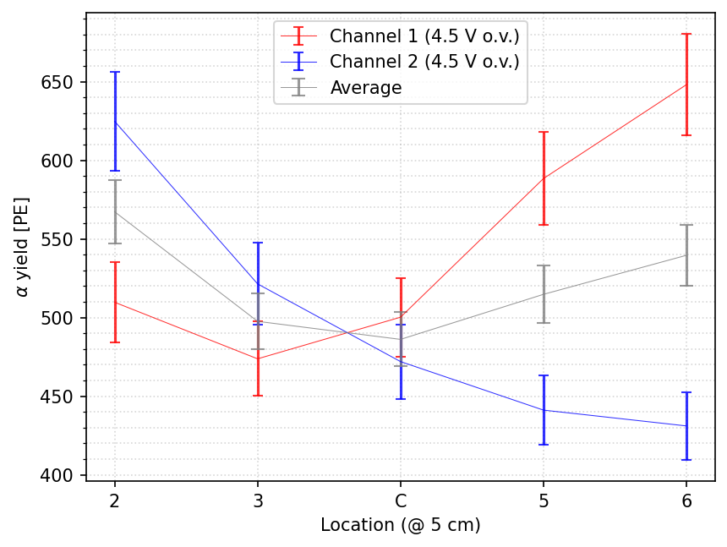
Alpha spectrum: PEs vs position@ OV=4.5V

Slide 20
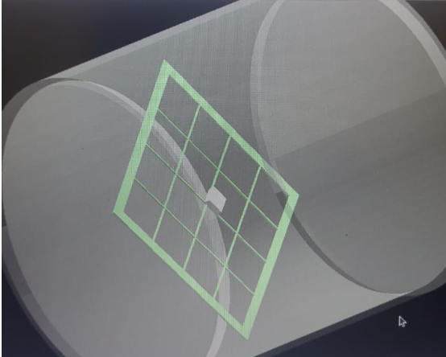
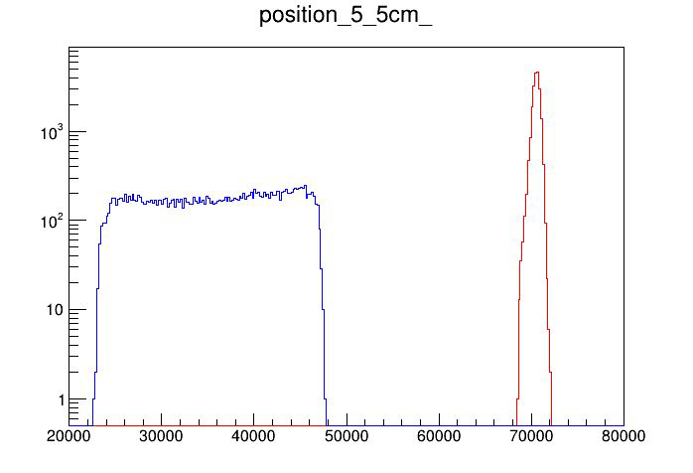
Simulation (A. Machado, G. Valdiviesso)
$$PDE=\frac{NPE}{NPhSIM}$$
Position | Average number of photons@ 5 cm
P2 | Under evaluation
P3 | Under evaluation
C | Under evaluation
P5 | $\sim$47000
P6 | Under evaluation
PRELIMINARY
number of photons in P5
Implementation of source holder
Other defects solved (see Gustavo presentation)
Initial LY = 36000ph/MeV

Slide 21
Preliminary results for PDE@OV=4.5V
Secondary pulse correcttion factor 1.28
PDE found to be in P5 about 2.2 %
 | PDE(%) @ OV=4.5V
Position | 5 cm
P2
P3
C
P5 | 2$.16±0.20$
P6

Slide 22
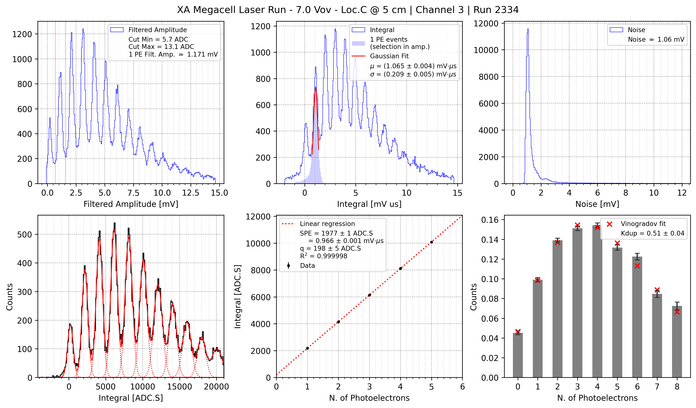
SPE response at OV=7.0V
SPE fitted at OV=7.0V
Vinogradov fit to photon statistics
duplication factor 0.51
f_{CTAP}=1.51

Slide 23
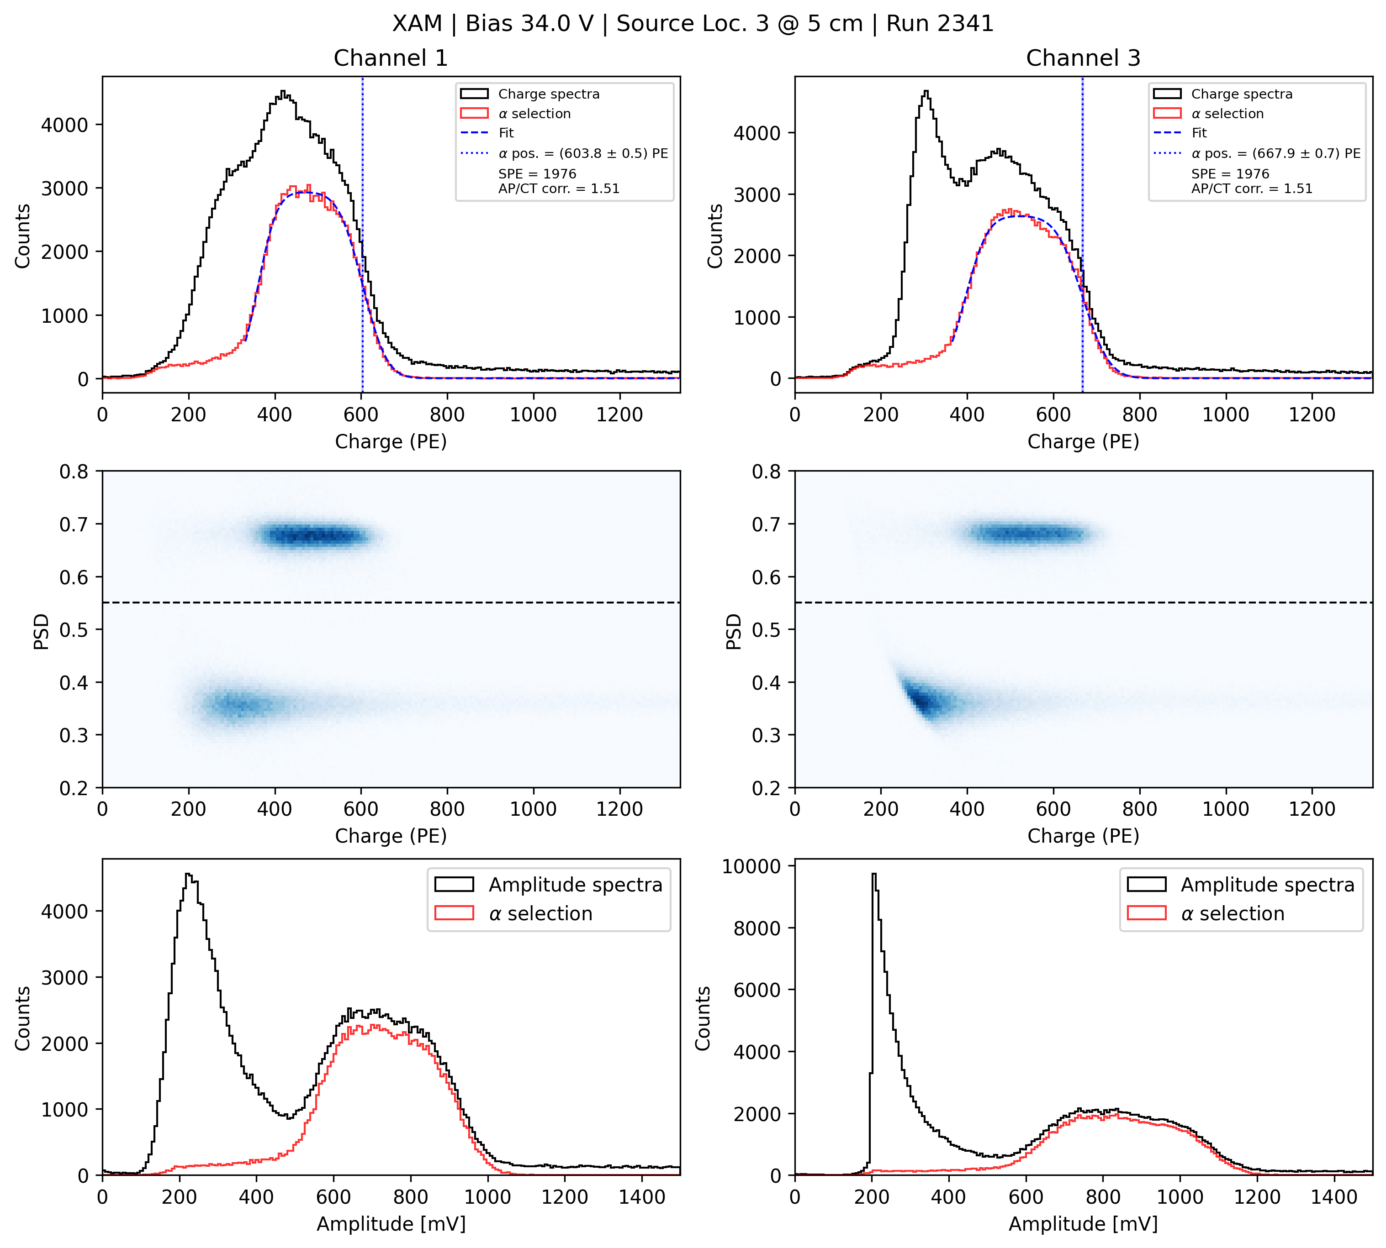
Alpha spectrum: OV=7.0 V
ch1
ch2
Alpha source analysis at OV=7.0V
Spectrum includes corrections for secondary pulses (AP/CT)

Slide 24
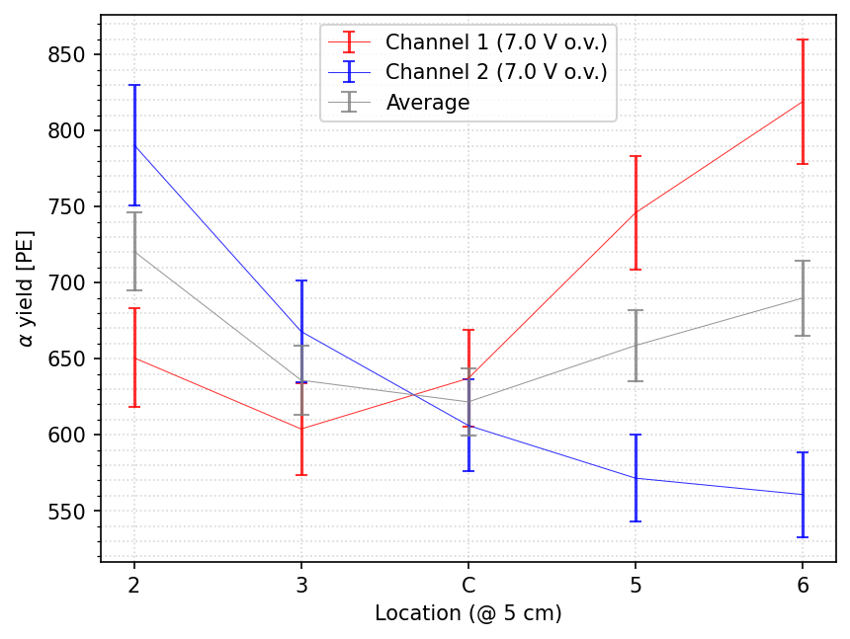
Alpha spectrum: PEs vs position@ OV=7.0V

Slide 25
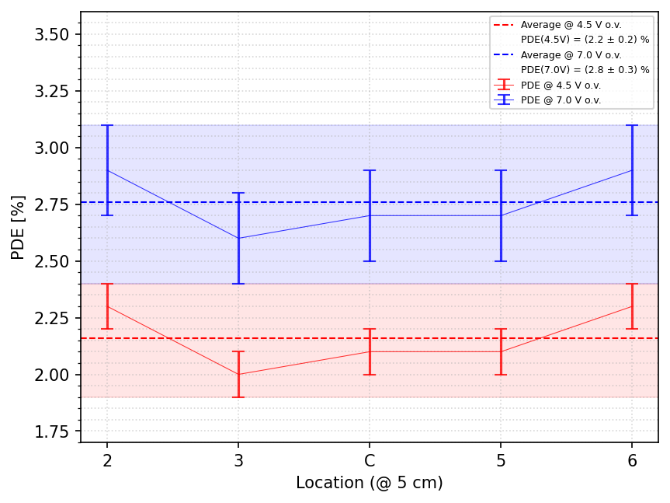
PDE summary
VERY PRELIMINARY
For the other positions used same scaling factor observed in simulation of P5 position before and after ne MC implementations

Slide 26
PDE Errors
Error evaluation is very preliminary:
SPE response: 5-10%
Source PE fitting procedure: <5%
Simulation: error in initial LY not included
Systematics in source positioning to be evaluated (with simulation)
Others…..

Slide 27
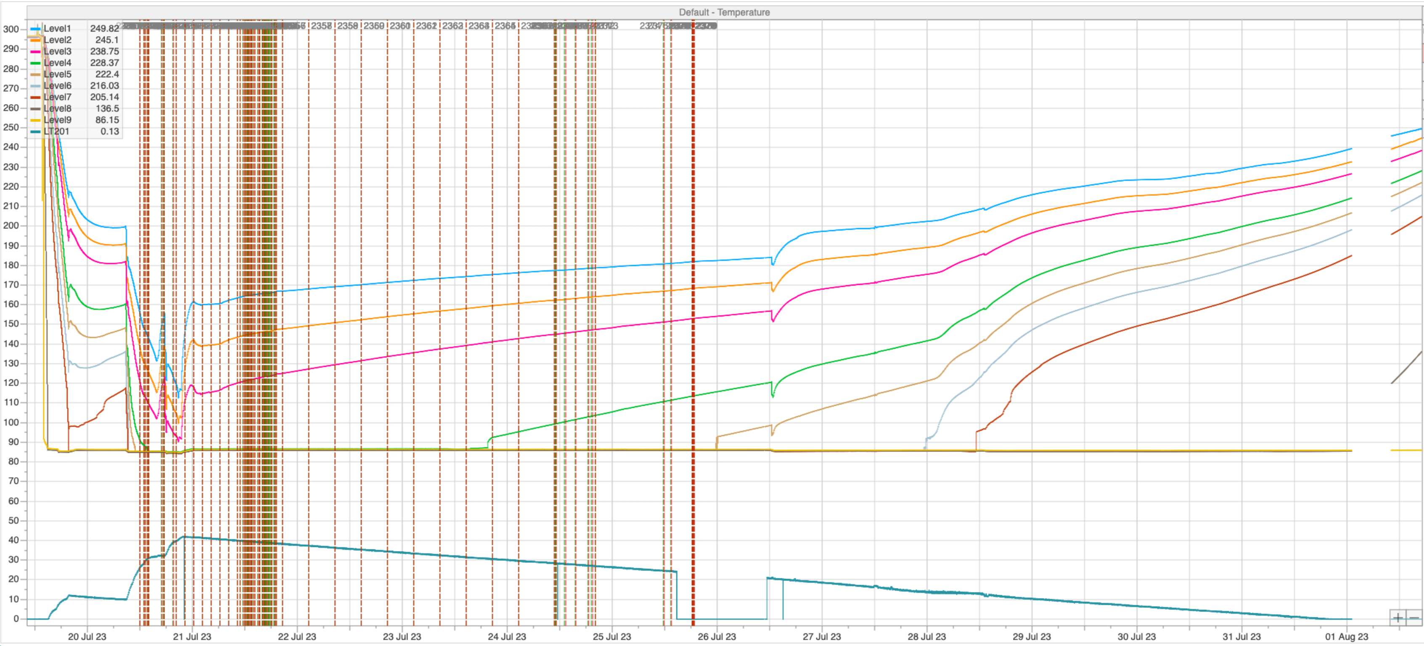
Megacell warming
At the moment the Megacell is still in the cryostat
LAr evaporated and the level is now below the X-Arapuca
Nitrogen gas flushing during warmup phase
Environment full saturated with Argon and Nitrogen gas

Slide 28
Conclusions
A preliminary evaluation of the PDE of XA-VD system equipped with ZAOT filters and FBK SiPM has been performed
Self shielding of the source holder introduced some issue in the analysis
One channel found to be very noisy: SPE evaluated only on the good channel
Attempt to re-schedule a new measurement in October, changing the holder and collimating the source, check if there is no filter degradation

