Slide 1
Influence of Solenoid Field Quality on Electron Cooling

Slide 2
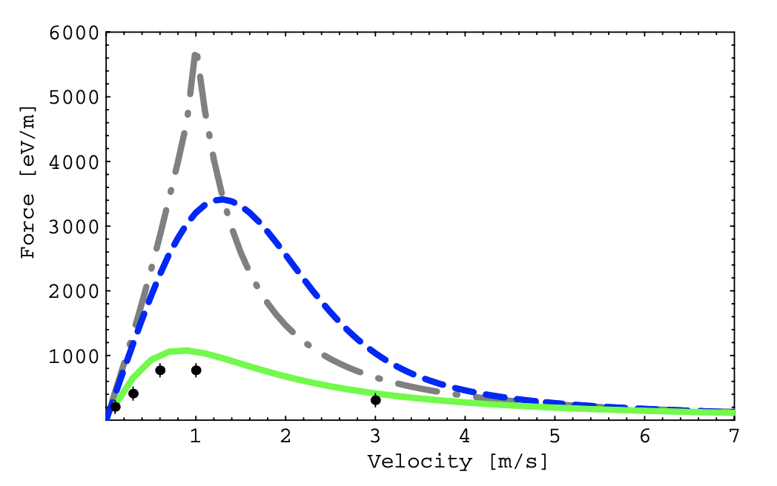
Motivation
Meshkov Asymptotic
Derbenev and Skrinsky
Magnetized electron trajectories follow magnetic field lines. -> Perturbations in velocity
Perturbations in velocity -> Reduction in electron cooling force
In Parkhomchuk model, the force depends on effective drift velocity.
Parkhomchuk
N particle simulations
A. V. Fedotov et. al., Numerical study of the magnetized cooling force, Phys. Rev. ST Accel. Beams 9, 074401, 2006.
Longitudinal drift: Voltage jitter, space-charge voltage depression.
Transverse drift: E X B drift, electron velocity perturbations due to magnet errors.
Larmor radius: Magnetic field, electron transverse temperature
Min/Max Impact parameters: Ion velocity, plasma frequency

Slide 3
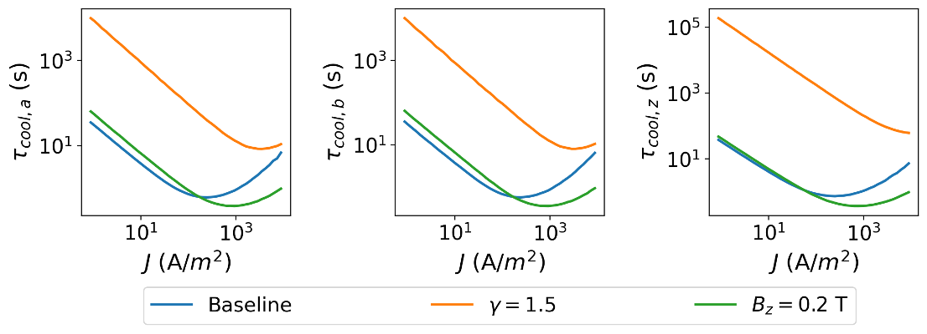
Cooling Times: As designed
The minimum moves up and to the right at higher energies.
Used the Parkhomchuk model to calculate cooling times.
Requirement: Counter IBS heating times of the order of seconds at $\left|Δν_{y}\right|=0.5$
Baseline
2.5 MeV p⁺, B_{z} = 0.1 T
Increasing the magnetic field boosts the maximum cooling rate marginally.
We’re almost at the limit of cooling rate achievable.
Radius (mm) | Current (mA) | Current Density (A/m²) | Cooling times (s)
18 | 80 | 78.6 | 0.79, 0.74, 0.94
14 | 1.7 | 2.76 | 12, 12, 13*
Estimates treat cooling as a single thin-lens kick and ignore tracking through the solenoid.
* Values published in IPAC’23 are incorrect.

Slide 4
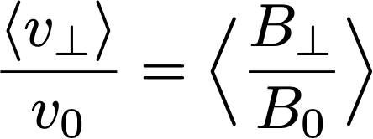
Field Errors: Simple Estimate
Assuming that the electrons follow the magnetic field lines. Ignoring the space-charge field from the electrons, the extra transverse velocity:
The temperature contribution is:
The above estimate assumes (1) No space-charge (2) We can make a practical solenoid with the above field quality.
1.1 eV @ 2 x 10⁻²

Slide 5
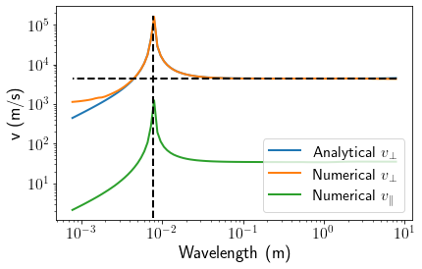
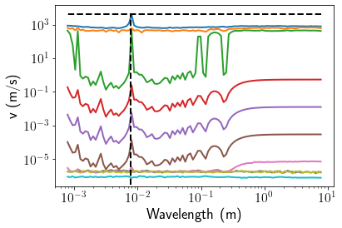
Recap of previous work
How does solenoid field quality translate to electron velocity perturbations in the presence of static space-charge?
For realistic perturbations, the additional electron velocity arises from change in direction of the magnetic field lines. How to model the effect on cooling?
Plane wave
Unrealistically small scales
Multipole
Inspired by D. L. Bruhwiler et al., in Proc. PAC'05, paper TPAT087, 2005.
Inspired by C. Montag and J. Kewisch, in Proc. PAC'03, paper WPAE030, 2003.

Slide 6
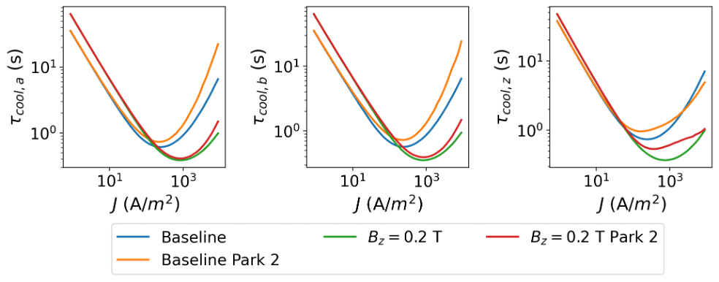
A 2nd look at the Parkhomchuk model
Central to the Parkhomchuk model is the effective velocity parameter.
Random: Voltage jitter
Function of position: Space-charge voltage depression, E X B drift, electron velocity perturbations due to magnet errors.
Use the voltage jitter as the sole source of effective velocity, treat position-dependent velocity changes as local frames of reference.
p⁺
p⁺
$$ρ_{max}≈70 μm$$
for strong cooler
Treat field errors as deterministic perturbations to the electron velocity field.
Predictions are within a factor of 2.

Slide 7
Tracking Algorithm
Solenoid Entry and Exit Kicks
Solenoid body map
Divide cooler into smaller segments.
Calculate local mean velocity of electrons at the position of the ions based on space-charge voltage depression, E X B drift, electron velocity perturbations due to magnet errors.
Calculate ion velocities w.r.t to this local rest frame.
Calculate cooling force using Parkhomchuk model and apply kick to ions.
Transport ions through a thick hard-edge ideal solenoid map in a drift-kick-drift fashion.
Transport through 1-turn 6D linear map and include an inverse map of the solenoid to cancel transverse coupling.
Other complexities: Matched distributions, eigenmode emittance calculations, fitting, fast field calculation (GPU), etc.
…
Thin-lens cooling kicks
$$M_{ring}$$
$$M_{sol}^{−1}$$

Slide 8
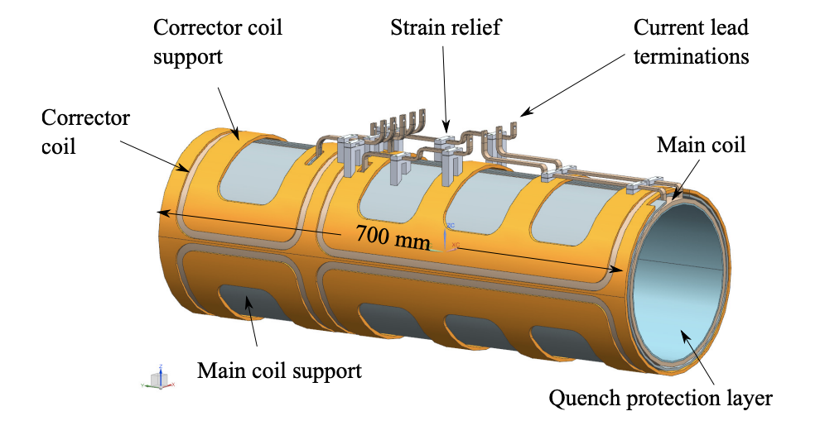
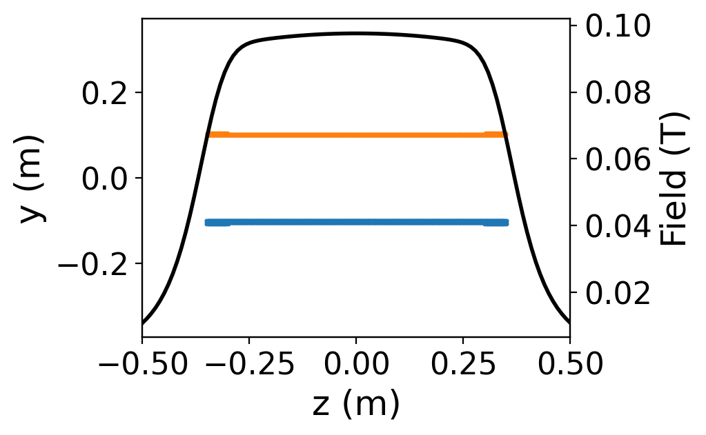
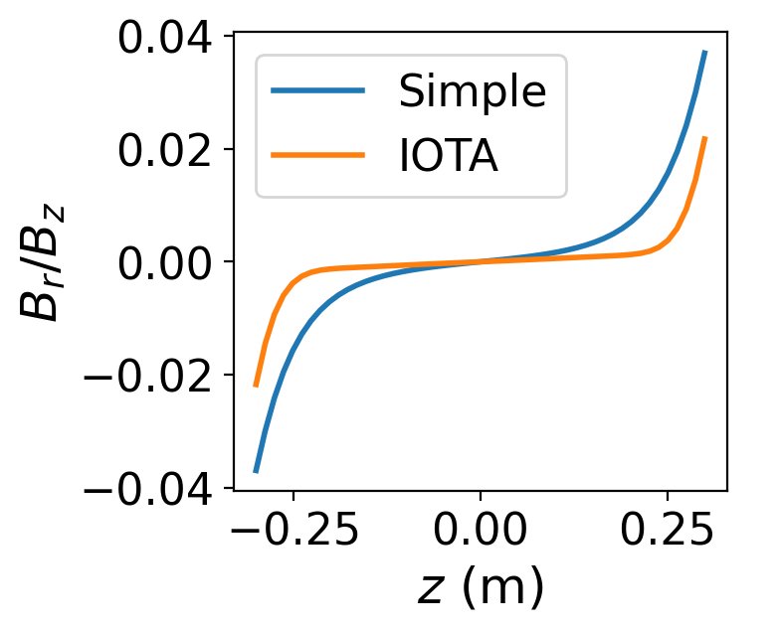
Actual Solenoid Design
Design Requirement: (1) Max $B_{z}=0.8$ T. (2) Good field region with $\frac{ B_{⊥}}{B_{z}}<2×{10}^{−4}$ of length 600 mm and radius 15 mm.
Possible modifications: (1) Increase length (2) Reduce ID (3) Ferromagnetic plugs
Trim coils (50 mm)
B_{r}/B_{z} = 0.02
z = 300mm
r = 15 mm
Main coil (600 mm)
R.C. Dhuley et al., JINST 16 T03009, 2021

Slide 9
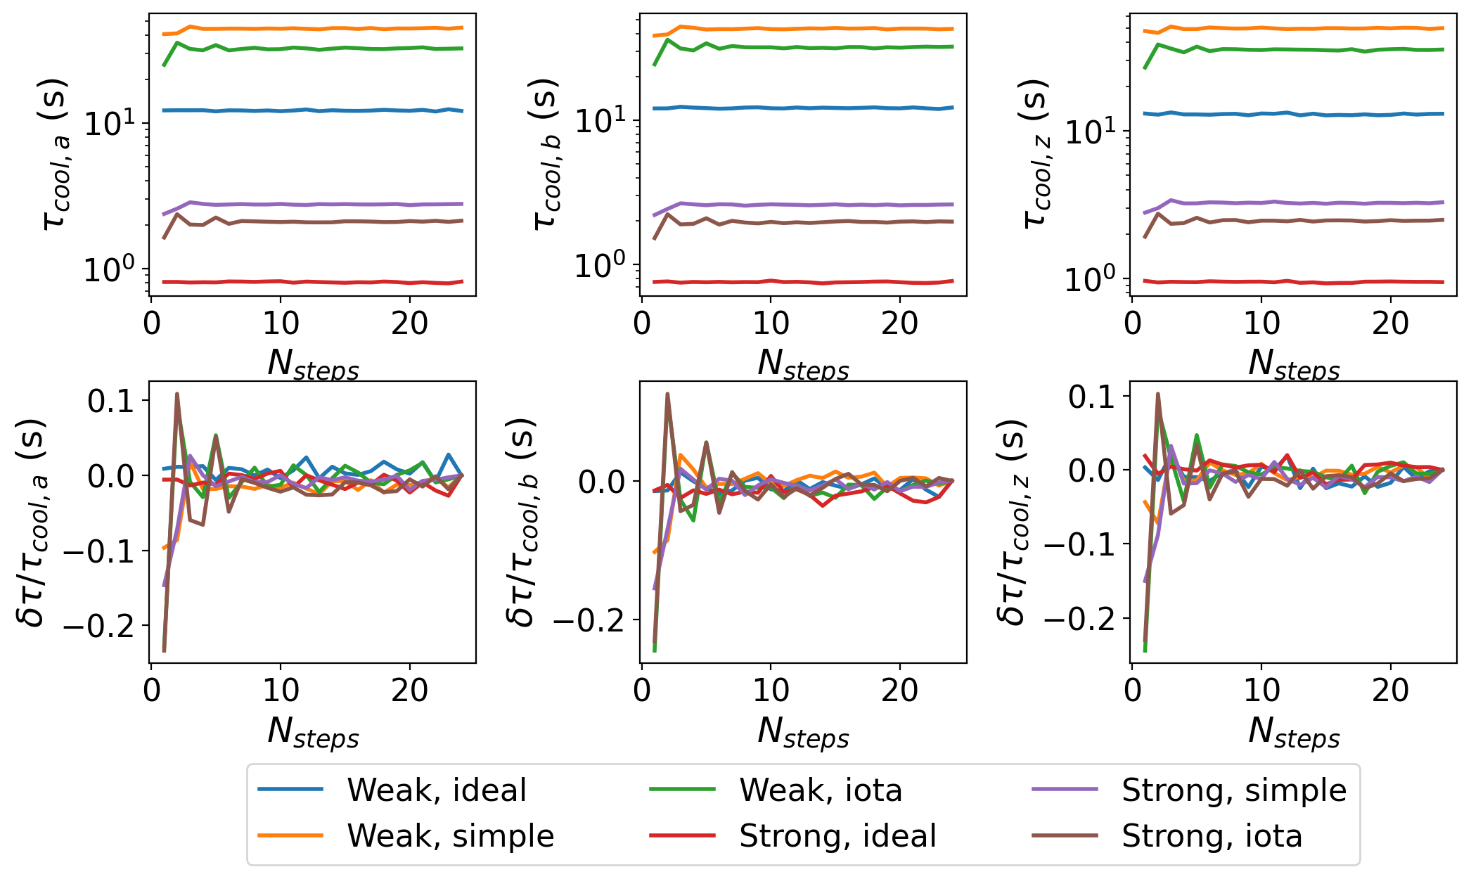
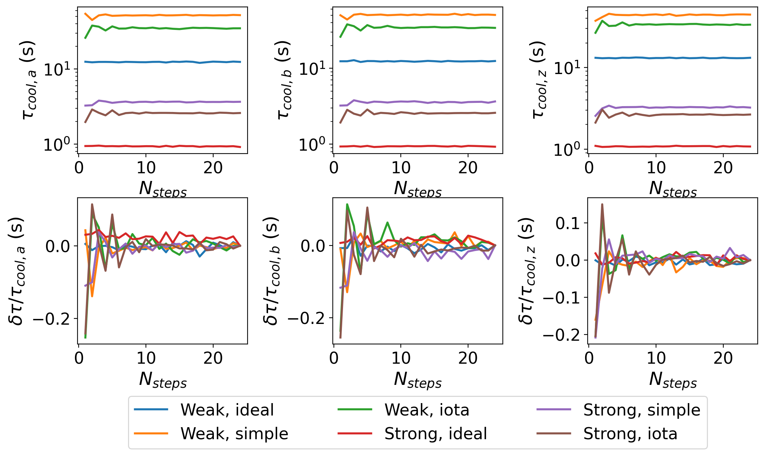
Cooling in Real Solenoid Field: Convergence
How many segments do we need to model the effect of field quality? About 10.
Parkhomchuk: $\frac{δτ}{τ}<0.05$ for N = 10
Parkhomchuk 2: $\frac{δτ}{τ}<0.10$ for N = 10

Slide 10
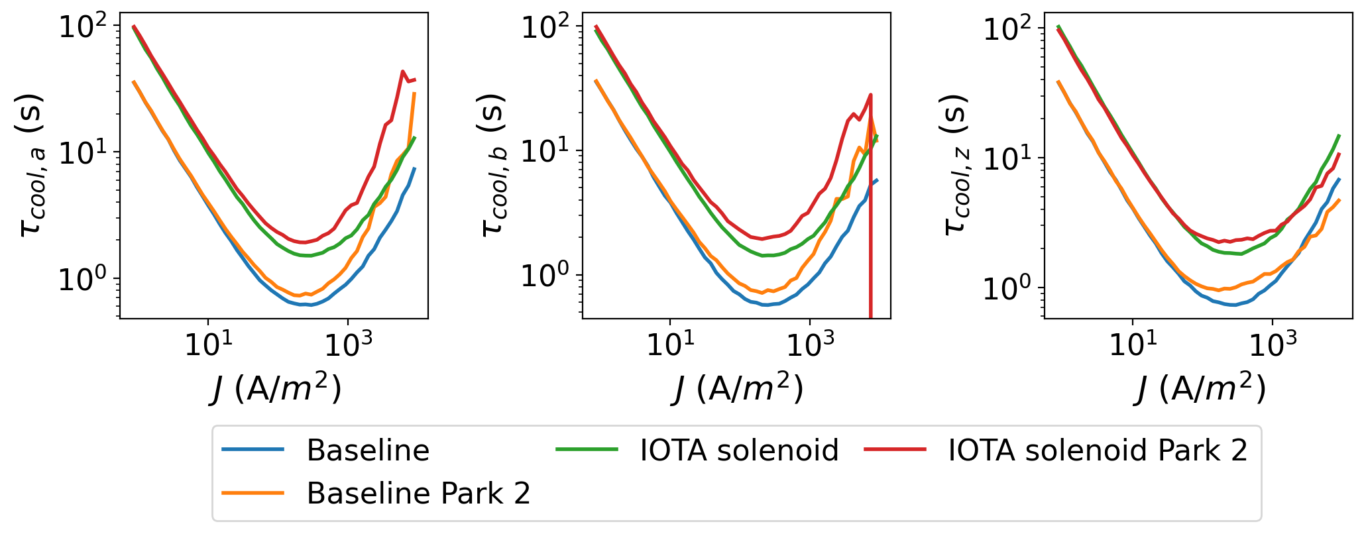
Cooling times in real solenoid
Calculate cooling with 20000 particles, 10 steps inside solenoid, 4 turns: 720 seconds/estimate with GPU acceleration
Radius (mm) | Current (mA) | Current Density (A/m²) | Cooling times (s)
18 | 80 | 78.6 | 2.1, 1.9, 2.4
14 | 1.7 | 2.76 | 32, 31, 34
Factor of 3 degradation!

Slide 11
Next Steps
Introduce winding errors and quantify effect on top of systematic errors.
Improve magnetic field model? (1) Increase length (2) Reduce ID (3) Ferromagnetic plugs (4) Different coil geometries?
Develop a simple way of incorporating cooling rate reduction into PyORBIT simulations.
Effect of steering toroids on field quality inside cooler and on proton beam orbit.
List plan of experiments and back-up with simulations.

Slide 12
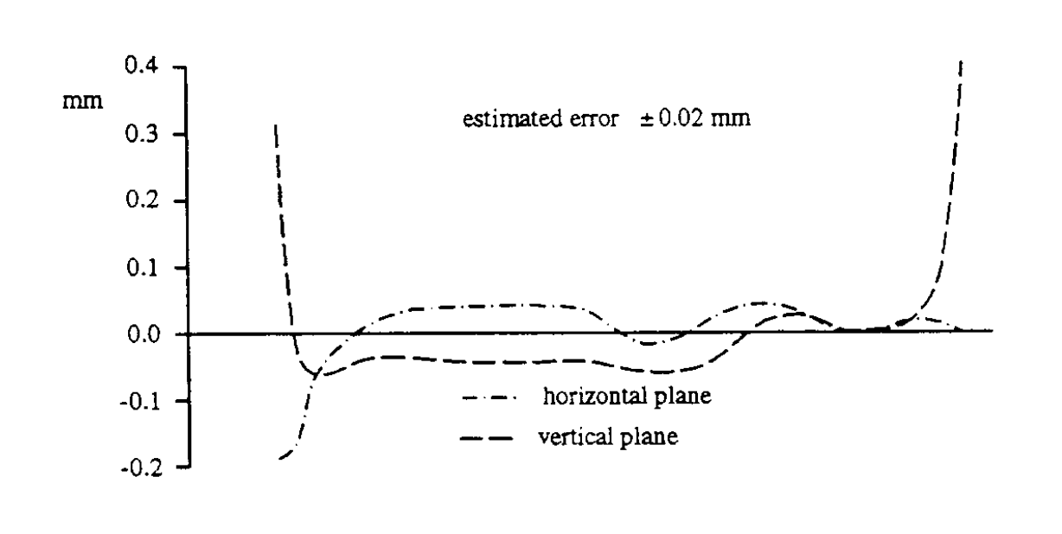
Appendix: Winding Errors
Design a winding error model which is consistent with experimental data.
Transverse field line deviations in CELCIUS cooler. http://cds.cern.ch/record/398603/files/p235.pdf

Slide 13
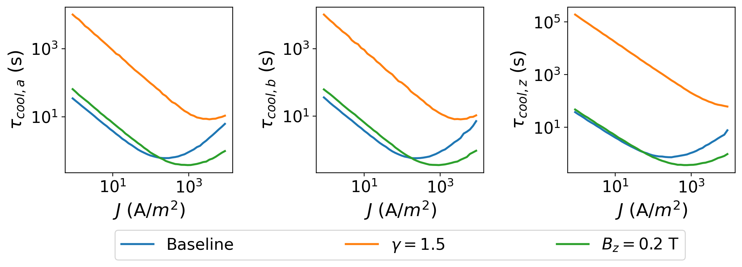
Appendix: Cooling time with and without coupling compensation
Current (mA) | Radius (mm) | Density (A/m²) | Cooling Times (s)
1.7 | 14 | 2.76 | 370, 5.3, 8.6
80 | 18 | 78.6 | 1.5, 0.45, 0.67
Current (mA) | Radius (mm) | Density (A/m²) | Cooling Times (s)
1.7 | 14 | 2.76 | 12, 12, 13
80 | 18 | 78.6 | 0.79, 0.74, 0.94
Without
With

