Slide 1
LFA wire max tension studies
Sotiris Vlachos

Slide 2
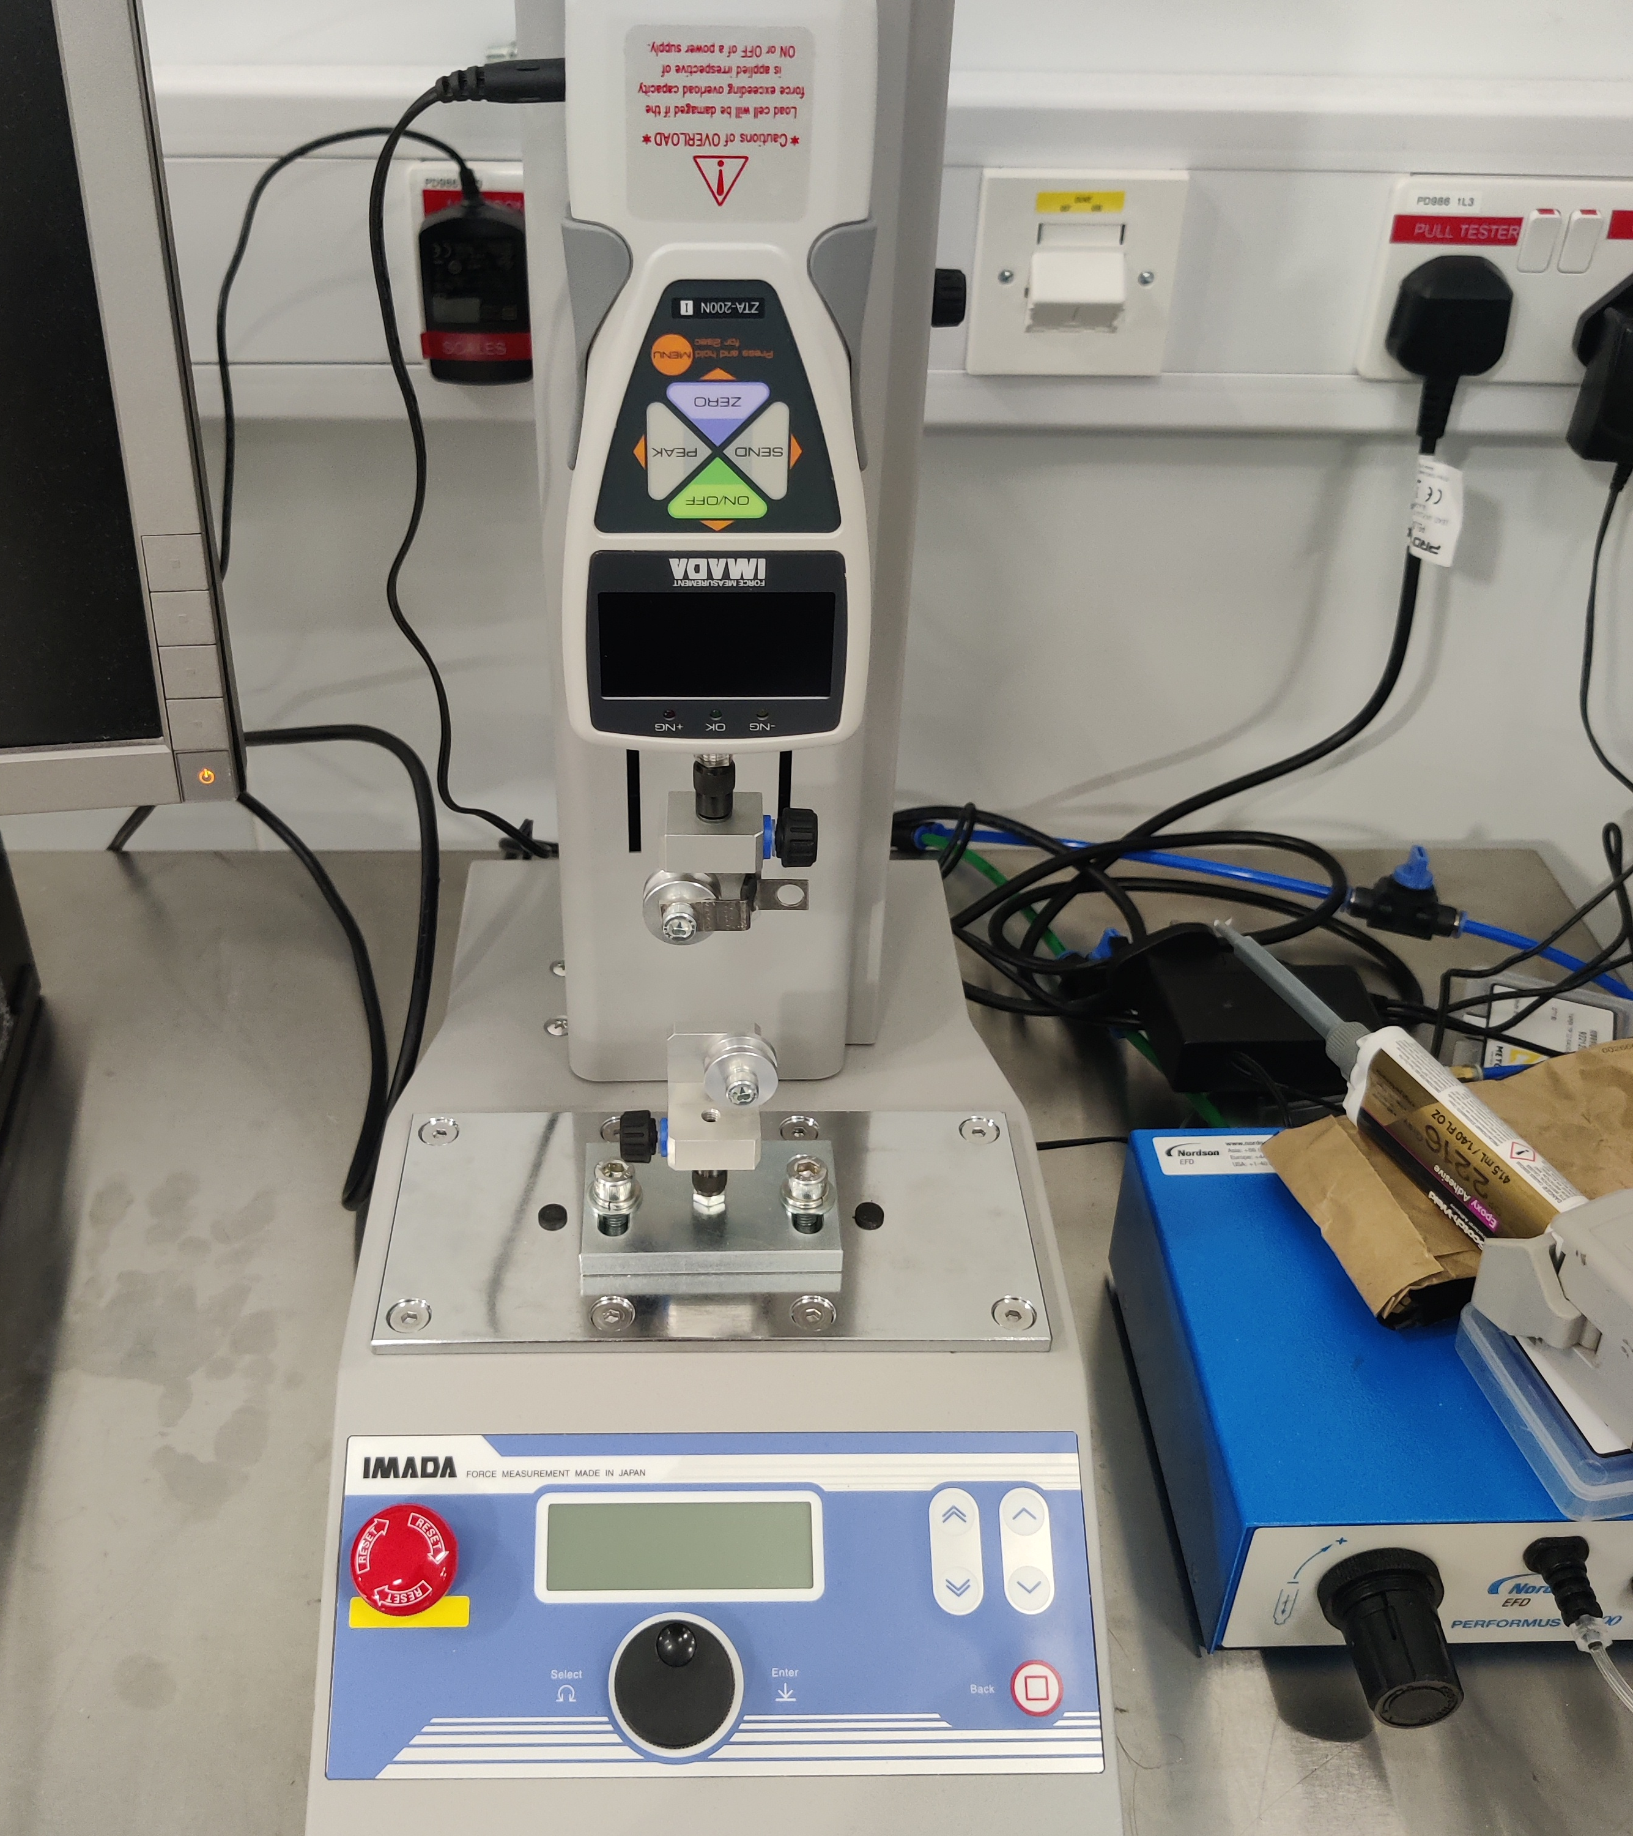
Equipment used
IMADA tension measurement system @ DL (used for qualifying wire spools)
NB : Amateur setup, simple models, gros assumptions !

Slide 3
Measurement of samples from a single LFA spool
Spool #1 – 26.9N
Spool #5 – 28.5N (less statistics)

Slide 4
Home made adaptor
To study maximum wire tension
of wires that are not straight

Slide 5
Wire over board

Slide 6
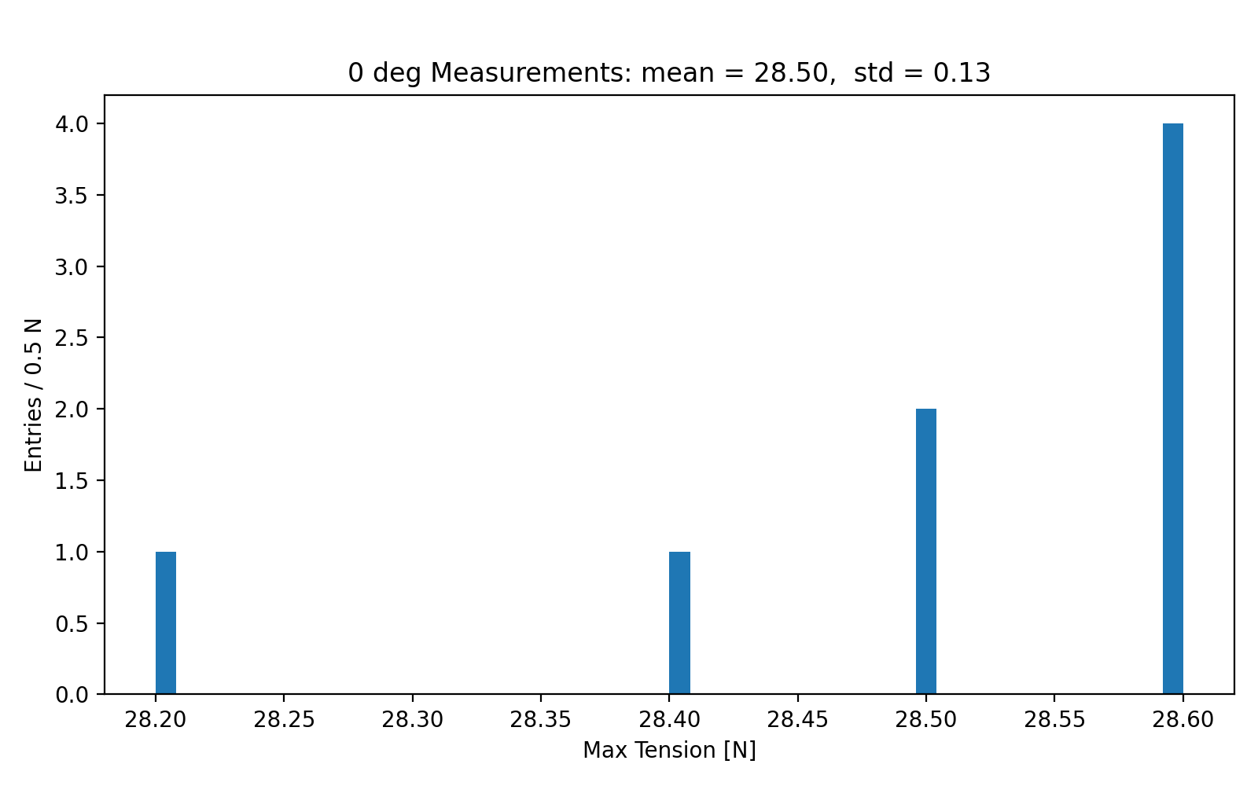
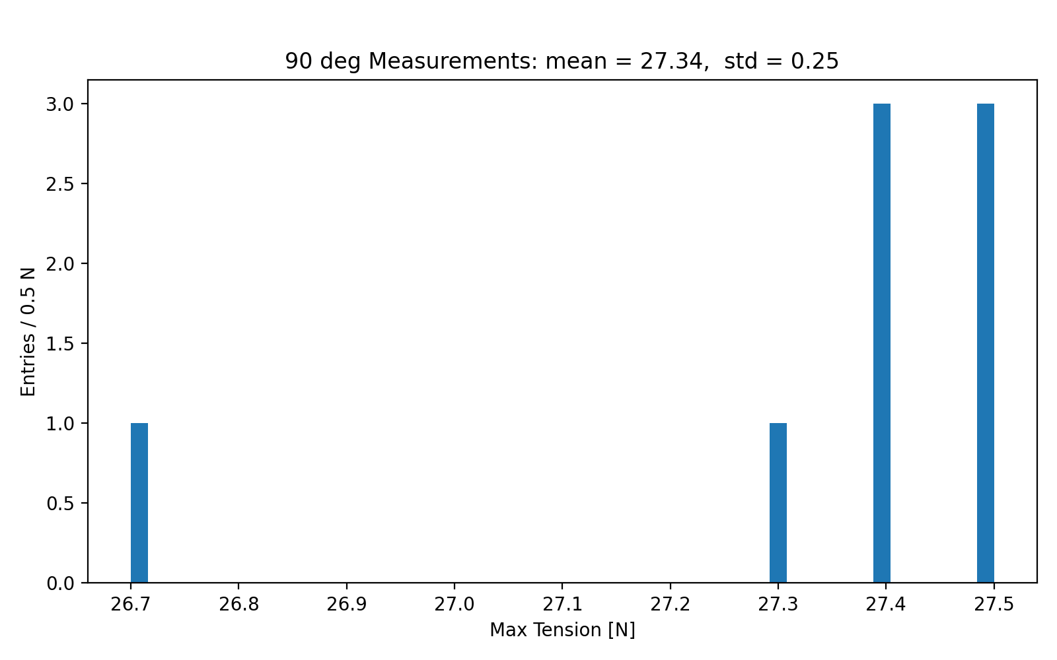
Bend wire measurements
Straight wire – 28.5N
Bent 90deg – 27.3N

Slide 7
Bend wire strength study

Slide 8
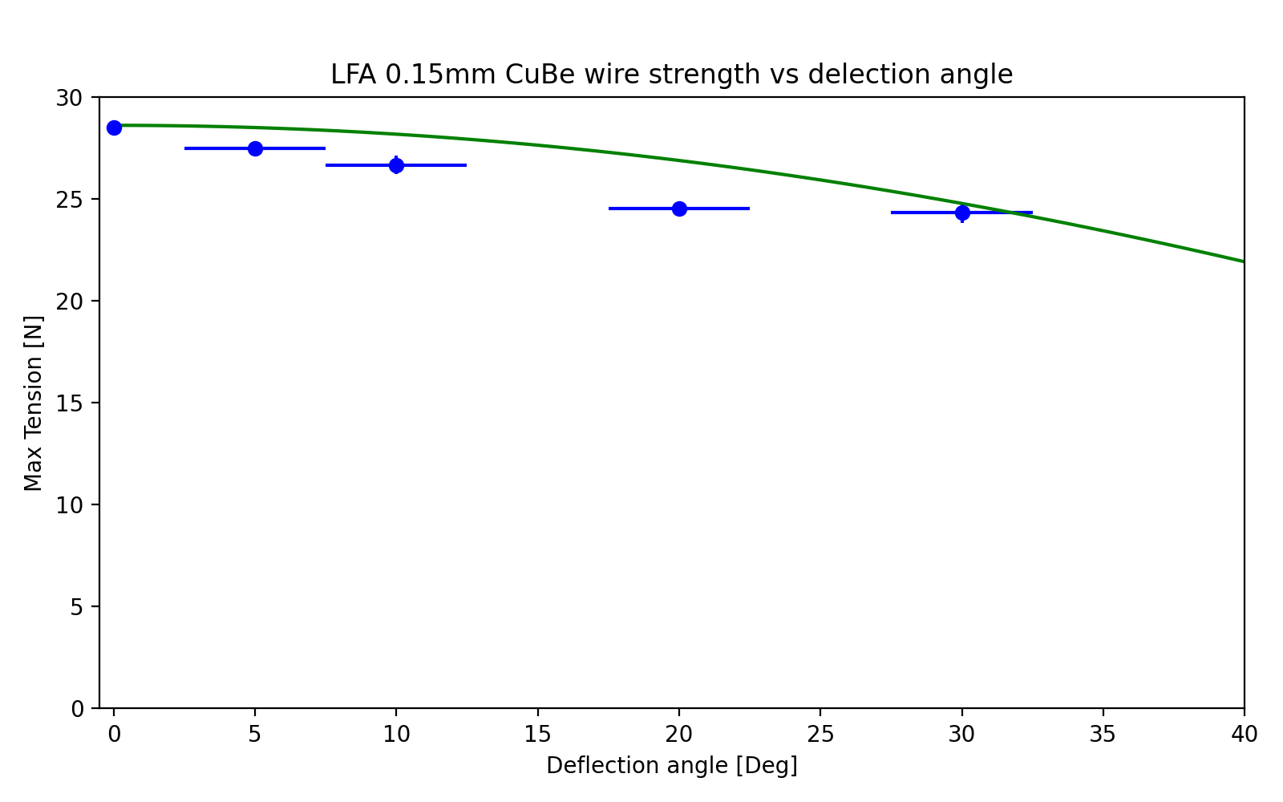
Bend wire strength vs deflection
Green line is a simple model based on component forces (1/cos(theta))
VERY ROUGH angle estimates
NB: not scientific result!
(rigidity of equipment not estimated, point of deflection is not rigid etc)

Slide 9
Conclusions….
Wire tension of a spool has a std dev of ~0.25N. 2 to 3 measurements should give a good estimate of the value
Straight or over coverboards etc : ~1N less strength
A few degrees of deflection do not weaken the wire

