Slide 1
Digital Image Correlation Strain Field Analysis of Materials for Target Systems
Onat Ayyildiz
TSD Topical Meeting
21 September 2023

Slide 2
Outline
Motivation
Digital Image Correlation
Overview
Correlation Criteria
Gauss-Newton Optimization
Experimental set-up
Results
Initial testing
High resolution camera
Conclusions and future goals

Slide 3
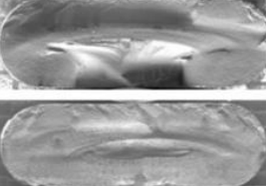
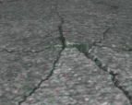
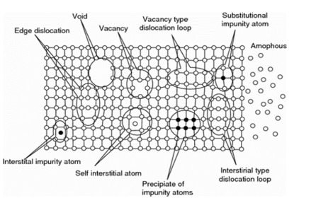
Motivation
Power of proton beams for neutrino production is limited by target facilities
Brittleness and hardness of targets affected by irradiation
Impacts target’s performance and longevity
Conduct Post Irradiation Examinations (PIEs)
Analyze how strain fields of samples under tensile stress change with irradiation
Using a camera and Digital Correlation Algorithm for non-contact analysis
MINOS NT-O2 Target Failure: Radiation Induced Swelling (FNAL)
Beryllium Window Embrittlement (FNAL)
Potential lattice defects due to irradiation

Slide 4
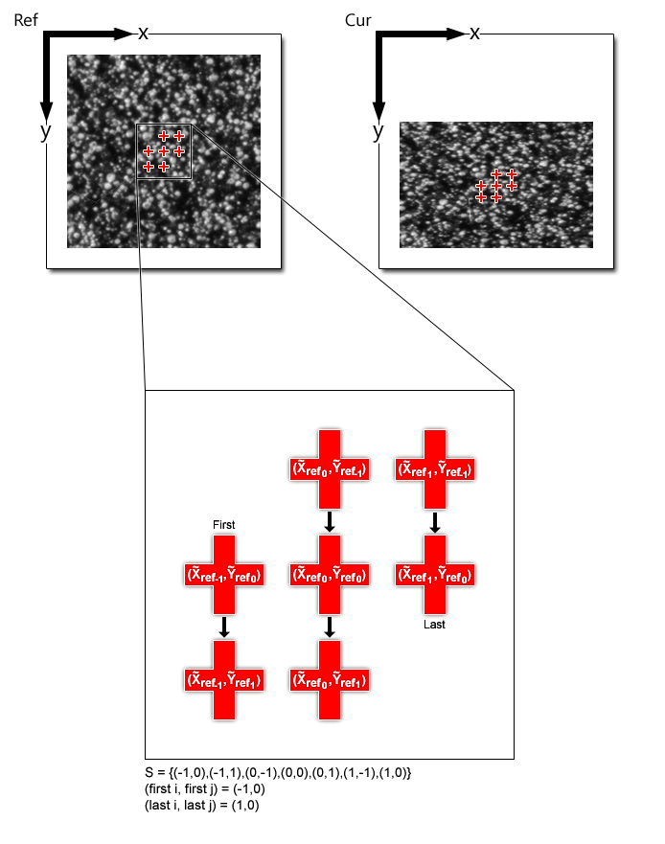
Digital Image Correlation - Introduction
DIC is a non-contact optical technique
Analyze deformation and strain
Compare images of the samples before and after external forces are applied
Keeps track of a defined region of interest (ROI)
Evaluates change in position of a pixel/group of pixels
Calculates strain
MATLAB Ncorr [1] and GOM Correlate [2] used for DIC
Representation of a Subset or ROI in MATLAB Ncorr [1]

Slide 5
Digital Image Correlation Algorithm - Overview
Algorithm keeps track of a subset:
Coordinate points and their corresponding pixel grayscale values
Deformation vector applied to subset
Linear combination of 6 parameters
Deforms subset coordinates through a warp function
Tracking algorithm finds optimal deformation vector
Coordinates of the subset in the deformed reference image best match the coordinates of the subset in the current image
Linear transformation of subset points
Deformation Vector
Visual representation of linear transformation [1]

Slide 6
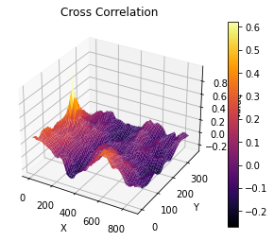
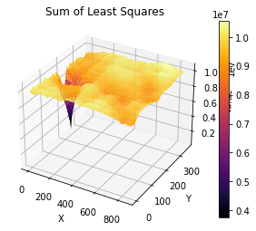
Digital Image Correlation Algorithm – Correlation Criteria
To find how “well-matched” transformed and current subset are
Cross – correlation gives highest correlation when values are maximum
Sum of Least Squares gives highest correlation when values are minimum
Initial guess for deformation vector made through Fast NCC
Only evaluates u and v parameters of deformation vector
Normalized Cross – Correlation Function [1]
Sum of Least Squares Function [1]
Normalized Cross – Correlation Coefficient Map
Sum of Least Squares Coefficient Map

Slide 7
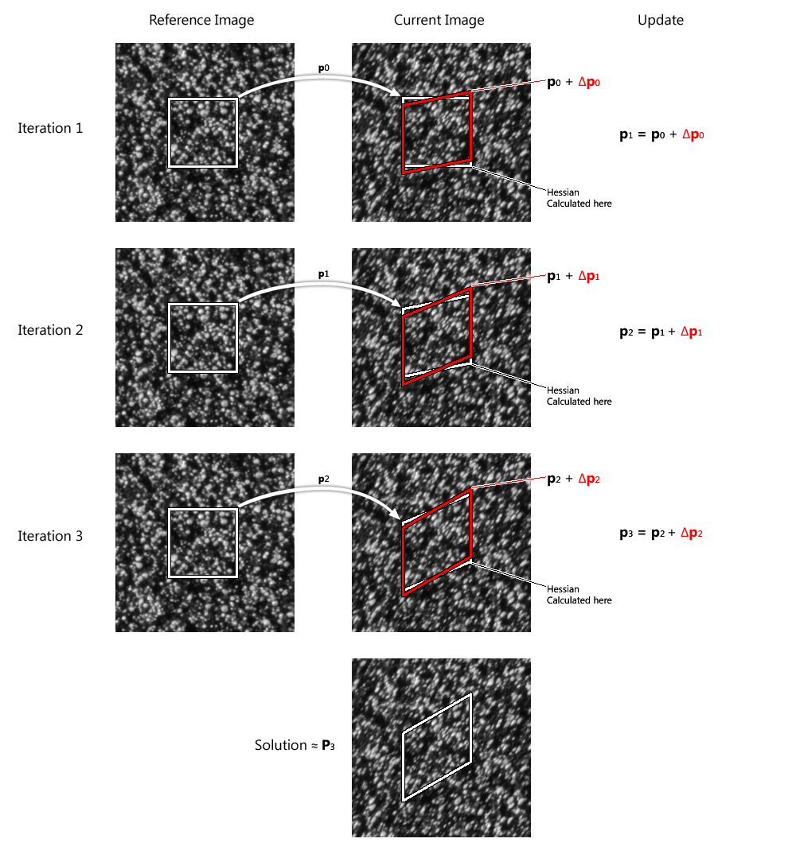
Digital Image Correlation Algorithm – Gauss-Newton Optimization
Gradient-descent optimization algorithms
Forward-Additive Least Squares:
Deformation vector applied to reference image
Least Squares Correlation Coefficient Assessed
Hessians simultaneously evaluated
Deformation vector is modified by Δ p
Iteration repeated until local minimum for the LSCC is reached
Forward-Additive Gauss-Newton Method [1]

Slide 8
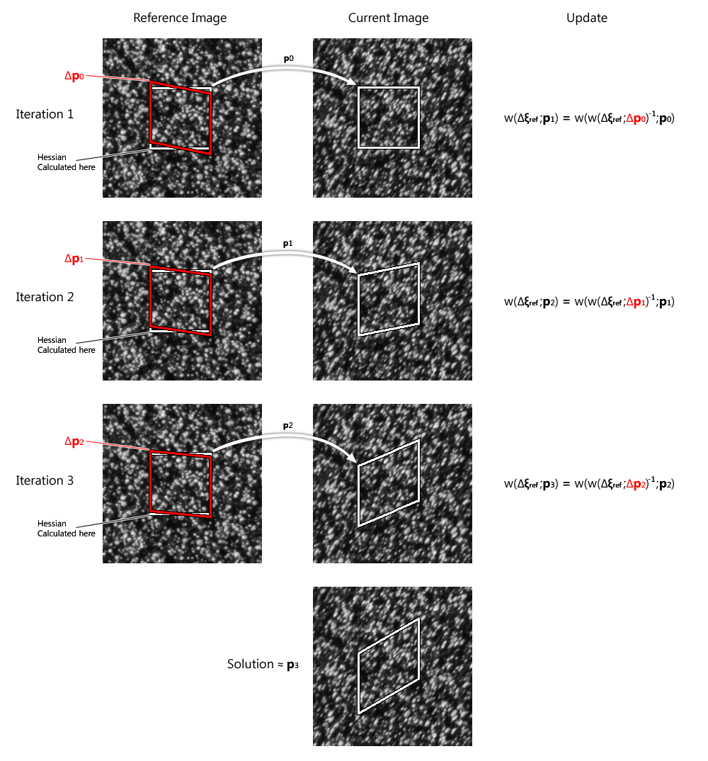
Digital Image Correlation Algorithm – Gauss-Newton Optimization
Inverse-Compositional Least Squares:
Deformation vector applied to current image
Least Squares Correlation Coefficient Assessed
Hessians evaluated simultaneously
Deformation vector modified by Δ p
Inverse of deformation vector is applied to reference image to match it with current image
Iteration repeated until local minimum for the LSCC is reached
Inverse-Compositional Gauss-Newton Method [1]

Slide 9
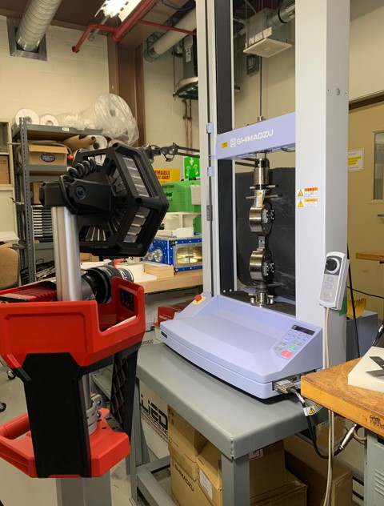
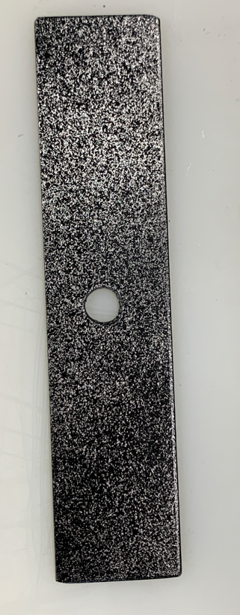
Experimental Set-up
Testing efficacy of DIC Algorithm
Activated samples from accelerator cannot be used
Aluminum samples
Stochastic pattern
Center hole
Camera and sample in parallel
Both at 45 ⁰
Limitation of sample holder
Initial testing done with cell phone
Detailed testing done with high resolution camera
Aluminum samples with stochastic pattern
Experimental Set-up at MI-8

Slide 10
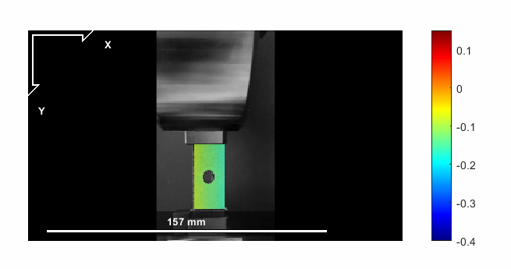
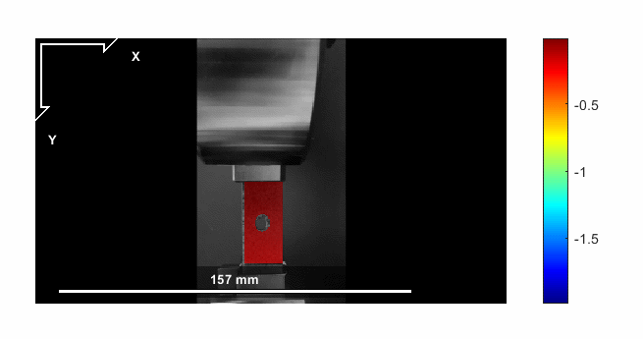
Results – Displacement Fields (Initial Testing)
U – Displacement from MATLAB Ncorr [1]
V – Displacement from MATLAB Ncorr [1]

Slide 11
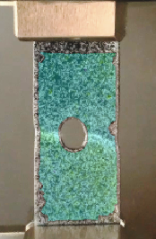
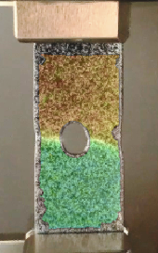
Results – Displacement Fields (Initial Testing)
x
y
U – Displacement from GOM Correlate [2]
V – Displacement from GOM Correlate [2]

Slide 12
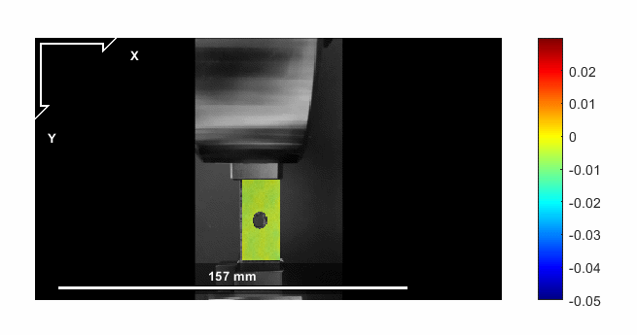
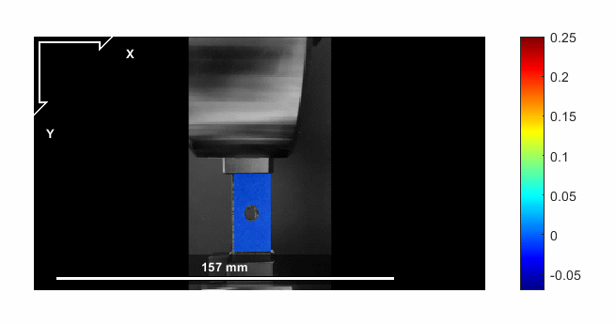
Results – Strain Fields (Initial Testing)
ε_{xx} from MATLAB Ncorr [1]
ε_{yy} from MATLAB Ncorr [1]

Slide 13
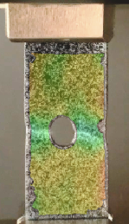
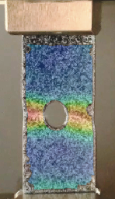
Results – Strain Fields (Initial Testing)
x
y
ε_{xx} from GOM Correlate [2]
ε_{yy} from GOM Correlate[2]

Slide 14
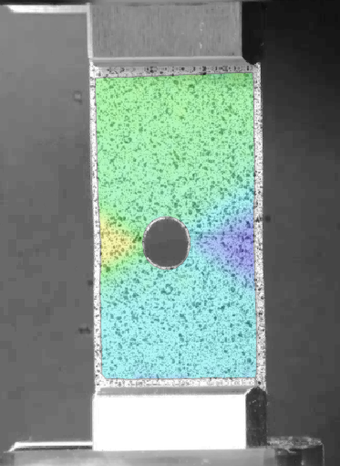
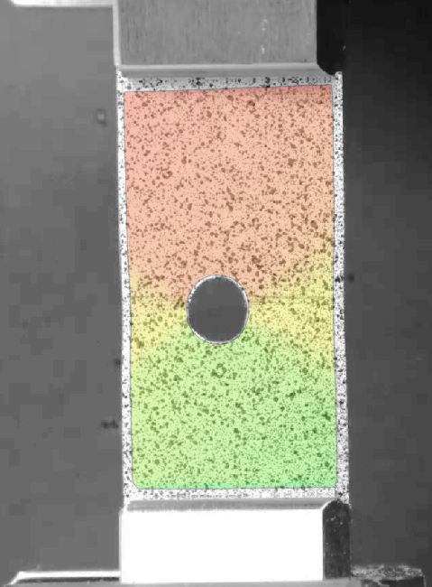
Results – Displacement Fields (Prosilica GT3300 Camera)
x
y
U – Displacement from GOM Correlate [2]
V – Displacement from GOM Correlate [2]

Slide 15
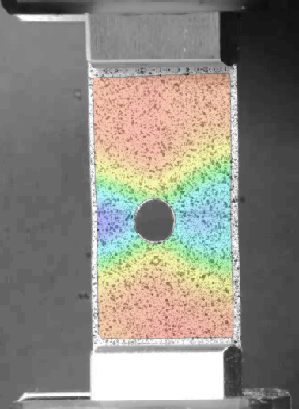
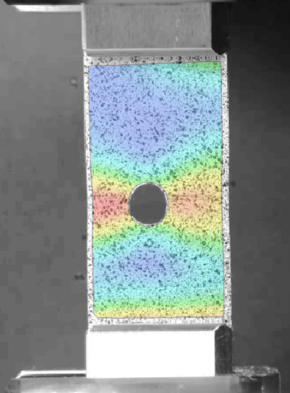
Results – Strain Fields (Prosilica GT3300 Camera)
x
y
ε_{xx} from GOM Correlate [2]
ε_{yy} from GOM Correlate[2]

Slide 16
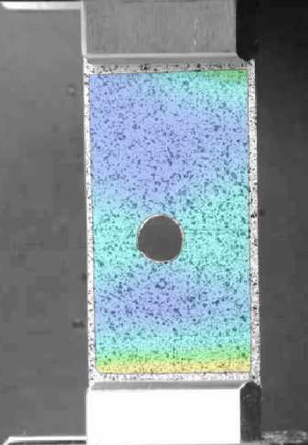
Results – Stress Concentration Coefficient Test
x
Stress Concentration Coefficient of circle is 3
In the elastic region
Average strain on segment calculated using Python
Stress Concentration Coefficient calculated as shown below
3.4 is a 13% deviation from 3
More accurate measurement could be averaging the strain values across another line segment near the circular hole.
Segment
y
Point
Stress Concentration Coefficient Test

Slide 17
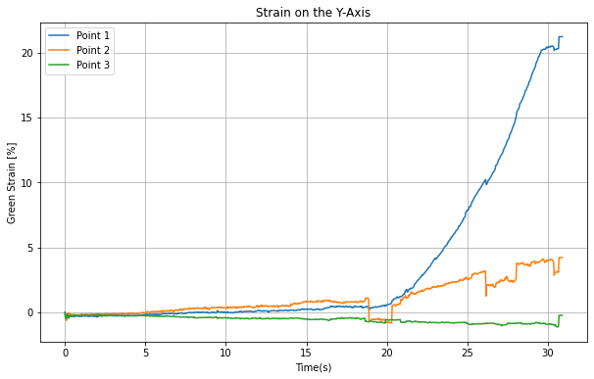
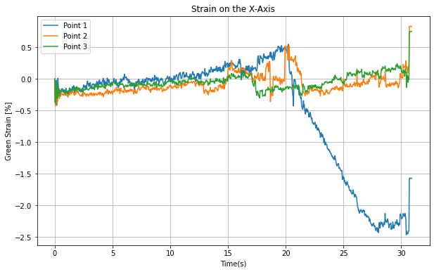
Conclusions and Future Goals
Project provides a foundation for future expansion
Processing multiple frames of high-resolution images was computationally costly
Slight compression performed to facilitate analysis
Loss of precision and information
Future goals
Incorporating DIC algorithm into Python
Normalized Cross-Correlation and Least Squares already incorporated
Synchronizing data to create Strain vs. Stress graphs
Studying irradiated samples
Analyzing out-of-plane motion using 3D-DIC
ε_{yy} vs. Time
ε_{xx} vs. Time

Slide 18
References
[1] Justin Blaber ”Ncorr” (https://github.com/justinblaber/ncorr 2D matlab), GitHub. Retrieved July 28, 2023
[2] GOM Correlate [Computer Software]. Retrieved from https://www.gom.com/en/products/zeiss-qualitysuite/gom-correlate-pro, Retrieved July 28, 2023
[3] B Pan, H Xie and Z Wang, ”Equivalence of digital image correlation criteria for pattern matching.” Optical Society of America (2010)
[4] David A. McClintock, et al. ”Characterization of mechanical properties and deformation behavior of highly irradiated 316L stainless steel from target modules at the Spallation Neutron Source Using Digital Image Correlation Analysis.” Journal of Nuclear Materials (2021).
[5] J P Lewis, ”Fast Normalized Cross-Correlation.” Industrial Light and Magic (1995)

Slide 19
Thank you
Special acknowledgements to Sujit Bidhar and Frederique Pellemoine for their guidance and leadership during my internship

Slide 20
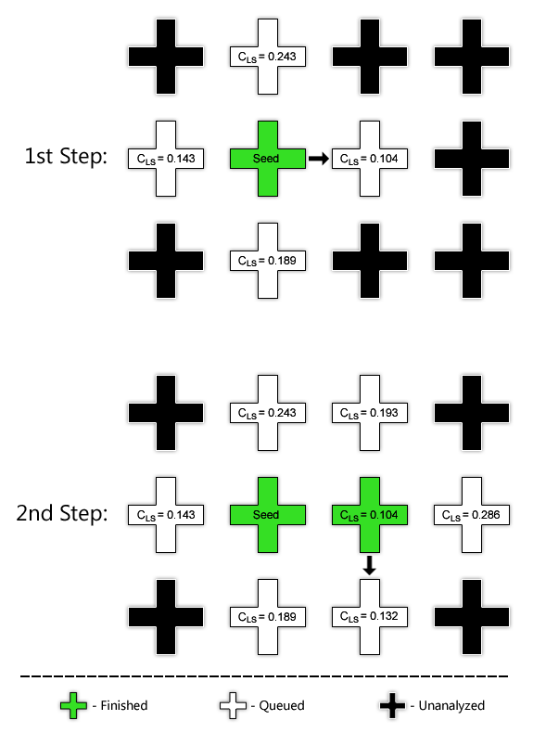
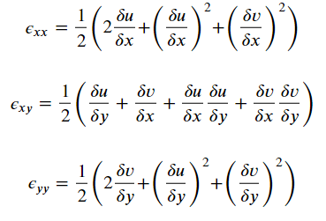
Appendix A – Strain and Displacement Fields
Green-Lagrange Strain [1]
RG-DIC for Full-Field Displacement [1]

