Slide 1
AD-Elog Data Search Using Natural Language Processing Techniques
Amiin Muse
Supervisor: Athula Wickremasinghe
TSD Topical Meeting
21 Sep, 2023

Slide 2
Outline
What is NLP (Natural Language Processing)?
Data Info
Data Preprocessing
Vectorization
Categorization
Future work

Slide 3
NLP (Natural Language Processing)
A branch of Computer Science, specifically a branch of Artificial Intelligence
Combines computational linguistics with statistical, machine learning and deep learning model
Enables computers to process and understand human language in the form of text, or voice text, to understand the full meaning
Examples products that use NLP that we interact with everyday:
- GPS navigation
- Language translation
- Spam monitoring

Slide 4
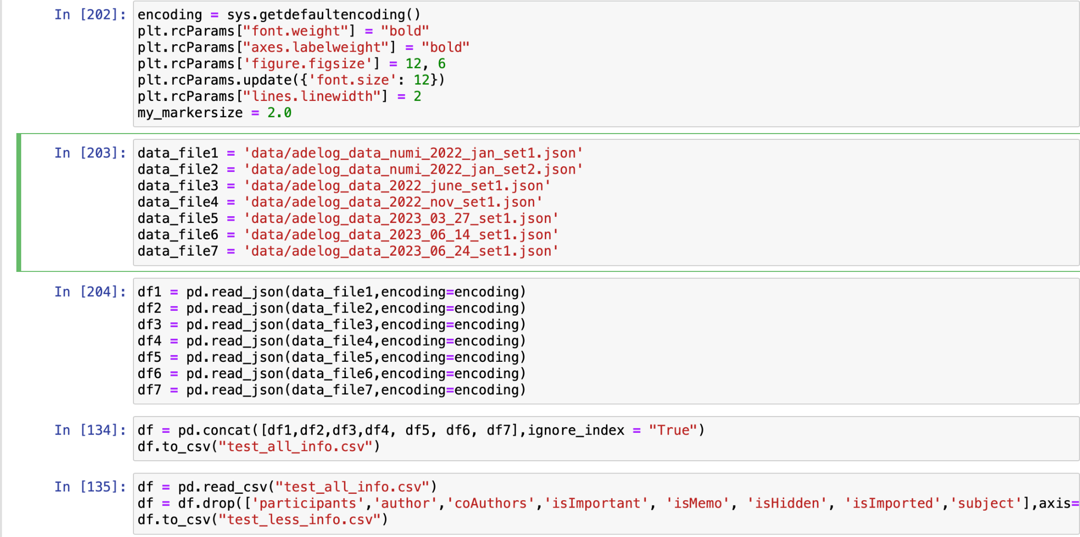
Data
Data included different columns such id, logs, text, comments and etc.
The non-useful columns were removed to focus on the important data
10+ files with 2767 entries

Slide 5
Data Preprocessing
NLP preprocessing technieques were done on the ‘text’ column that has the most useful data:
Removing links, html tags, punctuation and entries with no content
Tokenize
Remove Stopwords
Lemmatize/Stemming

Slide 6
Data Preprocessing
Remove
Remove links, html tags, punctuation and entries with no content
Hi <b> John </b>, check your messages.
Hi John message me
Tokenize
Split each entry into individual words
“Hi John check your messages”
[ Hi, John, check, your, messages]

Slide 7
Data Preprocessing
Remove stopwords
Remove commonly used english words
This is today’s entry
Today’s entry
Lemmatize
Group different forms of a word into
message, messaged, messages
message

Slide 8
Data Preprocessing
For example, this is what one text looks like after preprocessed:

Slide 9
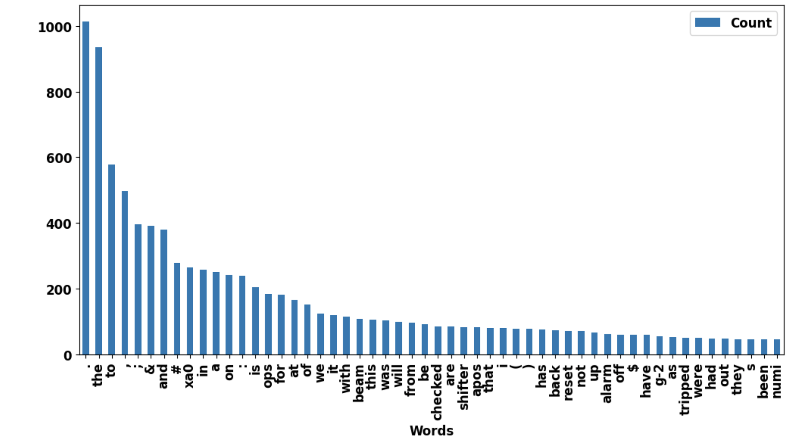
Common Elog Words (before preprocesing)

Slide 10
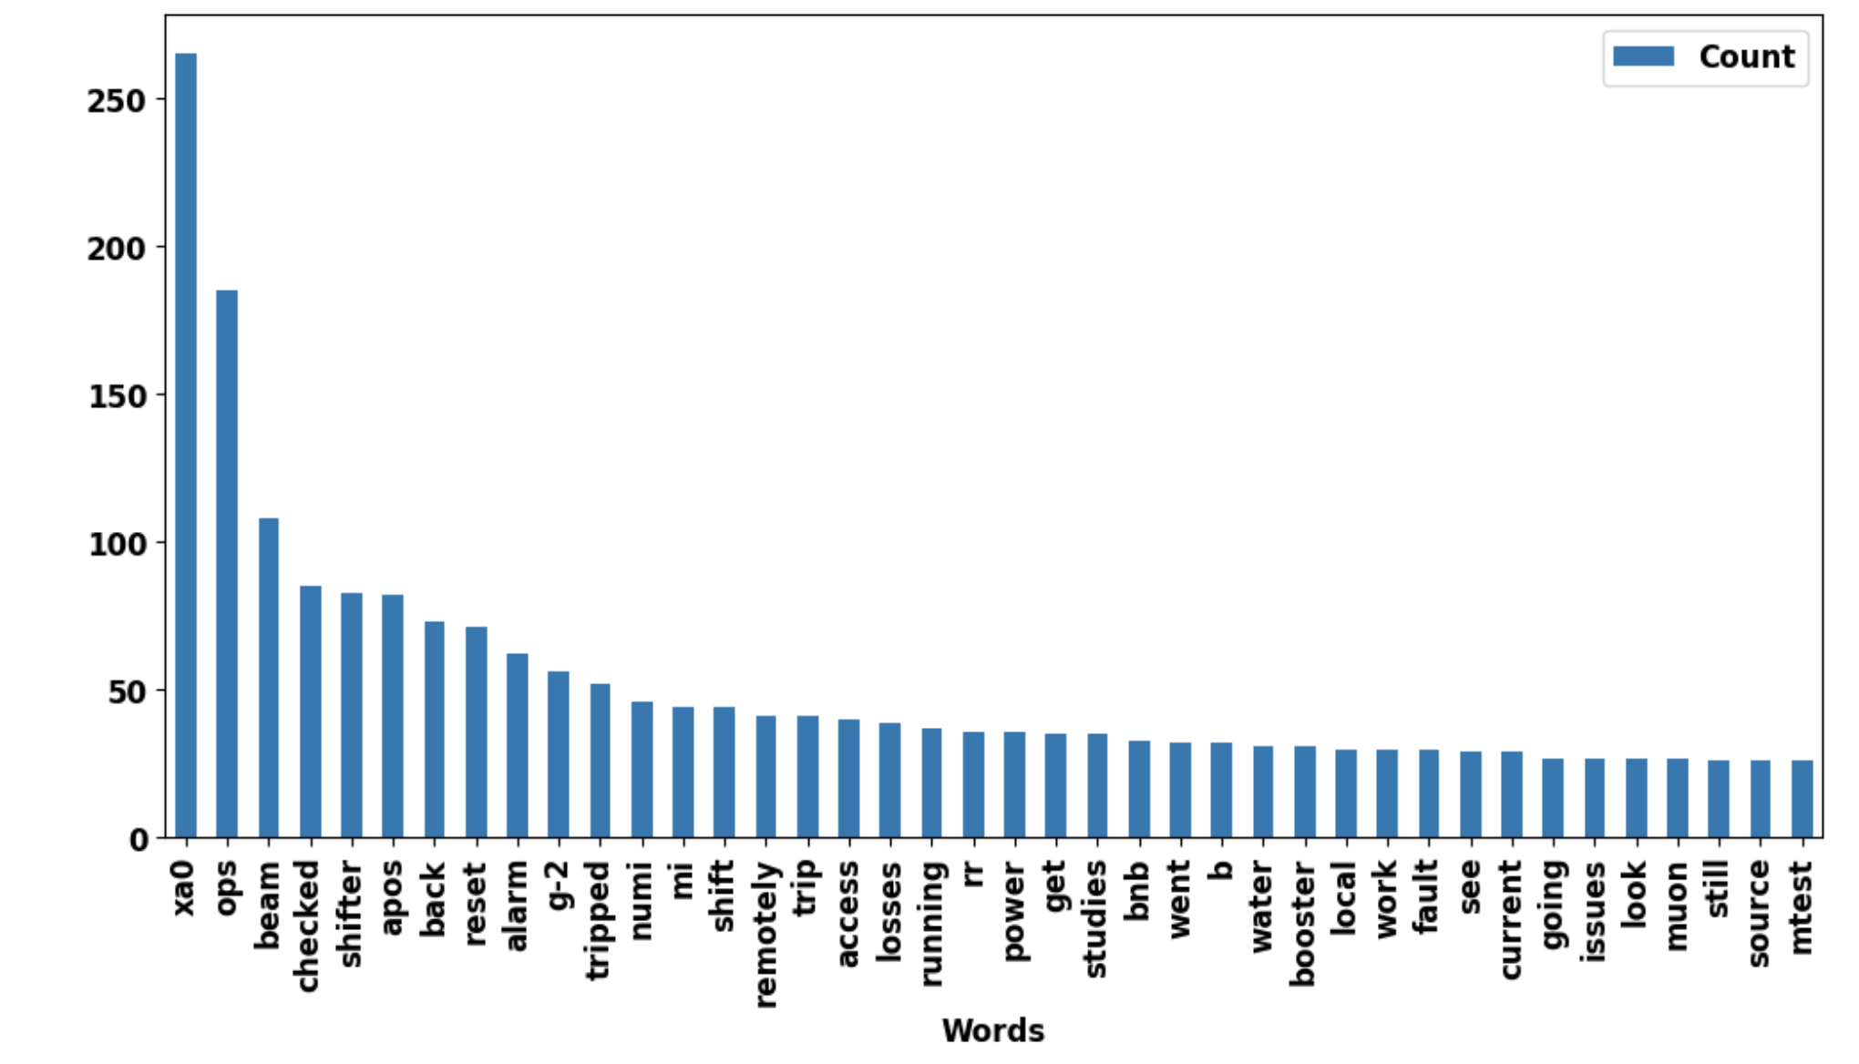
Common Elog Words (after preprocesing)

Slide 11
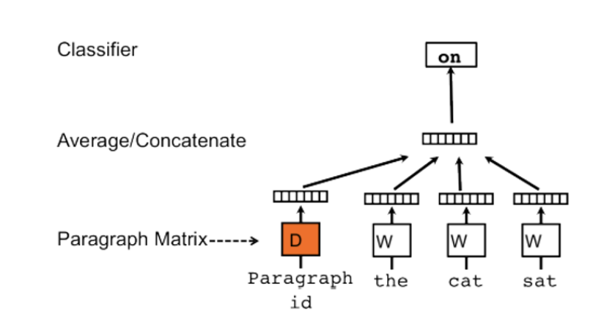
Vectorization
Different vectorization techniques and models:
CountVector
TFIDF
Word2Vec
Doc2Vec (The one we used)

Slide 12
Doc2Vec
Extension of Word2Vec
Word2Vec creates word representation based on word’s location in a sentence and other words
Gensim library in python has the Doc2vec model and it is based on a paper wrote by Le and Mikolov
Takes the processed text and creates a list of tagged documents
Then we train the D2V model using our tagged docs

Slide 13
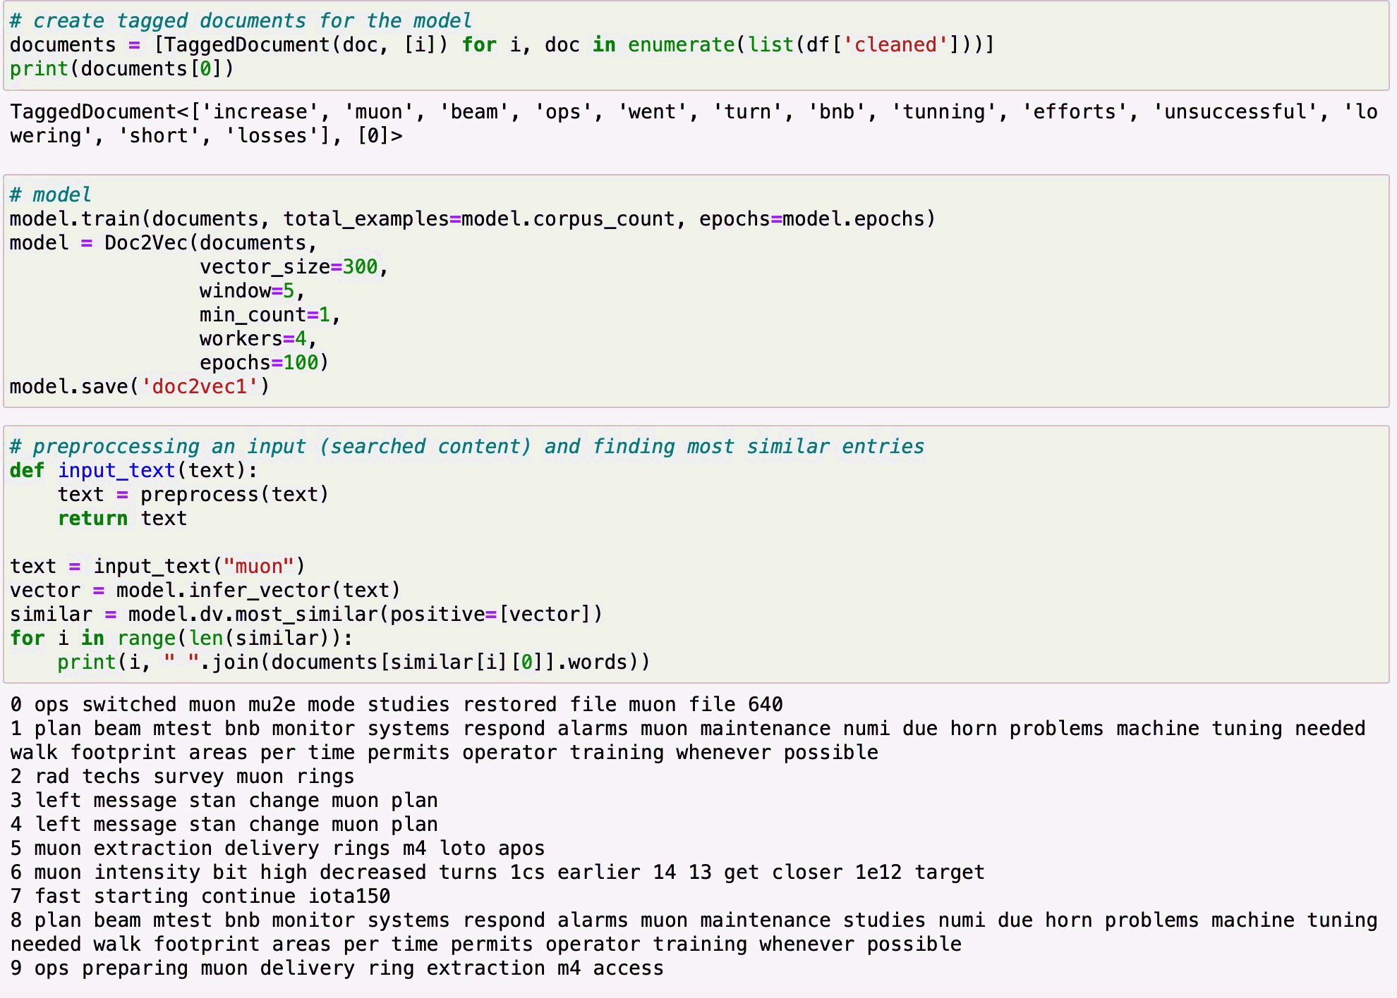
Doc2Vec
Then search some words and look for the most similar entries.

Slide 14
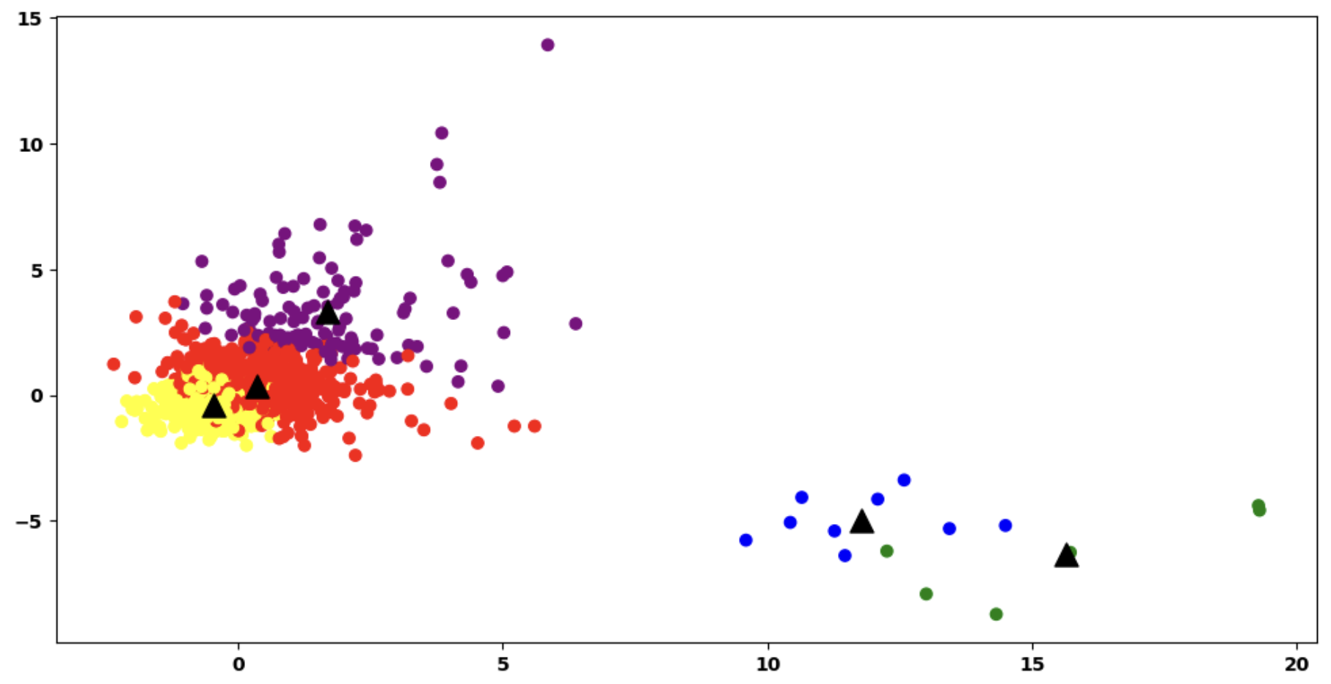
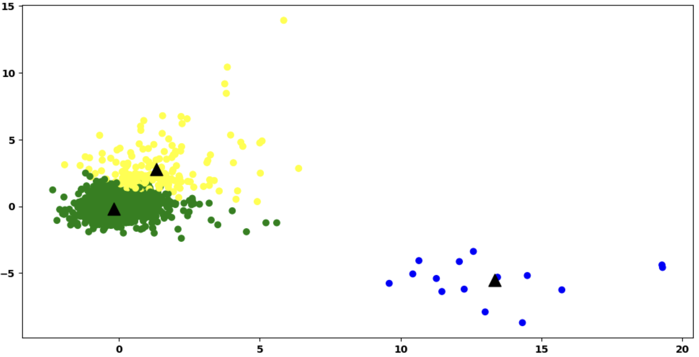
Categorization
Python libraries were utilized to make cluster of different groups of the data
The number of clusters is dependent on the number of variations the data has

Slide 15
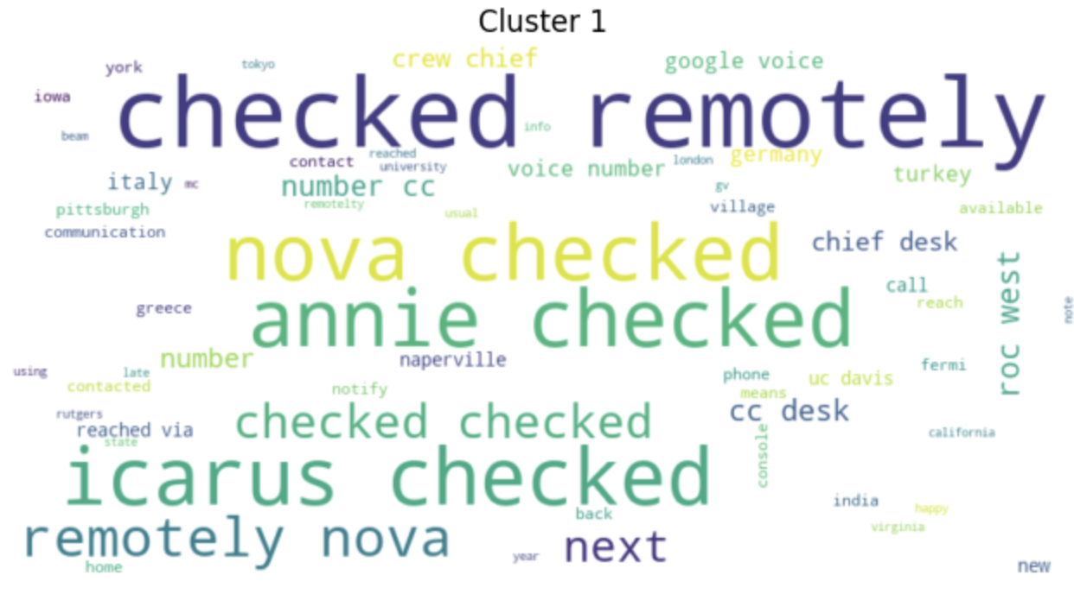
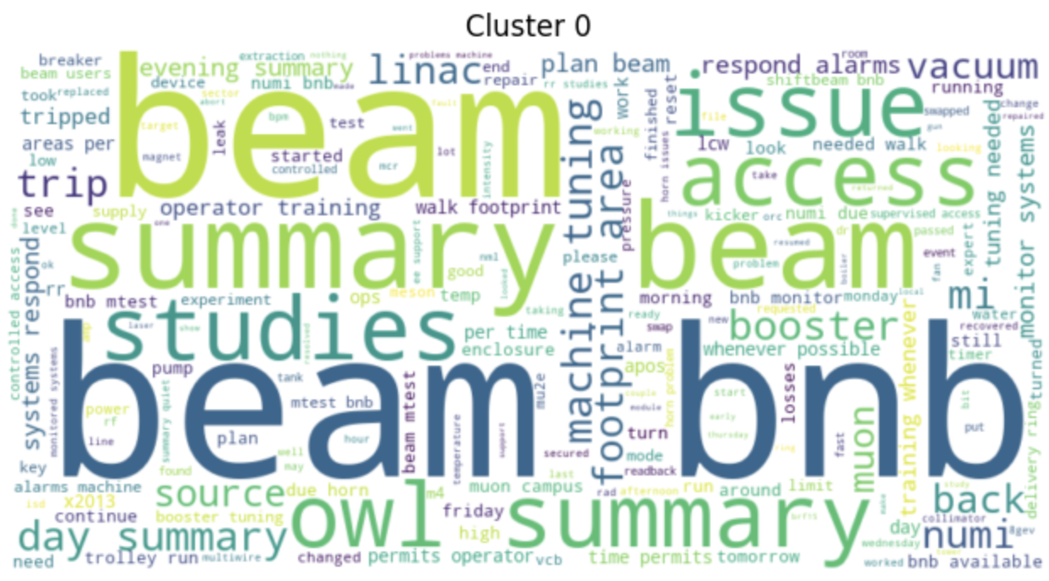
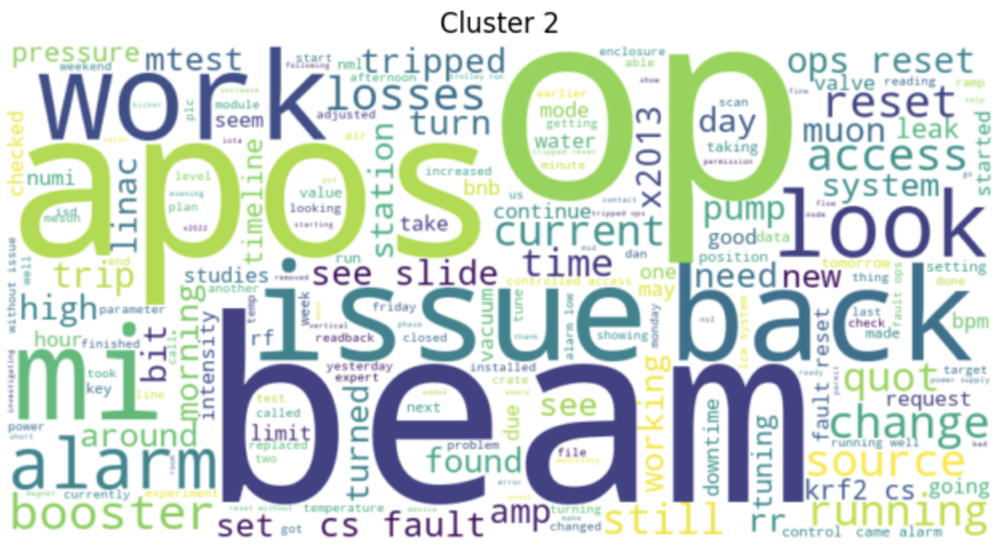
Labeling Clusters

Slide 16
Future Work
Get more data and train the model
1
Integrate this project with Elog
2
Perform user testing
3
Find ways to improve the model and tune the parameters
4
Create a system where the model is trained on every new entry
5

Slide 17
This is the end. Thank you!

