Slide 1
Simulating target tests at AP0 facility for Mu2e
Amii Matamoros Delgado, University of Rochester (SIST 2023)
Supervisor: Kevin Lynch
TSD Topical Meeting - September
21 September 2023

Slide 2
Outline
Introduction: About Mu2e
Goal and Motivation
Simulation in G4beamline
- AP0 model and test targets
- Energy deposition results
- Simulation: optimal location for a detector within AP0
Conclusions
- Applications and future goals

Slide 3
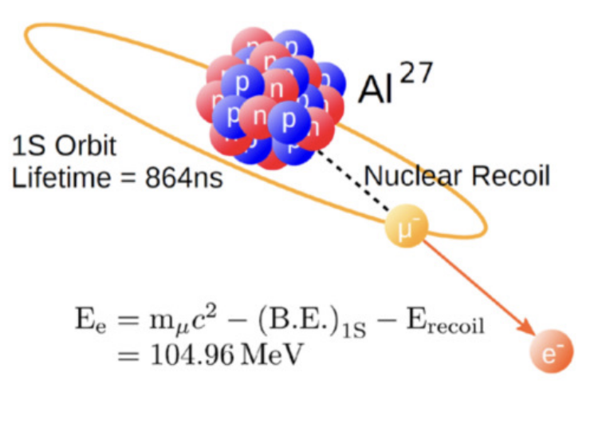
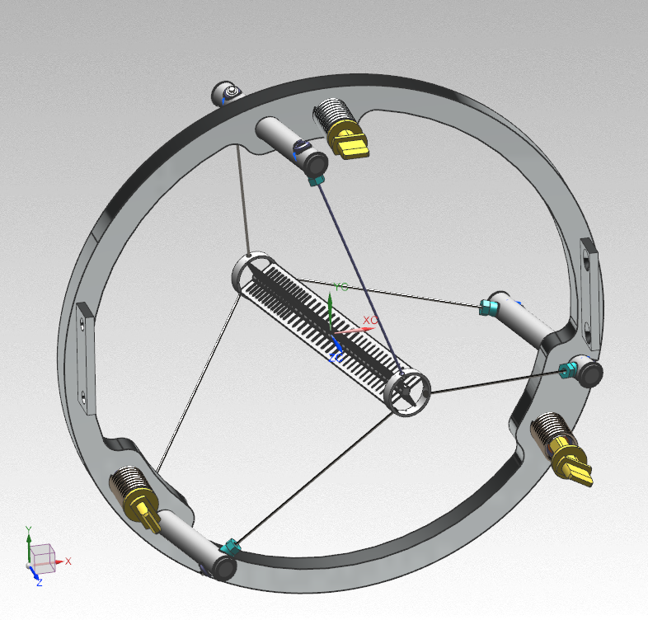
About Mu2e
Mu2e is looking for a rare interaction: muon converting to an electron, without neutrinos, in the presence of an atomic nucleus.
- Process with an unmeasurably small cross section:
- Standard Model rate: < 10^−50
- New physics rates: 10^−17 - 10^−15
Credit: symmetry magazine
Notes:
SM is incomplete
Muon to electron conversion is allowed, and there isn’t anything preventing it. But the fact that we dont see it it’s an interesting thing.
Process is a charged lepton flavor violating process with an unmeasurably small cross section.

Slide 4
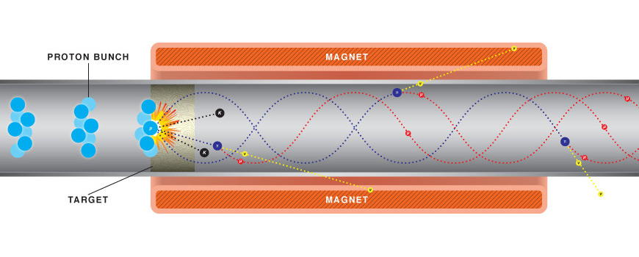
Mu2e production target
Protons hit the 3.15 x 160 mm production tungsten target. Generate pions that decay into muons.
A magnetic field then transports the muons to a detector that can track if any conversion event occurs. A goal of the experiment is to reach a single event sensitivity of 3x10^-17.
Production target
Credit: Fermilab Image: Dave Pushka

Slide 5
Goal
Simulate a target test at the AP0 Target Facility (previously used to create the muon beam for the Muon g-2 experiment).
Motivation
Predicted production of muons and energy deposition for the production target are dependent on the documentation of cross-sections values, the properties of the target material, etc.
Making real tests on similar targets before its use on Mu2e will be a good indicator of the accuracy of the simulations done for the experiment.

Slide 6
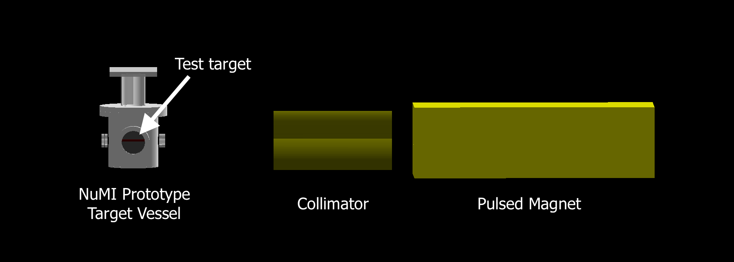
Simulation in G4beamline
The Neutrinos at the Main Injector (NuMI) Prototype Target Vessel is planned to be used as a holder for the test target.
Took the AP0 facility G4Beamline model made by Steven Boi from EBD, and added the NuMI Prototype Target Vessel. Various test targets were then placed inside the simulation for each run.
Notes:
Add picture of (possibly NuMI vessel) and G4beamline simulation of mine.

Slide 7
Test targets
An 8 GeV proton beam of 1 million particles was used for each run, $σ=$ 0.25mm
Ran simulation with different target sizes (cylinders):
- Radius of 1 to 5 mm.
- Length of 70 to 150 mm.
Energy deposition profiles for some target sizes.
Getting this done in G4beamline requires segmenting each cylinder into small volumes.
- Grid of cylindrical shells and circular partitions to calculate energy deposition across radius and length. Each small volume was set to have radius of 0.2 mm and length of 2 mm (number of small volumes vary depending on target size).

Slide 8
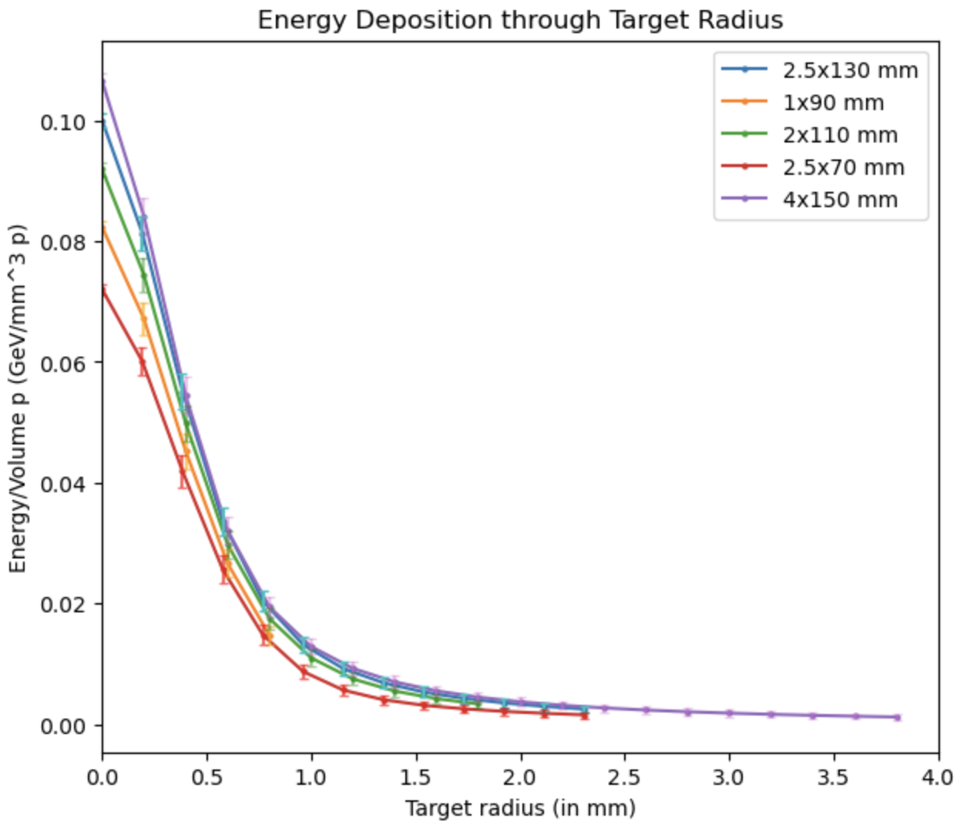
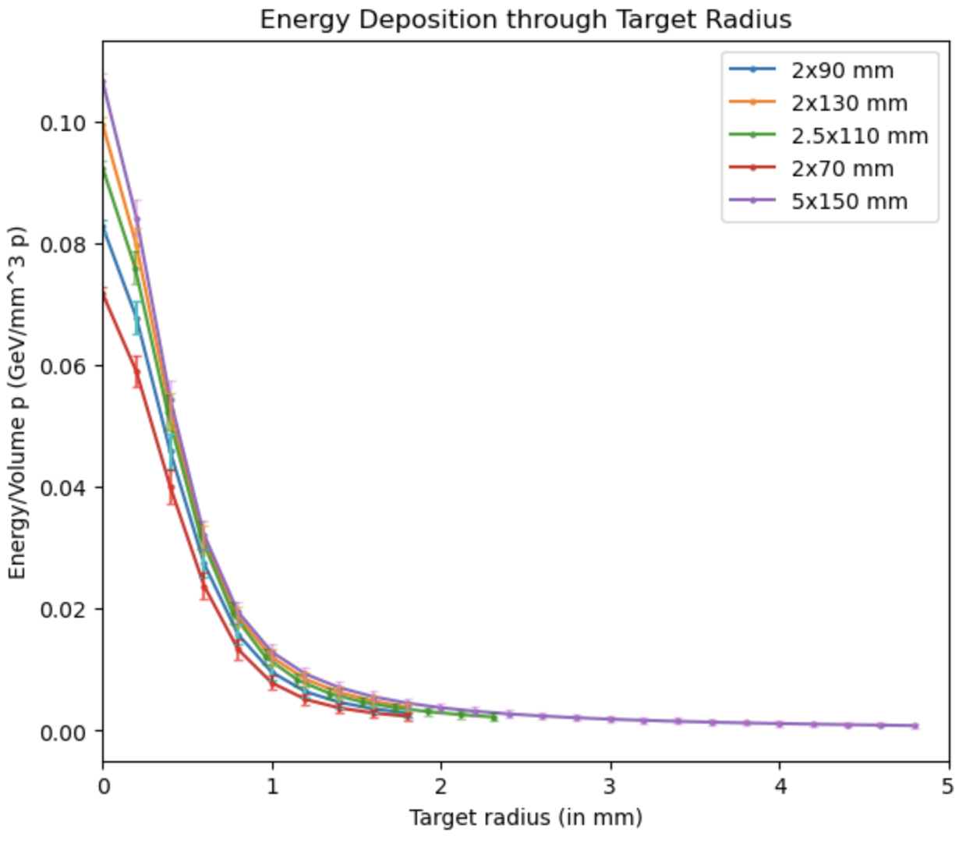
Energy deposition results
Notes:
Energy across target radius and length was normalized using the volume of each geometrical segment. Some statistical error bars, specifically through target radius, turned out to be very small.

Slide 9
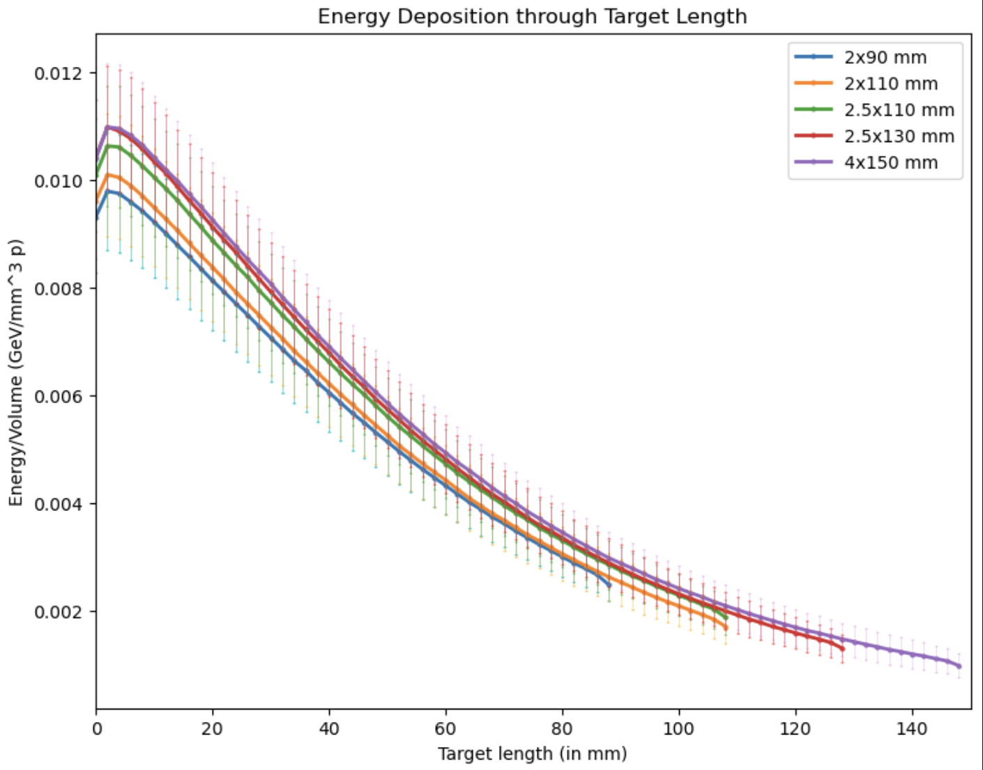
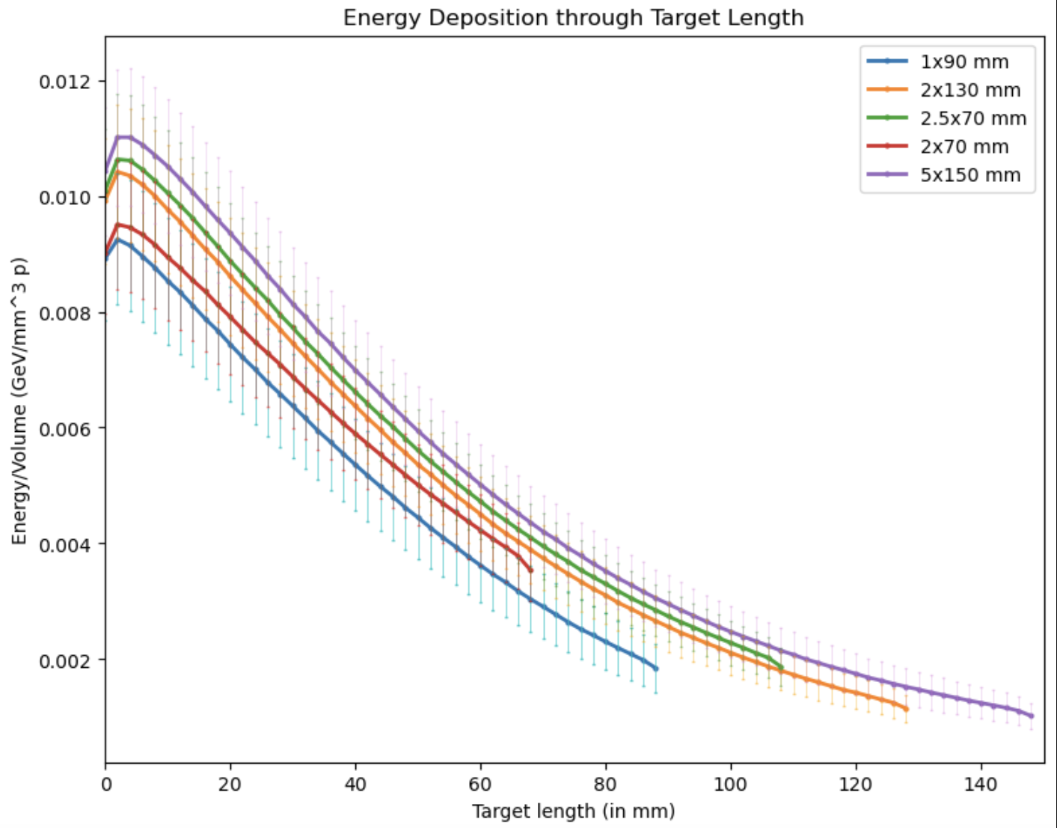
Statistical errors were based on multiple runs of each target size, each run with 1 million events. Systematic uncertainties from volume sections and model dependencies were not considered.
Notes:
Some statistical error bars, specifically through target radius, turned out to be very small.
Systematic uncertainties from volume sectioning and model dependencias were not considered, as the goal of the test program will be to validate cross section models in the simulation framework.

Slide 10
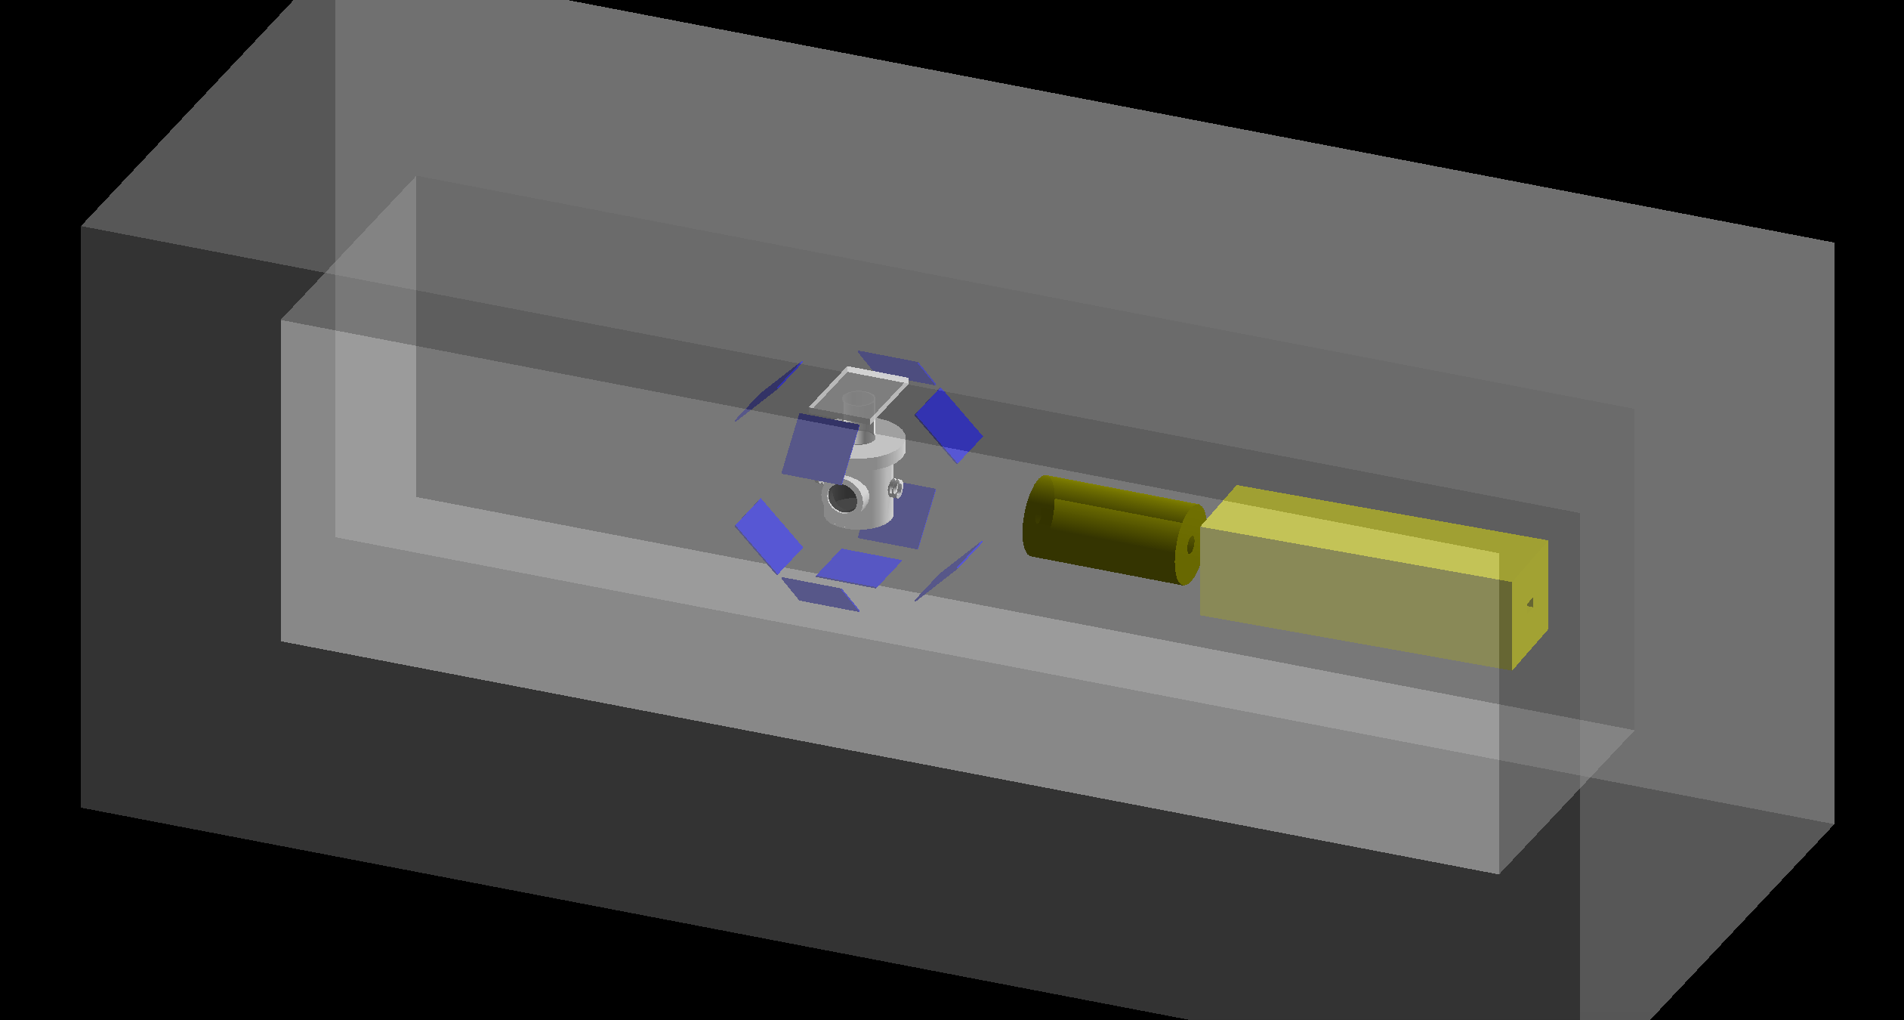
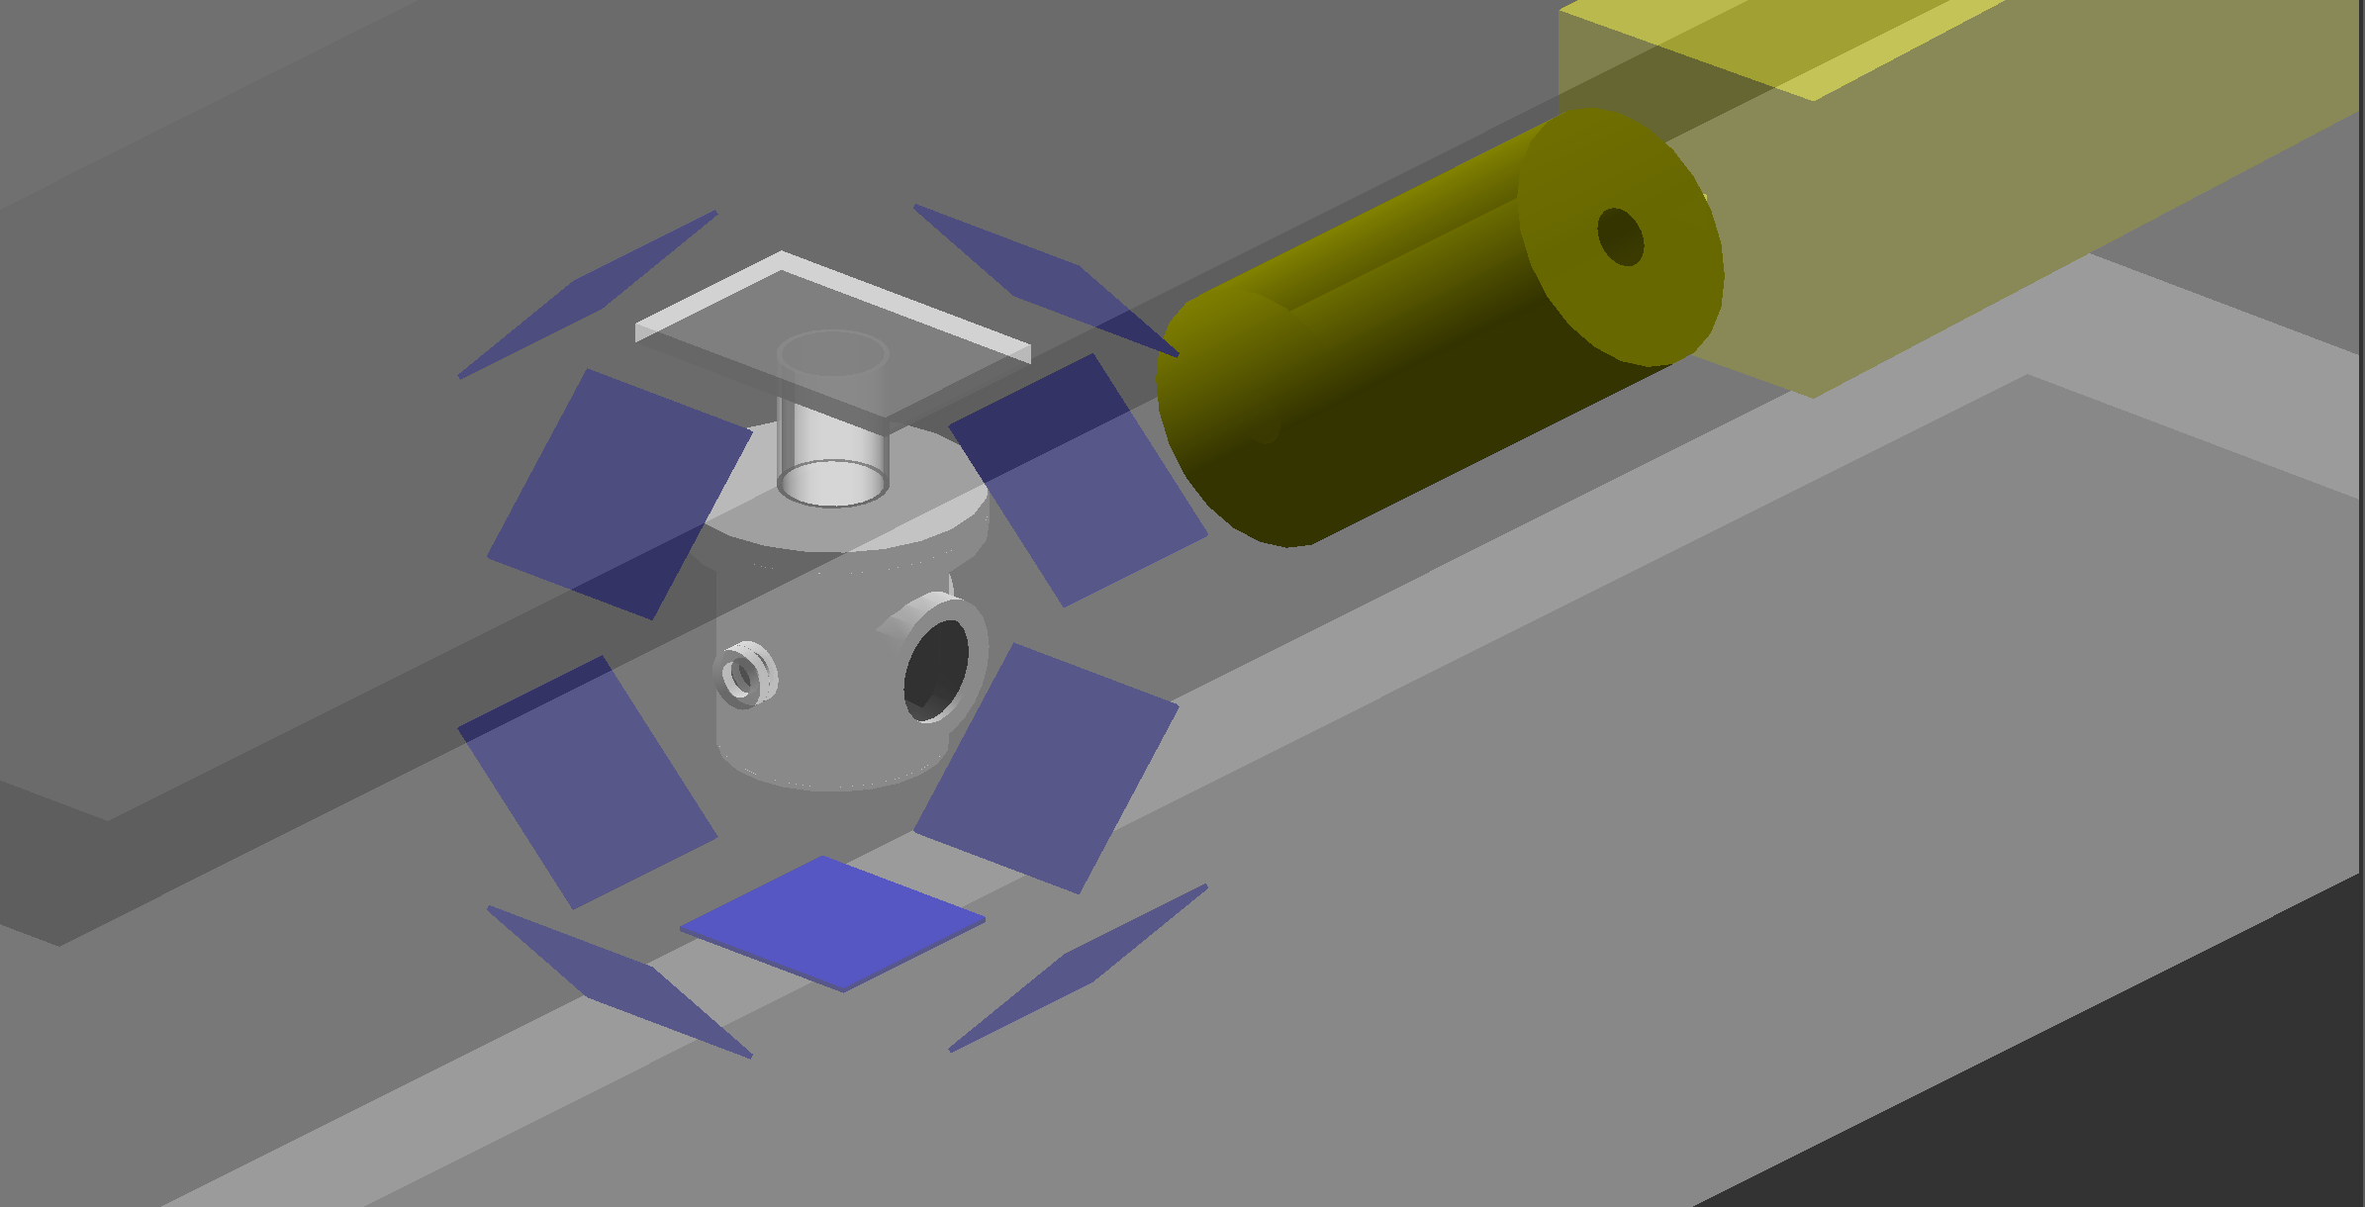
Determining optimal location for a detector at AP0
A set of detectors was placed surrounding the test target in the G4beamline model.
Analysis of muon/proton ratio for each detector
- Goal is to determine a good place to put a detector in real target testing.

Slide 11
Applications and future goals
Results from simulations can be used as input for engineering models of the target.
- Generate predicted stress and surface temperature distributions (parameters that can be measured in future beam runs to validate underlying cross section models).
Continue working on determining the optimal location to place particle detectors within AP0.
- Detectors to the side yielded a higher muon to proton ratio.
Notes:
Highest muon to proton ratio of about 100/10000

Slide 12
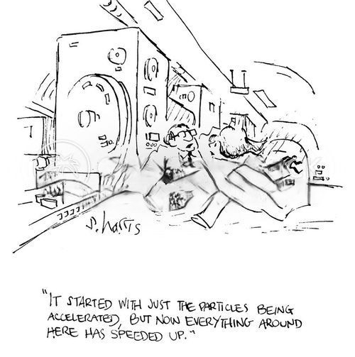
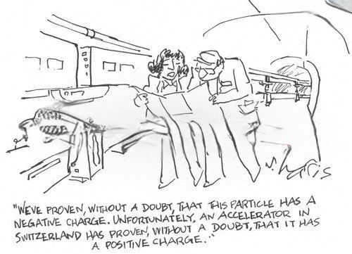
Thank you! Questions?

