Slide 1
Summer 2023 End of Term Co-op Presentation
David Gray
Co-op Update Presentation
9/21/2023

Slide 2
Assigned Projects
C-0 Service Building Floor Plan
Project Under Frederique Pellemoine
LBNF Strip Line Block Stands
Project Under Keith Anderson
CMTF Columns Engineering Note
Project Under Curtis Baffes

Slide 3
C-0 Service Building Floor Plan

Slide 4
C-0 Service Building Floor Plan
Objective: Create a floorplan for the two rooms in the C-0 service building to be used for Sujit’s lab currently at Mi-8.
Parameters:
Create a rough floorplan of both rooms including details such as: overall room dimensions, immoveable objects, electrical, utilities (compressed air, water).
Measure all these details by hand using laser measurement device and tape measure.
Include a possible arrangement of all the machines, tables, gas cylinders and vents. Account for needed electrical, ventilation, and utilities.

Slide 5
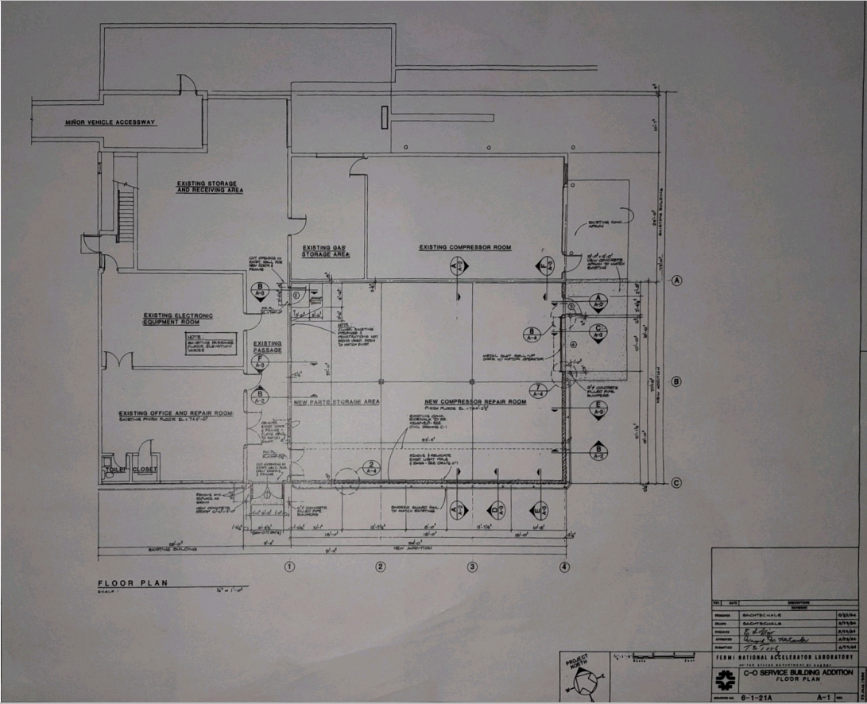
Existing Architectural Drawing
Bottom left and right rooms are the rooms being modeled in my project.
Some dimensions were taken from this drawing and used.
This drawing was made in 1984.

Slide 6
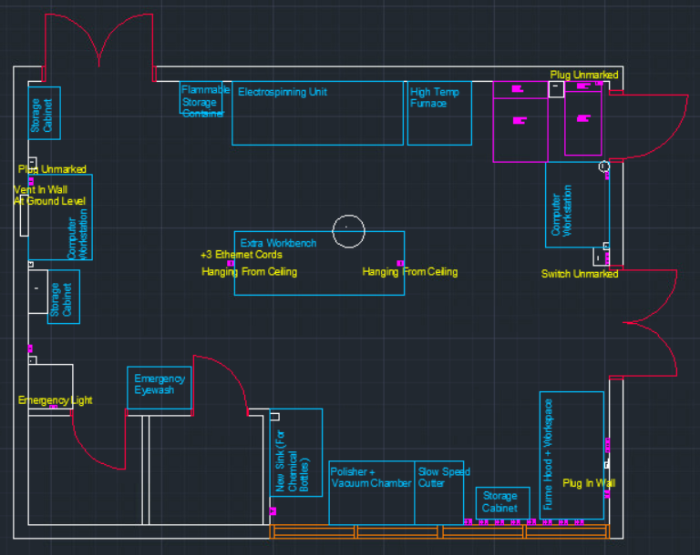
Current Drawing

Slide 7
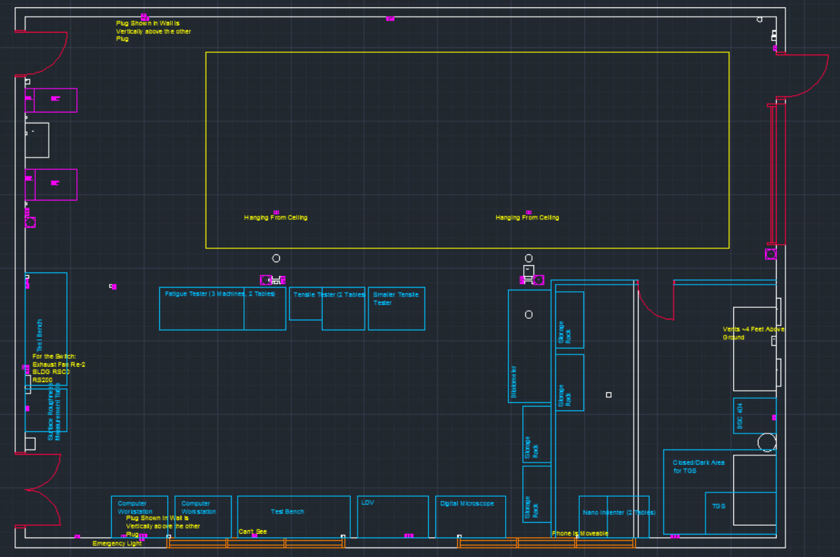
Current Drawing

Slide 8
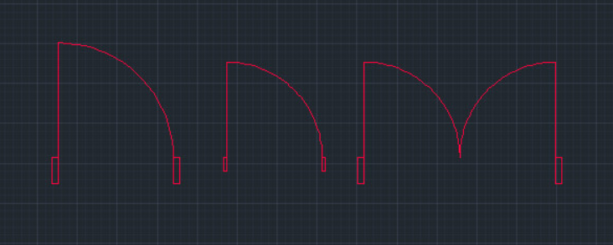
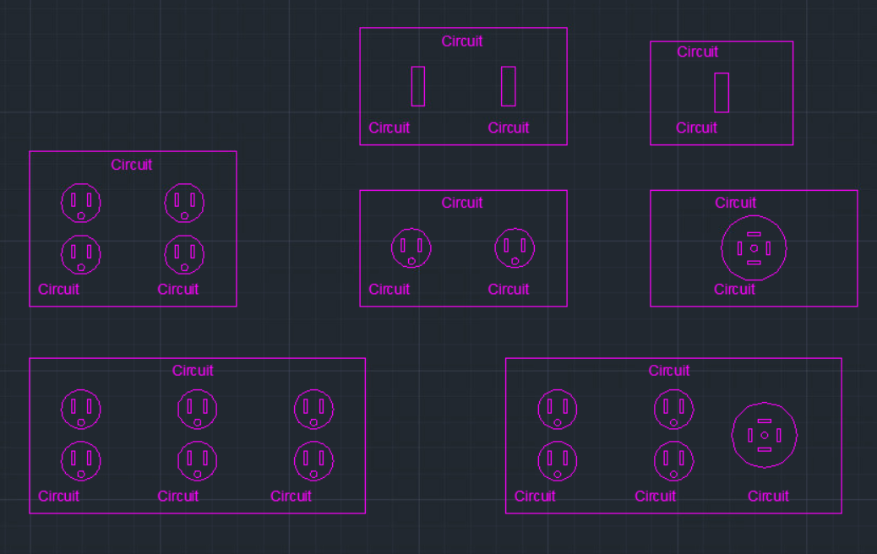
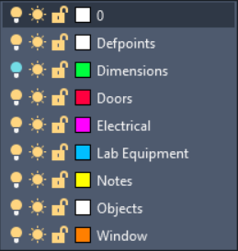
Blocks and Layers
Layers below in use.
Blocks used for doors and 120/208V electrical

Slide 9
LBNF Strip Line Block Stand

Slide 10
LBNF Strip Line Assy Stands
Objective: Design a stand for assembly, transportation and storage of the LBNF Stripline Blocks.
Parameters:
Adjust NuMi stands currently in use for the increased weight and size of the LBNF stripline blocks (46,000 lbs).
1 assembly stand design for the assembly of all 3 block models.
Block must be level during assembly
Must be a method of alignment during assembly
Two attachment structures for tipping the stand and block into a vertical position.
Analysis of stand sitting horizontally, vertically, and during the tipping motion.

Slide 11
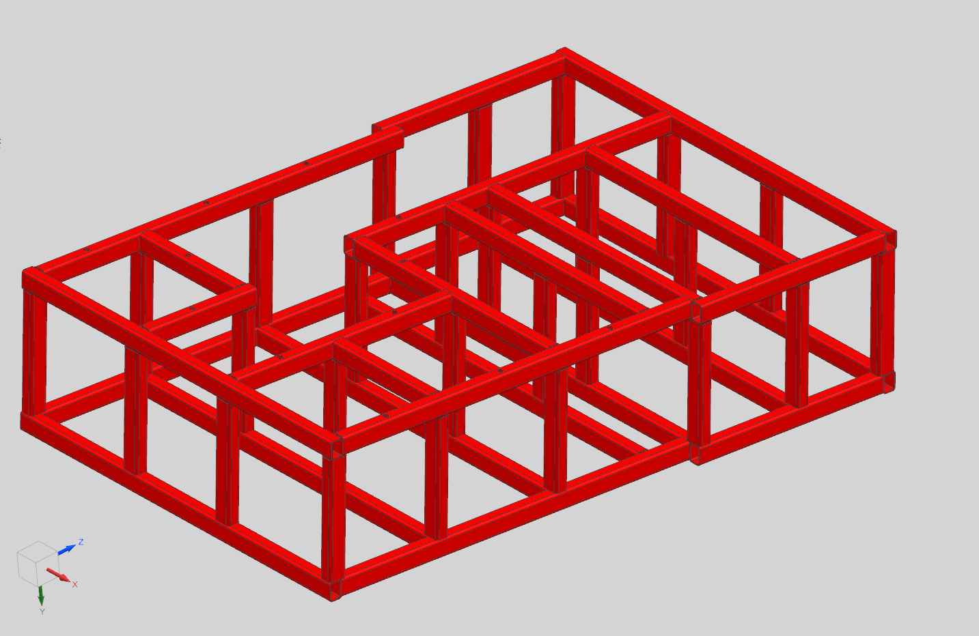
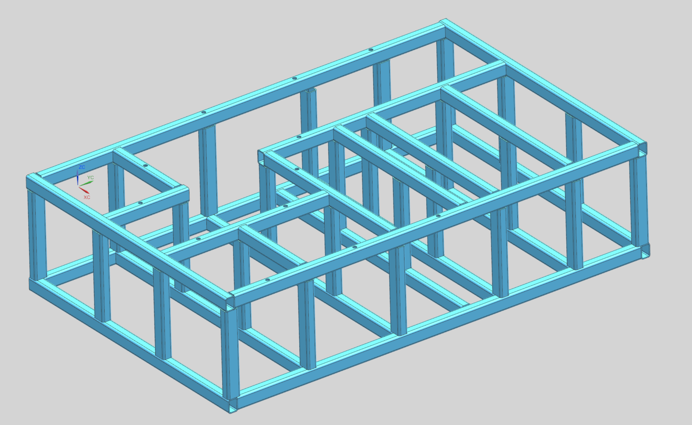
Model Changes
Reference pictures showcasing the big progress made each term.

Slide 12
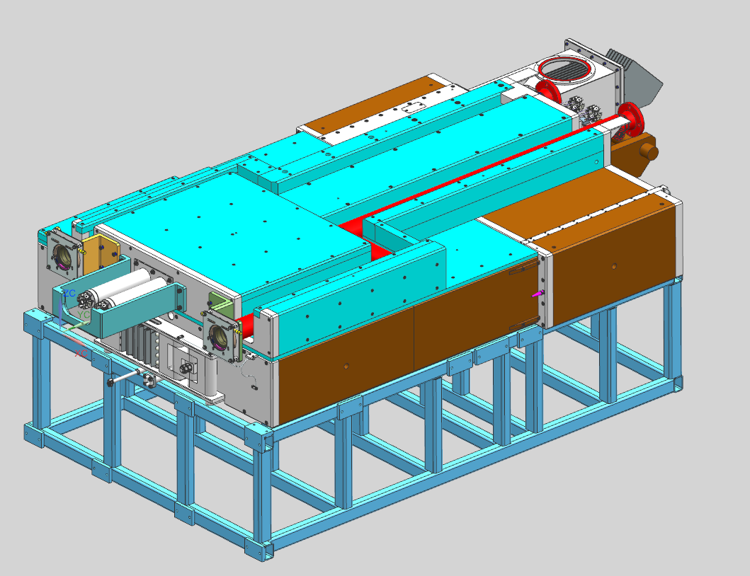
Model Changes

Slide 13
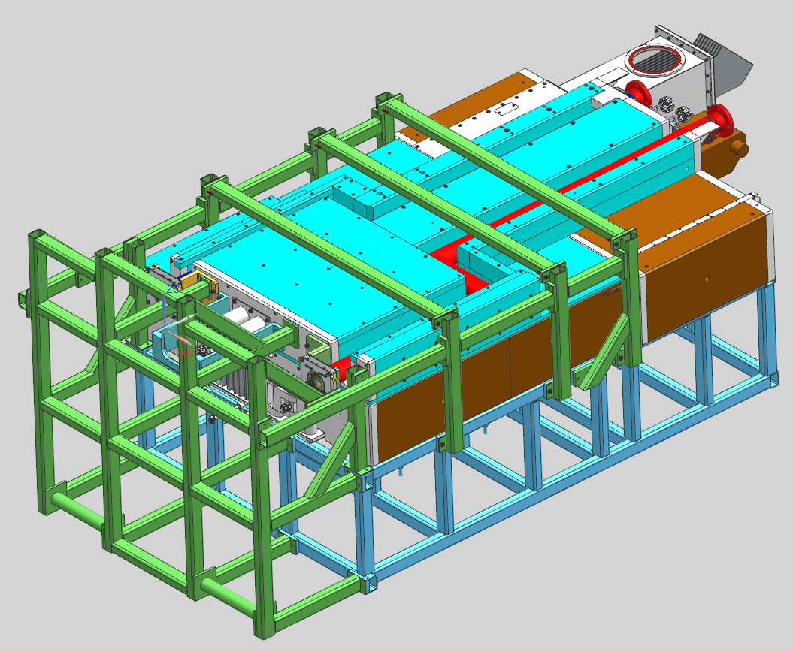
Model Changes

Slide 14
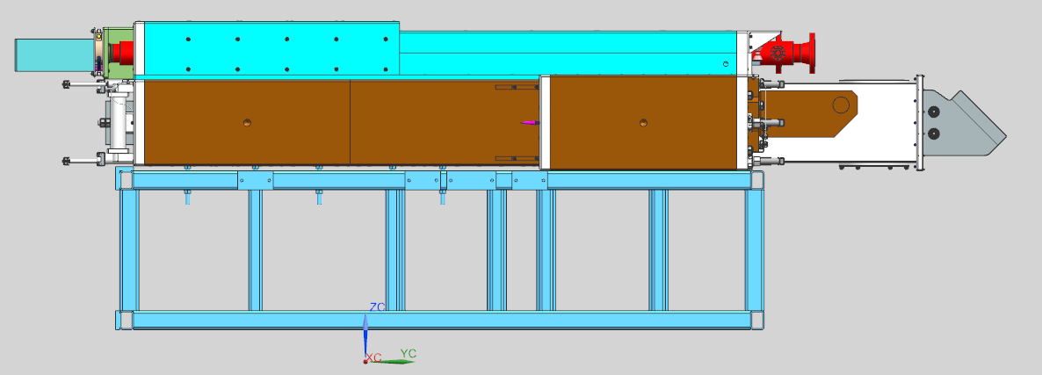
Design Features
Strip line block will be assembled on the original stand.
Needs to be tall enough for people to crawl underneath
Models B/C of the block don’t include the blue portion of the block.
12 bolts used on left side
Height difference and leveling

Slide 15
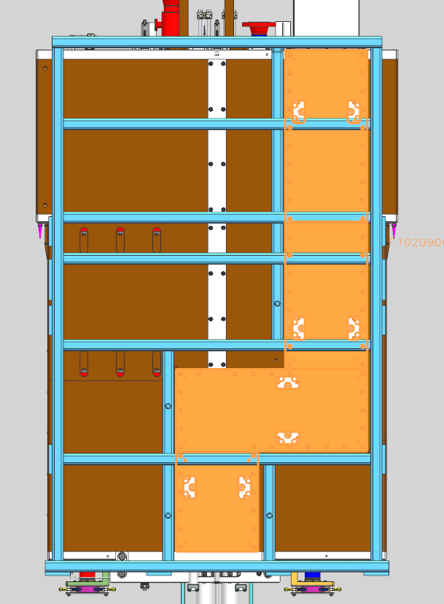
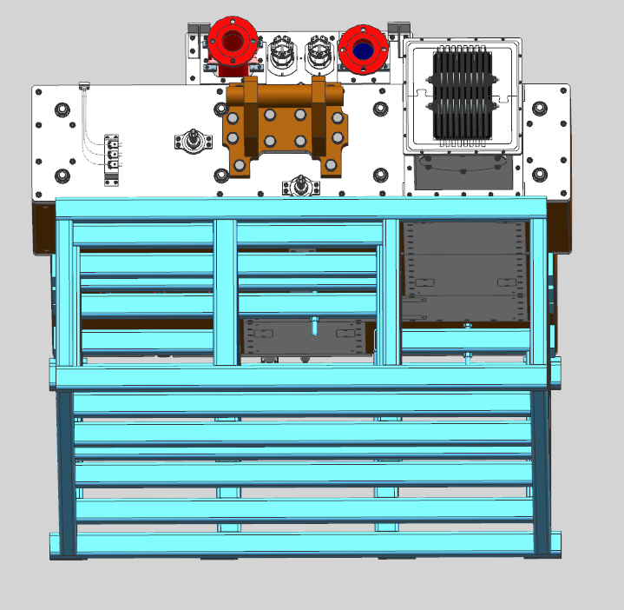
Design Features
Bottom plate has bolts running along the entire length.
All need to be accessible
Gap between holes is 3-3/16”
Also need a way to support the plates
Angle Irons

Slide 16
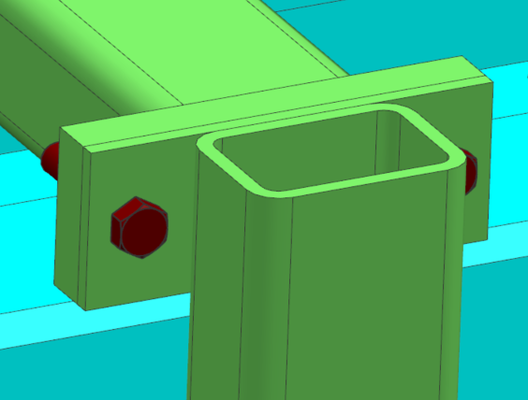
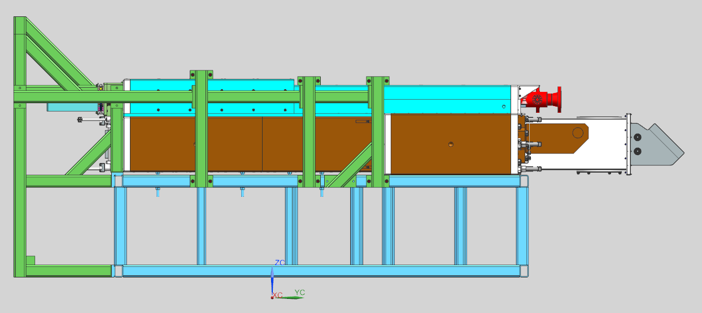
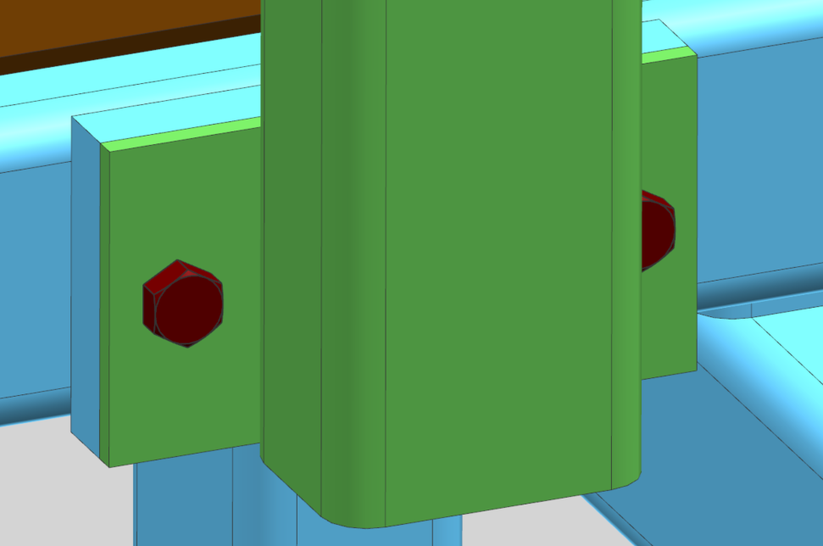
Design Features
Green structural tube is bolt connected to the original stand.
Thicker plate has threaded hole.
The stripline block should only move minimally.
The green attachment wraps around the entire stripline block.

Slide 17
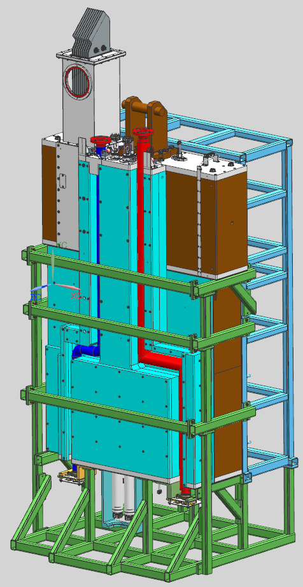
Design Features
Rotational pins
Diameter based on design being used for an absorber module stand
Vertical support points highlighted

Slide 18
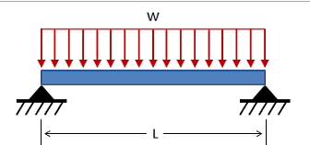
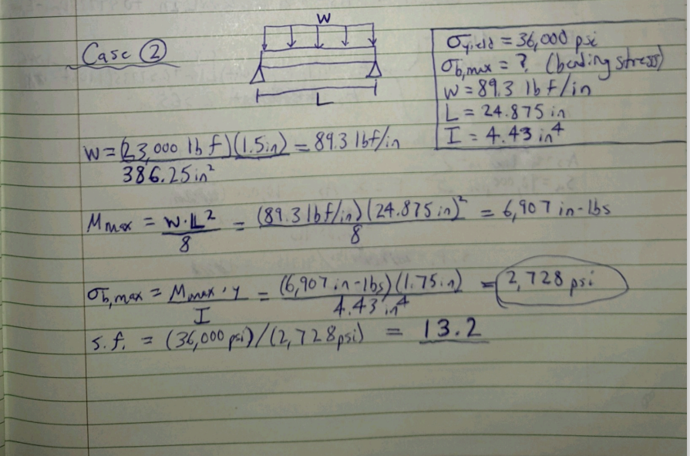
Current Analysis
This calculation is aimed at analyzing the tube while horizontal
Assumptions:
Half of block’s total weight is distributed on this half of the stand
Weight is evenly distributed
Longest length beam is worst case scenario
A36 steel

Slide 19
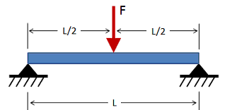
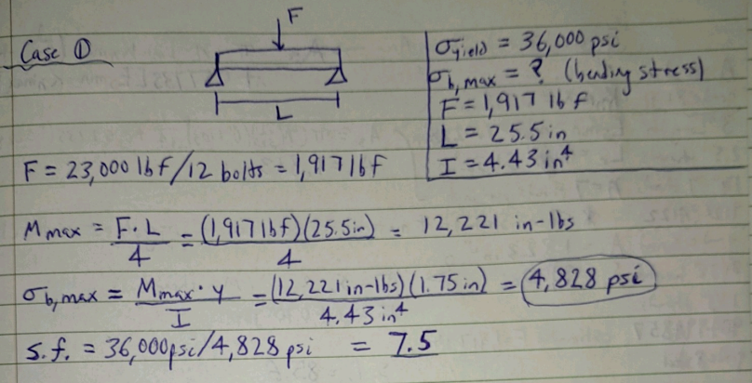
Current Hand Calculations
This calculation is aimed at analyzing the tube while horizontal
Assumptions:
Weight is evenly distributed among the 12 bolts
Half of block’s total weight is weighing on all 12 bolts
Longest length beam with force in the center is worst case scenario
Using A36 Steel
Thread shear analysis
Vertical Column Buckling

Slide 20
CMTF Column Engineering Note

Slide 21
CMTF Column Engineering Note
Objective: Analyze and create an engineering note for columns used at CMTF to outline the stress/force limits of the columns.
Parameters:
Analyze two load case scenarios for the column to determine maximum weight that can be added.
The focus will be on the base plate and drop-in anchors
Test various boundary conditions, forces and connection types to achieve the most realistic analysis in ansys
Follow Fermi Structural Support Guide.
Create an engineering note for the column showing allowable strength design.

Slide 22
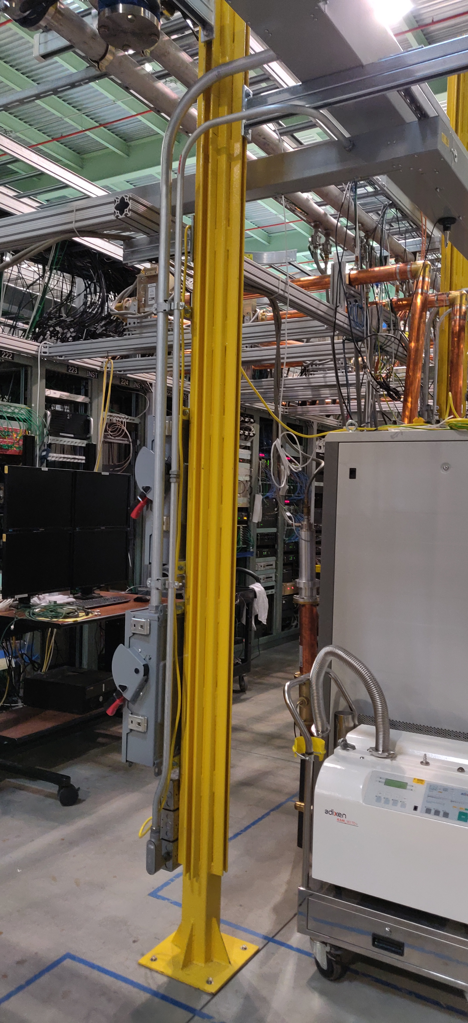
Engineering Note Progress
Analysis Outline
Unistrut Welds
Center beam buckling
Base plate welds
Base plate bending
Drop-in anchors tension/shear

Slide 23
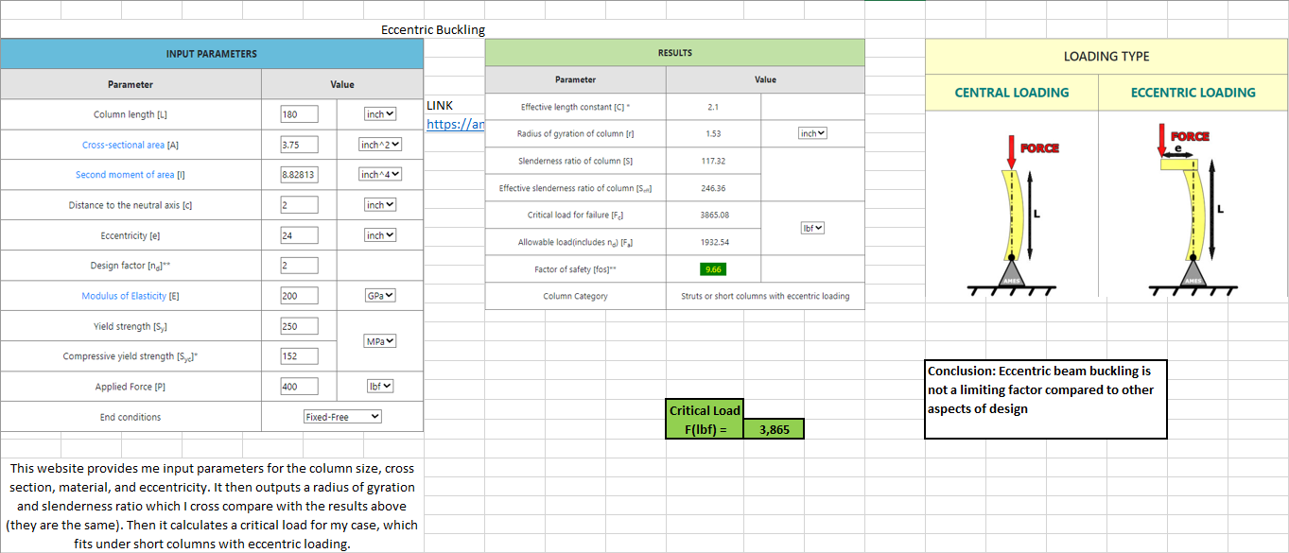
Center Beam Buckling
Central Loading
Critical Load of 17,690 lbs

Slide 24
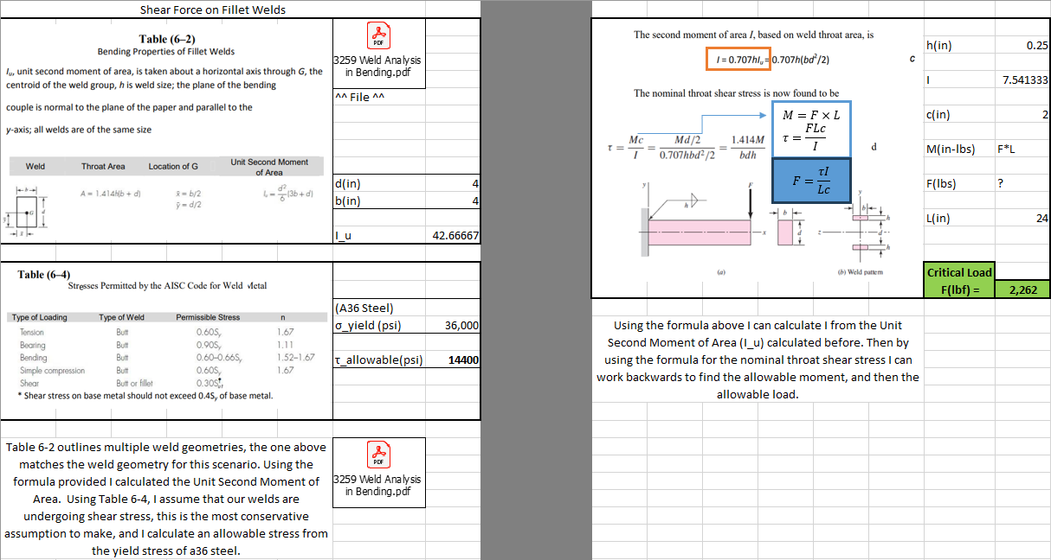
Base Plate Welds

Slide 25
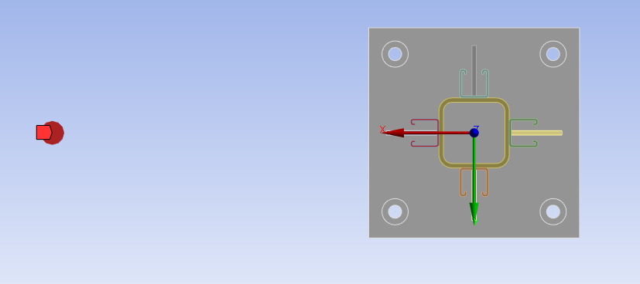
Ansys Setup
Load Case 1
Remote force applied at the top of the column; 2 feet off-center in the x-direction.
Load Case 2
An additional remote force is applied at the top of the column; 2 feet off-center in the y-direction
Connections
All the parts are connected with a bonded connection at contact regions.
Allowable Stress
21,600 psi calculated at 60% of A36 steel yield stress (36,000 psi)

Slide 26
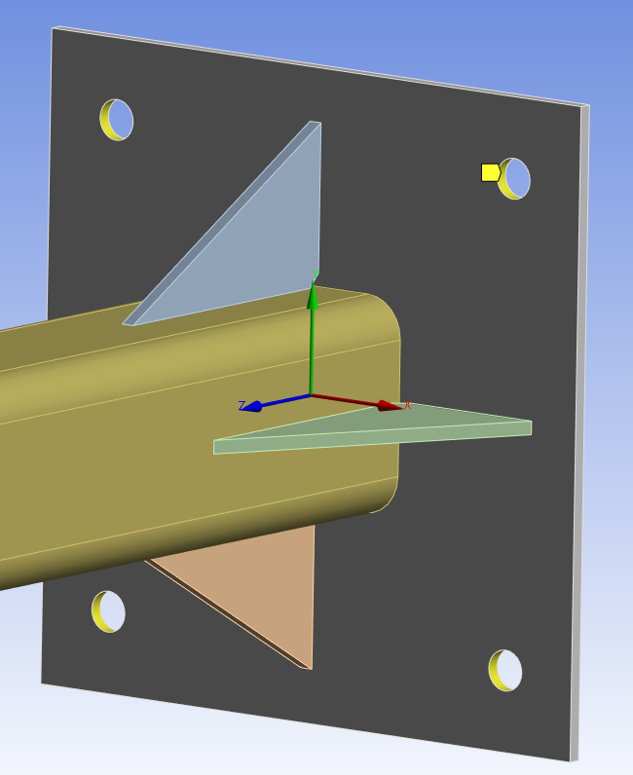
Old Base Plate Results
Result Set 1
0 displacement holes
This simulates the drop-in anchors holding the base plate into the cement flooring
Allowable Stress Reached
At weight of 580.9 lbs in load case 1
At weight of 349.4 lbs in load case 2

Slide 27
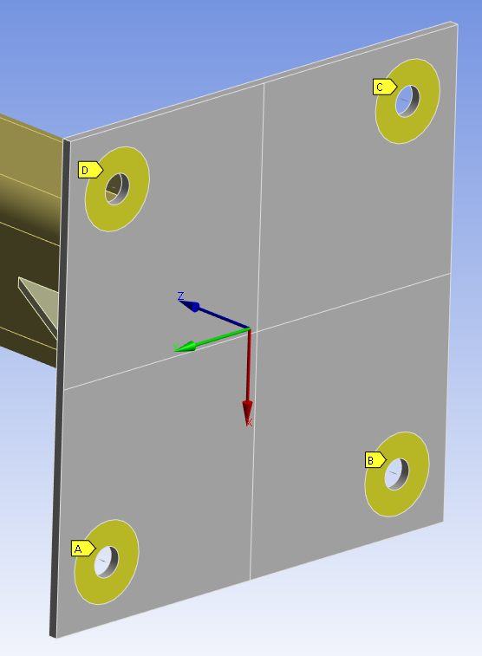
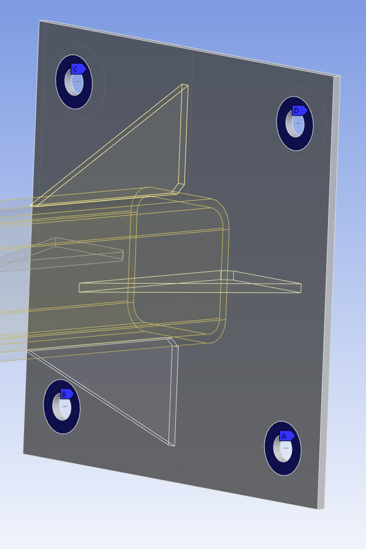
Ansys Setup
0 displacement
There is a 0 displacement in the z-direction around these holes.
This simulates the floor pushing back on the plate.
Connections
There is a spring connection used in the holes to simulate the drop-in anchor.
This spring has an inputted stiffness and preload.

Slide 28
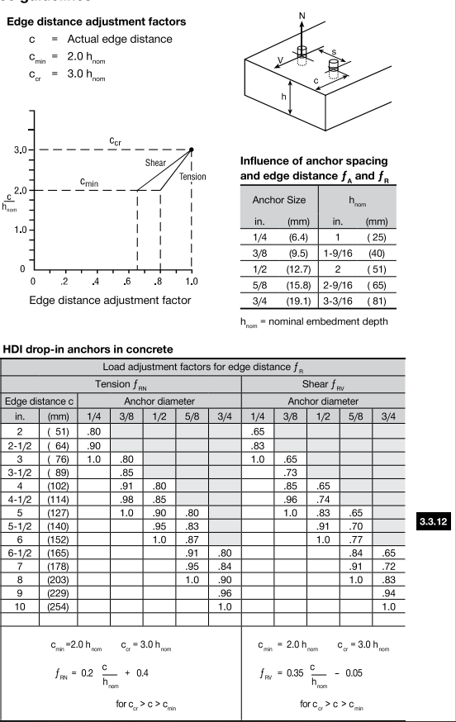
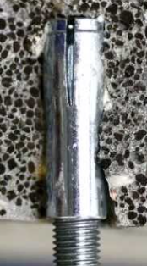
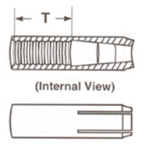
Drop-in Anchors
Spring Preload
This was calculated based on Hilti’s technical guide.
The allowable load for an edge distance of 4 inches is 5,713 N
We have anchors installed with a 1.5-inch edge distance
Spring stiffness
This was calculated for the different regions of the bolt/anchor cross section
Region with bolt threads was the highest and most conservative value

Slide 29
Drop-in Anchors and Base Plate Stress
Failure case for drop-in anchors
When the 0-displacement starts to pull downwards.
Load Case 1 Failure: 888 pounds
Load Case 2 Failure: 438 pounds
Failure case for drop-in anchors
When the von-mises stress in the base plate reaches yield stress
Load Case 1 Failure: 360 pounds
Load Case 2 Failure: 254 pounds

