Slide 1
Project Status: Quantum, AI, Microelectronics
Farah Fahim
ASIC PMG – Sep 2023

Slide 2
Hiring updates
Test engineer – 1 new position advertised
Interns
Renewal of internship for FY 2023

Slide 3
2023 submission plan
CMS_PIX_28 – May 2023: Integrated AI and frontend; changed to Nov 2023
SPROCKET / XROCKET – Nov 2023 – on track
Glebe – Aug 16, 2023. Changed to Oct
GF_28_HV_Chip – Oct 2023/ Jan 2024: 20V operation; confirmed for Jan 2024

Slide 4
22 nm projects
Glebe – Tape-out in October.
SNSPD related – preliminary design (might tapeout with MS chip)
Investigate 10 GSPS – RF DACs ( 9 – 12b) - NOT STARTED

Slide 5
Glebe chip for ROADS; Status and Schedule
Scalable Cryogenic Electronics LDRD and Microsoft Collaboration
Status:
Working towards next tapeout in October
Michigan testing is progressing slowly
Cold testing in progress
Need data for upcoming conference
Progress:
Glebe PLL is on track for October
The ADC is behind but committed to October tapeout
12 bit CDAC must be accurate to 1 in 8,000 and has been sensitive to changes at every design step
Upcoming:
Glebe tape out and Michigan testing
Status | Reviewed? |  | 4-Sep | 11-Sep | 18-Sep | 25-Sep | 2-Oct | 9-Oct | 16-Oct
In Progress |  | Chip | Neil | Neil | Neil | Neil | Neil | Neil | Tapeout
In Progress |  | PNR (floorplan, flow, verif)
In Progress |  | STA
In Progress |  | ADC | Troy | Troy | Troy | Troy
 |  | ADC Top Sim
In Progress |  | Input Buf & Sampling | Ali | Ali | Ali
In Progress |  | ADC Slice | Troy | Troy | Troy
In Progress |  | CDAC | Troy | Troy
In Progress | Need Review | Comparator | Troy | Troy
Done | Need Review | Slice Control (done)
In Progress |  | Voltage Ref Buffer | Kushal | Kushal
Done | Need Review | Interleaving Control (done)
Done |  | Voltage Reference (done)
Done | Need Review | Clock RX
In Progress |  | PLL | Frederic | Frederic | Frederic
 |  | PLL Top Sim | Xiaoran | Xiaoran | Xiaoran | Xiaoran | Xiaoran
Done |  | VCO
Done |  | Divider
Done |  | Phase Detect
Done |  | gm
Done | Need Review | Filter
Done |  | Clock Refence Buffer
In Progress |  | Analog Top (Clock Dist) | Ali | Ali | Ali | Ali
Done |  | Digital
Done |  | RAM Interface
Done |  | JTAG
Done |  | SRAM

Slide 6
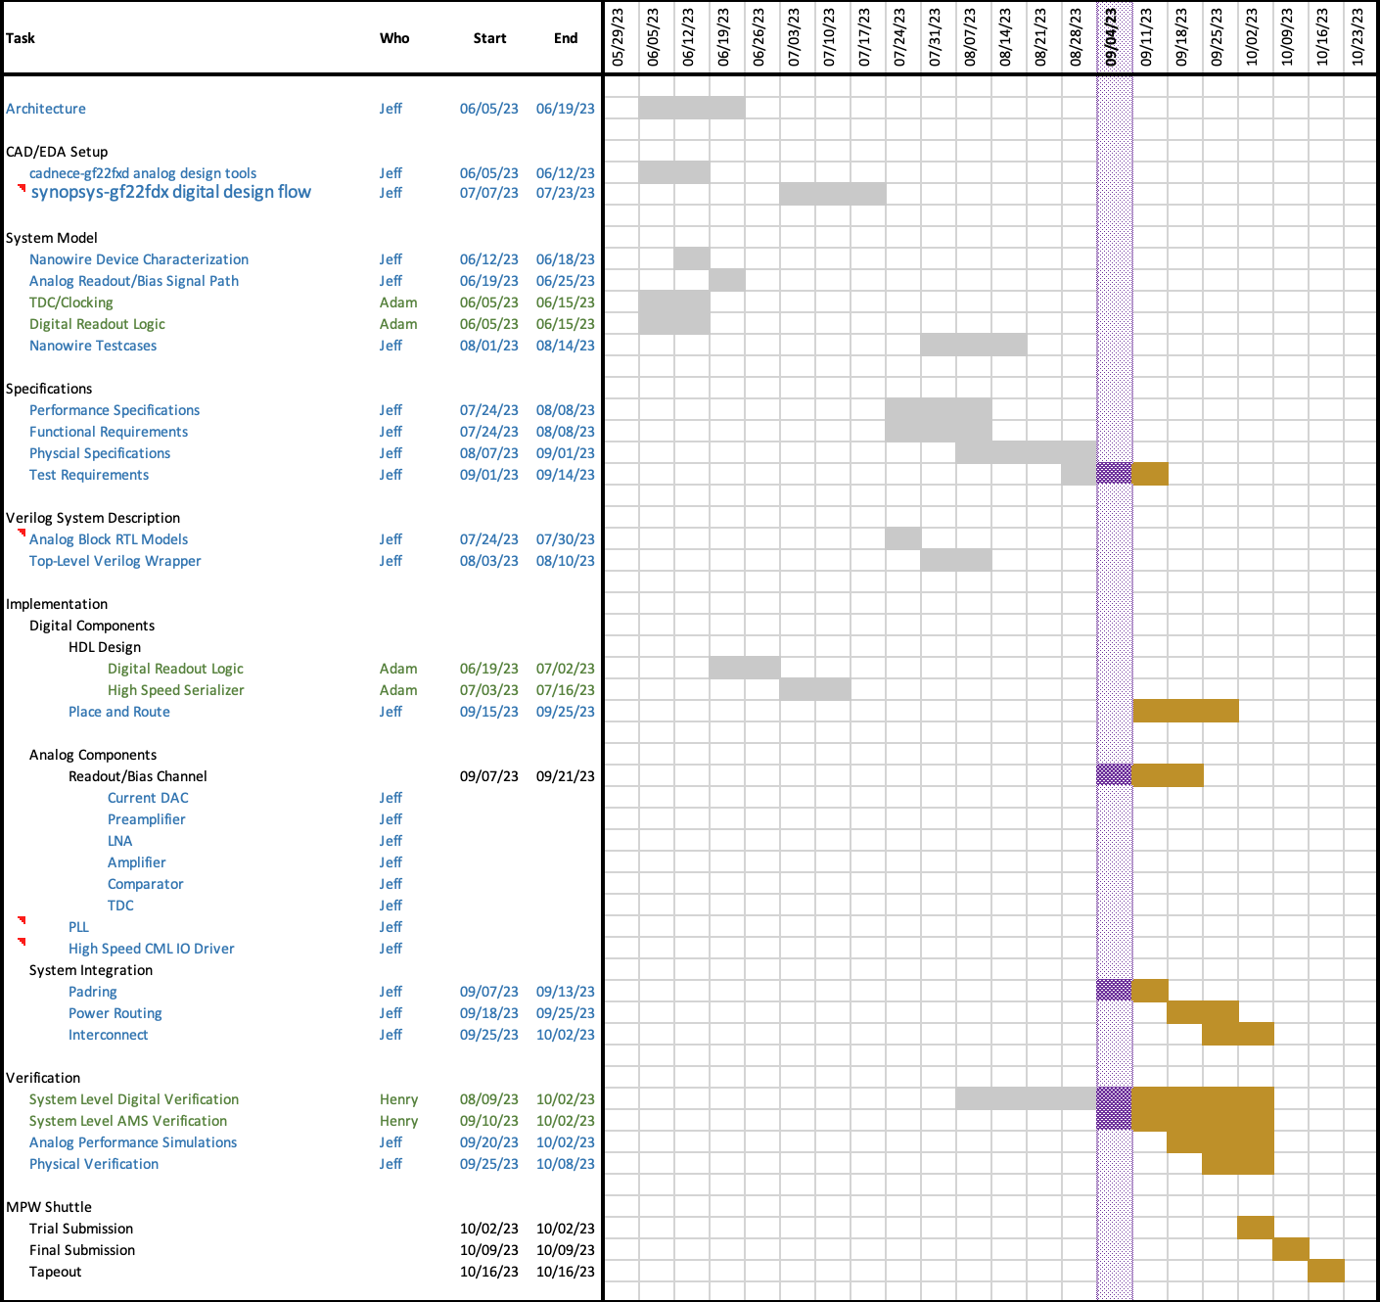
SUNROCK – GF22FDX SNSPD Readout Chip
Phase | Date
Design | In-Progress (schedule attached)
Tapeout | Oct 16, 2023
Chip Arrival | est. Feb‘24
Test Boards | est. Dec’23 – Feb’24
Packing/Assembly | est. Feb’24
Test/Characterization | est. Mar’24 – Jul’24
SNSP | TBD
Current Focus:
Starting system-level digital verification
Finish analog readout/bias channel block
Top-level integration
Risks:
Schedule pressure from digital verification taking longer than planned.
Project Documentation
sunrock-project-plan.docx
sunrock-project-plan-gantt.xlsx
sunrock-technical-guide.docx

Slide 7
28 nm projects
CMS_PIX_28
ACC2/CITC3

Slide 8
Ion-Trap Interface
 | Completed | On-going | Upcoming
CITC3 ACC2 | Customized digital decoder for current DAC-Kyle, Dyumaan | Mixed-signal simulation of CITC-Kyle | ACC2 full channel – Dyumaan, Kyle
 | Review of SPAD interface with MIT-LL - Hongzhi | Modify the SPAD interface based on comments from review - Hongzhi | Pad with ESD structures - Hongzhi
 | Level shifter design for CITC3-Kyle | ACC2 full signal path - Dyumaan | CITC3 full channel. - Kyle
 | Level shifters for ACC2 - Dyumaan | ESD structures of ACC2- Hongzhi | ACC2 algorithms - Hongzhi
 | Simulation of full signal path of SPAD interface - Hongzhi | Digital control logics of ACC2. - Kyle, Farah and Hongzhi
CITC2 ACC1 | CITC2 test board. –Hongzhi, Scott | Digital libraries - Pam | Lab testing of CITC2 test chips
 |  |  | Collaborations with Sandia to test CITC with their sensors – Scott, Hongzhi

Slide 9
CMS_PIX_28 ROIC design in 28nm for CMS
 | Status | upcoming effort
CHIP 1 - CMS_PIX_28 1st pixelated particle sensor prototype 16x32 analog frontend | Test structures: the CSA standalone and two versions of the analog frontend pixels show promising results – we are able to perform charge injections and measure charge sensitivity and result match simulation (Ben, Lou, Jieun) Matrix: The shift register suffers timing violations, the issues were duplicated in post-layout simulation. Workaround have been found and we can proceed with test normally. The data readout was tested at 10MHz and works as expected without violations. | We will perform charge injection tests on the 16x32 Matrix. We will test ENC, PSRR, threshold dispersion (Ben, Jieun, Lou) We will improve the precision of the charge injection of the CSA We will report the S curve of the pixels.
CHIP 2 - CMS_PIX_28_v2 2nd prototype with integrated digital AI 16x32 analog frontend Combinatorial 3-layer digital DNN Tapeout target: August 9 2023 Optimistic deadline | SUPERPIXELS Superpixel v1 implementation– placing and routing is completed with no short, LVS is to be run. (Chinar) Verification testbenches are being implemented (Lilian and Giuseppe) EVENT DRIVEN FRONT END Schematic completed – simulation 80% (Ben) | Complete superpixels implementation and backend verification (Chinar, Lilian, Giuseppe) Complete the DVS frontend layout implementation (Ben) Assemble the top level and tapeout (Ben, Chinar, Lilian)
Other IP design effort for future shuttle | SRAM BASED NN IMPLEMENTATION SRAM schematic and first NN layer matrix completed (Ben) TIA design - A frontend design inspired by ETROC for LGAD application. The front end will contain a 2-bit programmable TIA with hysteresis comparator. → TIA architectures selection completed –schematic implementation + simulation 50% (Ben) | SRAM NN: continue the implementation of the second layer, activation function and A/D conversion (Ben, Aniketh) TIA frontend: continue design (Ben)

Slide 10
65 nm Projects
SPROCKET
XROCKET
MIDNA

Slide 11
SPROCKET/XROCKET Project
(Skipper-CCD Parallel Read-Out Circuit / X-Ray Read-Out Circuit)
 | Tapeout Date | June Progress | July Plans
SPROCKET1 | 9/22 (shared) | Basic smoke test of all modules complete. | No resources; move on to SPROCKET2.
XROCKET1 | 9/22 | Developed “Glue” RTL2FPGA Flow Basic smoke test of config chain + serialOut | No resources; move on to XROCKET2.
SPROCKET2 | 12/22 (shared) | XROCKET2 PCB designed. | Finish SPROCKET2 PCB. Wirebond XROCKET2 and begin test w/ Glue
XROCKET2 | 12/22
SPROCKET3A | 5/23 | (Manufacturing) | Design PCB; will receive ASICs by end of month
SPROCKET3 | 11/23 | Initial project scheduling (see next slide). | Design of 10 GHz serializer for SP3 Tx based on lpGBT.

Slide 12
SPROCKET/XROCKET Project – Summer 2023 Gantt
Key Takeaway: We have three ASICs still to test this summer. Need Digital 1+2 and Test Engineer resources to complete even de minimis testing before SP3 tapeout.

Slide 13
MIDNA Series of Chips for CCD Readout
Tapeout Goals:
3 MIDNA2
1 MIDNA2.1 (lower pre-amp gain, 5 and 10x instead of 10 and 20x)
1 MIDNA3 (stretch goal)
Status:
Working towards shared tapeout with ECON
On time
Progress:
The design space has been set up
The preamp updates are done
Upcoming:
The multiplexor and biasing design
MIDNA 3 | 31-Jul | 7-Aug | 14-Aug | 21-Aug | 28-Aug | 4-Sep | 11-Sep | 18-Sep | 25-Sep | 2-Oct | 9-Oct | 16-Oct | 23-Oct | 30-Oct
Space Setup
Preamp Update
Multiplexor
Biasing for 16 Ch
I/O
Top Level
Tapeout
Est Availability | 31-Jul | 7-Aug | 14-Aug | 21-Aug | 28-Aug | 4-Sep | 11-Sep | 18-Sep | 25-Sep | 2-Oct | 9-Oct | 16-Oct | 23-Oct | 30-Oct
Troy | 5% | 5% | 5% | 5% | 5% | 20% | 20% | 20% | 20% | 20% | 90% | 90% | 90% | 90%
Fabricio | 10% | 10% | 10% | 10% | 50% | 50% | 50% | 50% | 50% | 50% | 50% | 50% | 50% | 50%
Hongzhi | 0% | 0% | 0% | 0% | 0% | 0% | 0% | 20% | 20% | 0% | 0% | 0% | 0% | 0%
Davide | 0% | 0% | 0% | 0% | 0% | 0% | 0% | 0% | 20% | 20% | 0% | 0% | 0% | 0%

Slide 14
Testing updates

Slide 15
Upcoming projects
MIDNA v3
Funding from U.Chicago ( ~200K) QIE; Additive manufacturing
3D IC
Discussions with Skywater
Radhard MAPS – Need scientist at Fermilab; LBL scientist has been allocated; ( Zoltan Gecse, Doug Berry was interested)
Phase II SBIR with Caporous technologies was awarded - $350K for 2 years
Discussions with Tower Semiconductor
3D LGADs – Working towards this option (Sensor design + ROIC design)
CMOS LGADs – on hold
SPADs – option available

Slide 16
Microelectronics activities
Joint workshop with ANL (March 7)
Sandia Grand challenge review
Meeting with IBM led consortium for 3D IC – designs
Presentation at Global Foundries
DOD Microelectronics Commons program
- ARI led Midwest Consortium (Purdue, UIUC, NU, Fermilab, ANL, Michigan): Quantum & AI (2 project )
- SRI led Quantum only hub (1 project with Martinis)
- Caltech led Feynman Quantum hub (1 project with Microsoft)
- MA led with MIT LL Quantum

Slide 17
ACCELERATE FOA
Microelectronics discovery platform – Fermilab led (submitted LOI) - Farah, Nhan, Doug, Lindsey
Quantum sensors– Fermilab led (submitted LOI) - Si Xie, Cristian Pena, Adam Quinn
SLAC led timing sensors (submitted LOI) - Davide Braga, Artur Apreysan
Sandia led ASCR proposal on neuromorphic computing (submitted LOI) - Ben Parpillon
ANL led NP proposal on superconducting electronics (submitted LOI) - Davide Braga, Pam Klabbers, Kyle Woodsworth

Slide 18
Papers in progress
CITC1 – Awaiting few more results from Scott: IEEE Quantum electronics
ACC1 – IEEE SSC? Started
AI-in-Pixel – NIM- Started ( due by May 17; special issue after ULITIMA conference)
Smart Pixels – 90% complete; compact algorithm implementation
Cryo_TDC – results are available
MIDNA_v2 – results are available; LN2 testing in progress – to be started

