Slide 1
PXIE RFQ EM design update.
G. Romanov
2012 Fall Project X Collaboration Meeting, Fermilab
PXIE RFQ meeting, November 29, 2012

Slide 2
Outline
Summary of basic EM design ( before August 2012)
Recent simulations
Plans

Slide 3
Summary of basic EM design
2D simulations (RFQ cross-section):
Frequency, Q-value, power dissipation per length unit.
3D simulations of RFQ periods:
Frequency shift/perturbation from pi-rods and Q value (or power dissipation by rods);
Frequency sensitivity from tuners, and frequency shift/perturbation from tuners at their nominal intrusion and power dissipation by the tuners;
Perturbations to field distributions due to pi-rods and tuners;
Frequencies of dipole modes with and without pi-rods;
3D simulations of complete RFQ model:
Cut-back designs to provide flat field flatness and frequency of 162.5 MHz;
Power dissipation (and density) at RFQ parts and Q value of the whole RFQ structure with everything.
Basic EM design have been performed for both PXIE RFQ and IMP RFQ.
See Derun Li’s talk for details.

Slide 4
Recent simulations
EM simulation and thermo-stress analyses of vacuum port grids.
Frequency shift and field distortion due to the power couplers.
RF design of the special end terminations to perform RF control measurements of the RFQ sections after brazing. Simulations of complete control measurements.
Multipactoring simulations in the areas that are typically susceptible to multipactoring, e.g. where the pi-mode stabilizer rods pass through the holes in the vane, the input power couplers and tuners, the terminations.
Last two items are not complete yet

Slide 5
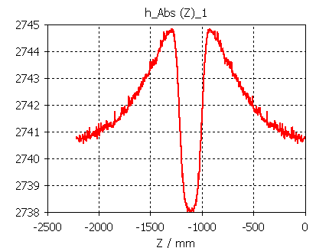
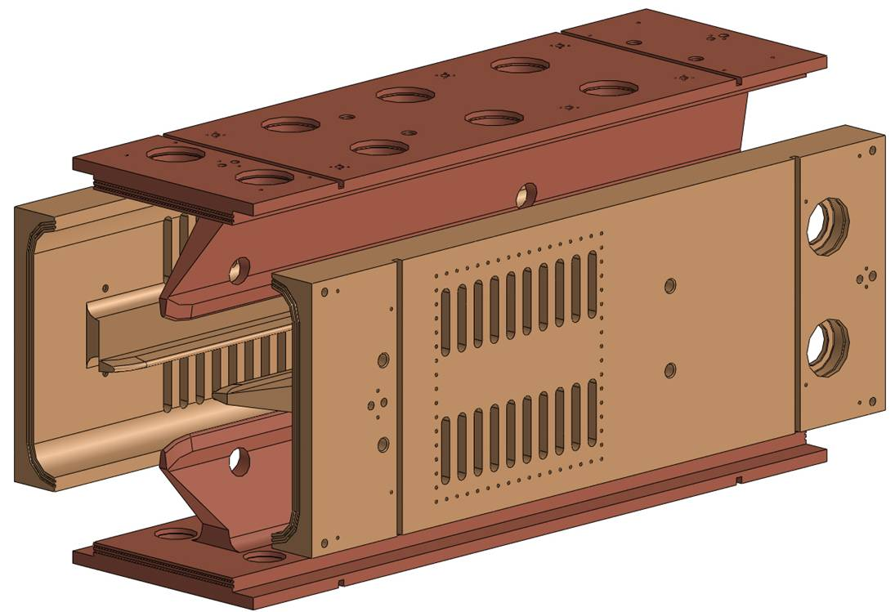
Vacuum grid. Field and frequency.
<1%
x = y = 100 mm
ΔF = -70 kHz
2215 mm

Slide 6
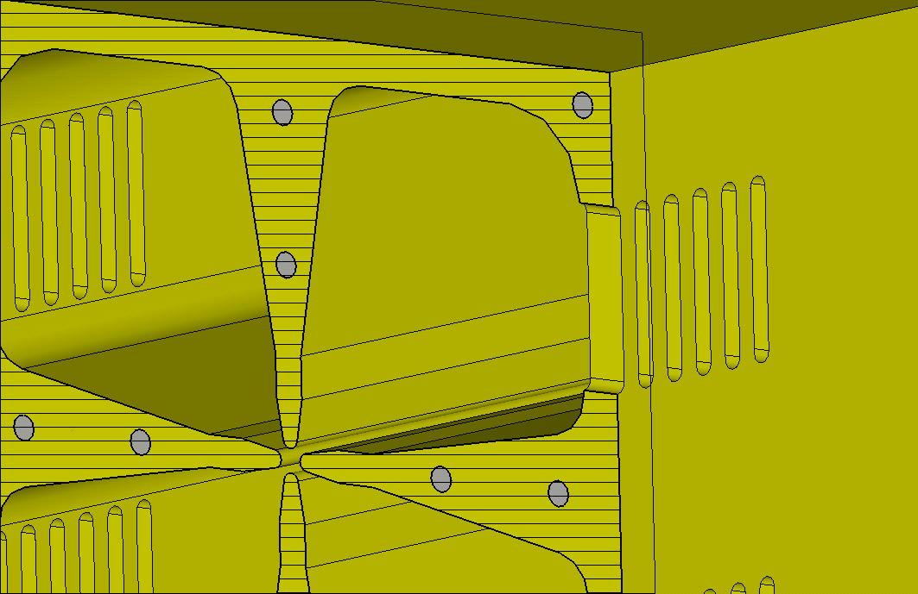
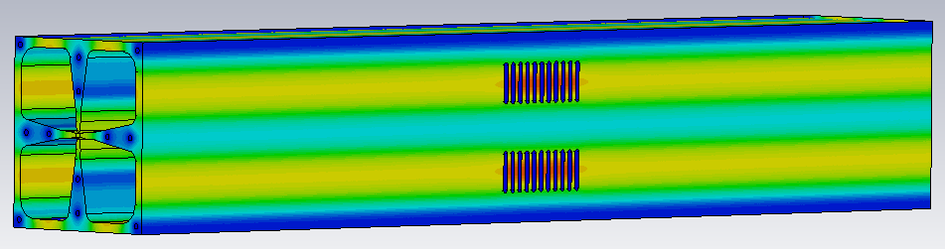
Vacuum grid. Heat.

Slide 7
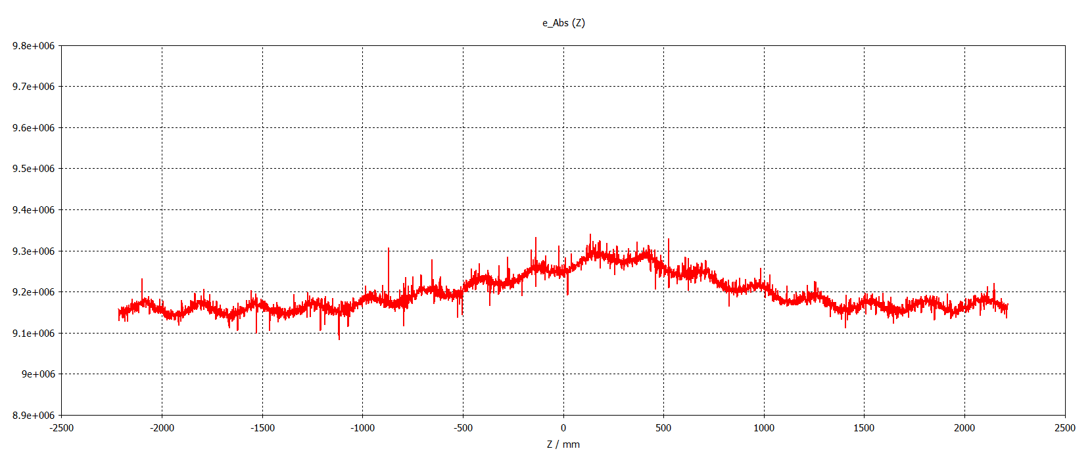
Coupler
Frequency shift of quadrupole mode in PISL period is ΔF = -279 kHz. Can be compensated by 2 mm displacement of 10 tuners. Frequency difference between dipole modes is 300 kHz.
556 mm
E_abs along line x = y = 5 mm in full length model with magnetic end-walls
Bump 1.3%

Slide 8
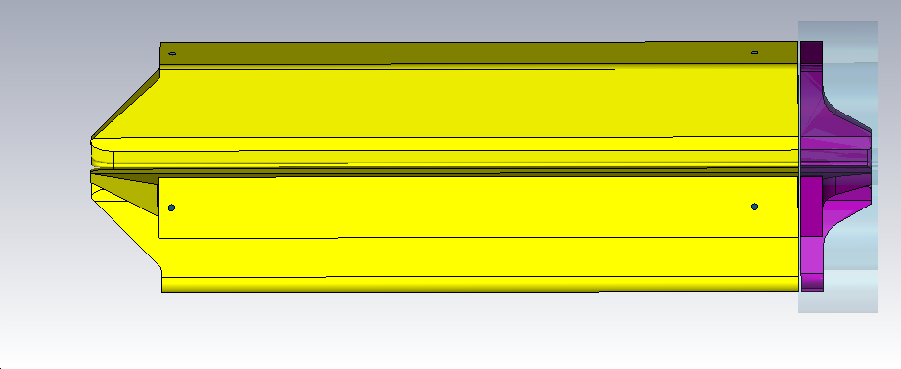
Terminations for modules

Slide 9
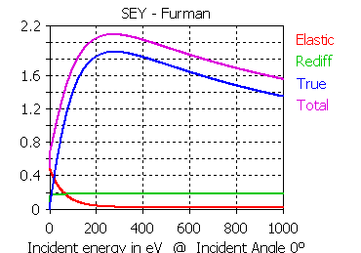
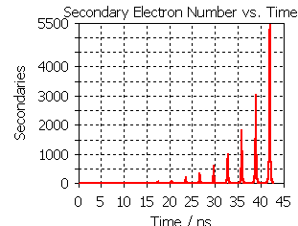
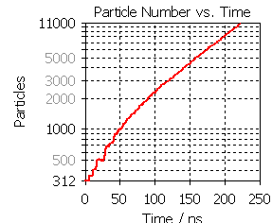
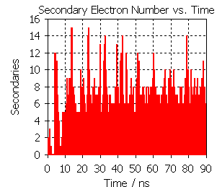
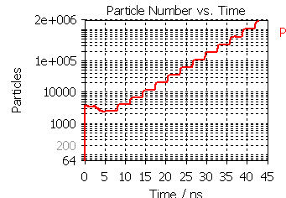
Multipactoring
S.Kazakov
Multipactor of 2-3 order with significant non-resonant component
Copper without any surface treatment

Slide 10
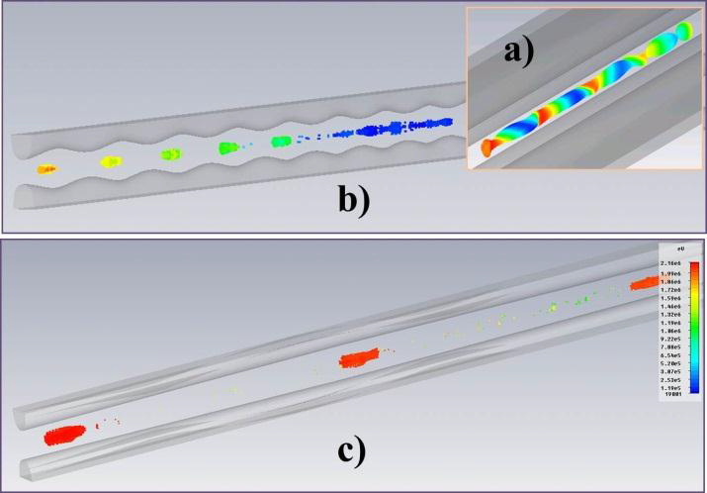
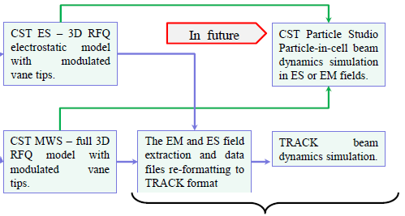
Beam dynamics
CST PIC
Track
- beam just after input matcher.
- beam after buncher section
- beam at the RFQ exit
Another example – Proton Improvement Plan RFQ.

Slide 11
Plans
Will be done
Multipactoring simulation in SNS RFQ.
EM simulation and thermo analyses of the end-wall lids.
May be will be done
Support the RFQ mechanical design and manufacturing with simulations and analyses when necessary after actual measurements of the parts are taken.
Support the RFQ assembly, frequency tuning and field distribution flatness. Evaluate the assemble and tuning errors impact onto RFQ performance.
Beam dynamics in RFQ using PIC code and “realistic” electromagnetic fields from complete RFQ model to study and evaluate beam halo formation. Includes simulation of beam transporting from ion source (measured beam parameters) through LEBT to RFQ entrance.

